Slide 1

Development of Novel Methods for The Determination of Synthetic Colorants
International Conference on
Food Safety and Regulatory Measures
August 17-19, 2015
Birmingham, UK
F. Ayça Özdemir Olgun
Istanbul Technical University

Slide 2

Content:
A Brief Look at Colorants
What are Food Colorants
Classification
Why do we use?
Legislations and Limitations
Objectives
Methodology
Experimental Studies
Results
Conclusion

Slide 3
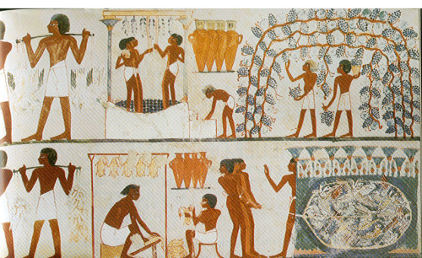
A Brief Look at Food Colorants
What are food colorants??
Food colorants are an important class of food additives attracting the attention of consumers, and give the first impression about the taste and quality of a food product.
Color in one form or another has been added to our foods for centuries. It is known that Egyptians colored candy and wine dating back to 400 BC.

Slide 4
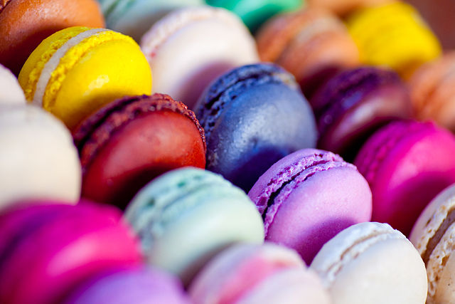
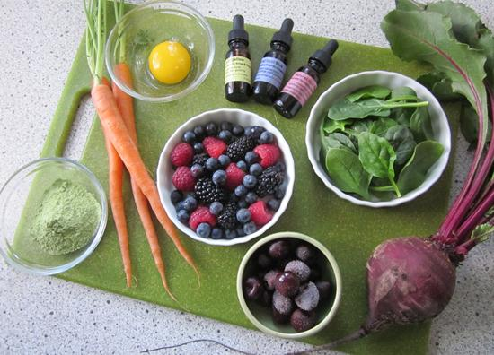
A Brief Look at Food Colorants
Any artificially synthesized substance, pigment or dye for coloring foods
High Stability to light, oxygen and pH
Color uniformity
Low microbiological contamination
Relatively lower production costs
(Alves et al. 2008)
✖ Some life-threatening risks (Kapadia et al. 1998; Eigenmann and Haenggeli 2007)
manufactured by extracting from
natural substances
no limitation for the quantity
low stability
high cost

Slide 5
A Brief Look at Food Colorants
Why do we use??
☛ to intensify the actual color of foods
☛ to obtain color stability in mass production
☛ to regain the lost color of a food after some food process
☛ coloring some types of food such as confectionary which are actually colorless

Slide 6



A Brief Look at Food Colorants
Legislations
EU COMISSION
(30 June 1994 on colors for use in foodstuffs)
World Health Organization
US Food and Drug Administration

Slide 7

A Brief Look at Food Colorants
Legislations
E Number | Name of Colorant | E Number | Name of Colorant
E 100 | Curcumin | E 155 | Brown HT
E 101 | Riboflavine | E 160 | Carotenoids
E 102 | Tartrazine | E 163 | Anthocyanines
E 132 | Indigo Carmine | E 124 | Ponceau 4R
E 133 | Brilliant Blue | E 170 | Calcium Carbonate
E 141 | Chlorophylls | E 171 | Titaniumdioxide
E 142 | Green | E 173 | Alluminum
E 150 | Amonnium Caramel | E 174 | Silver
E 151 | Brilliant Black | E 175 | Gold
E 153 | Carbon | E 180 | Litolrubin BK
E 154 | Brown FK | E 110 | Sunset Yellow

Slide 8
Objectives
Developing and investigating novel methods for the determination of synthetic food colorants
Analyzing synthetic colorant content of food products
Providing food control by informing consumers about the limitations of these substances
Aiming the issues above, adapting in-vitro antioxidant assay CUPRAC for the determination of synthetic food colorants
Correlation of proposed method results with HPLC findings
Combination of in-vitro antioxidant assays with HPLC technique - application of online HPLC-CUPRAC technique

Slide 9
Methodology
In Literature

Slide 10
Methodology
CUPRAC(Cupric ion Reducing Antioxidant Capacity)
The CUPRAC method is a simple and versatile antioxidant capacity assay useful for a wide variety of polyphenols, including phenolic acids, hydroxycinnamic acids, flavonoids, carotenoids,anthocyanins, as well as for thiols, synthetic antioxidants, and vitamins C and E.
The chromogenic oxidizing reagent bis(neocuproine)copper(II) cation (Cu(II)-Nc) is used as an outer-sphere electrontransfer agent and by reduction of this reagent with antioxidants, bis(neocuproine) copper(I) cation (Cu(I)-Nc) is formed.
nCu(Nc)₂²⁺ + n-electron reductant (AO) nCu(Nc)₂⁺ n-electron oxidized product + n H⁺
R. Apak, K. Guclu, M. OzyUrek, S. E. Karademir and M. Altun, Free Radical Res., 2005, 39, 949–961.
R. Apak, K. Guclu, M. Ozyurek, S. E. Karademir and E. Ercag, Int. J. Food Sci. Nutr., 2006, 57, 292–304.

Slide 11
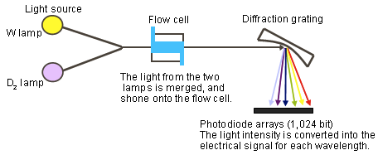
Methodology
HPLC-PDA Technique
Most preferred methods for the determination of synthetic food colorants are still chromatographic techniques coupled with ultraviolet (UV) or diode array detectors (Serdar and Knezevic 2009; Culzoni et al. 2009; Kirschbaum et al. 2006)
There are two main problems with the use of single-wavelength UV detectors.
Various UV–visible (UV–Vis) spectra with different maximum absorbance wavelengths ➔long seperation time
Possible overlap of colorant peaks or the presence of other organic compounds such as flavors in the sample.
☺ Both problems can be solved in the case of DADs. All dyes can be detected near to their maximum wavelength with the aid of multisignal detection capability, and peak identity can be easily confirmed.

Slide 12
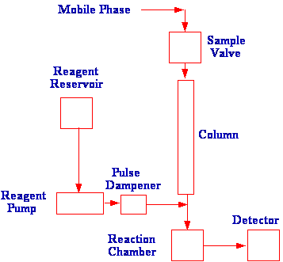
Methodology
On-Line HPLC Derivatization Techniques
Post-column derivatization involves the modification of the chromatographic system to allow the reaction to take place prior to entering the detector by inserting a post column reactor between the column and the detector.
The post-column reactor is required to fulfill the following functions:
1)Provide a source of reagent and a means of mixing it efficiently with the column eluent.
2)Ensure the reaction is complete before the derivatized product enters the detector.
3)Minimize the dispersion that takes place in the reactor so that the integrity of the separation achieved by the column is maintained.

Slide 13
Experimental Studies
Color index numbers, European codes, names and molecular formulas
of analyzed synthetic colorants
Color Index (CI) Numbers | E Codes | Name of Colorants | Molecular Formula
19140 | E 102 | Tartrazine | C₁₆H₉N₄Na₃O₉S₂
15985 | E 110 | Sunset Yellow | C₁₆H₁₀N₂Na₂O₇S₂
73015 | E 132 | Indigo Carmine | C₁₆H₈N₂Na₂O₈S₂
45430 | E 127 | Erytrsosine | C₂₀H₆I₄Na₂O₅
16255 | E 124 | Ponceau 4R | C₂₀H₁₁N₂Na₃O₁₀S₃

Slide 14
Experimental Studies
Preparation of Standard and Sample Solutions
The colorant standart and sample solutions were injected to the chromatographic
system after filtering through 0.45μm disposable syringe
filters.
Spectrophotometric CUPRAC procedure was applied.

Slide 15
Experimental Studies
Spectrophotometric Assays of Total Antioxidant Capacity Applied to the Determination of Total Colorant Content
TCC (g/ 100 g)=
( Absorbance value / ε_{ponceau 4R} ) × (total volume/ sample volume) × Mw _{ponceau 4R} (g/mol) / amount of sample(g) × 100

Slide 16
Experimental Studies
Chromatografic Methods
Chromatographic Separation
✔ In order to achieve full resolution of all colorants, a variety of gradient elution programs were tested, using different mobile phases and changing retention times. But in all optimization experiments, the flow rate and injection volume were kept constant as 1 ml min⁻¹ and 20 μL, respectively.
t (min) | A (%) | B (%)
0 | 100 | 0
2 | 100 | 0
20 | 45 | 55
30 | 0 | 100
32 | 0 | 100
33 | 100 | 0
35 | 100 | 0
Table 2. Optimized gradient elution program for the separation of colorants by HPLC-PDA
(A: 0.13 M ammonium acetate solution, B: HPLC grade methanol)
TCC _{HPLC} = Σ C_{i} PECC _{i} × [Total sample amount (L) /sample amount (g)] × 100
F. A. Olgun, B. Demirata, R. Apak,Food Anal. Methods,2012,5: 1335-1341

Slide 17
Experimental Studies
Chromatografic Methods
Chromatographic Conditions
Reversed phase C18 column system
Gradient elution program
(with mobile phase A: 0.13M ammonium acetate solution, B: methanol)
Flow rate: 1mLmin⁻¹
Injection volume: 20μL
Detection: PDA detector monitoring each colorant at its own
appropriate wavelength
(λ_{max} was chosen as 485 nm for mutual evaluation of colorants)
F. A. Olgun, B. Demirata, R. Apak,Food Anal. Methods,2012,5: 1335-1341

Slide 18
Experimental Studies
On-line HPLC CUPRAC Assay
flow rate: 1 mLmin⁻¹
flow rate: 0.5 mLmin⁻¹
On-line HPLC-CUPRAC method assayed by Celik et. al. (2010) was applied directly to synthetic food colorants separating with the related gradient elution program. Colorants were let to react with CUPRAC reagent in a time period of 1 minute.
TCC _{HPLC-CUPRAC} = (Σyi / slope) × Total volume (L) / sample amount (g)
S. E. Celik, M. Ozyurek, K. Guclu and R. Apak, Anal. Chim. Acta, 2010, 674, 79–88.

Slide 19
Results
CUPRAC Assay of Total Antioxidant Capacity Applied to the Determination of Synthetic Food Colorants
The indirect molar absorptivities and linear concentration ranges
of the tested colorants with respect to the CUPRAC method (N=5)
Name of colorants | ε (Lmol⁻¹cm⁻¹) | Workıng ranges (×10⁻⁵ M) | Calibratıon equations | LOD (M) | LOQ (M) | PECC
Ponceau 4R (E124) | 2.24 × 10⁴ | 0.48 – 3.90 | A= (2.24 ± 0.36) × 10⁴ × C_{Ponceau 4R} – (0.0227 ± 0.0073), r = 0.9990 | 0.11 × 10⁻⁶ | 0.36 × 10⁻⁶ | 1.00
Tartrazine (E102) | 1.34 × 10⁴ | 0.58 – 4.64 | A= (1.34 ± 0.12) × 10⁴ × C_{Tartrazine}– (0.0060 ± 0.0003), r = 0.9945 | 1.48 × 10⁻⁶ | 4.93 × 10⁻⁶ | 0.60
Erythrosine (E127) | 5.20 × 10³ | 0.10 – 0.38 | A= (5.20 ± 0.31) × 10³ × C_{erythrosıne} + (0.0087 ± 0.0020), r = 0.9996 | 0.21 × 10⁻⁶ | 0.70 × 10⁻⁶ | 2.32
Sunset Yellow (E110) | 1.49 × 10⁴ | 0.56 – 4.74 | A= (1.49 ± 0.06) × 10⁴ × C_{Sunsetyellow} + (0.0151 ± 0.0041), r = 0.9996 | 1.80 × 10⁻⁶ | 6.00 × 10⁻⁶ | 0.67
Indigo carmine (E132) | 1.03 × 10⁴ | 0.11 – 0.91 | A= (1.03 ± 0.11) × 10⁴ × C_{ındigocarmıneo} + (0.0829 ± 0.0588), r = 0.9912 | 1.91 × 10⁻⁶ | 6.38 × 10⁻⁶ | 0.46

Slide 20
Results
CUPRAC Assay of Total Antioxidant Capacity Applied to the Determination of Synthetic Food Colorants
The interaction of orange powder beverage with tartrazine (:1mL 10⁻²M CuCl₂ + 1mL 7.5×10⁻³M Nc +1mL 1M NH₄Ac+ tartrazine; : 1mL 10⁻²M CuCl₂ + 1mL 7.5×10⁻³M Nc +1mL 1M NH₄Ac+ tartrazine + orange powder beverage)
C_{tartrazin}×10⁶ (molL⁻¹)
The interaction of rosehip powder beverage with ponceau 4R (:1mL 10⁻²M CuCl₂ + 1mL 7.5×10⁻³M Nc +1mL 1M NH₄Ac+ ponceau 4R; : 1mL 10⁻²M CuCl₂ + 1mL 7.5×10⁻³M Nc +1mL 1M NH₄Ac+ ponceau 4R + rosehip powder beverage)

Slide 21
Results
CUPRAC Assay of Total Antioxidant Capacity Applied to the Determination of Synthetic Food Colorants
Relative Standard Deviation % and Recovery % of Synthetic Food Colorants added to powder beverage samples
Colorant addition to powder beverages | TCC (calculated with PECC coefficients) (M) | Concentration added (M) | Concentration expected (M) | Concentration found (M) | Recovery (%)
Tartrazine addition to orange powder beverage | 6.82 × 10⁻⁶ | 17.31 × 10⁻⁶ | 24.13 × 10⁻⁶ | 26.86 × 10⁻⁶ | 111.0
 |  | 21.49 × 10⁻⁶ | 28.31 × 10⁻⁶ | 32.01 × 10⁻⁶ | 113.0
Ponceau 4R addition to rosehip powder beverage | 4.58 × 10⁻⁶ | 12.76 × 10⁻⁶ | 18.23 × 10⁻⁶ | 16.72 × 10⁻⁶ | 91.7
 |  | 14.32 × 10⁻⁶ | 19.79 × 10⁻⁶ | 18.38 × 10⁻⁶ | 92.9

Slide 22
Results
Determination of Synthetic Food Colorants by HPLC-PDA
The chromatogram of standard colorant mixture solution (Colorant mixture consists of 1: E102, 2: E132, 3: E110, 4: E124, 5: E127, respectively. Flow rate: 1mLmin-1; λ_{max}: 485nm)
AU
E124
E110
E102
E127
E132
t_{R}(min)

Slide 23
Results
Determination of Synthetic Food Colorants by HPLC-PDA
Retention times (t_{R}(min)), linear ranges, calibration equations, regression coefficients, LOD and LOQ values of the tested colorants with respect to HPLC-PDA technique
Name of colorants | λ_{max} (nm) | t_{R}(min) | Working ranges (M) | Calibration Equation A= mC+n (A: Peak Area) | R² | LOD (M) | LOQ (M)
Ponceau 4R (E124) | 508 | 17.43 ± 0.05 | 8.27 × 10⁻⁶ – 8.27 × 10⁻⁵ | A= (8.0 ± 0.69) × 10¹⁰ C + (1.07 ± 2.50) × 10⁵ | 0.9935 | 7.56 × 10⁻⁶ | 25.21 × 10⁻⁶
Tartrazine (E102) | 427 | 14.58 ± 0.03 | 9.20 × 10⁻⁶- 9.20 × 10⁻⁵ | A= (2.06 ± 0.16) × 10¹¹ C + (1.11 ± 128.5) × 10⁵ | 0.9997 | 2.02 × 10⁻⁶ | 6.74 × 10⁻⁶
Erythrosine (E127) | 528 | 27.39 ± 0.03 | 5.68 × 10⁻⁶ – 5.68 × 10⁻⁵ | A= (3.39 ± 0.05) × 10¹¹ C - (1.06 ± 1.17) ×10⁵ | 0.9998 | 8.64 × 10⁻⁷ | 28.89 × 10⁻⁷
Sunset Yellow (E110) | 482 | 16.41 ± 0.04 | 1.11 × 10⁻⁵ – 1.11 × 10⁻³ | A= (6.60 ± 0.61) × 10¹⁰ C + (1.25 ± 2.94) × 10⁵ | 0.9995 | 1.06 ×10⁻⁶ | 3.55 × 10⁻⁶
Indigo carmine (E132) | 608 | 13.53 ± 0.03 | 1.91 × 10⁻⁶ – 1.91 × 10⁻⁵ | A= (2.12 ± 0.18) × 10¹⁰ C + (7.02 ± 17.02) × 10³ | 0.9994 | 1.47 × 10⁻⁶ | 4.87 × 10⁻⁶

Slide 24
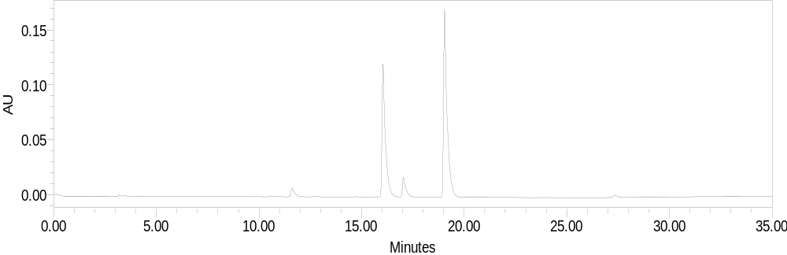
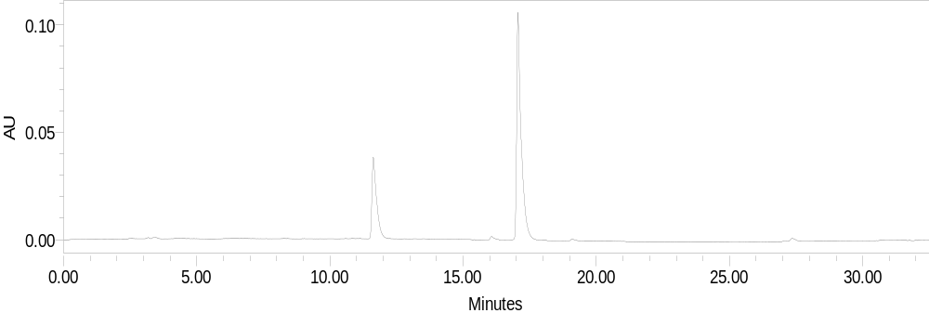
Results
Determination of Synthetic Food Colorants by HPLC-PDA
1
2
The chromatogram of
rosehip powder beverage
monitored at λmax: 485nm
(1: sunset yellow, 2: ponceau4R)
The chromatogram of
orange powder beverage
monitored at λmax: 485nm
(1: tartrazine, 2: ponceau4R)
2
1

Slide 25
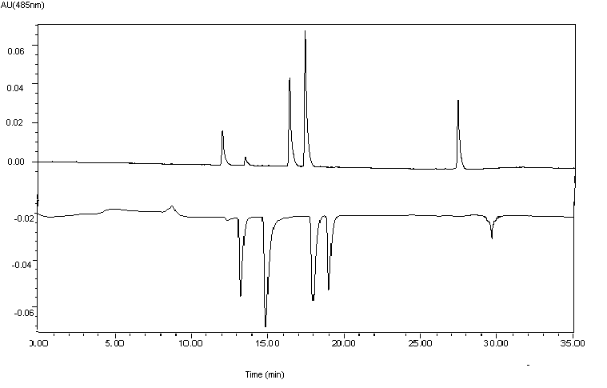
Results
Determination of Synthetic Food Colorants by on-line HPLC-CUPRAC Method
AU
3
4
5
1
2
4
5
1
2
3
Time (min)
The chromatogram of synthetic mixture of synthetic food colorants mixture solution
(consists of 1: E102, 2: E132, 3: E110, 4: E124, 5: E127), at 485 nm and 450 nm
respectively.

Slide 26
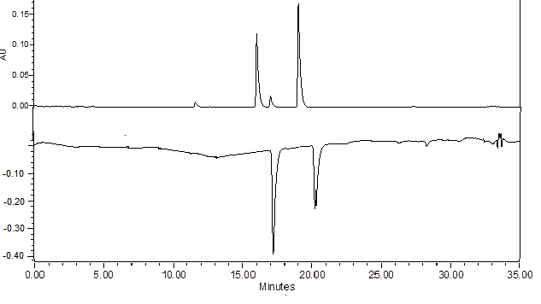
Results
Determination of Synthetic Food Colorants by on-line HPLC-CUPRAC Method
AU
1
2
Time (min)
The chromatogram of rosehip powder beverage sample solution monitored at 485 nm and 450 nm, respectively. (Peak 1: sunset yellow; Peak 2: ponceau 4R)

Slide 27
Results
Determination of Synthetic Food Colorants by on-line HPLC-CUPRAC Method
Retention times (t_{R}(min)), linear ranges, calibration equations, regression coefficients, LOD and LOQ values of the tested colorants with respect to on-line HPLC-CUPRAC method
Name of colorant | t_{R} (min) | Calibration equation A=mC(M)+n | R² | working range ( × 10⁻⁶ M) | LOD (M) | LOQ (M)
Tartrazine (E102) | 12.81 ± 0.15 | A= (7,27 ± 1,31) × 10¹¹ C- (1,51 ± 2,49) × 10⁵ | 0.9937 | 0.46 – 3.71 | 4.17 × 10⁻⁷ | 13.90 × 10⁻⁵
Sunset Yellow (E110) | 17.17 ± 0.08 | A= (6.88 ± 0.85) × 10¹⁰ C – (9.92 ± 18.88) × 10⁴ | 0.9959 | 5.70 – 41,20 | 3.72 × 10⁻⁶ | 12.40 × 10⁻⁶
Erythrosine (E127) | 27.39 ± 0.03 | A= (1.25 ± 0.27) × 10¹¹ C – (1.14 ± 2.73) × 10⁴ | 0.9990 | 0.26 – 2.10 | 0.27 × 10⁻⁷ | 0.90 × 10⁻⁷
Indigo Carmine (E132) | 14.34 ± 0.03 | A= (7.71 ± 2.89) × 10¹⁰ C – (4.73 ± 10.68) × 10⁵ | 0.9953 | 8.95 – 71.60 | 1.39 × 10⁻⁶ | 2.33 × 10⁻⁶
Ponceau 4R (E124) | 17.43 ± 0.05 | A= (8.19 ± 2.08) × 10¹⁰ C – (3.97 ± 4.84) × 10⁵ | 0.9978 | 5.65 – 45.20 | 3.00 × 10⁻⁶ | 10.00 × 10⁻⁶

Slide 28
Results
Determination of Synthetic Food Colorants by on-line HPLC-CUPRAC Method
Relative Standard Deviation and Recovery % of Synthetic Food Colorants added to powder beverage samples with respect to on-line HPLC-CUPRAC Method
Colorant addition to powder beverage samplse | Colorant content (M) | Added concentration (M) | Expected concentration (M) | Found Concentration (M) | Recovery (%)
Tartrazine addition to orange powder beverage | Tartrazine in orange powder beverage (M) 1.02 × 10⁻⁶ | 0.93 × 10⁻⁶ | 1.95 × 10⁻⁶ | 2.24 × 10⁻⁶ | 114.8
 |  | 1.85 × 10⁻⁶ | 2.87 × 10⁻⁶ | 3.00 × 10⁻⁶ | 104.5
Ponceau 4R addition to rosehip powder beverage | Ponceau 4R in rosehip powder beverage (M) 9.77 × 10⁻⁶ | 1.13 × 10⁻⁶ | 10.90 × 10⁻⁶ | 10.12 × 10⁻⁶ | 92.80
 |  | 2.26 × 10⁻⁶ | 12.03 × 10⁻⁶ | 10.73 × 10⁻⁶ | 90.12

Slide 29
Results
Comparison of retention times (tR), limit of detection values (LOD) and limit of qualification values (LOQ) of tested colorants, with respect to HPLC-PDA technique and on-line HPLC-CUPRAC method
Name of Colorant | t_{R} (HPLC-PDA) | t_{R} (on-line HPLC-CUPRAC) | LOD (HPLC-PDA; 485 nm) | LOD (on-line HPLC-CUPRAC, 485nm)
Ponceau 4R | 17.43±0.05 | 18.16±0.03 | 7.56 × 10⁻⁶ | 2.80 × 10⁻⁶
Tartrazine | 12.03±0.08 | 12.81±0.15 | 2.02 × 10⁻⁶ | 4.17× 10⁻⁷
Erythrosine | 27.39±0.03 | 28.27±0.06 | 8.64 × 10⁻⁷ | 2.70 × 10⁻⁸
Sunset Yellow | 16.41±0.04 | 17.17±0.08 | 1.06 ×10⁻⁶ | 3.72 × 10⁻⁷
Indigo Carmine | 13.53±0.03 | 14.34±0.11 | 1.42 × 10⁻⁶ | 1.39 × 10⁻⁶

Slide 30
The Analyses of Powder Beverage Samples
Colorant contents of powder beverage samples found by HPLC and on-line HPLC-CUPRAC assays (N=5)
Name of colorant | Orange powder beverage (g/100g powder beverage) |  | Rosehip powder beverage (g/100g powder beverage)
 | HPLC-PDA (485 nm) | On-line HPLC-CUPRAC (450 nm) | HPLC-PDA (485 nm) | On-line HPLC-CUPRAC (450 nm)
Tartrazine (E102) | 0,61±0,02 | 0,45±0,03 | 0,29±0,03 | 0,28±0,04
Sunset Yellow (E110)
Erythrosine (E127) | 0,07±0,01 | 0,04±0,01 | - | -
Indigo Carmine (E132) | - | - | - | -
Ponceau 4R (E124) | - | - | 0,24±0,02 | 0,22±0,01

Slide 31
The Analyses of Powder Beverage Samples
Total colorant contents of powder beverage samples found by HPLC (with CUPRAC calculations) and on-line HPLC-CUPRAC assays (N=5)
Name of sample | CUPRAC g Ponceau 4R/ 100 g | HPLC (CUPRAC calculations ) g Ponceau 4R/ 100 g | On-line HPLC-CUPRAC g Ponceau 4R/ 100 g
Orange powder beverage | 0.85±0.01 | 0.65±0.01 | 0.76±0.02
Rosehip powder beverage | 0.68±0.02 | 0.51±0.01 | 0.49±0.01
Statistical Analysis with two-way ANOVA Test | CUPRAC, HPLC (CUPRAC calculated) and on-line HPLC-CUPRAC | P= 0.05; F_{experimental} = 8.04; F_{critical}= 18.51; F_{experimental} < F_{critical}

Slide 32
Conclusions
In this study, determination of five synthetic food colorants was investigated using spectrophotometric and chromatographic methods.
By adapting the novel spectrophotometric CUPRAC assay of total antioxidant capacity to the determination of total food colorant content, certain beverage samples were easily and accurately analyzed. The total colorant content was found at low reagent and instrumentation costs with the use of a UV–vis spectrophotometer easily found in a conventional laboratory equipped with simple instruments.

Slide 33
Conclusions
HPLC analysis of colorants was performed with two different techniques.
1)In conventional HPLC method, PDA detector system was used to monitor each colorant at its maximum absorbance wavelength. The selected mobile phase for the gradient elution program enabled the shortening of total analysis time when compared to other chromatographic methods. Furthermore, since acetonitrile as the conventional solvent was not used in the eluent, solution costs were minimized.
2)On-line HPLC-CUPRAC was adapted for the determination of synthetic food colorants. Optimized gradient elution program was used for the separation of colorants. Retention time periods were increased due to additional installation for derivatization coil. However, LOD values were decreased with on-line HPLC-CUPRAC method.

Slide 34
Conclusions
Two-way ANOVA test results were calculated for CUPRAC, HPLC (with CUPRAC calculations) ve on-line HPLC-CUPRAC (P= 0,05; F_{experimental} = 0,26; F_{critical}= 18,51; F_{experimental} < F_{critical}) with 95% confidence levels.

Slide 35
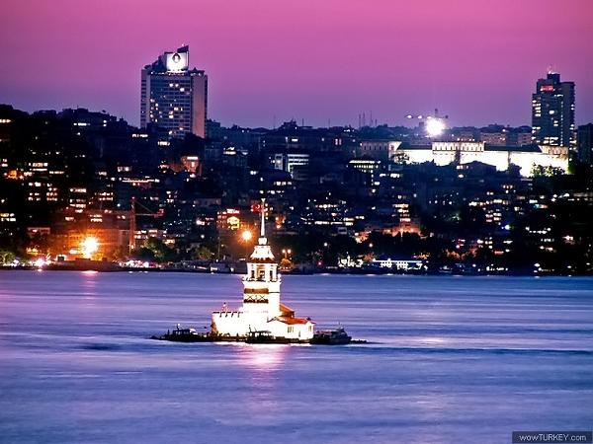
THANK YOU...

