Slide 1
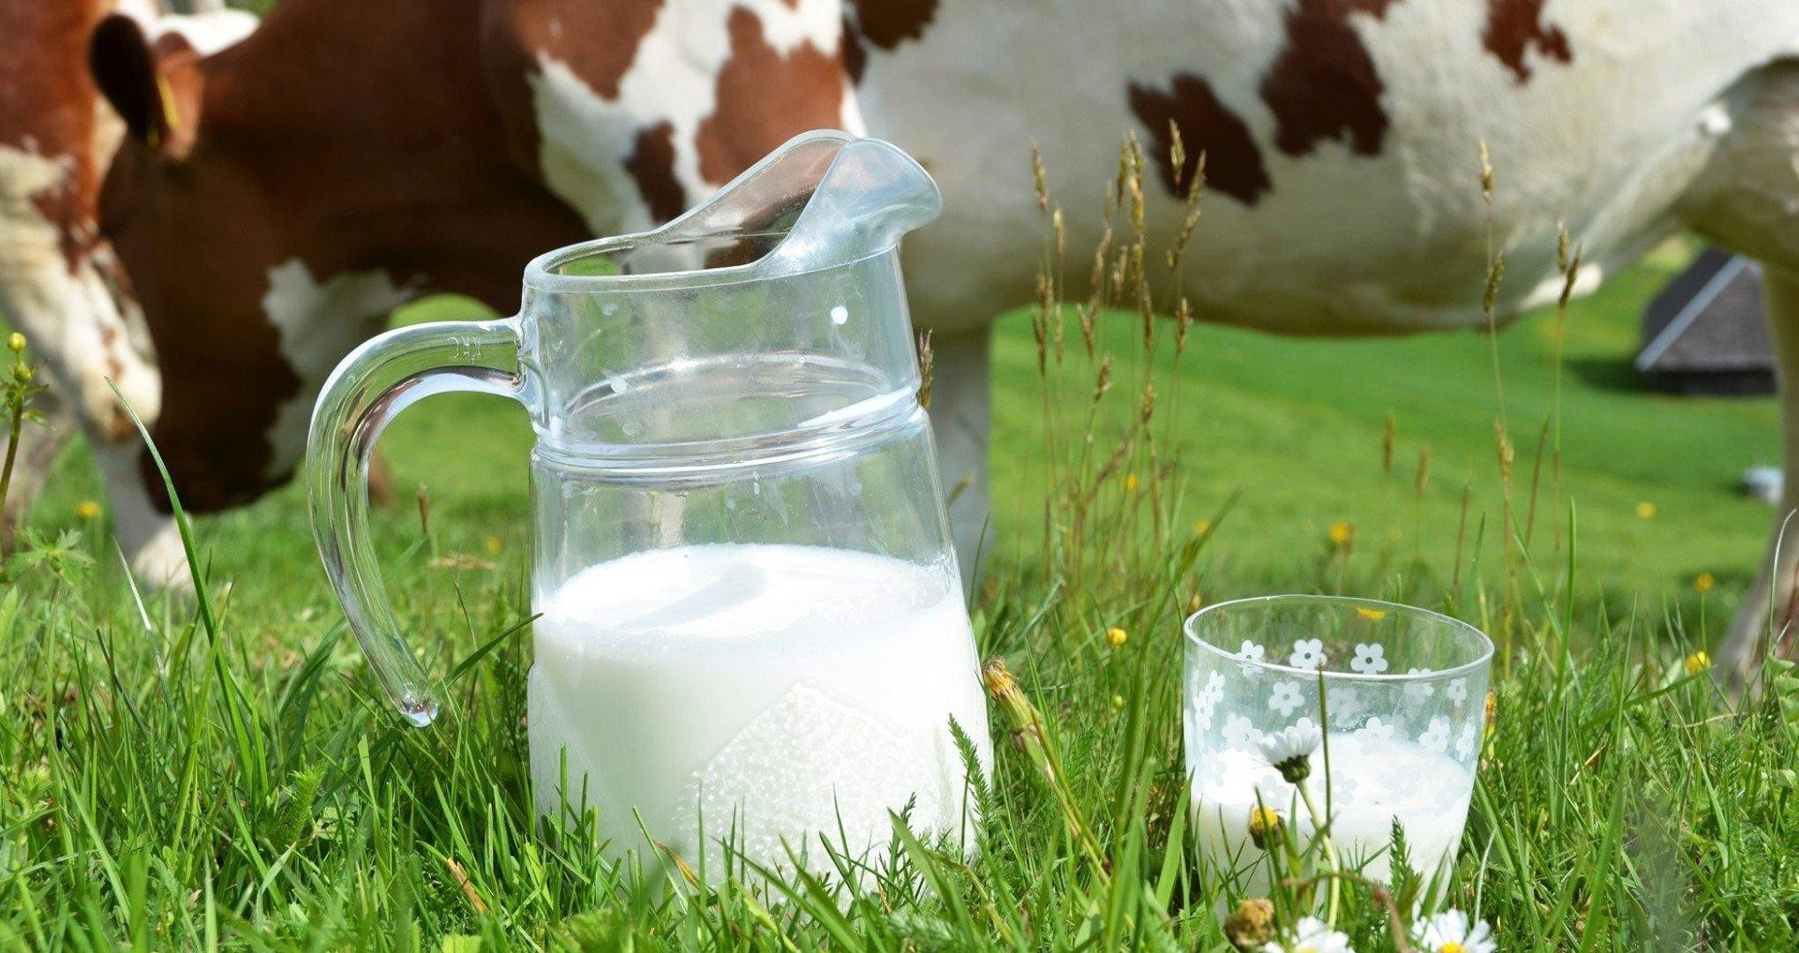
Cow`s Milk Protein Allergy
COW`s MILK PROTEIN ALLERGY
Eyad Altamimi, MD

Slide 2
Agenda of the talk
Definitions
CMPA Epidemiology and Pathogenesis
CMPA Diagnosis
CMPA Management
CMPA prevention

Slide 3

Adverse Food Reaction
Broad term indicating a link between an
ingestion of a food and an abnormal response
Reproducible adverse reactions may be caused by a toxin, a pharmacologic effect, an immunologic response, or a metabolic disorder

Slide 4
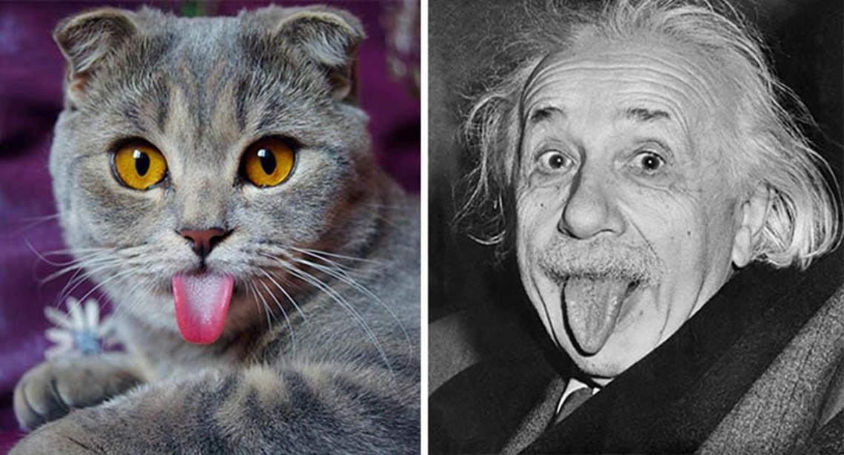

Slide 5
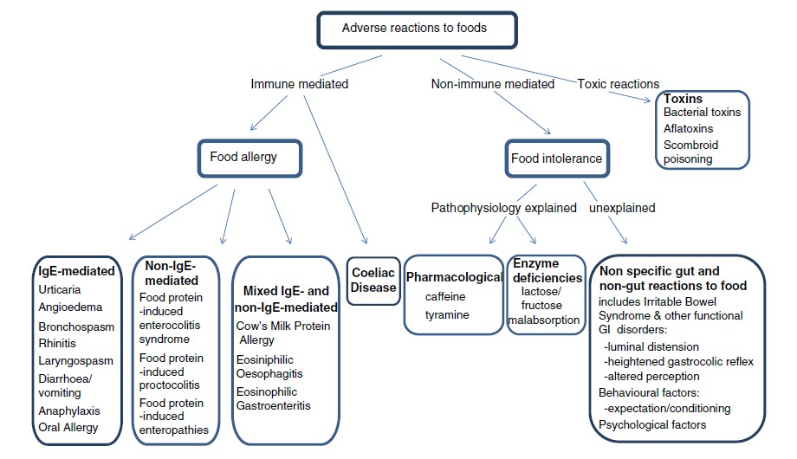



Slide 6
Food allergy is an adverse health effect arising from a specific immune response that occurs reproducibly on exposure to a given food
Food allergens are specific components of food or ingredients within, that are recognized by allergen-specific immune cells and elicit specific immunologic reactions, resulting in characteristic symptoms
Nutr Res. 2011 January ; 31(1): 61–75

Slide 7
Sensitization indicates demonstrable IgE antibody to a food without having clinical symptoms on exposure
This does not equate with clinical food allergy
J Allergy Clin Immunol 2004;114:1146-50

Slide 8

Tolerance is the suppression of adverse immune responses to non-harmful ingested food antigens
Pediatr Allergy Immunol 2010: 21 (Suppl. 21): 1–125

Slide 9
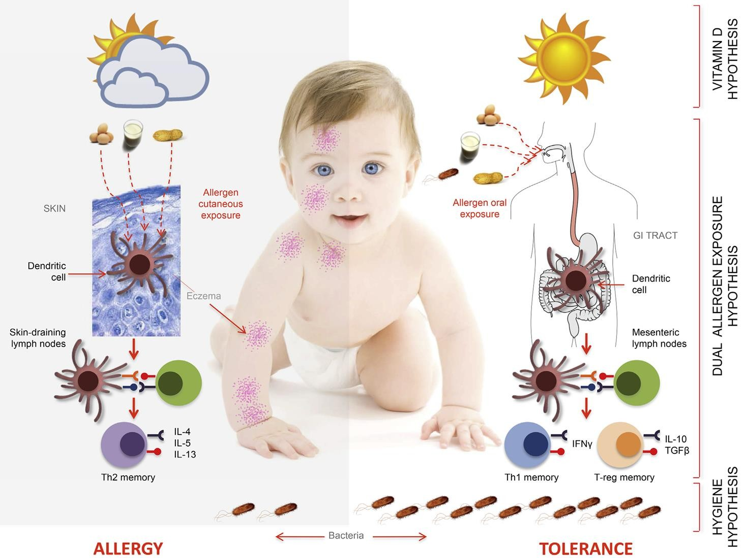

What happened to newly introduced
oral non-harmful Antigens?

Slide 10
Food allergy Epidemiology
Prevalence of food allergies is rising in both developed and developing countries, especially over the last 10-15 years which increases the personal as well as global health burden

Slide 11
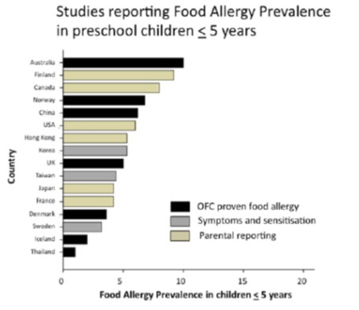



The most common food allergens in children less than 5 years of age were relatively similar across all regions, generally including cow`s milk, egg, peanuts and seafood
World Allergy Organization Journal 2013, 6:21

Slide 12
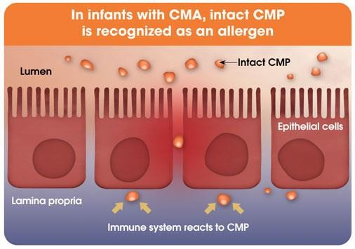
Cow's milk protein allergy (CMPA)
is an immunological reaction to one or more milk proteins

Slide 13

What is the allergen?

Slide 14

α-lactalbumin &
β-lactoglobulin
αs1-, αs2-, β-, and κ-
Patients are more often sensitized to alpha (100%)
and kappa caseins (91.7%)

Slide 15
Cross-reactivity may occur when an antibody reacts not only with the original allergen, but also with a similar allergen
Adverse reaction to food or aeroallergin might be provoked by another allergen which share structural or sequence similarity
Milk allergens of various mammalian species cross-react
Mayo Clin Proc. Oct. 2015;90(10):1411-1419

Slide 16
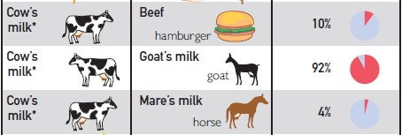
The greatest homology is among cows, sheep and goats, while proteins in the pig, horse, donkey and camel milk have less structural homology
Mayo Clin Proc. Oct. 2015;90(10):1411-1419

Slide 17

Why?

Slide 18
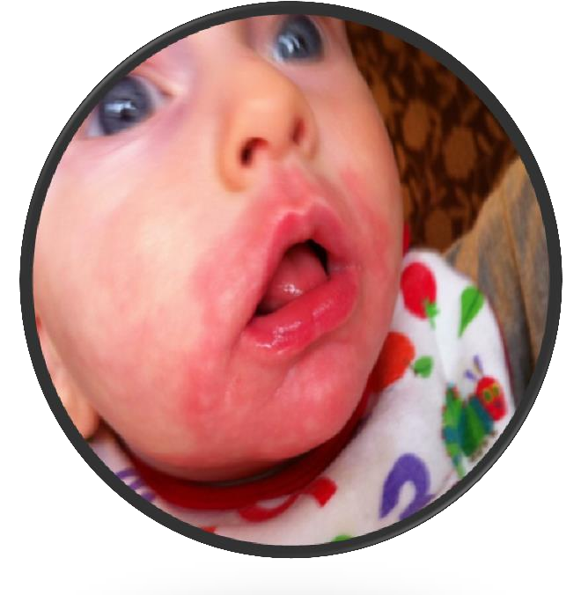
Cow`s milk feeding
Maternal
Factors
Atopy

Slide 19
Atopy:
Allergy Genes
Risk of CMPA increases by 20-40% if one
parent had allergic disease
Risk of CMPA increases by 40-60% if both
parent had allergic disease
Pediatr Gastroenterol Hepatol Nutr 2014 March 17(1):1-5

Slide 20
Cow`s Milk Feeding
Significantly higher cow`s milk protein
compared to breast milk
Loss of immunomodulators in breast milk
Different gut microflora
Arch Dis Child. 2007;92:902-908

Slide 21
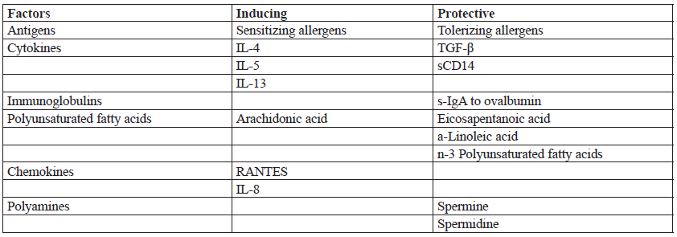
Maternal Factors
Hippokratia. 2011; 15(3): 216-222

Slide 22


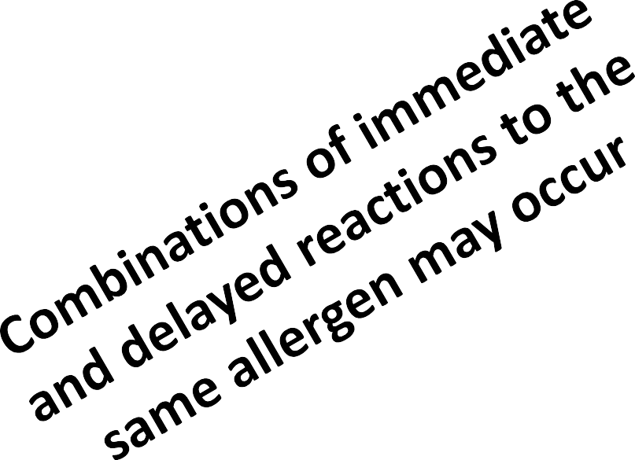





Allergy can be immunoglobulin E (IgE)-
mediated or non-IgE-mediated
IgE mediated
Minutes to 2 hr
May persist beyond 1 yr of age Two phases :“sensibilization” and “activation”
Specific serum IgE, skin prick test
Non-IgE mediated Several hours to days Usually resolved by 1 yr
Reactions mediated by Th1 cells, interactions between T lymphocytes, mast cells and neurons that alters the function of the smooth muscle and the intestinal motility
Oral challenge test

Slide 23

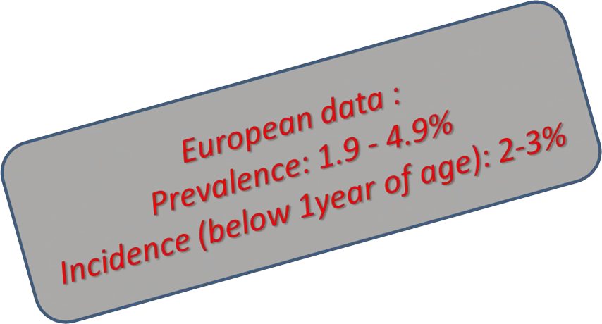
Prevalence of CMPA in children
Ann Allergy Asthma Immunol 2002;89(6 Suppl 1):33-7

Slide 24
Clinical Manifestations
Most infants with CMA develop symptoms within the first month after introduction of CMP-based Formula
The majority has two or more symptoms from
two or more organ systems
Clinical symptoms and signs in the digestive tract may be due to inflammation, dysmotility, or a combination of both
Pediatr Gastroenterol Hepatol Nutr 2014 March 17(1):1-5

Slide 25
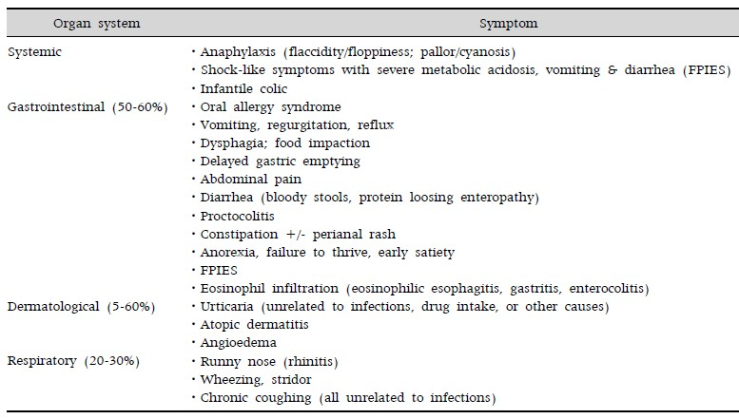
Systems involved
JPGN 2012;55: 221–229

Slide 26

Diagnosis
The First step
History and Physical Examination

Slide 27
Suspect CMPA if:
Family history of atopy
Abrupt onset of symptoms (within 2 hrs.)
Appearance of symptoms within two months
after ingesting Cow`s milk protein
More than two systems involved
Symptomatic treatment failed

Slide 28
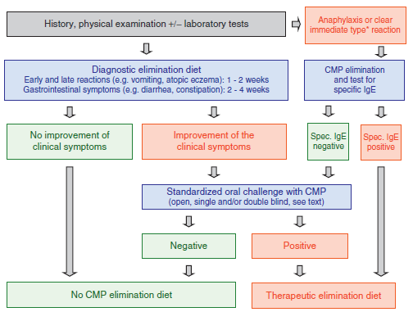


Slide 29
Serum IgE & Skin Prick Test
Multiple guidelines consider them useful or
confirmatory for the diagnosis
Limited value in case of non-IgE mediated CMPA May identify a sensitization to a specific allergen Positive results in these assays do not necessarily
predict the existence of a clinically significant allergy
Skin prick test should preferably utilize fresh foods, thermal processing may destroy heat-labile proteins which contribute to the allergenicity producing false negative results

Slide 30
Recent studies suggest that these two assays are
not interchangeable tests as they show only a moderate agreement in young children
One study also suggests SPT results are more closely related to clinical symptoms than sIgE in children under the age of 5
Allergy 2015;70(1):41-48

Slide 31
Quantification of both of these test results allows prediction of the likelihood of a further reaction and hence is useful for prognostic purposes
The higher the antibody titer and the larger the diameter of the SPT reaction, the greater is the probability of having a reaction to CMP and allergy persistence

Slide 32
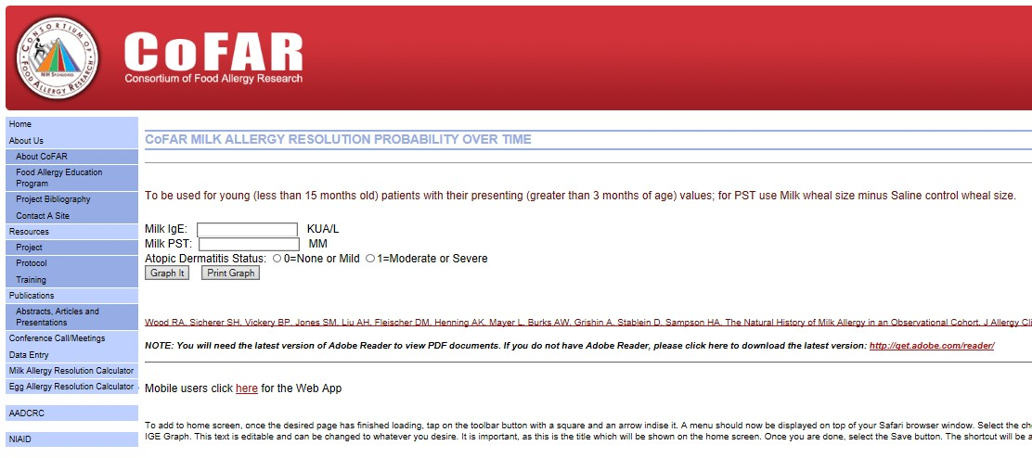

Slide 33




Eliminate dairy products from maternal diet, supplement mother with Calcium
Encourage breastfeeding
Consider Egg, Soy elimination
Fed with a therapeutic formula for a period of from several days to a maximum of 2 weeks
AAF for diagnostic elimination in these extremely sick exclusively breast-fed infants

Slide 34
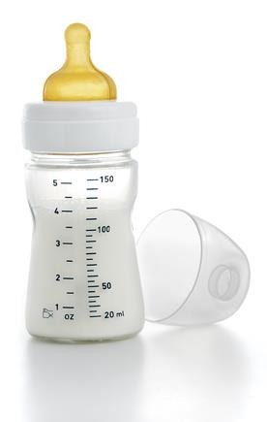
Soy F
eHF
First choice
AAF
> 6 months who do
Chemical &
In infants with
Enzymatic Hydrolysis extremely severe or ^{not accept the bitter}
taste of an eHF, or in cases in which the higher cost of an eHF is a limiting
Small peptides and AA
Less palatable More costly
life-threatening symptoms
After 2 weeks with no response on eHF

Slide 35
Confirming Diagnosis of CMPA
Oral Challenge Test
Challenge procedure may be omitted because either the likelihood of CMPA is extremely high or an allergen challenge procedure would be too risky (eg, history of anaphylaxis in a sensitized child)

Slide 36
Challenge
Open vs DBPCFC
Formula Cow`s milk formula
Volume
Fresh Cow`s milk
Lactose-Free Formula
Small
Increase gradually

Slide 37

 |  |  | Interpretation
No Allergic symptoms after Two weeks |  |  | Objective symptoms and positive specific IgE |  |  | Uncertain symptoms /severe eczema
CMPA
confirmed, Elimination treatment
Do DBPCFC

Slide 38

Management of Cow`s Milk Protein
Allergy
Strict avoidance of CMP is presently the safest
strategy for managing CMPA

Slide 39
Hypoallergenic formulas
The ideal protein hydrolysed formulas should:
not contain peptides larger than 1,5KD
contain no intact proteins
demonstrate no anaphylaxis in animals
reveal protein determinant equivalents less than 1/1,000,000 of original protein
Most importantly, the formula must be demonstrated safe in milk allergic infants by both double-blind placebo-controlled
HIPPOKRATIA 2011, 15, 3: 216-222

Slide 40
Extensively hydrolyzed Formulas
First choice
No complete avoidance of CMP: could lead to persistence of allergy or induce severe reaction
/Better in inducing tolerance
Palatability
Cost
Higher renal solute load
Might induce delay in intestinal enzymatic maturation
World Allergy Organization Journal (2016) 9:35

Slide 41
Provide protein as AA with no peptide
AAF
AAFs are suitable first line formulas for cow’s milk allergy but are usually reserved, because of their higher cost, for those infants with :
Multiple food allergies
Severe cow’s milk allergy
Allergic symptoms or severe atopic eczema when exclusively breast fed
Severe forms of non-IgE mediated cow’s milk allergy such as eosinophilic oesophagitis, enteropathies and FPIES
Faltering growth
Reacting to or refusing to take eHF
Clin Exp Allergy 44:642–672

Slide 42
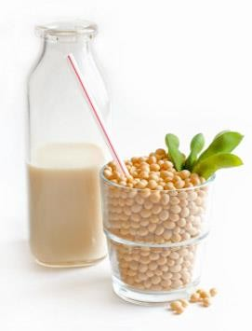
Palatable
Less expensive
Can be used in infants after 6 months of age Concomitant soya protein allergy affects about 1 in
10 infants with cow’s milk allergy, occurring equally in IgE mediated and non-IgE mediated cow’s milk protein allergy

Slide 43
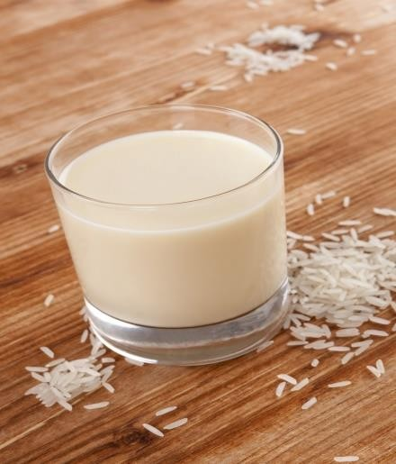
Stable, less allergenic food
Enzymatic proteolysis of rice protein
Fortification with (ess. AA ,Fe , Zn)
No growth issues
Safe in case of Cow`s milk and soy protein allergy
Ten years in use
The availability is an issue

Slide 44
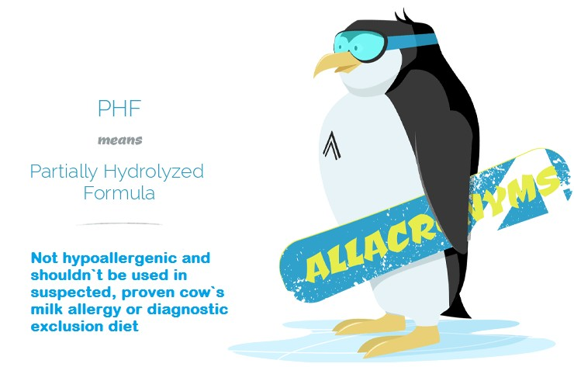

Slide 45
Milk reintroduction
The speed with which this tolerance develops varies
greatly, so the appropriateness and timing of reintroduction
should be individually assessed
Re-evaluation every 6 months
Non- IgE mediated allergy will resolve more rapidly than IgE mediated allergy
Dropping in the sIgE level / smaller SPT wheel predict achievement of tolerance
Home Vs. Hospital reintroduction
Very slow and meticulous process
Counseling and training of parents play an important role in achieving the tolerance

Slide 46









Milk Ladder
Stepwise movement from more denatured/ Low protein dose to less denatured/ high protein dose
Stage IV
Stage III
Stage II
Stage I | Larger quantities of baked cookies, cakes, muffins, waffles or products containing margarine or butter
Smaller amounts, baked dairy products, and matrix
Products containing cow’s milk protein like cheese, yogurts, chocolate, puddings, etc , up to heat processed whole cow’s milk
Consumption of fresh milk products as ice-cream, uncooked dairy products, etc.

Slide 47
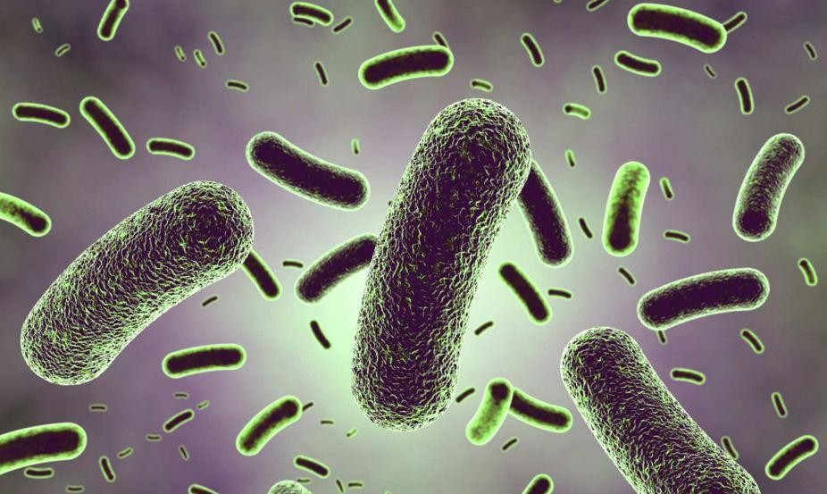
Probiotics
Evidence showed that probiotics may promote the gut immune regulation and the allergenic tolerance eHF supplemented with L. GG induce oral tolerance
more than non-supplemented formula
J Pediatr 163:771–777

Slide 48
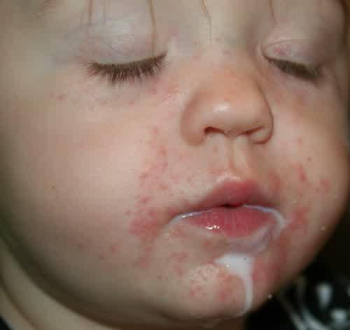

Cow`s milk protein Allergic infants are at increased risk of failure to thrive:
Mo₁r.e_{In}p_{a}ro_{p}n_{p}o_{ro}u_{p}n_{r}c_{i}e_{a}d_{te}in_{su}a_{b}s_{s}u_{ti}b_{tu}g_{t}r_{i}o_{o}u_{n}p of
2.^{p}Dªis^{ti}c^{e}o^{n}m^{ts}fo^{w}r^{i}t^{th}of^{e}tªh^{r}e^{ly}oºr^{n}ig^{s}i^{e}n^{t}al^{th}dªis^{n}ea^{in}se
thos₃e_{. F}w_{e}i_{e}th_{di}l_{n}a_{g}te_{d}r_{i}o_{ff}f_{ic}s_{u}y_{l}m_{tie}p_{s}toms

Slide 49

of CMPA

Slide 50
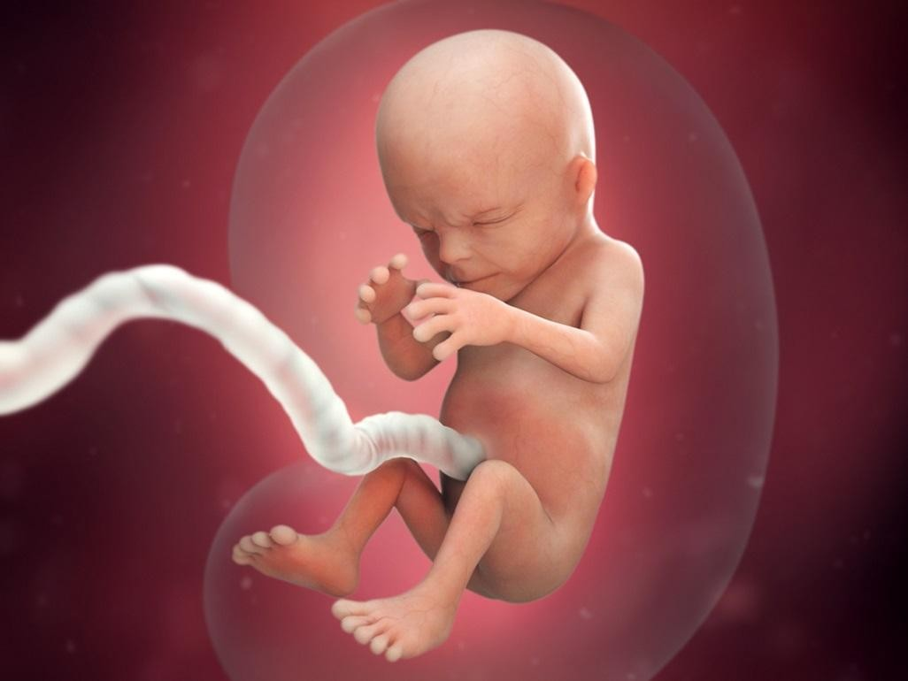
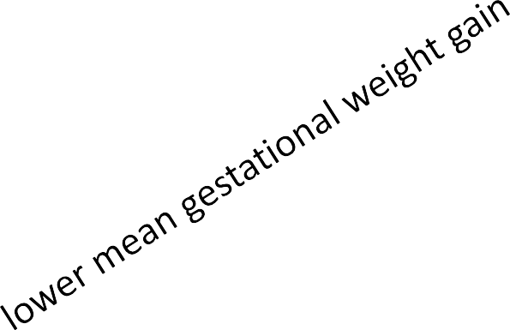
Cow’s milk antigen avoidance during pregnancy and lactation is not recommended
Dietary restrictions on the nutrition of the pregnant woman and her fetus should be considered harmful
Prebiotics and probiotics may help in prevention of allergy studies to suggest that probiotic supplementation of mothers during pregnancy and lactation may prevent early atopic disease in infants
Supplementation with LCPUFAs during pregnancy and postnatally conflicting evidence
Pediatrics 2008;121:183-91.
Pediatr Allergy Immunol 2008;19:1-4. Lancet 2003;361:1869-71.
Br Med J 344:e184

Slide 51
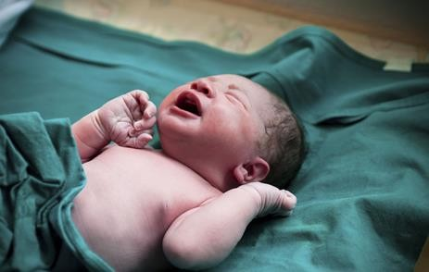
If the baby can be breastfed exclusively, Exclusive breastfeeding until 4-6 months
Pediatr Gastroenterol Hepatol Nutr 2014 June 17(2):61-73

Slide 52
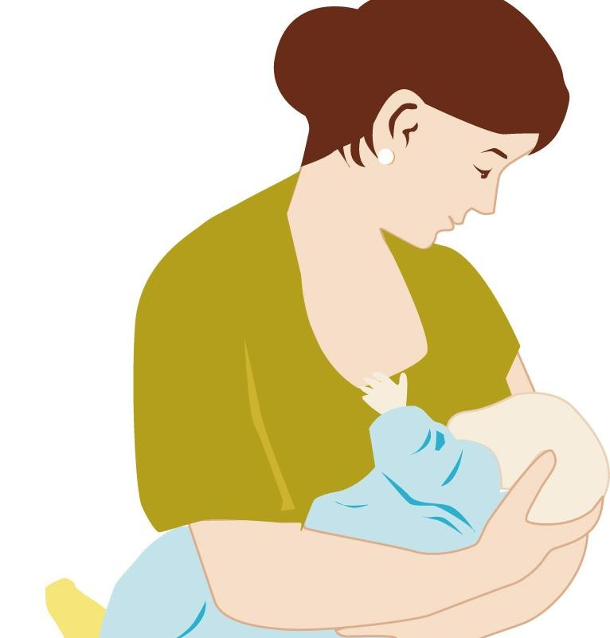
Decrease exposure to exogenous antigens
Provide substances capable of protecting the infant against infections
Induce maturation of the
gastrointestinal mucosa
Promote the development of
healthy gut microbiota
Grant immunomodulatory and anti-inflammatory benefits
J Allergy Clin Immunol 2013;131:1565-73. Br J Dermatol 2009;161:373-83.

Slide 53
If the baby can`t be breastfed exclusively,
Assess allergy risk (F.Hx. of atopy)
YES
NO Not Assessed
Start pHF until 4-6 months
And solid foods as normal
Start CMF
Start pHF until assessment done
Pediatr Gastroenterol Hepatol Nutr 2014 June 17(2):61-73

Slide 54
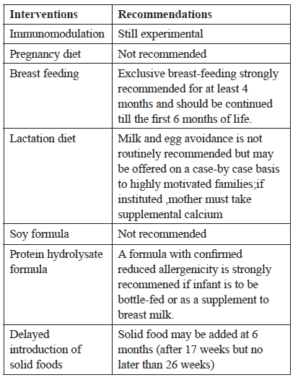
Recommendations on primary prevention of
Food Allergy, incorporating current Guidelines of the ESPACI
/ ESPGHAN 2008

Slide 55


Slide 56
In summary
Food allergy is on the rise
Cow`s milk protein allergy is the leading cause of food allergy in young children
Impaired tolerance of new allergen result in allergy
CMPA might be IgE or non-IgE mediated
CMPA is a multi-organ disease
Accurate diagnosis depends on elimination and re-introduction of cow`s milk protein and observe for symptoms progression

Slide 57
In infants with established CMPA: -If breastfed: Continue breastfeeding, mother to avoid dairy products – -If formula fed: Switch to eHF or AA formula(superior to Soy F)
To prevent allergy in atopic families: exclusive breastfeeding if possible starting infants on eHF
Dietary restriction during pregnancy and delayed introduction of solid food have no role in preventing allergy
CMPA patients are at increased risk of FTT, and need nutritional follow up

