Slide 1
About OMICS Group
OMICS Group is an amalgamation of Open Access publications and worldwide international science conferences and events. Established in the year 2007 with the sole aim of making the information on Sciences and technology ‘Open Access’, OMICS Group publishes 500 online open access scholarly journals in all aspects of Science, Engineering, Management and Technology journals. OMICS Group has been instrumental in taking the knowledge on Science & technology to the doorsteps of ordinary men and women. Research Scholars, Students, Libraries, Educational Institutions, Research centers and the industry are main stakeholders that benefitted greatly from this knowledge dissemination. OMICS Group also organizes 500 International conferences annually across the globe, where knowledge transfer takes place through debates, round table discussions, poster presentations, workshops, symposia and exhibitions.

Slide 2
About OMICS International Conferences
OMICS International is a pioneer and leading science event organizer, which publishes around 500 open access journals and conducts over 500 Medical, Clinical, Engineering, Life Sciences, Pharma scientific conferences all over the globe annually with the support of more than 1000 scientific associations and 30,000 editorial board members and 3.5 million followers to its credit.
OMICS Group has organized 500 conferences, workshops and national symposiums across the major cities including San Francisco, Las Vegas, San Antonio, Omaha, Orlando, Raleigh, Santa Clara, Chicago, Philadelphia, Baltimore, United Kingdom, Valencia, Dubai, Beijing, Hyderabad, Bengaluru and Mumbai.

Slide 3




3rd International Conference on Integrative Biology
Valencia, Spain
Antiangiogenic treatment
in non-small cell lung cancer NSCLC
Ewa Maj
Ludwik Hirszfeld Institute of Immunology
and Experimental Therapy
Polish Academy of Sciences
Wroclaw, Poland
August 05, 2015

Slide 4

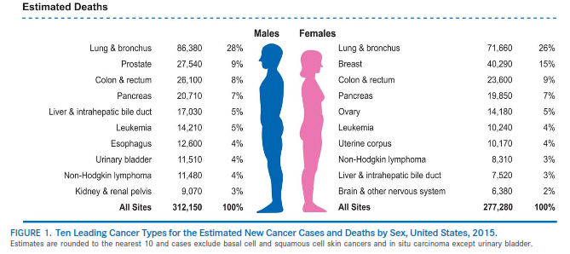


Lung cancer worlwide
Lung cancer - leading cause of cancer related deaths
5-year overall survival rate accounts for 15,6% patients
Advanced stage of disease at the time of diagnosis (stage IIB – IV), it exludes tumor surgical resection
Siegel R.L. et al., CA Cancer J. Clin. 2015; 65; 5-29
Dela Cruz Ch.S. et al., Clin. Chest Med. 2011; 32; 605-644

Slide 5
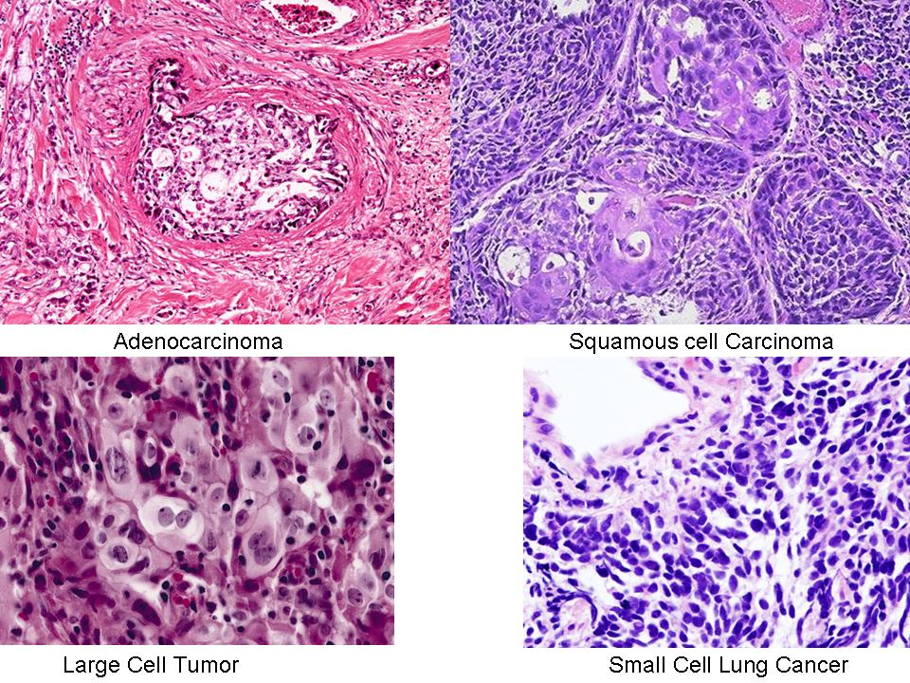
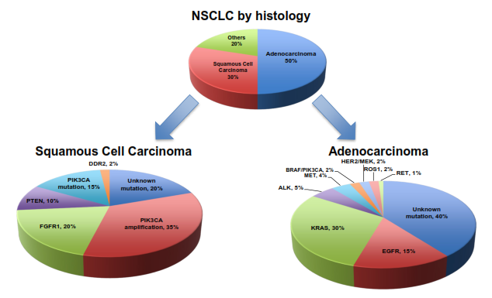
Lung cancer histology
http://cancergrace.org/lung/2010/04/05/an-introduction-to-lung-cancer/
http://cancergrace.org/lung/2010/04/05/an-introduction-to-lung-cancer/
Chan and Huges, Transl Lung Cancer Res 2015; 4(1): 36-54

Slide 6
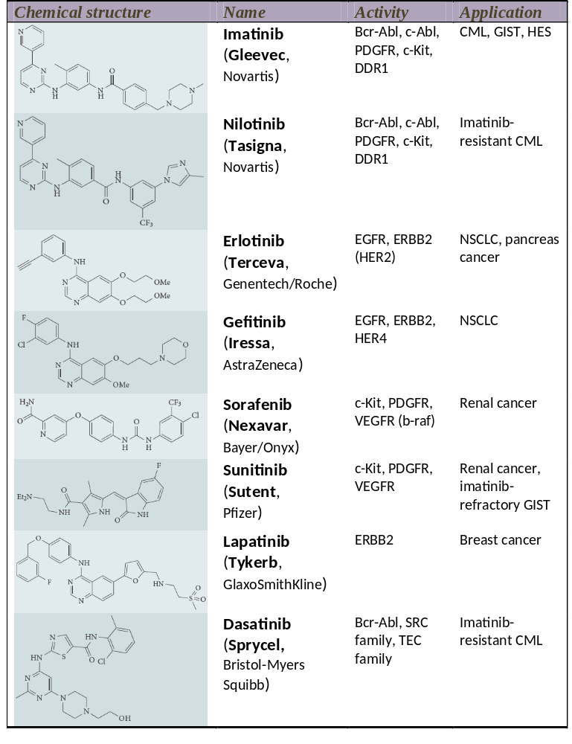
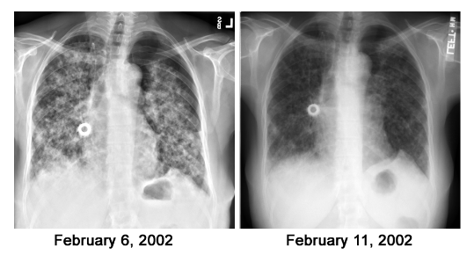
Targeted therapies
Rapid response after treatment with gefitynib (EGFR inhibitor)
Ladanyi M. Molecular Pathology of Lung Cancer: role in patient selection
for targeted therapy, Memorial Sloan-Kettering Cancer Center
Janne P. A. et al. Nature Review 2009; 8: 709-723

Slide 7
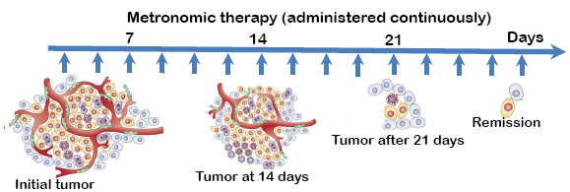

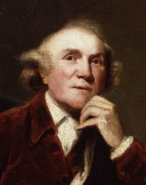
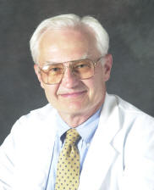
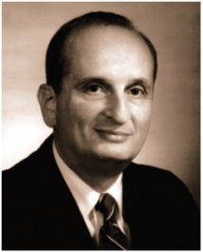
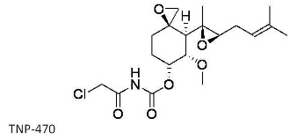
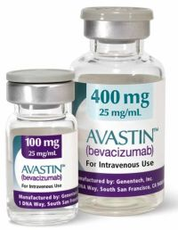
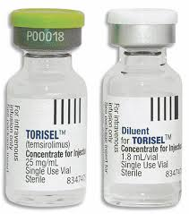
Milestones in antiangiogenic therapy
Based on: http://www.angio.org/learn/angiogenesis/

Slide 8
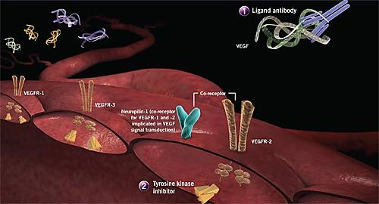

Strategies interfering tumor angiogenesis
1. Monoclonal antibodies anti-VEGF: bevacizumab
2. VEGF receptor inhibitors (TKI): sunitinib, sorafenib
http://www.biooncology.com/research-education/vegf/vegf

Slide 9
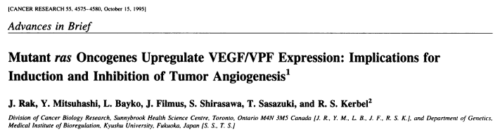
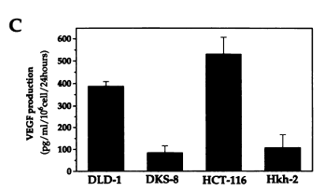
Oncogenes impact VEGF expression regulation

Slide 10
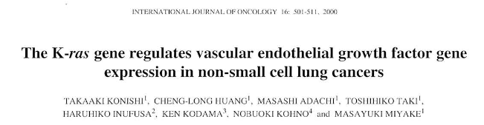
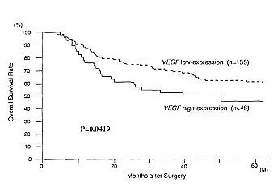
Angiogenesis in NSCLC
Overexpression of VEGF in NSCLC
High VEGF serum level is a negative prognostic factor
Yuan A. et al., Int J Cncer 2000, 89, 475-483
Kaya A. et al., Respiratory Medicine 2004, 98, 632-636

Slide 11
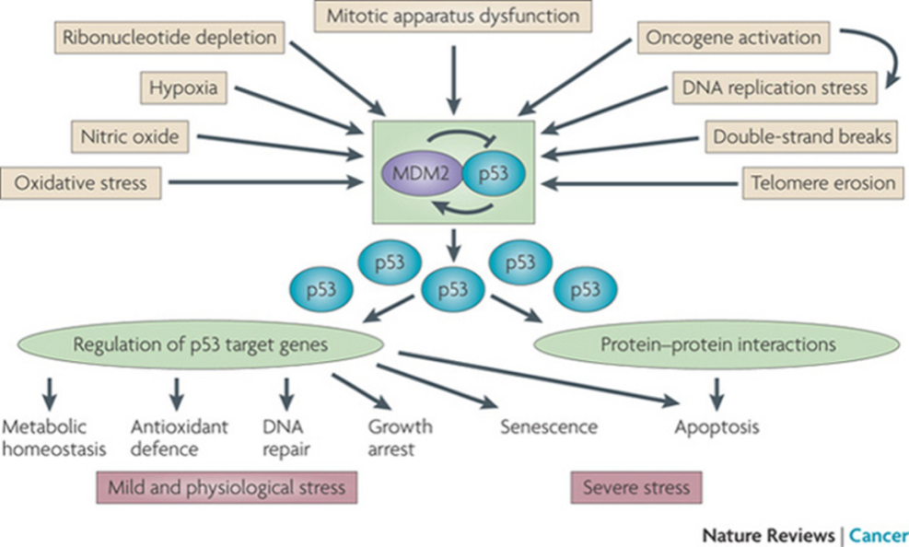
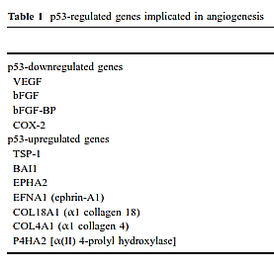
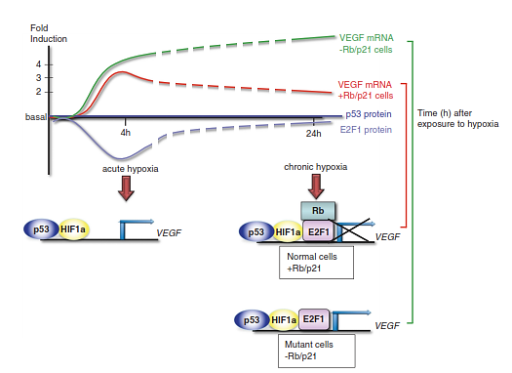
Interplay between p53 and VEGF
Levine A.J. and Oren M. Nature Review Cancer 2009, 9, 749-758
Teodoro J.G. et al., J. Mol. Med. 2007, 85, 1175-1186
Haupt et al. Cell Death and Differentiation, 2013, 20, 852-854

Slide 12
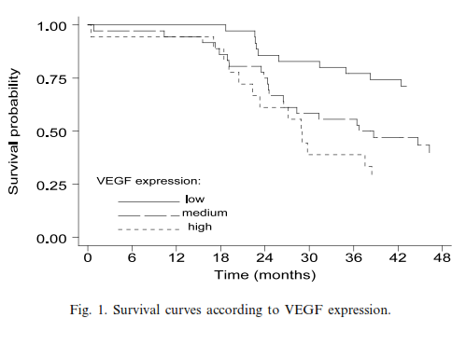
Interplay between p53 and VEGF in NSCLC
p53 down regultes VEGF expression; mutated p53 up-regulates VEGF expression
p21/E2F/Rb pathway in extended hypoxia acts as represor of VEGF expression
(Ghahremani M. F. et al. Cell Death and Differentiation 2013, 20: 888-897)
Mutated p53 positively correlated with VEGF level in NSCLC tumor specimens
(Niklińska et al., Lung Cancer 2001, 34, 59-64)
wt p53
VEGF
mutant p53
VEGF

Slide 13
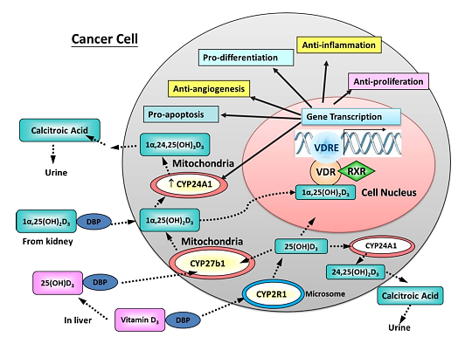
Anticancer activity of vitamin D
Chiang and Chen Anti-cancer agents in Medicinal Chemistry, 2013, 13, 126-139

Slide 14
Anticancer activity of GV and vitamin D compounds in A549 NSCLC model

Slide 15
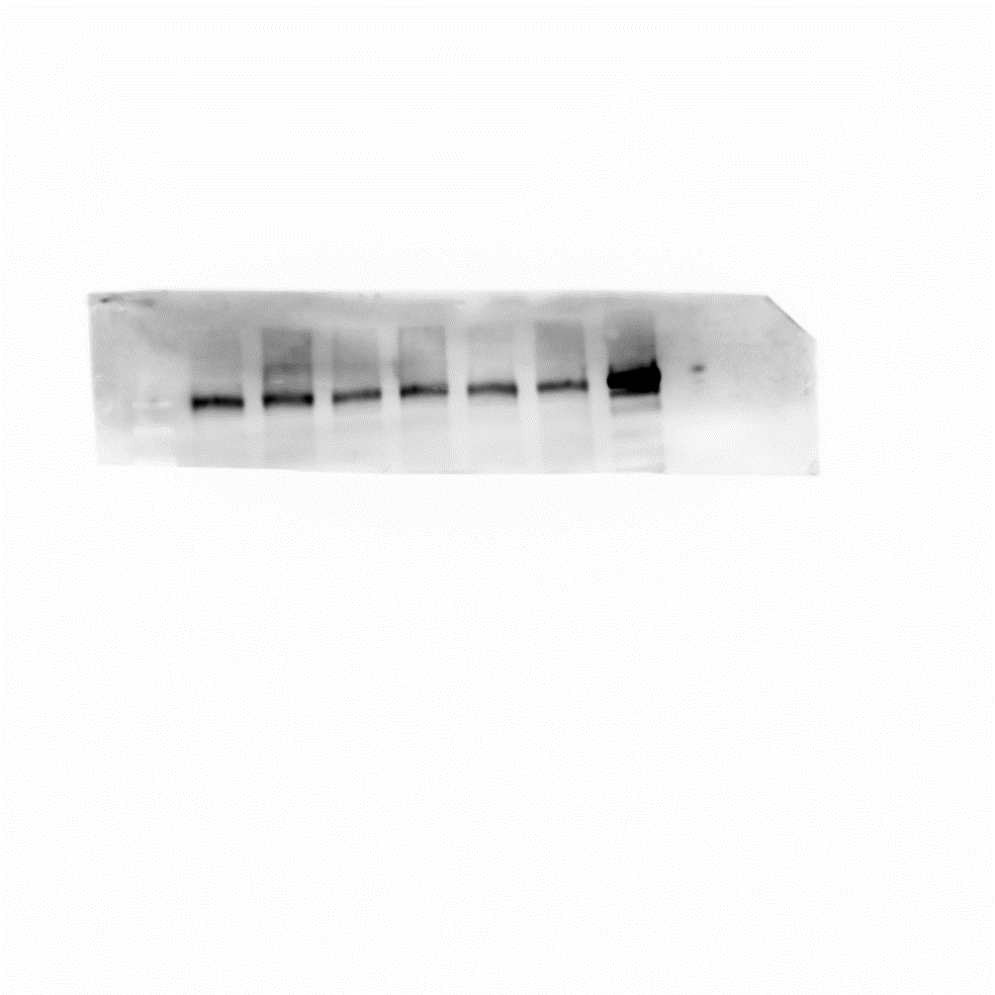
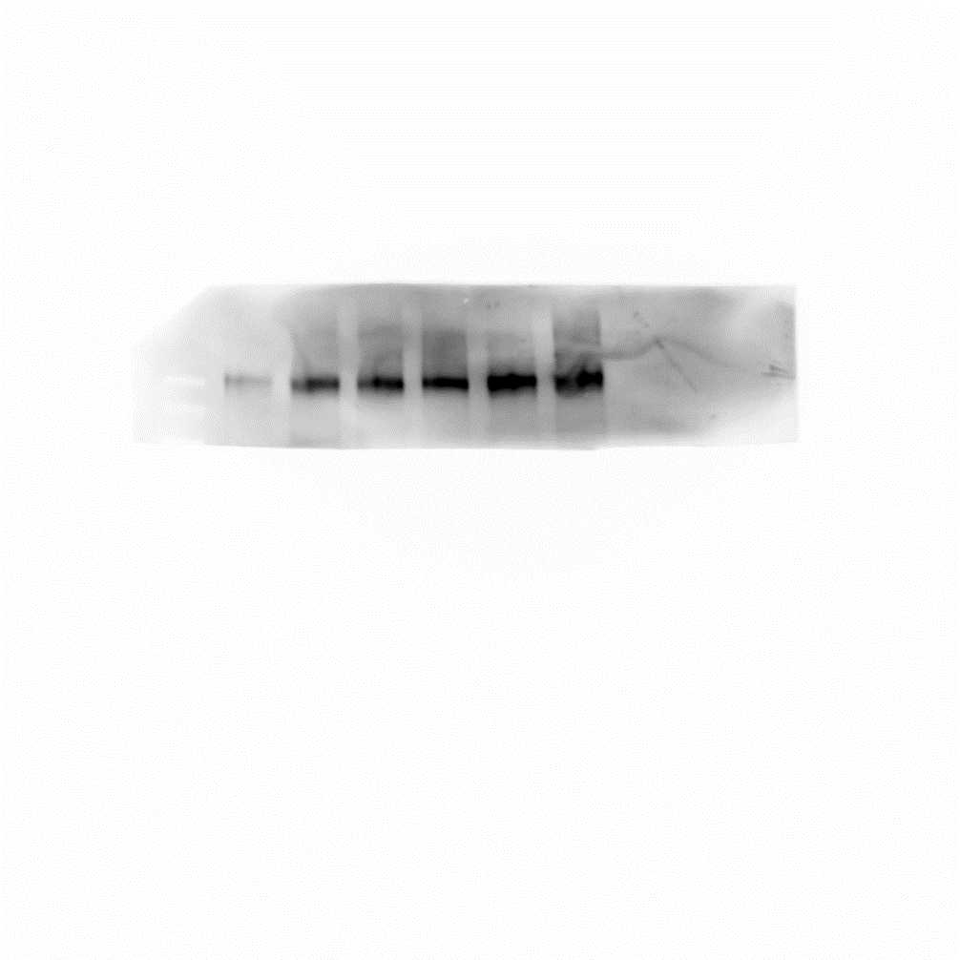
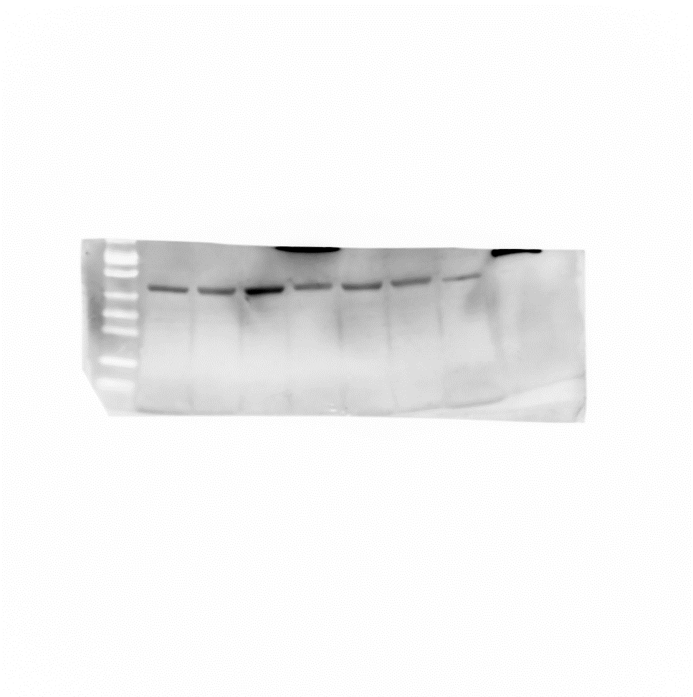
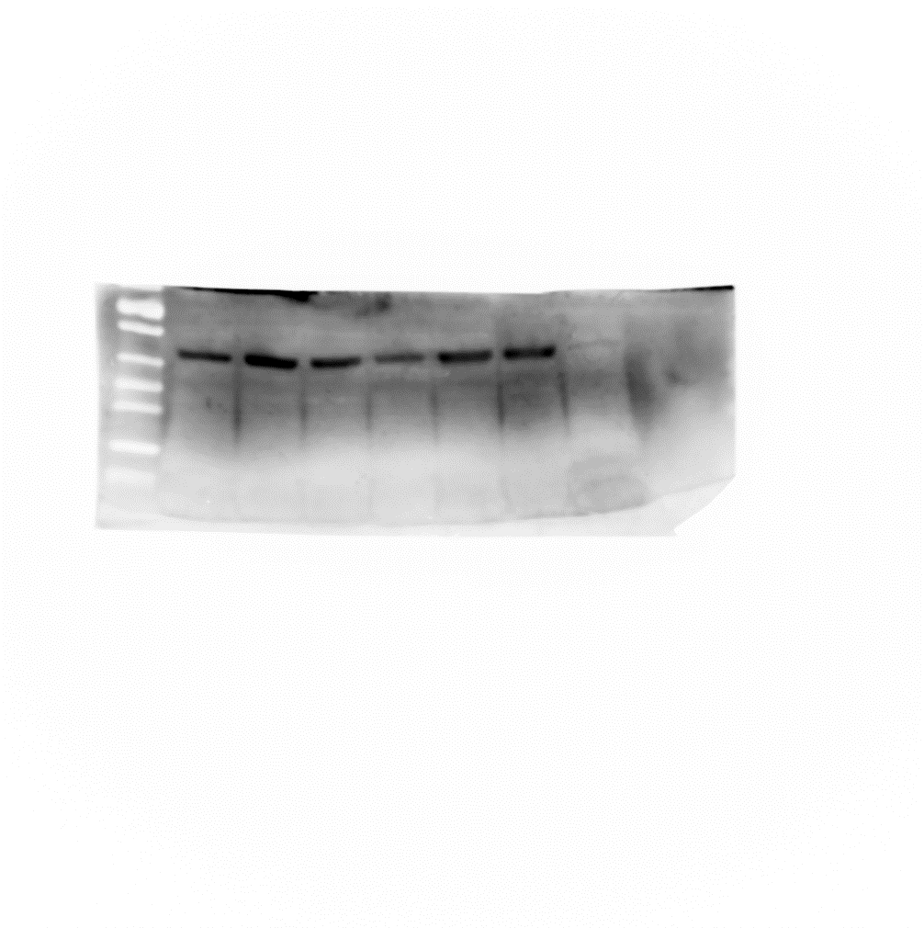
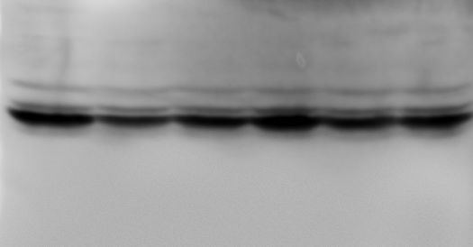
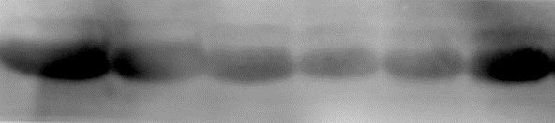
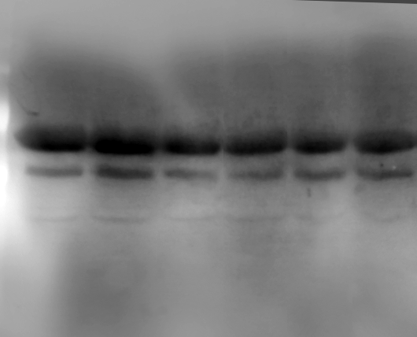
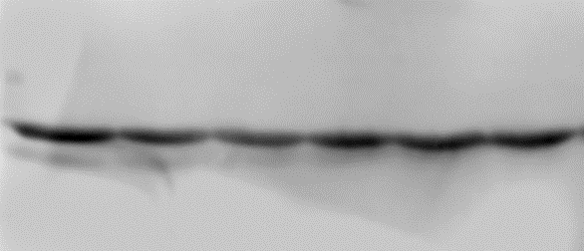
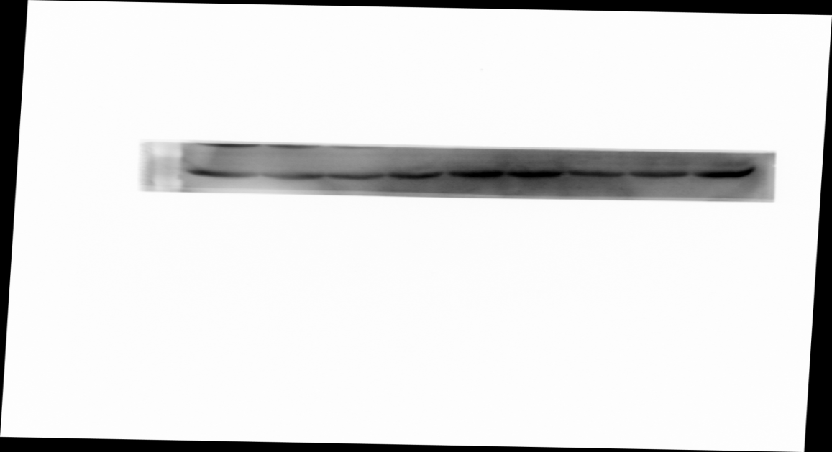
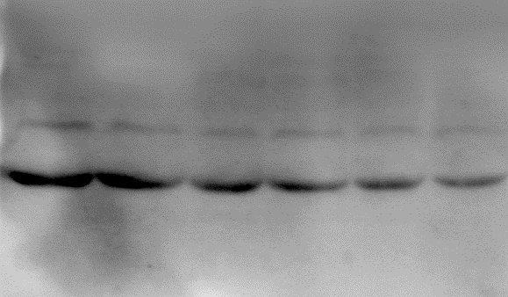
Anticancer activity of GV and vitamin D compounds in A549 NSCLC model
PDGFRα
PDGFRβ
PDGFR α
PDGFR β
Actin
Actin
VDR
CYP27B1
CYP24
VDR
CYP27B1
CYP24
Actin
Actin
Actin

Slide 16
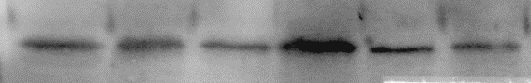
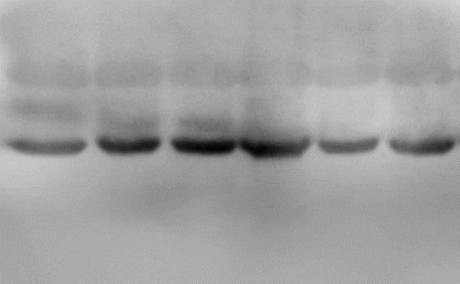
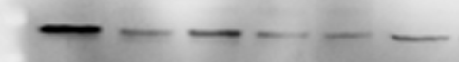
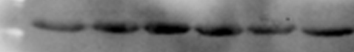
Anticancer activity of GV and vitamin D compounds in A549 NSCLC model
p53
Bcl-2
p53
Actin
Bcl-2
Actin

Slide 17
Antiproliferative activity of GV, CIS, DTX and PRI-2191
in A549 NSCLC model
Table. Flow cytometry cell death analysis (propidium iodide staining)
A549 | -- | PRI-2191 (100nM)
Control | 12,34±7,15 | 8,73±1,86
Imatinib | 13,60±5,80 | 13,93±2,81
Docetaxel | 15,35±1,48 | 16,90±1,27
Imatinib + docetaxel | 33,00±0,28 | 33,17±3,09
Cisplatin | 25,03±6,17 | 27,77±4,55
Imatinib + cisplatin | 36,25±3,61 | 39,85±5,02

Slide 18
Antiproliferative activity of SU, CIS, DTX and PRI-2191
in A549 NSCLC model
Table. Flow cytometry cell death analysis (propidium iodide staining)
A549 | -- | PRI-2191 (100nM)
Control | 12,34±7,15 | 8,73±1,86
Sunitinib | 9,00±3,60 | 10,33±4,34
Docetaxel | 15,35±1,48 | 16,90±1,27
Sunitinib + docetaxel | 16,65±0,92 | 19,03±1,90
Cisplatin | 25,03±6,17 | 27,77±4,55
Sunitinib + cisplatin | 29,85±8,98 | 30,63±16,90

Slide 19
Antiproliferative activity of GV, CIS, DTX and PRI-2191
on human lung microvascular endothelial cells HLMEC
Table. Flow cytometry cell death analysis (propidium iodide staining)
HLMEC | -- | PRI-2191 (100nM)
Control | 8,03±3,75 | 19,23±1,06
Imatinib | 7,98±3,09 | 21,85±2,47
Docetaxel | 13,7±4,82 | 23,57±5,91
Imatinib + docetaxel | 17,53±5,20 | 29,00±2,97
Cisplatin | 11,85±0,49 | 18,97±8,52
Imatinib + cisplatin | 16,6±5,23 | 20,25±3,89

Slide 20
Antiproliferative activity of SU, CIS, DTX and PRI-2191
on human lung microvascular endothelial cells HLMEC
Table. Flow cytometry cell death analysis (propidium iodide staining)
HLMEC | -- | PRI-2191 (100nM)
Control | 8,03±3,75 | 19,23±1,06
Sunitinib | 12,77±6,55 | 29,8±4,81
Docetaxel | 13,7±4,82 | 23,57±5,91
Sunitinib + docetaxel | 28,55±8,98 | 50,90±6,61
Cisplatin | 11,85±0,49 | 18,97±8,52
Sunitinib + cisplatin | 15,3±2,26 | 32,75±7,00

Slide 21
Anticancer activity of SU, DTX and PRI-2191 in A549 NSCLC model

Slide 22
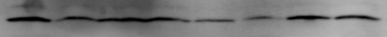
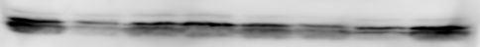
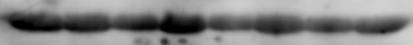
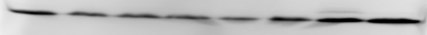


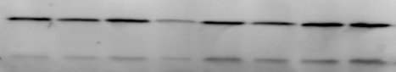
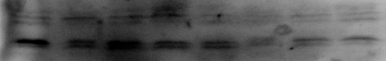
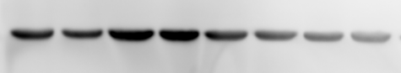

Anticancer activity of SU, DTX and PRI-2191 in A549 NSCLC model
Bcl-2
VDR
CYP24
Bcl-2
VDR
CYP24A
Actin
Actin
Actin
NFκB
IκB
NFκB
IκB
Actin
Actin

Slide 23
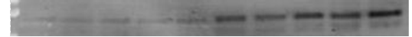
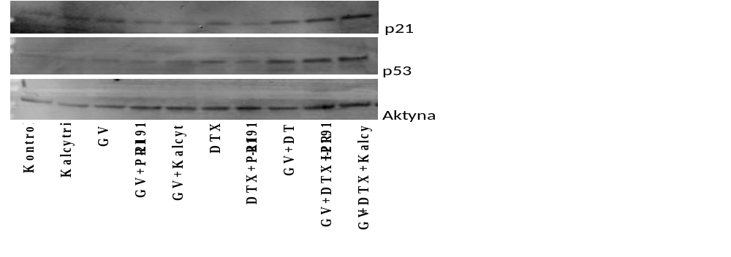
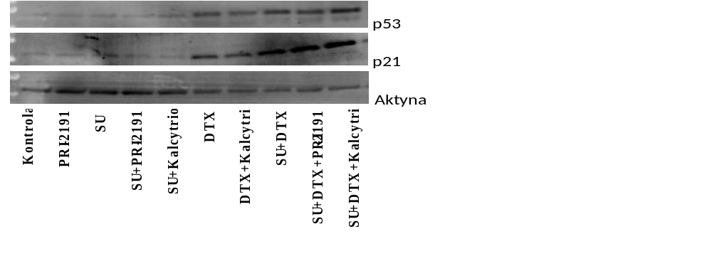
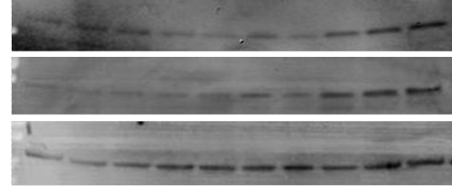
SU downregulates VEGF expression in A549 NSCLC model
p53
p53
Actin
Actin
Control | PRI-2191 | SU | SU+PRI-2191 | SU+Calcitriol | DTX | DTX+PRI-2191 | DTX+Calcitriol | SU+DTX | SU+DTX+PRI-2191 | SU+DTX+Calcitriol
Control | Calcitriol | GV | GV+PRI-2191 | GV+Calcitriol | DTX | DTX+PRI-2191 | DTX+Calcitriol | GV+DTX | GV+DTX+PRI-2191 | GV+DTX+Calcitriol

Slide 24
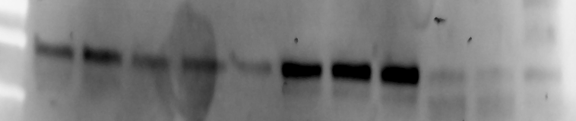
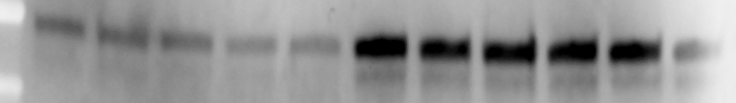
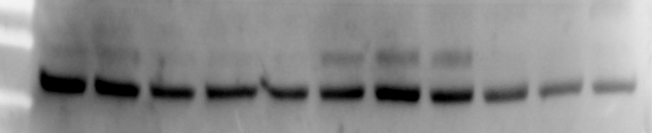

SU and CIS downregulates VEGF expression in A549 NSCLC model
p53
p53
Actin
Actin
EtOH/DMSO | Calcitriol | GV | GV+PRI-2191 | GV+Calcitriol | GV+CIS | GV+CIS+PRI-2191 | GV+CIS+Calcitriol
Control | PRI-2191 | SU | SU+PRI-2191 | SU+Calcitriol | CIS | CIS+PRI-2191 | CIS+Calcitriol | SU+CIS | SU+CIS+PRI-2191 | SU+CIS+Calcitriol

Slide 25
Conclusions
Vitamin D compounds potentiate:
anticancer activity of tyrosine kinase inhibitors GV and SU in vivo in A549 NSCLC model
cytotoxic activity of TKI and cytostatics on endothelial cells HLMEC
downregulation of VEGF expression in A549 tumors
Combinations of TKI with cytostatics:
reveal stronger antiproliferative activity comparing with agents used alone
upregulate p53 expression in A549 lung cancer cells
downregulate VEGF expression in A549 lung cancer cells in vitro
Conference participation supported by Wroclaw Centre of Biotechnology, programme The Leading National Research Centre (KNOW) for years 2014-2018

Slide 26



Laboratory of Experimental Anticancer Therapy
IIET PAS, Wroclaw, Poland
Professor Joanna Wietrzyk, Ph.D. – Head of Laboratory
Anna Nasulewicz-Goldeman, Ph.D.
Dagmara Kłopotowska, Ph.D.
Katarzyna Szczaurska-Nowak, Ph.D.
Marta Świtalska, Ph.D.
Eliza Turlej, Ph.D.
Magdalena Milczarek, Ph.D.
Agnieszka Błażejczyk, Ph.D.
Beata Filip-Psurska, M.Sc.
Mateusz Psurski, M.Sc.
Magdalena Maciejewska, M.Sc.
Ph.D. students:
Justyna Trynda, M.Sc.
Agata Pawlik, M.Sc.
Diana Papiernik, M.Sc.
Ksenia Porshneva, M.Sc.
Joanna Sadowska, M.Sc.
Artur Anisiewicz, M.Sc.

Slide 27


Thank You for Your attention

Slide 28
Let Us Meet Again
We welcome you all to our future conferences of OMICS International
Please Visit:
http://integrativebiology.conferenceseries.com/
http://conferenceseries.com/
http://www.conferenceseries.com/genetics-and-molecular-biology-conferences.php

