Slide 1





¹East Belitung General Hospital, Indonesia
²University of San Fransisco, California, USA
Departement of Cardiology and Vascular Medicine, Faculty of Medicine, University of Brawijaya, Malang, Indonesia
“Lipid Profiles and Atherogenic Index with Coronary Artery Lesions: is there any correlation?”
Evan Hindoro¹, Rafi A. Ferdian², Djanggan Sargowo^{2,4}
Notes:
Good afternoon ladies and gentleman, I’m First, I would like to say thank you for giving me the opportunity to present my research which was conducted in Indonesia, Entitled: “Lipid profiles and atherogenic index with coronary artery lesions: is there any correlation?”

Slide 2
Disclosure
I do not have any potential conflict of interest

Slide 3
Introduction
Materials & methods
Results
Discussion
Conclusion

Slide 4

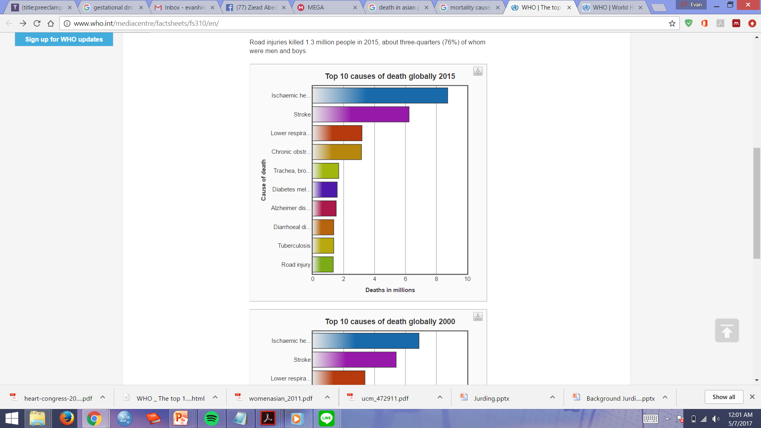

“Cardio-cerebro-vascular disease as TOP RANK cause of death”
Background
Global Burden
Notes:
We can see from the diagram published by the World Health Organization, in the year 2015, Cardio-Cerebro-Vascular diseases are among the top 10 causes of death globally. This is a very serious issue. Thus, we need to aggressively fight this devastating fact.

Slide 5
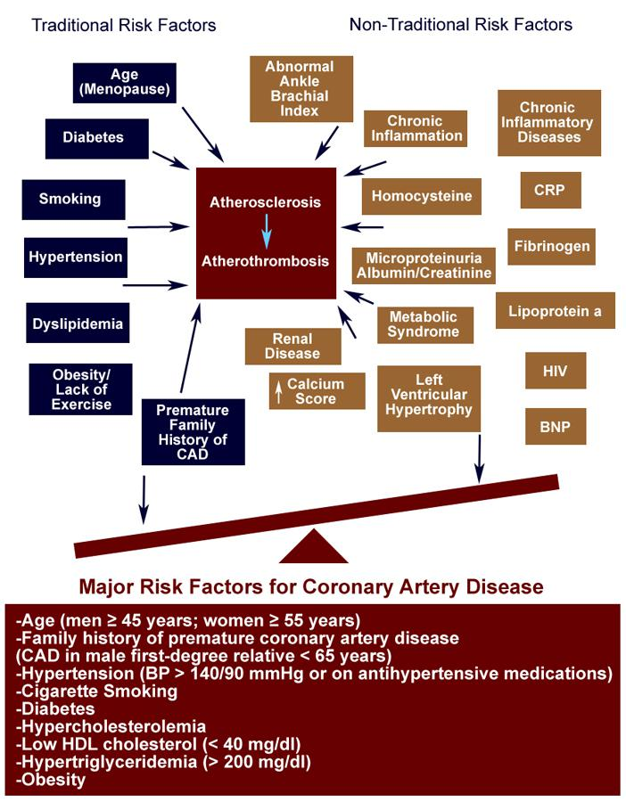
Background
Traditional Risk Factors of Ischemic Heart Disease:
Hypertension
Metabolic Syndrome
Tobacco smoking
Dyslipidemia
Lack of Physical Activity
Age (Menopause)
Diabetes Mellitus
Premature Family History of CAD
Boudi F, Ahsan C. Risk Factors for Coronary Artery Disease: Practice Essentials, Risk Factor Biomarkers, Conventional Risk Factors (2016)
Notes:
Let us explore the reasons behind Ischemic Heart Diseases. IHD comprises of two main risk factors which are traditional and non-traditional risk factors. As we can see here, the traditional risk factors are listed above. All of them are connected to the main pathophysiology of IHD, Which is endothelial dysfunction.
An important factor that we need to seriously highlight is DYSLIPIDEMIA.
Why dyslipidemia?
One of the biggest challenges in preventive cardiology is TO OPTIMIZE LIPID LOWERING THERAPY to achieve the desired lipid profile parameters. By doing this, we would be able to reduce MACEs.
But, according to Haynes, many patients are at risk for noncompliance because "the short-term disadvantages of following chronic disease therapy substantially outweigh the short-term benefits, and patients require persistent reminding of the long-term benefits to swing this unfavorable balance in a positive direction
ATP III have suggested that only ~50% of patients who receive a prescription for a lipid-lowering drug continue to take the medication 6 months later.^{[10]} This proportion falls to ~40% after 12 months^{[11]} and to ~15%-30% after 5 years

Slide 6
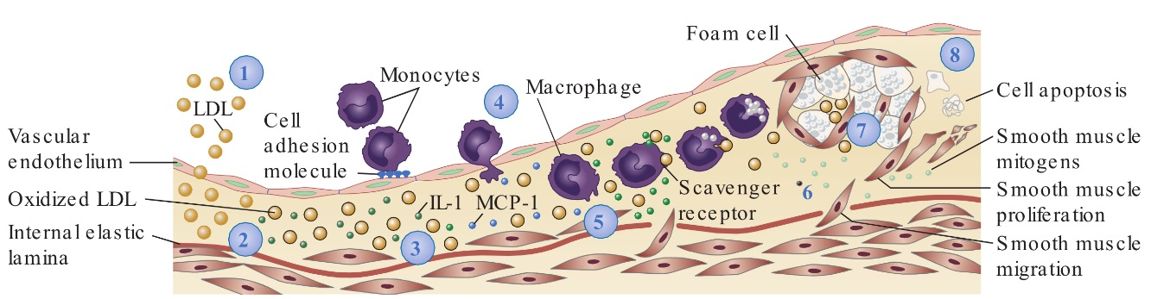
Background
Lipid Profiles
(Lilly LS, Pathophysiology of Heart Disease, 2016)
Atherogenic Index
Notes:
Dyslipidemia plays a major role in atherosclerotic processes. it is described as elevated plasma concentrations of lipid and their blood transporting lipoproteins
Strong scientific evidence indicates that there is a strong association between incidence of CVD and high level of LDL-C and also low level of HDL-C
Therefore, the LDL-C/HDL-C ratio is often calculated to estimate cardiovascular risk
On the other hand, high level of TG has been related with an increased LDL-C particles and an increased cardiovascular risk
On that basis, atherogenic dyslipidemia, defined as high LDL-C/HDL-C ratio and hyper TG, is associated with high cardiovascular risk
Many clinical studies have recently increased the effort to introduce a better marker for atherogenic dyslipidemia that can predict the risk of CVD which can be useful for evaluating the response to treatment instead of the classical ratio.
It has been shown that Atherogenic Index of Plasma (AIP) is a strong marker to predict the risk of atherosclerosis and coronary heart disease
AIP is calculated according to the formula, log(TG/HDL-C)

Slide 7
Objectives
Aims of Study
To determine the correlation of lipid parameters with coronary angiographic findings

Slide 8
Introduction
Materials & methods
Results
Discussion
Conclusion

Slide 9
MATERIAL AND METHODS
STUDY DESIGN AND PARTICIPANTS
RESEARCH PROCEDURES
OUTCOMES
STATISTICAL ANALYSIS
Notes:
Let’s look at the the material and methods. These consist of STUDY DESIGN AND PARTICIPIANTS, RESEARCH PROCEDURES, OUTCOMES, AND STATISTICAL ANALYSIS

Slide 10


Study design
A cross-sectional, analytic observational study
Single-centered study (Conducted in Dr. Saiful Anwar General Hospital, Malang, East Java, Indonesia)
January – December 2016
Notes:
Our Study design is a cross-sectional, analytic observational study. It’s a single centered study conducted in Dr. Saiful Anwar General Hospital, Malang, East Java Indonesia, from January to December 2016

Slide 11
* Cannon CP, Brindis RG, Chaitman BR, et al. 2013 ACCF/AHA key data elements and definitions for measuring the clinical management and outcomes of patients with acute coronary syndromes and coronary artery disease. J Am Coll Cardiol 2013; Crculation 2013; Circulation 201310
  Inclusion criteria:
  Age > 18 years
  Patients who are diagnosed with coronary artery diseases (either diagnosed by acute coronary syndrome, or diagnosed as stable coronary artery diseases*)
  All patients of coronary artery disease who have undergone coronary angiography irrespective of their sex and races
  Exclusion criteria:
    Age <18 years old
    Patients with non-coronary heart diseases (congenital heart disease, valvular heart disease, myocarditis/pericarditis)
    Patients who rejected the coronary angiography procedures

Slide 12
Research procedures
220 patients with CAD
> 18 years old
Diagnosed with coronary artery diseases (based on 2013 AHA definition)
Undergone for coronary angiography
40 pts excluded:
35 not meeting inclusion criteria
5 incomplete medical data
72 patients
(Control)
vs
108 patients
(CAD)
Smoking status, Sex, Family history
Anthropometric status (Body weight, Height)
Body mass index (BMI), Blood pressure
Fasting Lipid profile (LDL, HDL, Total cholesterol, TG)
Atherogenic index (AI) and TG/HDL ratio
Coronary angiographic assessment from two or more independent cardiologists
Notes:
The research procedures are: we enrolled 220 patients with CAD. 40 of them are excluded because 35 patients did not meet the inclusion criteria, and 5 of them had an incomplete medical data. From those, 180 patients are further divided into two groups: 72 patients in the control group and 108 patients in the CAD group.

Slide 13

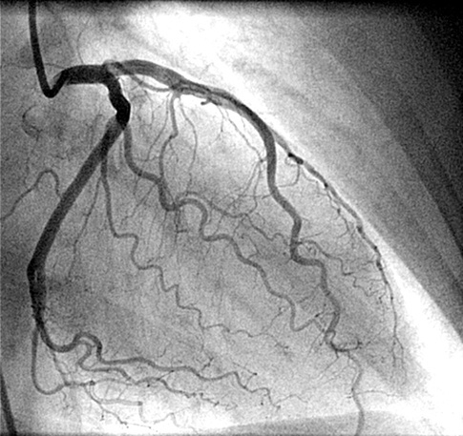
How?
Coronary angiographies were performed using a standard Judkins technique through the femoral artery or radial artery
The angiograms were interpreted by two or more independent cardiologists in a blind fashion
Notes:
CAG are then performed using a standard Judkins technique through the femoral artery or radial artery. The results are then assessed and interpreted by two or more independent cardiologists, of course, in a blind fashion to ensure the validity of this study

Slide 14
Outcomes
Outcome
End-point: the correlation of lipid profile, atherogenic index and coronary artery lesions
Notes:
The outcome of this study is to find the correlation between lipid profiles, atherogenic index and coronary artery lesions

Slide 15
Definition
Significant stenosis was defined as a reduction of at least 50% in the coronary artery:
  Multi-vessel diseases: the involvement of any > 3 of the following 4 arteries (LM artery, LAD artery, LCx artery and RCA)
  Multi-lesion diseases: three or more lesions in a single vessel
  Extensive lesion: a stenosis of > 10 mm in length
T Wu, L Wang. Angiographic characteristics of the coronary artery in patients with type 2 diabetes. Exp Clinical Cardiology 2003;7(4):199-200.
Notes:
We decided to define “significant stenosis” as a reduction of at least 50% of the coronary artery.
Multiple vessel diseases (MVDs) are defined as the involvement of any more than 3 of the following 4 arteries (LM artery, LAD artery , LCx artery and RCA).
Multi lesion diseases are defined with three / more lesions in a single vessel
MEANWHILE, extensive lesions are defined with a stenosis of > 10 mm in length

Slide 16
STATISTICAL ANALYSIS
Statistical Analysis
Data were analyzed using statistical software (SPSS 17.0)
Continuous variables are presented as mean ± SD
Categorical variables are presented as numbers and percentages
The level of statistical significance was set at p value < 0.05
Notes:
Let’s discuss how we processed the data. They were analyzed using a statistical software, SPSS version 17.0
Continuous variables are presented as mean standard deviation
Categorical variables are presented as numbers and percentages
The level of statistical significance was set at p value < 0.05

Slide 17
Introduction
Materials & methods
Results
Discussion
Conclusion

Slide 18
Demographic and clinical characteristics of the study population
Characteristics | Men |  | Women
 | Control (n=35) | CAD (n=65) | Control (n=37) | CAD (n=43)
Age, (mean + SD)ʵʶ | 57.2 ± 11.2 | 63.1 ± 11.4ˁ | 62.5 ± 12.7 | 68.3 ± 11.3ˁ
BMI, kg/m² | 24.2 ± 4.07 | 24.6 ± 4.01 | 24.3 ± 4.12 | 24.6 ± 4.12
Smokers | 10 (28.6%) | 19 (24.2%)ˁ | 1 (2.7%) | 1 (2.3%)
Hypertensionʵʶ | 18 (51.4%) | 39 (60%)ˁ | 22 (59.2%) | 30 (69.7%)ˁ
Family history | 3 (8.6%) | 3 (4.6%) | 2 (5.4%) | 4 (9.3%)
Total Cholesterolʵʶ | 198.23 ± 3.21 | 229.17 ± 6.4ˁ | 201.45 ± 3.4 | 227.13 ± 5.7ˁ
HDL Cholesterol | 42.08 ± 4.21 | 35.24 ± 1.06ˁ | 39.76 ± 2.37 | 37.32 ± 1.38ˁ
LDL Cholesterolʵʶ | 102.98 ± 2.9 | 157.19 ± 6.45ˁ | 107.53 ± 4.41 | 162.22 ± 3.32ˁ
Triglyceridesʵʶ | 160.22 ± 3.12 | 182.13 ± 6.62ˁ | 169.59 ± 2.52 | 188.09 ± 5.27ˁ
ʵ Significantly different in men compared to women in the control (no CAD) group
ʶ Significantly different in men compared to women in the CAD group
ˁ Significantly different compared to control (no CAD) group within the same gender
Notes:
Several demographic and clinical characteristics (such as, AGE, HT, smoking status, Tot Cholesterol level, LDL-C, TAG) were observed and it shows a significant difference between both genders IN CONTROL group and IN CAD group

Slide 19
Outcomes
Lipid parameters | Severity of the CAD |  |  | p value
 | Multi-vessels | Multi-lesions | Extensive lesion
Total Cholesterol | 225 ± 4.32 | 223 ± 6.79 | 223 ± 5.92 | 0.051
HDL Cholesterol | 35.62 ± 2.12 | 35.22 ± 1.07 | 36.79 ± 2.01 | 0.067
LDL Cholesterol | 152.17 ± 6.22 | 149.21 ± 6.72 | 150.14 ± 5.93 | 0.048
Triglyceride | 189.67 ± 4.37 | 184.32 ± 6.23 | 160.2 ± 5.62 | 0.012
TG/HDL ratio | 5.9 | 5.1 | 4.7 | 0.001
Atherogenic index | 4.36 ± 0.72 | 4.42 ± 0.28 | 4.56 ± 0.53 | 0.047
Notes:
From this table, we can see that the HIGHER fasting LDL-C levels shows a HIGHER incidence of MVDs
The same results were observed in other parameters, like TAG levels and TG/HDL ratio
The biological plausibility that support this finding is the role of LDL-c and an oxidized LDL-C in atherosclerotic processes, starting from fatty streaks → plaque progressions and plaque disruptions
therefore, LDL-C, TAG levels, TG/HDL ratio, Atherogenic index → were associated with the severity of CAD

Slide 20
Introduction
Materials & methods
Results
Discussion
Conclusion

Slide 21
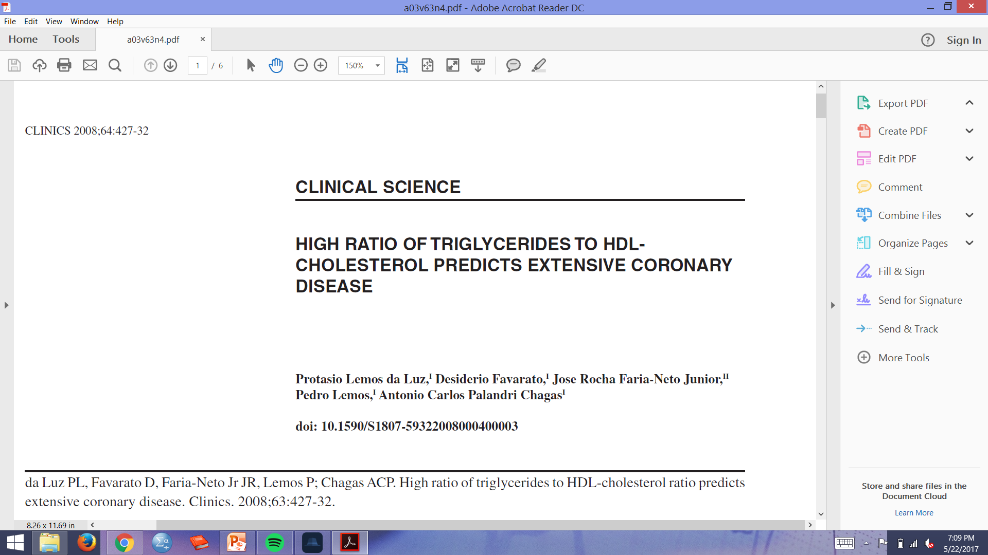
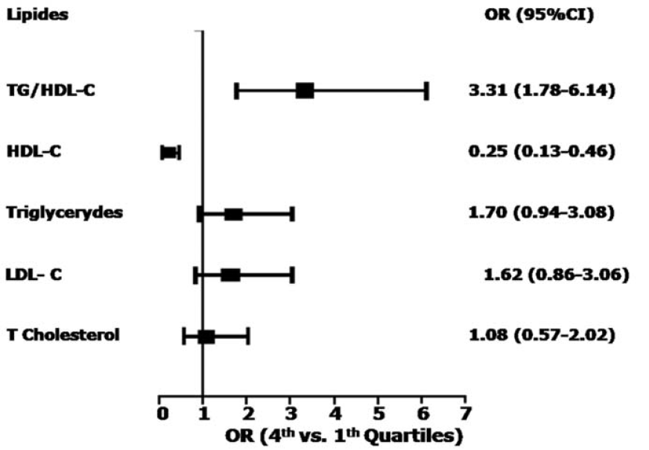
Notes:
(1) Our findings are consistent with previous study which was conducted by DA LUZ et al, this study demonstrated TG/HDL-C ratio were robustly associated with disease extent.
(2) Elevation in the ratio of TG to HDL-c was the single most powerful predictor of extensive coronary heart disease among all the lipid variables examined.
(3) The atherogenic link between high triglycerides & HDL-c is due to the higher plasma concentration of triglyceride-rich, VLDL that generates small-dense LDL during lipid exchange & lipolysis. These LDL particles accumulate in the circulation and form small-dense HDL particles, which undergo accelerated catabolism, thus closing the atherogenic circle
(4)so, TG/HDL ratio show positive associations with cholesterol esterification rates, lipoprotein particle size, and remnant lipoproteinemia

Slide 22
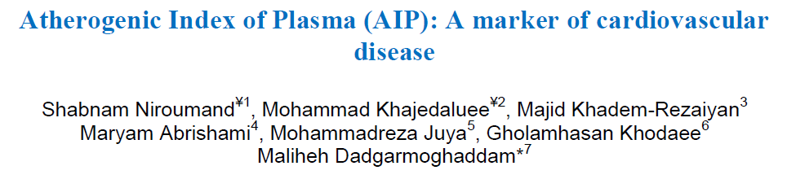
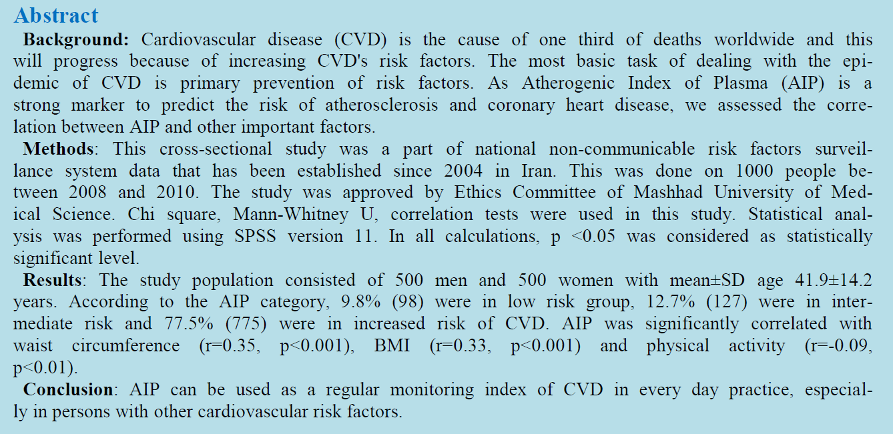
Atherogenic index of plasma (AIP)
Med J Islam Repub Iran 2015; 29 : 240
Notes:
Niroumand et al from Iran demonstrated the more risk factors a patients have, the higher AIP levels

Slide 23
Introduction
Materials & methods
Results
Discussion
Conclusion

Slide 24
Conclusion
Dyslipidemia is inexorably linked to the severity of coronary artery lesions
Nearly all routine parameters of lipid variables were associated of with extent of coronary artery lesion
Atherogenic index and TG/HDL ratio are correlated to coronary angiography findings
As the sample size was small in our study, further large-scale population studies are required on this subject to draw solid conclusions

Slide 25
Thank you for your attention
ありがとうございました
Notes:
Good luck dr. Evan Hindoro, Sp.JP! ♥

Slide 26
