Slide 1
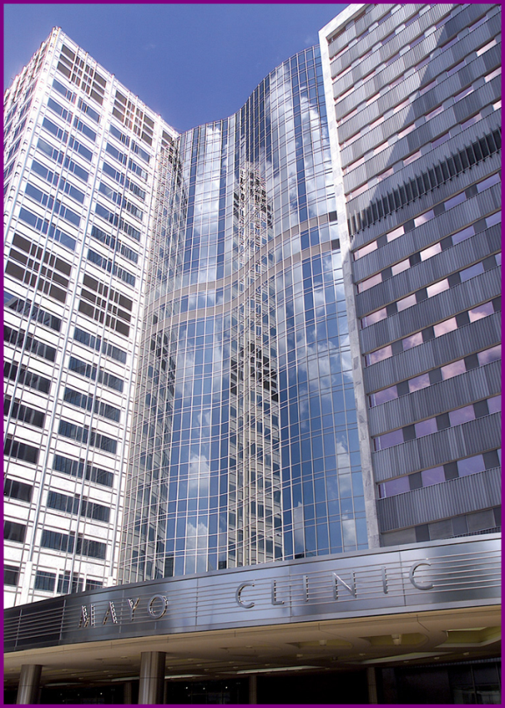
The inflammasome of activated human B-cells regulates IL-1β and IgM: A crosstalk between the innate and the adaptive immune response
Eva M Carmona MD, PhD
8th European Immunology Conference June 29th 2017
Madrid, Spain

Slide 2
The less well-known function of B cells
Activated B-lymphocytes secrete cytokines that participate in cellular innate host response
  TNFα, Lymphotoxin β, IL-10
  IL-8
These cytokines play also a role in autoimmune diseases
Acute exacerbations of many autoinflammatory diseases are preceded by infectious illness
FE Lund. Curr Opin Immunol. 2008
Duddy M et. al. J. Immunol. 2007
Ali MF et. al. J. Immunol. 2015

Slide 3
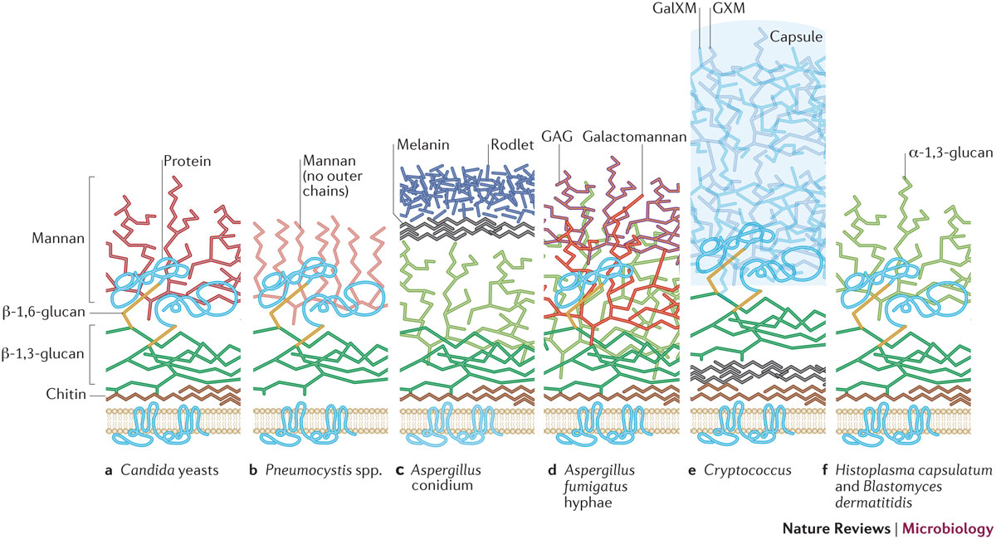
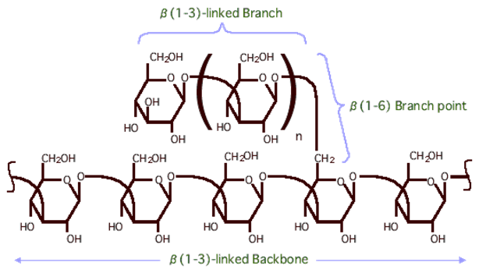
Fungal β-glucans and immune activation
Nature Reviews Microbiology 14, 163–176 (2016)

Slide 4

β-Glucans are potent immunomodulators
Beta-glucan
AP-1
NF-κB
+
EM Carmona et al. Respir Res. 2010.
IL-8
IL-8
IL-17
Th17
B
complement
CD86
CD80
Th17
EM Carmona et al. Am J Respir Cell Mol Biol. 2012. Feb 16.
CCR7
Th17
IL-6
TGF-β
IL-23
CD86
CD80
IL-17
IL-22
IgM
B
CCR7
Th1
EM Carmona et al. J Immunol. 2006 Jul 1;177(1):459-67.
IL-1β
Th1
IFN-γ
Th1
IFN-γ
      Modified from Carmona EM and Limper AH. Int J Clin Rev 2012;03:01

Slide 5
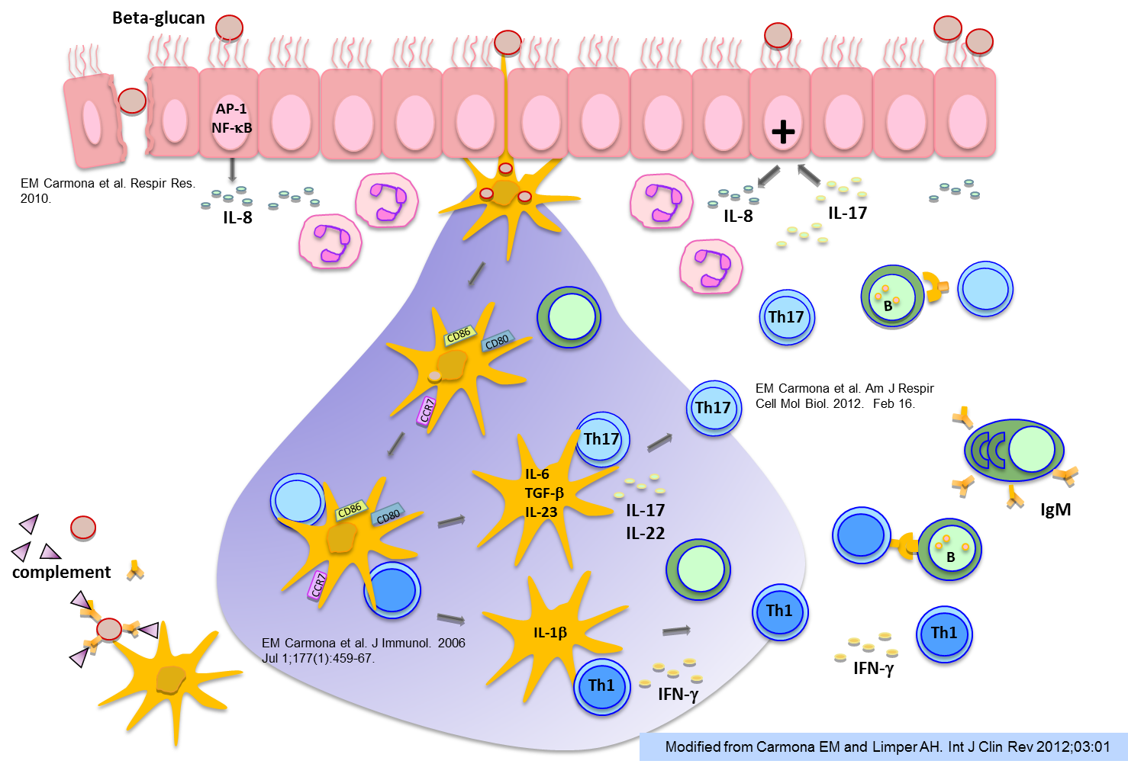
B-cells responses to fungal β-glucans
?
IL-8
MMP-7
B
MF Ali. et al. J.Immunol. 2015
MF Ali. et al. Sci Rep. 2017
IL-6

Slide 6
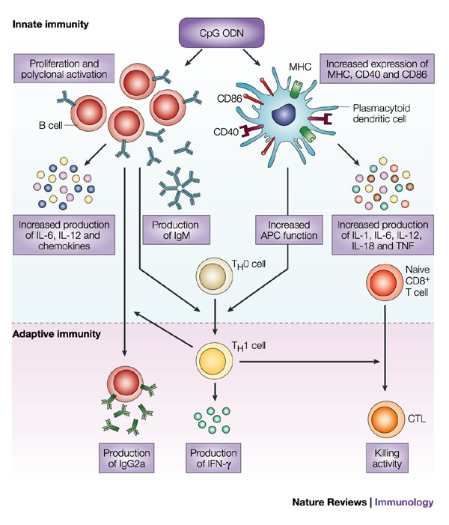
CpG
Bacterial DNA has unmethylated CpG motifs that are released during infection and recognized by PRR (TLR9)
Syntheic oligodeoxynucleotides (ODN) contain CpG motifs similar to those found in bacteria.
DM Klimman. Nature Reviews 2004
Notes:
DNA from bacteria has stimulatory effects on mammalian immune cells^{1, 2, 3}, which depend on the presence of unmethylated CpG dinucleotides in the bacterial DNA. In contrast, mammalian DNA has a low frequency of CpG dinucleotides, and these are mostly methylated; therefore, mammalian DNA does not have immuno-stimulatory activity. CpG DNA induces a strong T-helper-1-like inflammatory response⁴

Slide 7
IL-1β
IL-1β is essential in the clearance of fungal and bacterial infections
Increase levels can also be found in several autoimmune diseases
Il-1β and IL-18 are secreted as inactive precursors
Cleaved by the inflammasome
Pre-IL1β
IL1β
Netea MG et al. Plos Pathogens. 2010

Slide 8
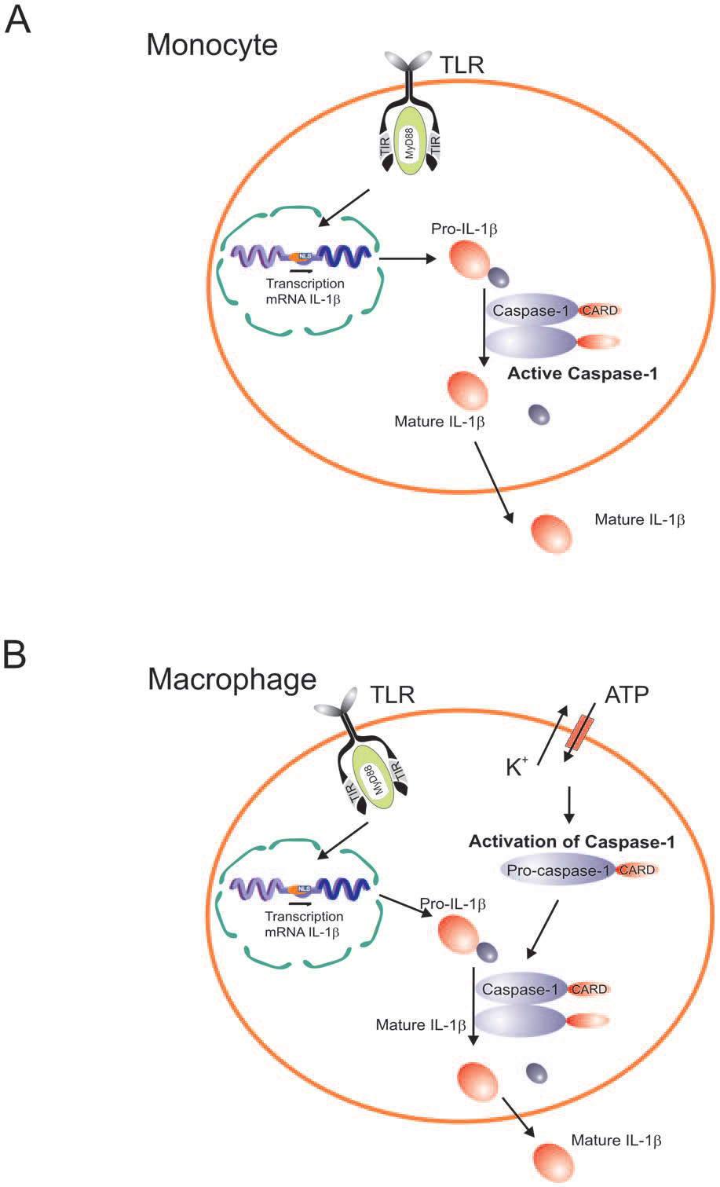
Inflammasome
Netea MG et al. Plos pathogens 2010

Slide 9
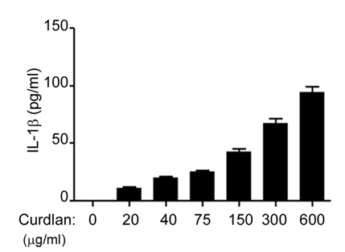
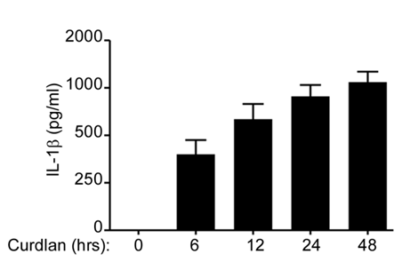
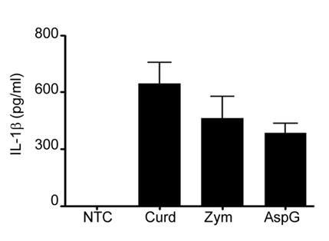
IL-1β after 1,3 β-glucan stimulation

Slide 10
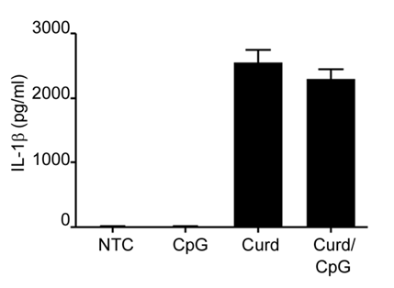
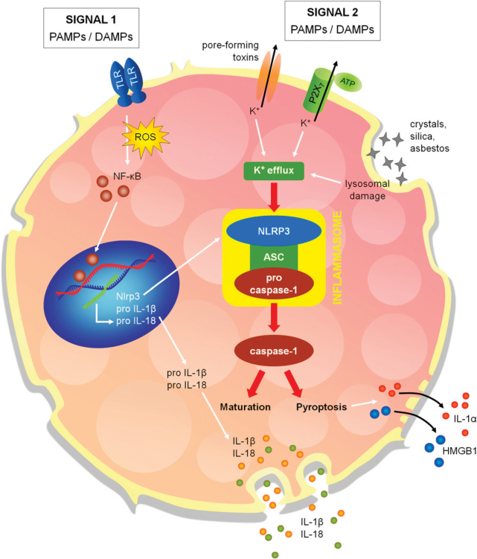
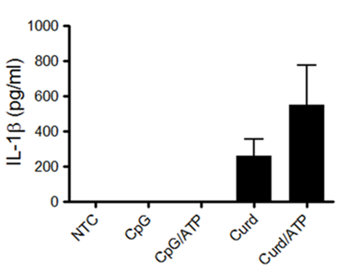
IL-1β secretion after β-Glucan but not CpG stimulation

Slide 11
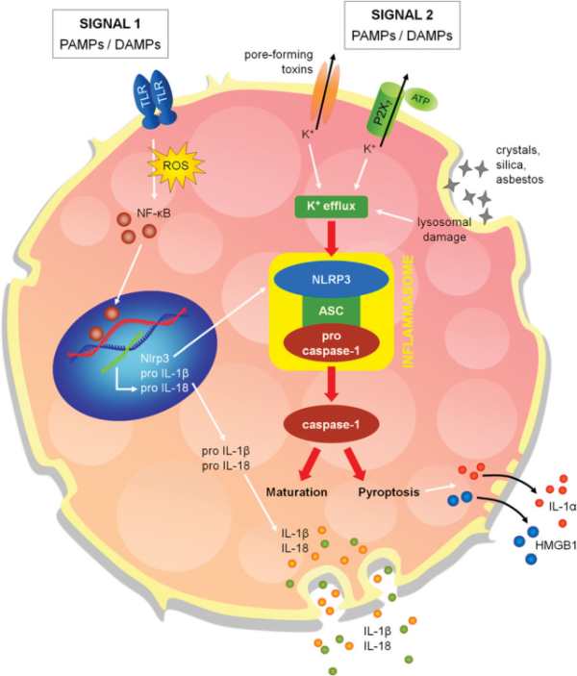
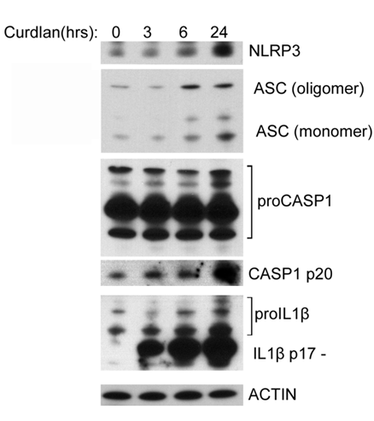
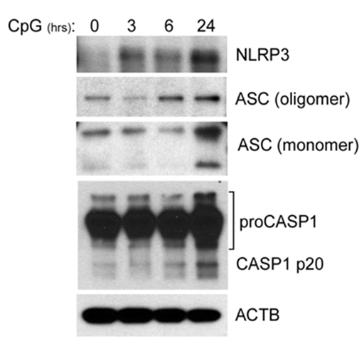
β-Glucan and CpG stimulate the NLRP3 Inflammasome

Slide 12
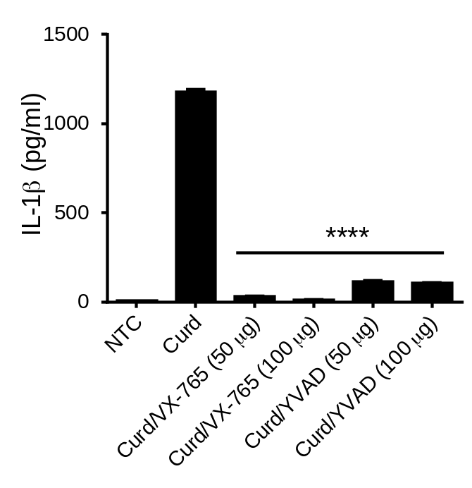
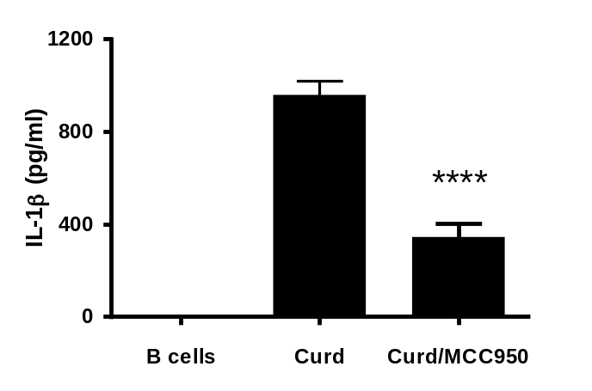
IL-1β Secretion is Dependent on NLRP3 and Caspase-1

Slide 13
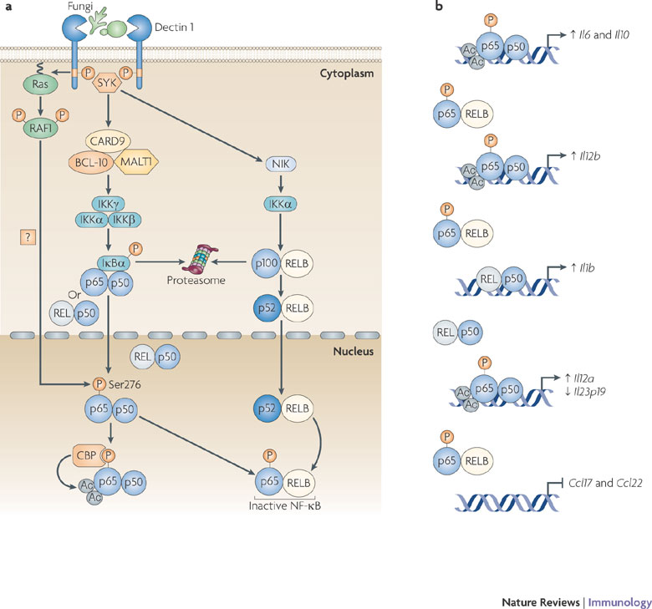
β-glucan signaling

Slide 14
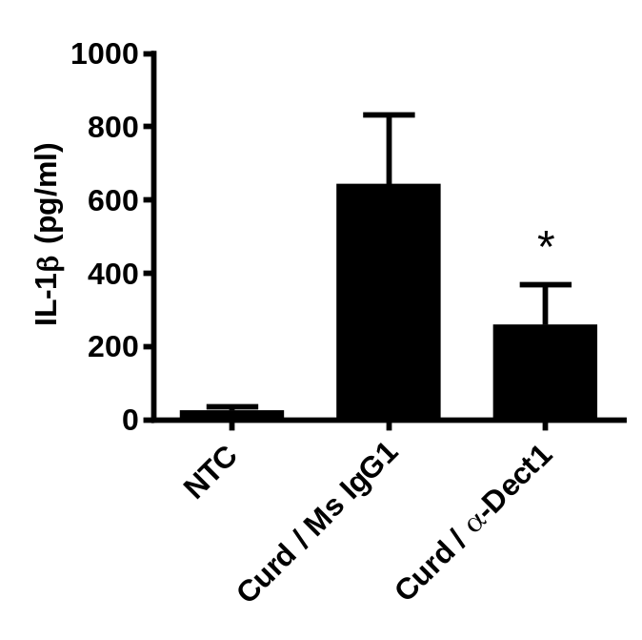
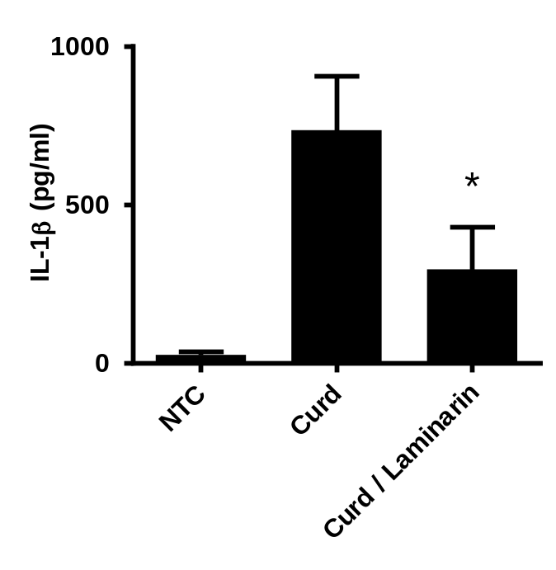
Dectin-1 is Required for β-glucan-Induced IL-1β Secretion

Slide 15

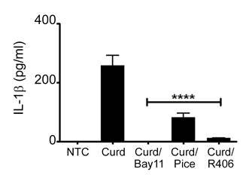
SYK and NF-κB are Required in β-glucan-Induced IL-1β Secretion

Slide 16
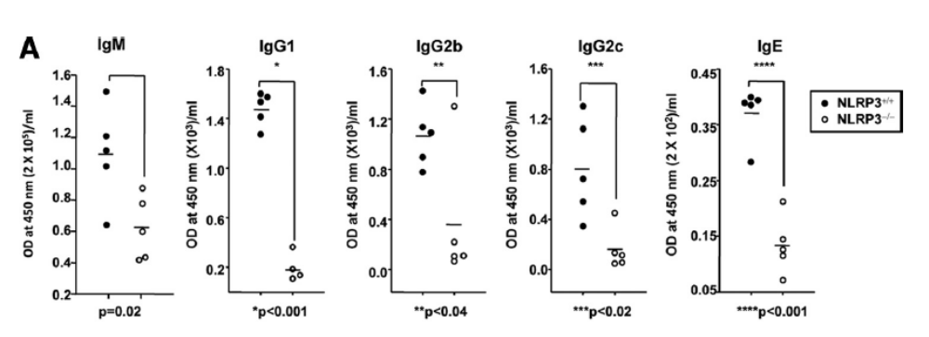
Decreased IgM levels in NLRP3 deficient mice
Kumar H et al. J. Immunol. 2015

Slide 17
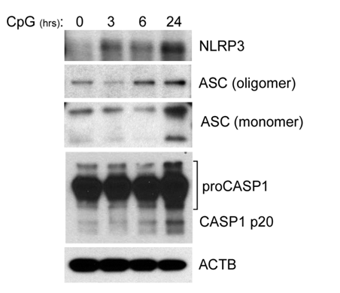
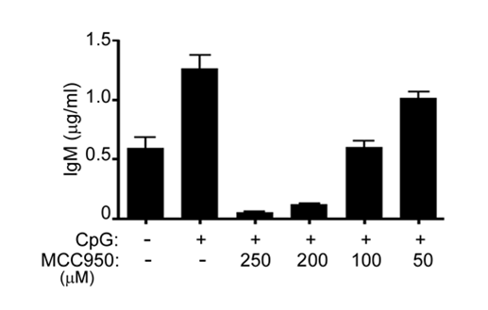
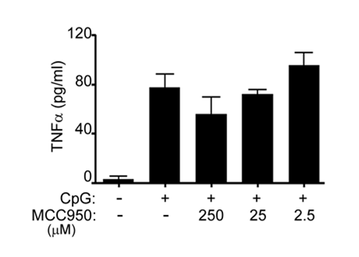
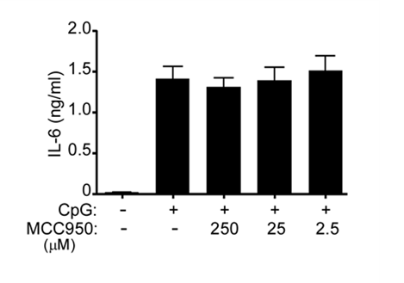
NLRP3-mediates IgM Production
****
ns
ns

Slide 18
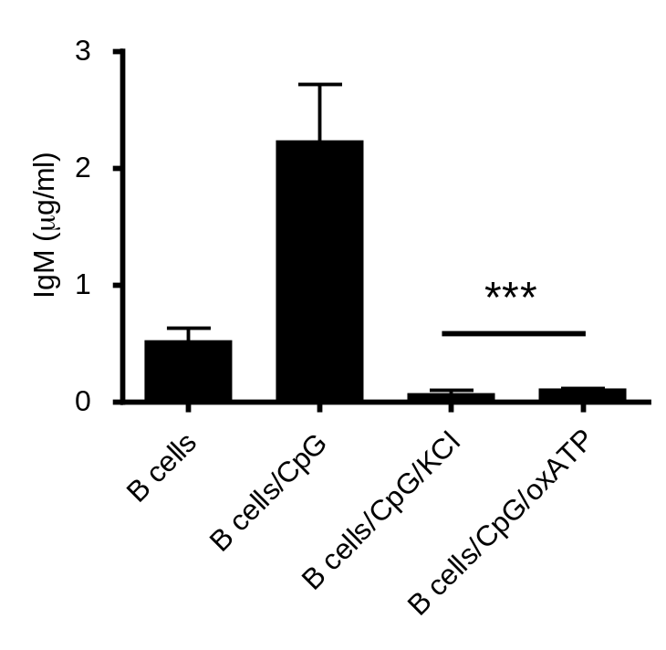
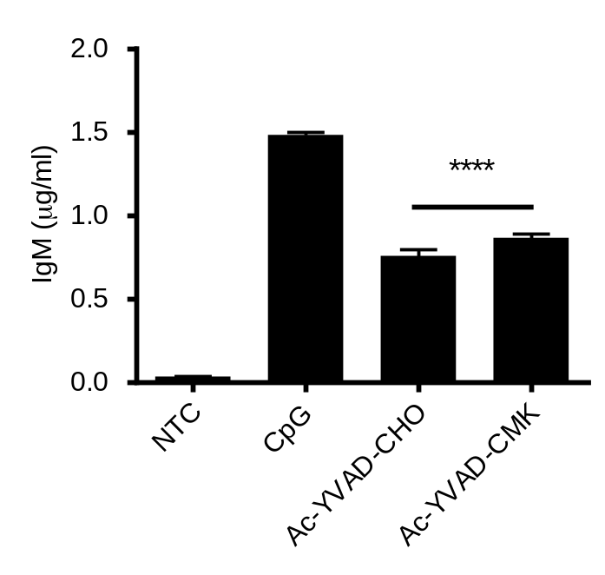
IgM induction by CpG is Mediated by ATP, K⁺ Depletion and CASP1

Slide 19
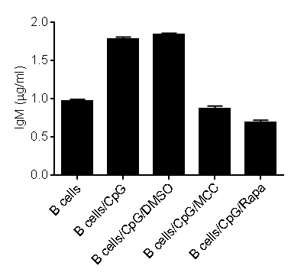
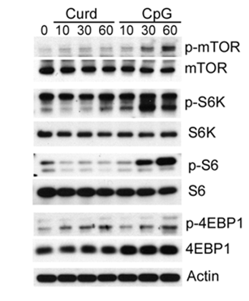
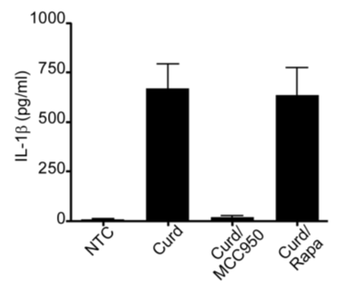
mTOR is Required for IgM Production in CpG Stimulated B-Lymphocytes

Slide 20
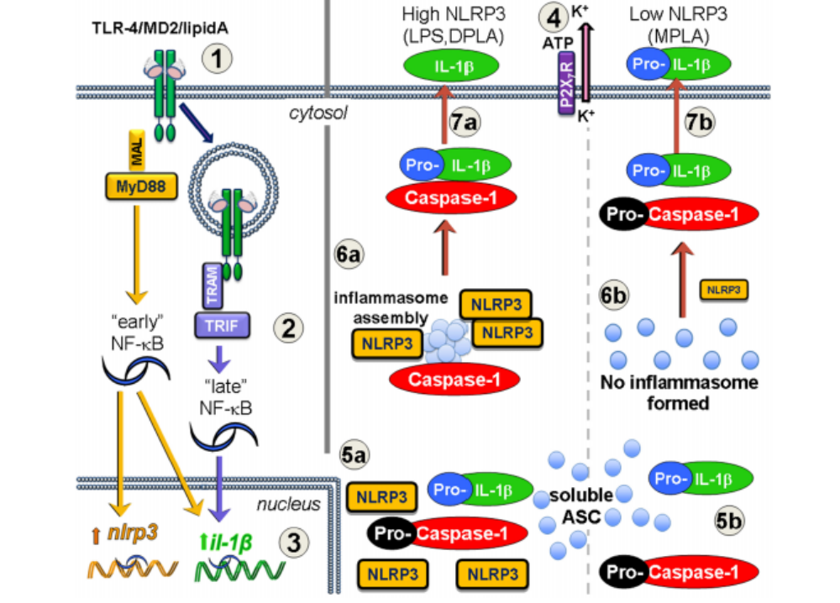
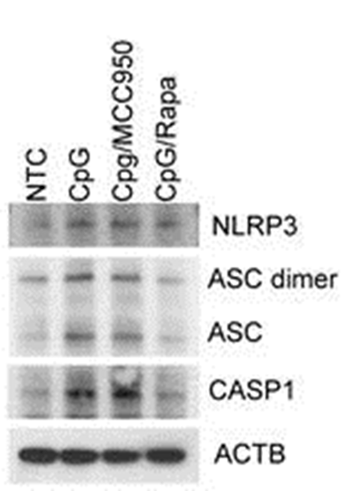
How does mTOR regulate IgM?

Slide 21
Proposed Mechanism
?NF-κB

Slide 22
Questions & Discussion

Slide 23
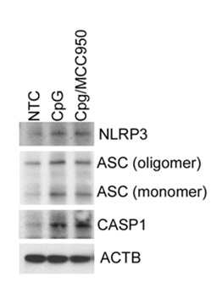
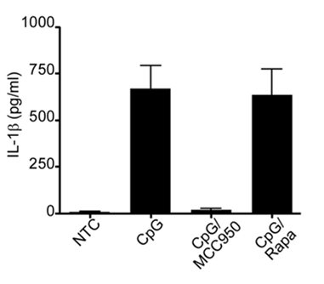
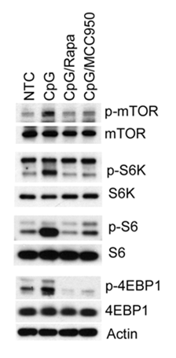
mTOR is Required for IgM Production in CpG Stimulated B-Lymphocytes

Slide 24
β-Glucans are potent immunomodulators
Beta-glucan
AP-1
NF-κB
+
EM Carmona et al. Respir Res. 2010.
IL-8
IL-8
IL-17
MF Ali. et al. Sci Rep. 2017
MMP-7
B
B
Th17
CD86
CD80
IL-8
IL-6
EM Carmona et al. Am J Respir Cell Mol Biol. 2012. Feb 16.
CCR7
Th17
MF Ali. et al. J.Immunol. 2015
Th17
IL-6
TGF-β
IL-23
CD86
CD80
IL-17
IL-22
IgM
complement
B
CCR7
Th1
EM Carmona et al. J Immunol. 2006 Jul 1;177(1):459-67.
IL-1β
Th1
IFN-γ
Th1
IFN-γ
      Modified from Carmona EM and Limper AH. Int J Clin Rev 2012;03:01

