Slide 1
Interaction of the parasite Trichomonas vaginalis with human neutrophil extracellular traps
Eva Edilia Avila
Universidad de Guanajuato, México
Yordan Jhovani Romero Contreras
Valeria Janeth Elías Soria
María Guadalupe Ramírez
Mayra Cecilia Rodríguez Solís

Slide 2
Trichomonas vaginalis and trichomoniasis
Trichomonas vaginalis is a flagellated protozoan that contain lipoglycan in the cell surface.
This parasite causes the most common non-viral sexually transmitted infection in human.
Trichomoniasis is associated with others disorders:
Premature births
Higher risk for getting and transmitting HIV
Higher risk of contracting Human Papilloma Virus
Bacterial vaginosis
Infertility

Slide 3
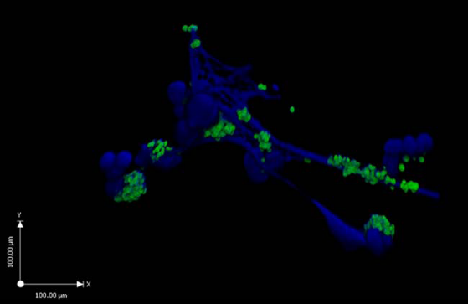
Functions of neutrophils in infections
Neutrophils are the most abundant white blood cells and the first to arrive to an infection site.
Neutrophils contribute to the excesive inflammatory process that occur during trichomoniasis.
The microbicidal effect of neutrophils may occur by endocytosis, degranulation and the formation of extracellular traps (NETs).
Maren von Köckritz-Blickwede & Victor Nizet, 2009

Slide 4
The role of neutrophils in the response to T. vaginalis
T. vaginalis induces IL-8 secretion by neutrophils and this cytokine activates neutrophil degranulation. Altstaed & col., 1996; Sook Ryu &col., 2003; Hee Nam & col., 2011.
Neutrophils actived by T. vaginalis express myelo-peroxidase and produce nitric oxide and superoxide anion. Ouk-song &col.,2013.
T. vaginalis infection activates neutrophils through toll-like receptor- 4. Zarifarrd & col., 2004.
Lysates of T. vaginalis delay neutrophil apoptosis; but live trophozoites induced neutrophil apoptosis, this induction is depending of reactive oxygen species. Kang & col., 2006; Ouk-song &col.,2007; Ouk-song &col.,2010.
Groups of neutrophils surrounding individual T. vaginalis are able to fragment trophozoites and to phagocyte the pieces. Rein & col., 1980.

Slide 5
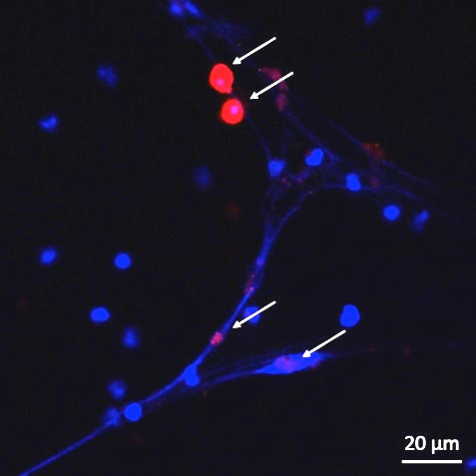
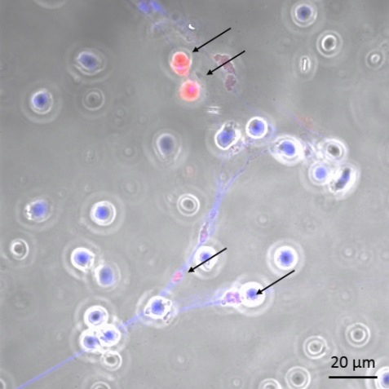
T. vaginalis induces the formation of neutrophil extracellular traps
Hoechst 33342 + PKH26
Merge with phase contrast
Ratio: 1 trophozoite for every 5 neutrophils(1:5)
Yordan Jhovani Romero Contreras

Slide 6
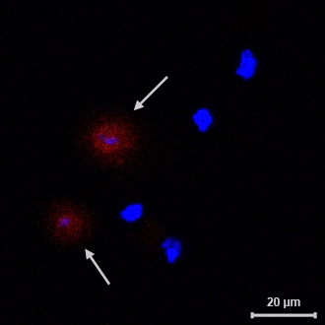
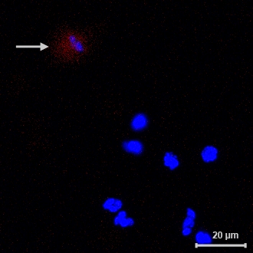
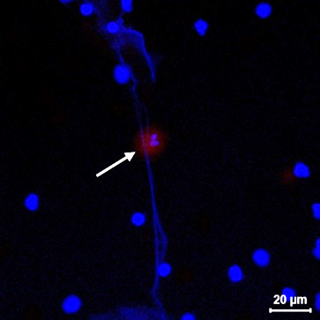
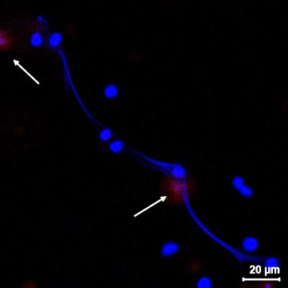
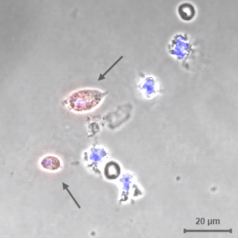
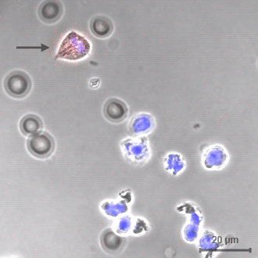
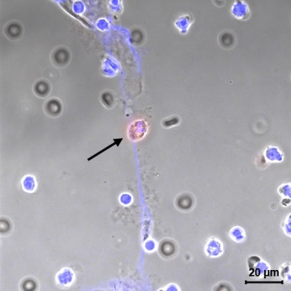
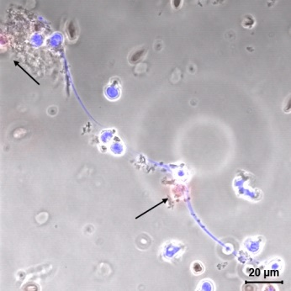
Time 0 30 min 1 h 2 h
Kinetics of neutrophil extracellular traps induction by T. vaginalis
DNA stainning with HOECHST 33342, T. vaginalis pre-staining with PKH26. Bar, 20 µm.
Yordan Jhovani Romero Contreras
Valeria Janeth Elías Soria

Slide 7
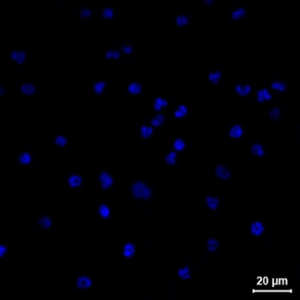
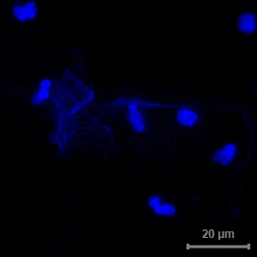
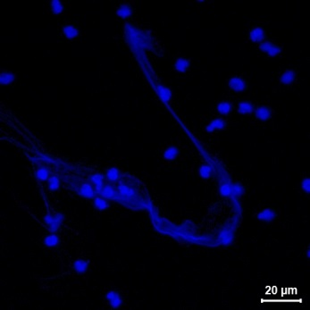
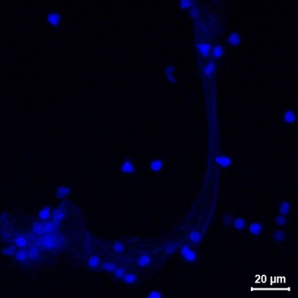
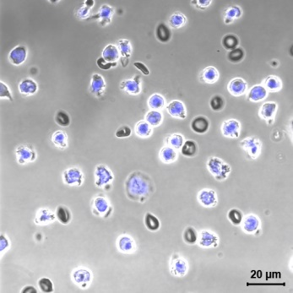
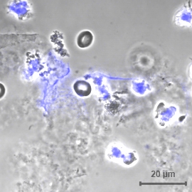
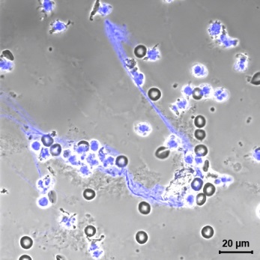
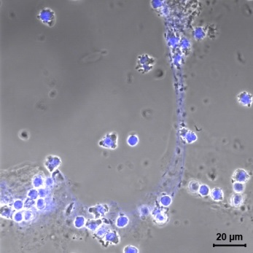
Time 0h 30 min 1 h 2 h
Lipoglycan from T. vaginalis surface induces neutrophil extracellular traps
T. vaginalis Lipoglycan at 10 ng/ml, DNA staining with HOECHST 33342. Bar, 20 µm.
Yordan Jhovani Romero Contreras
Valeria Janeth Elías Soria

Slide 8
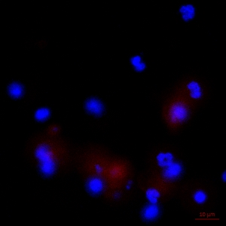
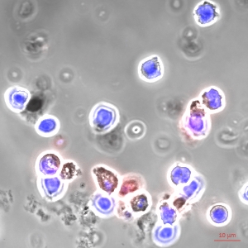
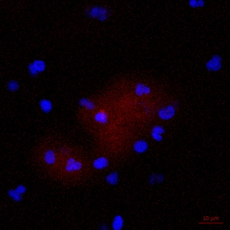
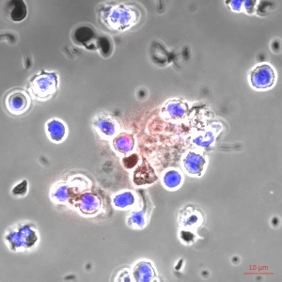
Inhibition of NET formation by antibodies to TLR-4 and TLR-2
Neutrophils+ α-TLR-4
+
T. vaginalis
Neutrophils+ α-TLR-2
+
T. vaginalis
Merge of dyes
Merge with phase contrast
María Guadalupe Ramírez

Slide 9
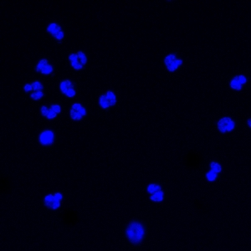
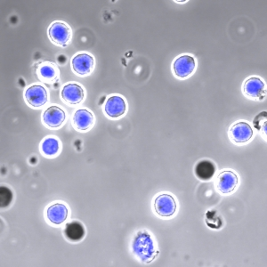
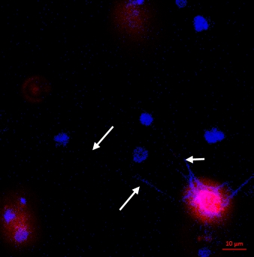
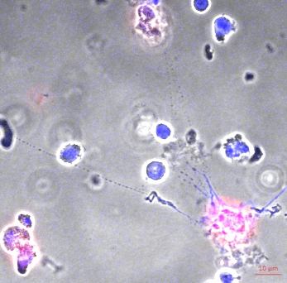
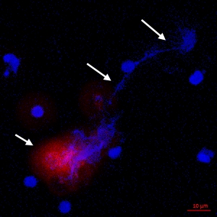
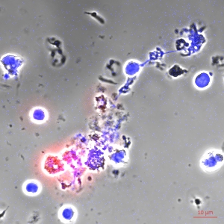
Induction of neutrophil extracellular traps by T. vaginalis in presence of normal IgG
Neutrophils
Negative control
Neutrophils
+T. vaginalis
Positive control
Neutrophils
+ IgG +
T. vaginalis
10 µg/ml rat IgG
Merge of dyes
Merge with phase contrast
María Guadalupe Ramírez

Slide 10
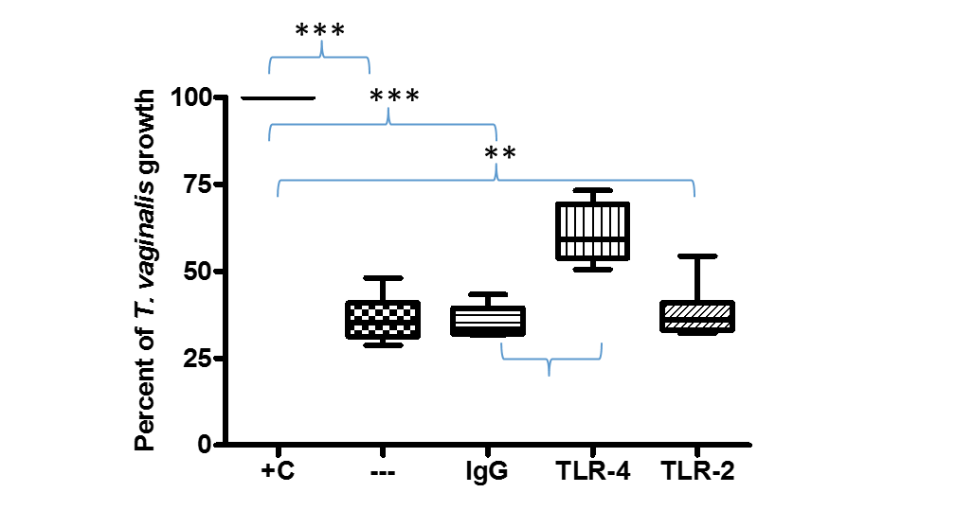
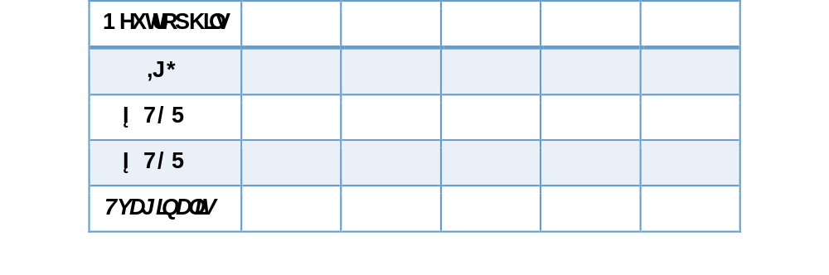
T. vaginalis growth after interaction with human neutrophils and NETs
*
Kruskal-Wallis statistic analysis, four independent experiments performed by duplicate. *** p<0.001, ** p<0.01, * p<0.05
María Guadalupe Ramírez
*

Slide 11
CONCLUSIONS
Trichomonas vaginalis and its surface lypoglycan induce the formation of neutrophil extracellular traps.
Neutrophil extracellular traps sequester T. vaginalis and reduce parasite growth.
Bloking TLR-2 or TLR-4 receptors inhibit NET formation.
When TLR-2 is blocked, neutrophils reduce T. vaginalis growth similarly to NETs,. However, whenTLR-4 is inhibited, neutrophils are less trichomonicidal.

Slide 12
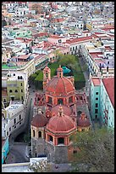
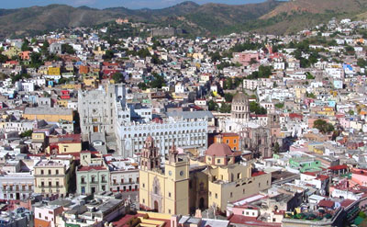
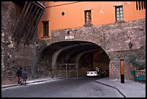
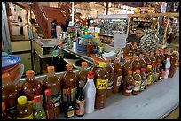
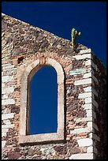
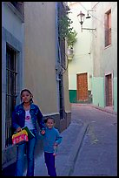


Thank you

