Slide 1
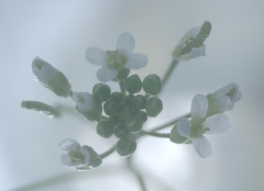
Potential targets of VIVIPAROUS1/ABI3-LIKE1 (VAL1) repression in developing Arabidopsis thaliana embryos
Eva Collakova, Ph.D.
Virginia Tech, Blacksburg, VA, USA
Andrew Schneider (experiments)
Delasa Agharmizaie (bioinformatics)
4th International Conference on Integrative Biology
July 18, 2016
Berlin, Germany

Slide 2
VAL1 protein domains & function
PHD-L
B3
CW
EAR
PHD-L (plant homeodomain-like zinc finger domain)
Epigenetic - putative H3K27me3 binding
Important for POLYCOMB REPRESSIVE COMPLEX2 (PRC2)-mediated repression in seedlings
B3 DNA-binding domain (present in LEC2, ABI3, & FUS3)
Transcriptional - Sph/RY motif
CW (zinc finger Cys- & Trp-(W)-containing domain)
Epigenetic/ transcriptional - H3K4me3 binding
EAR (ethylene-responsive element binding factor-associated amphiphilic repression) motif
Epigenetic/ transcriptional –
potential interactions
with histone modifiers
Veerappan et al (2012) Planta 236
Veerappan et al (2014) BMC Plant Biol 14
Guerriero et al (2009) New Phytol 184
Suzuki et al (2007) Plant Physiol 143
Guo et al (2013) Plant J 75
Hoppmann et al (2011) EMBO J 30
Tsukagoshi et al (2007) PNAS 104

Slide 3
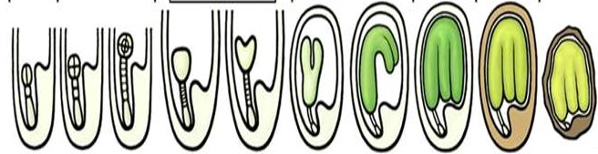
Oilseed lifecycle
Embryogenesis
Maturation
Desiccation
globular
triangular
heart
linear
bent cotyledon
dormant
Establishment of symmetry
Cell division & differentiation
Tissue & organ development
Acquisition of desiccation tolerance & establishment of dormancy
Storage compound synthesis and accumulation
Modified from Le et al (2010) PNAS 107

Slide 4
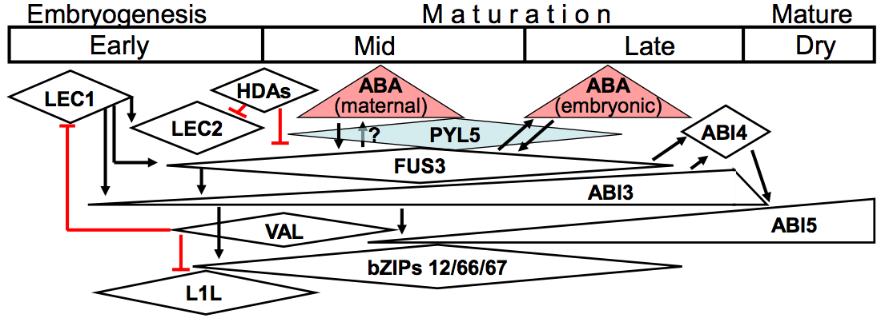
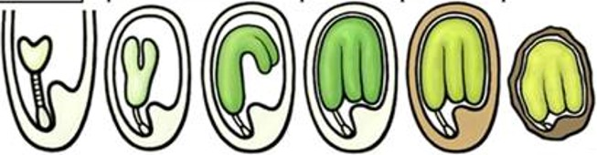
Temporal aspects of seed development in Arabidopsis
Days after pollination (DAP) →
7 & 8
10, 12, &13
15 & 17
heart
linear
bent cotyledon
dormant
Modified from Finkelstein (2013) Arabidopsis Book 11 & Le et al (2010) PNAS 107
Notes:
Interactions among some of the hormonal and developmental signals and regulatory elements controlling seed maturation.
In the upper portion (“Accumulation”), factors regulating gene expression during the progression through seed development are shown in boxes representing the relative timing and abundance of their expression. ABA accumulation is depicted in pale red triangles. PYL5 is the ABA receptor that is most highly expressed in mid-seed development, and therefore likely to mediate ABA signaling during this stage. To simplify the diagram, intermediates in this signaling pathway are not shown (see Fig.4 for details).
Bottom – corresponding developmental stages

Slide 5
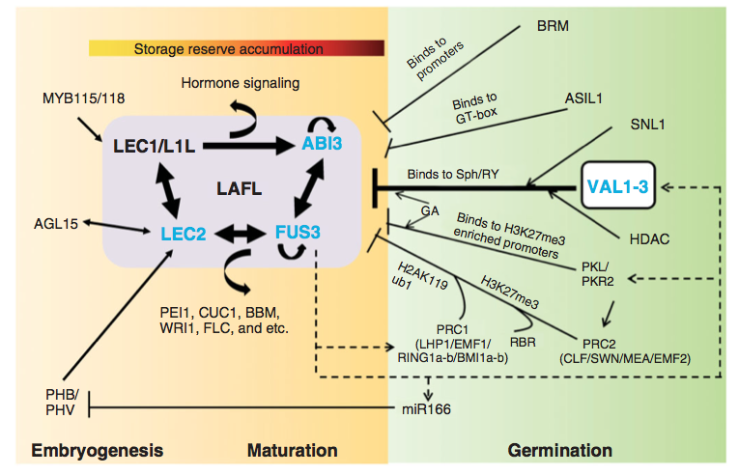
VALs repress the embryonic program in seedlings
Jia et al (2014) WIRES Dev Biol 3
Notes:
LAFL and VAL networks regulate the seed to seedling phase transition. Spatial and temporal patterns of LAFL gene expression are refined by mutual interactions.[12-15] Important direct targets of LAFL factors include ( 1) SSP [12, 16-18] and LEA genes,[19, 20] (2) transcription factor genes that control seed specific processes including PEI1,[15, 21] CUC1,[22] BBM,[22] WRI1[22-24] and FLC,[15, 25] and (3) genes that function in major hormone metabolism and signaling pathways.[13, 15, 22, 26-29] AGL15,[30, 31] PHB/PHV,[32] and MYB115/118 [33]are proposed to act upstream of LAFL network. The LAFL network is repressed by VAL B3 factors and other repressors during seed germination to enable the transition to seedling development. VAL factors play a central role in repression of LAFL network in part by binding to the Sph/RY motif and recruiting an HDAC.[10, 11, 34, 35] The interaction of VAL B3 factors with HDAC may be mediated by the co-repressor SNL1.[36] PRC2 proteins (CLF/SWN/MEA/EMF2) add H3K27me3 marks to LAFL genes.[37, 38] Acting in concert with PRC2, PRC1 proteins (LHP1/ EMF1/RING1a-b/BMI1a-b) bind to H3K27me3 marks and deposit H2AK119ub1 to maintain a stable repressed state of LAFL genes.[37, 39, 40] The CHD3 chromatin remodeling factors, PKL and PKR2, can indirectly promote H3K27me3 modification by up-regulating genes encoding PRC2 proteins.[41] PKL is also present in the promoter region of LEC1, LEC2 and FUS3 genes that are enriched for H3K27me3.[42] RBR can interact with the promoter of ABI3, and is required for establishing H3K27me3 modification by cooperating with PRC2.[43, 44] The SNF2 chromatin remodeling ATPase, BRM, can repress seed maturation genes by physically interacting with their promoters.[45, 46] The plant-specific trihelix factor, ASIL1, contributes to repression of LAFL genes by binding to the GT element (CGTGATT).[47] miR166 indirectly represses LEC2 transcription by targeting upstream PHB and PHV.[32] GA signaling enhances VAL and PKL repression of the LAFL network.[10, 48] Negative feedback loops: LAFL factors (FUS3 and LEC1) up-regulate VAL1, RING1b, miR166, and PKL.[22, 24] Black lines with arrows indicate activation, and black lines ending with bars indicate repression. Inferred functions with less experimental evidence are indicated by dashed lines.

Slide 6
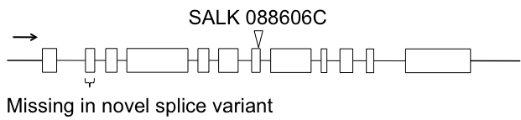
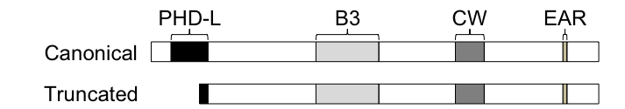
VAL1 has two splice variants
Alternate start site
Missing 77% of the PHD-L domain
Multiple targeting mechanisms?
Canonical →
Truncated →
ADLCYRCGSAYESSLFCEQFHKDQSGWRECYLCSKRLHCGCIASKVTIELMDYGGVGCSTCACCH-
MDYGGVGCSTCACCH-
Schneider et al (2016) Plant J 85
Notes:
The VAL1 gene and corresponding SVs. The VAL1 gene with T-DNA insertion shown on top. The SALK_088606C mutant line carries a T-DNA insertion in the seventh exon, which encodes part of the B3 domain. The novel SV is missing the entire second exon. Splicing of the VAL1 premature RNA yields two SVs encoding two different protein variants. The full-length protein contains all four domains. The truncated SV is missing 77% of the PHD-L domain.

Slide 7
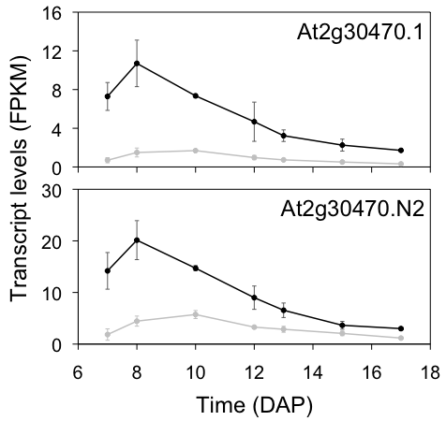
Transcript level changes of two VAL1 splice variants
Insertion seems to produce a knockdown – not true…
Splice variant existence confirmed through TaqMan
Wild type
val1 mutant
Schneider et al (2016) Plant J 85
Notes:
Expression of both VAL1 SVs in developing Arabidopsis embryos. The full-length SV (At2g30470.1) is expressed nearly two fold less than the truncated SV (At2g30470.N2) at each time point in the wild type. Transcript levels of both SVs appear reduced in developing val1 embryos based on RNA-Seq transcriptomics.

Slide 8
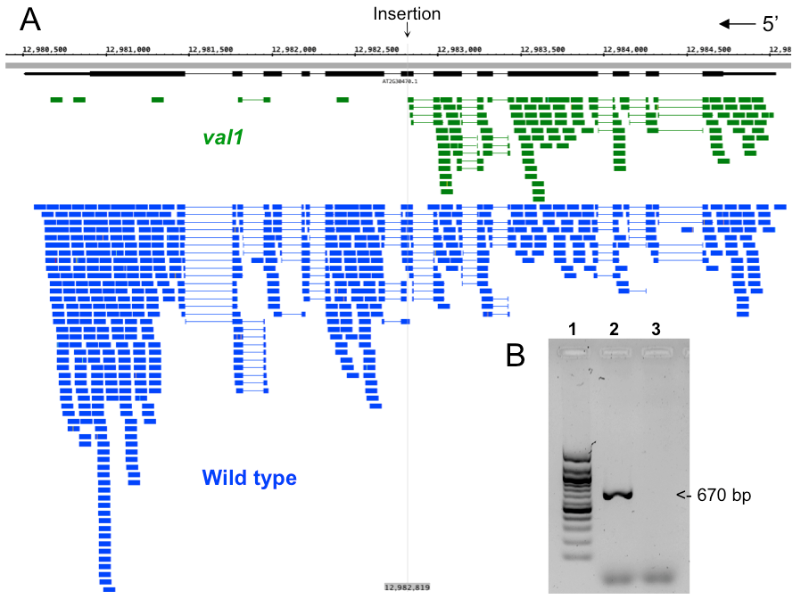
The val1 mutant does not accumulate detectable levels of wild type VAL1 transcripts
Schneider et al (2016) Plant J 85
Notes:
The val1 mutant does not accumulate wild type VAL1 transcripts in developing embryos. Density of reads mapped to the wild type VAL1 gene in wild type and val1 embryos at a representative time point. The majority of reads in the val1 mutant mapped to the region upstream of the T-DNA insertion site. Based on the density of the reads, transcription efficiency for the val1 gene was not affected in the mutant. Inset: PCR of the region flanking the T-DNA insertion site of the val1 gene in 8-day-old embryos using the genotyping primers. Lanes: 1. 100-bp ladder; 2. wild type cDNA template diluted 12 fold; 3. val1 cDNA undiluted template. An expected 670-bp band was amplified from the wild type cDNA, but not from the mutant.

Slide 9
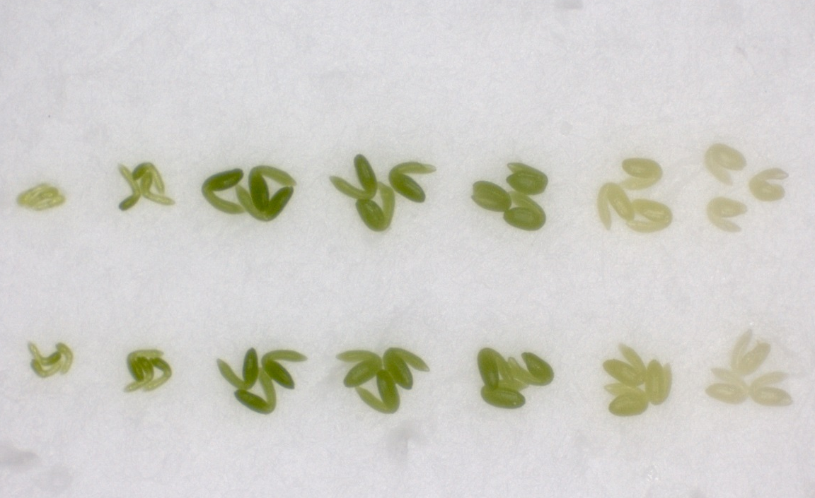
Wild type & val1 mutant embryos are similar
seed maturation
early
middle
late
DAP →
7
8
10
12
13
15
17
wild type
val1
1 mm
wild type
val1 mutant
Dry weight (μg embryo⁻¹)
Time (days after pollination (DAP))
Schneider et al (2016) Plant J 85
Notes:
Developing val1 mutant embryos show no visible phenotypes. Top: Embryos dissected from seeds of specified age from a representative wild type and val1 mutant, respectively, plant are shown. Separation of embryo development into three major phases of seed maturation (early, middle, and late seed filling) is shown by vertical lines. Bottom: Biomass accumulation in developing wild type and val1 mutant embryos. Averages ± SD of nine biological replicates for each line are shown. No differences in the appearance or DW of wild type and mutant embryos of comparable developmental stages were observed.

Slide 10
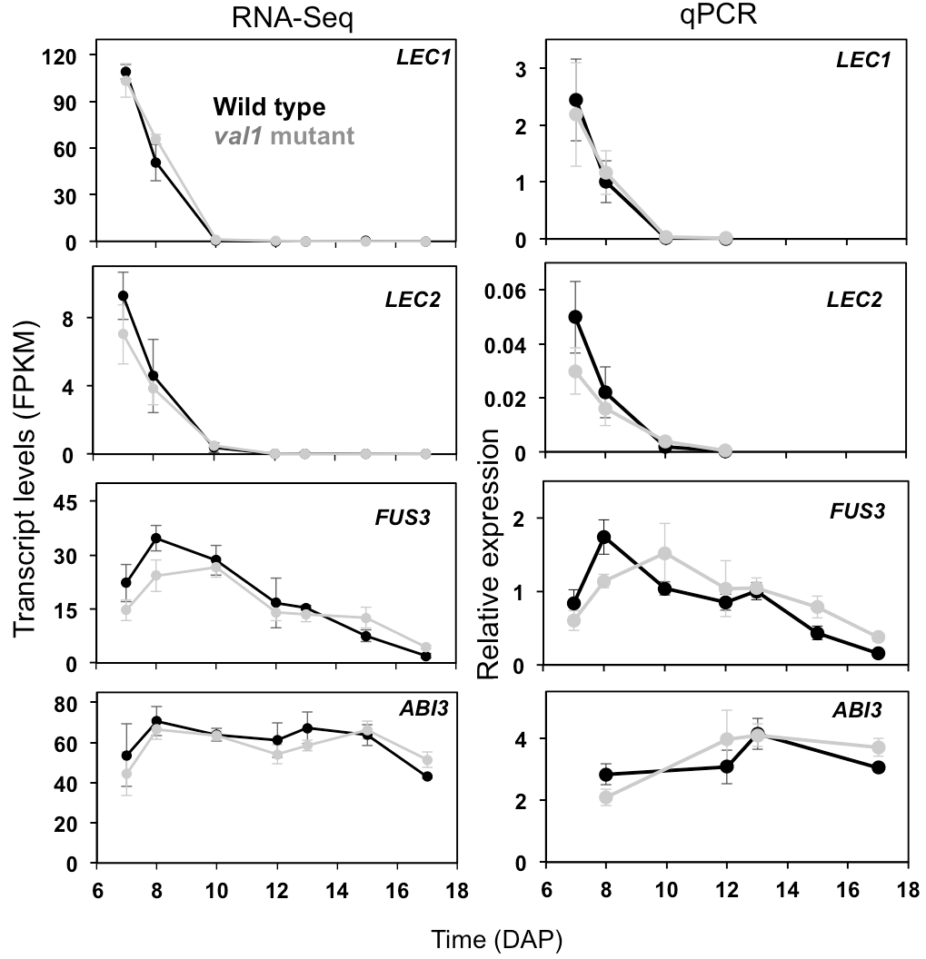
VAL1 does not regulate transcription of LAFL regulators in developing embryos
Jia et al (2014) WIRES Dev Biol 3
Unexpected
During germination – VALs repress LAFL regulators
Schneider et al (2016) Plant J 85
Notes:
Expression profiles of the core LAFL TF transcripts in wild type and val1 embryos. RNA-Seq and qPCR results are shown in parallel and were consistent between these two methods. In cases where multiple SVs were detected (e.g., FUS3), expression of only the known SV are shown. No statistically significant changes were observed between the wild type and val1 mutant.

Slide 11
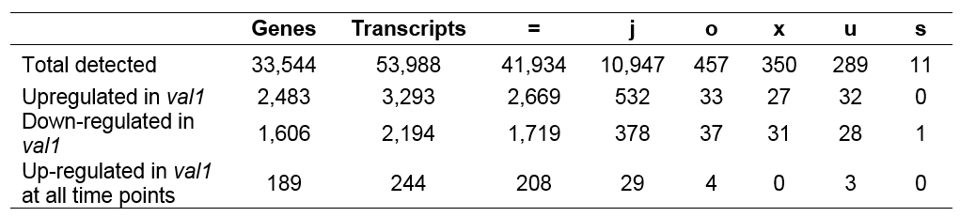
VAL1 regulates expression of targets of the LAFL transcriptional regulators
LEC1
ABI3
FUS3
LEC2
Number of LAFL targets de-repressed in the absence of VAL1
(excludes overlapping targets)
84
8
623
240
Schneider et al (2016) Plant J 85
Notes:
All differential expression and fold change analyses were performed on the basis of comparing transcript expression in wild-type with val1 embryos at each time point. Transcripts were categorized as upregulated or downregulated for at least four or for all time points, with a twofold change cut-off and P < 0.05. The total number of genes and transcripts are indicated, as are cuffcompare classifications defined in Trapnell et al. (2010). Transcript classification: =, known transcripts; j, previously unreported splice variants (SVs); o, partial overlap with known reference transcripts; s, antisense intron transcripts; u, intergenic transcripts; x, antisense exon transcripts. *Includes plastidic and mitochondrial genes.

Slide 12
Potential direct targets of VAL1
LAFL
Sph/RY (B3 domain)
419
29
121
All up-regulated in the absence of VAL1
Analyzed for having Sph/RY motif and/or the epigenetic mark and/or belonging to LAFL regulons
18
31
176
504
H3K27me3 (PHD-L domain – canonical VAL1 isoform only)
Schneider et al (2016) Plant J 85
Notes:
Venn diagram depicting the intersection of transcripts associated with the Sph/RY motif and H3K27me3 mark, and members of the LAFL regulatory network. Several TFs belonging to the LAFL regulatory network could be indirectly implicated in the up-regulation of transcripts in val1 embryos through the Sph/RY motif. Exclusion of known targets of LAFL regulatory network (29 and 18) containing the Sph/RY motif resulted in 121 de-repressed transcripts representing potential direct targets of VAL1. VAL11 repressed the majority of its potential targets through epigenetic regulation.

Slide 13
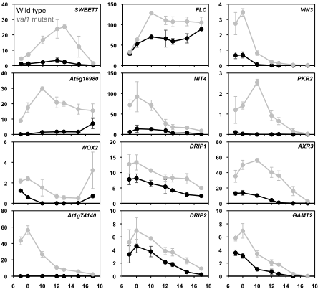
Transcripts upregulated in the val1 mutant at all time points
SWEET7 – sucrose transport
FLC & VIN3 – flowering locus C & Vernalisation-insensitive – induction of flowering
NIT4 – nitrilase
PKR2 – pickle-related – seed development – epigenetic regulator
WOX2 – wuschel-related homeobox TF - embryogenesis
DRIPs – DREB2A-interacting proteins – ubiquitin ligases
AXR3 – auxin-resistant – TF – repressor of auxin signaling
GAMT2 – GA methyltransferase – inactivation of GA
Relative transcript levels (FPKM)
Time (DAP)
Schneider et al (2016) Plant J 85
Notes:
Selected transcripts de-repressed in developing val1embryos. All transcripts shown are known, not novel, transcripts.

Slide 14
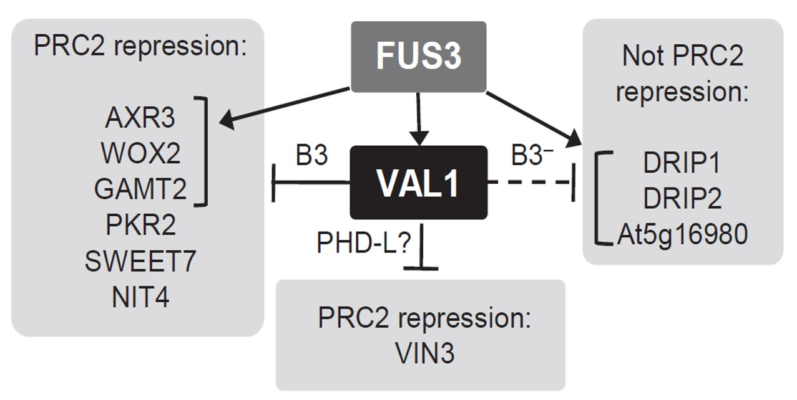
Complex actions of VAL1
Based on the presence or absence of epigenetic marks in genes & B3-domain binding motifs in promoters of genes – several basic modes of VAL1 action – different sub-sets of genes
  PRC2 repression & B3-domain-mediated regulation
  PRC2 repression
  PRC2- and B3-independent regulation
Schneider et al (2016) Plant J 85
Notes:
VAL1 represses genes in the FUS3 regulon through several potential mechanisms. The VAL1 B3 domain could target several genes for PRC2-mediated deposition of H3K27me3 marks, including the FUS3-regulated AXR3, WOX2, and GAMT2. In addition, the CHD3 repressor PKR2 is repressed completely in wild type embryos and upregulated in the val1 mutant. The putative sucrose transporter SWEET7 and the nitrilase NIT4 are repressed by PRC2 and have the RY/Sph motif in their promoters. Genes encoding the members of the FUS3 regulon, including VIN3 lack the RY/Sph motif, but are repressed through PRC2 activity. These two genes could be targeted by the VAL1 PHD-L domain. DRIP1 and 2, and At5g16980 are regulated by FUS3, but do not have the RY/Sph motif, nor they are repressed by PRC2. They could be indirectly repressed by VAL1 or targeted through a different, B3-independent (B3-) mechanism. In the val1 mutant, these genes are de-repressed to different degrees that are consistent with whether they are regulated by VAL1 alone or both VAL1 and FUS3. FUS3-activated genes are indicated by brackets.

Slide 15

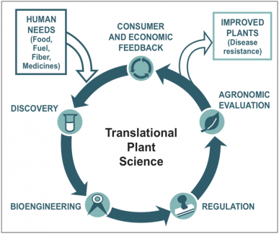


Acknowledgements
Collaborators:
  Prof. Ruth Grene
Prof. Lenny Heath
Dr. Abe Koo (U of Missouri)
Graduate students:
  Delasa Aghamirzaie
  Andrew Schneider
  Haitham Elmarakeby
  Arati Poudel (U of Missouri)
Collakova lab members:
  Bhadra Gunesekera
  Joe Powers
  Brittany Lassiter
  Aalok Parekh
Notes:
Funding:
NSF MCB-1052145

Slide 16
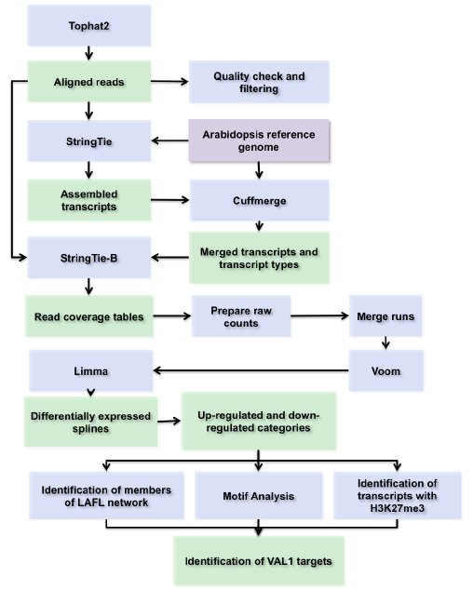
RNA-seq pipeline
Schneider et al (2016) Plant J 85
Notes:
Tophat2 = read mapping (HISAT – more accurate and 10 x faster)
Stringtie (replaces Cufflings) = transcript assembly (Steven Salzberg)
Cuffmerge = merging – gtf (reference transcriptome file)
Cuffcompare = class codes – identification of different transcript types
Stringtie B + gtf = read coverage tables
Limma = differential expression analysis (Ballgown)

