Slide 1



Behaviors of Flag-Shaped Dampers Using Combination of Magnetic Friction and Rubber Springs
Eunsoo Choi, Gyuchan Choi, Yunjeong Son, Seungmin Gin
Speaker : Yunjeong Son
Master’s Course, Hongik University
2015.11.17
Notes:
[Good Morning] I’m Yunjeong Son, currently taking a Master's course in civil engineering at Hongik University.
It’s honor for me to be presented to here on behalf of prof. Eunsoo choi.
I would like to begin my presentation.
Presentation will be on Behaviors of flag-shaped dampers using combination of magnetic friction and rubber springs.

Slide 2

Contents
Background & Objective
Magnetic-frictional damper dynamic Test
Pre-compressed Rubber spring dynamic Test
Smart damper dynamic Test
Conclusions
Notes:
The presentation will be presented in the order of 'Background and Objective of the experiment'
and then to the 'tests and results for the experiments'
'Magnetic-frictional damper dynamic test', 'rubber spring dynamic test‘, and smart damper dynamic test.

Slide 3
Background & Objective
  Dampers are used to dissipate input energy and reduce vibration of a system.
  In civil engineering, they are mainly applied in the protection of bridges and building from seismic attacks.
  In addition, they are used to control the vibration of structures induced by vehicles, human-being, or environmental loadings.
  Therefore, several type of dampers are developed, including fluid dampers, frictional dampers, metallic dampers, and SMA dampers.
Notes:
First, let me explain the background and objective of the experiment.
Dampers are used to dissipate input energy and reduce vibration of a system.
In civil engineering, they are mainly applied in the protection of bridges and building from seismic attacks.
In addition, they are used to control the vibration of structures induced by vehicles, human-being, or environmental loadings.
Therefore, several type of dampers are developed, including fluid dampers, frictional dampers, metallic dampers, and SMA dampers.

Slide 4
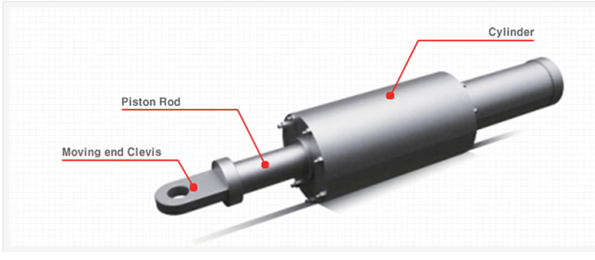
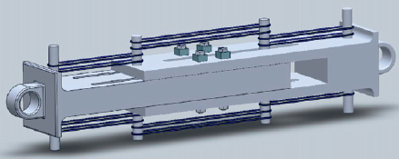
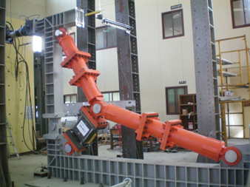
Background & Objective
Several type of dampers
  Viscosity(fluid) damper → Long time usage of liquid based damper creates high possibilities of liquid leaks
  Damper using memory alloy(SMA damper) → New materials have a problem of being uneconomical.
  Frictional damper(Using bolt tension) → Slight variation of bolt-tension or the surface-condition of frictional material may reduce frictional force.
Proposed a new concept of a smart damper using magnet and rubber spring.
<Viscosity damper>
<SMA damper>
<frictional damper>
Notes:
There are several types of dampers.
However, these dampers have some disadvantages.
About Viscosity damper, Long time usage creates high possibilities of liquid leaks.
SMA damper have a problem of uneconomical becuase of price.
And frictional damper do not provide recentering capacity. And they have a bolting problem.

Slide 5
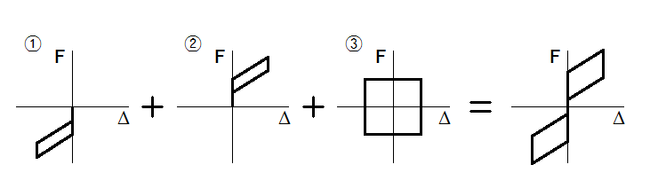
Background & Objective
Concept of smart damper
  A new concept of smart damper will be proposed that using the friction of permanent magnets and pre-compressed rubber spring.
  The magnetic friction provides energy dissipation capacity.
  The pre-compressed rubber springs provides self-centering capacity.
  The combination of magnetic friction and pre-compressed rubber springs generates ‘flag-shaped’ behavior for a smart damper.
Notes:
In this study, a new concept of smart damper will be proposed theoretically that using the friction of permanent magnets and pre-compressed rubber springs;
The magnetic friction provides energy dissipation capacity That is figure 3.
And the pre-compressed rubber springs provide self-centering capacity. That is figures 1 and 2.
The combination of magnetic friction and pre-compressed rubber springs generates ‘flag-shaped’ behavior for a smart damper shown last figure.
For this purpose, a series of dynamic tests of magnetic friction dampers and pre-compressed rubber springs were conducted.

Slide 6
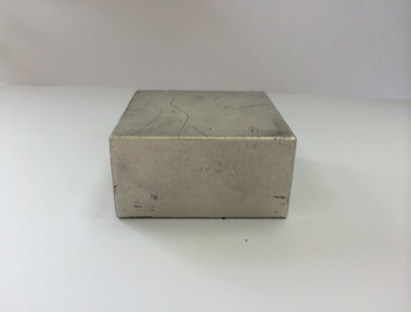
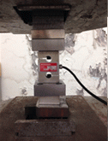
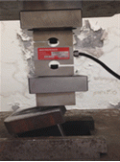
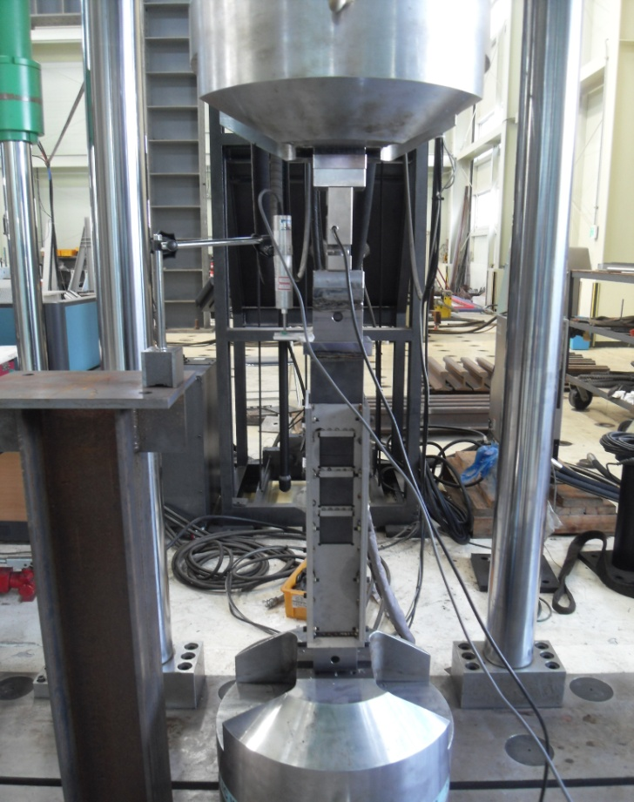
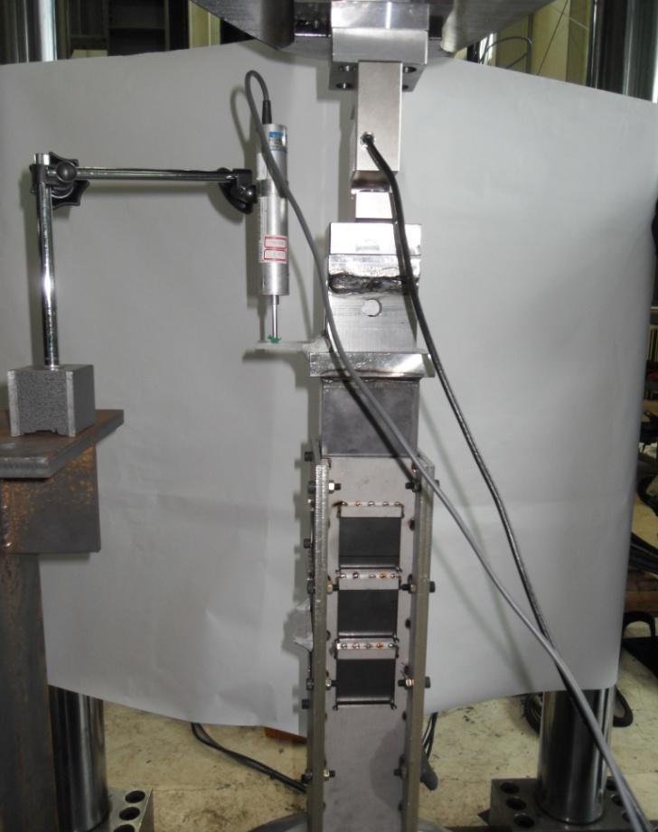
Dynamic tests of magnetic friction damper
Experiment Preparation
The pulling force is 800N for each magnet.
<Shape of the Magnet>
<Tensile test of the magnet>
Identify the friction force and frictional coefficient by controlling the number of magnets and frequency of the UTM.
<Dynamic experiment preparation of magnetic damper >
Notes:
There are pictures of the magnet and tensile test of the magnet.
In tensile test of the magnet, the pulling force is 800N for each magnet.
Next is the magnetic-frictional damper dynamic test.
This test identifies the friction force and frictional coefficient by controlling the number of magnets and frequency of the UTM.
(The out part of the piston is non-magnetic(stainless) and the inner piston is magnetic, Therefore the magnet is adhered to the inner piston and the magnetic force creates frictional force.)

Slide 7
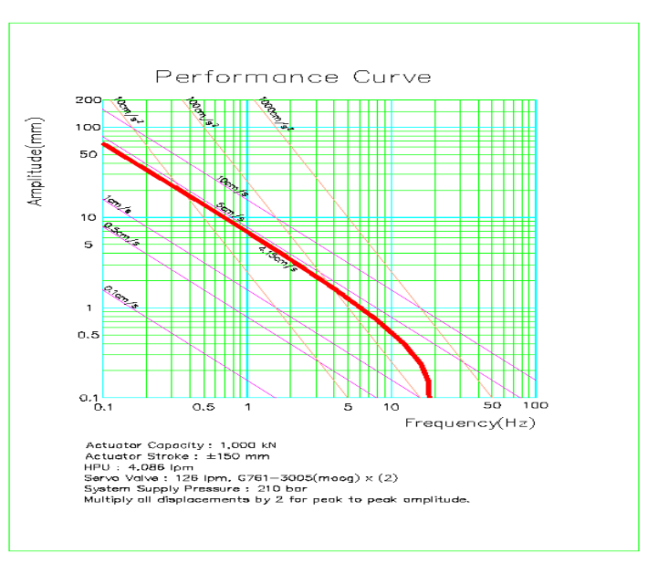
Dynamic tests of magnetic friction damper
Experiment procedure
  The experiment is proceeded by changing the number of magnets in the order of 2, 4, 6, 8, 10, 12 magnets each.
  The experiment is proceeded by controlling the frequency of UTM in the order of 0.1, 0.25, 0.5, 0.75, 1, 2 Hz.
  Stroke is controlled in consideration of the Performance curve of the UTM.
No. of frequency | Stroke
0.10 Hz | ± 10 mm
0.20 Hz | ± 10 mm
0.50 Hz | ± 10 mm
0.75 Hz | ± 5 mm
1.00 Hz | ± 5 mm
2.00 Hz | ± 2 mm
<UTM Perfomance curve>
Notes:
Here is the experimental procedure.
The experiment is proceeded by increasing the number of magnets from 2 to 12 magnets.
and by controlling the frequency of UTM to 0.1 Hz to 2 Hz as shown the figure.
The stroke is controlled in consideration of the performance curve of the UTM
And this procedure is equal to other test about smart damper.

Slide 8
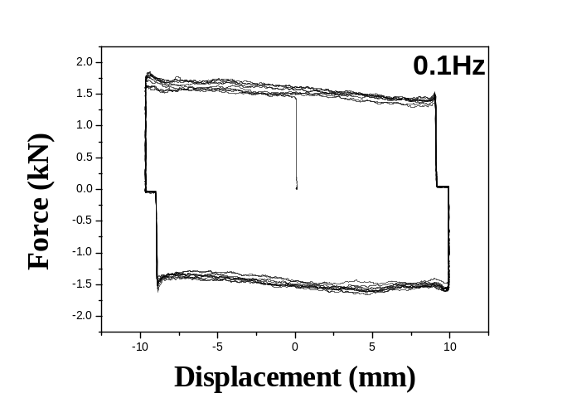
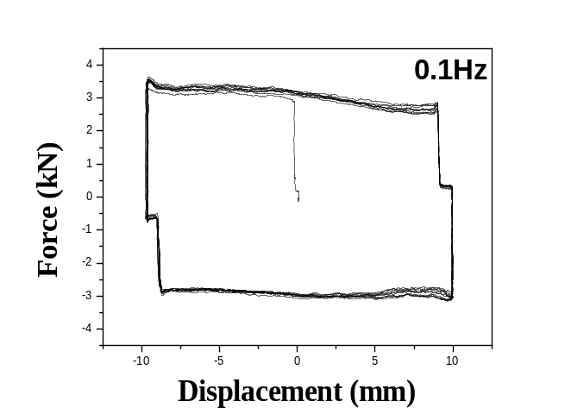
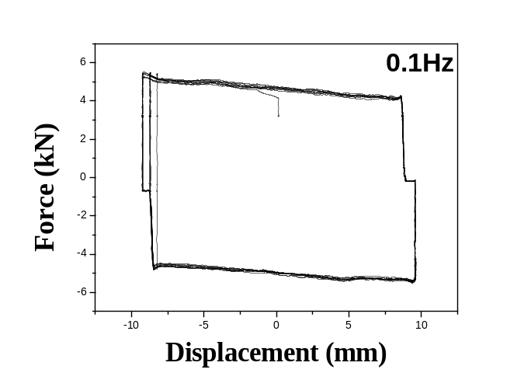
Dynamic tests of magnetic friction damper
Result of magnets adhered
<4 magnets adhered>
<8 magnets adhered>
<12 magnets adhered>
Magnets | 0.1 Hz | 0.25 Hz | 0.5 Hz | 0.75 Hz | 1 Hz | 2 Hz
4 magnets | 1.51 | 1.58 | 1.64 | 1.68 | 1.73 | 1.82
8 magnets | 3.05 | 3.35 | 3.44 | 3.35 | 3.45 | 3.5
12 magnets | 4.75 | 4.86 | 5.1 | 4.95 | 5.05 | 4.92
(kN)
<Friction forces along with magnets number>
Notes:
These are analysis of 4, 8 and 12 magnets adhered.
The frictional force is measured as shown. and there is little effect on the frequency of the force.
The behavior of the magnetic frictional damper shows exactly rectangular shape like other friction damper.
The bellow table shows the friction force.
And from the test, we knew that frictional coefficient Mu is about 0.5 by using simple friction equation F=Mu*N. (times)

Slide 9
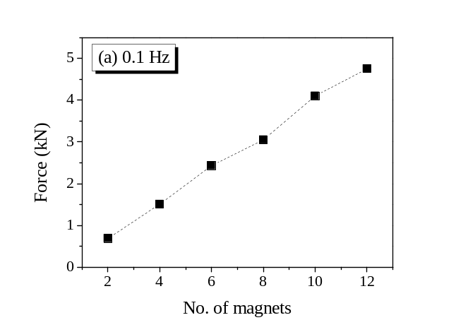
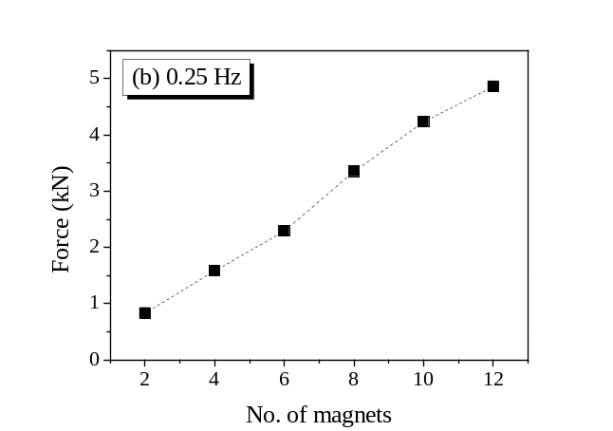
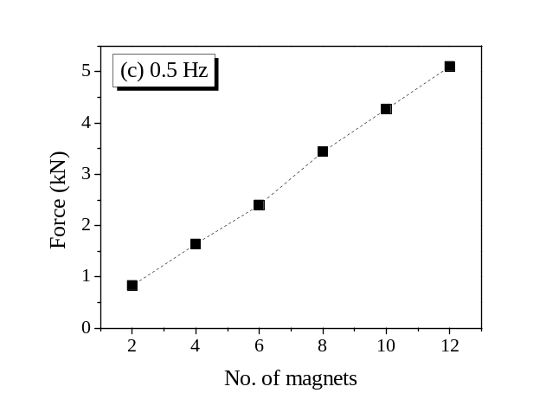

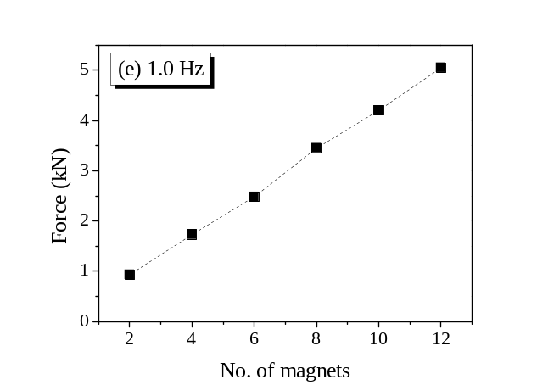

Dynamic tests of magnetic friction damper
Estimation of friction force
  The friction force depending on in number of magnets was a linear increase.
Notes:
And the graph shows linearity for the friction force.
Estimation of friction force tendency depending on the number of magnets.
There was a linear increase in the friction force tendency for each on.

Slide 10




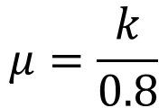

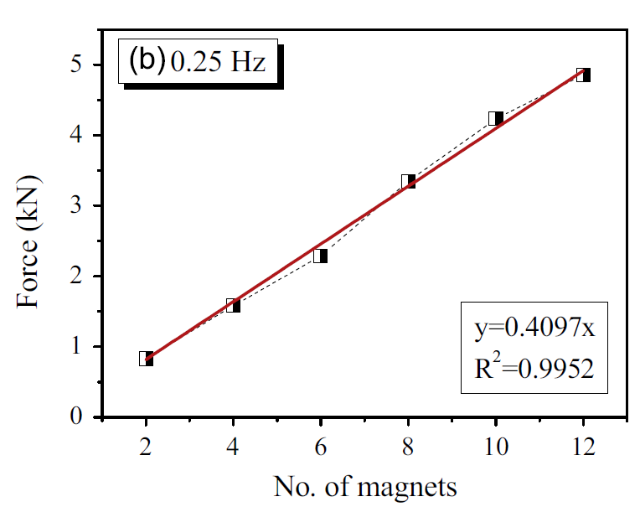
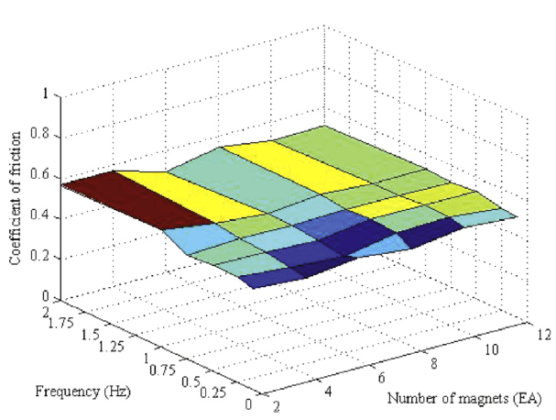
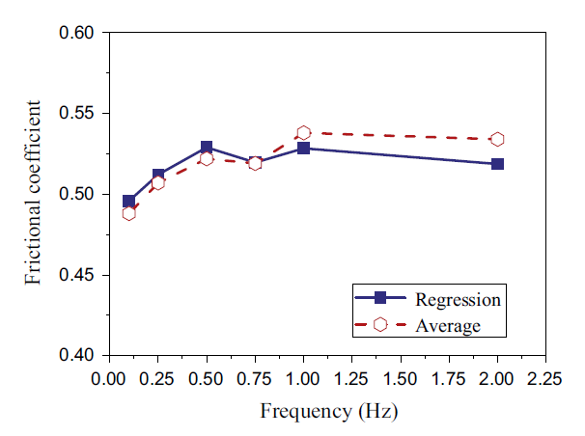
Dynamic tests of magnetic friction damper
Estimation of frictional coefficient.
: Frictional force
: Frictional coefficient
: Normal force induced by magnetic force
: Slope of the regression line
: Number of magnet
Frictional force as a function of number of magnet
(and regression line)
Frictional coefficient of the damper in a 3D graph
Frictional coefficient of average and regression
Notes:
The frictional coefficient μ can be obtained from the estimated frictional forces using the first equation.
F is frictional force.
And N is normal force induced by magnetic force and can be obtained by multiplying 0.8 KN.
And μ is frictional coefficient and is equal to k divided by 0.8.
Figure in center shows the frictional coefficients with the variation of frequency and number of magnets in a 3D graph.
Right figure shows estimated frictional coefficient using a linear regression(리그레션) between the normal and frictional force.

Slide 11
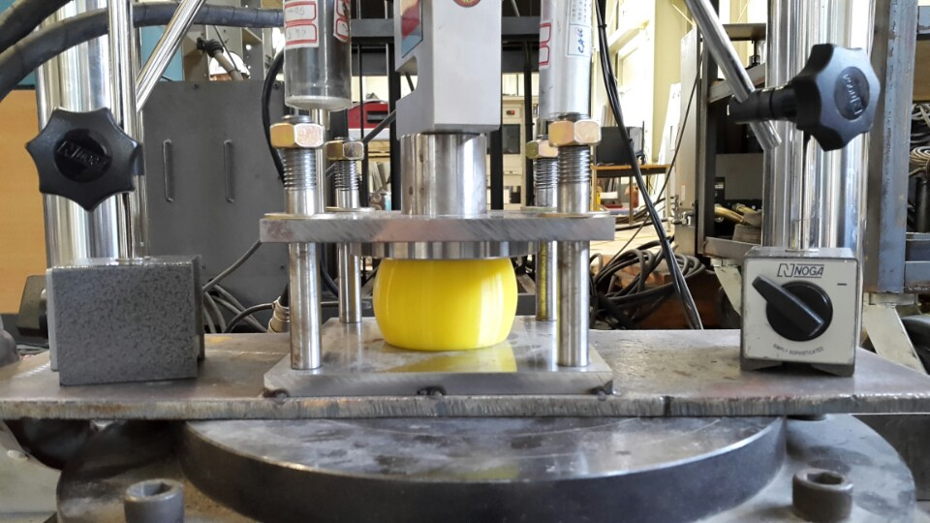
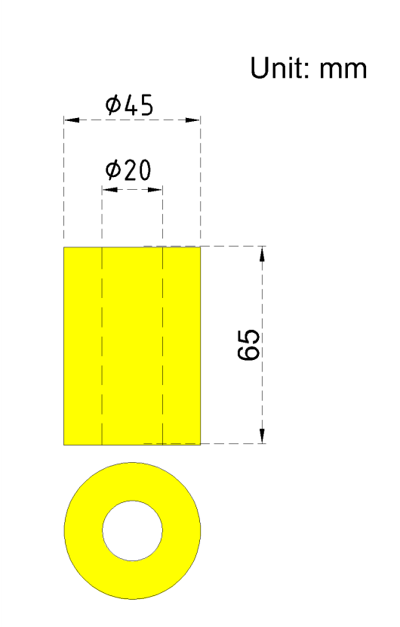
Pre-compressed rubber springs test
Purpose of experiment
  In order to develop the rubber spring + magnetic-frictional damper system, we made experimental rubber spring model.
  Experimental test identify the behavior of the rubber spring and performing dynamic test. And the control frequency is 0.1-2Hz
Preparation of Experiment
80
80
<Shape of the rubber spring>
<Test for dynamic tests>
Notes:
This part will discuss the pre-compressed rubber springs test.
In order to develop the rubber spring and magnetic-frictional damper system, we made experimental rubber spring model.
So we identify the behavior of the rubber spring and perform dynamic test. And the control vibration frequency is from 0.1 to 2Hz.

Slide 12
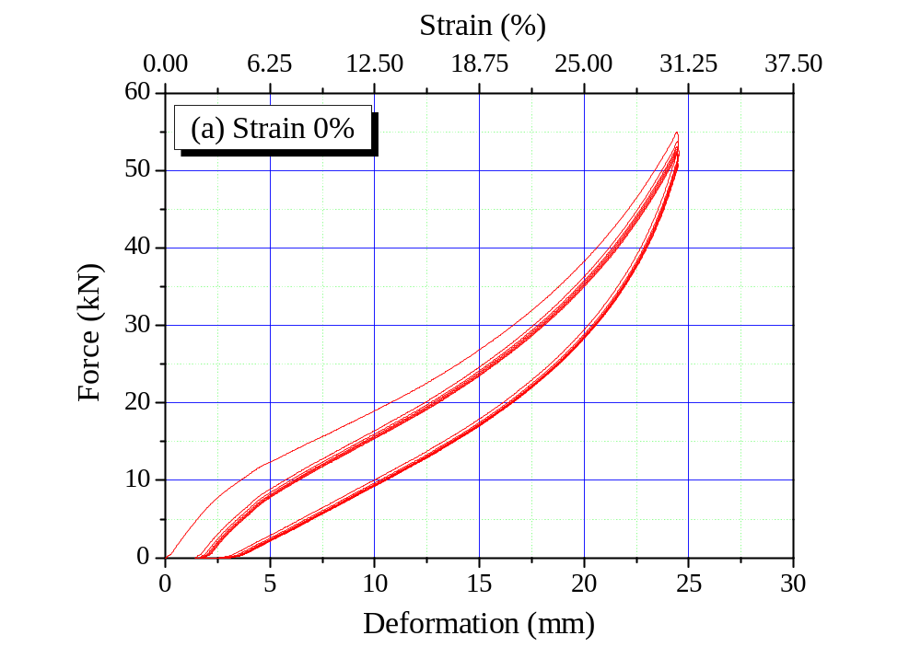
Pre-compressed rubber springs test
Rubber spring’s behavior
  Compression until 25 mm (31.25 % strain)
  Residual deformation : 3.2 mm (4.0% strain)
  Recovery deformation : 2 mm (2.5% strain)
  Remained deformation : 1.2 mm (1.5% strain)
1.2 mm
3.2mm
  The rubber spring should be initially compressed by at least 4.0% strain to prevent a slack behavior during vibrational cycles.
Notes:
Figure shows compressive behavior of a rubber spring until the deformation of 25 mm, which corresponds to a strain of 31.25% (서리원 포인트 투파이브) for the first and second cycles without any pre-compression.
After unloading, the rubber spring retained a residual deformation of 3.2(쓰리 포인트 투) mm (4.0% strain), and 2 mm (2.5% strain) deformation was recovered immediately(이미디엇리).
Thus, 1.2 mm (1.5% strain) deformation remained; it took time to recover this remaining deformation because of the rubber viscosity.
The second cycle started with the deformation of 1.2 mm, but its unloading path followed that of the first cycle.
Based on this observation, the rubber spring should be initially compressed by at least 4.0% strain to prevent a slack behavior during vibrational cycles.

Slide 13
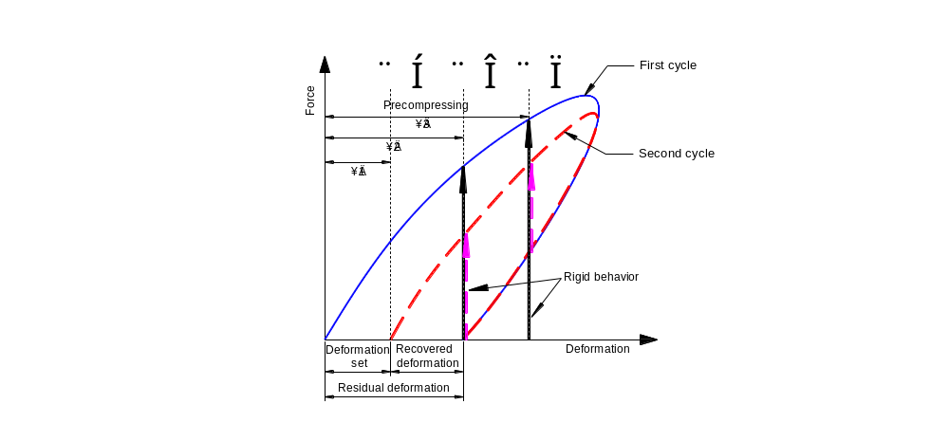
Pre-compressed rubber springs test
Effect of pre-compression
Pre-compression < Δ1
The second cycle begins with a gap.
Δ1 < Pre-compression < Δ2
The deformation set is removed by the pre-compression. But, the recovered deformation remains.
Δ2 < pre-compression
The behavior shows a rigid behavior up to the first loading path hen the unloading stops with remaining force and the curve goes up to the second loading path rigidly.
<Effect of precompression in the rubber spring>
Notes:
I will explain about effect of pre-compression in case 3.
If pre-compression deformation is larger than delta 2, residual deformation is not remained and behavior shows a rigid behavior.
Its rigid behavior provide recentering capacity.

Slide 14
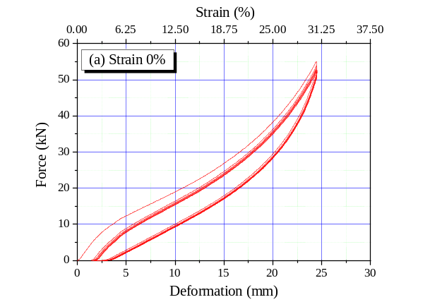
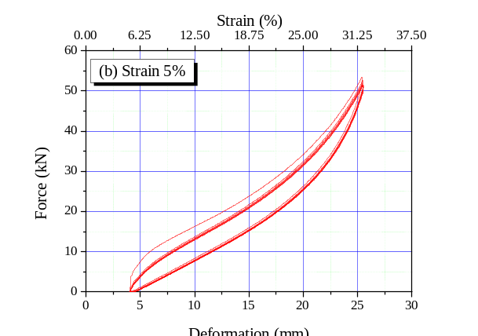
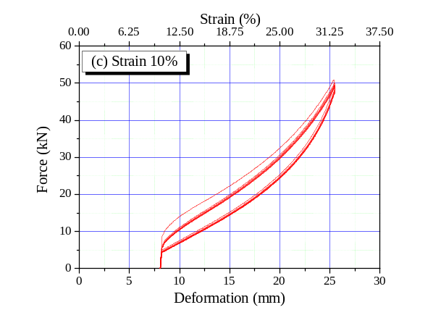
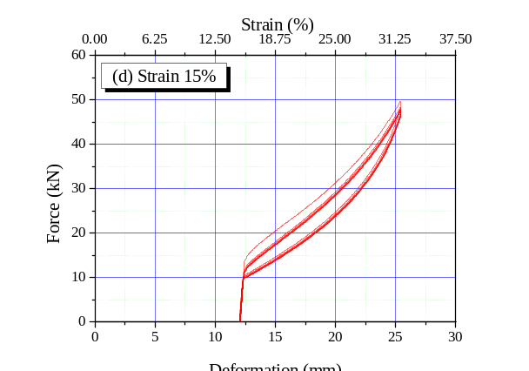
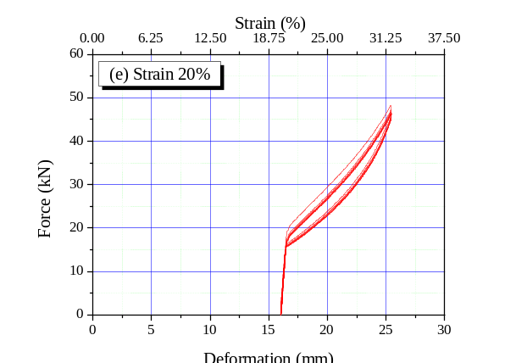
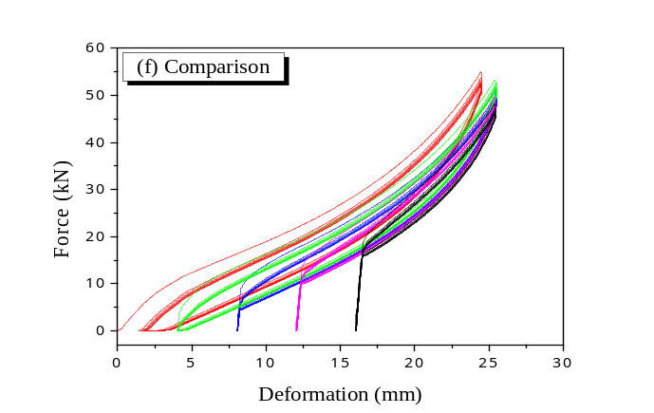
Pre-compressed rubber springs test
Rubber spring’s behavior along with pre-compression
2mm
3.2mm
< Force-deformation curves of the rubber springs >
Notes:
Pre-compressive deformations were introduced with strains from 5%(4mm) to 20%(16mm).
The hysteric behaviors of the pre-compressed rubber springs showed a trend similar to that of uncompressed springs except for initial rigid behavior that force increase vertically without deformation.

Slide 15
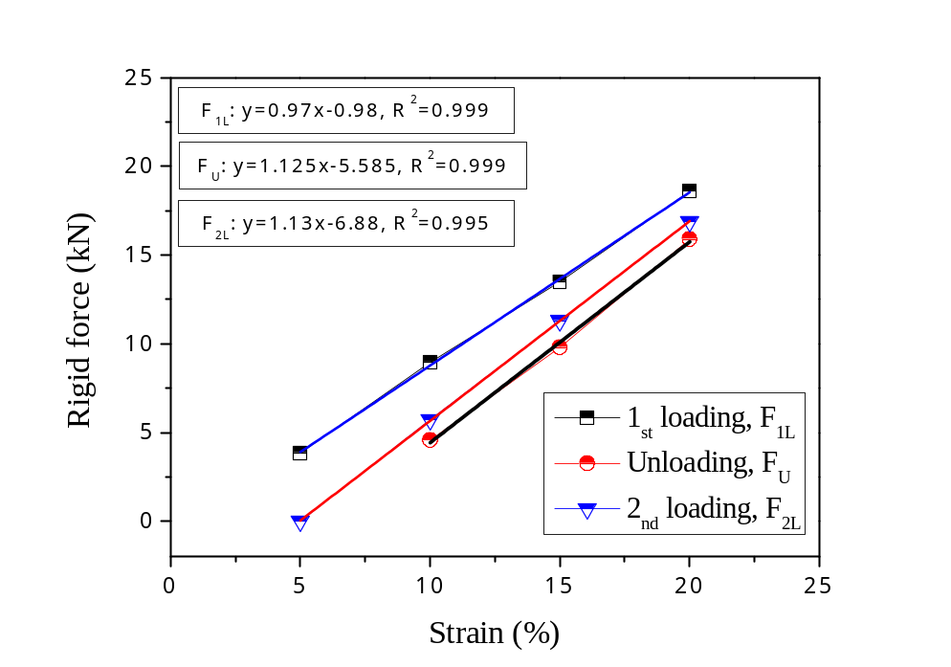

Pre-compressed rubber springs test
Determination of pre-compression strain
  Frictional force for 8 magnets is 4.2 kN.
  From the equation, we obtained the corresponding strain (8.69%)
  In this study, use 10% (8.0 mm deformation) pre-compression strain
Notes:
Before conduction of smart damper test, we must determine pre-compression strain of rubber springs.
Because rubber spring’s unloading path is consistent always, we can set up the equation.
Frictional force for 8 magnets is 4.2 kN.
From the equation, the corresponding strain can be obtained; the value was 8.7% strain.
So, in this study, the pre-compression strain was set as 10% (8.0 mm deformation) conservatively.

Slide 16
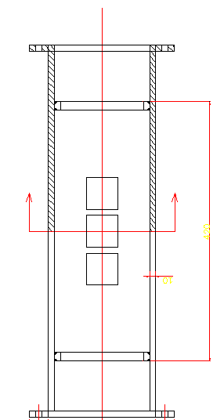
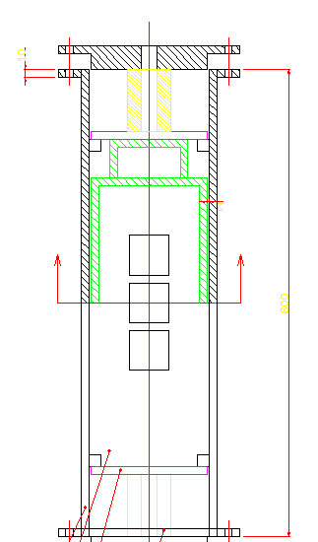
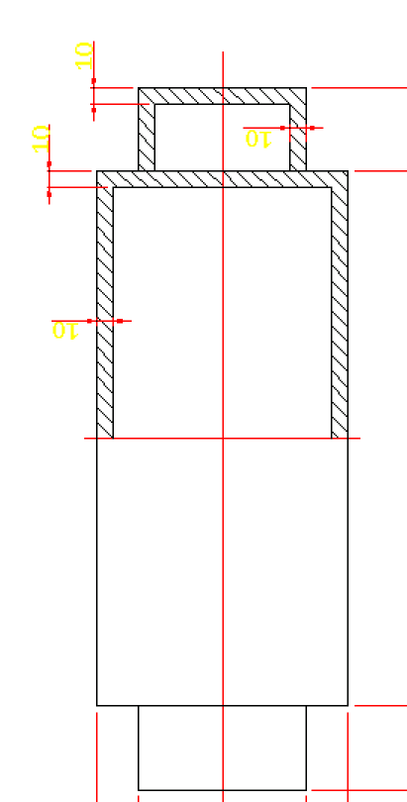
Smart damper dynamic test
Shape of the smart damper
Rubber spring
(a) Drawing of outer cylinder
(b) Drawing of inner piston
(c) Drawing of damper
<Drawing of smart damper>
Notes:
The next chapter, we will discuss the smart damper dynamic test.
The figures show drawing of smart damper.
is outer cylinder (which consists of non-magnetic material that is stainless),
is inner piston (that magnets are attached),
And (c) is drawing of assembled with (a) and (b).
Inner piston operates upward and downward by using UTM. The rubber spring is arranged in the red rectangular box and then inner cylinder compress the rubber.

Slide 17
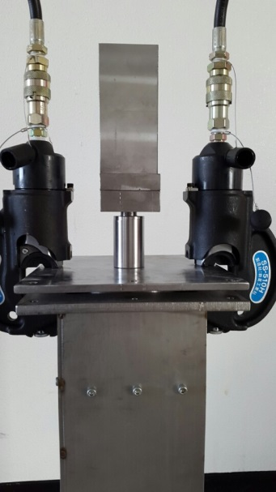
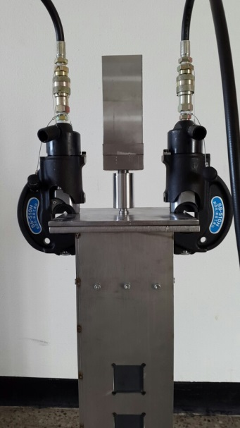
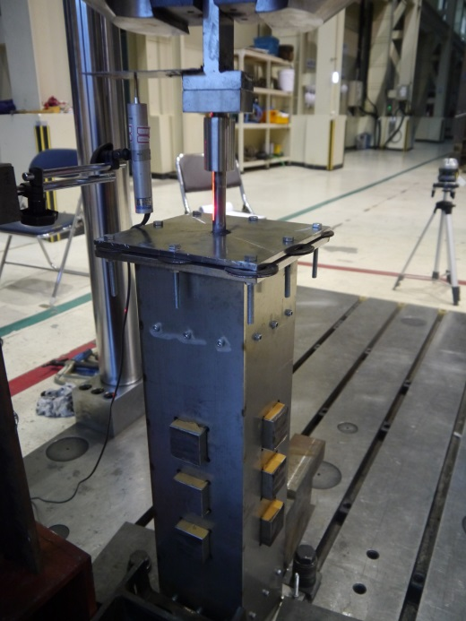
Smart damper dynamic test
Experiment preparation
(a) Before pre-compression
(b) Pre-compression
(c) Dynamic test
<Experiment preparation>
Notes:
This is the real model to conduct the test and experiment preparation(프리페레이션).
(a) Is the picture before rubber pre-compression.
And (b) shows that rubber is pre-compressed by compressure acting on 2 plates.
Picture © represents dynamic test operation.
Dynamic UTM grib the damper’s zig that is in the red circle and operates up and down.
In the white circle, the holes are part for magnets that adhere to inner piston.
(Between inner piston and magnets, strong magnetic force 800N occur. So, it induces the friction between piston and magnets.)
(A displacement transducer was installed at the shaft of the top based on the base-plate, and a load-cell measured applied force.)

Slide 18
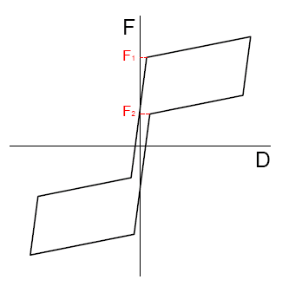
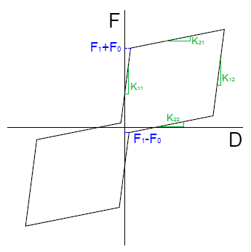
Smart damper dynamic test
Determination of pre-compression strain
Rigid force for self-centering > Frictional force
  Return to the origin position
Rigid force for self-centering < Frictional force
  Remain residual displacement
Notes:
This part will discuss the determination of pre-compression strain.
In case of rigid force for self-centering is larger than frictional force, there return to the origin position.
In the reverse, there would be remain residual displacement.

Slide 19
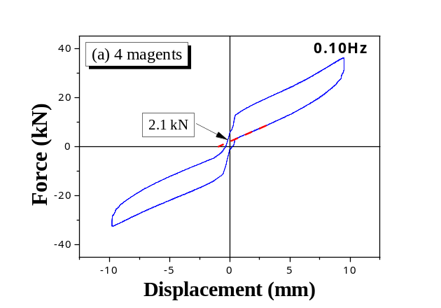
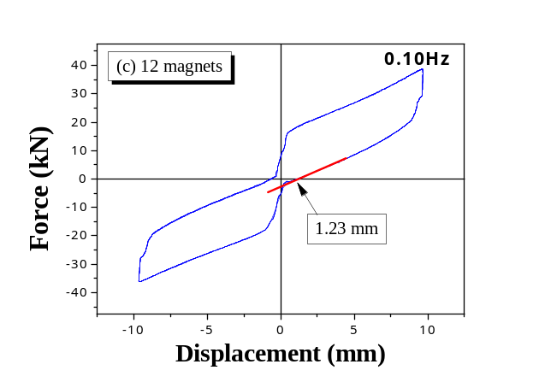
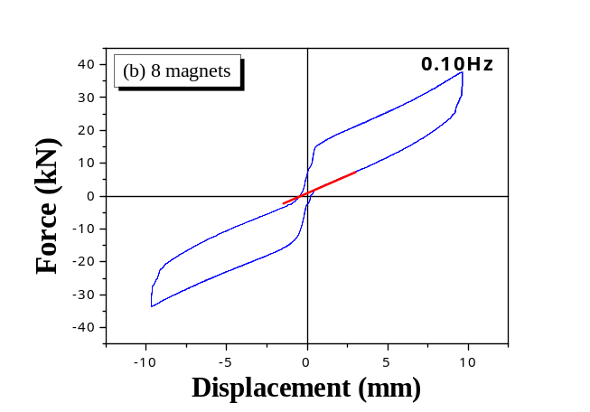
Smart damper dynamic test
Determination of pre-compression strain
4 magnets
12 magnets
Remained rigid force
(2.1 KN)
Residual displacement
(1.23 mm)
8 magnets
  Return to the origin position
  The unloading rigid force of the pre-compressed rubber spring should be greater than the magnetic friction.
Notes:
For experimental tests, With 4 magnets, there is a remaining rigid force. 2.1KN.
And with 12 magnets, there would be remaining residual deformation. 1.23mm.
In the particular case with 8 magnets and 10% pre-compression strain, the damper would return to the initial position.
(The damper with 8 magnets would almost pass through the origin during unloading.)
Thus, in this study, the unloading rigid force of the pre-compressed rubber spring should be greater than the magnetic friction.

Slide 20
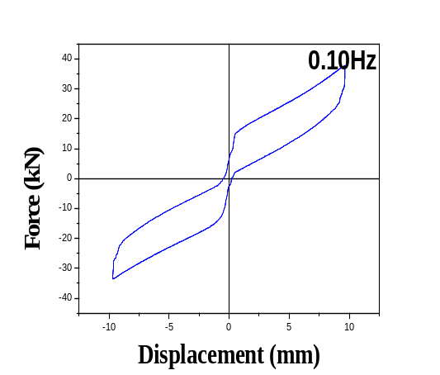

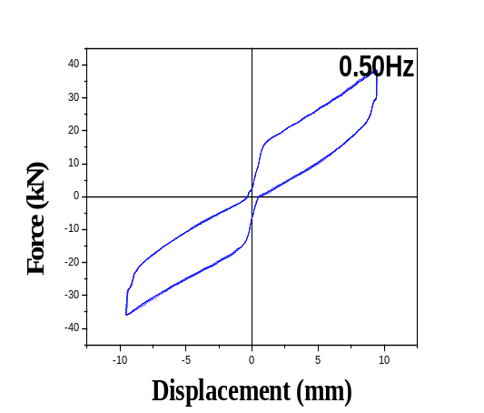
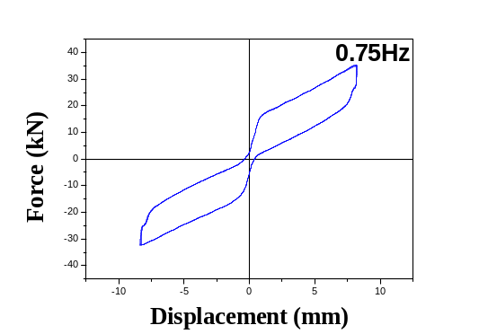
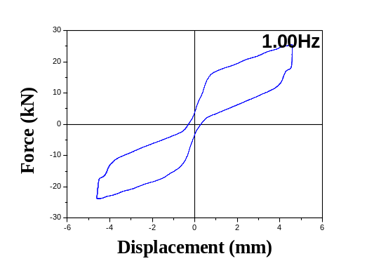
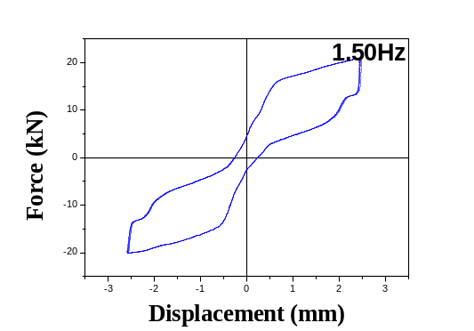
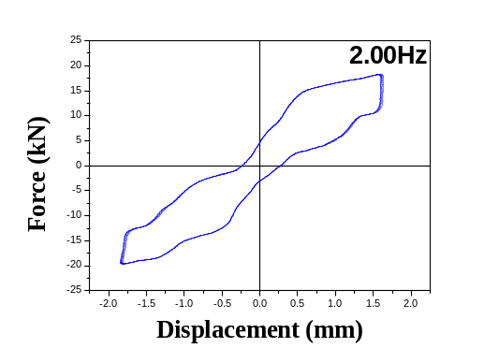
Smart damper dynamic test
Results of vibration tests (8 magnets)
<Graph of symmetric behavior along with frequency>
Notes:
The pre-compression strain of the rubber was fixed at 8%(10mm).
The figures show the hysteretic curves of the dampers with variation of the frequency.
(In the figures, positive area represents downward pushing action, and opposite area shows upward pulling action.)
(And the interesting point is the initial loading paths. The initial loading paths were not perfectly rigid because the pre-compressed rubber springs showed slight deformation in the rigid region.)
From the results, we can get hysteretic curve as expected.
Additionally, We know that hardening stiffness of the damper increased with increasing loading frequency
and decreased with increasing frictional force.

Slide 21
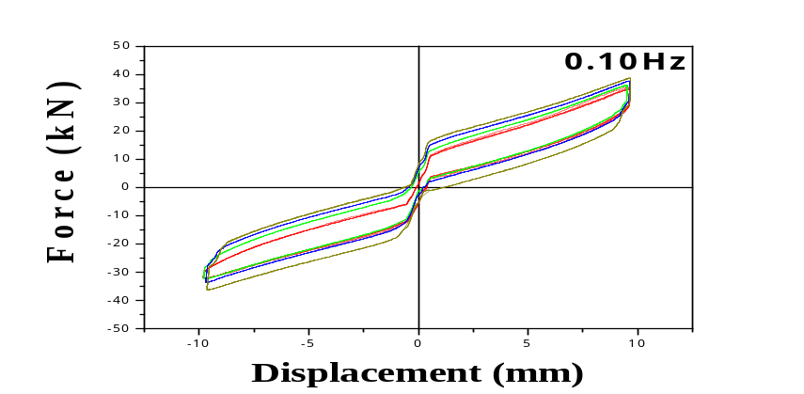



Smart damper dynamic test
Symmetric behavior of the smart damper
<Comparison with symmetric behavior>
Notes:
It is figure that represent symmetric behavior along with magnets number.
The red line is behavior of damper with non-magnet.
You can see the tendency(텐던시) that force increase depending on changing the number of magnets from 4 to 12.

Slide 22

Smart damper dynamic test
Damping ratios of the hysteretic curves
Frequency (Hz) | No. of magnets
 | 0 | 4 | 8 | 12
0.1 | 3.19 | 4.04 | 5.32 | 6.55
0.25 | 2.51 | 3.93 | 5.21 | 6.91
0.5 | 2.90 | 4.06 | 5.40 | 7.21
0.75 | 2.51 | 4.16 | 6.16 | 7.81
Average | 2.78 | 4.05 | 5.52 | 7.12
1.0 | 3.28 | 4.96 | 6.85 | 8.76
1.5 | 3.63 | 6.16 | 9.02 | 11.62
2.0 | 3.53 | 6.32 | 10.24 | 13.41
  Damping ratios seemed not to increase with increasing loading frequency.
  Damping ratio increased almost linearly with an increasing number of magnets.
< Damping ratio according to frequency and No. of magnets (%) >
Notes:
The damping ratios of the hysteretic curves can be calculated as equation.
(where E(sub)d and E(sub)so are dissipated and elastic energy, respectively. )
The damping ratios in Table seemed not to increase with increasing loading frequency.
(1 click) After the loading frequency of 1 Hz, the increment of the damping ratios was caused by the relatively small strokes.
Furthermore(펄더모얼), the damping ratio increased almost linearly with an increasing number of magnets.
(2 click) Thus, the average damping ratio without magnets was 2.78% up to the test of 0.75 Hz, and the value increased to 7.12% with 12 magnets,
which is 2.6 times the value without magnets.

Slide 23
Smart damper dynamic test
Asymmetric behavior of the smart damper
(the proposed smart damper can easily produce asymmetric behavior with the removal one rubber spring)
  The damper will provide only friction in one direction and friction plus rubber spring force in the opposite direction.
  Asymmetric damper would be useful for structures or systems that have resisting capacities that vary according to direction.
  For a bridge, abutments generally have strong resisting capacity in passive action (pushing) but relatively small resistance in active action (pulling).
Notes:
Additionally, the proposed smart damper can easily produce asymmetric behavior with the removal of one rubber spring.
Then, the damper will provide only friction in one direction and friction plus rubber spring force in the opposite direction.
This type of damper would be useful for structures or systems that have resisting(리지스팅) capacities that vary according to direction.
For a bridge, abutments generally have strong resisting(리지스팅) capacity in passive action (pushing) but relatively small resistance in active action (pulling).

Slide 24




Smart damper dynamic test
Asymmetric behavior of the smart damper
<Asymmetric behavior of the smart damper>
Notes:
There are the results about asymmetric behavior.
It is useful for various civil structures.
In this case, large developed force in active action can induce damage in the abutment; therefore, relatively small force is required in the active action.
However, for the passive action, relative large developed force that can be resisted by the passive action is helpful to reduce the deck movement of the bridge. So, these asymmetric behavior is useful to solve that problems.

Slide 25

Conclusion
This study proposed a new concept of a smart damper using pre-compressed rubber springs and magnetic friction. The performance of the magnets and pre- compressed rubber springs was verified through the dynamic.
The damper with only rubber springs of 8% strain pre-compression excluding magnetic friction showed flag-shaped behavior; thus, the damper provided self-centering capacity and energy dissipation with a damping ratio of 2.7%.
Additionally, the proposed damper can be used to support or control vibration of pipes in power plants and also it may be applied to structural parts such as beam-column-connections and bracing in moment frames because inexpensive materials is used, its mechanism is relatively simple, and prove that it provide self-centering and energy dissipation.
Notes:
In conclusion,
This study proposed a new concept of a smart damper using pre-compressed rubber springs and magnetic friction.
The performance of the magnets and pre- compressed rubber springs was verified through(또로우) the dynamic.
The damper with only rubber springs of 8% strain pre-compression excluding magnetic friction showed flag-shaped behavior; thus, the damper provided self-centering capacity and energy dissipation with a damping ratio of 2.7%.
Additionally, the proposed damper can be used to support or control vibration of pipes in power plants
and also it may be applied(어플라이드) to structural parts such as beam-column-connections and bracing in moment frames
because inexpensive materials is used,
its mechanism(매캐니즘) is relatively simple, and prove that it provide self-centering and energy dissipation.

Slide 26
Thank you for your attention
Acknowledgement
This work was supported by a National Research Foundation of Korea (NRF) grant funded by the Korean government (MSIP) (Project No. 2015-041523).
Notes:
Thank you for your attention.

