Slide 1


differences in cytokine concentrations in maternal serum and umbilical cord blood may be related to placental transfer control mechanisms
Estibalitz Laresgoiti-Servitje, MD MSc PhD
National Institute of Perinatology, Mexico
Tecnológico de Monterrey, Mexico
IMMUNOLOGY SUMMIT 2015, Houston TX

Slide 2
Introduction
Cytokine placental transfer is very important because some cytokines (especially IL-6) have been associated with fetal inflammatory response syndrome, which in term may condition adverse neurological outcomes.
Trans-placental passage of cytokines has also been thought as a possible mechanism by which maternal asthma could increase asthma susceptibility in the newborn.
Recently, there is and increased interest regarding the role of maternal cytokines on immunologic and endocrine programming of the fetus.

Slide 3
Cytokine placental transfer
While some studies refer that pro inflammatory cytokines do not cross normal term placenta, other studies have shown that trans-placental passage of certain cytokines occurs.
  Not all cytokines are transferred equally.
Gestational age may affect cytokine trans-placental passage
  Studies on this matter are still lacking.

Slide 4
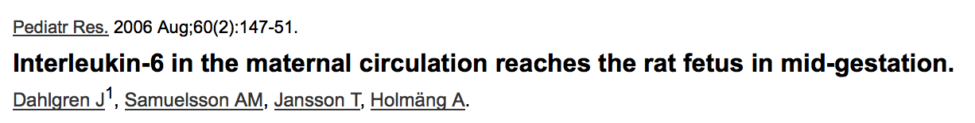
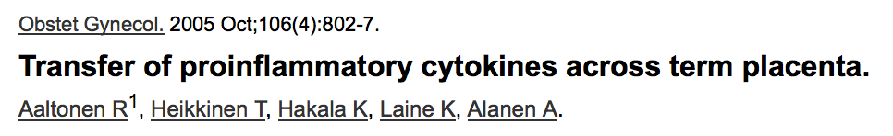
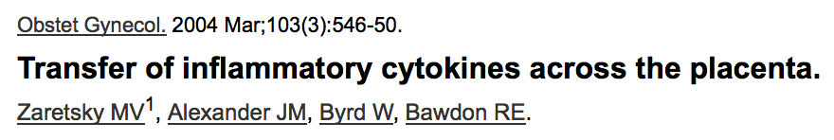
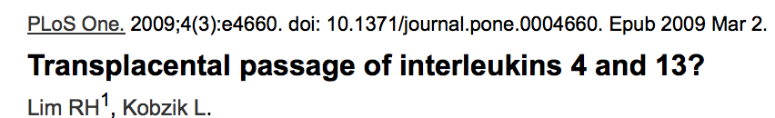
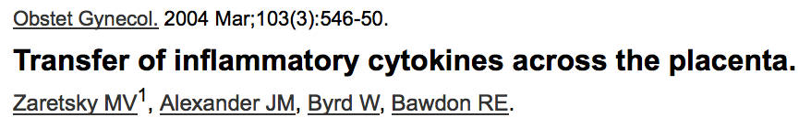
Which cytokines?
TNF- alpha and IL-1 have minimal placental transfer
IL-4, IL-8 and IL-13 do not cross the placenta in detectable amounts
Transfer of IL-6 appears to be bidirectional
Studies in rats indicate that IL-6 permeability may be higher in mid-gestation compared to late pregnancy and may be potentially harmful to the fetus

Slide 5
Maternal factors that could affect maternal cytokine concentrations and, potentially, placental transfer: maternal obesity
Maternal obesity has been linked to placental oxidative stress and inflammation (MAPK-JNK activation).
It has also been related to an increased risk in asthma rates in the offspring, which may be promoted by immune system regulation early in life
Saben. Placenta 2014
Rizzo. Paediatric Respiratory Reviews 2015

Slide 6
Placental factors that could affect cytokine transfer
Damaged placentas may be permeable to cytokines
In order to decrease the probability of altered cytokine permeability, only patients with normal pregnancies and no placental disorders were included in this study

Slide 7
Objectives
Evaluate differences in cytokine concentrations between maternal serum samples and umbilical cord samples
Evaluate differences in serum cytokine concentrations between normal weight and overweight mothers
Evaluate differences in cytokine concentrations in babies born from normal weight and overweight mothers

Slide 8
Methods
Thirty-four pregnant women were included in this study after being admitted at the Labor and Delivery Unit of the National Institute of Perinatology.
All participants had single non-complicated pregnancies and did not receive any medication during the 3 weeks prior to pregnancy termination. Immediately after delivery, maternal blood was obtained by venipuncture and fetal blood was obtained from the umbilical artery.
Clinical and demographic data was obtained from clinical records.

Slide 9
Methods
Cytokine concentrations were measured in maternal and umbilical blood serum samples using a 27 plex-panel cytokine assay from Bio-Plex (BioRad).
  IL1B
  IL-1Ra
  IL-2
  IL-4
  IL-5
  IL-6
  IL-7
  IL-8
  IL-9
  IL-10
  IL-12
  IL-13
  IL-15
  IL-17
  PDGF
  Eotaxin
  FGF
  G-CSF
  GM-CSF
  IFN-gamma
  IP-10
  MCP-1
  MIP-1a
  MIP-1b
  RANTES
  TNF-alpha
  VEGF

Slide 10
Results
 | Maternal sample Mean (SD) n=34 | Umbilical cord sample Mean (SD) n=34 | Mean Differences (CI 95%)* | p
PDGF | 748.24 (644.7) | 1290.2 (834.5) | -542.04 (-884.6, -199.4) | 0.003
IL-1RA | 152.56 (76.4) | 104.96 (48.4) | 47.60 (14.39, 80.82) | 0.006
IL-4 | 2.89 (1.6) | 3.66 (1.5) | -0.769 (-1.51, -0.02) | 0.045
IL-6 | 10.17 (4.9) | 5.41 (2.33) | 4.75 (2.96, 6.55) | 0.000
IL-7 | 4.05 (1.83) | 15.26 (14.1) | -11.21 (-16.31, -6.11) | 0.000
IL-12 | 0.25 (0.42) | 1.84 (2.5) | -1.59 (-2.47, -0.72) | 0.001
IL-13 | 3.64 (2.61) | 2.64 (1.40) | 1.00 (0.03, 1.97) | 0.043
IL-17 | 1.00 (1.45) | 4.09 (4.57) | -3.09 (-4.75, -1.42) | 0.001
Eotaxina | 5.22 (9.89) | 83.37 (80.2) | -78.15 (-105.4, -50.88) | 0.000
GCSF | 37.85 (15.56) | 63.92 (35.1) | -26.06 (-40.44, -11.69) | 0.001
GMCSF | 0.773 (1.06) | 63.92 (35.14) | -32.26 (-43.17, -21.36) | 0.000
IP-10 | 992.6 (368.7) | 531.65 (231.2) | 460.95 (314.04, 607.88) | 0.000
MCAF | 9.82 (4.85) | 33.44 (24.47) | -23.61 (-31.71, -15.51) | 0.000
RANTES | 1532.9 (362.0) | 3872.4 (2959.8) | -2339.43 (-3349, -1329) | 0.000
VEGF | 0.89 (1.11) | 8.02 (6.41) | -7.12 (-9.40, -4.84) | 0.000
Differences between maternal and newborn cytokines (pg/ml)
Paired-samples student t test

Slide 11
Results
Paired-samples student t test
No significant differences were found for theses cytokines between maternal and newborn samples:
  IL1B
  IL-2
  IL-5
  IL-8
  IL-9
  IL-10
  il-15
  FGF
  IFN-gamma
  MIP-1a
  MIP-1b
  TNF-alpha

Slide 12
Results
  Lower concentration in maternal serum compared to newborn
PDGF
IL-4
IL-7
IL-12 (p70)
IL-17
EOTAXIN
G-CSF
GM-CSF
MCAF
Paired-samples student t test
  Higher concentration in maternal serum compared to newborn
IL-1Ra (IL-1 receptor antagonist)
IL-6
IL-13
IP-10 (Interferon-gamma inducible protein 10)

Slide 13
Results
Plasmatic levels (pg/mL) | Maternal sample Mean (SD) n=34 | Umbilical cord sample Mean (SD) n=34 | Mean Differences (CI 95%)* | According Maternal BMI Maternal blood vs cord blood samples Mean differences (CI 95%)†
 |  |  |  | BMI>25 Pregestational n=20 | BMI≤25 Pregestational n= 14
PDGF | 748.24 (644.7) | 1290.2 (834.5) | -542.04 (-884.6, -199.4) | -255.1 (-714, 204) | -951* (-1446, -457)
IL-1RA | 152.56 (76.4) | 104.96 (48.4) | 47.60 (14.39, 80.82) | 51.38* (4.45, 98.3) | 42.2 (-10.2, 94.6)
IL-4 | 2.89 (1.6) | 3.66 (1.5) | -0.769 (-1.51, -0.02) | -0.29 (-1.29,0.70) | -1.45* (-2.63, 0.27)
IL-6 | 10.17 (4.9) | 5.41 (2.33) | 4.75 (2.96, 6.55) | 3.58* (1.4, 5.7) | 6.43* (3.23, 9.63)
IL-7 | 4.05 (1.83) | 15.26 (14.1) | -11.21 (-16.31, -6.11) | -11.1* (-18.0, -4.2) | -11.32* (-19.9, -2.71)
IL-10 | 1.55 (0.60) | 1.39 (0.53) | 0.15 (-0-11, 0.43) | 0.05 (-0.37, 0.4) | 0.31 (-0.04, 0.66)
IL-12 | 0.25 (0.42) | 1.84 (2.5) | -1.59 (-2.47, -0.72) | -1.6* (-3.0, -0.2) | -1.49* (-2.55, -0.43)
IL-17 | 1.00 (1.45) | 4.09 (4.57) | -3.09 (-4.75, -1.42) | -2.7* (-4.9, -0.5) | -3.60* (-6.44, -0.76)
Eotaxina | 5.22 (9.89) | 83.37 (80.2) | -78.15 (-105.4, -50.88) | -80.1* (-120, -39.6) | -75.35* (-114.4, -36.3)
FGF | 0.774 (3.84) | 1.38 (1.94) | -0.61 (-2.18, 0.95) | 0.26 (-2.3, 2.8) | -1.85* (-3.03, -0.68)
GCSF | 37.85 (15.56) | 63.92 (35.1) | -26.06 (-40.44, -11.69) | -19.8 (-39, 0.36) | -35.02* (-56.9, -13.0)
GMCSF | 0.773 (1.06) | 63.92 (35.14) | -32.26 (-43.17, -21.36) | -31.6* (-45.9, -17.2) | -33.22* (-52.4, -13.9)
IFN γ | 88.85 (38.6) | 73.48 (32.13) | 15.37 (-0.82, 31.56) | 25.4* (2.6, 48.2) | 1.04 (-22.2, 24.3)
IP-10 | 992.6 (368.7) | 531.65 (231.2) | 460.95 (314.04, 607.88) | 515.1* (295, 734) | 383.5* (184, 582)
MCAF | 9.82 (4.85) | 33.44 (24.47) | -23.61 (-31.71, -15.51) | -24.7* (-36.9, -12.5) | -21.9* (-33.1, -10.8)
RANTES | 1532.9 (362.0) | 3872.4 (2959.8) | -2339.43 (-3349, -1329) | -2358.6* (-3789, -927) | -2311* (-3903, -720)
TNFα | 5.87 (6.43) | 8.78 (7.9) | -2.90 (-6.37, 0.57) | -3.1 (-8.0, 1.7) | -2.55* (-12.18, -5.64)
VEGF | 0.89 (1.11) | 8.02 (6.41) | -7.12 (-9.40, -4.84) | -5.8* (-9.1, -2.6) | -8.91* (-12.1, -5.64)
Differences between maternal and newborn cytokines, considering pre-gestational BMI (pg/ml)
Paired-samples t test
†Mothers compared to
newborns
*p<0.05

Slide 14
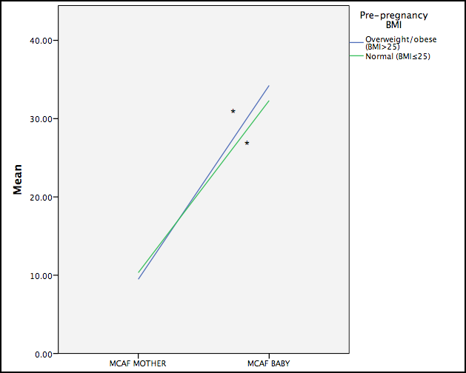
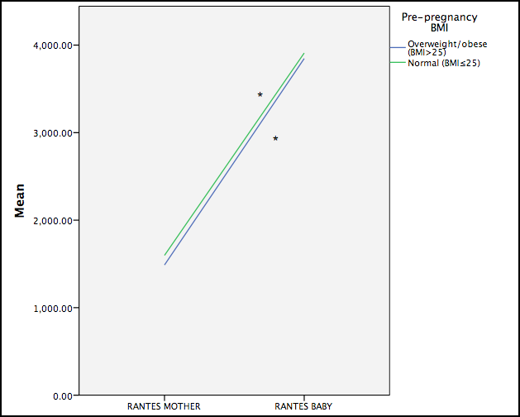
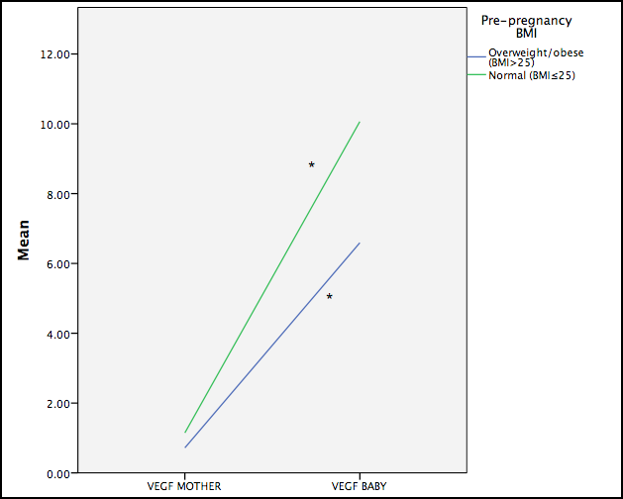
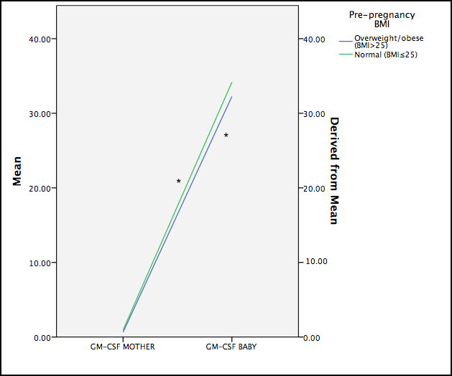

Slide 15
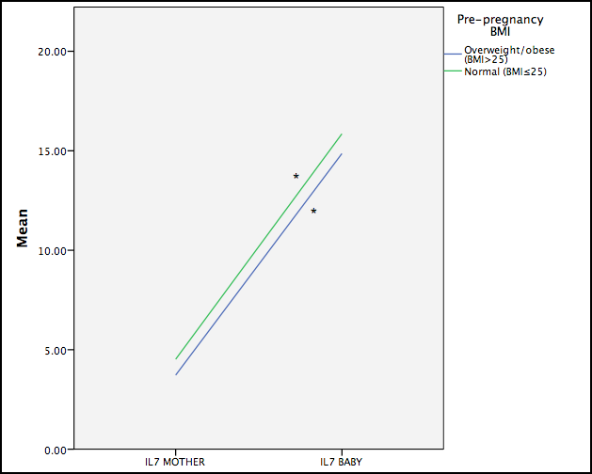
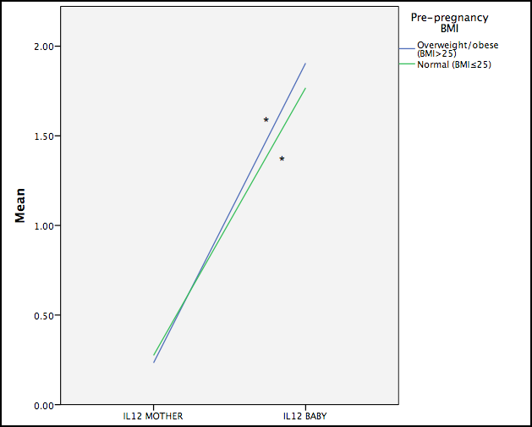
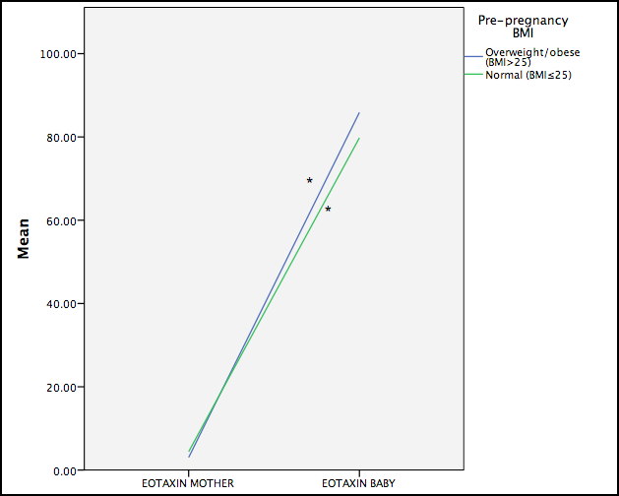
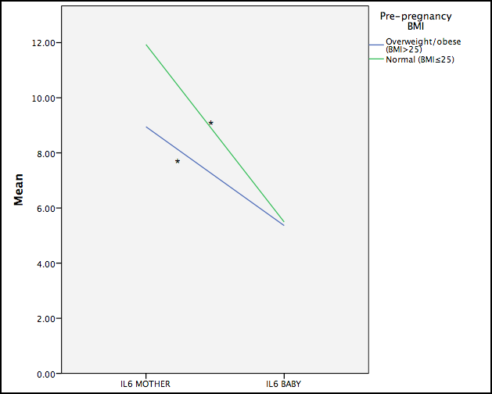

Slide 16
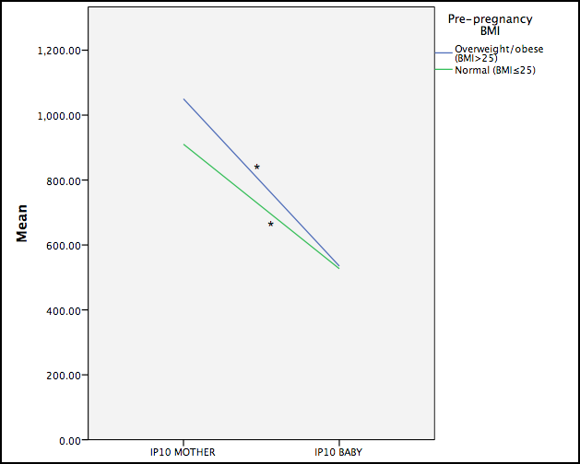

Slide 17
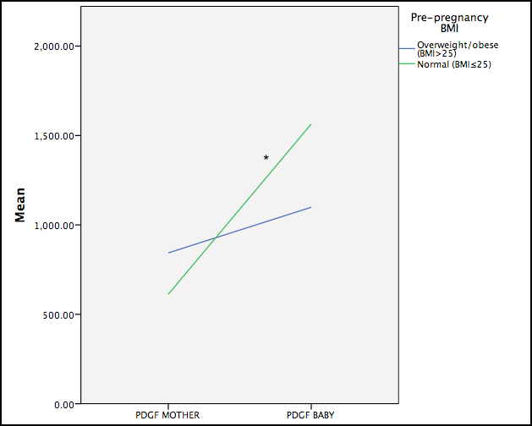
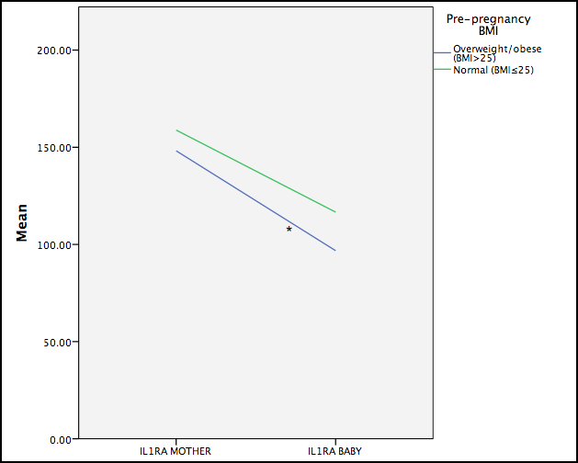
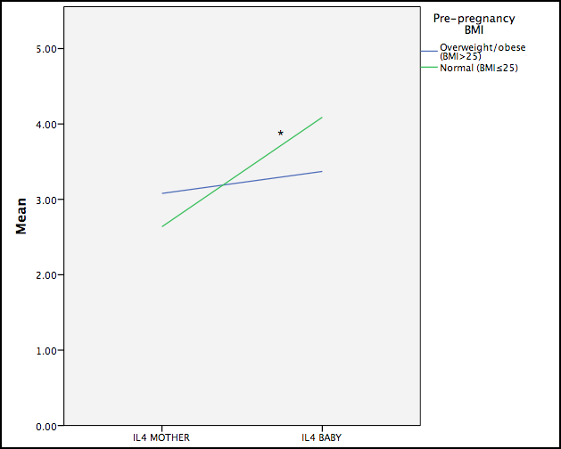
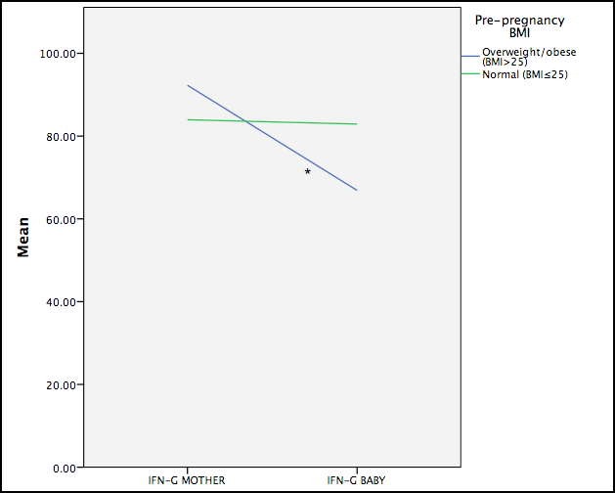

Slide 18
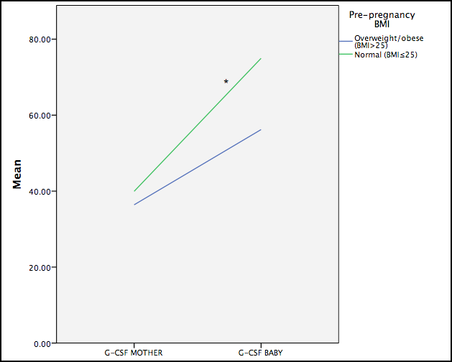
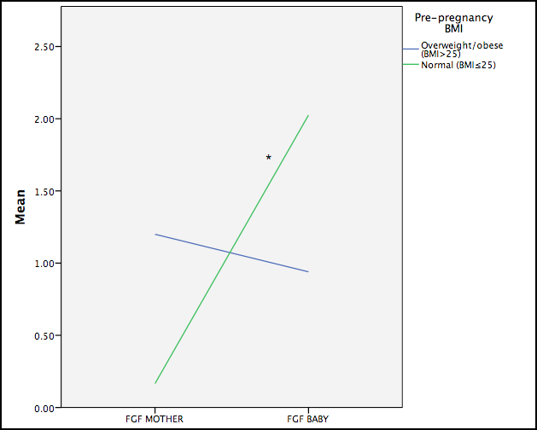

Slide 19
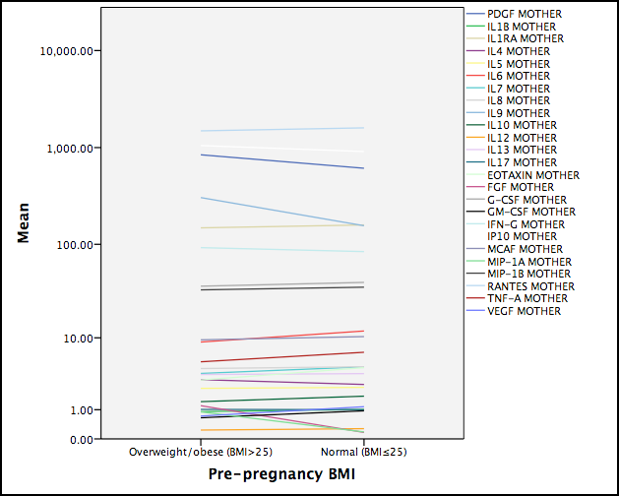
Results
Differences in cytokines concentrations in normal and overweight/obese mothers
Independent samples student t test
No significant differences were found for any cytokine

Slide 20
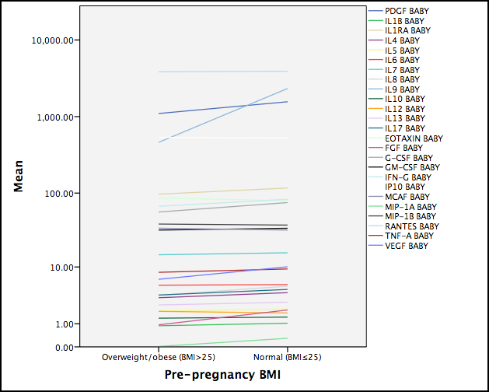
Results
Differences in cytokines concentrations in babies born from normal and overweight/obese mothers
Independent samples student t test
No significant differences were found for any cytokine

Slide 21
Conclusions
Cytokine serum concentrations are similar among normal and overweight pregnant women and among babies born from normal and overweight mothers
Significant differences were found in the concentrations of several cytokines between maternal serum and cord blood samples
Cytokine concentrations of PDGF, IL1Ra, IL-4, FGF and G-CSF between mother and newborn were not significantly different in both BMI groups (normal and overweight mothers)

Slide 22
Conclusions
Cytokines with higher concentrations in maternal serum that are not reflected as increased in the newborn are IL-1Ra, IL-6, IL-13, IP-10
  Lower IL-1ra, IL-6 and IL-13 in the newborn is noteworthy.
This findings are similar to those reported by other authors and may reflect cytokine transfer control mechanisms during pregnancy.
The placenta is clearly an important mediator of the maternal-fetal cytokine exchange.

Slide 23
Collaborators
Dr. Maria Hernandez-Trejo (Principal researcher)
Dr. Aurora Espejel-Nuñez

Slide 24
Thank you!

