Slide 1
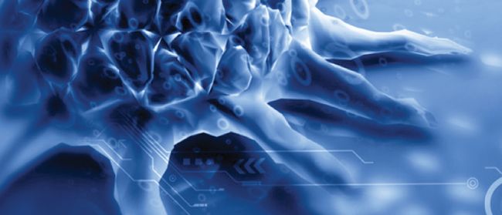



Human secretory RNases as multifaceted antimicrobial proteins
Ester Boix
Notes:
First of all I want to thank the organizers for inviting me to this meeting. My name is Ester Boix and I am working at the UAB,. Here you can see Barcleona skyline, eith Guadi’sagrada familia, and our university which is located just behind the mountains. Today I am going to talk on the structural elements of human antimicrobial RNases, as innate immunity players.

Slide 2
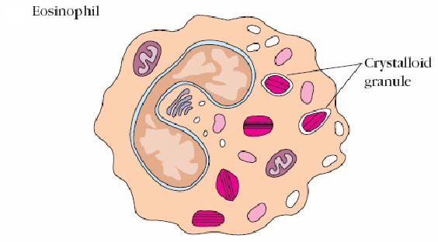
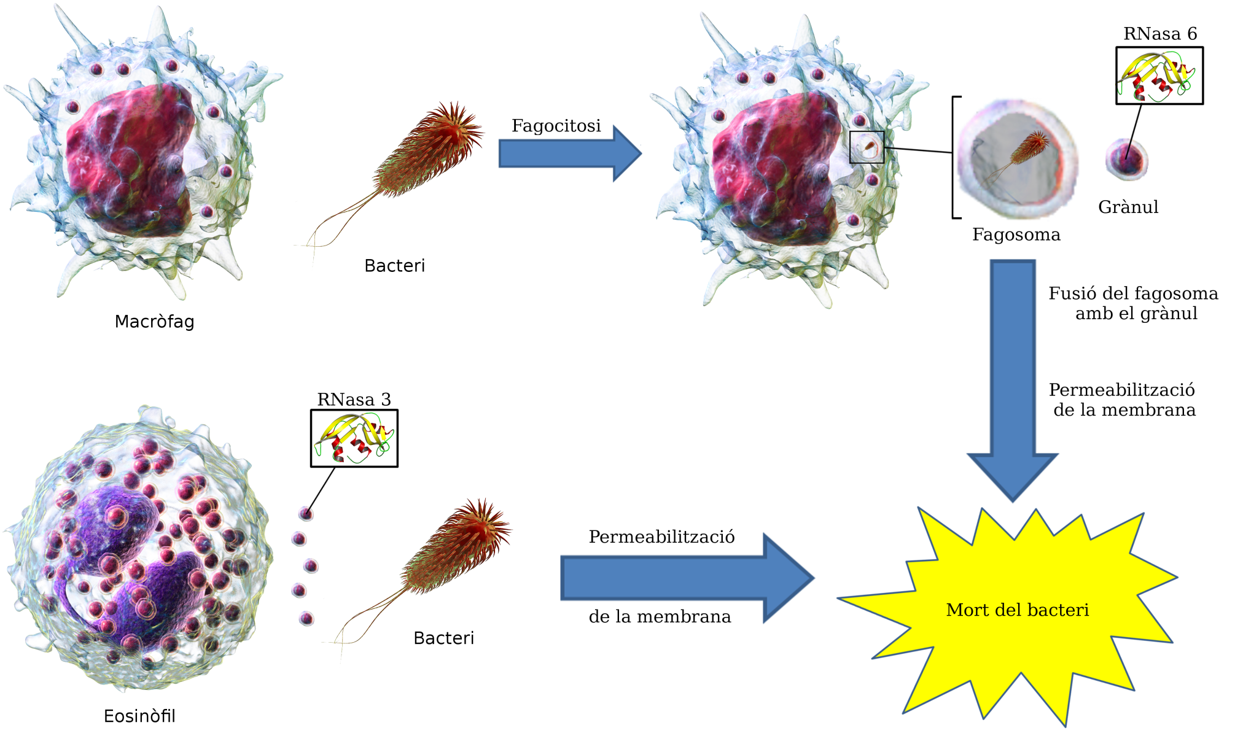
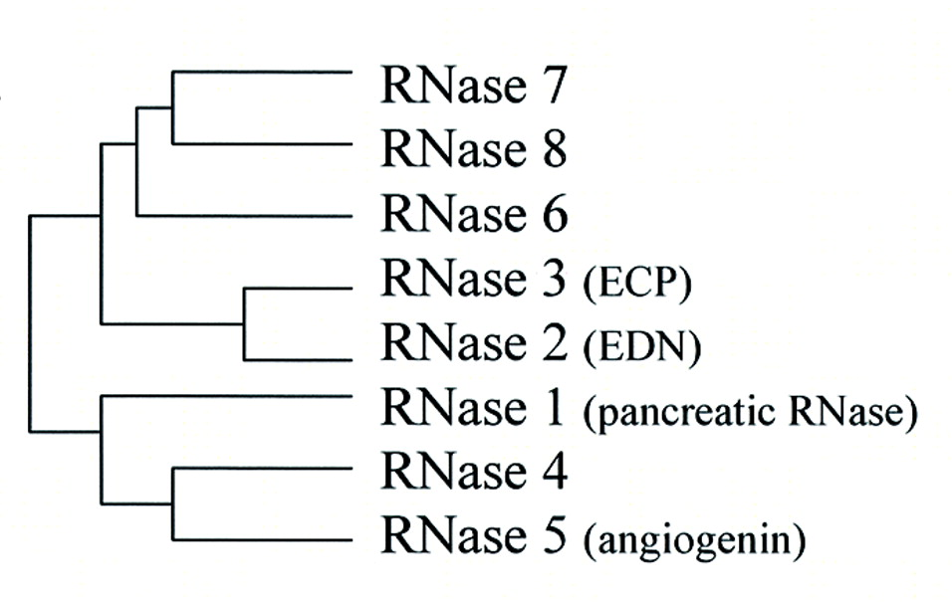
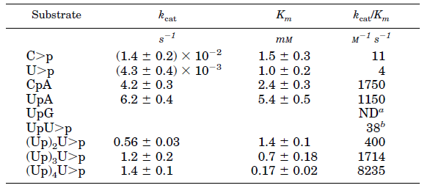
Human secretory RNases
Zhang et al. PNAS 2002
Boix et al. JBC 1999
Notes:
Human secretory rnases are small cationic proteins, with cytotoxic properties secreted by innate cells (epithelial and blood cell types), We have been working during more than 20 years on rnases and have applied structural –functional studies for several of the family members. In Humans we find 8 functional members. We find rnases secreted by epithelial cells, like th skin derived rnase (rnase 7), or by blood cell type, like rnase 2 and 3, secreted by the eosinophil granule and also called eosinophil cationic protein and eosinophil derived neurotoxin. Then we have rnase 6, expressed in neutrophils and macrophages. All these RNase are small cationic proteins with cytotoxic properties. Indeed some of them have other complementary porperties, as angiogenin, promoting angiogenesis. Also we can find them secreted into the extracelular media, as rnase 8, which is abundant in the placenta.
Our group has been working on this protein family for a long time. Coming from a enzymology background we have analysed first the protein catalytic activity on different nucleotide substratesBut before speaking about our results I would like to introduce the reference family member, which is the bovine pancreatic rnase

Slide 3
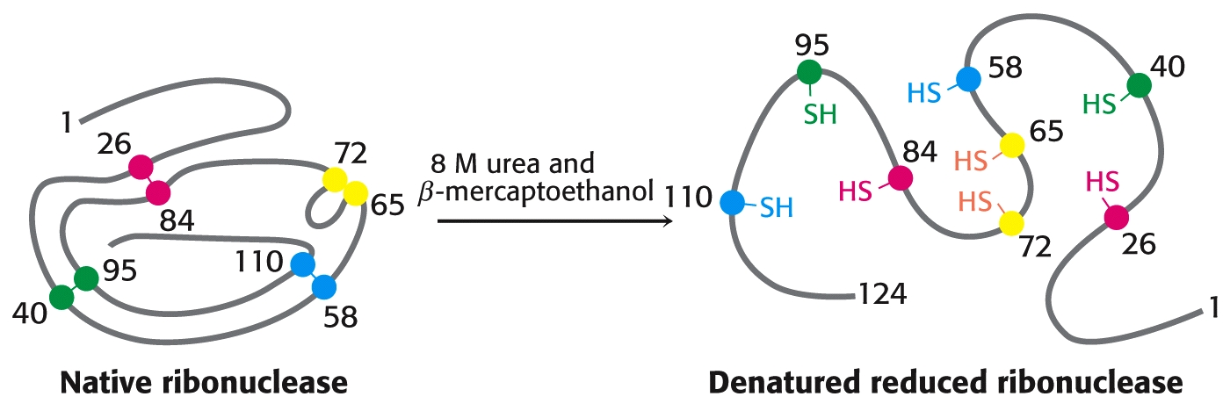
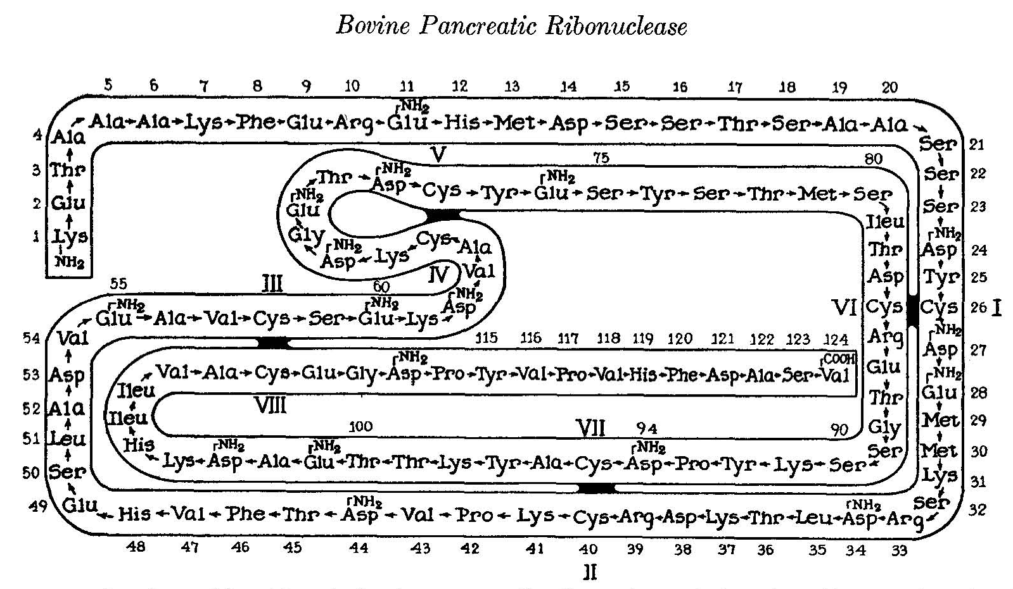
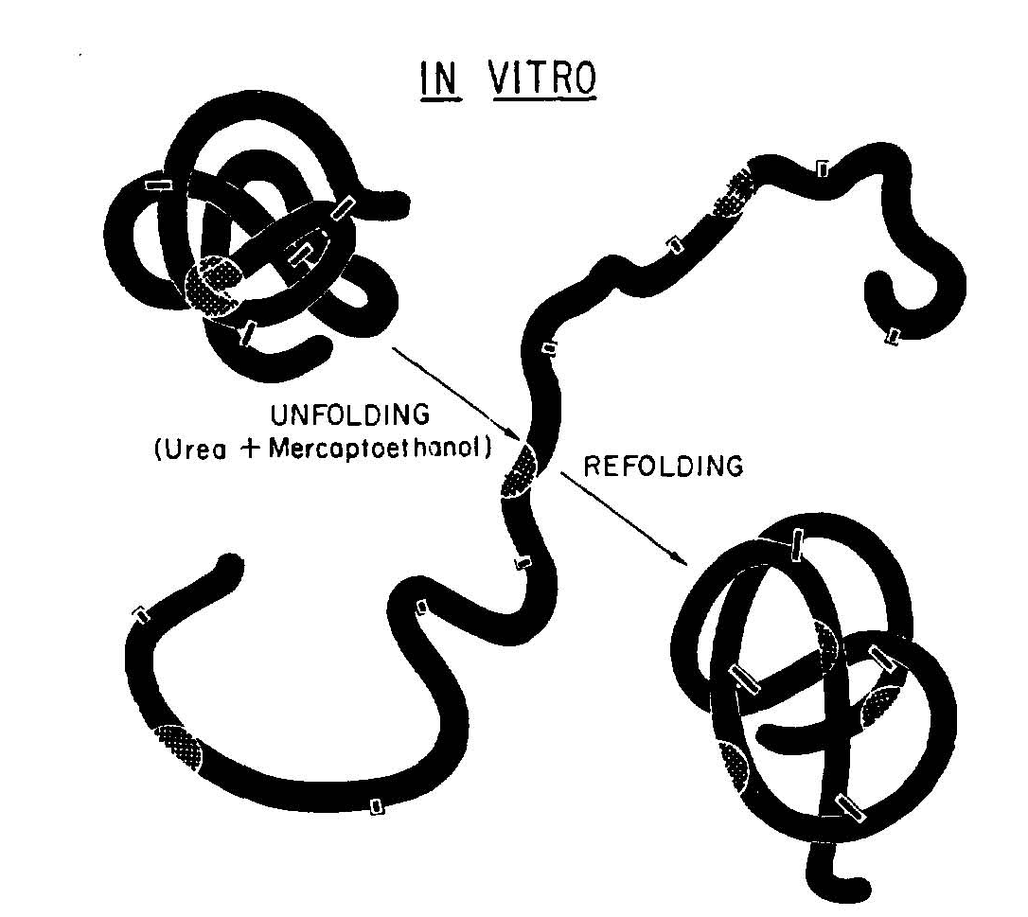
RNase A, the best studied enzyme
Christian Anfinsen. Nobel Lecture (1972).
Bruce Merrifield. Nobel Lecture (1984).
Notes:
Probably you are familiiar with this protein, which is found in most graduate students text books. the RNase A, whihc is probably one of the best studied enzyme during the XX century.
RNase A refers to the bovine pancreatic RNase, one of the first enzymes discovered (1920) and crystallized (1939). The enzyme was easily obtained from bovine pancreas at slaughterhouses and at the beginning of the 40’, 1 kg of purified protein was obtained and made available for researchers. Its abundance, small molecular weight and high stability converted this protein in one of the predilected for biochemists in early XX century.
It was the first enzyme whose primary structure was known, and in 1972, three nobel prizes were awarded for their work.
Christian Anfinsen was the first to relate the aminoacid sequence of a protein with the final three dimensional structure., showing how the denatured protein could recover by itself the 3D when removing the presence of the denaturing agent
Later, in 1984 Bruce Merrifield was awarded the Nobel Prize for the synthesis of the first polypeptide,

Slide 4
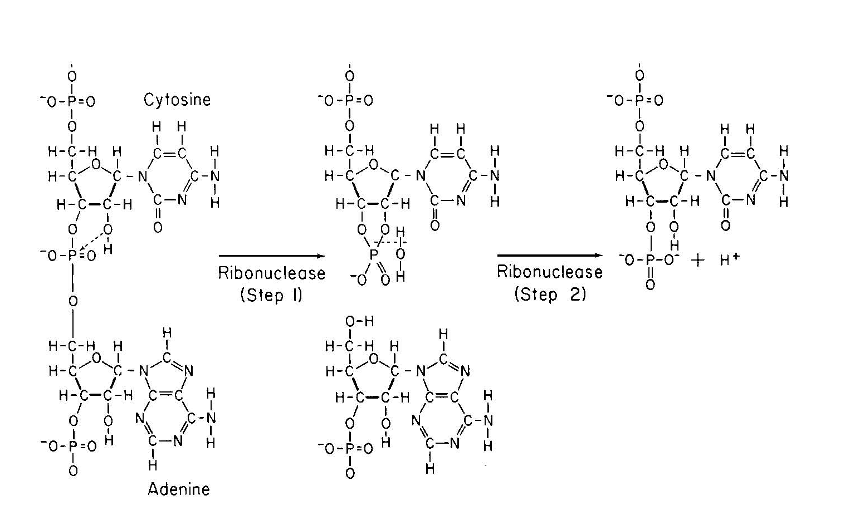
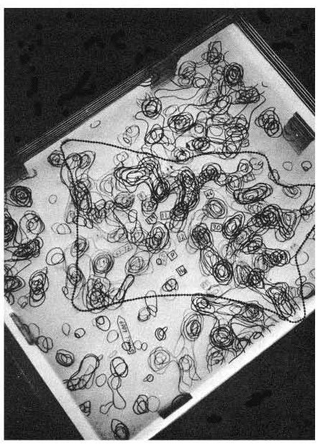
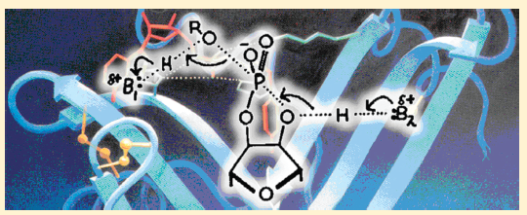
RNase A, the first catalytic mechanism
Standord Moore and William Stein. Nobel Lecture (1972).
Wyckoff et al. J. Biol. Chem. (1967)
Cuchillo et al. Biochemistry (2011).
Notes:
Rnasa A catalytic mechanism was proposed by Mathias et al. In 1961 before its 3D was solved (the 50th anniversary was celebrated just two years ago)
RNase A was also one of the 1st enzyme whose 3D structure was solved [(3rd) and the 4th protein.
The two histidines that act as a general base and acid cleaving the 3’5’ fosfodiester bond, adn the lysine residue that stabilize the intermediate are conserved through the whole family

Slide 5
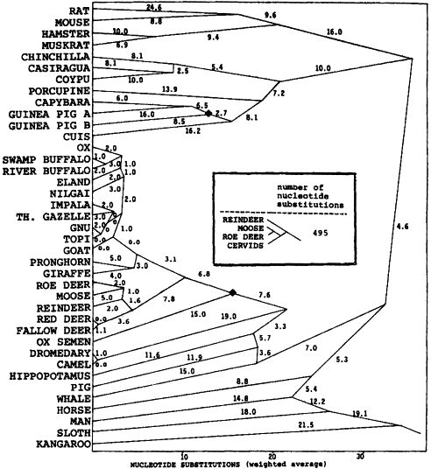
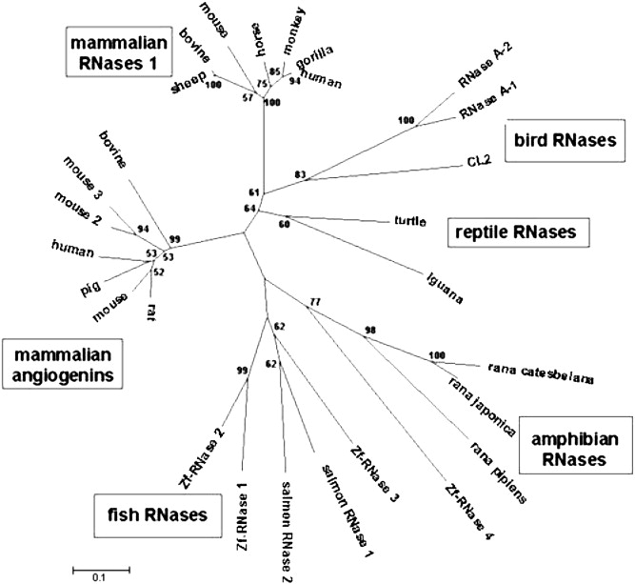
Pioneering evolution studies of mammalian RNases
Beintema et al. (1986) Mol. Biol. Evol. 3, 262
Pizzo and D’Alessio (2007)
Notes:
And last, but not least, pionering sequencing by Beintema and coworkers provided around 40 sequences of ruminants and other mamifers, setting the basis for evolutive studies.
It was proposed that the pancreatic RNase would digest the huge amount of RNA in the stomach of ruminants produced by the intestinal flora. But the quest trying to find out the family physiological role was just starting.
Many evolution studies followed. The antibacterial activity of distantly related RNases (as chicken and fish RNases) suggested that ancestral RNases were in fact host-defense RNases

Slide 6
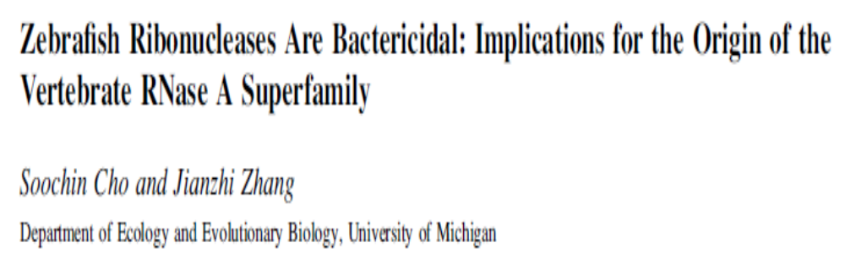
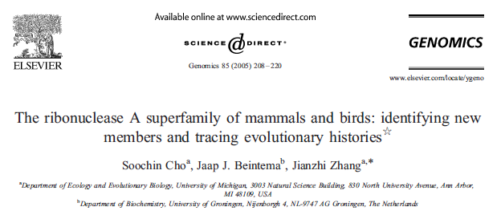
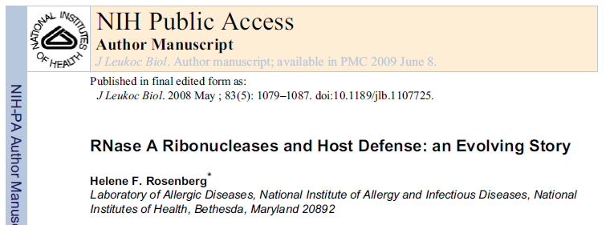
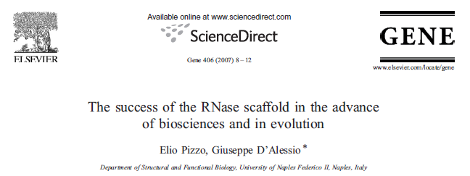
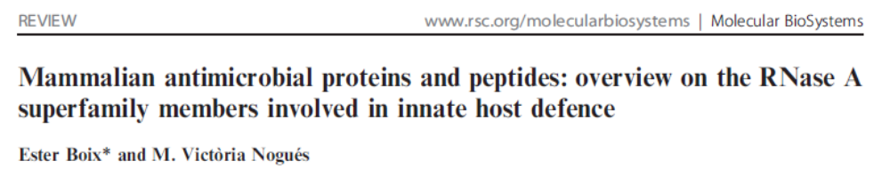
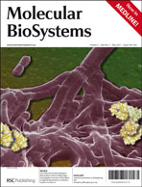
An ancestral host defense role?
Notes:
Many evolution studies followed. We must recall here the effort made by Jaap Beintema, Giuseppe D’Alessio and Helene Rosenberg trying to solve the puzzle.
Here are few titles just to illustrate this path:
Xxxxx
The family could have started with an host defense function, but Since the puzzle seemed to be solved new data provided new questions and, as Helene Rosenberg indicated, the story continued evolving.

Slide 7

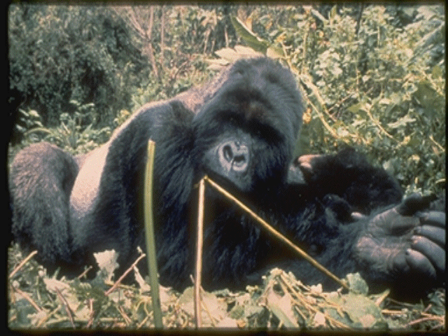
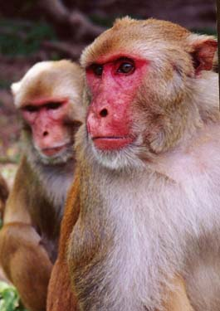
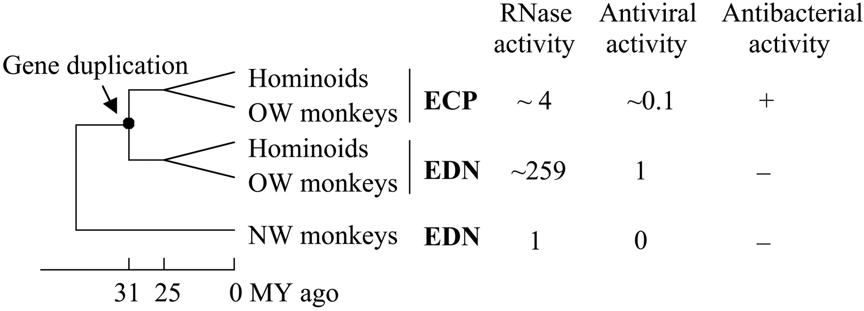
Cationization versus catalytic efficiency
R
Zhang et al., PNAS (1998)
Zhang et al. PNAS (2002)
Notes:
As an example, the sutdies by rosenberg and coworkers comparing old and new world primates indicated that the two eosinophil rnases RNase 2 and RNase 3 (ECP and EDN) were among the most rapidly evolving coding sequences in primates. Interestingly, the Arg content of RNase 3, which confers the protein a particular high pI, the highest amongst its partners, have been accumulate during a short evolutive period of time and may have provided the protein with a higher cytotoxicity in detriment of its catalytic activity.
Critical residues for structural and catalytic requirements were retained. However, the increase in Arg surface residues have reduced the Rnase catalytic efficiency, probably by interfering with the correct aligment of the RNA at the active site.

Slide 8
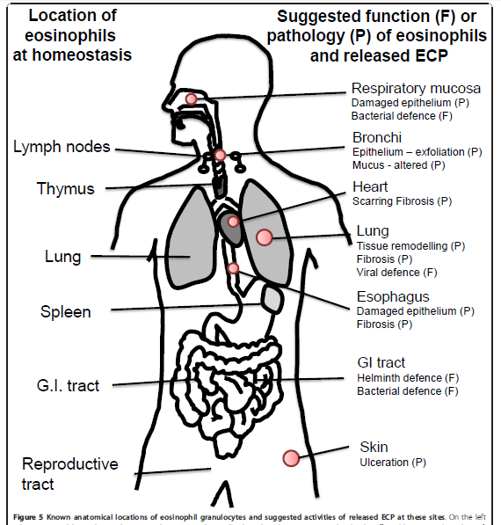
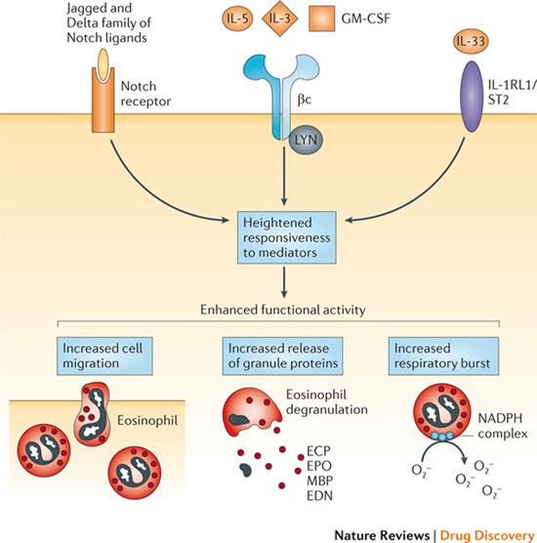
hRNases in host defense
Fulkerson and Rothenberg Nature Reviews 2013
Bystrom et al. 2011
Notes:
Eosinophil rnases cytotoxicity would then be involved in the protein antipathogen activity contributing to the host defense and protecting the respiratory and digestive tracts against infection.
ECP as an eosinophil secretion protein participates in innate immunity. ECP levels in biological fluids are increased during infection at epthelial tissues and may mostly contribute to the protection of the respiratory tract, and secondarily at the digestive tract. In detriment,
[the oversecretion of eosinophil granule protein would contribute to asthma and inflammation side effects, as the proteins at high concentration would be toxic to the host tissues]

Slide 9
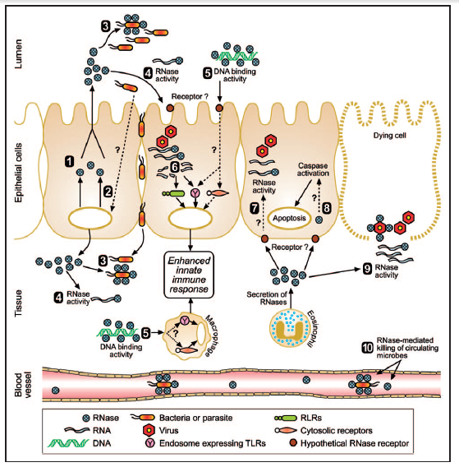
Proposed mechanisms for secretory RNases
Gupta and Wheeler, 2013
Notes:
The working mechanism of these rnases is still under study. We observe the induced production and secretion of RNases in response to microbial challenge;
Among the multiple mechanisms by which hRNases can work, we have: RNase activity to clear microbial RNA; DNA-binding activity of RNases facilitating recognition of microbial DNA to innate immune receptors; specific RNase activity produces short fragments of viral RNA which are then recognised by innate immune receptors; rnases 2 and 3 secreted by eosinophils degrades viral RNA; cytotoxicity inducing apoptosis of infected cell ; EDN or ECP degrade microbial RNA released from infected and dying cells; RNases in extracellular space contributing to clearance of biological fluids. And recetnly reported to be related to xenophagy processes

Slide 10
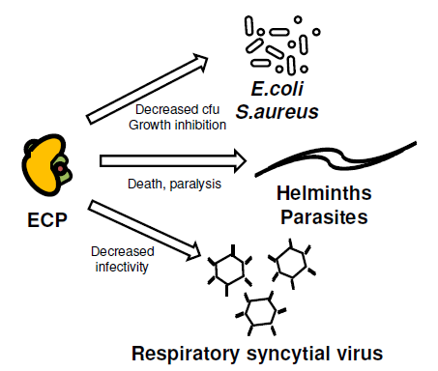
hRNases antipathogen activities
Helminths:
  Schistosoma mansoni, Brugia malayi, …
Protozoa:
  Leishmania, Trypanosoma cruzi, T. brucei, and Plasmodium
Bacteria:
  E. coli, S. aureus, Mycobacterium,…
Viruses:
  RSV,..
Bystrom et al. Respiratory Res. 2011
Notes:
hRNases toxicity in vitro has been reported against a wide range of pathogens, : parasite, as helminths and protozoa, some of which are the origin of life threatening diseases, as sleeping sickness (especies trypanosoma a Africa) and chagas disease (especies Trypanosoma a Amèrica) and malaria (espècies Plasmodium).
Brugi és un nematode que cause filiarosis
In favor of this scenario are nucelotide polimorhisms related to hRNase 3 geographical distribution (for shistosoma and Plasmodium)
Also hRnase 2 activity is required for antiviral activity

Slide 11
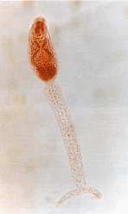
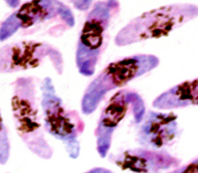
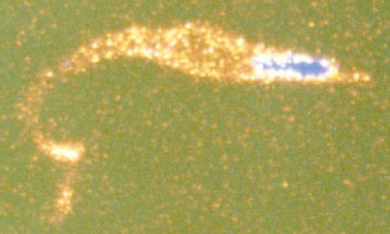
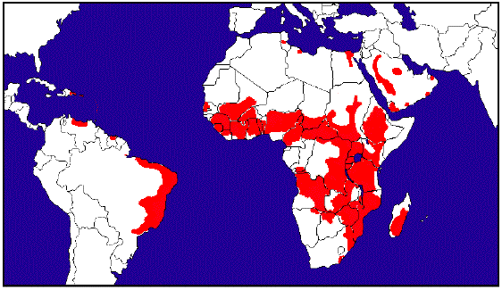

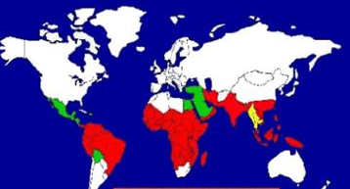
hRNases antiparasite activities
Schistosomiasis
Chagas disease
Malaria
Schistosoma mansoni
Trypanosoma
Plasmodium falciparum
-
-
Notes:
Among the studied parasties, we have helminths and protozoos.
Antiparasite activities: antihelminths (against schistosoma), antiprotozoos
Schistosoma mansoni Endèmica a Àfrica, Carib Amèrica del sud i Orient Mitjà.
- Malaltia parasitària més important després de la Malària.
Trypanosoma brucei (sleep sickness)
T. Cruzi (chagas disease)
Chagas: Endèmica a Amèrica central i Amèrica del sud.
-16-18 millons d’infectats
- 30 % mortalitat
Fàrmacs poc efectius
Malaria: 70% a africa, afecta principalment nens, moren 1 millio/any. Apareixen moltes soques resistents. En vermell resistens a cloroquina. En groc: multiresistents

Slide 12
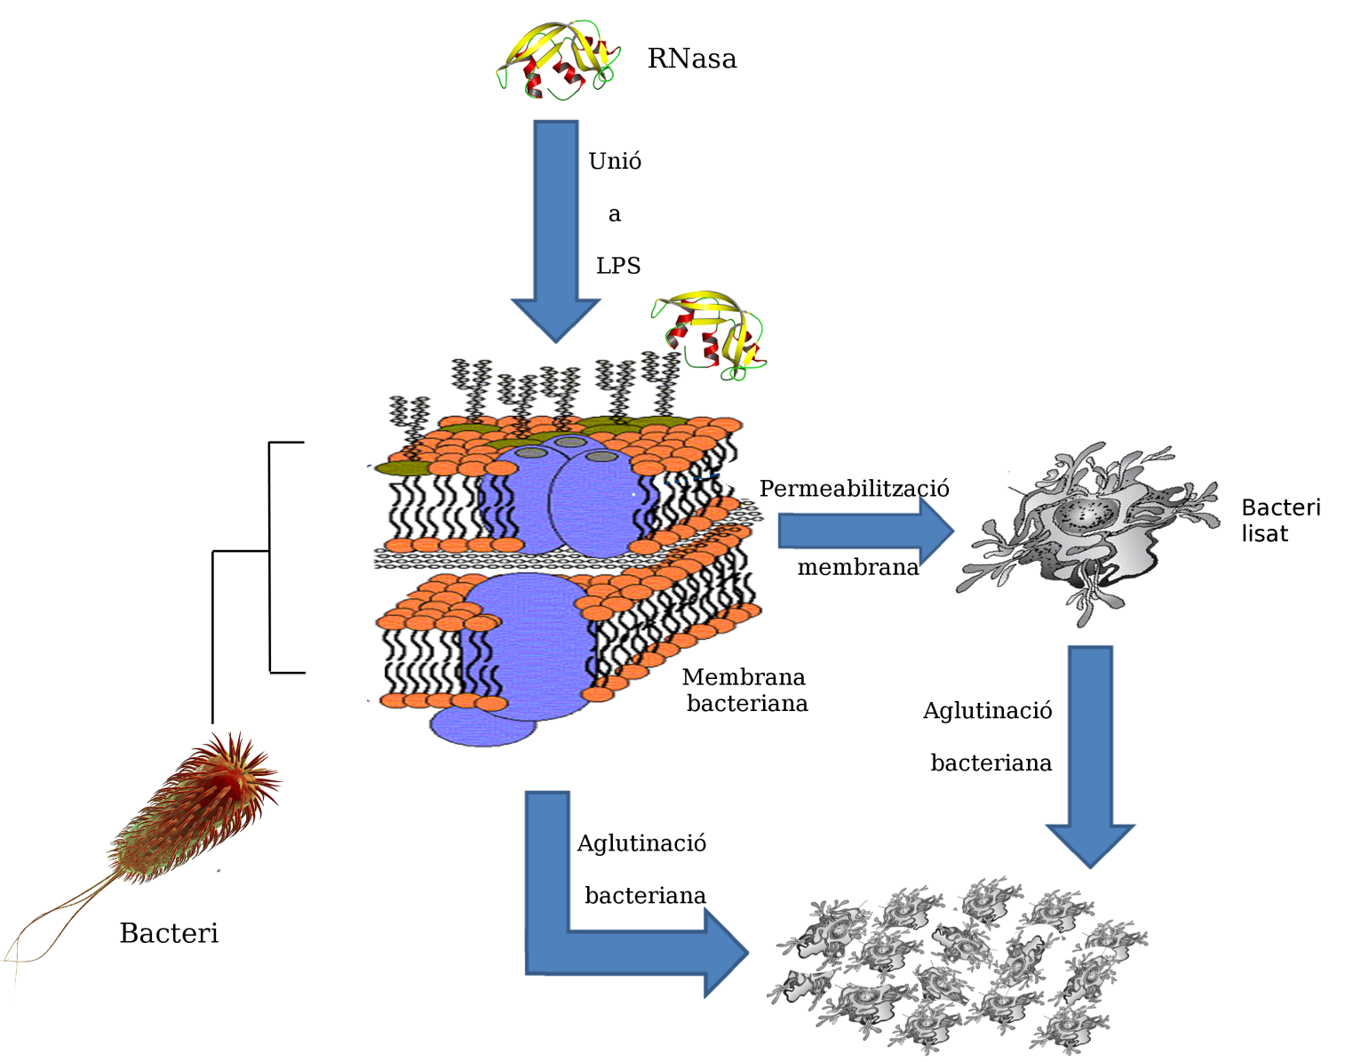
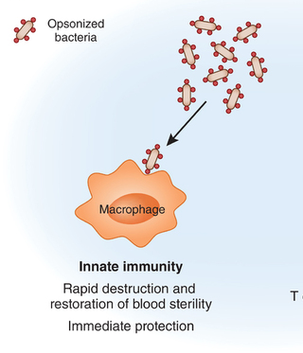
hRNases bactericidal activity
Jung Nature Immunology 2011
Notes:
Alternatively macrophages can also directly engulf bacteria for their removal. ECP can work as a glue protein, binding to bacteria and agglutinating them. Opsonised bacteria are more readily engulfed by macrophages (as described also in invertebrates innate immunty). ECP would act as an opsonin molecule, with high affinity to the carbohydrates exposed at the bacteria surface, that can wrap around bacteria and facilitate their removal.
Our group has been caracterizying the hRNases action on bacteria, and in particular on Gram negative species

Slide 13
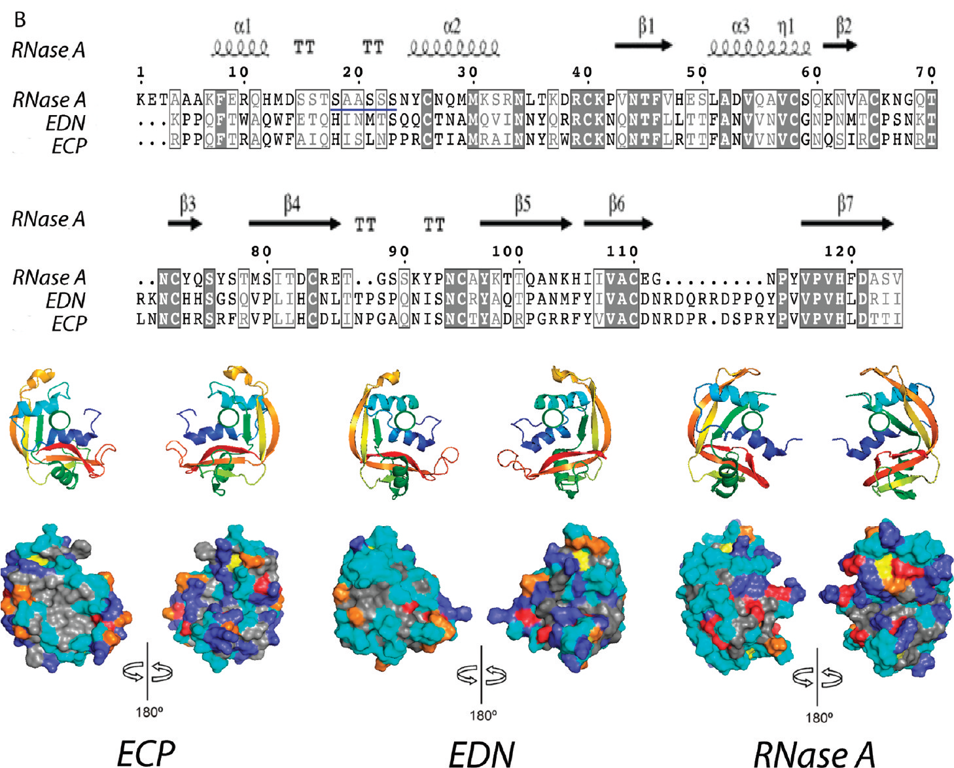
Structural determinants for antimicrobial proteins
Torrent et al., Biomacromolecules 2010
Notes:
Coming from a structural biology backgground, we tried to unravel the structural determinants. We have been looking for the structural determinants of ECP that distinguish it from the other non antimicrobial Rnases. A close inspection reveals that the protein complies most of the properties of an antimicrobial protein: it is a small (around 15kDa), highly cationic, with a positive net charge and very stable protein. Its alternance of cationic and hydrophobic patches confers it an amphipaticity which also contribute to its final properties.
Although the sequence identity is as low as 30%, all members of the family share a common overall 3D structure with the same conserved cys positions and a 4 disulfide bridge pattern
We can see a patch of hydrophobic residues (labeled in gray) not present in other family representants (as EDN and RNase A), and an overabundance of cationic residues (in blue) (Arg in particular), and underrepresentation of anionic residues (in red) in comparison to rnase A,
[cysteine residues in yellow, proline residues in orange and noncharged polar residues in cyan.]

Slide 14
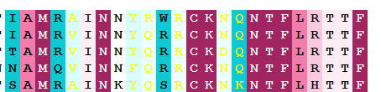
Dissecting hRNases properties
hRNase 3
pI ~ 11
Conservation score
Notes:
When analyzing ECP properties we observe hRNase 3 cationicity is unusually high (as its name indicates), with an overabundance of arginine residues (19 out of 133 residues) and a pI around 11
A closer look at the protein structural determinants identifies a huge cationic patch at the catalytic groove, close to an hydrophobic surface, where Trp 35 residue is hyperexposed to the solvent.
Here at the bottom we have an analysis of conserved residues within the family. When analyzying the conserved and variable residues within the closest family members we identify the conserved residues, mostly involved in the shared 3D protein structure and catalytic mechanism (in dark red), together with particular residues (in blue) as exposed Arg and trp 35), which are only found in human and other primate ECP and not in the other family members.

Slide 15
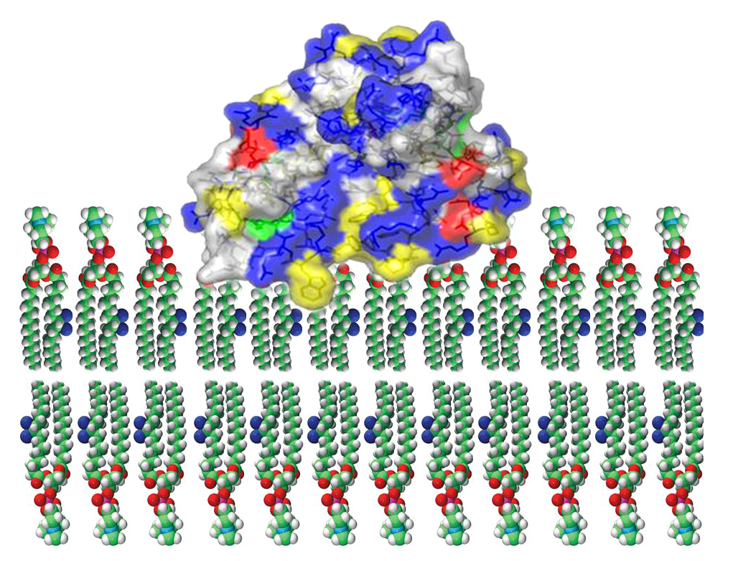
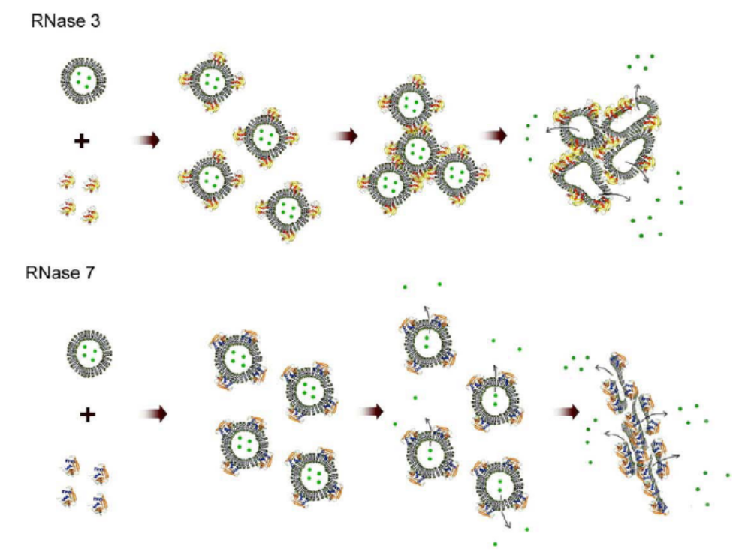
hRNases action on model membranes
W35
Torrent et al. Biochemistry 2007
Torrent et al. Biochim Biophys Acta, 2009
Notes:
The protein amphipathicity facilitates its action on model membranes.
As a general rule, the protein complies the main common properties of antimicrobial peptides, they are cationic, with a positive net charge, that would enable them to interact electrostatically with the negatively charged phospholipids of the bacterial membrane, Antimicrobial proteins and peptides also have a high % of hydrophobic aminoacids, and regions which can adopt amphipatic secondary structures upon membrane interaction.
Our previous work using liposomes as a model membranes estimated the protein partial insertion into the lipid bilayer. By fluorescence intrinsec assays we confirmed the direct interaction of the Trp residue with the fatty acid core of the phospolipid molecule
We also observed how the protein high binding affinity towards anionic phospholipids triggers the lipid vesicles aggregation at a nanomolar range. This activity is specific for anionic membranes, as no activity is observed for neutral membranes. This confers a specificity for bacterial membranes. Indeed the rnases have high therapeutic indexes (as calculated by evaluating the hemolisis rates)
Besides, we observed the release of the vesicle content was observed to take place only after the vesicle aggregation, as depicted in the picture model.

Slide 16
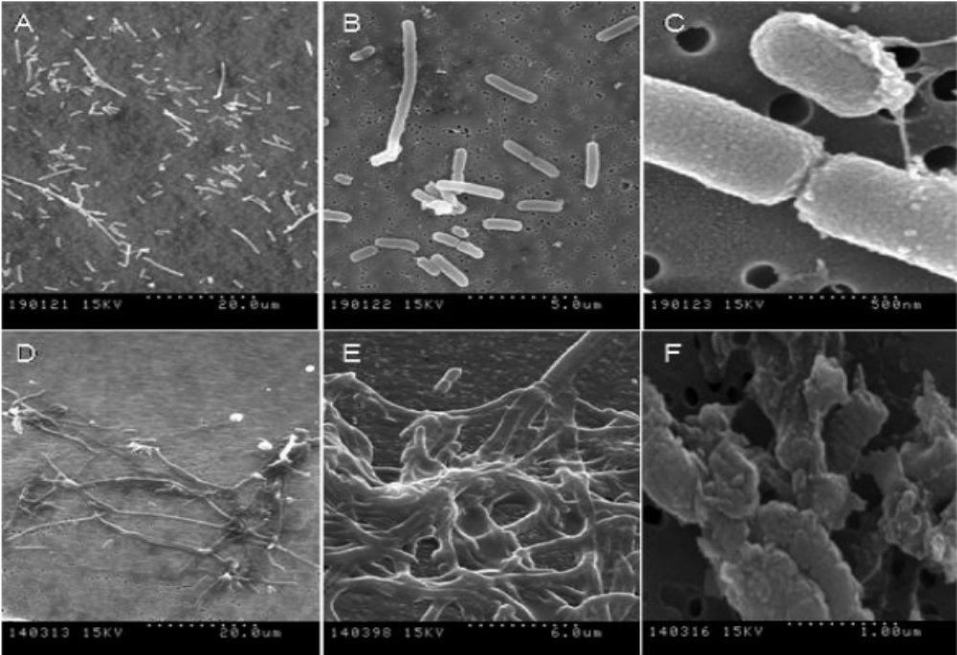
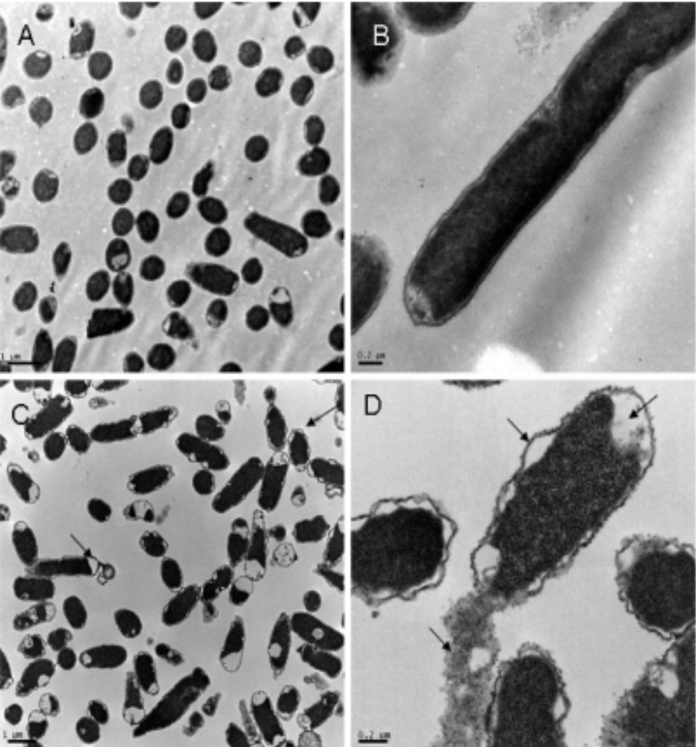
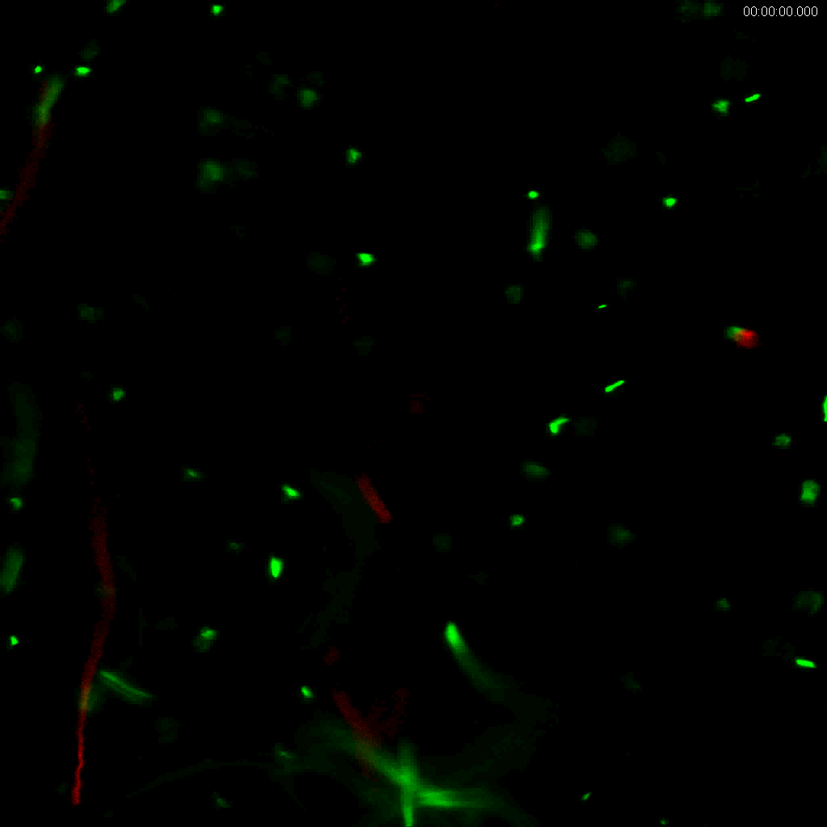
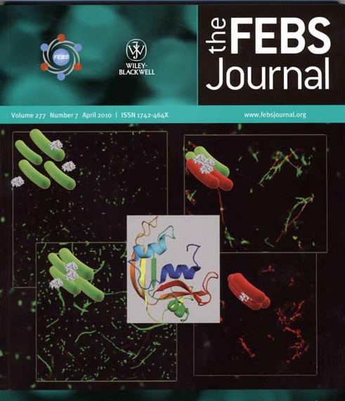
hRNase 3 action on bacteria envelope
Torrent et al., Biochemistry 2008
Torrent et al., FEBSJ 2010
Notes:
The high cationicity also facilitates the protein interaction with anionic molecules at the bacteria surface, like LPS at the Gram negative envelope.
Following, we have analysed the ECP activity on bacteria cell cultures. RNase 3 has a high binding affinity towards anionic molecules at the bacteria wall, as lipolysaccharides at the Gram negative surface and agglutinates Gram negative bacteria at a nM- mM scale, but not Gram positive bacteria.
[The protein damage to the bacteria wall was visualized by electron microscopy. Scanning electron microscopy shows the damage and aggregation of e. coli cells, and transmission electorn microscopy reveals the outer membrane detachment and release of the cell content]
The agglutination process was follow in vivo by confocal microscopy. Fluorescence staining revealed how the cell agglutination preceded the bacteria death.
We have further investigated the structural determinants for ECP bacteria agglutination activity, as an attractive property that can facilitate the host clearance process at the infection focus

Slide 17
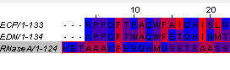
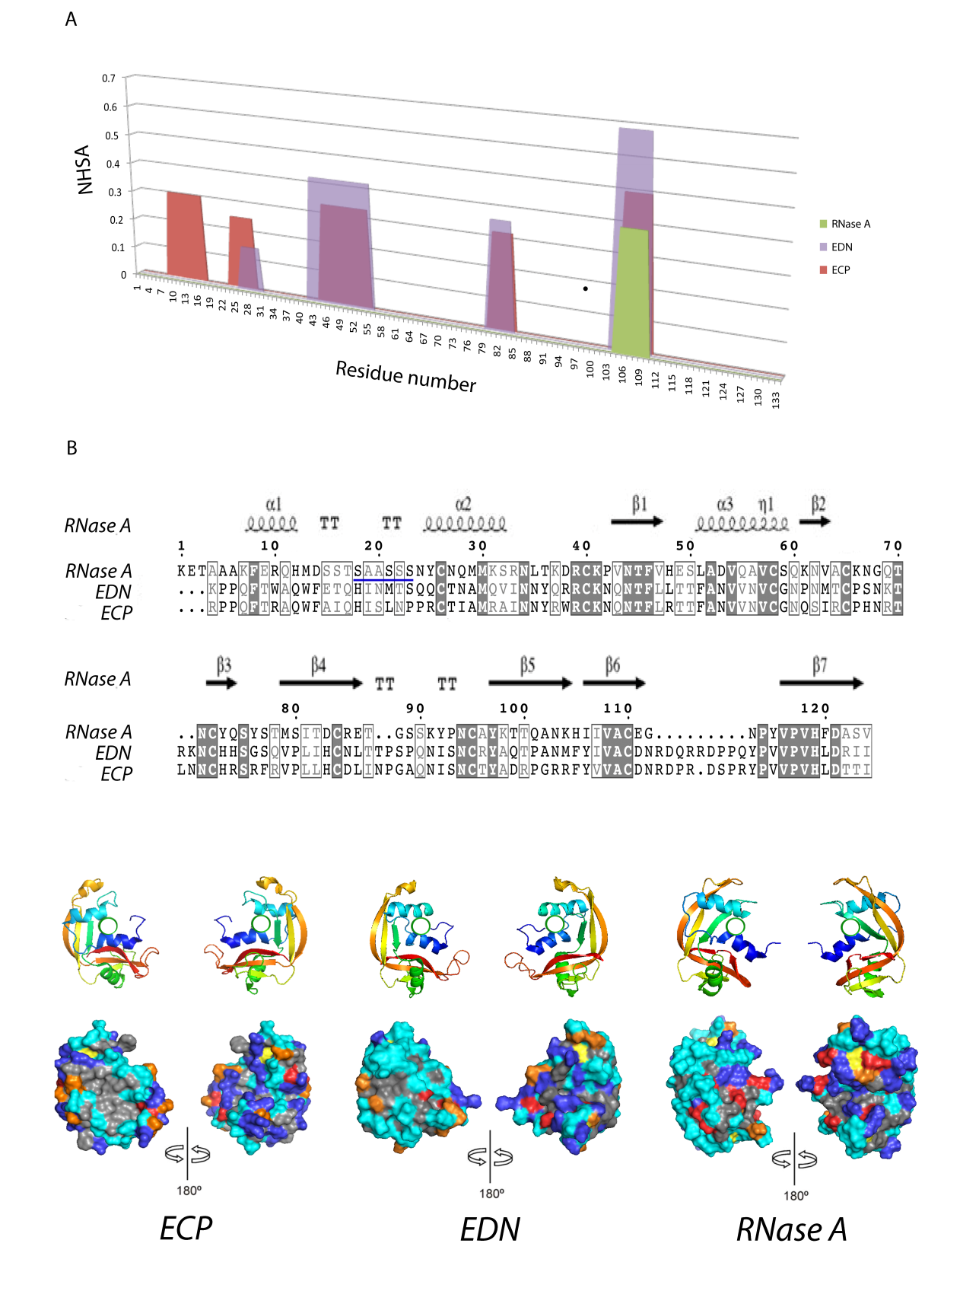
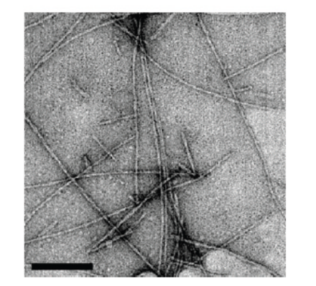
An hydrophobic patch promotes hRNase 3 self-aggregation
hRNase 2
hRNase 3
ECP(1-19) peptide
Torrent et al. Biomacromolecules 2010
Notes:
We have identified at the`protein N-terminus an hydrophobic patch unique to hRNase 3 which would be responsible for the protein aggregation properties. A unique hydrophobic patch (8-16) was identified in hRNase 3 by an aggregation prediction software. The program spots a stretch of consecutive hydrophobic residues (labelled in red). We confirmed the aggregation propensity of the protein region, by sintezying a peptide, corresponding to 1-19 residues, which can form amyloid-like aggregates. The whole protein also forms amyloid aggregates when exposed to a low pH.

Slide 18
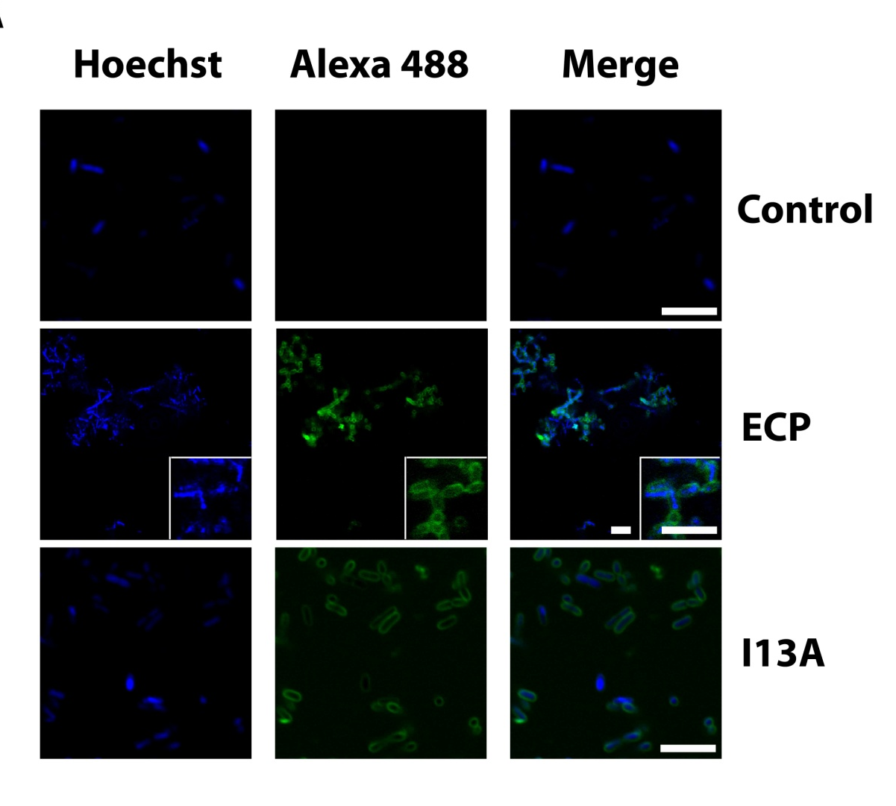
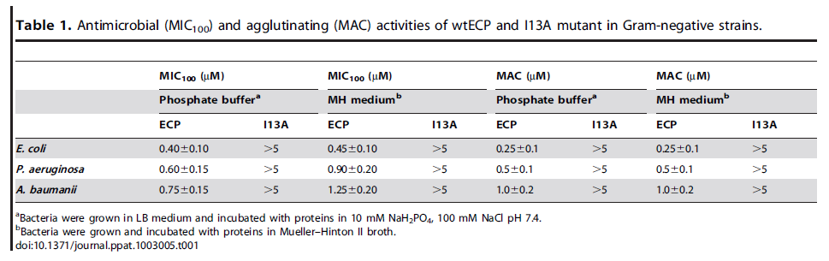
Protein self- aggregation triggers bacteria agglutination
Torrent et al. Plos Pathogens 2012
Notes:
To further confirm the involvement of the spotted sequence, we design a protein mutant with a unique amino acid substitution Ile to Ala that disrupts the hydrophobic patch and loose the self aggregation propensity. A single substitution at Ile 13 disrupts the hydrophobic patch and abolishes the protein agglutination activity.
We then proved in vivo how , switching off the self-aggregation propensity by a single amino acid substitution abolished the cell agglutination activity and hence impaired the antimicrobial activity.
Agglutination activity was checked for several Gram negative strains. In all cases the I13A mutant looses its agglutination ability.
We observe here how labelled cells colocalize with labelled protein

Slide 19
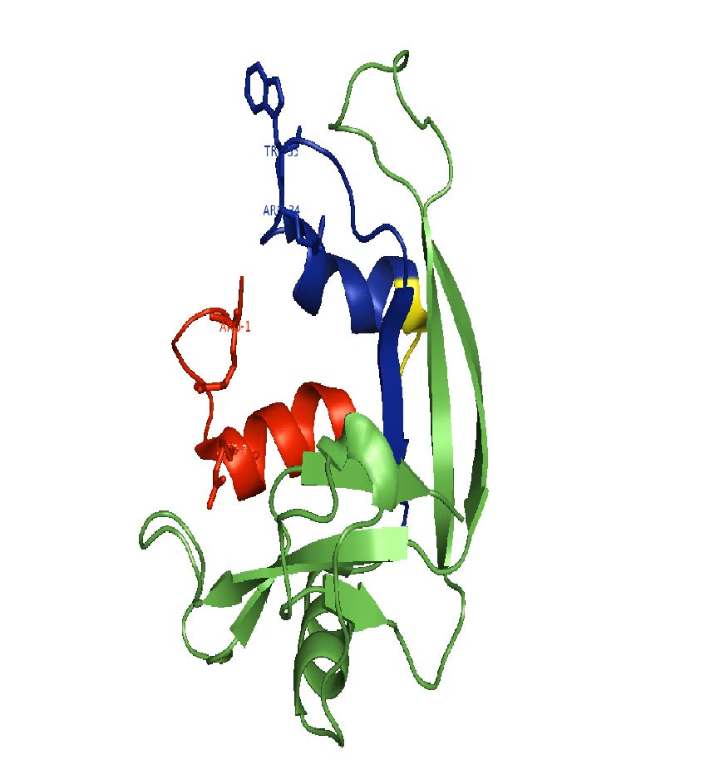
A domain involved in hRNase 3 binding to heterosaccharides
33-38
8-16
RPPQFTRAQWFAIQHISLNPPRSTIAMRAINNYRWRSKNQNTFLR
Notes:
We show here the first protein alfa helix essential for the aggregation activity,
But this is not the whole story: structural analysis identified at the protein second alfa helix an interacting domain for heterosaccharides, which would explain the protein high affinity for bacteria wall suface. In particular, there is a specific TAG sequence involved in ECP binding to sugar derivative molecules. Peptide synthesis and site directed mutagenesis confirmed that residues spanning from Tyr33 to Lys38 are directly involved in the protein affinity to heterosaccharides.

Slide 20
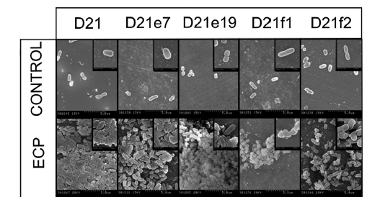
Structural determinants for hRNase 3 binding to lipopolysaccharides
NAG
D21 Ra
Glu
Gal
D21e7 Rc P-
Gal
D21e19 Rc P-
Glu
D21f1 Rd P-
Hep
Hep
P
P
P
Hep
P
D21f2 Re
-
-
KDO
KDO
P
P
E.coli k12 mutant strains
Pulido et al. AAC 2012
Notes:
Rnase 3 binds with high affinity to LPS exposed at the Gram negative outer membrane, as confirmed by using a battery of E. Coli defective strains with progressively truncated LPS.
We could correlate the protein binding to the bacteria LPS structrure. ECP shows a progressive reduction of its antimicrobial activity as the LPS structure is shortened. Bacteria agglutination is also dependant on the LPS and no aggltuination is observed for the D21f2 strain.
[LPS are glicolipids showing a lipidic portion (lipid A) and a chain of carbohydrates, fosforilated at several positions.]

Slide 21
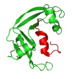
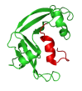




Binding to lipopolysaccharides triggers bacteria agglutination
Notes:
We could then suggest a model where the protein bacteria agglutination, which is specific for Gram –negative cells would be facilitated by its interaction to the lipopolysaccharides. Bacteria agglutination would then trigger the cell death

Slide 22


Binding to glycosaminoglycans
García-Mayoral et al. ACS Chem Biol 2013
Notes:
The protein high affinity to heterosaccharides may also explain the high affinity to GAGs, like heparan sulfate, at the eukaryote extracellular matrix, which may contribute to protein cytotoxicity to eukaryote cells when oversecreted at host tissues during inflammation, and potentially inducing harmful side effects.
Binding to heterosaccharides was inspected by nuclear magnetic ressonance. ECP complex with an heparinderived trisaccharide (O-iPr-α-D-GlcNS6S-α(1−4)-L-IdoA2S-
α(1−4)-D-GlcNS6S). The results highlighted the contribution of residues at the N-terminus (Arg 7, Gln 14, His 15 and Gln40 together with other key residues that conform the protein catalytic groove (as Lys 38 and His 128).
A model has been proposed for the protein interaction at the cell surface, where the protein anchoring to the exposed sugar molecules would facilitate its further membrane destabilization activity.. The protein binding to the heparan sulfate would orientate the molecule in such a way that the hyperexposed trp could partially insert whithin the lipid bilayer.
[Identification of the structural determinants for ECP binding to heparin derivatives could assit the design of inhibitors of ECP toxicity to host tissues in inflmmation and other eosinophil assocaited pathologies.]
[The protein high affinity to heterosaccharides may also explain the high affinity to GAGs found at the eukaryote extracellular matrix, which may contribute to protein cytotoxicity for host tissues during inflammation. Would explain effects like allergy side effects]

Slide 23


hRNase 3 – SO₄ complex structure
Arg 34
S₁
Arg 36
Asn 39
Arg 7
S₃
Boix et al. JSB 2012
Arg 1
Notes:
By X-ray crystallography we studied the protein 3D structure in complex with sulfate. When we crystallize the protein in ammonium sulfate, we observe the sulfate binding to the prot surface
ECP crystal structure in complex with sulfate anions reveals the potential anion binding sites that could anchor sulfated compounds as glycosaminoglycans
We observe here the cationic patches binding the sulfate anions

Slide 24




hRNase 6 – SO₄ complex structure
Notes:
A similar scenario has been just recently revealed for human Rnase 6, expressed in macrophages

Slide 25


hRNase 3 binding to sulfated GAGs
S1
Arg 34
S2
Arg 36
Asn 39
Torrent et al. JMR 2010
Gln 14
Lys 38
S3
His 128
Arg 1
Boix et al. JSB 2012
Arg 7
Notes:
In particular we observed key exposed arginine residues, are involved in the sulfate binding. We can identify three main sulfate anion binding sites, located around the catalytica active site. The data confirms the previous complex suggested by modelling studies. Heparin binding blocks Rnase activity and the structural data confrims the involvement of active site residues (Lys and His)

Slide 26

Further exploring hRNases binding sites
Boix et al. Biochimie 2013
Notes:
And last, but not least ECP cationic sites that are found to be involved in the interaction with anionic groups at the heterosaccharides may also assist the protein binding to nucleic acids. As a Ribonuclease, ECP conserves the main active site residues, which are shared by all family members. Particular differences are observed for the secondary sites that can contribute to each RNase specificity to distinct RNA substrates
[phosphate sites are numbered according to their relative position]

Slide 27


hRNase 6 nucleotide binding pattern
Notes:
We can also trace a path for oligonucleotide binding at the recently solved hRNase 6 structrure

Slide 28


Binding sites for a polymeric substrate
RNase A substrate subsites
Moussaoui et al. (1996) J. Biol. Chem. 271, 4687
Notes:
Subsites that are located at both side of the catalytic site can work as anchoring points that can help to fix oligomeric molecules and their relative position would determine the cleavage mode.

Slide 29
A common binding pattern for nucleotides and saccharides
7 Å
7 Å
Boix et al. JSB 2012
Notes:
Therefore we can delineate at the catalytic groove a path that can accomodate oligomeric anionic compounds where phosphate or sulphate groups are spaced at equivalent distances (about 7A)
(fosforilated nucleic acids and sufated saccharides)

Slide 30

A protein scaffold- a source of antimicrobial peptides
Torrent et al. J Med Chem. 2011
RPPQFTRAQWFAIQHISLNPPRSTIAMRAINNYRWRSKNQNTFLR
Notes:
And finally to end up I would like to briefly introduce some work we have done with synthetic peptides which have enable us to further locate the key functional regions
Protein engineering work and structure based peptide design to debvelop new peptide based antibiotics

Slide 31

Design of N-terminus antimicrobial peptides
ECP
1
2
3
4
5
6
7
8
9
Torrent et al., JMC 2011
Notes:
To further delimitated the protein key active regions a structure minimization strategy was applied, to select the best antimicrobial peptide.
The peptide was prone at both N and C terminus ends. The two key helical stretches were further linked with a connector, which provides flexibility to the construct. Further proning at both peptide ends lead to the lost of peptide activity
The final selected construct (number 7) includes the hydrophobic patch required for self-aggregation and the 33-36 sequence, required for antimicrobial activity and LPS binding. The peptide represents a 40% size reduction but can mostly reproduce the antimicrobial and cell agglutination activity of the parental protein

Slide 32





The multiple faces of hRNase 3
8
15
16
Catalytic activity
Aggregation
His128
Ile13
His15
Lys38
45
Trp35
33
1
Arg36
38
Antibacterial Activity
GAGs Binding
Boix et al. Biol. Chem. 2012
Notes:
To conclude, I would like to emphasize how our sutructure function results highlight the multifaceted role of the eosinophil cationic protein. Belonging to the Rnase A family the protein conserves its catalytic site and displays activity agains RNA substrates. We have also observed that the Nterminus region (from 1 to 45) is the key domain required for the protein antimcirobial activity. An aggregation prone patch was spotted by a prediction software and was confirmed to drive the protein self- aggregation. A sugar binding site is located at the 33-38 region, and both the aggregation domain and sacaride binding domain contribute to induce the protein bacteria agglutination activity.

Slide 33

hRNases antifungal activity
Notes:
We recently started to characterize the hRNases activity on Candida albicans, and we use this model to track the protein interanlization into the cell, and have correlated the protein uptake with its activity towards cellular nucleic acids. Intracelular location of labelled protein can be followed when working at sublethal concentrations

Slide 34

Timing of events

Slide 35


hRNases as multifunctional proteins
Hancock and Sahl, Nature Biotech. (2006)
Brodgen Nat Rev Microbiol 2005
Notes:
Therefore, the multifaceted properties characteristic of toxic proteins involved in immune defense are also observed for hRNases.
ECP would work as a multitask protein. Action at the bacteria membrane, induction of the cell lysis or an activity towards the intracellular content could be dependant on the effective local protein concentration and the incubation time. To visualize the protein intracellular action we should work at sublethal concentration. These properties might previously have been overlooked
Key concentrations below and above the protein MIC value would be critical for the protein functionality.
We also find other examples of antimicrobial proteins: There are examples of proteases or dnases which beside displaying their enzymatic activity can also work at high protein concentration range, by disrupting the cellular envelope.
Some other antimicrobial peptides are reported to translocate and inhibit key cell functions, as cell division or protein synthesis. Inhibition of the cell synthesis machine by binding to nucleic acids at lower sublethal concentrations, without inducing cell lysis is observed for other cationic antimicrobial peptides.
However, little is known on the potential internalization pathway of antimicrobial proteins in bacteria. There is a critical matter of size, which difficults the potential protein internalization. May depend on the targeted pathogen

Slide 36









Acknowledgements
, Vivian Angelica Salazar, Javi Arranz, Guillem Prats, Marc Torrent, David Pulido, Mohammed Moussaoui, José Antonio Blanco, Claudi Cuchillo and Victòria Nogués.
Dpt. Bioquímica, Fac. Biociències, UAB
Beatriz de la Torre and David Andreu
PRBB, Universitat Pompeu Fabra, Barcelona
Manuel Rico, Marta Bruix and Flor García Mayoral
Instituto Rocasolano, CSIC, Madrid
Dr. Jordi Benach and Fernando Gil, ALBA synchrotron, Cerdanyola del Vallès
Notes:
I finally I would like to thank all our group members and collaborators (peptide synthesis was one at D. Andreu laboratory and NMR studies at M Rico and Marta Bruix grup)
Also, protein Xray crystallography were performed at ALBA synchroton, close to our university
And I also want to acknowledge for funding

