Slide 1
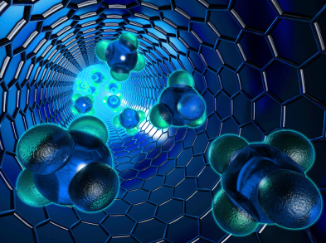
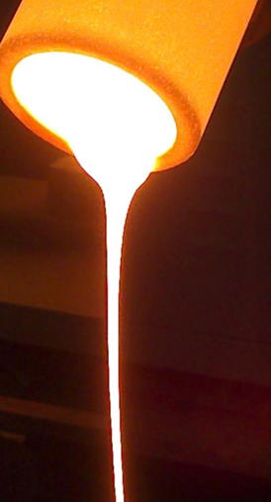


Development of glass-ceramic glazes
formulated from industrial residues
RESEARCH GROUP OF SOLID STATE CHEMISTRY
DEPARTMENT OF INORGANIC AND ORGANIC CHEMISTRY
Universitat Jaume I, Castellón de la Plana, SPAIN
ESTER BARRACHINA ALBERT
Notes:
Good morning to everybody and thank you very much for inviting me to participate in this congress,
I am a researcher /ruisércher/ of the Solid State Chemistry Group directed /dairectid/ by the Full Professor Juan B. Carda and this group belongs to the Inorganic /ínooganic/ and Organic Chemistry department /depáarment/ in the UJI /yuniversity/. Now I am going to explain my presentation titled /taitold/ development /devélopmen/ of glass-ceramic glazes formulated /fóomulaited/ from industrial residues /résidus/.

Slide 2


Index
1. INTRODUCTION: SOCIO-ECONOMIC CONTEXT
2. VITRIFICATION OF INDUSTRIAL RESIDUES
3. GLASS-CERAMIC GLAZES FROM INDUSTRIAL WASTES
4. GLASS-CERAMIC LAMINATE FROM INDUSTRIAL WASTES
5. CONCLUSIONS
Notes:
First of all, I will introduce you the socio-economic /sousioeconomic/ context of the Universitat Jaume I, next to the Spanish ceramic cluster /clasta/ to understand the fundamentals of this work /güek/.
Secondly, I will show you a brief characterization of three of the most representative residues of Castellon area that have been considered in this work.
Then, I will present to you the development of some glass-ceramic glazes based on those industrial wastes.
After, a glass-ceramic laminate have been also produced using the explained residues.
Finally, the conclusions of the work.

Slide 3
Introduction: socio-economic context
1

Slide 4

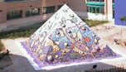
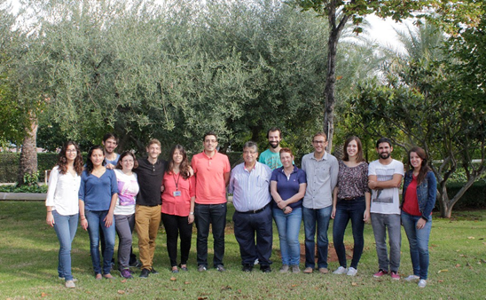
Solid State Chemistry Research Group
Group leader: Full Professor Juan B. Carda Castelló
Professors: Eloisa Cordoncillo Cordoncillo and Hector Beltrán Mir
4 Experienced researchers (PhD)
5 PhD students
Notes:
The solid state chemistry group at UJI is formed by a leader, full prof. Juan B. Carda, 2 professors, 4 experienced researchers and 5 PhD students.

Slide 5
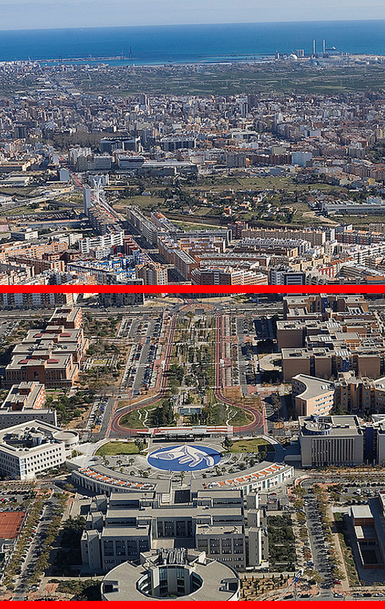
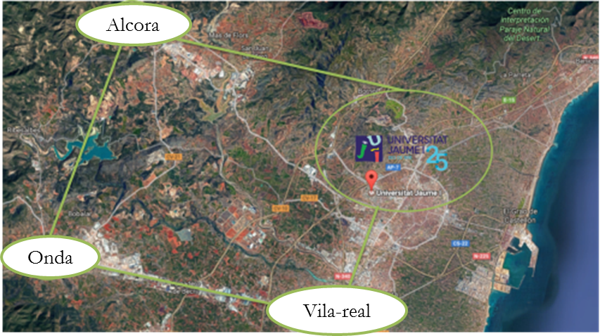
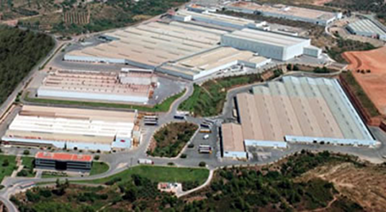
Industrial sector of Castellón:
CERAMIC TILE INDUSTRY
Notes:
As I said before, my university is located in the capital of Castellón province, where it is situated the Spanish ceramic tile cluster. Since its foundation in 1991 the main objective of UJI has been to interact with the society and with the industrial sector of Castellón, specially with the ceramic tile industry.
In that sense, the university in general and my research group in particular, is continuously exchanging knowledge and sharing scientific projects to obtain the real technological transference from Academy to industry.

Slide 6
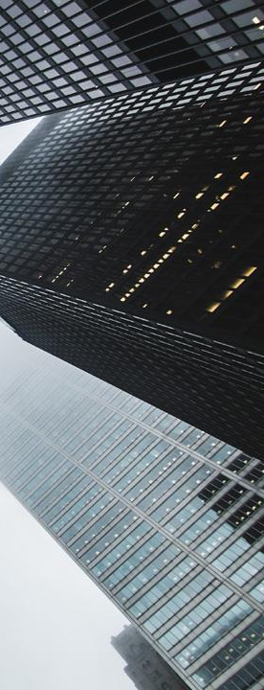
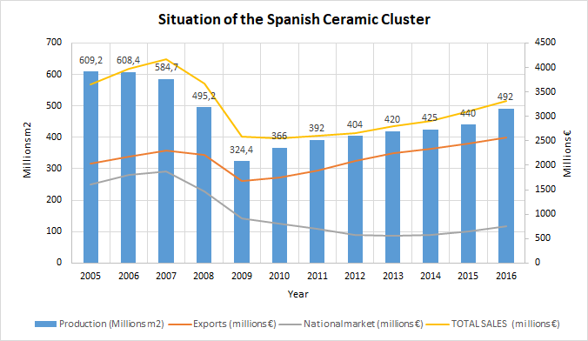
Spanish Ceramic cluster data
Employment: 14,550 direct jobs
Notes:
The Spanish ceramic cluster located in CS is overcoming the industrial crisis /kruaisis/ since 2010, where the tiles production begins to improve as the demand of international sales increases, while the national sales decrease, due to the crisis of the Spanish building sector.
In 2016, 492 millions m2 are produced and the exports are next to 2500 millions euros /yurou/.
Sales /seiels/
PRONUNCIACION AÑOS
Antes año 1000: 863 8 hundred and sixty-three
1000-2000 : 2 cifras: 1934: nineteen thirty-four
1800: eighteen hundred
2000-a más: 2001 two thousand and 1
2012 two thousand and 12

Slide 7
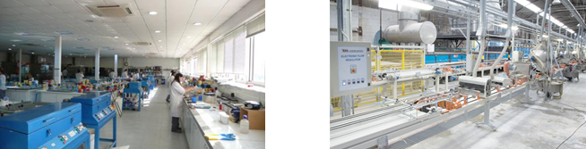
New challenges for the ceramic tiles
New sintering processes: PVD decoration, laser firing
New large-format laminated porcelain covered by a thin film PV solar cell to BIPV
Development of new pigments suitable for ink-jet decoration on ceramic tiles
Development of new functionalities of the ceramic tiles by means of the glaze: anti-slip tiles, bactericidal tiles, anti-fogging and self-cleaning tiles
Residues revalorization to substitute a huge part of raw materials
Notes:
So, following with challenges, here are the new challenges for the ceramic tiles.
Laser /leisa/
Suitable /sutebol/

Slide 8
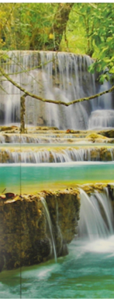
Ceramic tile industry
Spanish ceramic industry is totally automated→ TECHNOLOGY 4.0
Spanish ceramic sector is leader in decoration with the DIGITAL PRINTING on ceramic tiles
To be more competitive and to improve the increasing trend in exports:
The challenge proposed by Europe: CIRCULAR ECONOMY: it aims to redefine products and services to design waste out, while minimising negative impacts.
Example of ceramic tile decoration
Notes:
So, the ceramic tile industry manufacture /manifaccha/ traditional product that needs technological, environmental and energetic innovation to be competitive throughout /zrúgaut/ the world /güelt/.
Fortunately, the Spanish ceramic sector presents 2 main fundamentals:
Its high automation /otomeison/ called technology 4.0 and its large experience in digital printing.
However, the challenge /chálens/ proposed by Europe consists of the production of ceramic tiles under the concept of circular economy. This concept includes not only the revalorization of residues, but to ensure a environmental friendly end of the life cycle /saicol/ of each product.

Slide 9
Vitrification
of industrial residues
2

Slide 10
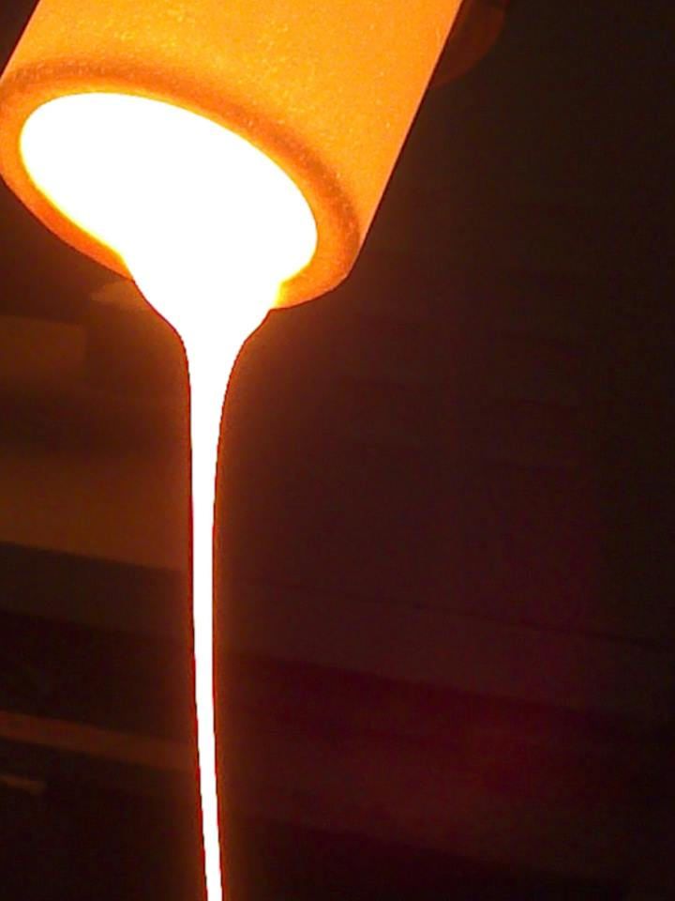
2. Vitrification of residues: alternative method to treat industrial residues
Homogenisation of industrial residues
Relative low manufacturing cost compared with the advanced ceramics.
The high energetic cost of the melting stage can be amortized thanks to the optimization of the thermal processes of crystallization / sintering and to the use of industrial residues as raw material.
There are obtained products of high mechanical resistance from formulations that contain more than 90 % of industrial residues.
The inertization, recovery and valuation of residues proceeding from the incineration of the urban and industrial residues are fundamental challenges to promote the environmental sustainability.
Notes:
SiO2 silicon dioxide
Aluminium oxide
Sodium oxide
Calcium oxide
Iron oxide
Recycled glass: soda-lime silicate glass
X-ray fluorescence
X-ray difraction

Slide 11
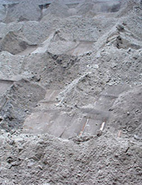
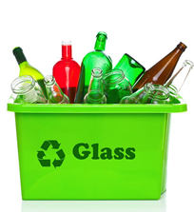
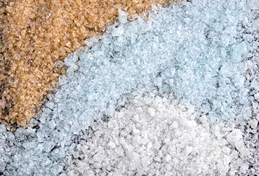
Industrial residues
in Castellón region
ASHES FROM A COAL-FIRED POWER STATION
RECYCLED GLASS
CERAMIC FRITS WASTE

Slide 12
Characterization of residues
XRF-%WT | Na₂O | MgO | Al₂O₃ | SiO₂ | K₂O | CaO | TiO₂ | Fe₂O₃ | BaO | ZnO | LOI
ASHES FROM A COAL-FIRED POWER STATION | 0,2 | 1,2 | 26,0 | 43,4 | 1,2 | 5,4 | 0,9 | 18,0 | 0,0 | 0,0 | 0,0
RECYCLED GLASS | 12,6 | 3,8 | 0,9 | 73,2 | 0,3 | 8,9 | 0,1 | 0,1 | 0,0 | 0,0 | 0,0
CERAMIC FRITS WASTE | 10,4 | 0,0 | 4,0 | 57,7 | 1,8 | 20,3 | 0,0 | 0,0 | 0,5 | 1,1 | 3,1
XRD: AMORPHOUS STRUCTURE
Notes:
SiO2 silicon dioxide
Aluminium oxide
Sodium oxide
Calcium oxide
Iron oxide
Recycled glass: soda-lime silicate glass
X-ray fluorescence
X-ray difraction

Slide 13
Glass-ceramic glazes
from industrial wastes
3
Notes:
Esmalt de Mado

Slide 14
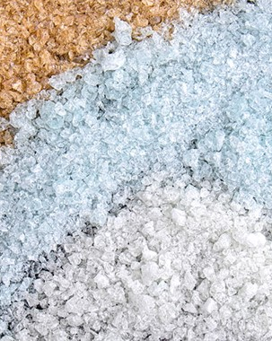
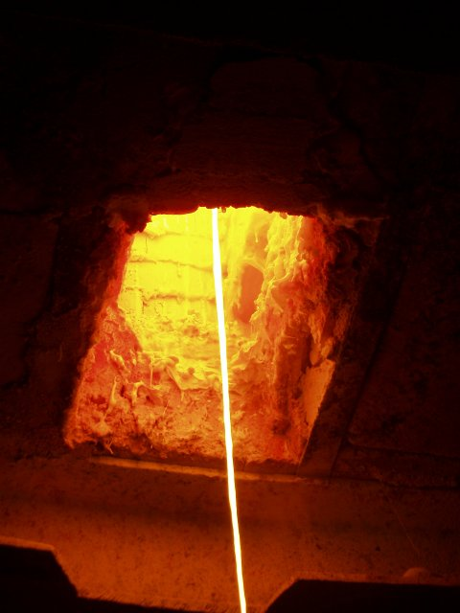
3.1. Glass-ceramic glaze from frit waste

Slide 15
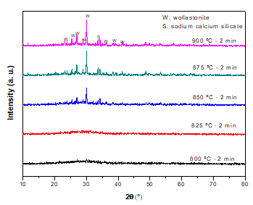
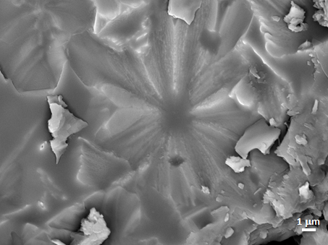
3.1. Glass-ceramic glaze from frit waste
Wollastonite and sodium calcium silicate
Diffractograms of samples fired for 2 min at different temperatures.
SEM micrograph of glass-ceramic samples fired at 900ºC - 2min
E. Barrachina Albert, J. Llop Pla, M. Notari Abad, J. Carda Castelló, “Potentiality of a frit waste from ceramic sector as raw material to glass-ceramic material production”, Boletín de la Sociedad Española de Cerámica y Vidrio, 54 101-108, 2015.

Slide 16
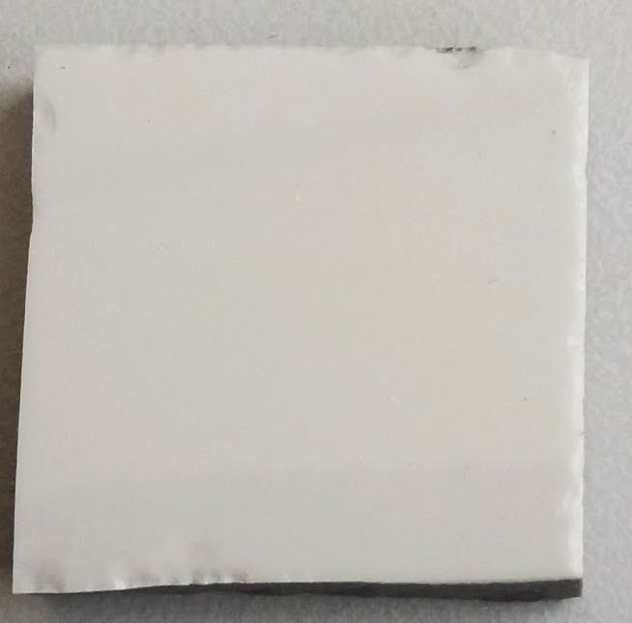
3.1. Glass-ceramic glaze from frit waste
A glaze has been prepared with this frit waste to be used in porcelain tiles: FW glaze. Applicated by doctor blade method
 | Vickers microhardenes (HV-1N 30s) | Flexural Strength (N/mm²) | Chemical resistance*
STD-glaze | 600 | 450 | Medium
FW-glaze | 800 | 550 | High
INTRODUCING FRIT WASTE → MAINTAINING WHITENESS → SAVING EXPENSIVE RAW MATERIALS TO PRODUCE GLAZE WHITENESS (ZrSiO4) AND ENERGY
* ISO 10545-13:1995
E. Barrachina Albert, J. Llop Pla, M. Notari Abad, J. Carda Castelló, “Potentiality of a frit waste from ceramic sector as raw material to glass-ceramic material production”, Boletín de la Sociedad Española de Cerámica y Vidrio, 54 101-108, 2015.
Notes:
It is resistant against cleaning products, swimming-pool salts, high concentration of acids and bases because it is not appreciated any stain on the glaze after been treated.

Slide 17
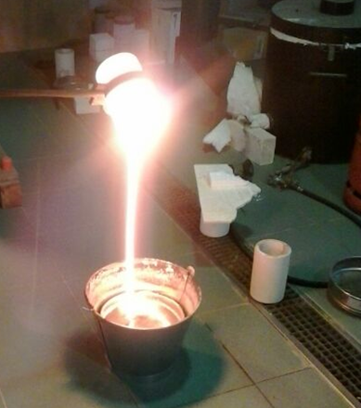
3.2. Glass-ceramic glaze using ashes from the coal-fired power station ASHES FROM A COAL-FIRED POWER STATION

Slide 18
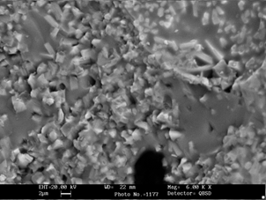
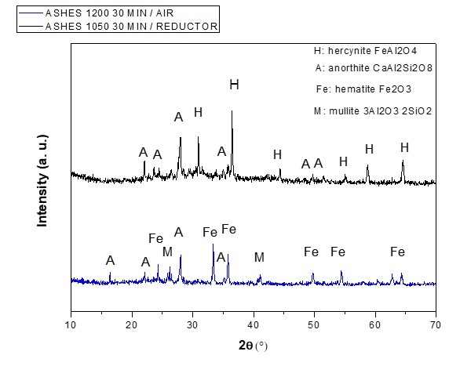
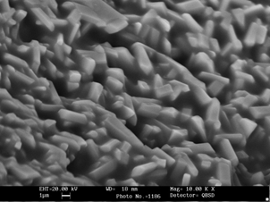
3.2. Glass-ceramic glaze from ashes
Reductor atmosphere: hercynite and anorthite
SEM micrographs
Air atmosphere: anorthite, hematite and mullite
Notes:
Drx magnetico

Slide 19
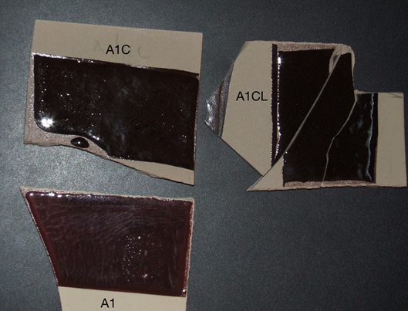
3.2. Glass-ceramic glaze from ashes
Reductor atmosphere: hercynite and anorthite
Air atmosphere: anorthite, hematite and mullite
 | Vickers microhardenes (HV-1N 30s) | Flexural Strength (N/mm²) | Chemical resistance*
STD-glaze | 600 | 450 | Medium
Oxidated glaze | 800 | 550 | High
Reduced glaze | 1050 | 620 | High
SAVING RAW MATERIALS
AND ENERGY
RECOVERING
OF ASHES
Notes:
Drx magnetico

Slide 20
Glass-ceramic laminate from industrial wastes
4
Notes:
Esmalt de Mado

Slide 21
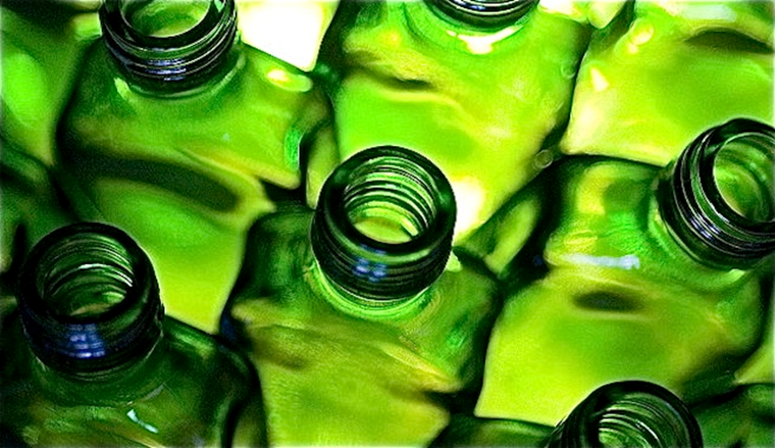
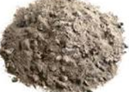
4. Glass-ceramic laminate from industrial wastesSHES FROM A COAL-FIRED POWER STATION

Slide 22
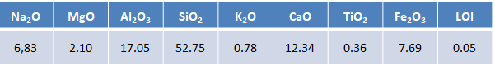
4. Glass-ceramic laminate from industrial wastes
COMPOSITION: 50wt% recycled glass + 40wt% ashes + 10 wt% CaCO₃
XRF-%WT
Notes:
Drx magnetico

Slide 23

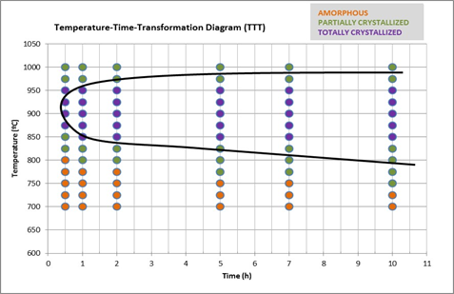
4. Glass-ceramic laminate from industrial wastes
COMPOSITION: 50wt% recycled glass + 40wt% ashes + 10 wt% CaCO₃
Notes:
Drx magnetico

Slide 24
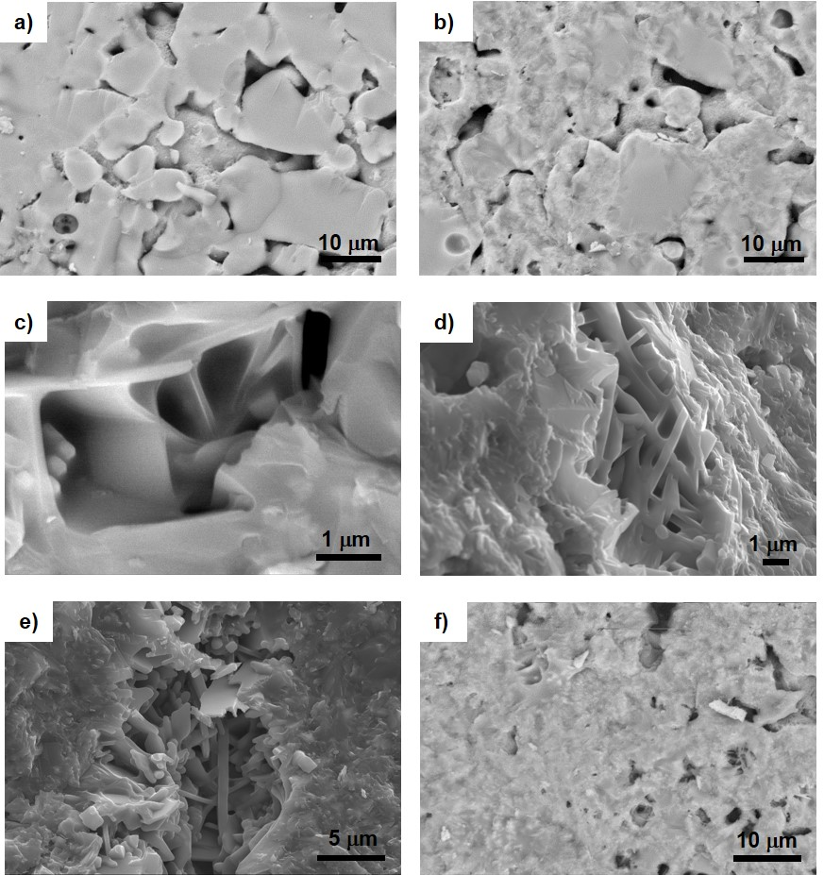
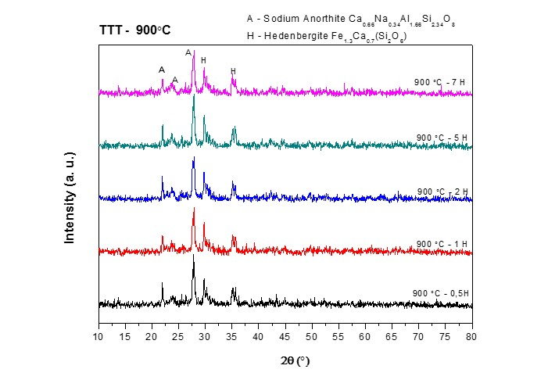
4. Glass-ceramic laminate from industrial wastes
COMPOSITION: 50wt% recycled glass + 40wt% ashes + 10 wt% CaCO₃
Notes:
Drx magnetico

Slide 25
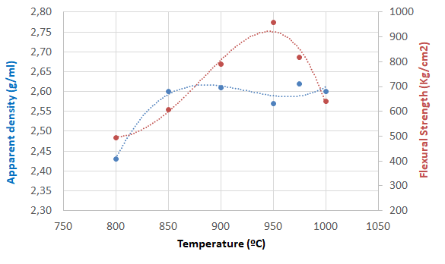
4. Glass-ceramic laminate from industrial wastes
Fired ceramic porcelain at 1200ºC
Apparent density: 2.4 g/cm³
Flexural Strength: 600 kg/cm²
Notes:
Drx magnetico

Slide 26
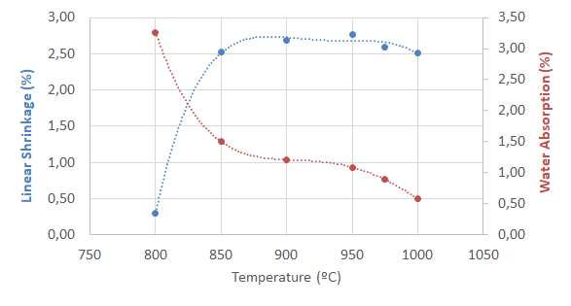
4. Glass-ceramic laminate from industrial wastes
Fired ceramic porcelain at 1200ºC
Linear Shrinkage: 7%
Water absorption<1%
Notes:
Drx magnetico

Slide 27
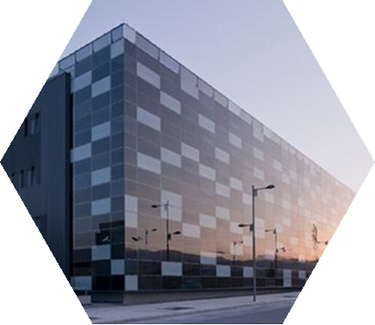
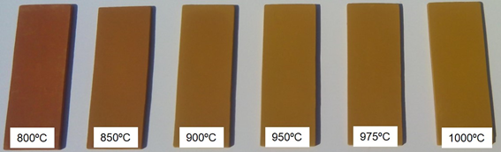
4. Glass-ceramic laminate from industrial wastes
APPLICATIONS:
High-resistance floors and covers
Kitchen worktops
High - resistance substrates in thin films solar cells
SAVING RAW MATERIALS AND ENERGY
VALORIZATION
OF INDUSTRIAL WASTES

Slide 28
Conclusions:
5
Notes:
I agraiments

Slide 29
5. Conclusions
The Spanish ceramic sector needs to improve the technological offer to be competitive and to continue the growing tendency of its exports.
OPPORTUNITY:
The revalorization of industrial residues by means of the glass-ceramic method (vitrification):
  Glass-ceramic glazes
  Glass-ceramic laminates
Glass - ceramic products exhibiting high- mechanical and chemical resistances have been synthesized, using a huge percentage of industrial waste.
Revalorization of industrial wastes, we save raw materials and energy.
Notes:
Drx magnetico

Slide 30
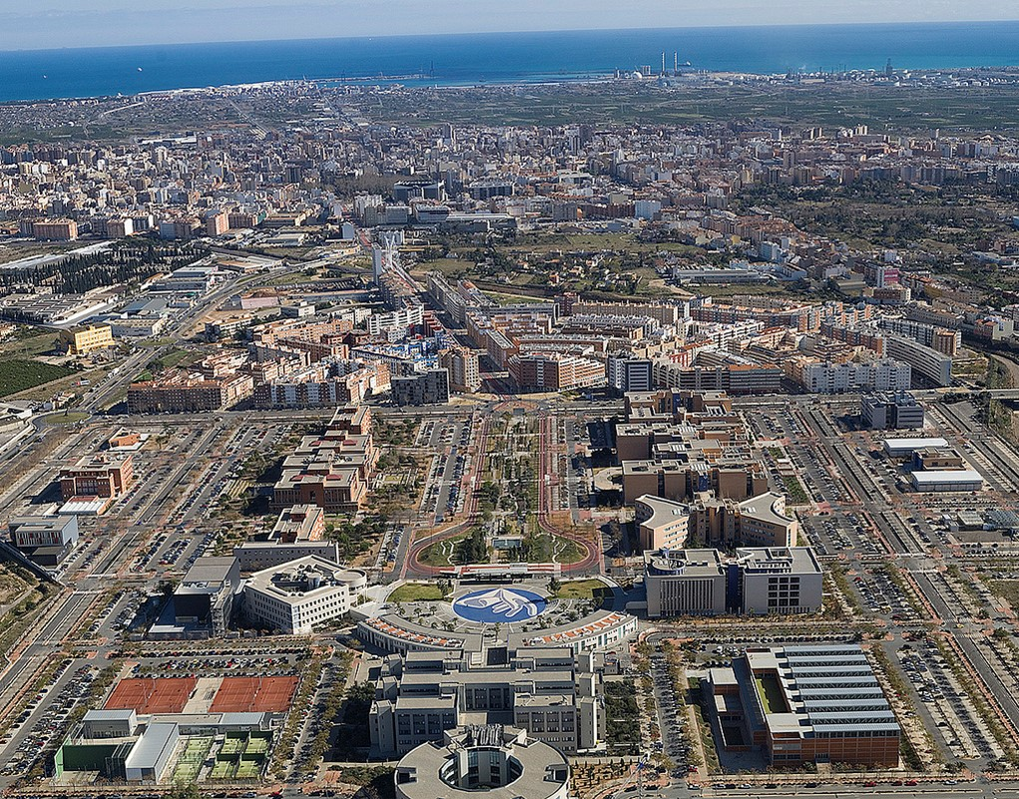


Aknowledgements
Solid State Chemistry Research Group of Universitat Jaume I
Central Services of Scientific Instrumentation of Universitat Jaume I
High School of Ceramic in l´Alcora, Castellón, Spain
Spanish Ministry of Economy, Industry and Competitiveness
Notes:
Drx magnetico

Slide 31

Thanks!
Any questions?
You can find me at
ebarrach@uji.es

