Slide 1



Computational Analysis of the Intermolecular Interaction Driving the
Self-assembly of Collagen
Esma Eryilmaz¹, Winfried Teizer^{2,3}
Wonmuk Hwang^{2,4}
¹Selcuk University, TR
²Texas A&M University, USA
³AIMR, Tohoku University, JAPAN
⁴Korea Institute for Advanced Study, S.KOREA
esma@tamu.edu
Bioscience 2016

Slide 2
OUTLINE
What is collagen?
Motivation for collagen research
Self-assembly of collagen
Experimental observation of self-assembled collagen patterns
  D-periodic motif of collagen fibril
  Materials, methods, and results
Computational investigation of collagen self-assembly and microstructure
  Sequence level analysis of collagen alpha chains
  Intermolecular interaction analysis between collagen molecules
  Many body interaction energies
Notes:
I will start my presentation with an introduction of collagen and its characteristics. Then mention the motivation for collagen research. What are the research areas in which collagen is used. Self-assembly of collagen and experimental procedure to obtain in vitro fibrillar collagen matrix. Then, I discuss the self-assembly process with a computational approach by using the amino acid sequence of the protein molecule, collagen and a high level programming language, Python.

Slide 3
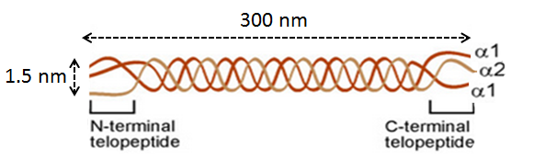
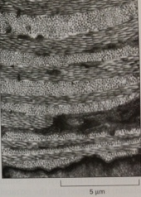
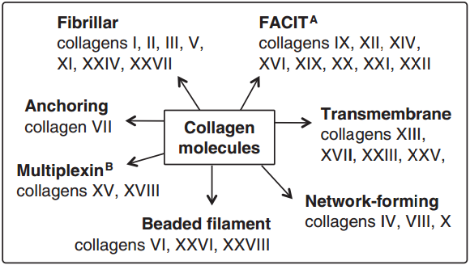

What is Collagen?
most abundant protein ~30%
~300nm length and 1.5nm diameter
hybrid form
huge family
5 $μ$m
Type-I
Most abundant
Heterotrimer
Hard and soft tissues
Type-III
Second most abundant
Homotrimer
Soft tissues
Molecular Biology of The Cell, 2008
Muiznieks, L.D., Biochim Biophys Acta, 2013
Notes:
Collagen represents the most abundant structural, fibrous protein in the body (mammals/vertebrate/all multicellular animals) and the largest components of the ECM which is the living environment for cells. SEM image of a tissue that is a tadpole skin, is seen on top right. This organization is also found in cornea and bond.
Collagen is a fibrillar protein w/300nm length and 1.5nm diameter. As I will mention in later slide in detail, collagen molecule assemble into a microfibrillar, fibrillar and bundle structures by self assembly. Collagen fibrils not only reinforce the mechanical properties of tissues, but also they influence cellular motility and morphology by shaping and organizing the extracellular matrix(ECM).
Fibrillar collagens, usually constitute the majority of molecules. They provide the structural framework and the mechanical strength of tissues (Silver2003)
Bone- tendon, soft tissues such as sikin, artery walls, internal organs..
They co-exist in same tissue as a hybrid form and little known about it.
Collagen is synthesized in the precursor form procollagen with non-helical extensions at both ends. After removal of the N- and C- propeptides by specific proteinases, tropocollagen with short non-helcal and long helical triple helical chain, it becomes ready for assembly into fibrils.
Each collagen molecule is made of three peptide chains that form ~300nm long triple helical collagen molecule.

Slide 4
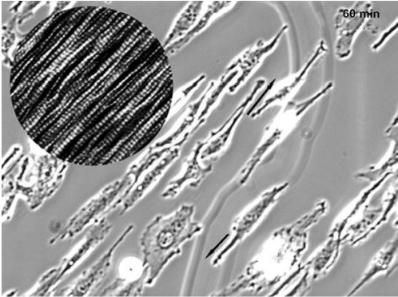
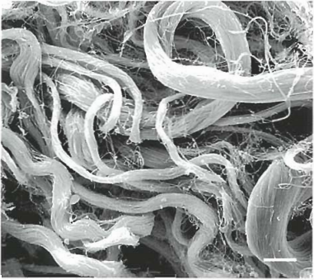
Motivation
Engineering aspect
Medical aspect
Pattern Formation
Surface Assembly
Cisneros, D. A., Small, 2007, 3, p.965
Ushiki T., 2002, 25, p.109
Notes:
Self-assembly of biomolecules on solid surfaces has a great importance in both medical and engineering applications.
In this research, we work with ECM protein Collagen. Collagen is frequently used as platforms for cell biological and tissue engineering app, such as coating non-biological surfaces and enhance biocompability or pattern functionalized surfcaces. In the figure at bottom left, directing attachment, alignment, and growth of embrionic fibroblast(conn tiss cell) on collagen ttype-I matrices A light mic image. The circular inset shows the hight resolution AFM topograpy of collagen fibrils.
Biomolecule-surface interaction is also important in medical applications. For example, plaque formation on teeth, artificial organ devices such as coronary stent, or fouling of contact lences are some phenomena including this interaction..

Slide 5
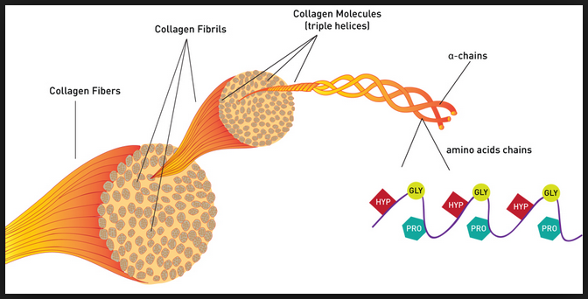
Self-Assembly of Collagen
hierarchical
tissue specific
heterotypic assembly
ECM-cell communication
entropy driven
D-period
http://www.proto-col.com/blog/2014/07/collagen
Notes:
In the EC space and in vitro, coll mol hierarchically self-assemble into many ddiff structures that is suited to their physilogical function. At neutral pH, composition of hydrophobic, hydrogen bonding and electrostatic interaction between adjacent molecules result in the formation of collagen fibrils with D-periodic spacing.
Macroscale structure and organization of collagen fibrils are key contributor to the mechanical propeties of soft tissue, bone, tendon, ligaments.
Yet, we understand relatively little about how collagen molecules combine to form larger-scale structural elements such as fibrils and fibers and how they provide crucial mechanical properties to the organism. The lowest hierarchical level element of all collagen-based tissues is collagen molecule which is arranged in a staggered manner and form microfibrils. This structure creates an observable periodicity known as the D-band (D-period) where D=67nm. (The collagen mol length’s is 4.46D.)
According to the Hodge-Petruska model, a structural model of collagen microfibril, molecules in fibrils are deposited side by side, parallel, but a staggered with respect to each other as shown in later..

Slide 6
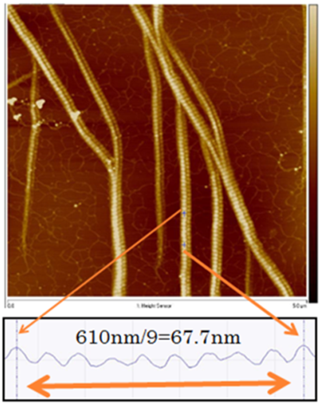
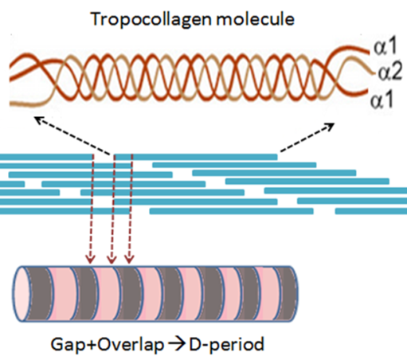
Characteristics of Collagen : D-Period
Notes:
D-period is the characteristic signiture of col fibrils observed in characterization tecniques. AFM images of the characteristic D-periodic spasing on type-I collagen fibril. The image is taken from the sample of 5 Mg/ml concentration upon 1h incubation on phlogopite mica. 5x5 Mm2.
The lowest hieracrhical element of all coll based tissues is collagen mol. Coll mole are deposited side by side, parallel, but a staggered manner and form microfibrils. Illustration of D-period as suggested in Petrusha model as a combination of gap and overlap regions on the fibril.
Macroscale structure and organization of collagen fibrils are key contributor to the mechanical propeties of soft tissue, bone, tendon, ligaments.
The organization of collagen on microscale profoundly influences cell morphology, migration, prolofiration, and gene expression [ThakarRG03,307]. In the extracelular space, coll mol hierarchically self-assemble at the nano, micro, and macro scales into many different structures that is suited to their physiological function. While the linear periodicity of coll fibrils rather easy to detect, much more effort needs to be devoted to the investigation of lateral packing.
Molecular deformation of collagen fibrils upon loading, applied stress (PMa). At small deformation, until the fibril stress reaches 50 Mpa(which corresponds to ~10% strain), deformation occurs in gap region, and the collagen reaches its counter length. Beyond this point, the molecular end-to-end distance still increases, but the slope is smaller in Panel c. This is due to the fact that, below ~10% strain, the molecule is straightened within the microfibril, while beyond this point, the molecule is actually stretched resulting in a larger resistance of the whole microfibril -Gautieri. Several reports also indicates that strain beyond 2% results in a molecular slippage. Mosler 1985.

Slide 7
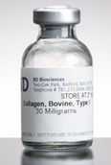
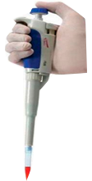
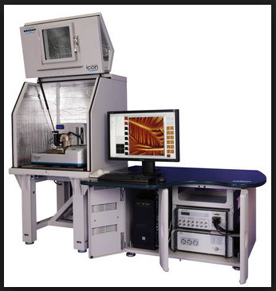
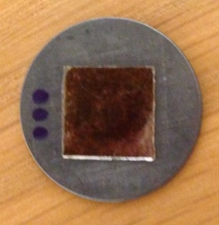
Experimental: Materials and Methods
4⁰C
Collagen buffer
Self-assembly
Imaging w/ AFM
Collagen buffer
30mM Na₂HPO₄
10mM KH₂PO₄
200mM KCl
Type-I
-20⁰C
Deposition
Self-assembly
Collagen buffer
Type-III
Notes:
We purchase typ-I and type-III as a soluable and freezed form respectively. we incubate the solutions on fresly cleaved mica substrate for a given time. After that, flush with DI water and leave at air dry. The resulting network is imaged w/AFM.

Slide 8
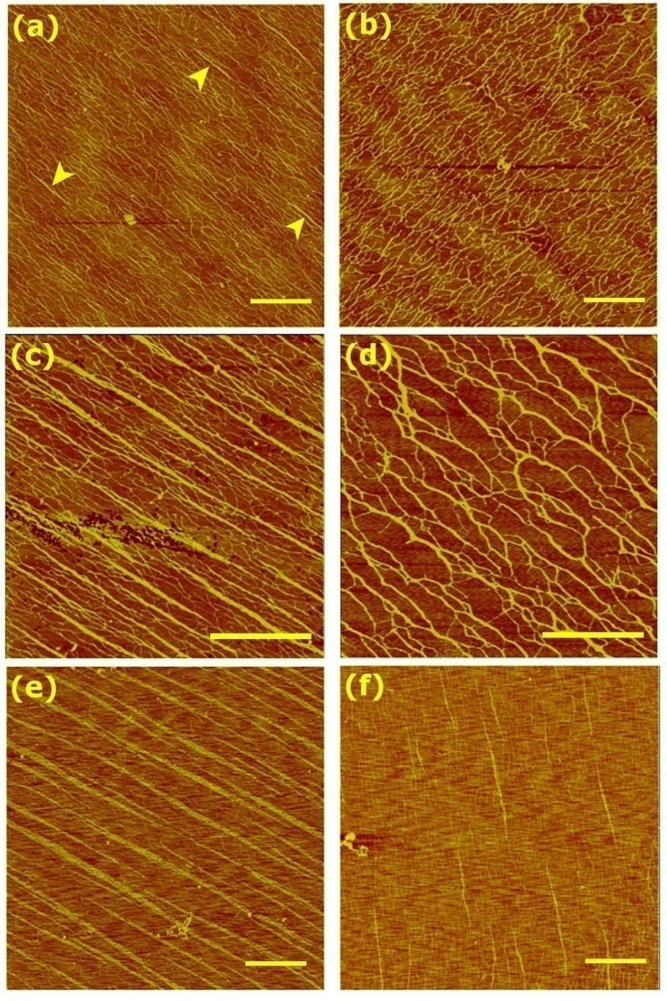
Comparative self-assembly-Longer lag phase for type-III
Type-I
Type-III
(a-b) 2 μg/ml, 2 nm color scale
(c-d) 4 μg/ml, 2 nm color scale
(e-f) 5 μg/ml, 5 nm color scale
2 min deposition on muscovite.
Scale bar: 1 μ m
Eryilmaz, E, Cell Mol Bioeng,
2016, p.1-13
Notes:
The self-asssembly of collagen type-I has been investigated for decades, but very little known about the self-assembly of type-III collagen. We compared the emergence of homotypic type-I vs. type-III fibrils by increasing collagen concentration to 2-5 Mg/ml, with 2 min incubation. Color scales are (a-d) 2 nm, and (e,f) 5 nm. In (a), examples of nascent fibrils are marked by arrowheads. Scale bar: 1 Mm.
At 2 Mg/ml, extensively connected networks form, where nascent fibrils can be seen in type-I, but not in type-III collagen.
At 4 Mg/ml, straight fibrils form extensively, whereas type-III forms interconnected fibrils possessing branched and kings.
At 5 Mg/ml, type-I collagen behaves similarly to the case of 4 Mg/ml, except that fibrils are wider. This indicates that type-I fibrils can grow laterally. For type-III collagen, straight fibrils are visible in f, which is analogous to the nucleation of straight fibrils for typeI collagen at 2Mg/ml.
Overall, these results suggest that type-III collagen has lower propensity to nucleate straight fibrils than type-I does.

Slide 9
Homotypic Self-Assembly of Type-I and Type-III on
phlogopite
5 µg/ml of concentration
1 h incubation time
Color scale
(a) 7 nm, type-I
(c) 4 nm, type-III
Eryilmaz, E, Cell Mol Bioeng,
2016, p.1-13
Hwang W.and Eryilmaz, E, PRL,
2014, 025502
Notes:
AFM images of the self-assembly of types-I and III collagens on phlogopite mica. All images are with 5 Mg/ml concentration and 1-h incubation. Scan sizes are 20 Mm. Color scales correspond to (a,c) 10 nm (b,d) Corresponding networks constructed by CAFE. Number of identified filaments is given on each panel.

Slide 10
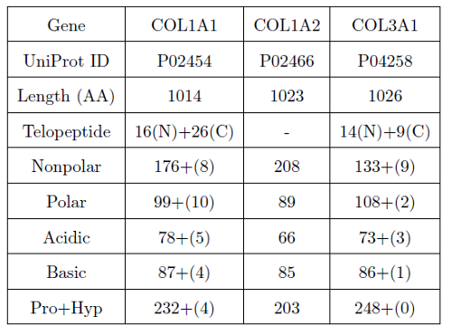
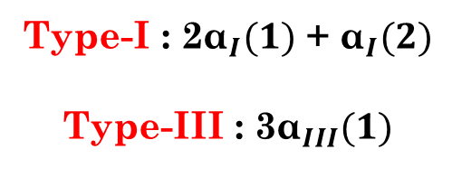
Theoretical: Primary structure of type-I and type-III
collagen
Protein Knowledge Database, UniProtKB (http://www.uniprot.org/uniprot/).
Amino Acid Calculator, http://proteome.gs.washington.edu/cgi-bin/aa_calc.pl.
Notes:
Now, let’s look at the sequence level properties of each molecule. Sequences are for rat (type-I) and bovine (type-III) collagen. (a) Counts for individual chains. Type-I
collagen consists of two 1 and one 2 chains, Type-III collagen is a homotrimer of 1 chains. The numbers
in parentheses are counts for telopeptides. COL1A2 does not have telopeptides marked in the UniProt
Database.

Slide 11
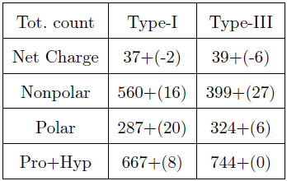
Theoretical: Primary structure of type-I and type-III
collagen
Non-polar : Val, Leu, Ile, Met, Phe, Trp, Cys
Polar: Gln, Asn, His, Ser, Thr, and Tyr.
Notes:
This table shows the net molecular properties of each type of collagen. For the number of hydrophobic amino acid, we considered Val, Leu, Ile, Met, Phe, Trp, Cys (sayilar check edilmeli) [Barnes03, tezimden]. For polar amino acids, we considered Gln, Asn, His, Ser, Thr, and Tyr.
(b) Total counts.
By using these informations and the sequences

Slide 12
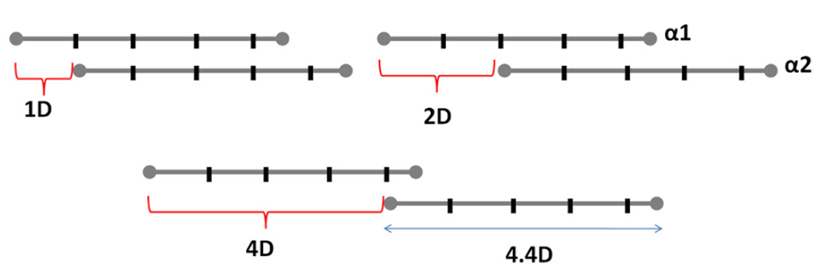

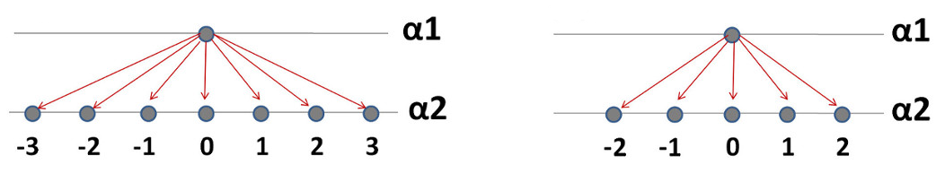
Amino acid level interaction analysis for D-periodic binding positions
Notes:
Information for molecular packing and higher level fibrillar structure of a protein is actually carried by its primary sequence. However, due to the considerably higher number of residues of polypeptides , the success and accuracy in a study of aa level analysis requires a high level computer program that can recognize each aa and calculate its corresponding contribution. To achieve that, we used a scripting language Python.
D-periodic staggered arrangements of alpha chains of collagen molecules are illustrated on top.
An illustration of the interaction range of our computational approach to count the electrostatic and the hydration interaction scores(hydrophobic&polar).
To a first approximation, we considered the collagen molecules as linear molecules of only alpha-1 chain. Collagen molecules possesses a length of 4.4D. As D characteristic binding space of 67nm, an alpha chain is arranged at specific staggered positions of 0D, 1D, 2D, 3D, and 4D with another alpha chain. The system gains score for some specific amino acid pairs (in defined range) on the two sequences located at a given positions to calculate the degree of interaction. We excluded the small aa Gly and Alanine and considere the strong non-polar aa as V, M, I, L, and F for hydrophobic int. For polar interaction, S,T, C,N, and Q is used in the program.

Slide 13
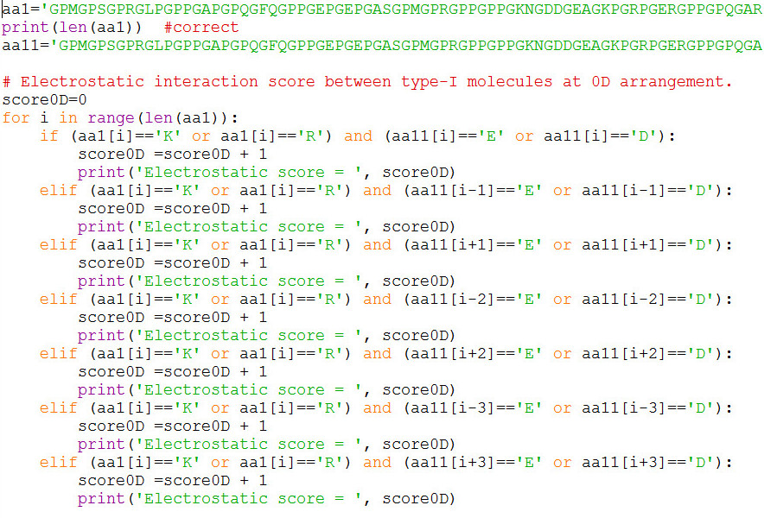
Amino acid level intermolecular interaction analysis

Slide 14
Contribution of each interaction scores on molecules
Notes:
To understand the D-periodic arrangement of collagen fibils, 0D represents the perfect alignment of the two collagen molecules, so that the max number of interaction between the chains occurs at 0D. The total interaction scores shows that type-I has a higher attraction at 0D and 1D, while type-III has that at 2D and 3D. However, the considerably stronger magnitude of interaction for 0 and 1D, could give type-I molecules higher propensity for nucleation and growth as shown in the experiment.

Slide 15
Energy change upon sliding chains by one amino acid
Number of amino acid
D = 234 ± 1 aa
Notes:
To understand the D-periodic arrangement of collagen fibils, 0D represents the perfect alignment of the two collagen molecules, so that the max number of interaction between the chains occurs at 0D. When we look at the local change on the energy score plot, the local energy minima correspond to the D-periodic binding of collagen molecules reported/observed.

Slide 16
Energy change upon sliding chains by one amino acid
0D
1D
2D
3D
4D
Number of amino acid
D = 234 ± 1 aa
Notes:
0D represents the perfect alignment of the two collagen molecules, so that the max number of interaction between the chains occurs at 0D. When we look at the local change on the energy score plot, the local energy minima correspond to the D-periodic binding of collagen molecules reported/observed.

Slide 17
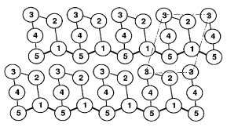
Many body interactions
2-body
3-body
4-body
5-body
Semi-hexagonal
Orgel , J.P.R.O, Structure,
2001, p.1061-1069
Notes:
Now, we want to understand microfibrillar 5 collagen molecules generating D-period.
Their observation reveals that the three dimentional molecular packing arrangement of type-I collagen molecules are arranged on a quasihexagonal lattice.

Slide 18
Many body energy scale per amino acid
Only attractive contributions, hydrophobic and electrostatic, were considered as a score of 1 for each (hydrophobic and electrostatic) pair.

Slide 19
Total energy per molecule
The total energies for 2-, 3-, 4-, and 5-body model configurations.

Slide 20
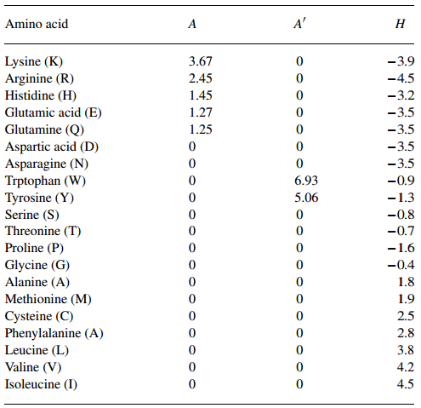
Amphiphilicity and hydropathy indices of amino acids
Mitaku S., Bioinformatics,
2002, p.608 - 616
Notes:
A represents the Amphiphilicity values of strongly polar residues, A` weakly polar residues.
The last column represents the hydropathy index.

Slide 21
Summary
Collagen super family and collagen research
Experimental/In vitro self-assembly of collagen
Comparative nucleation rate of type-I and type-III collagen
Investigation of D-periodic binding with experimental and Python methods
Involving the amphiliphilicity and hydropathy index
THANK YOU.

Slide 23
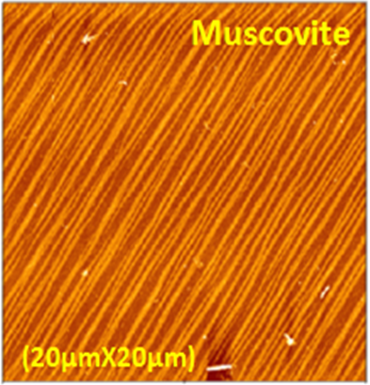

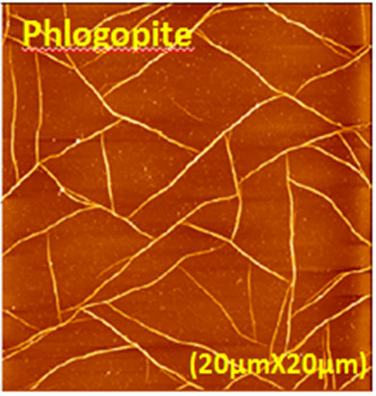
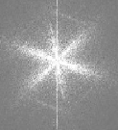
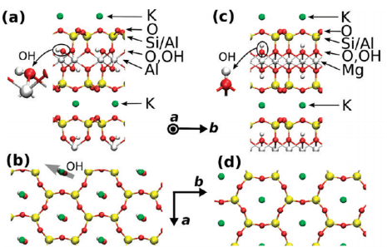
Epitaxial Control of Collagen Assembly
5μg/ml collagen
2h incubation
200mM KCl
(a,b) muscovite, (c,d) phlogopite mica structure.
LeowWW., Langmuir, 27, 2011, 10907
Notes:
As we mention in engineering aspect, it is possible to use the self-assembly ability of collagen to produce the patterned surface. By using the protocol provided by our group before, we prodeceed two different.. We used the two structure as a temple for the purpose assembly search.
Atomic structure of muscovite and ph mica is seen the bottom figure. (a, c) is the view from the a axis of the unit cell, (b,d) is view from above the cleavage plane(ab plane). Middle Al layer of muscovite Al is a dioctahedral sheet, whereas Mg layer in phl is a trioctahedral sheet. Atoms are vertically ligned in phl compared to musc. The two K layer are separated by 9.98 A in musc and 10.24 A in phlo. The insets show different orientation of OH group in the two lattices. The proximity and the direction of OH group to the K+ atom in phl reduce its binding affinity.

Slide 24
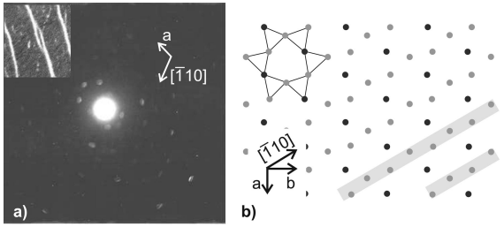
Sun M., Langmuir,(24) 2008, 5418.

