Slide 1

About OMICS Group
OMICS Group International is an amalgamation of Open Access publications and worldwide international science conferences and events. Established in the year 2007 with the sole aim of making the information on Sciences and technology ‘Open Access’, OMICS Group publishes 400 online open access scholarly journals in all aspects of Science, Engineering, Management and Technology journals. OMICS Group has been instrumental in taking the knowledge on Science & technology to the doorsteps of ordinary men and women. Research Scholars, Students, Libraries, Educational Institutions, Research centers and the industry are main stakeholders that benefitted greatly from this knowledge dissemination. OMICS Group also organizes 300 International conferences annually across the globe, where knowledge transfer takes place through debates, round table discussions, poster presentations, workshops, symposia and exhibitions.

Slide 2
About OMICS Group Conferences
OMICS Group International is a pioneer and leading science event organizer, which publishes around 400 open access journals and conducts over 300 Medical, Clinical, Engineering, Life Sciences, Pharma scientific conferences all over the globe annually with the support of more than 1000 scientific associations and 30,000 editorial board members and 3.5 million followers to its credit.
OMICS Group has organized 500 conferences, workshops and national symposiums across the major cities including San Francisco, Las Vegas, San Antonio, Omaha, Orlando, Raleigh, Santa Clara, Chicago, Philadelphia, Baltimore, United Kingdom, Valencia, Dubai, Beijing, Hyderabad, Bengaluru and Mumbai.

Slide 3
Shape Optimization of a Wind Turbine Airfoil by Using Genetic Algorithm
Erkan Orman and Gokhan Durmus (co-author)
Anadolu University, Faculty of Aeronautics and Astronautics, Eskisehir, Turkey

Slide 4
Presentation Layout:
Introduction: Airfoil Design
PARSEC Airfoil Parameterization Method
Optimization Algorithm: Genetic Algorithm
Flow Analysis Program: XFOIL
Results
References

Slide 5
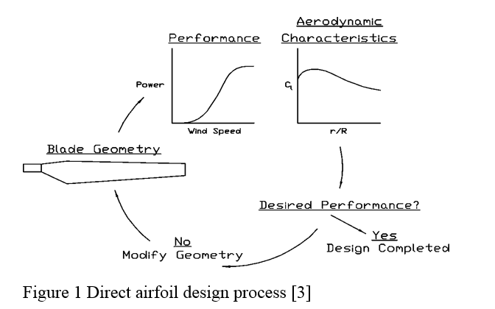
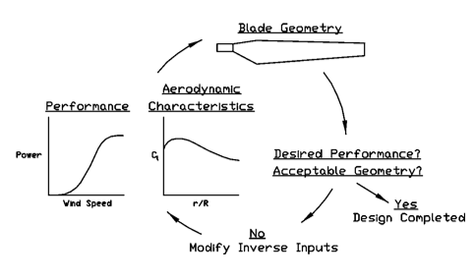
Direct Airfoil Design-Inverse Airfoil Design
Figure 1: Direct and Inverse Airfoil Design Process

Slide 6
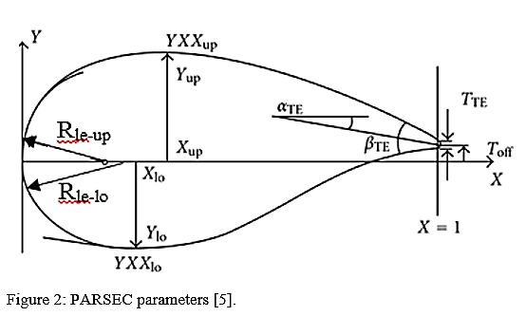
PARSEC Airfoil Parameterization Method
PARSEC Parameter Name | Range for NACA 4415
 | Lower Boundary | Upper Boundary
P1-(Rle-up) Upper Leading Edge Radius | 0.028 | 0.032
P0-(Rle-lo) Lower Leading Edge Radius | 0.012 | 0.018
P2-(Xup) Position of Upper Crest Point | 0.31 | 0.37
P3-(Yup) Upper Crest Point | 0.09 | 0.13
P4-(YXXup ) Upper Crest Curvature | -0.85 | -0.89
P5-(Xlo) Position of Lower Crest Point | 0.15 | 0.19
P6-(Ylo) Lower Crest Point | -0.02 | -0.06
P7-(YXXalt) Lower Crest Curvature | 0.60 | 0.75
P11-(αTE) Trailing Edge Direction Angle | -8.2 | -8.8
P12-(βTE) Trailing Edge Wedge Angle | 27.4 | 27.6
P8-Trailing Edge Offset (Toff) and P9-Trailing Edge Thickness (TTE) are zero.
P4
P3
P10
P9
P1
P2
P11
P8
P5
P0
P6
P7

Slide 7

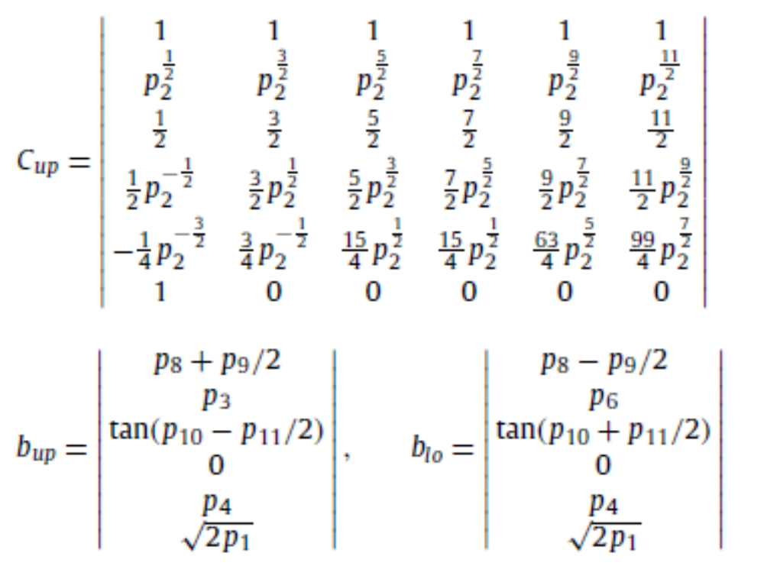

PARSEC Airfoil Parameterization Method
P4
P3
P10
P9
P1
P2
P11
P8
P5
P0
P6
P7

Slide 8
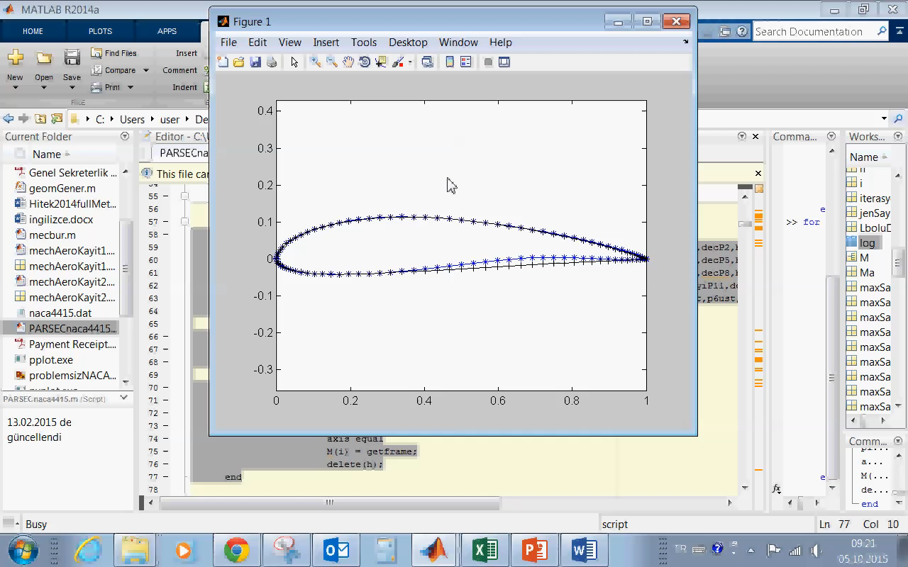
PARSEC Airfoils Based on NACA 4415

Slide 9
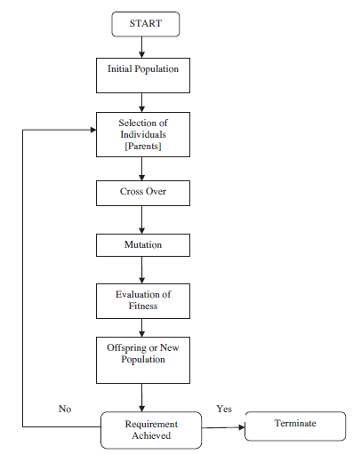
Optimization Algorithm: Genetic Algorithm
Fitness function: cl/cd
Pc: 0.45
Pm: 0.05
Selection Method: Tournament Selection
Coding Method: Binary

Slide 10
Flow Analysis Program: XFOIL
Re: 350000
AoA Interval: 2°-5°
Mach Number: 0.03
Flow: Inviscid, irrotational, incomppressible
Flow Solution Method: Panel Method

Slide 11
Results (2-5 AoA Range)
AoA | cLopt | cLorg | cL_inc(%) | cDopt | cDorg | cD_inc(%) | cL/cDopt | cL/cDorg | cL/cD_inc(%)
2 | 0,789 | 0,768 | 2,72 | 0,00974 | 0,00969 | 0,52 | 80,97536 | 79,23633 | 2,19
2,5 | 0,839 | 0,808 | 3,80 | 0,01002 | 0,01 | 0,20 | 83,70259 | 80,8 | 3,59
3 | 0,884 | 0,845 | 4,58 | 0,01029 | 0,0102 | 0,88 | 85,91837 | 82,88235 | 3,66
3,5 | 0,927 | 0,887 | 4,56 | 0,01052 | 0,01052 | 0,00 | 88,10837 | 84,26806 | 4,56
4 | 0,971 | 0,927 | 4,67 | 0,01085 | 0,01081 | 0,37 | 89,46544 | 85,79093 | 4,28
4,5 | 1,010 | 0,968 | 4,37 | 0,01108 | 0,01118 | -0,89 | 91,13718 | 86,53846 | 5,31
5 | 1,052 | 1,006 | 4,58 | 0,01142 | 0,01148 | -0,52 | 92,15412 | 87,65679 | 5,13
mean | 0,924 | 0,887 | 4,226 | 0,01056 | 0,010554 | 0,05 | 87,35 | 83,88 | 4,14

Slide 12
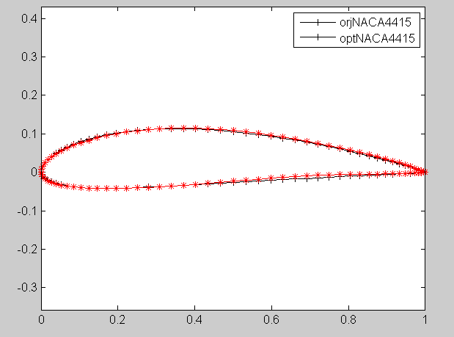
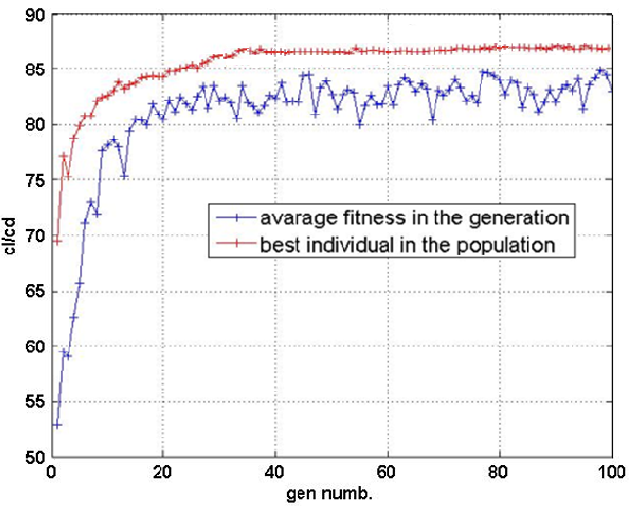
Results (2-5 AoA Range)

Slide 13
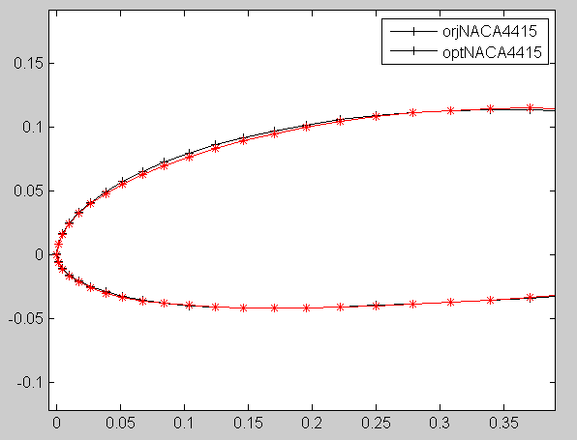
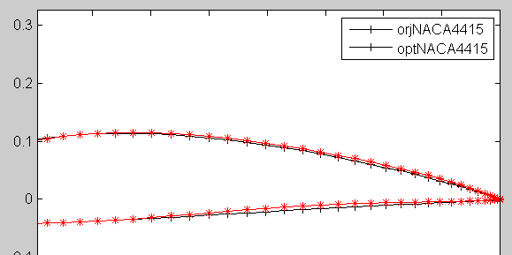
Results (2-5 AoA Range)

Slide 14
References
[1] B. A. Gardner and M. S. Selig, “Airfoil design using a genetic algorithm and an inverse method, 41st Aerospace Sciences Meeting and Exhibit, AIAA, Reno, Nevada, 6-9 January 2003.
[2] P. Giguère, “Part IV: Blade Geometry Optimization”, Department of Aeronautical and Astronautical Engineering, University of Illinois at Urbana-Champaign, NREL, 1999.
[3] J. Hajek, “Parameterization of airfoils and its application in aerodynamic optimization”, WDS'07 Proceedings of Contributed Papers, Part I, pp. 233–240, 2007.
[4] B. M. Kulfan, “Universal parametric geometry representation method”, Journal of Aircraft, AIAA, vol. 45, no.1, 2008.
[5] Sobieczky H., “Parametric airfoils and wings”, Notes on Numerical Fluid Mechanics, vol. 68, Vieweg Verlag, 1998.
[6] R. Mukesh, K. Lingadurai and U. Selvakumar, “Airfoil shape optimization using non- traditional optimization technique and its validation”, Journal of King Saud University- Engineering Sciences, Elsevier, 2013.
[7] M. Drela, XFOIL: Interactive program for the design and analysis of subsonic isolated airfoils, http://web.mit.edu/drela/Public/web/xfoil/

Slide 15
Thanks for your attention...

