Slide 1
Optimization of oil uptake of predried and deep-fat-fried carrot slices as a function of process conditions
By Dr. Erkan KARACABEY¹
Dr. Cem BALTACIOĞLU² and Dr. Erdoğan KÜÇÜÖNER¹
¹ Food Engineering Deparment, Engineering Faculty, Suleyman Demirel University, Isparta, Turkey
² Food Engineering Deparment, Engineering Faculty, Niğde University, Niğde, Turkey

Slide 2
Outline
Introduction to Deep-Fat-Frying
Aim
What we did
What we obtained
Let’s Discuss it
Conclusion

Slide 3
Deep-Fat-Frying
Popular cooking method
  Especially for vegetables
    Carrot
Frying
  Using vegetable oil
  At high temperature levels
  For certain time

Slide 4
Deep-Fat-Frying
What is going on during deep-fat-frying?
  Type of dehydration process including simultaneous heat and mass transfer
    Rapid temperature raise
    Water molecules evaporate
    Increasing internal pressure of frying material
    Transition of water vapor throughout solid matrix
    Simultaneously partial oil absorption by solid matrix
    Changes in textural properties of frying material

Slide 5
Deep-Fat-Frying
Important points for evaluation of deep-fat-fried products
  Oil uptake
  Moisture content
  Textural properties
  Taste, flavor, aroma
  Surface color
  Shape, size etc.

Slide 6
Deep-Fat-Frying
Oil uptake is the main concern of deep-fat-fried foods
  High oil content means high calorie
    Possible obesity reason
    Rising related health problems
      Cardiovascular disorders
      Heart diseases
      High tension

Slide 7
Deep-Fat-Frying
Factors affecting oil uptake of final fried product
  Raw material
    Type
    Composition
  Preprocess
    Boiling
    Drying
    Other possible applications

Slide 8
Deep-Fat-Frying
Main objective was the control of oil absorption of fried carrot slices.
As a pretreatment, drying was performed to decrease the moisture content of carrot slices
There is a relation between initial moisture content of frying material and its final oil content.
Less moisture content results in limited oil absorption.

Slide 9
Deep-Fat-Frying
As a pretreatment,
  Conventional oven drying
  Microwave oven drying
  To decrease the moisture content of carrot slices before frying process

Slide 10
Deep-Fat-Frying
Factors affecting oil content of final fried product
  Frying process
    Oil temperature
    Process time
    Pretreatment

Slide 11
Outline
Introduction to Deep-Fat-Frying
Aim
What we did
What we obtained
Let’s Discuss it
Conclusion

Slide 12
Aim of the study
Main purpose of the current study was
  To evaluate the change of oil uptake of deep-fat-fried product , initial moisture content was lowered by two different drying methods (conventional oven and microwave oven).
  To optimize the predrying and deep-fat-frying process conditions in terms of oil uptake of final fried carrot slices

Slide 13
Outline
Introduction to Deep-Fat-Frying
Aim
What we did
What we obtained
Let’s Discuss it
Conclusion

Slide 14
Material & Methods
Carrots were purchased from local producer’s orchard to avoid changes due to carrot type and environmental-climatic variations.
Stored @ +4ºC
Before process
  washed
  peeled
  sliced (slice thickness selected according to preliminary studies to determine consumer demands towards conventionally fried carrot slices)
  boiled for 90 sec in boiling water (~ 100ºC) (enough for enzyme inactivation)

Slide 15
How was carrot slice predried and fried?
Predrying
  Conventional oven
    Constant air flow (around 0.8 m/sec)
    temperature is adjustable (from 50ºC to 300ºC)
  Microwave oven
    Temperature is adjustable (from 30ºC to 100ºC)
Deep-fat-frying
  Industrial fryer
    Temperature is adjustable (from 50ºC to 200ºC)

Slide 16
Experimental Design
For optimization experimental design should be created using different tools including statistical based ones
For conventional predrying & frying
  Central Composite Design
    4 independent variables at 5 levels with 4 central points
For microwave predrying & frying
  Full Factorial Design
    3 independent variables at 3 levels

Slide 17
Coded & Real Values of Independent Variables of Conventionally Predrying & Deep-Fat-Frying
Independent Variable | Real/Coded Values of Variables
Drying Temperature (ºC) | 41 / -2 | 48 / -1 | 55 / 0 | 62 / 1 | 69 / 2
Weight Loss (%) | 10 / -2 | 12.5 / -1 | 15 / 0 | 17.5 / 1 | 20 / 2
Frying Temperature (ºC) | 120 / -2 | 135 / -1 | 160 / 0 | 165 / 1 | 180 / 2
Frying Time (sec) | 120 / -2 | 240 / -1 | 360 / 0 | 480 / 1 | 600 / 2

Slide 18
Experimental Design of Conventional Predrying & Deep-Fat-Frying
Run Order | Drying Temperature | Weight Loss | Frying Temperature | Frying Time
1 | -1 | -1 | 1 | 1
2 | 1 | -1 | -1 | 1
3 | 1 | -1 | 1 | 1
4 | 0 | 0 | 2 | 0
5 | 0 | 0 | 0 | -2
6 | 0 | 0 | 0 | 0
7 | 1 | 1 | -1 | 1
8 | -1 | 1 | 1 | -1
9 | 0 | 0 | 0 | 0
10 | -1 | 1 | -1 | -1
11 | -2 | 0 | 0 | 0
12 | 2 | 0 | 0 | 0
13 | -1 | -1 | 1 | -1
14 | -1 | 1 | -1 | 1
15 | 0 | 0 | -2 | 0
16 | 0 | -2 | 0 | 0
17 | -1 | 1 | 1 | 1
18 | 0 | 2 | 0 | 0
19 | 1 | -1 | -1 | -1
20 | 1 | 1 | 1 | 1
21 | -1 | -1 | -1 | 1
22 | -1 | -1 | -1 | -1
23 | 1 | 1 | 1 | -1
24 | 0 | 0 | 0 | 2
25 | 1 | 1 | -1 | -1
26 | 0 | 0 | 0 | 0
27 | 1 | -1 | 1 | -1
28 | 0 | 0 | 0 | 0

Slide 19
Coded & Real Values of Independent Variables of Predrying Using Microwave oven & Deep-Fat-Frying
Independent Variable | Real/Coded Values of Variables
Weight Loss (%) in Microwave Oven | 10/ -1 | 15/ 0 | 20/ 1
Frying Temperature (ºC) | 140 / -1 | 160 / 0 | 180 / 1
Frying Time (sec) | 200 / -1 | 350 / 0 | 500 / 1

Slide 20
Experimental Design of Microwave Predrying & Deep-Fat-Frying
Run Order | Weight Loss | Frying Temperature | Frying Time
1 | 0 | 0 | 0
2 | 1 | 1 | 1
3 | 1 | 0 | 0
4 | 1 | 0 | 1
5 | 0 | -1 | 1
6 | -1 | 1 | 0
7 | -1 | 1 | 1
8 | 0 | -1 | -1
9 | 0 | 1 | 0
10 | 1 | 1 | 0
11 | 0 | 0 | 1
12 | 1 | -1 | 1
13 | 1 | 0 | -1
14 | -1 | 0 | 0
15 | 1 | -1 | -1
16 | -1 | 0 | 1
17 | 1 | -1 | 0
18 | 0 | 1 | -1
19 | 0 | 1 | 1
20 | -1 | -1 | 1
21 | -1 | 1 | -1
22 | 1 | 1 | -1
23 | 0 | 0 | -1
24 | -1 | -1 | 0
25 | 0 | -1 | 0
26 | -1 | 0 | -1
27 | -1 | -1 | -1

Slide 21
Oil Uptake
Predried and Fried Carrot Slices were subjected to Soxhlet extraction to determine their oil content.
  Fried carrot slices were dried in a conventional oven at 60ºC under vacuum before oil extraction.
  Soxhlet extraction using hexane for 5 hours
  Oil content was calculated as dry bases.

Slide 22
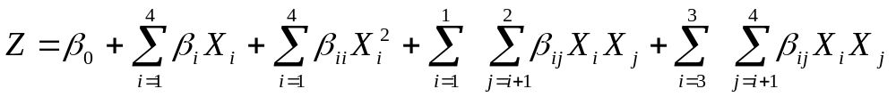
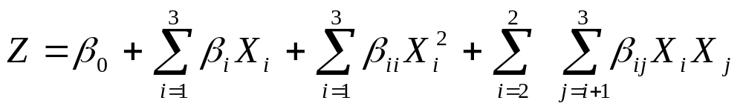
Optimization
Statistical method
  Response Surface Methodology
    Minitab Statistical Package Program
  Full Quadratic Model
    For conventional drying and frying
    For microwave drying and frying

Slide 23
Outline
Introduction to Deep-Fat-Frying
Aim
What we did
What we obtained
Let’s Discuss it
Conclusion

Slide 24
Oil uptake measured for conventionally predried and fried carrot slices
Run Order | Oil Up take (%)
1 | 13.25
2 | 7.48
3 | 14.37
4 | 18.71
5 | 5.66
6 | 10.95
7 | 8.48
8 | 8.86
9 | 12.78
10 | 5.84
11 | 9.07
12 | 9.68
13 | 11.01
14 | 9.36
15 | 5.88
16 | 9.82
17 | 21.76
18 | 17.02
19 | 5.65
20 | 15.34
21 | 8.33
22 | 4.90
23 | 11.49
24 | 14.00
25 | 7.85
26 | 11.02
27 | 10.16
28 | 11.67
Model | Oil Up take (%)
Model coefficients | coefficient | p-value
intercept | 11.60 | *
DTemp | -0.10 | ^{ns}
WL | 2.35 | ^{ns}
FTemp | 6.17 | ***
FTim | 4.11 | **
DTemp*DTemp | -2.88 | ^{ns}
WL*WL | 1.17 | ^{ns}
FTemp*FTemp | 0.05 | **
FTim*FTim | -2.43 | *
Dtemp*WL | -0.71 | ^{ns}
FTemp*FTim | 3.45 | ^{ns}
Regression | ***
R² | 88.2
R²_{adj} | 81.2
Lack-of-fit | ^{ns}
*, p≤0.05; **, p≤0.01; ***,p≤0.001, ^{ns}: statistically non-significant DTemp: Drying temperature (ºC), WL: Weight loss (%), FTemp: Frying temperature (ºC), FTim: Frying time (sec)
Developed models and corresponding performance parameters of conventionally predried and fried carrot slice’s oil uptake

Slide 25
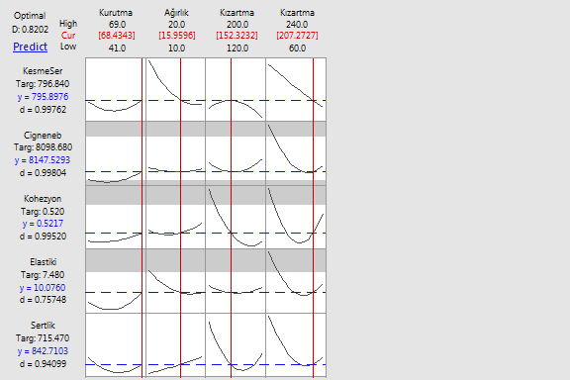
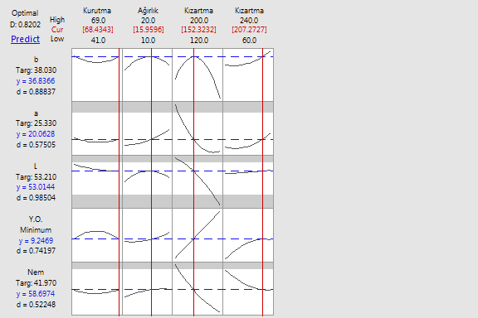
Optimal process conditions for desired value of corresponding response of conventionally dried and fried carrot slices
Drying Temp Weight Loss Frying Temp Frying Time
Oil Uptake (%)

Slide 26
Oil uptake measured for predried in microwave oven and fried carrot slices
Run Order | Oil Up take (%)
1 | 13.17
2 | 43.59
3 | 15.85
4 | 30.45
5 | 13.91
6 | 21.62
7 | 34.92
8 | 9.20
9 | 28.02
10 | 17.08
11 | 35.28
12 | 21.41
13 | 8.53
14 | 10.44
15 | 5.56
16 | 34.22
17 | 8.55
18 | 8.39
19 | 42.96
20 | 11.18
21 | 7.27
22 | 12.94
23 | 7.02
24 | 6.87
25 | 10.78
26 | 7.53
27 | 6.10
Model | Oil Up take (%)
Model coefficients | coefficient | p-value
intercept | 16.49 | ***
WL | 1.32 | ^{ns}
FTemp | 6.85 | ***
FTim | 10.85 | ***
WL*WL | -1.85 | ^{ns}
FTemp*Ftemp | -0.81 | ^{ns}
FTim*Ftim | 4.21 | **
FTemp*FTim | 5.60 | ***
Regression | ***
R² | 93.7
R²_{adj} | 91.3
Lack-of-fit | ^{ns}
*, p≤0.05; **, p≤0.01; ***,p≤0.001, ^{ns}: statistically non-significant WL: Weight loss (%), FTemp: Frying temperature (ºC), FTim: Frying time (sec)
Developed models and corresponding performance parameters of predried in microwave oven and fried carrot slice’s oil uptake

Slide 27
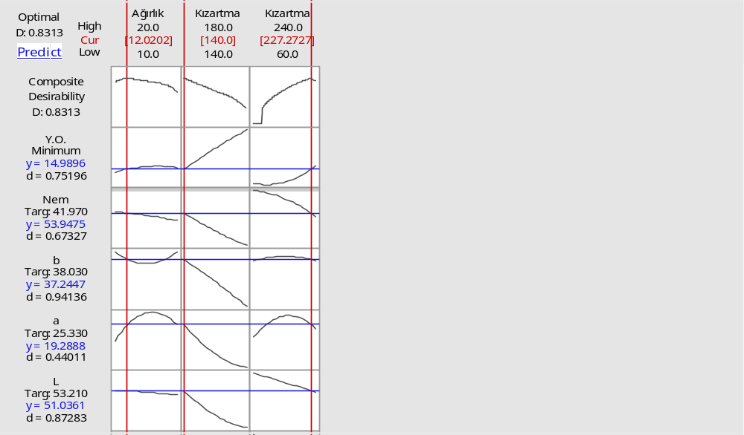
Optimal process conditions for desired value of corresponding response of dried in microwave oven and fried carrot slices
Weight Loss Frying Temp Frying Time
Oil Uptake (%)

Slide 28
Outline
Introduction to Deep-Fat-Frying
Aim
What we did
What we obtained
Let’s Discuss it
Conclusion

Slide 29
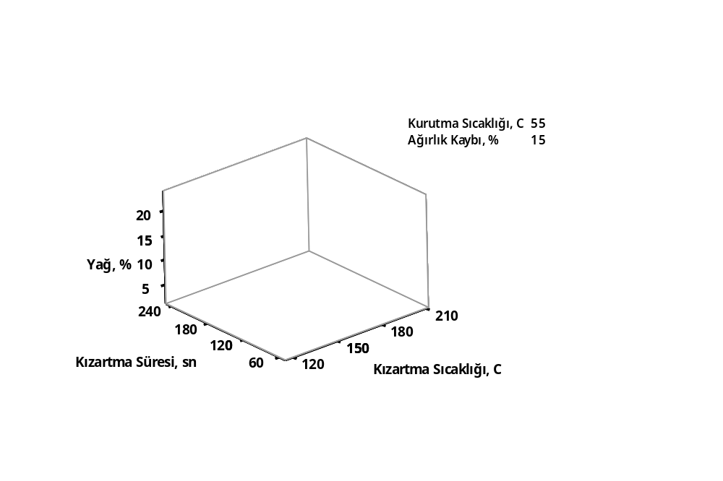
Drying temperature, 55ºC
Weight loss, 15%
Oil uptake, %
frying time, sec
frying temperature, ºC
Figure 1. Change of oil uptake of carrot slices conventionally predried and fried under effects of frying temperature and time

Slide 30
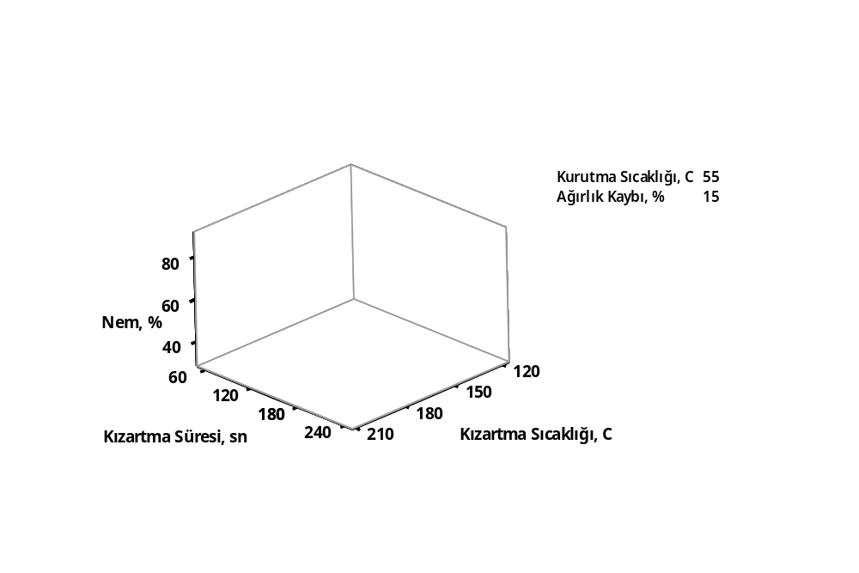
Drying temperature, 55ºC
Weight loss, 15%
Moisture content, %
frying time, sec
frying temperature, ºC
Figure 2. Change of moisture content of carrot slices conventionally predried and fried under effects of frying temperature and time

Slide 31
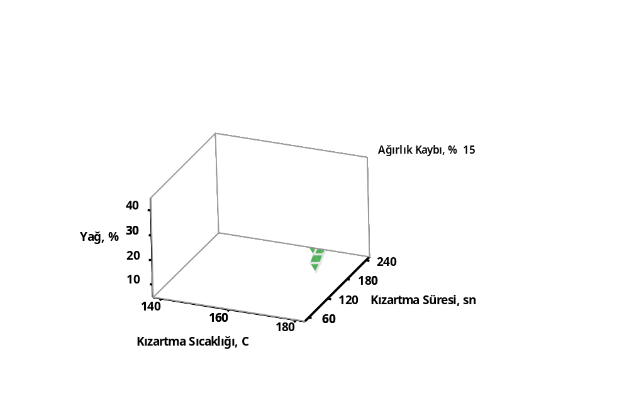
Weight loss, 15%
Oil uptake, %
frying time, sec
frying temperature, ºC
Figure 3. Change of oil uptake of carrot slices predried in a microwave and fried under effects of frying temperature and time

Slide 32
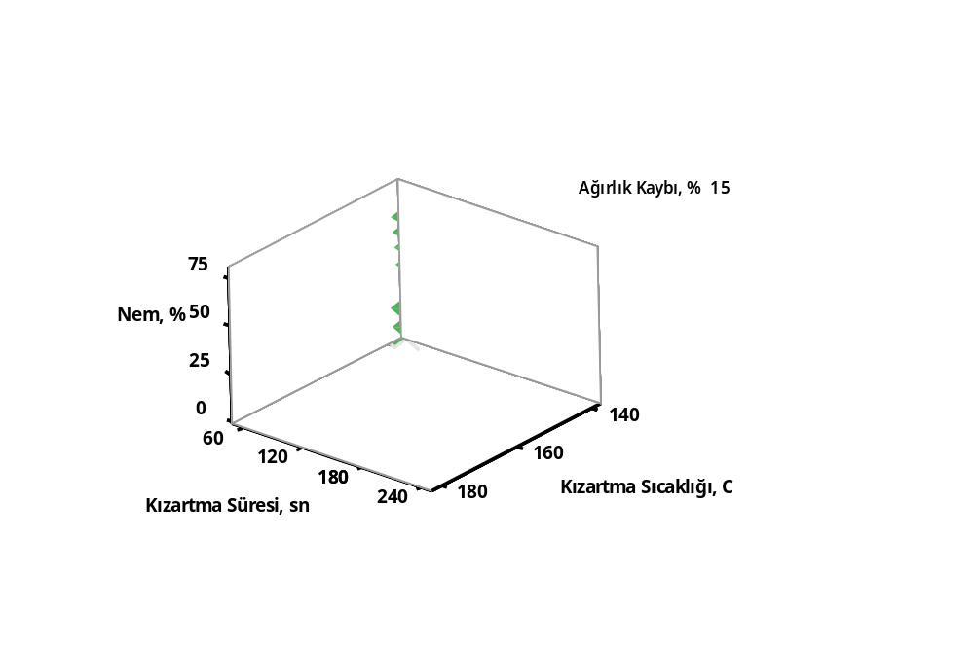
Weight loss, 15%
Moisture content, %
frying temperature, ºC
frying time, sec
Figure 4. Change of moisture content of carrot slices predried in a microwave and fried under effects of frying temperature and time

Slide 33
Outline
Introduction to Deep-Fat-Frying
Aim
What we did
What we obtained
Let’s Discuss it
Conclusion

Slide 34
It could be suggested that
  Partial drying before frying is important pretreatment in terms of food characteristics.
  Oil uptake is one of them and mainly affected by frying conditions and partially predrying ones.
  Weight loss related to water removal during predrying is significant to control final oil uptake of fried carrot slice since a decrease in moisture content of frying material limits frying process, thus oil uptake.
  Direct influences of predrying conditions were not seen on oil uptake most probably due in part to the drying processes conducted at moderate conditions.

Slide 35
Acknowledgements
The current study was financially supported by TUBITAK sources (Project #: 113R015).

Slide 36
Thank you for your attendances and attentions…
Your questions and/or comments

