Slide 1

About OMICS Group
OMICS Group International is an amalgamation of Open Access publications and worldwide international science conferences and events. Established in the year 2007 with the sole aim of making the information on Sciences and technology ‘Open Access’, OMICS Group publishes 400 online open access scholarly journals in all aspects of Science, Engineering, Management and Technology journals. OMICS Group has been instrumental in taking the knowledge on Science & technology to the doorsteps of ordinary men and women. Research Scholars, Students, Libraries, Educational Institutions, Research centers and the industry are main stakeholders that benefitted greatly from this knowledge dissemination. OMICS Group also organizes 300 International conferences annually across the globe, where knowledge transfer takes place through debates, round table discussions, poster presentations, workshops, symposia and exhibitions.

Slide 2
About OMICS Group Conferences
OMICS Group International is a pioneer and leading science event organizer, which publishes around 400 open access journals and conducts over 300 Medical, Clinical, Engineering, Life Sciences, Pharma scientific conferences all over the globe annually with the support of more than 1000 scientific associations and 30,000 editorial board members and 3.5 million followers to its credit.
OMICS Group has organized 500 conferences, workshops and national symposiums across the major cities including San Francisco, Las Vegas, San Antonio, Omaha, Orlando, Raleigh, Santa Clara, Chicago, Philadelphia, Baltimore, United Kingdom, Valencia, Dubai, Beijing, Hyderabad, Bengaluru and Mumbai.

Slide 3
FINITE ELEMENT ANALYSIS OF ELECTRIC BIKE RIMS COUPLED WITH HUB MOTOR
International Conference and Exhibition on
Automobile Engineering
September 1 – 2, 2015
Valencia, SPAIN
Erinç ULUDAMAR
Şafak YILDIZHAN, Erdi TOSUN, Kadir AYDIN

Slide 4
Contents
Introduction
Material and Method
Results and Discussion
Conclusions

Slide 5

Introduction
The aim of this study:
Performing static and fatigue analysis of three different electrical bikes’ rim which are coupled with electrical hub motor was compared and investigated by using finite element method.

Slide 6

Introduction
Nowadays, electric vehicles are becoming more and more important due to financial and energy crisis.
Electric bike which is a bicycle with an integrated electric motor, is one of the most popular electric vehicle all over the world.
Advantages; high efficiency, almost zero emissions, low initial, running and maintenance cost.

Slide 7
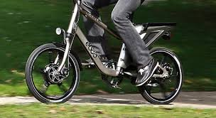
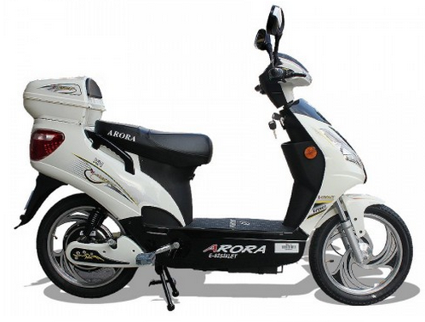
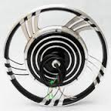
Introduction
Tyres are the only part of vehicle which directly contact with the road surface. Rim, skeleton of the tyre, must be light and provide enough strength to transmit vehicle power.

Slide 8
Introduction
Over the years, scientists are researching on various rim designs. They are trying to find best material composition and best mechanical design of the rim.

Slide 9
Material Method
Three different rims which has 406,4 mm (R16) outer diameter and made of aluminium alloy were compared by finite element methods in order to comprehend their behaviour on the road.
Preparation of 3D models and analyses were carried out in Çukurova University Automotive Engineering Laboratories with the aid of workstation, which has 2 processors (24 cores) and 32 GB RAM.

Slide 10
Steps of Analysis
3D CAD
Design
Entering Material Properties
Specifying Boundary Conditions
Meshing
Analysis
Post Processing

Slide 11
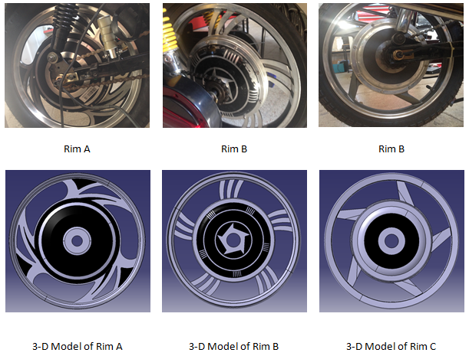
3D CAD Models

Slide 12
Entering Material Properties
The prepared models were exported to ANSYS Workbench software program for stress analyses.
Default mechanical properties of aluminium alloy material according to software program was performed
Material | Young’s Modulus (GPa) | Poisson’s Ratio (ν) | Yield Strength (MPa)
General aluminium alloy. Fatigue properties come from MIL-HDBK-5H, page 3-277. | 71 | 0.33 | 280

Slide 13
Specifying Boundary Conditions
Tyre pressure was applied on the rim from outside of the circumference as 0,2344 Mpa (34 Psi)
Radial load was considered and applied as pressure and distributed according to cosine function along to 90⁰ portion of the bead seat in order to simulate the total weight of electric bike
43.5 rad/s rotational velocity was also added to the models
The models were fixed from the hub where axle mounted inside it

Slide 14
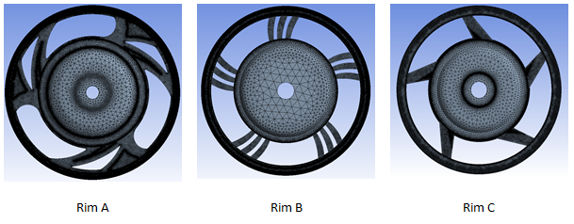
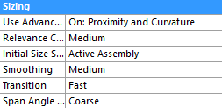
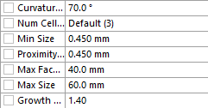
Meshing
Nodes: 5099008
Elements: 3430607
Nodes: 3843764
Elements: 2577860
Nodes: 3466721
Elements: 2336248

Slide 15
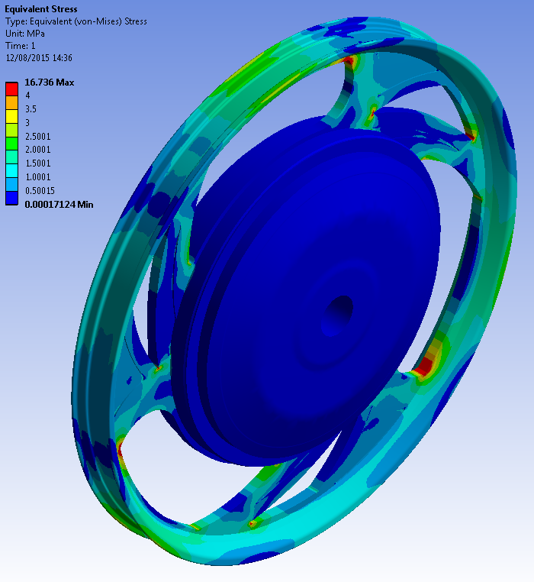
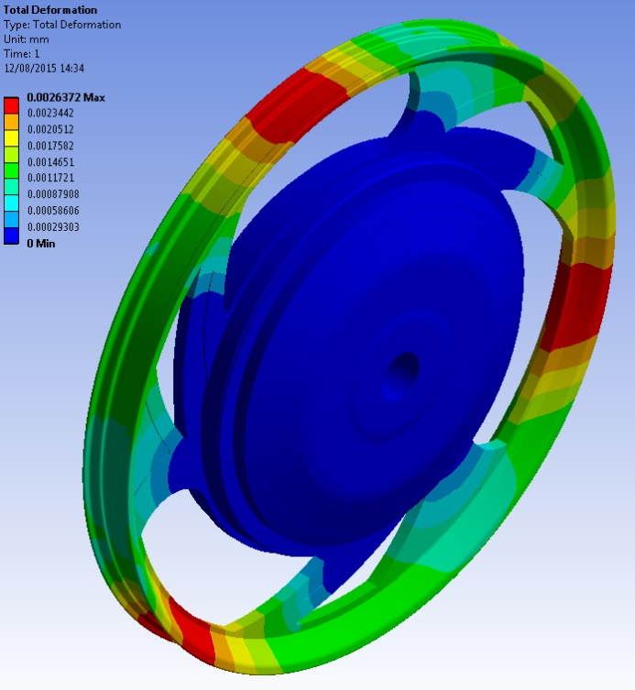
Results and Discussion
Rim A
von-Mises stress Deformation distribution
Maximum von-Mises Stress |  | Maximum Deformation
16.7 MPa |  | 0.0026 mm

Slide 16
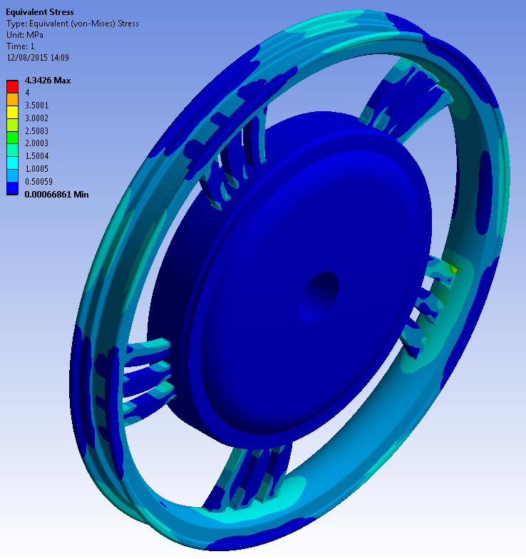
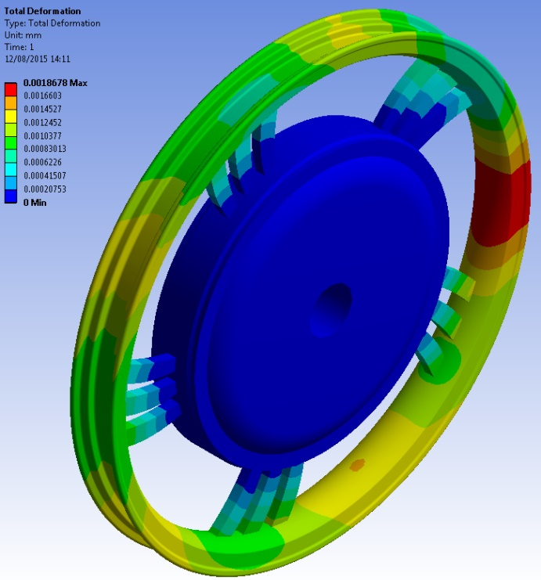
Results and Discussion
Results and Discussion
Rim B
von-Mises stress Deformation distribution
Maximum von-Mises Stress |  | Maximum Deformation
4.3 MPa |  | 0.0019 mm

Slide 17
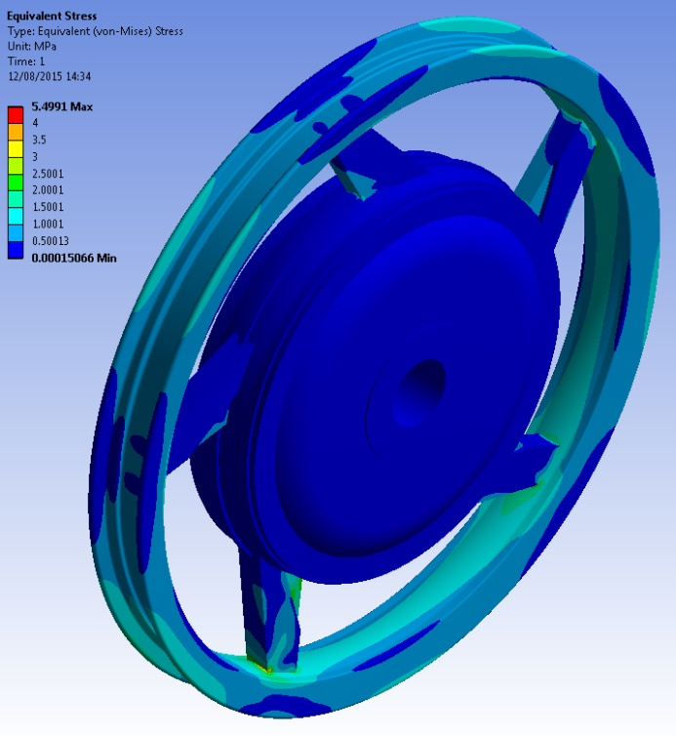
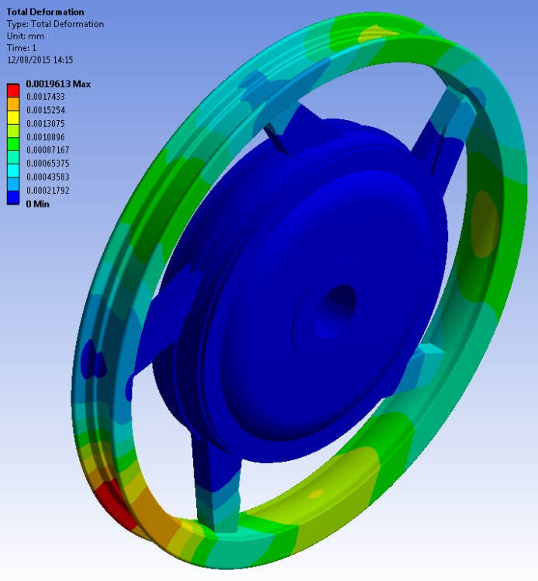
Results and Discussion
Results and Discussion
Rim C
von-Mises stress Deformation distribution
Maximum von-Mises Stress |  | Maximum Deformation
5.5 MPa |  | 0.002 mm

Slide 18
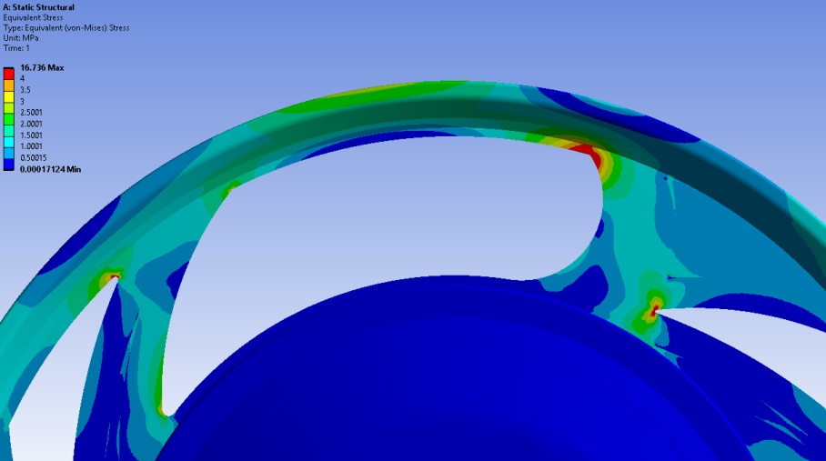
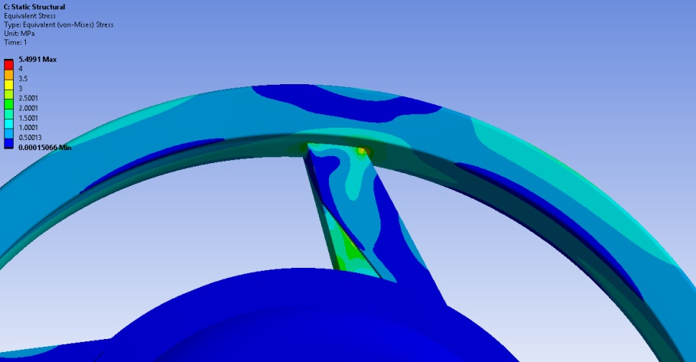
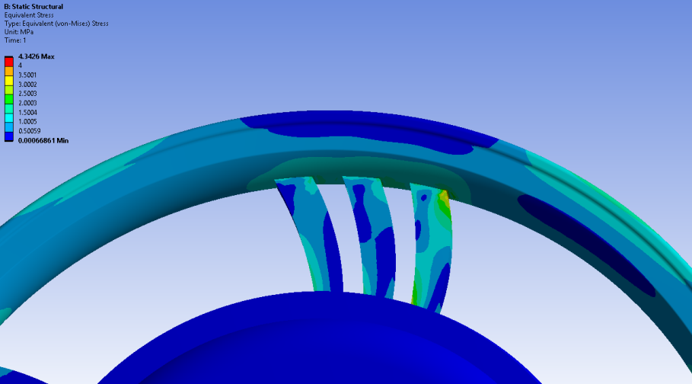
Results and Discussion
Static tests showed that the highest stresses were occurred at sharp edges and spoke to flange connections. It must be pointed out that the stress was increased when spoke-flange connection section area decreased.

Slide 19
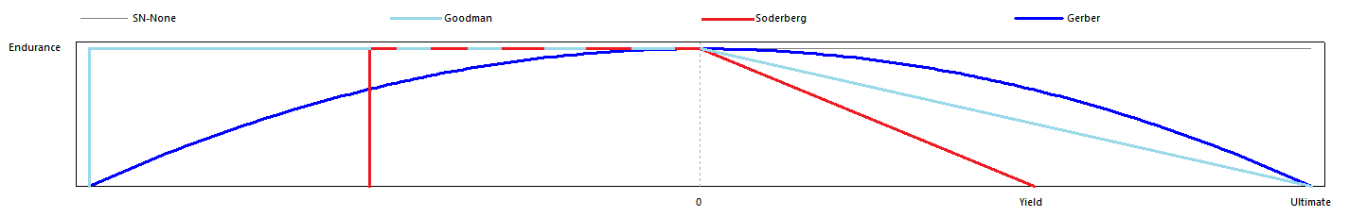
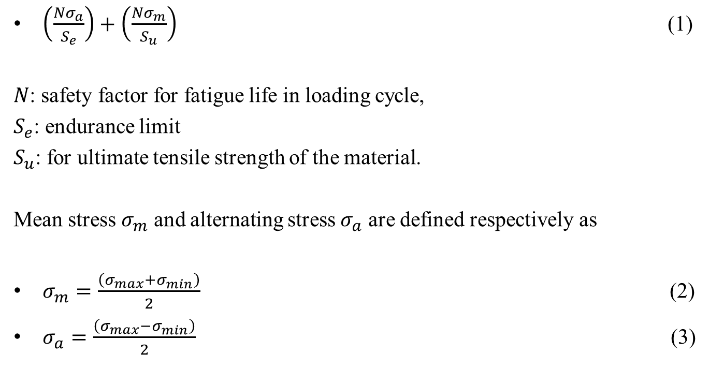
$\left(\frac{Nσ_{a}}{S_{e}}\right)+\left(\frac{Nσ_{m}}{S_{u}}\right)$ (1)
$N$: safety factor for fatigue life in loading cycle,
$S_{e}$: endurance limit
$S_{u}$: for ultimate tensile strength of the material.
Mean stress $σ_{m}$ and alternating stress $σ_{a}$ are defined respectively as
$σ_{m}=\frac{\left(σ_{max}+σ_{min}\right)}{2}$ (2)
$σ_{a}=\frac{\left(σ_{max}−σ_{min}\right)}{2}$ (3)

Slide 20
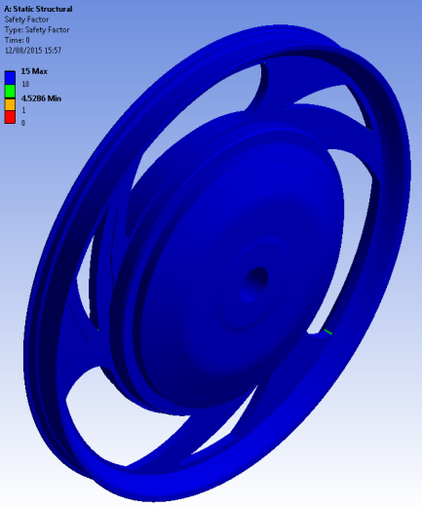
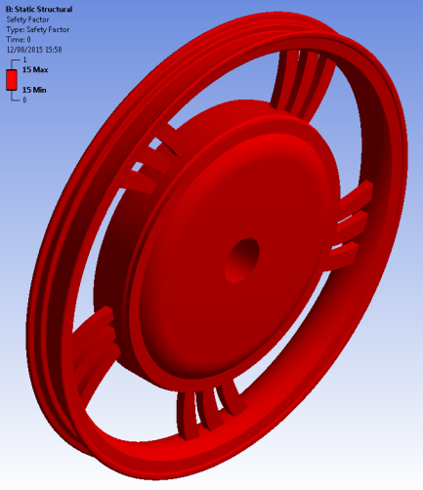
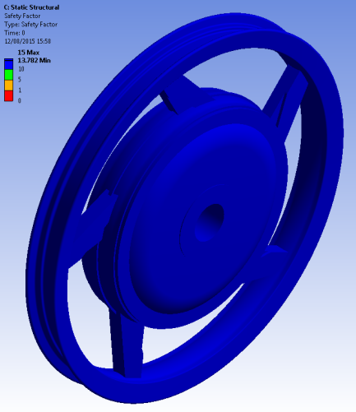
Results and Discussion
Rim A Rim B Rim C
Safety Factor
4.5 | >15 | 13.8

Slide 21
Conclusions
From the static and fatigue analyses tests, the following results were conducted;
Von-Mises stresses were primarily affected by sharp corners, due to the stress concentration on edges,
Von-Mises stress can be decreased by increasing flange to spoke cross section areas,

Slide 22
Conclusions
The rims which were investigated in this study can withstand 10⁶ cycles,
All tests results revealed that test rims are extremely safe (except on sharp corners), they may be re-designed in order to cost and weight safe,

Slide 23

Thank you for your attention!
Erinç ULUDAMAR
Research Assistant
Çukurova University
Department of Mechanical
Engineering
Automotive Division

