Slide 1

About OMICS Group
OMICS Group International is an amalgamation of Open Access publications and worldwide international science conferences and events. Established in the year 2007 with the sole aim of making the information on Sciences and technology ‘Open Access’, OMICS Group publishes 400 online open access scholarly journals in all aspects of Science, Engineering, Management and Technology journals. OMICS Group has been instrumental in taking the knowledge on Science & technology to the doorsteps of ordinary men and women. Research Scholars, Students, Libraries, Educational Institutions, Research centers and the industry are main stakeholders that benefitted greatly from this knowledge dissemination. OMICS Group also organizes 300 International conferences annually across the globe, where knowledge transfer takes place through debates, round table discussions, poster presentations, workshops, symposia and exhibitions.

Slide 2
About OMICS Group Conferences
OMICS Group International is a pioneer and leading science event organizer, which publishes around 400 open access journals and conducts over 300 Medical, Clinical, Engineering, Life Sciences, Pharma scientific conferences all over the globe annually with the support of more than 1000 scientific associations and 30,000 editorial board members and 3.5 million followers to its credit.
OMICS Group has organized 500 conferences, workshops and national symposiums across the major cities including San Francisco, Las Vegas, San Antonio, Omaha, Orlando, Raleigh, Santa Clara, Chicago, Philadelphia, Baltimore, United Kingdom, Valencia, Dubai, Beijing, Hyderabad, Bengaluru and Mumbai.

Slide 3
VIBRATION ANALYSIS OF A DIESEL ENGINE FUELLED WITH SUNFLOWER AND CANOLA BIODIESELS
International Conference and Exhibition on
Automobile Engineering
September 01-02, 2015 Valencia, Spain
Erinç Uludamarª, Gökhan Tüccar^{b}, Kadir Aydınª, Mustafa Özcanlı^{c}
a Department of Mechanical Engineering, Çukurova University, Adana, Turkey
b Department of Mechanical Engineering, Adana Science and Technology University, Adana, Turkey
c Department of Automotive Engineering, Çukurova University, Adana, Turkey

Slide 4
Contents
Introduction
Material and Method
Result and Discussion
Conclusion
Biodiesel
Preparation of Test Fuels
Comparison of Different Fuels
Conclusion
Purpose of the Study
Determination of Test Fuel Properties
Comparison at Different Engine Speeds
Acknowledgements
Experimental Set-up
Comparison of different fuels at x- y- z axes
Calculation of RMS value
Total a_{rms} Values of Canola Biodiesel
Axes of the Test Engine
Total a_{rms} Values of Sunflower Biodiesel

Slide 5



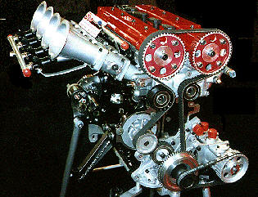
Introduction
Advantages of Biodiesel
Renewable, Non-toxic, Biodegradable
Lower exhaust emissions
Can be used with little or no engine modifications

Slide 6


Purpose of the Study
Biodiesel is one of the most popular alternative fuel. The usage of biodiesel is increasing day by day. Therefore, all effects of biodiesel on internal combustion engines must be known.
In this study, vibration effect of canola and sunflower biodiesels at different engine speed was investigated in longitudinal, vertical and lateral axes.

Slide 7
Material and Method
Experiments were conduced at 6 different engine speeds with 11 different fuels.
Low Sulphur Diesel
1300 rpm
Sunflower Biodiesel and its blends
1300 rpm
Canola Biodiesel and its blends
1300 rpm
1600 rpm
1600 rpm
1600 rpm
1900 rpm
1900 rpm
1900 rpm
2200 rpm
2200 rpm
2200 rpm
2500 rpm
2500 rpm
2500 rpm
2800 rpm
2800 rpm
2800 rpm

Slide 8
Preparation of Test Fuels
Methanol
(Reactant )
Sunflower/ Canola
Oil
Sodium Hydroxide (Catalyst)
Transesterification
Glycerin
Washing
Preparation of Biodiesels
Drying
Biodiesel

Slide 9
Preparation of Test Fuels
TEST FUELS
Fuel Name | Ratio of Low Sulphur Diesel (% by volume) | Ratio of Biodiesel (% by volume) | Abbreviation
Low Sulphur Diesel | 100 | - | D
Sunflower Biodiesel | 80 | 20 | S20
 | 60 | 40 | S40
 | 40 | 60 | S60
 | 20 | 80 | S80
 | - | 100 | S100
Canola Biodiesel | 80 | 20 | C20
 | 60 | 40 | C40
 | 40 | 60 | C60
 | 20 | 80 | C80
 | - | 100 | C100

Slide 10
Determination of Test Fuel Properties
Fuel Properties of Test Fuels
Test Fuels | Density (kg/l) | Cetane Number | Kinematic Viscosity at 40ºC (mm²/s) | Gross Heating Value (kcal/kg)
D | 0,837 | 59,3 | 2,7 | 45857
S20 | 0,844 | 53,8 | 4,2 | 44246
S40 | 0,854 | 53,0 | 4,5 | 43430
S60 | 0,865 | 50,9 | 4,6 | 42472
S80 | 0,876 | 47,6 | 5,1 | 41388
S100 | 0,886 | 44,5 | 5,5 | 39149
C20 | 0,846 | 54,3 | 4,5 | 43413
C40 | 0,857 | 53,4 | 4,8 | 42986
C60 | 0,867 | 51,7 | 5 | 41756
C80 | 0,877 | 49 | 5,2 | 40129
C100 | 0,883 | 46 | 5,4 | 38363
Zeltex ZX 440 NIR petroleum analyzer: Cetane Number
Tanaka AKV 202 auto kinematic viscosity test: Viscosity
Kyoto electronics DA-130: Density Measurement
IKA-Werke C2000 Bomb Calorimeter: Gross Heating Value

Slide 11
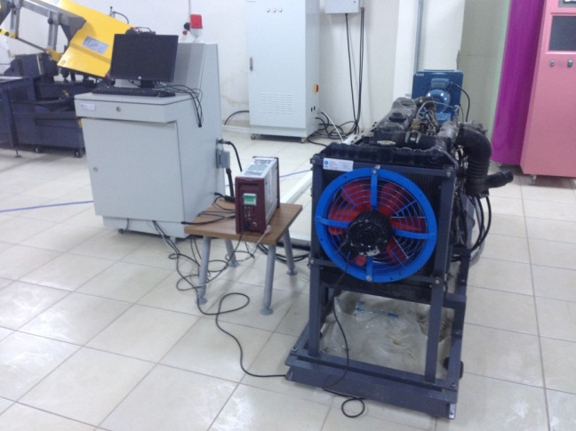
Experimental
Set-up
Brand | Mitsubishi Canter
Model | 4D31
Configuration | In line 4
Type | Direct injection diesel with glow plug
Displacement | 3298cc
Bore | 100 mm
Stroke | 105 mm
Power | 91 HP @ 3500rpm
Torque | 223 Nm @ 2200rpm
Oil Cooler | Water cooled

Slide 12
Technical Data of Measuring System
Brand | SINUS Messtechnik GmbH Soundbook_MK2
Resolution | 24 Bit
Number of Channels | 4 Measuring Channels (LEMO)
Accuracy | EN 60651 and EN 60804 class 1, IEC 61672-1 class 1, group Z, percentages according to DIN 45657
Sampling rates | 51.2 kHz
Transducer Supply | Polarization voltage 20 V, 63 V or 200 V and ICP (2mA, 4mA)
Time Weighting | Fast =0.125 s
 | Slow =1 s
 | Impulse =0.035 s
 | Peak = 20µs
Technical Specifications of Accelerometer (PCB-356A33)
Brand | PCB-356A33
Performance
Sensitivity (±10 %) | 1.02 mV/(m/s²)
Measurement Range | ±4905 m/s² pk
Frequency Range (±5 %) | 2 to 10000 Hz
Frequency Range (±5 %) | 2 to 7000 Hz
Resonant Frequency | ≥55 kHz
Broadband Resolution (1 to 10000 Hz) | 0.04 m/s² rms
Non-Linearity | ≤1 %
Transverse Sensitivity | ≤5 %
Environmental
Overload Limit (Shock) | ±98100 m/s² pk
Temperature Range | -54 to +121 °C
Physical
Sensing Element | Ceramic
Sensing Geometry | Shear
Housing Material | Titanium

Slide 13
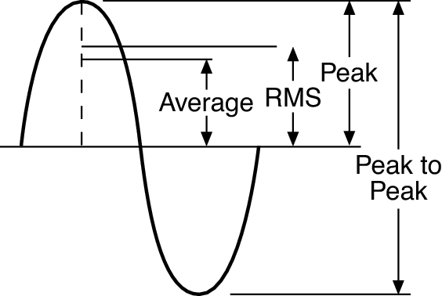
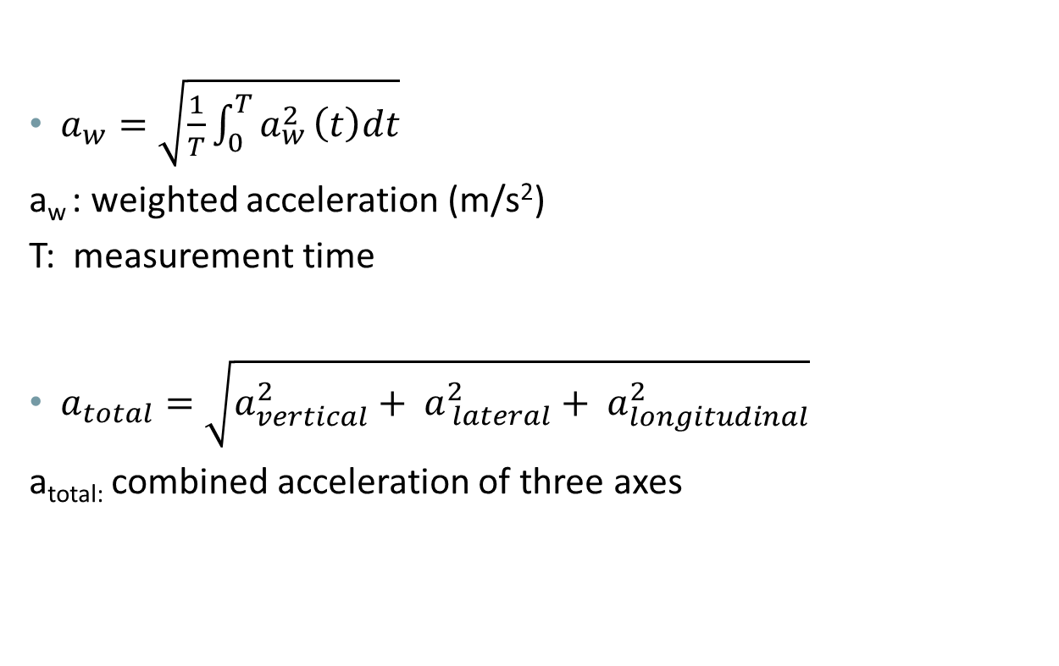
Calculation of RMS value
$a_{w}=\sqrt{\frac{1}{T}\int_{0}^{T}{a_{w}^{2}}\left(t\right)dt}$
a_{w} : weighted acceleration (m/s²)
T: measurement time
$a_{total}=\sqrt{a_{vertical}^{2}+ a_{ lateral}^{2}+ a_{longitudinal}^{2}}$
a_{total:} combined acceleration of three axes

Slide 14
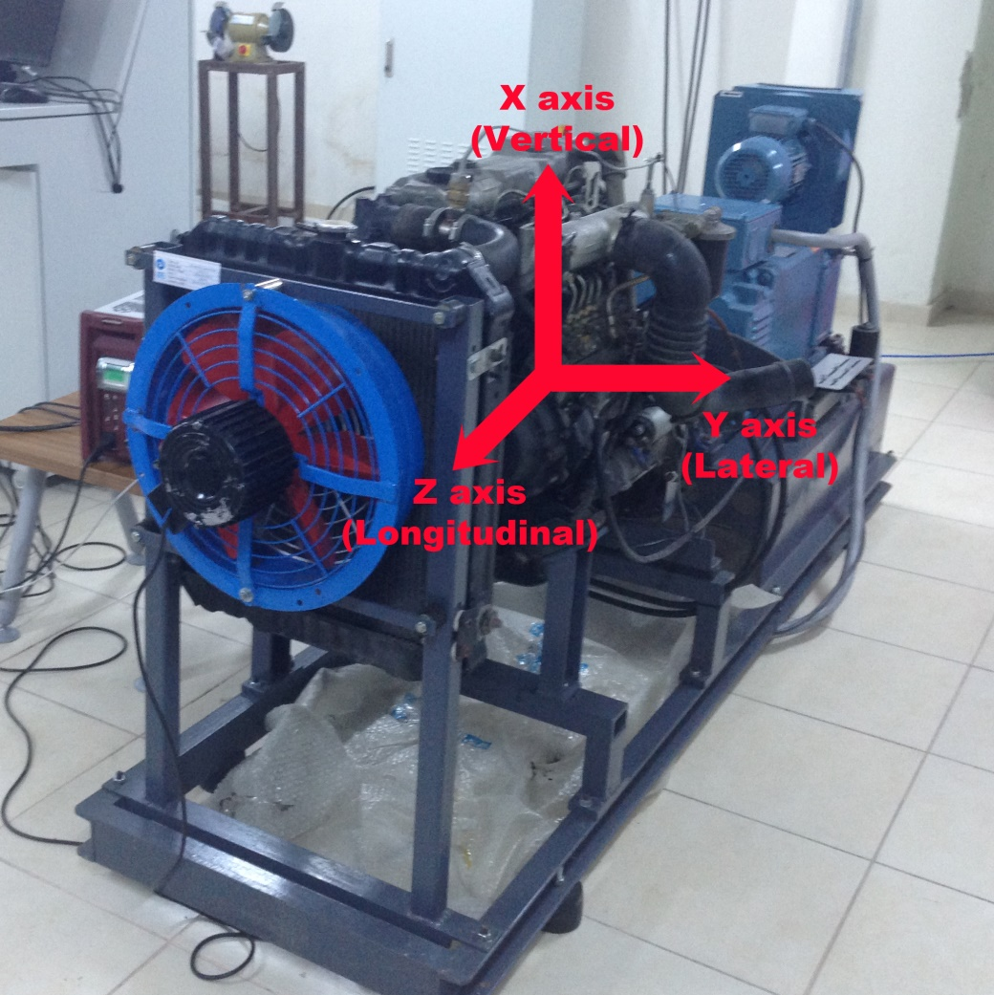
Axes of the Test Engine

Slide 15
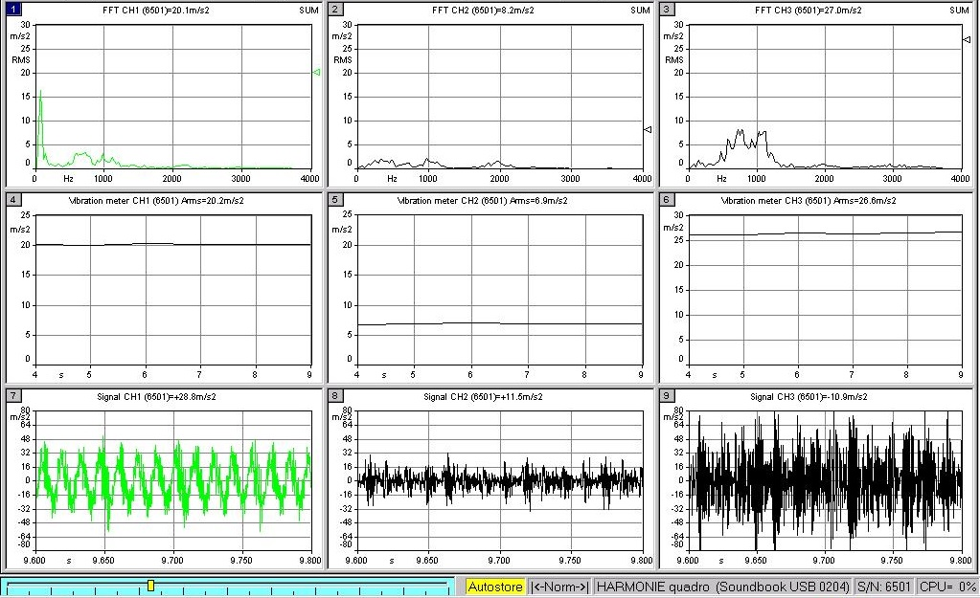
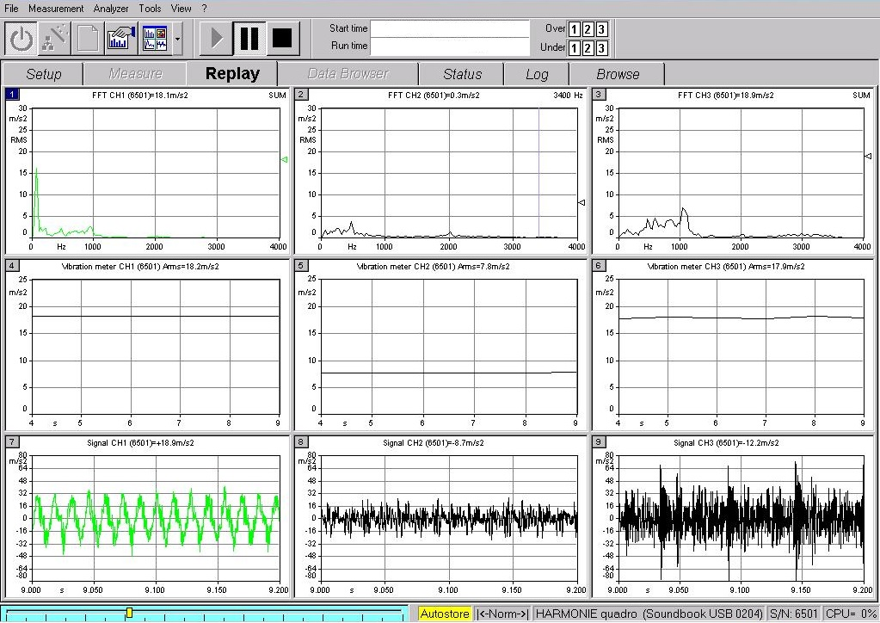
Comparison of Different Fuels
D@2200 rpm
C60@2200 rpm

Slide 16
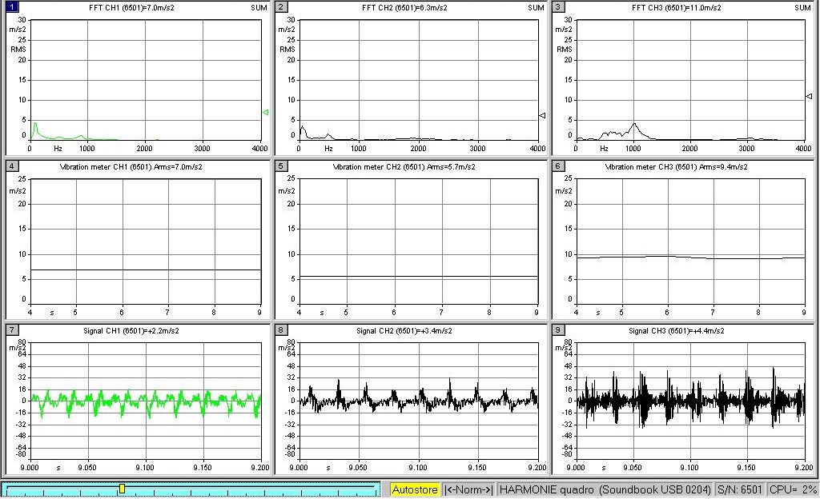
Comparison at Different Engine Speeds
C60@1300 rpm
C60@2200 rpm

Slide 17
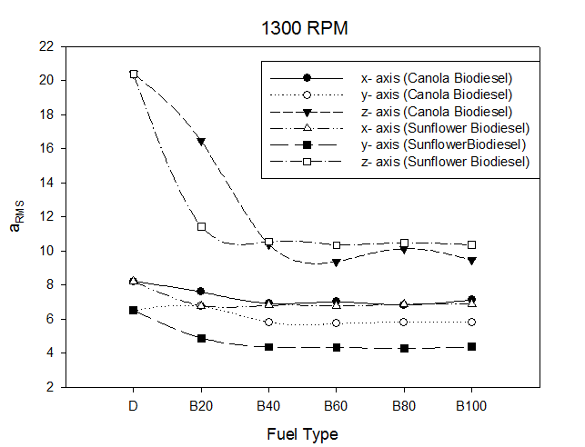
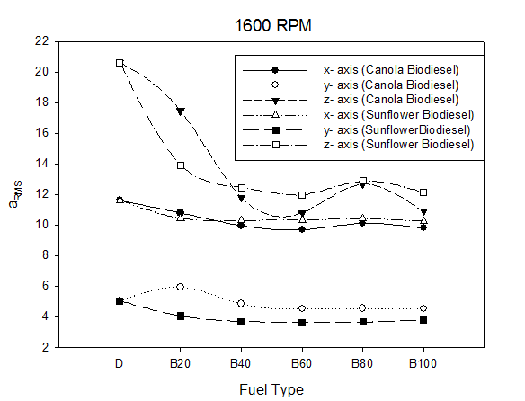
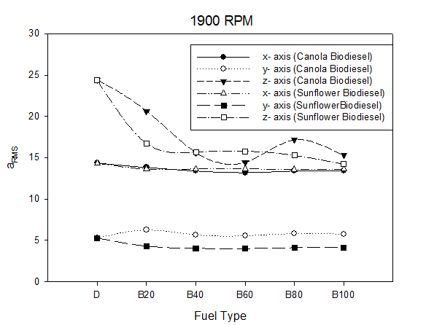
D : Low Sulphur Diesel
B20 : 20% biodiesel ratio into D (by volume)
B40 : 40% biodiesel ratio into D (by volume)
B60 : 60% biodiesel ratio into D (by volume)
B80 : 80% biodiesel ratio into D (by volume)
B100: Biodiesel
Comparison of different fuels at x- y- z axes

Slide 18
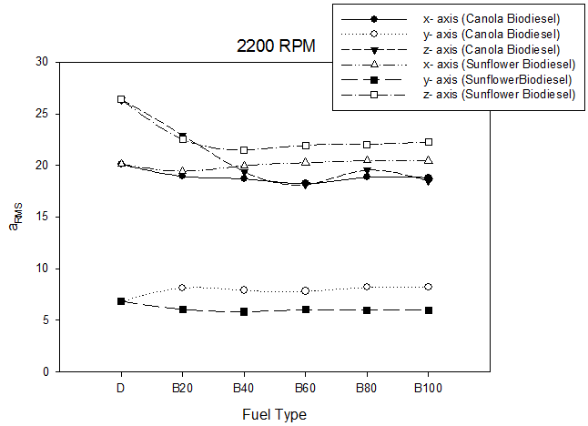
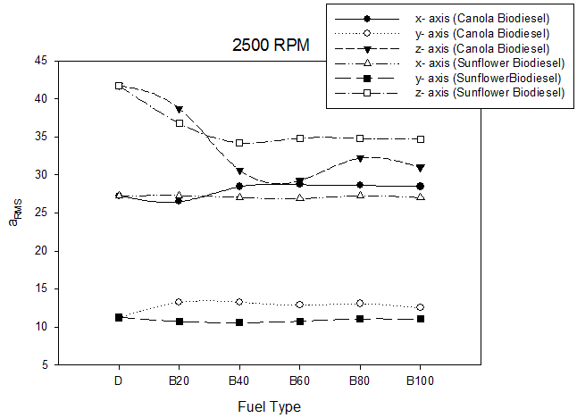
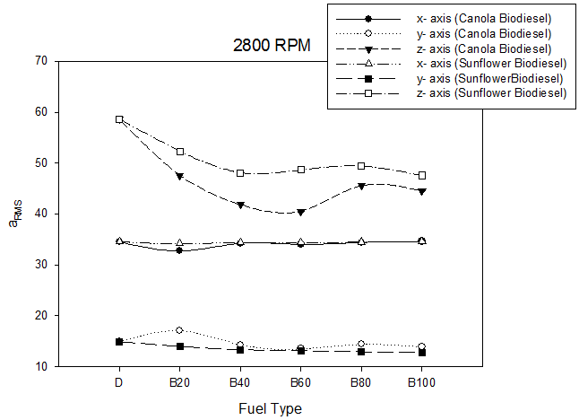
D : Low Sulphur Diesel
B20 : 20% biodiesel ratio into D (by volume)
B40 : 40% biodiesel ratio into D (by volume)
B60 : 60% biodiesel ratio into D (by volume)
B80 : 80% biodiesel ratio into D (by volume)
B100: Biodiesel
Comparison of different fuels at x- y- z axes

Slide 19
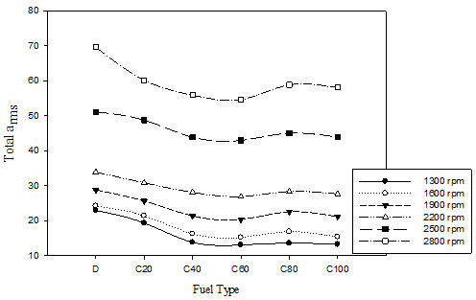
Total a_{rms} Values of Canola Biodiesel

Slide 20
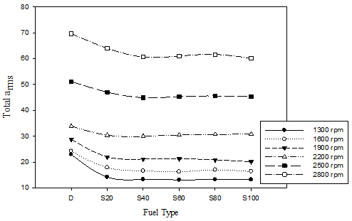
Total a_{rms} Values of Sunflower Biodiesel

Slide 21
CONCLUSIONS
Vibration amplitude increased with engine speed.
Canola and sunflower biodiesel addition into the low sulphur diesel fuel decreased the vibration acceleration of the diesel engine. Sunflower biodiesel was improved the vibration amplitude more than canola biodiesel.
Up to 40% biodiesel blend of canola and sunflower biodiesels with low sulphur diesel fuel, vibration values significantly improved, and the least value observed with 60% biodiesel blend for most of the test fuel.
The results also showed that, even though total a_{rms} of all frequencies were highest at longitude axis, at all engine speeds; the maximum vibration amplitude occurred in vertical axis due to upward and downward piston movement.

Slide 22

Acknowledgements
The authors would like to thank to SINUS Messtechnik GmbH for their technical support.

Slide 23

Thank you for
your attention!
Erinç ULUDAMAR
Research Assistant
Çukurova University
Department of Mechanical
Engineering
Automotive Division

