Slide 1
Conference Series LLC Conferences
Conference Series LLC is a pioneer and leading science event organizer, which publishes around 500 open access journals and conducts over 500 Medical, Clinical, Engineering, Life Sciences, Pharma scientific conferences all over the globe annually with the support of more than 1000 scientific associations and 30,000 editorial board members and 3.5 million followers to its credit.
Conference Series LLC has organized 500 conferences, workshops and national symposiums across the major cities including San Francisco, Las Vegas, San Antonio, Omaha, Orlando, Raleigh, Santa Clara, Chicago, Philadelphia, Baltimore, United Kingdom, Valencia, Dubai, Beijing, Hyderabad, Bengaluru and Mumbai.

Slide 2

Starch–guar gum extrudates: Microstructure, physicochemical properties and in-vitro digestion
Erich von Borries Medrano
Instituto Politecnico Nacional
Centro de Investigación en Ciencia Aplicada y Tecnología Avanzada

Slide 3
Sarnali, et al., 2010

Slide 4
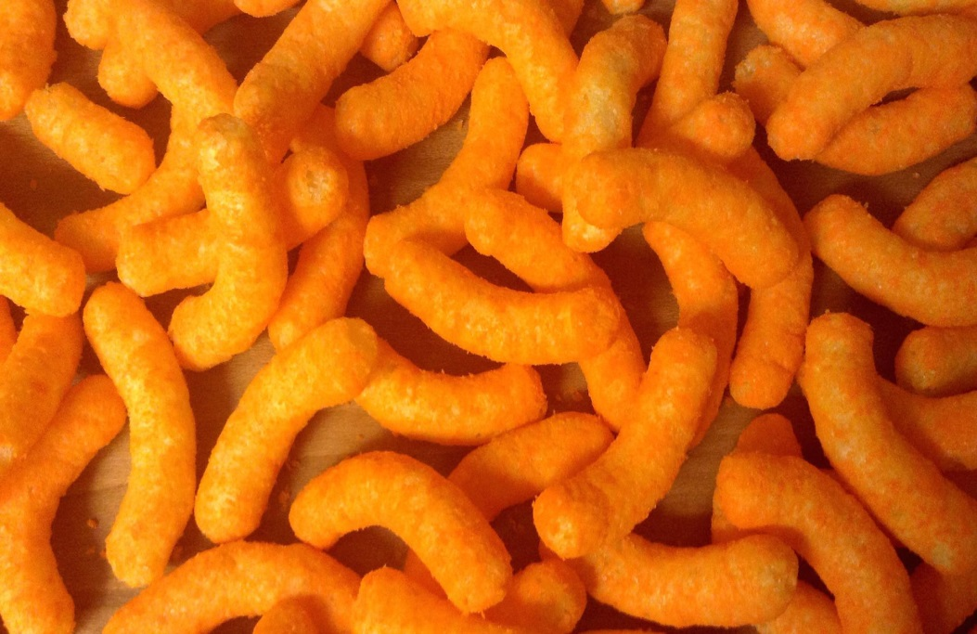


Processed foods
Obesity
Diabetes

Slide 5
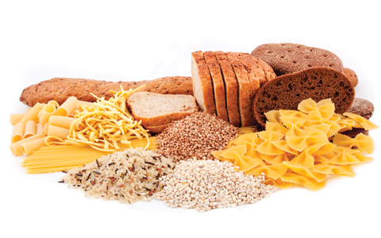
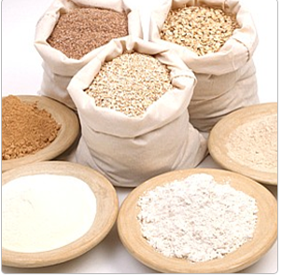
Starch present in food

Slide 6
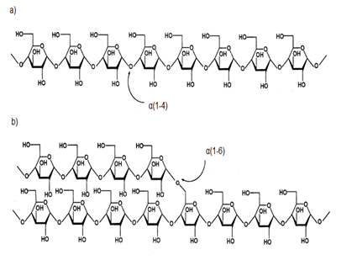
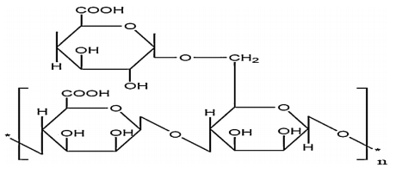
Amylose
Corn starch
Amylopectin
Guar gum

Slide 7
OBJECTIVES

Slide 8
The objective of this work was to study the effect that moisture content, guar gum concentration and extrusion temperature has on the morphology, physicochemical properties and digestibility of corn starch in limited moisture conditions like extrusion.

Slide 9
MATERIALS AND METHODS

Slide 10
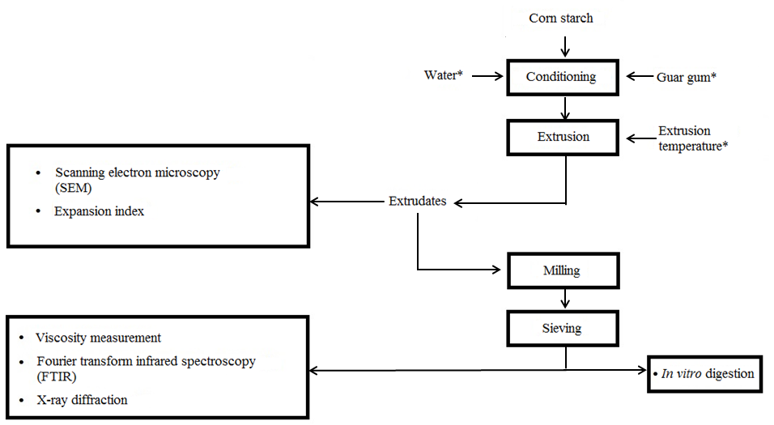
General methodology
*According to the experimental design

Slide 11
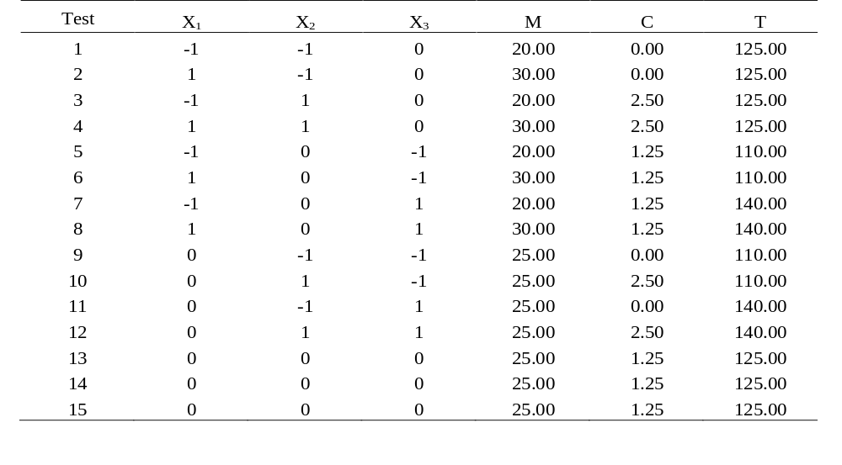
Box-Behnken statistical design for preparing starch-guar gum mixtures through extrusion.
.
 | -1 | 0 | 1
Moisture content (%) | 20 | 25 | 30
Concentration of guar gum (%, w/w) | 0 | 1.25 | 2.5
Temperature of extrusión (ºC) | 110 | 125 | 140
X₁, M = Moisture content [%]
X₂ , C = Concentration of guar gum [%, w/w]
X₃ , T = Temperature of extrusion [ºC]

Slide 12
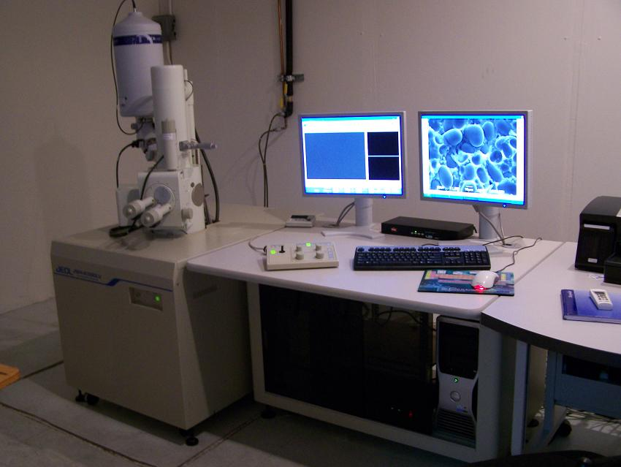
Morphology studies
Microstructure was evaluated using a JEM-6390 LV scanning electron microscope (SEM)

Slide 13
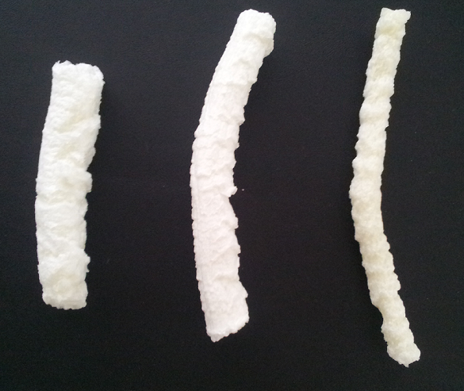
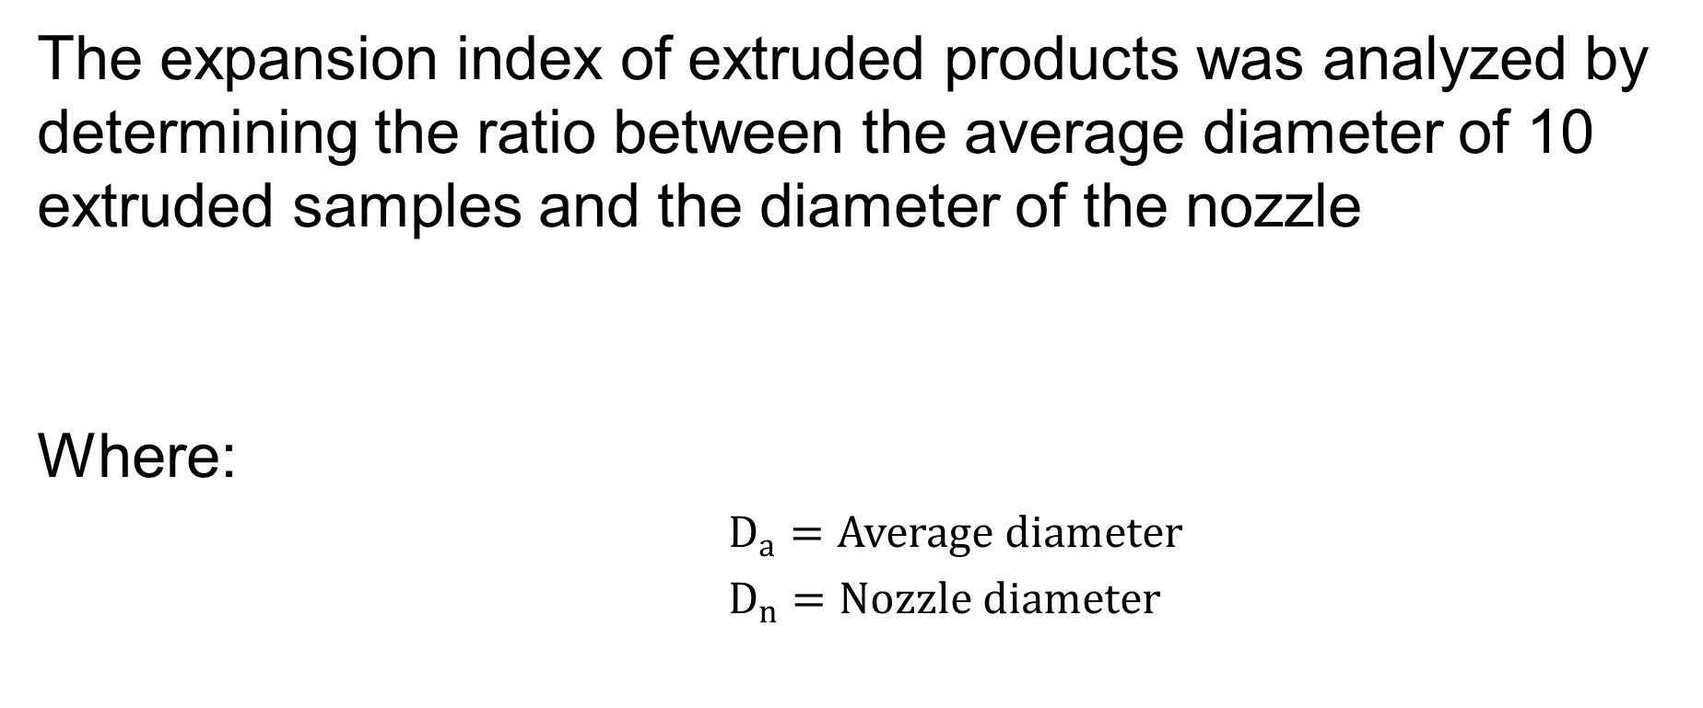
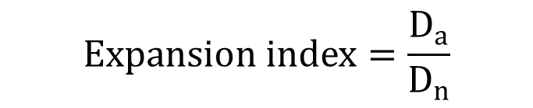
Physicochemical studies
The expansion index of extruded products was analyzed by determining the ratio between the average diameter of 10 extruded samples and the diameter of the nozzle
Where:
$D_{a}=Average diameter$
$D_{n}=Nozzle diameter$
$$Expansion index=\frac{D_{a}}{D_{n}}$$

Slide 14
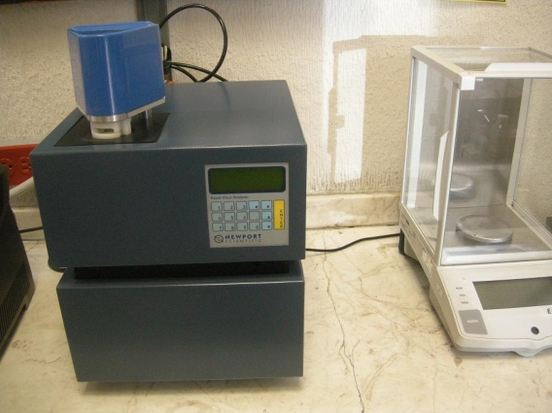
Physicochemical studies
Viscosity analysis was carried out in a Rapid Visco Analyzer (RVA) RVA-4 D; Newport Scientific

Slide 15
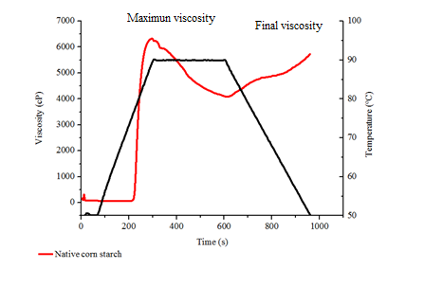
Physicochemical studies
The response surface was calculated using: maximum viscosity and final viscosity

Slide 16
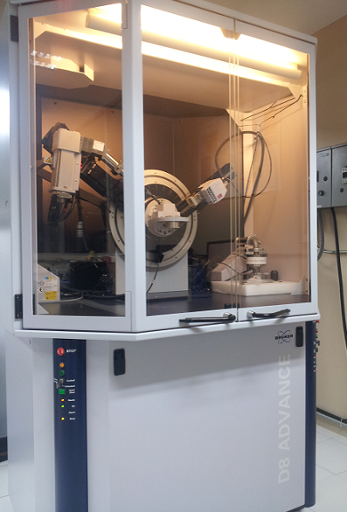
Physicochemical studies
X-ray diffractograms of the samples were obtained using a
Bruker D8 Advance diffractometer

Slide 17
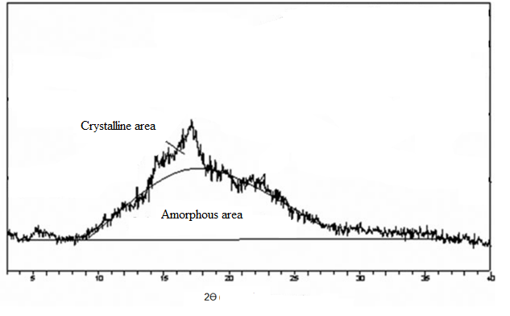
Physicochemical studies
The crystallinity index was measured according to the methodology described by Zhang and Rempel (2012)

Slide 18
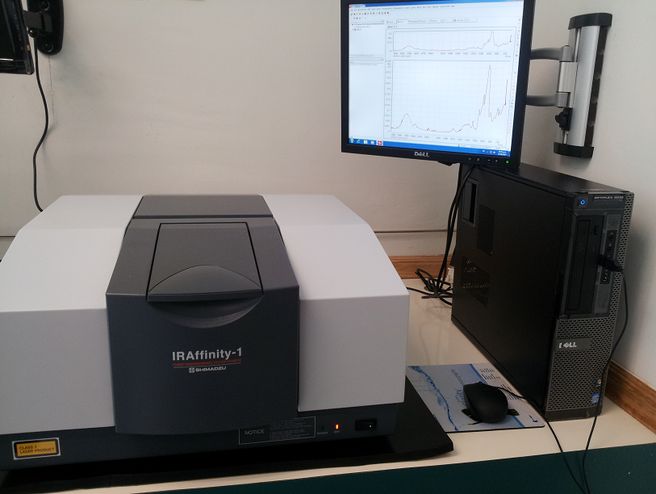
Physicochemical studies
The absorbance infrared spectrum was obtained using a Fourier Transform Infrared Spectrophotometer IRAffinity-1

Slide 19
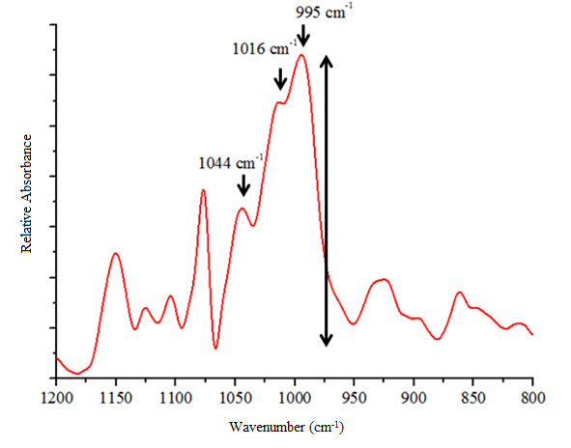


Physicochemical studies
The intensities of deconvoluted spectra were measured taking the height of the absorbance band peaks from the baseline
Double helix organization$=\frac{I_{995}}{I_{1016}}$
Amount of ordered domains$=\frac{I_{1044}}{I_{1016}}$
I_{n} = Intensity on the absorbance band n

Slide 20
In vitro digestion studies
In vitro digestion method was done using a 250 ml stirred reactor according to the Lo Curto et al. (2011) methodology
Conditions | Values
Temperature | 37 ºC
pH | 6.5 ± 0.05
α-amylase | 17 U/ml
Amyloglucosidase | 90 U

Slide 21
Statistical analysis
Statistical analysis
A Box–Behnken statistic design was employed: 15 experiments and three repetitions in the central point.
Significance of the model was evaluated using the variation analysis (F test) and the determination coefficient.

Slide 22
Results and discussion

Slide 23
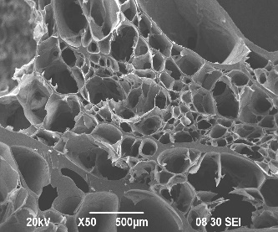
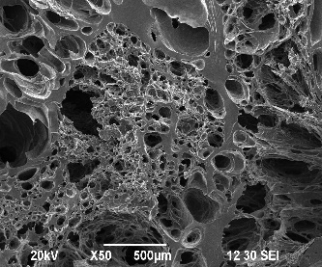
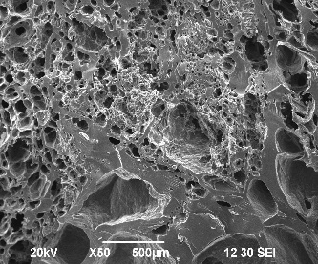
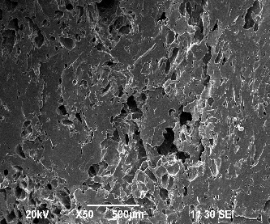
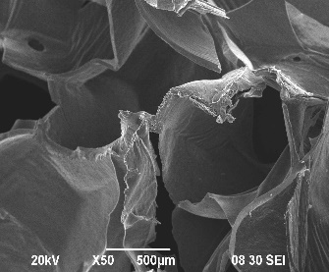
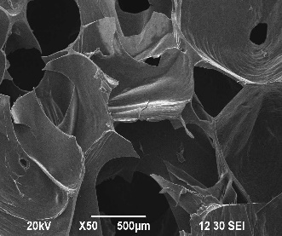
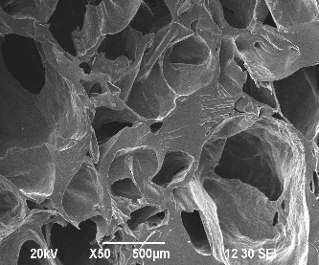
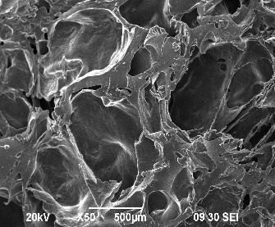
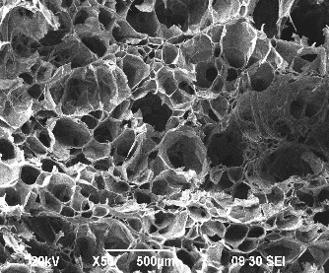
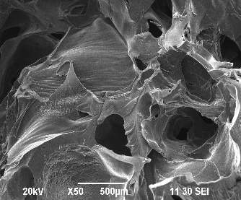
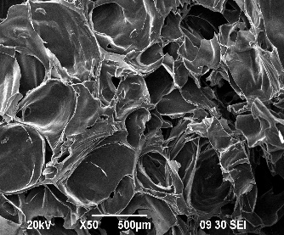
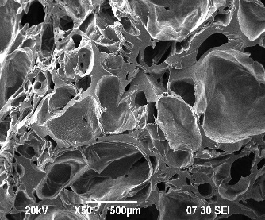
Microstructure of different extrudates
20 %
25 %
25 %
30 %
110 ºC
125 ºC
140 ºC

Slide 24
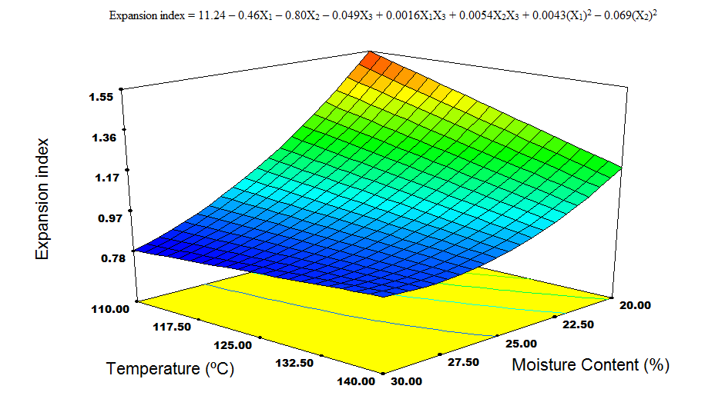
Expansion index (1.25% w/w Guar gum concentration)

Slide 25
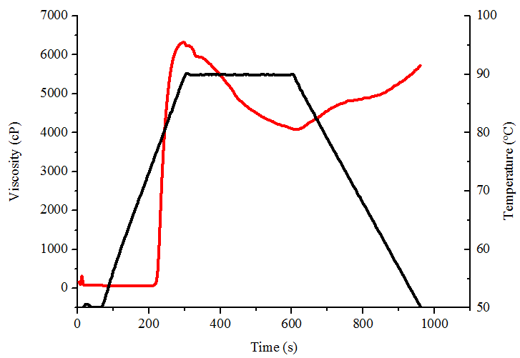
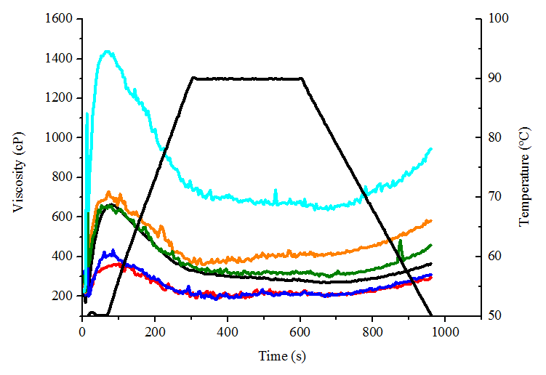

Characteristic profiles of viscosity from native corn starch and extruded samples.
(a)
(b)

Slide 26
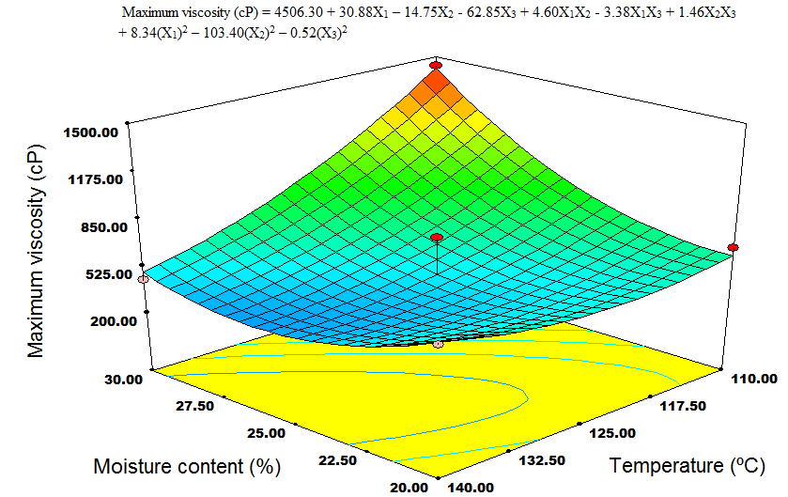
Maximum viscosity (1.25% w/w guar gum concentration)

Slide 27
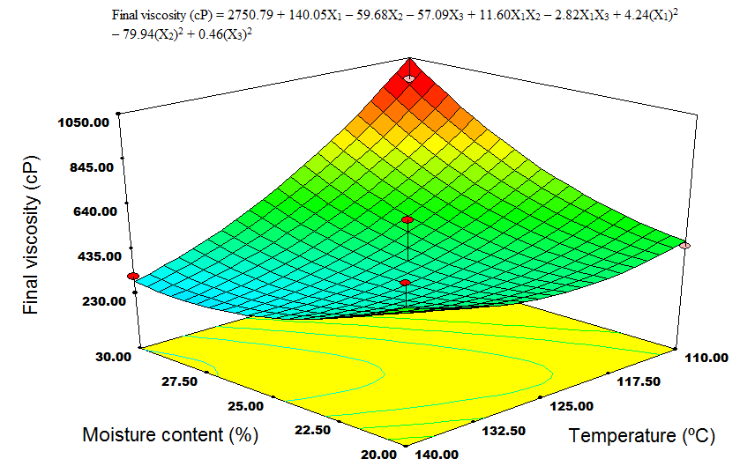
Final viscosity (1.25% w/w guar gum concentration)

Slide 28
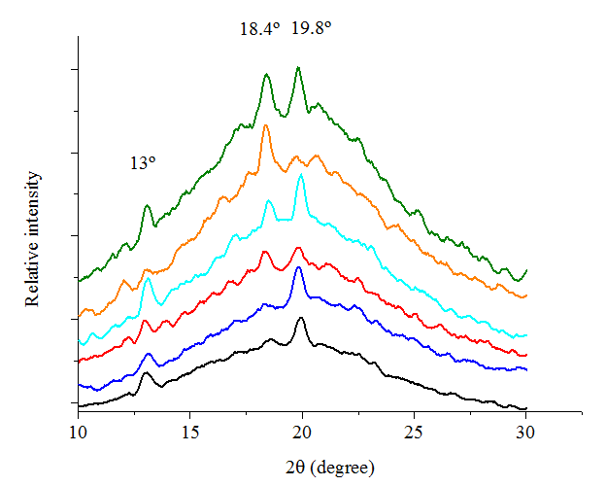

X-ray diffraction patterns

Slide 29
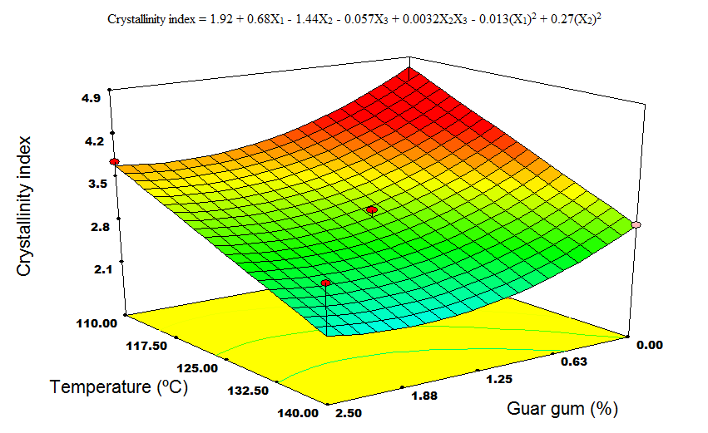
Crystallinity indexes of extrudes samples (25% moisture content)

Slide 30
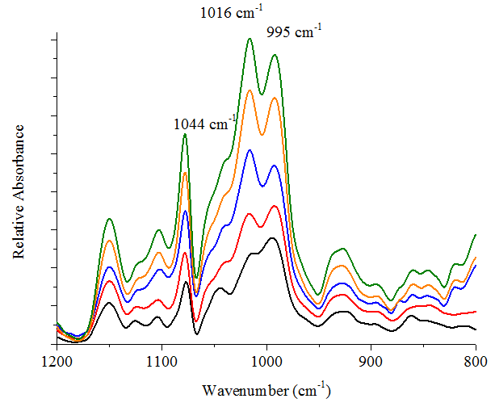

FTIR spectra of the extruded samples and native corn starch

Slide 31
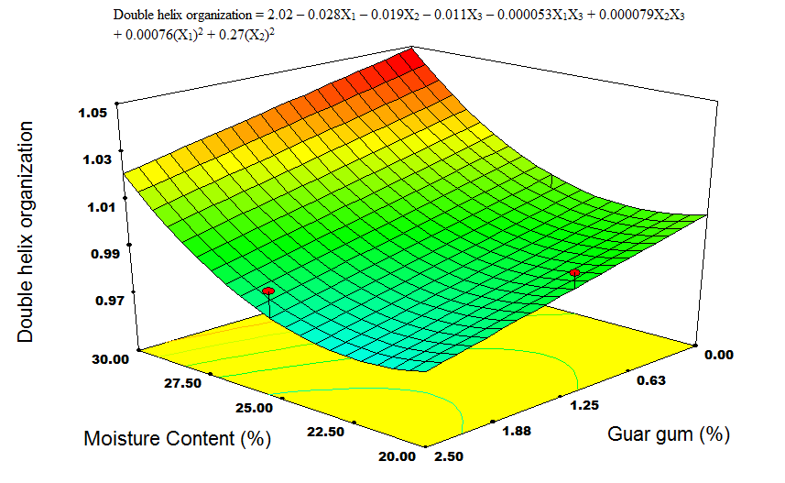
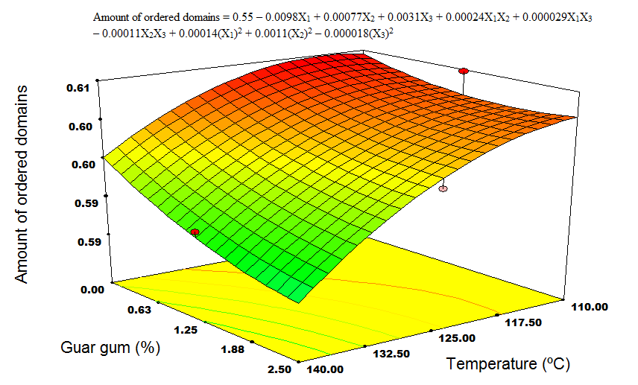
The double helix organization (110 °C) and amount of ordered domains (30% of moisture content)
(a)
(b)

Slide 32
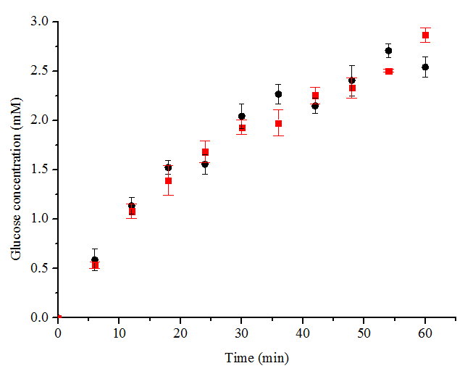
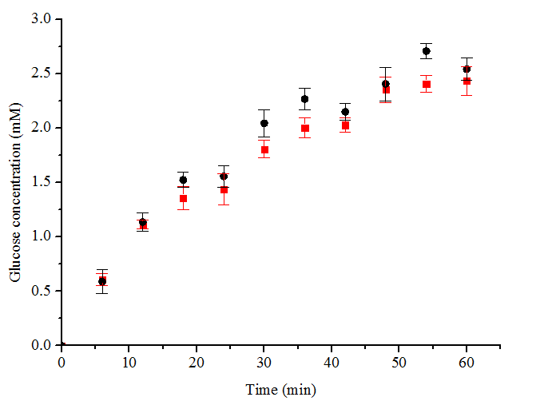
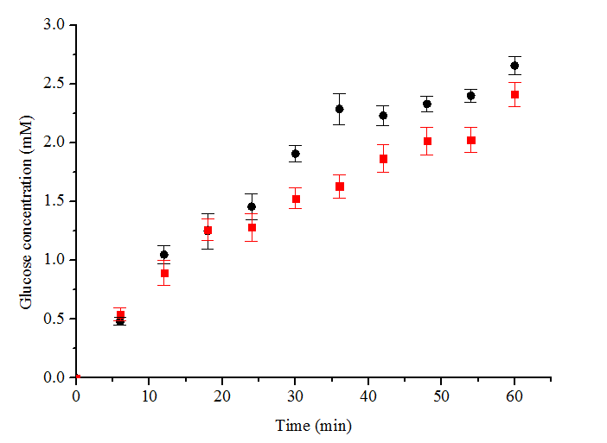



In vitro digestion of corn starch
Effect of (a) guar gum (0-2.5%, w/w), (b) moisture content (20-30%) and (c) temperature of extrusion (110-140 °C) on glucose release.
(a)
(b)
(c)

Slide 33
Conclusions

Slide 34
The SEM micrographics showed the existence of ungelatinizated starch granules and different extents of expansion related to the interaction among the variables.
The expansion index and the viscosity of starch added with guar gum reduced as the extrusion temperature increased.
In order to elaborate samples with a high viscosity, extrusion temperature must be maintained at 110 ºC, conditioning the sample with moisture percentages greater than 25%.

Slide 35
The analysis of X-ray diffraction highlighted the interaction of starch with guar gum, showing the changes in formation of new type V and E amorphous structures
From FTIR, the interaction between both biopolymers might occur by hydrogen bonding.
It was generally observed that the extrusion process can be used to develop functional products, like snacks or breakfast cereals, favoring interactions with guar gum and modifying the semicrystalline structure of native corn starch.

Slide 36
References
Adamu, B. (2001). Resistant starch derived from extruded corn starch and guar gum as affected by acid and surfactants: Structural characterization. Starch‐Stärke, 53(11), 582-591.
Altan, A., McCarthy, K., & Maskan, M. (2009). Effect of Extrusion Cooking on Functional Properties and in vitro Starch Digestibility of Barley‐Based Extrudates from Fruit and Vegetable By‐Products. Journal of food science, 74(2), E77-E86.
Ambigaipalan, P., Hoover, R., Donner, E., & Liu, Q. (2013). Retrogradation characteristics of pulse starches. Food Research International, 54(1), 203-212.
Bornet, F. (1993). Technological treatments of cereals. Repercussions on the physiological properties of starch. Carbohydrate polymers, 21(2), 195-203.
Bradley, T., Ball, A., Harding, S., & Mitchell, J. (1989). Thermal degradation of guar gum. Carbohydrate polymers, 10(3), 205-214.
Brennan, M. A., Merts, I., Monro, J., Woolnough, J., & Brennan, C. S. (2008). Impact of guar and wheat bran on the physical and nutritional quality of extruded breakfast cereals. Starch‐Stärke, 60(5), 248-256.
Chiu C-W, Solarek D. (2009). Modiﬁcation of starches. In Whistler R.L., BeMiller J.N., Paschall E.F. (Eds.), Starch Chemistry and Technology. 3rd ed. (p. 629–55) Orlando FL: Academic Press
Colonna, P., Tayed, T. & Mercier, C. (1989). Extrusion cooking of starch and starchy products. In: Mercier C., Linko P. & Harper J. M. (Eds.), Extrusion Cooking, (pp. 247–319). St. Paul, MN: American Association of Cereal Chemists.

Slide 37
References
De Pilli, T., Jouppila, K., Ikonen, J., Kansikas, J., Derossi, A., & Severini, C. (2008). Study on formation of starch–lipid complexes during extrusion-cooking of almond flour. Journal of food engineering, 87(4), 495-504.
Lehmann, U., & Robin, F. (2007). Slowly digestible starch–its structure and health implications: a review. Trends in food science & technology, 18(7), 346-355.
Lo Curto, A., Pitino, I., Mandalari, G., Dainty, J. R., Faulks, R. M., & John Wickham, M. S. (2011). Survival of probiotic lactobacilli in the upper gastrointestinal tract using an in vitro gastric model of digestion. Food microbiology, 28(7), 1359-1366.
Pérez, S., & Bertoft, E. (2010). The molecular structures of starch components and their contribution to the architecture of starch granules: A comprehensive review. Starch‐Stärke, 62(8), 389-420.
van Soest, J., De Wit, D., Tournois, H., & Vliegenthart, J. (1994). Retrogradation of potato starch as studied by Fourier transform infrared spectroscopy. Starch‐Stärke, 46(12), 453-457.
van Soest, J. J., Tournois, H., de Wit, D., & Vliegenthart, J. F. (1995). Short-range structure in (partially) crystalline potato starch determined with attenuated total reflectance Fourier-transform IR spectroscopy. Carbohydrate Research, 279, 201-214.
Zhang, Y., & Han, J. (2010). Crystallization of High‐Amylose Starch by the Addition of Plasticizers at Low and Intermediate Concentrations. Journal of food science, 75(1), N8-N16.

Slide 38

THANKS FOR YOUR ATTENTION

Slide 39
Let us meet again..
We welcome you to our future conferences of Conference Series LLC
through
8th World Congress on Bioavailability & Bioequivalence: BA/BE Studies Summit
June 26-29, 2017 at San Diego, USA
http://bioavailability-bioequivalence.pharmaceuticalconferences.com/

