Slide 1
Air Mercury Speciation Accuracy and Calibration
Presented at the
SFO Air Mercury Speciation Workshop
July 2014
Eric M. Prestbo, Ph.D.
Notes:
Well .. It was. We’ve made it a whole lot easier.

Slide 2
How hard can it be to measure Hg speciation?
GOM & PBM ~ 1 ppqv
GEM ~ 170 ppqv
Cl
R-
H₂O
How likely is it that an automated atmospheric speciation system can automatically measure at the 1 PPQV (10 pg/m³) level without any artifact bias in all types of atmospheres such as Arctic, urban Asia, free-trop, tropics, sub-tropics, marine, desert, etc.?
Br
Particle
HgCl₂
HgCl₂
SO₄
HgBr₂
Hg⁰
*oxidants
*organics
*org-acids
*radicals
*light
*precip
*dust
*-40° +40°
*5-100% RH
*sea-salt
Hg⁰
Hg⁰
Hg⁰
O
O
O
Calvert and Lingberg (2005)

Slide 3
Q1: Is there a better way?
Starting over, is there a better way to continuously measure GEM, PBM_{2.5} and GOM with hourly resolution, 5 pg/m³ (0.5 ppqv) DL and routine GEM and periodic GOM calibration?
Conclusion – A 2.5 um inlet > annular denuder > particulate filter > gold-trap AFS is the only method that makes sense for the vast majority of ongoing and future scientific programs

Slide 4
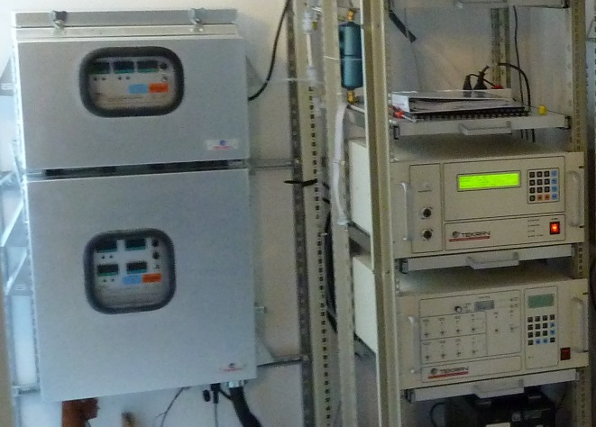
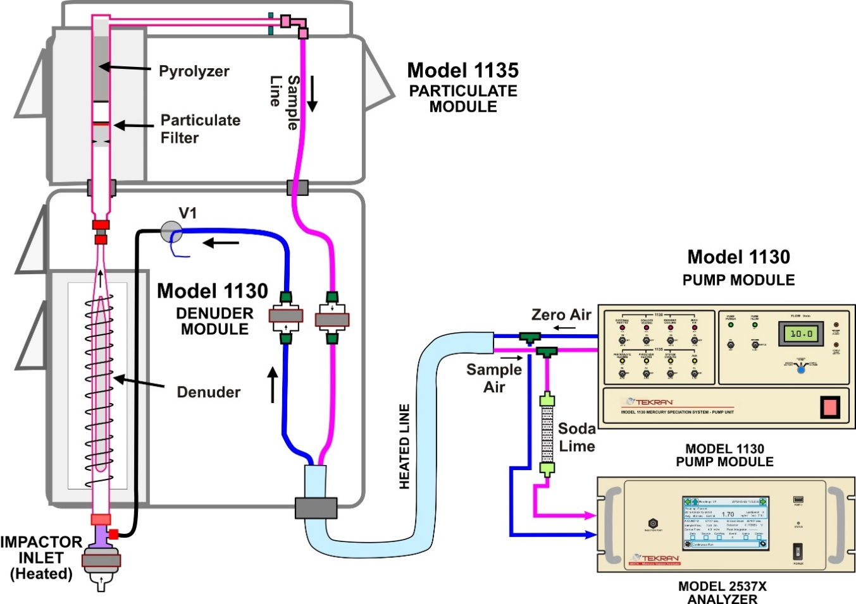
Automated Hg
Speciation Method (pat’d)
PBM
Method is:
Lab tested
Widely published
QA Challenged
Adopted by all advanced int’l & national networks
GEM
GOM
Notes:
-Real time species separation and pre-concentration.
-Note nomenclature
-Method was designed with USEPA design input
-Inlet designed to remove large particles, have short residence time and have 100% transmission efficiency
-Method is operationally defined
-Mercury speciation accuracy is challenging because GOM and PBM act like semi-volatile compounds

Slide 5
SIDEBAR

Slide 6
Historical Perspective for Atm. Hg Speciation Measurement
1994 GENESIS: Small group of international experts convened and concluded that GOM should exist & method development must be a high priority (EPRI Report).
EARLY EXAMPLE: 1996 at ICMGP – Report of unbelievable GOM levels of ~800 pg/m3 at Izania free troposphere site using manual filter pack method (Prestbo and Bloom). Is method biased?
DISCOVERY: 2000 - Using automated Hg speciation method, Landis and many others* started reporting high GOM in the free troposphere and Swartzendruber et al. (2006) published the first peer-reviewed article. *Lyman, Jaffe, Obrist, Sheu, Feng, Slemr….
Notes:
1994 Speciation methods were deemed a priority
Observations with early methods suggested big discoveries may be possible with a reliable method

Slide 7
Select Hg Speciation Discoveries
High GOM and PBM observations where reactive halogen chemistry is favorable
  Polar Regions, Dead Sea, Free Troposphere, Marine Boundary Layer
Elevated PBM/GOM from Biomass fires
Confirmation of speciated mercury emissions from point sources
  Coal Burning, Chlor-Alkali Plants & Waste Incinerators
Conclusion: Hg speciation measurements are scientifically coherent
Notes:
Reminder that although we have unresolved analytical questions, the automated Hg speciation method has led to big discoveries that make scientific sense (chemistry and meteorology)

Slide 8
Two questions for the automated air mercury speciation method
Scientists are asking:
Exactly what is being measured?
How accurate are the GOM and PBM measurements?
Notes:
What are we measuring – very challenging question that probably would require focus and estimated 10 years and 50 million dollars to solve.
How accurate is incrementally possible

Slide 9
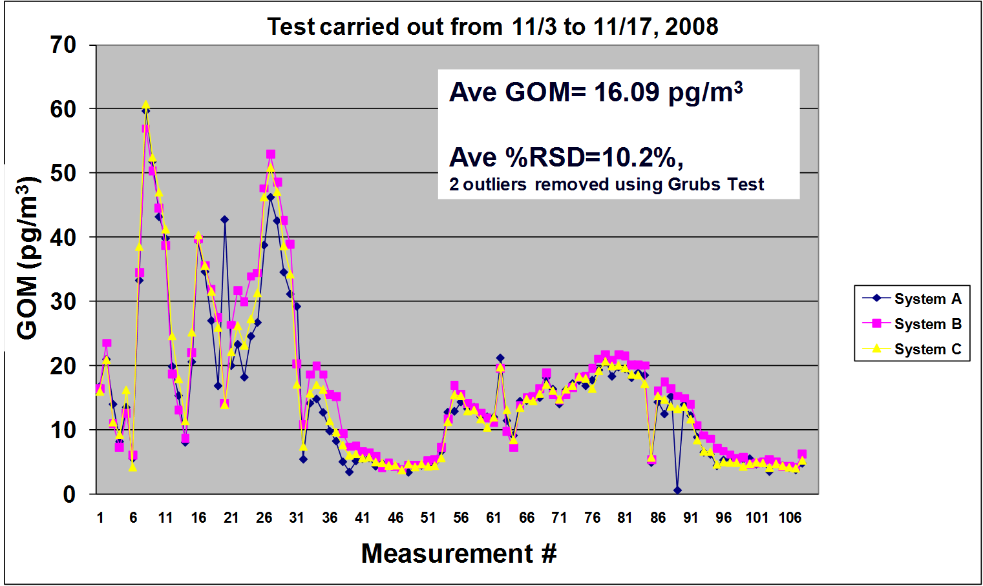
QA Challenge Example: GOM Manifold Comparison of 3 Tekran Systems
(See Olson et al., ICMGP-2013)
Notes:
Quick example of past QA – comparisons – precision for GOM. Many more exists with similar results. Remember this slide of manifold results.

Slide 10
Side-Bar: Accuracy dependent on siting, operation, maintenance and QA
2007 Survey Says – experts rarely do external calibration and no audit of the sample volume measurement
Inlet must be in free air with unobstructed large fetch
Current and developing networks are improving the accuracy of Hg speciation measurements
  CAMNet/CAPMoN, UBA-Germany, AMNet, GMOS, EMEP, AMAP, S. Korea, etc.
Notes:
Skip – mention networks

Slide 11
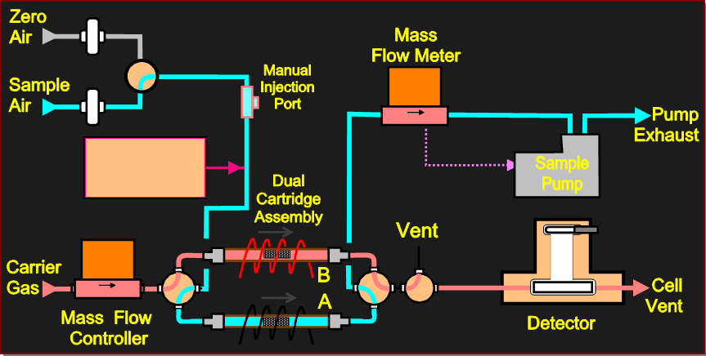

Traceable Hg⁰ calibration and performance check options
Automated calibration with permeation source
Validation of permeation source at injection port
Manual standard additions at injection port
Automated perm source std. additions with 1120
Model 1120 Controller
Model 2537 Schematic
Hg⁰ perm source
11
Notes:
11
In zero air – just evaluating accuracy of detector (not transport or gold trap reliability)
In sample air – spiking tests matrix effects on gold traps

Slide 12
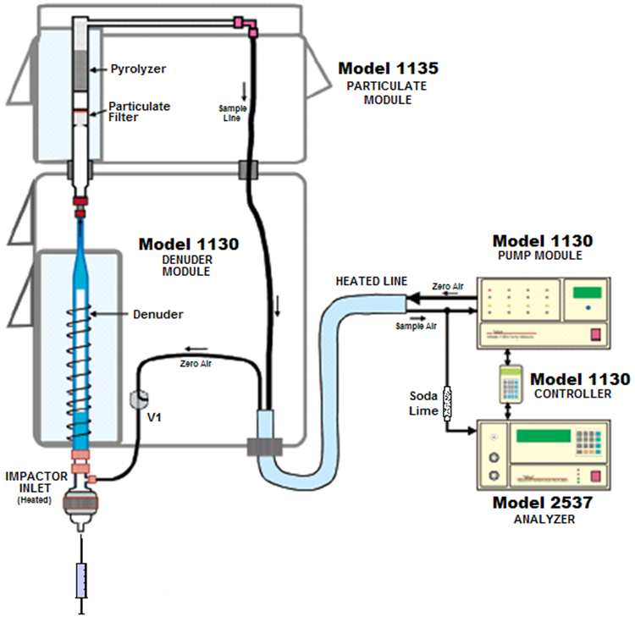

Traceable Hg⁰ fictive-loss test options during ambient air sampling
Simple – manual Hg⁰ injection upstream of the soda lime
Difficult – manual Hg⁰ injection at 1130 inlet
Automated – proposed permeation source Hg injection at 1130 inlet
1
2
3
Notes:
Transport tests – soda lime – glassware
Injection with elemental shows Hg^0 recovery, but would not be able to show if 1% of Hg^0 were converted to HgCl2 or PBM

Slide 13
GOM Calibration Challenges
HgCl₂ and HgBr₂ are solids at room temperature, so will adsorb to reactive and/or unheated surfaces
Thus, quantitative transport requires optimization for laminar flow and short residence time (Tekran 1130 inlet and denuder) and/or brute force of high temperature through entire, non-reactive flow path (150-180º C)

Slide 14
GOM Calibration Challenges
HgCl₂ adsorbed to surfaces will convert to Hg⁰, especially at high temperature or even changing air chemistry
parts per quadrillion (10 to 500 picogram/m³) concentrations required for calibration
Source must be stable, reproducible, robust and can be turned on & off

Slide 15
Traceable Calibration of GOM Measurements
Available Methods
  Reaction of traceable Hg⁰ + 2 Cl > HgCl₂(g) (catalyzed by reactive metal surface)
  Gas permeation of pure solid HgBr₂ to HgBr₂ gas (sublimation)
  Nebulization of NIST traceable standard [HgCl₄]²⁻ solution
  Manifold Spiking Research – Ideally use independent NIST traceable GOM Source
Not 100% efficient 

Slide 16
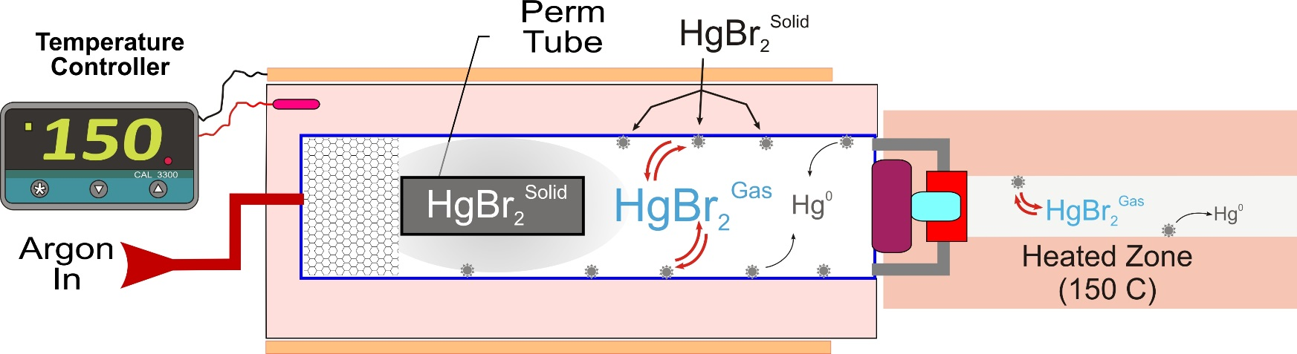
The Trouble with Permeation for GOM Calibration
ADSORPTION: Loss to surfaces in perm chamber or transport tubing (when off, cold spots) means device emission rate is a function of permeation and wall emissions.
STABILITY: Wall losses in chamber or transport tubing, means that it can take weeks to stabilize or worse, the rate changes between uses
TEMPERATURE: small changes in chamber or transport line temperature and/or humidity can cause big side-effects
CONVERSION: HgBr₂ and HgCl₂ will convert to Hg⁰ on surfaces

Slide 17
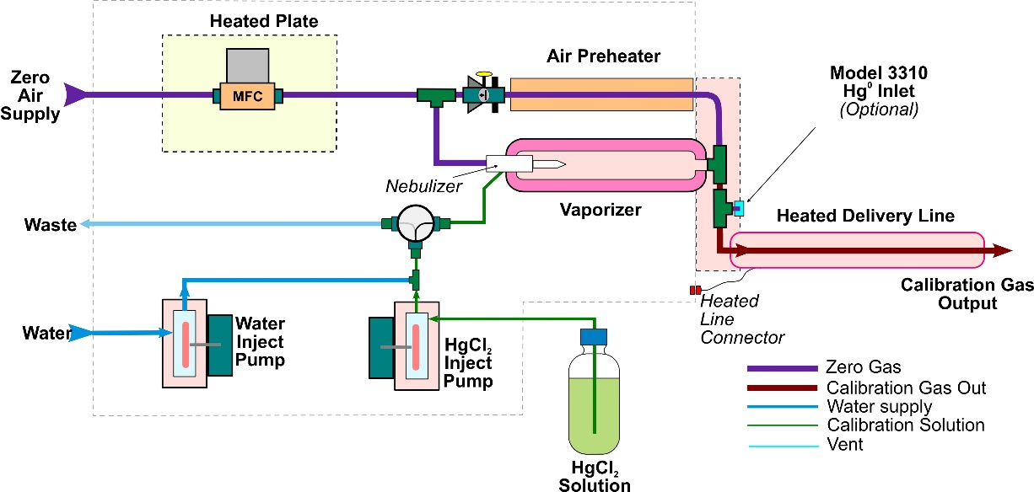
Nebulizing Liquid Hg Standard
Tekran Model 3315
Proven, traceable GOM source for HgCEM equipment QA
Designed for 30 lpm and 1-40 ug/m³
Challenge is to modify device for delivery of GOM to the Tekran Model 1130 inlet at 1-15 lpm and 20 -1000 pg/m³.

Slide 18
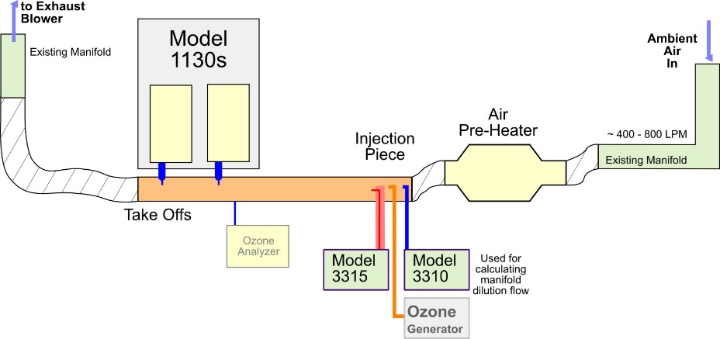
Manifold Studies – RAMIX Comments
Gustin et al., doi:10.1021/es3039104
Manifold studies to assess GOM and PBM accuracy are challenging and have a high degree of risk.
Ideal manifold
design prototype
The ideal manifold study would use GOM and GEM generators that are NIST traceable and independent of the measuring equipment being evaluated. RAMIX used a GOM permeation source, calibrated by the same equipment being evaluated.

Slide 19
Manifold Studies – RAMIX Comments
Gustin et al., doi:10.1021/es3039104
GEM measurements did not agree using 2 highly QA’d identical Hg speciation instruments (Tekran) connected to the RAMIX manifold. A 30% fudge factor was applied to correct this experimental bias.
GEM comparisons with two fully QA’d Hg speciation instruments are nominally better than 5%. GOM is nominally 10%.

Slide 20
Manifold Studies – RAMIX Comments
Gustin et al., doi:10.1021/es3039104
Non-standard setup. 1.5 meters of inlet line & 4 lpm flow rate for the Tekran Hg speciation equipment. Transport losses and species conversion likely, but not tested.
Lab manifold tests were done on a ¼ length of the field manifold. Lab tests showed uncertainty and less than 100% transmission efficiency for GEM & GOM. Flow uncertainty was +/- 15%
Unusual results were explained by hypothesizing that GOM was generated in the manifold.

Slide 21
Conclusions
Determination of accuracy for GOM and PBM at the parts per quadrillion level are difficult, but badly needed
The Tekran 3315 modified for ambient levels may be the best option for field-based GOM accuracy determination. Tekran needs willing partners and funding to implement.
Manifold studies for accuracy are difficult to do and prone to have their own artifacts

Slide 22
Q2: What does the consensus of the research & monitoring community need to improve “accurate” Hg speciation measurements, at high resolution, with a commercially available and supported system?
Current 2537-1130/1135 system, with modifications to improve accuracy & robustness and add a GOM calibration source?
A system that switches a 2537 between a GEM and TAM_{2.5} mode, with the difference being a function of [GOM+PBM_{2.5} + V_{GEM-PBM-GOM}], where V_{GEM-PBM-GOM} is the natural variability of these species over the 5 to 10 minute time cycle of measurement. Est. DL of 100 pg/m³ and 30% uncertainty?
A UW - DOHGS type system with two Tekran 2537 Units measuring TAM_{1.0} and GEM simultaneously, including a GOM calibration source. Est DL of 50 pg/m³?
Other?

Slide 23
Tekran future contributions to improve GOM/PBM automated method
Prestbo would be willing to ask Tekran to contribute a large amount of in-kind resources to an acceptable, funded research project to develop modifications and new calibration sources for the 2537-1130-1135 system.
Open invitation…..
The size of the problem seems to require a coordinated, funded contribution from a larger community of atmospheric Hg experts ……

