Slide 1


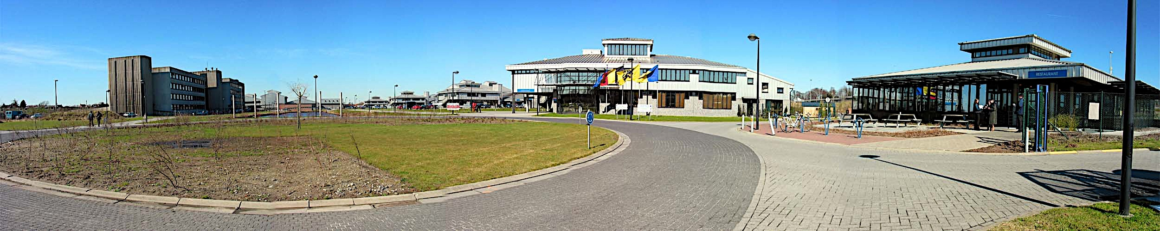
Heat-labile enterotoxin enhances small intestinal colonization with F18ac+ verotoxigenic E. coli in newly weaned piglets
Faculty of Veterinary
Medicine
M. Atef Yekta¹, M. Loos¹, A. Coddens¹, S. Arnouts³, W. Van den Broeck², B. Devriendt, U. Lundberg⁴, D. Epperson⁴, E. Cox¹
Eric.Cox@Ugent.be
Notes:
Le français n'est pas ma langue maternelle, alors je vais faire des erreurs.Je les veux m'excuser à l'avance

Slide 2
Overall hypothesis of the study
LT enterotoxin in subclinical concentrations affects the small intestinal mucosa making it more susceptible to other enteropathogens
Pig as model
Enterotoxigenic E. coli as source of LT
If this could be proven vaccination against LT would be a valid strategy
Gregory Glenn

Slide 3
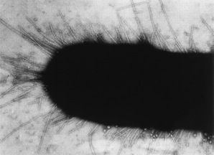
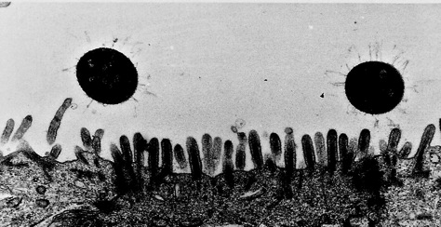
E. coli infections post weaning in piglets
Enterotoxigenic E. coli (ETEC), F4 or F18 fimbriae
Vérotoxinogenic E. coli (VTEC), F18 fimbriae
Fimbriae (F4, F18)
colonisation
Enterotoxins (LT-I, STa, STb)
Shiga-toxin (Stx2e)
Diarrhoea
Oedema disease
Hypothesis: Can an F4 ETEC infection enhance an F18 VTEC infection
Notes:
Gyles, 1994. Escherichia coli verotoxin and other cytotoxins. Pages 151–170 Escherichia coli in Domestic Animals and Humans. C. L. Gyles, ed. CAB International, Wallingford, U.K
La souche

Slide 4
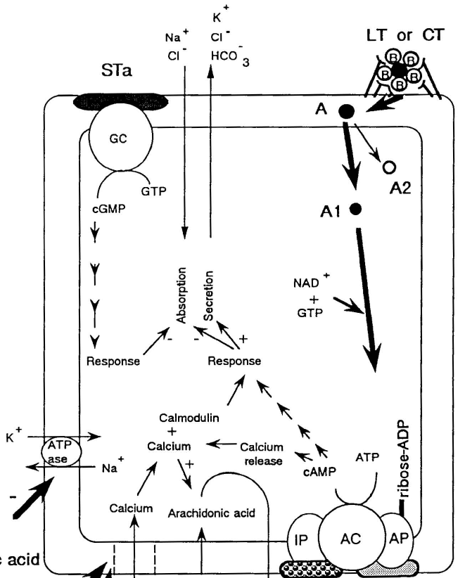
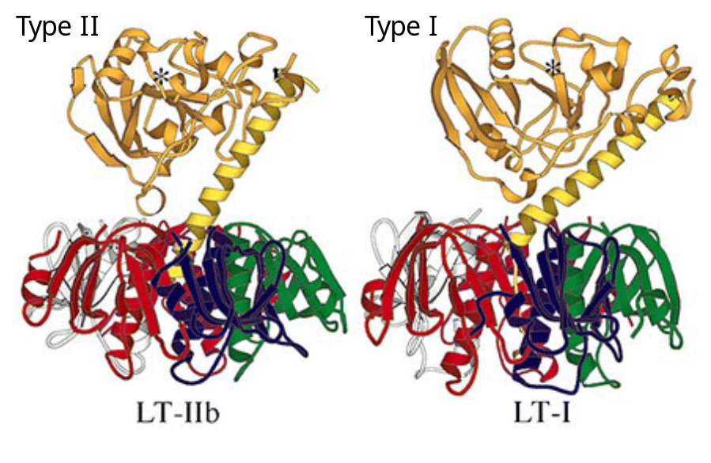
F4 + ETEC faecal excretion
F4 fimbriae
700
C
MAJOR subunit FaeG = adhesin
F
600
G
G
G
500
diarrhoea first week post-weaning
G
G
10⁶ E. coli/g faeces
F
400
H
G
G
300
G
G
G
200
Enterotoxins
(LT-I, STa, STb, EAST1)
100
0
Water loss
2
3
4
5
6
7
Days post infection
/ H⁺
Thermo-labile enterotoxin (LT)
=AB5 toxin
Binds to GM1Ganglioside on enterocytes
CFTR
CFTR= cystic fibrosis transmembrane regulator
cGMPKII
PKA
PKA= protein kinase A
Enterocyte

Slide 5
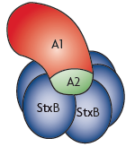
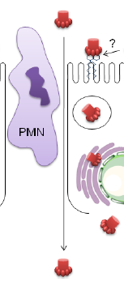
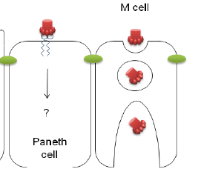
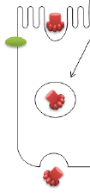

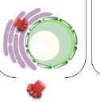
700
F18+ VTEC faecal excretion
F18 fimbriae
600
F
Minor subunit FedF = adhesin
A
500
A
A
A
10⁶ E. coli/g faeces
Oedema disease second week
Post-weaning
A
400
A
300
A
A
A
200
A
Shiga-toxin (Stx2e)
100
0
2
3
4
5
6
7
8
9
10
11
Stx
Binds to Gb3
Intestinal
epithelium
oedema
Sensitive cells
Apoptosis endothelial cells
Johannes and Römer, 2010. Nature Review Microbiology; Schüler, 2011. Toxins

Slide 6
Verdonck et al., 1999. Vaccine
900
800
F4-specific IgA ASC
700
600
500
400
300
200
Mean ASC per 10⁷ cells
10O
0
500
day 0
450
F18-specific IgA ASC
day 4
Absence of
LT
400
day 7
day 11
350
day 15
300
250
Different interaction of F18 fimbriae?
200
150
100
50
0
Mes Lnd
Ileal
Peyer’s p.
Jejunal
Peyer’s p.
lamina
propria
propria

Slide 7
F4 and F18
Minor subunits
C
MAJOR subunit FaeG
MINOR subunit
FedF
F
F
G
A
G
G
A
= ADHESIN =
A
G
A
G
A
Major
subunit
F
H
G
A
G
A
G
A
G
A
G
A
F4 fimbriae
F18 fimbriae
F4ab/ac/ad
F18ab/ac

Slide 8
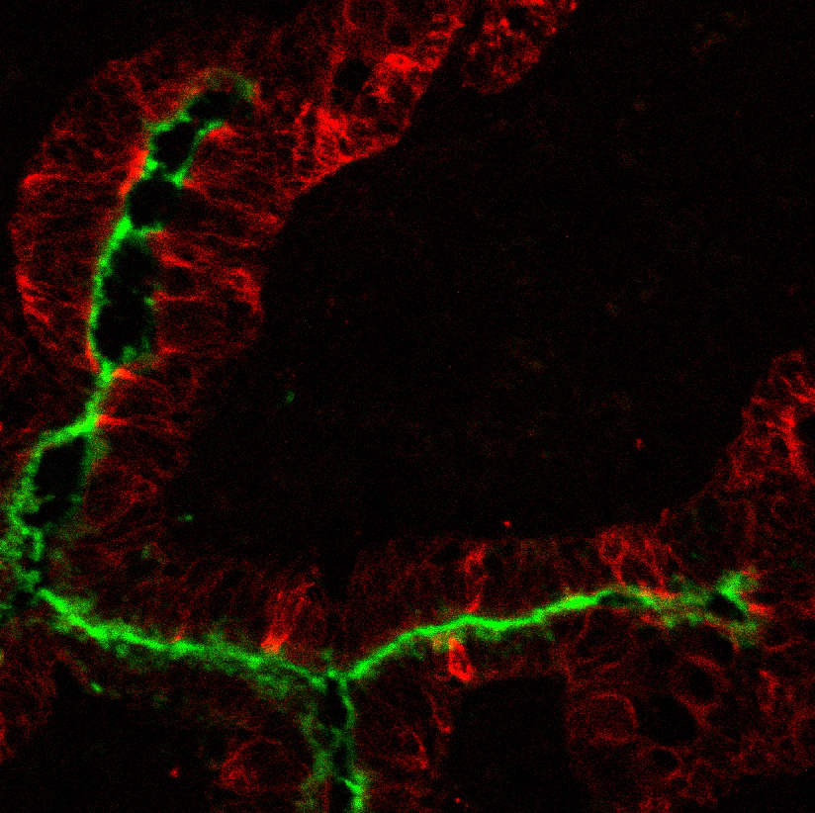
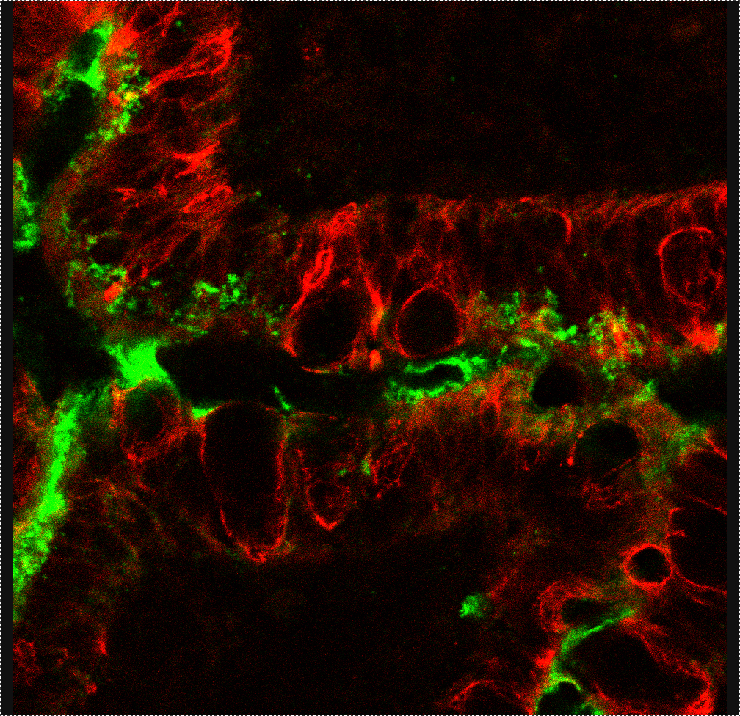
Follicle-associated epithelium
Binding and uptake of F4
M cells (cytokeratin 18+)
Ligated loops injected with F4
FLUOS-labeled F4
F4 in M cell
Goblet cell
F4 in
Enterocytes
Cytokeratin-18 18
Snoeck et al., 2008. Vet Imm Immunopath.
F4 fimbriae

Slide 9
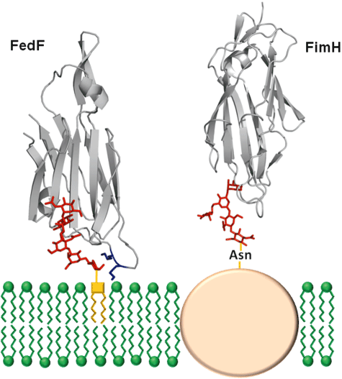
Structural insight in binding of blood group A6-1 sugar by the F18 fimbrial adhesin FedF
Adhesin of Type I fimbriae
F
Adhesin of F18
fimbriae
A
A
A
F18
A
A
A
K115
A
A
Blood group 0
A
A
FedF adhesin at tip
Blood group A
Blood group A6-1 sugar
+ polybasic
-
Moonens et al., Molecular Microbiology, 86, 82-95.
Notes:
Model of FedF receptor binding on the host cell surface, based on FedF15-165 A6-1 complex. The glycan receptor is bound in an elongated binding groove.
(Crystal structure of the FedF15-165 bound to Type 1 blood group A and B hexaose. A. Ribbon representation of FedF15-165 bound to A6-1 (depicted in stick model).)
Model of glycoprotein binding by FimH, based on the crystal structure of the FimH lectin domain in complex with oligomannose-3 (PDB entry 2VCO).
Receptor binding topologies in FedF and FimH. Left panel: Model of FedF receptor binding on the host cell surface, based on FedF_{15‐165} A6‐1 complex. The glycan receptor is bound in an elongated binding groove. In addition to the FedF–glycan interaction, the lectin domain comes in close proximity of the cell surface, where two positively charged lysine residues (blue) on an extended surface loop interact with the negatively charged phospholipid bilayer. Right panel: Model of glycoprotein binding by FimH, based on the crystal structure of the FimH lectin domain in complex with oligomannose‐3 (PDB entry 2VCO). FimH binds the terminal D‐mannose residue in a defined pocket at the tip of the Ig‐like domain. Based on the complex with oligomannose‐3 the binding topology of FimH is more distant from the protein surface.
© This slide is made available for non-commercial use only. Please note that permission may be required for re-use of images in which the copyright is owned by a third party.

Slide 10
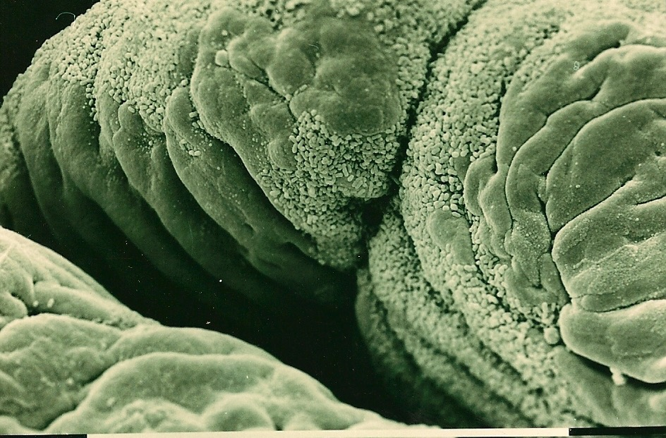
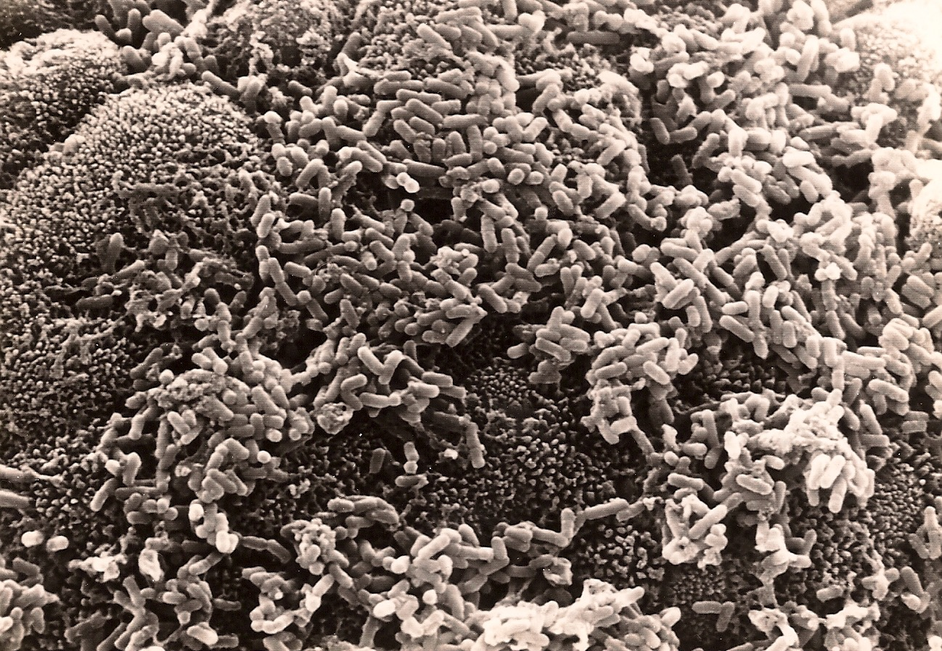
F18
F4

Slide 11
Hypothesis
Can LT enterotoxin in subclinical concentrations affect the small intestinal mucosa of newly weaned piglets so that it enhances F18 VTEC colonization ?

Slide 12
F4 + ETEC faecal excretion
700
600
500
diarrhoea first week post-weaning
400
300
200
100
0
10⁶ E. coli/g faeces
Days post infection
2
3
4
5
6
7
700
F18+ VTEC faecal excretion
600
500
400
Oedema disease second week
Post-weaning
300
200
100
0
2
3
4
5
6
7
8
9
10
11
Verdonck et al., 2002. Vaccine
Notes:
faible

Slide 13
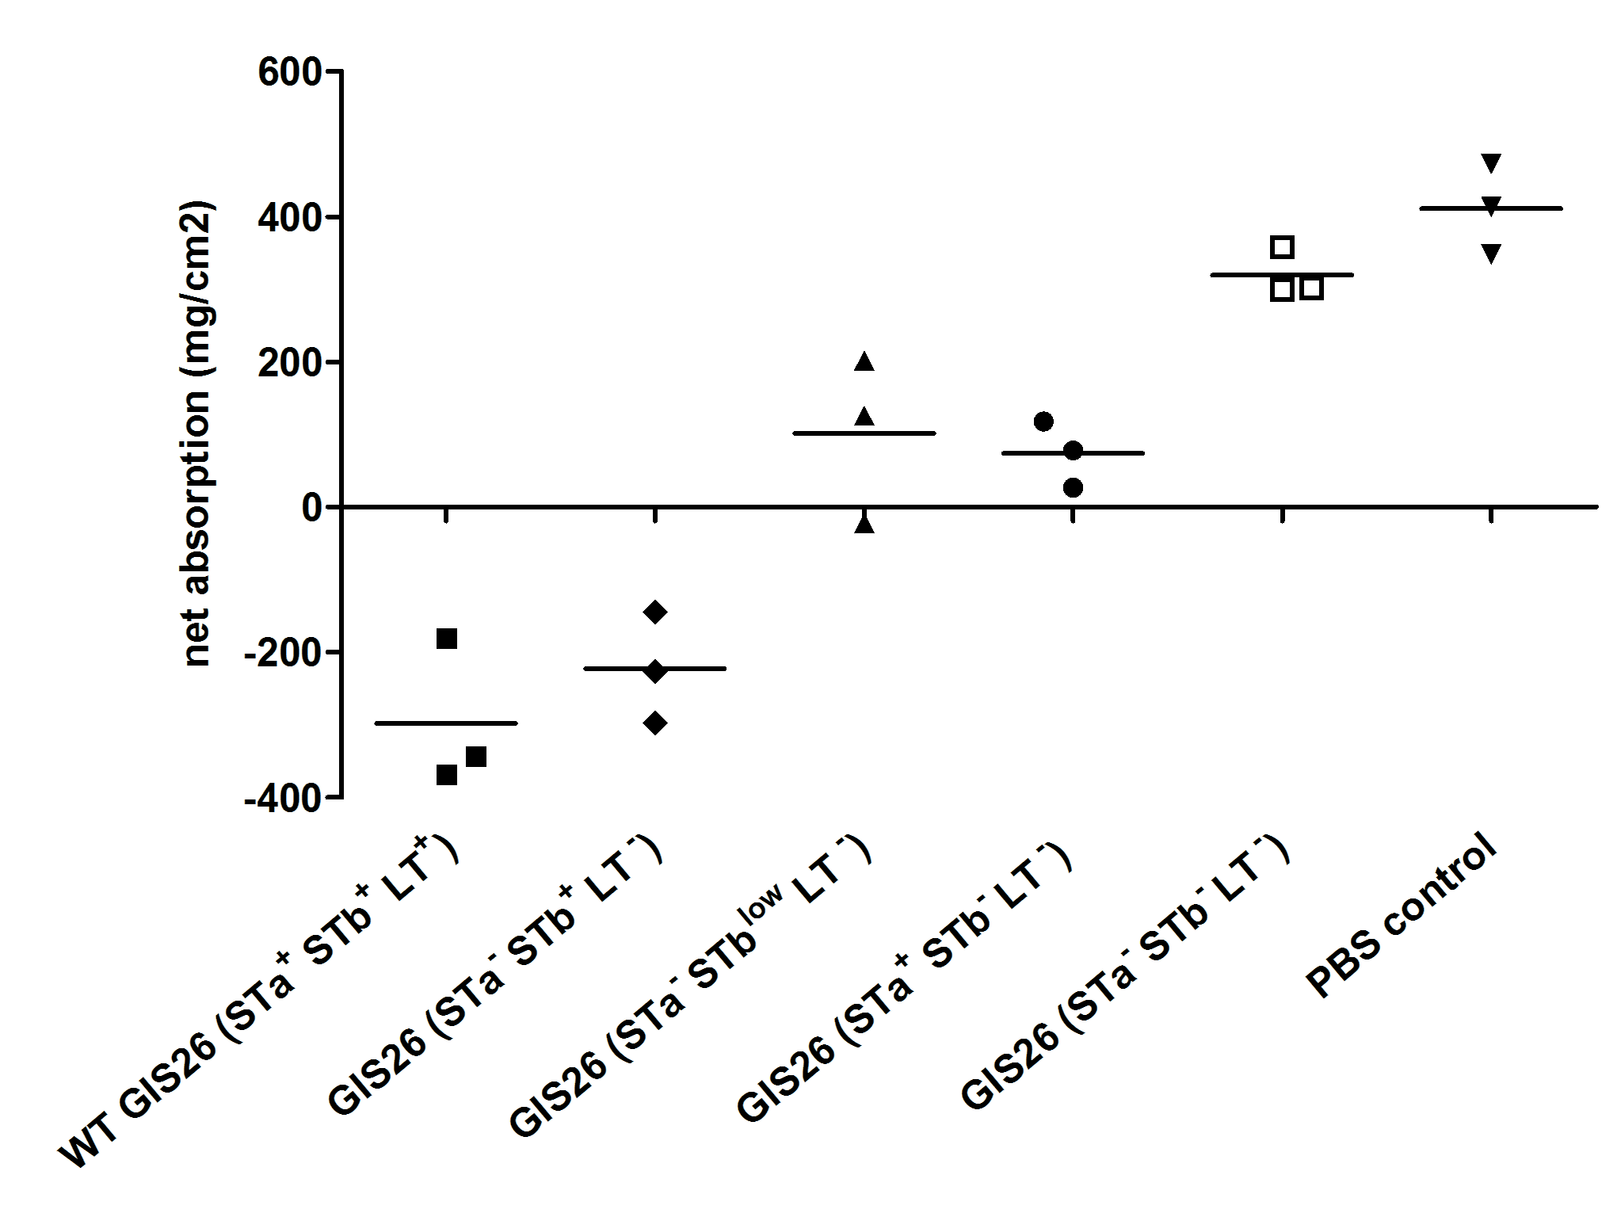
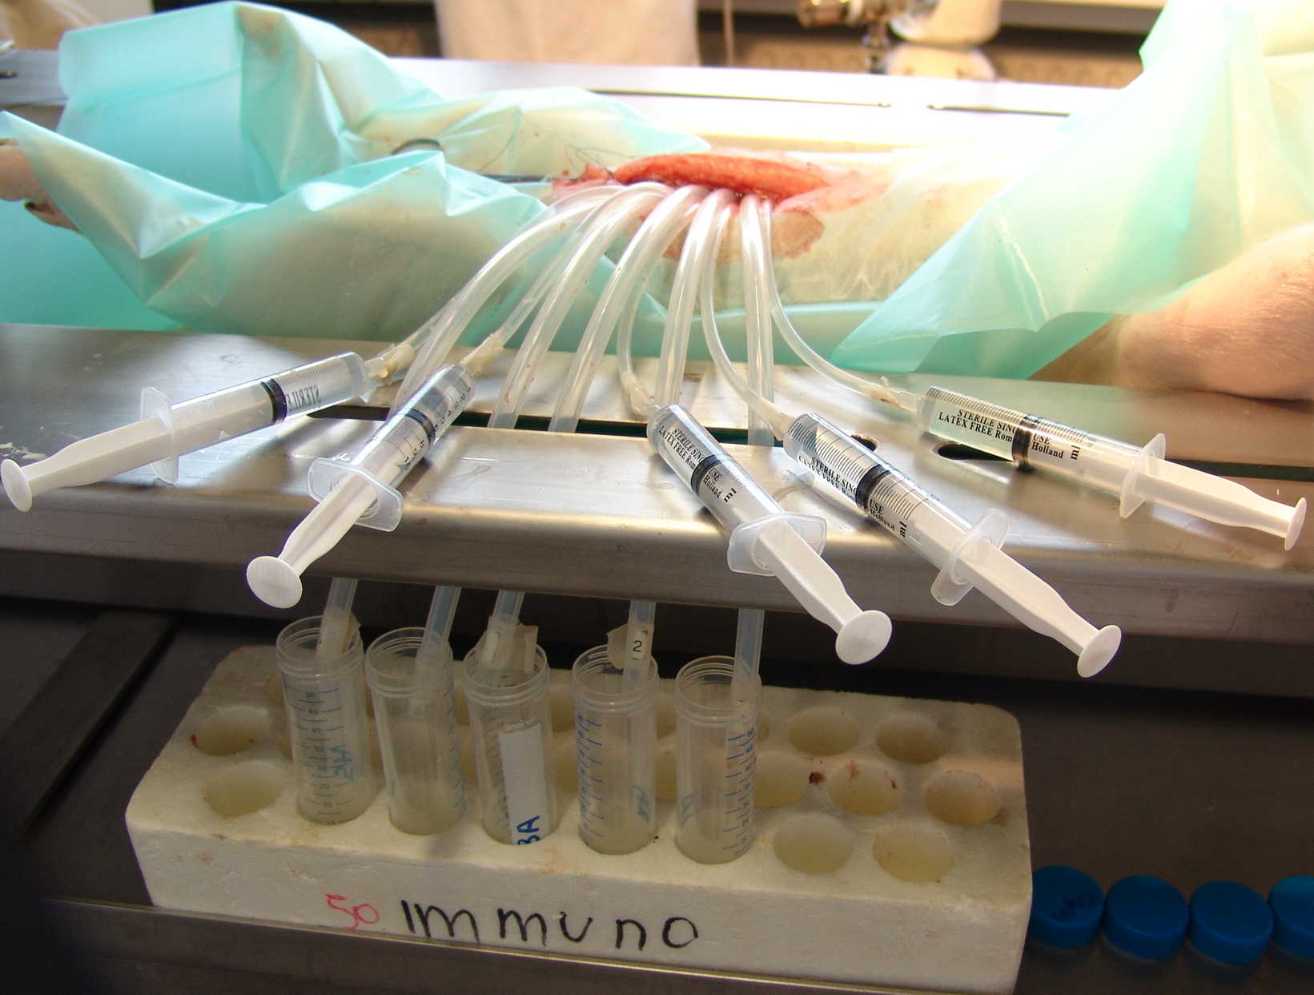
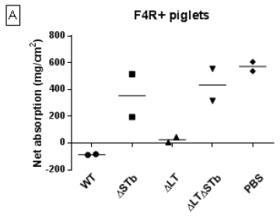
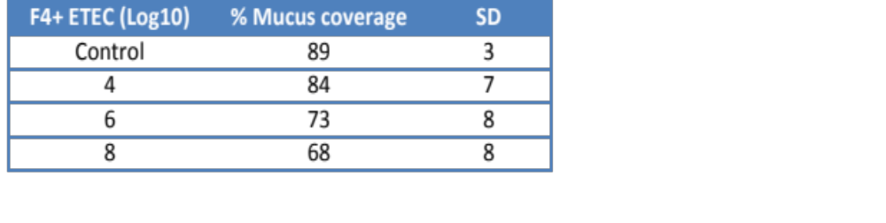
Small Intestinal Segment Perfusion (SISP)
  GIS26 (O149:K91:F4ac, LT⁺ STb ⁺Sta+)
2.5 x 10^{9 CFU}
N = 3 F4R⁺
F4R⁺ pig 4h perfusion
Absorption
20 cm
segment
Secretion
F4R⁺ pig 7h perfusion
2.5x10⁹ CFU
  IMM01 (O149:K91:F4ac, LT⁺ STb⁺)
Absorption
Secretion
Loos et al., 2012. PLoS ONE 7(7): e41041; Loos et al., unpublished data
Notes:
Is de geïnjecteerde dosis correct? 5X 108 per ml en dan 5 ml
Voor het dosis effect is het zeker de dosis in 5 ml

Slide 14
What dosis for LT enterotoxin in the SISP of 20 cm?
After 6 hours perfusion 10 µg was the lowest dose with
Consistent fluid secretion
56 ± 70 g fluid per cm² mucosa

Slide 15
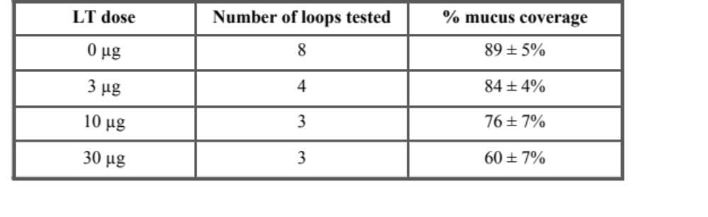
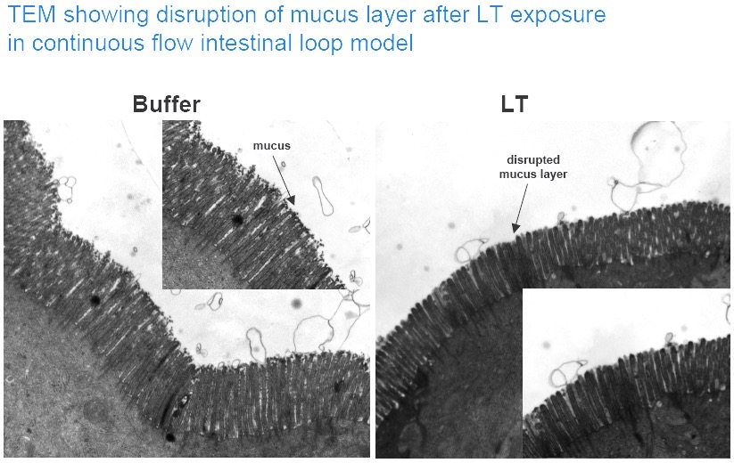
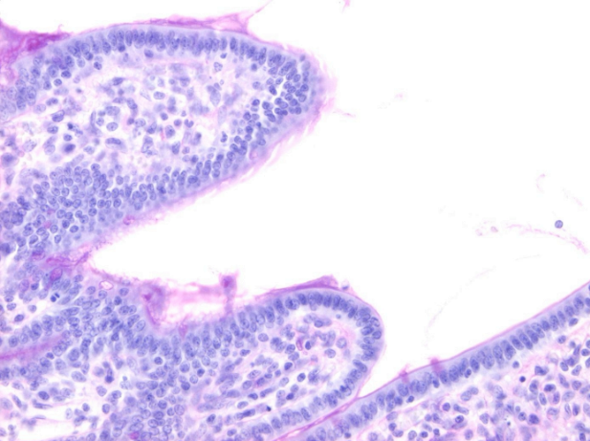
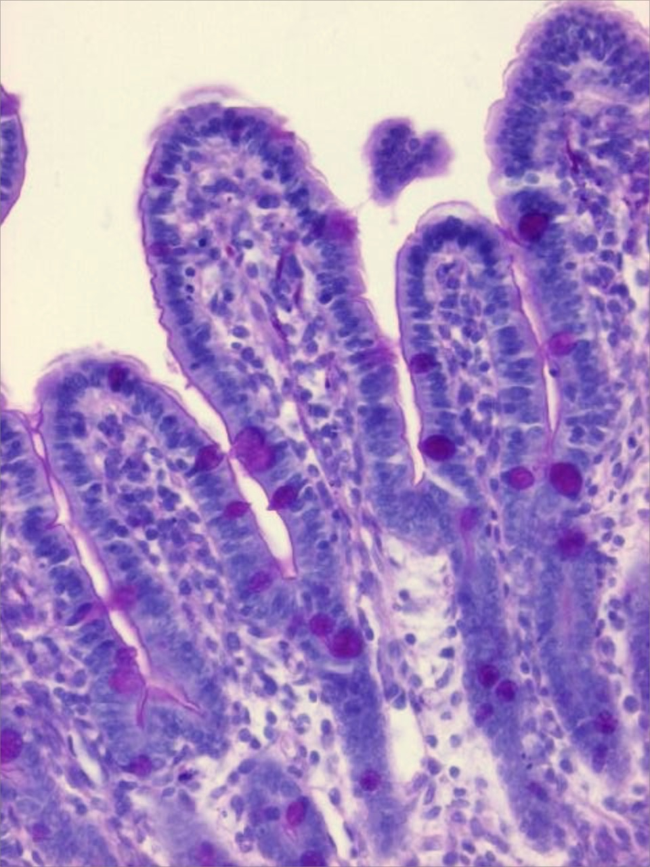
What is the effect of these dosages on mucus?
Normal
Thin
PAS staining
EM
EM
PAS staining
Control
30 µg LT /ml

Slide 16
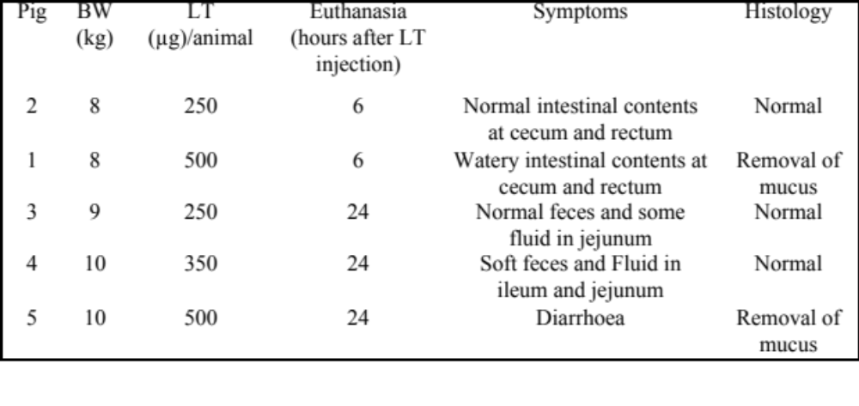
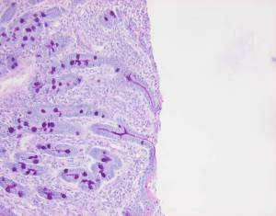
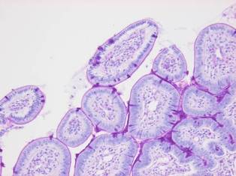
From 20 cm intestinal segments to 8 m intestine in pigs
(injection at 5 sites)
6.25 x 40 = 250 µg
12.5 x 40 = 500 µg

Slide 17
Conclusions
Intra-intestinal injection of 500 µg LT induces diarrhoea in 4-week-old pigs.
250 µg LT did not induce diarrhoea.
Removal of mucus layer was only clearly detectable in animals which developed diarrhoea.

Slide 18
What is the effect on VTEC colonization
6 hours later
LT | F18ab+ VTEC | Pig
250 µg | 10**11 CFU in 10 ml PBS | 1 | excreting 7 days
 |  | 2 | excreting 7 days
 |  | 3 | excreting 7 days
 |  | 4 | † day 3
 |  | 5 | † day 3
 |  | 6 | † day 1
 |  | 7 | † day 1
350 µg |  | 8 | excreting 7 days
 |  | 9 | excreting 7 days
 |  | 10 | excreting 7 days
 |  | 11 | † day 3
0 µg |  | 12 | excreting 5 days
 |  | 13 | excreting 6 days
 |  | 14 | excreting 3 days
 |  | 15 | excreting 6 days
 |  | 16 | excreting 7 days
 |  | 17 | † day 3
 |  | 18 | † day 3
250 µg | - | 19 | † 6 hours
PBS |  | 20
Mean duration
VTEC +LT: 7.0 ± 0.0 days*
*
*
*
VTEC: 5.4 ± 1.4 days
* p<0.05

Slide 19
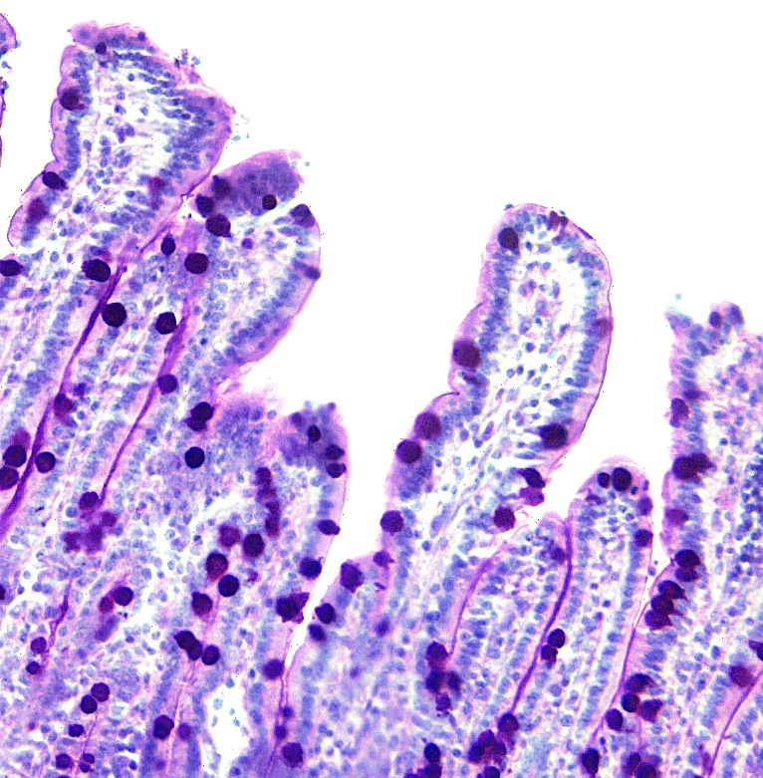
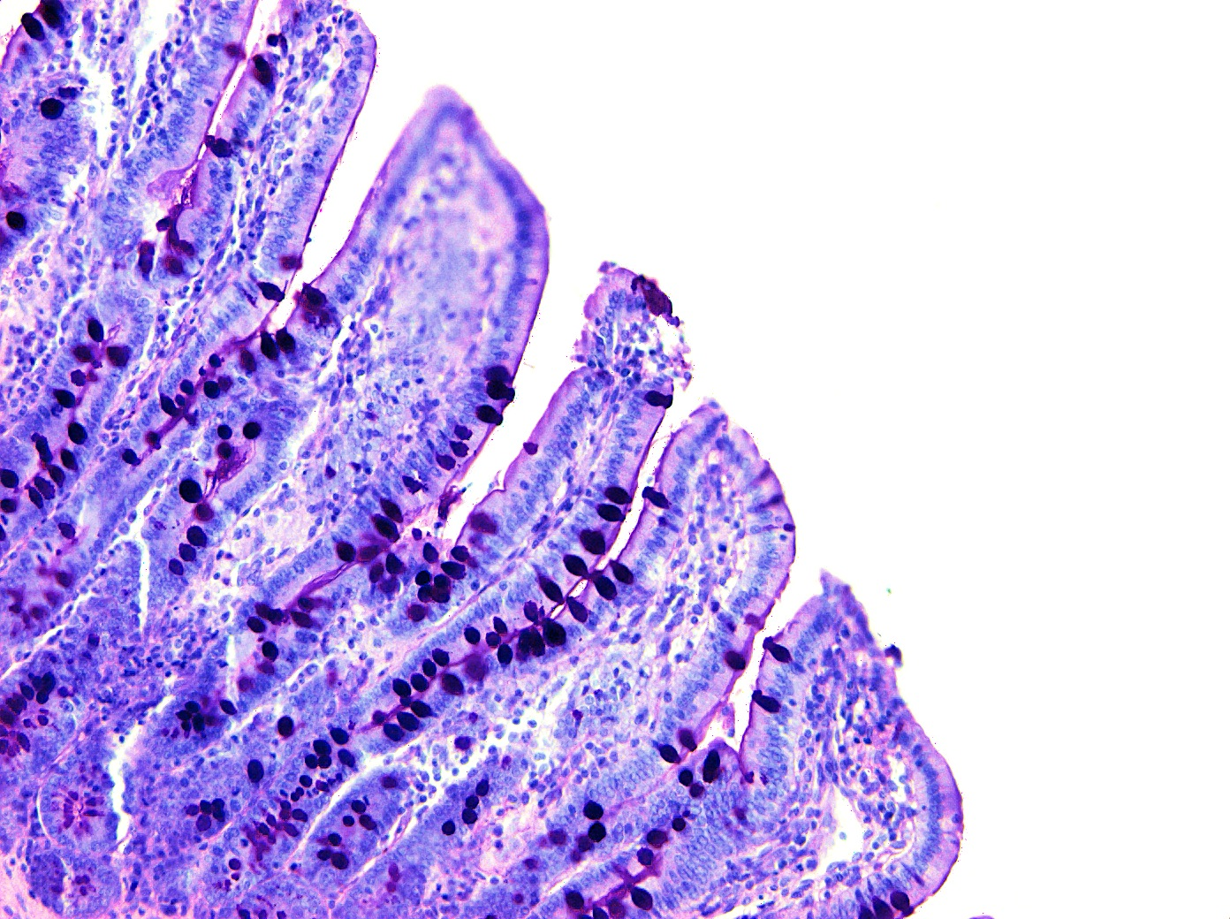
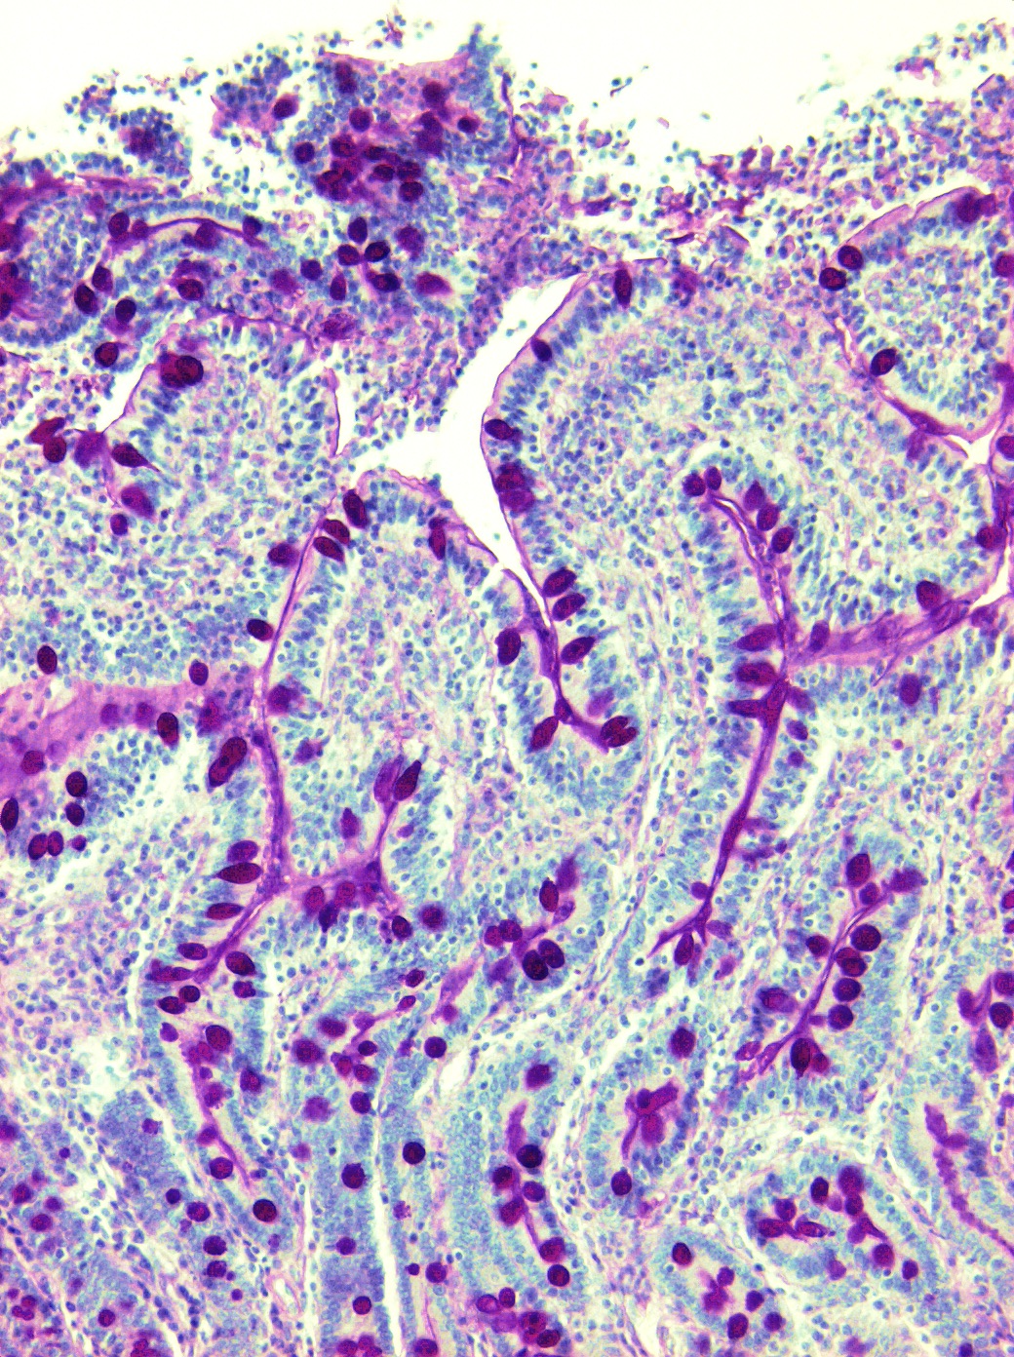
Mucus
thin at tips
Pig 19
250 µg LT 6 hours
Pig 7
250 µg LT + VTEC 4 hours
Pig 6
PBS

Slide 20
Conclusions
Intra-intestinal injection of LT (250 or 350 µg) enhanced colonization with VTEC
F4+ ETEC producing LT could play a role in colonization of the intestine with VTEC

Slide 21
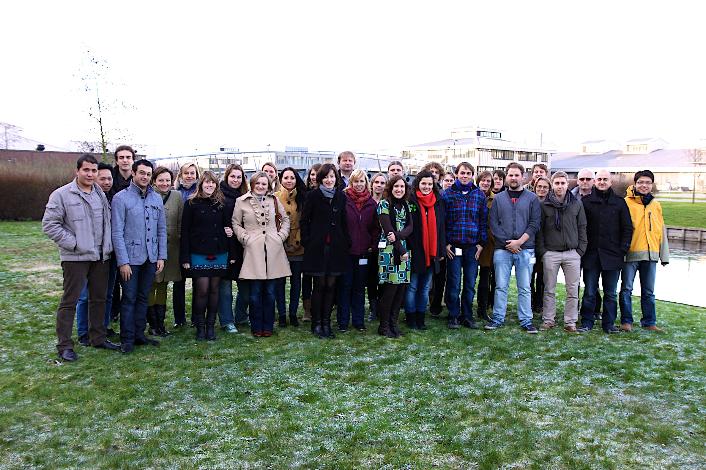
Acknowledgements
Former PhD students:
dr. Michaela Loos
dr. Annelies Coddens
dr. Myriam Atef Yekta
Prof. dr. Wim Van den Broeck
Lab of Immunology (UGent)
Prof dr. Bruno Goddeeris (Lab Immuno/
KULeuven)
dr. Bert Devriendt
Valneva Austria
Dr. Diane Epperson
Urban Lundberg
Financial support
Valneva Austria
Faculty of Veterinary
Medicine

Slide 22
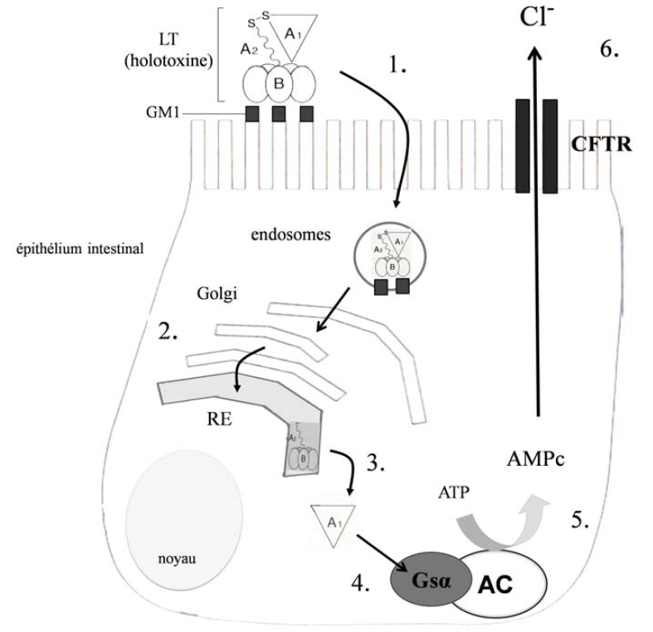
Mechanism of action of LT-I
Hirst & D'Souza, 2006, Masignani et al., 2006

Slide 23
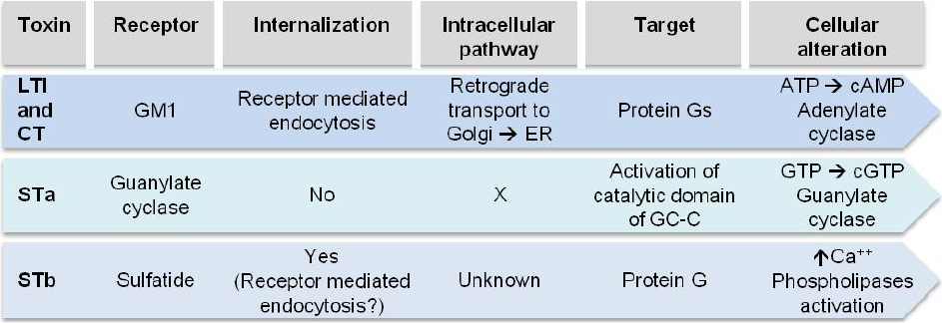
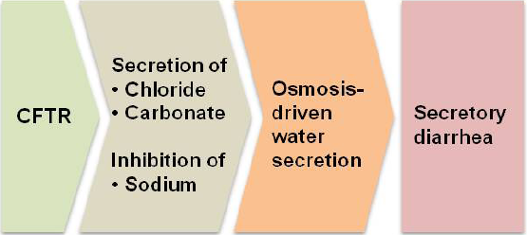
Protein kinase A =>
phosphorylation
cGMP-dependent
protein kinase II
=>
cystic fibrosis transmembrane regulator
Protein kinase C =>
phosphorylation
Adapted from Dubreuil JD, 2013. Toxins

Slide 24
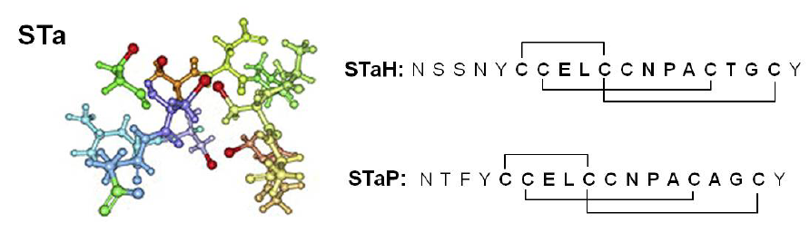
LT enterotoxin
Sta enterotoxin
Enterocyte

