Slide 1
About OMICS Group
OMICS Group International is an amalgamation of Open Access publications and worldwide international science conferences and events. Established in the year 2007 with the sole aim of making the information on Sciences and technology ‘Open Access’, OMICS Group publishes 400 online open access scholarly journals in all aspects of Science, Engineering, Management and Technology journals. OMICS Group has been instrumental in taking the knowledge on Science & technology to the doorsteps of ordinary men and women. Research Scholars, Students, Libraries, Educational Institutions, Research centers and the industry are main stakeholders that benefitted greatly from this knowledge dissemination. OMICS Group also organizes 300 International conferences annually across the globe, where knowledge transfer takes place through debates, round table discussions, poster presentations, workshops, symposia and exhibitions.

Slide 2
About OMICS Group Conferences
OMICS Group International is a pioneer and leading science event organizer, which publishes around 400 open access journals and conducts over 300 Medical, Clinical, Engineering, Life Sciences, Phrama scientific conferences all over the globe annually with the support of more than 1000 scientific associations and 30,000 editorial board members and 3.5 million followers to its credit.
OMICS Group has organized 500 conferences, workshops and national symposiums across the major cities including San Francisco, Las Vegas, San Antonio, Omaha, Orlando, Raleigh, Santa Clara, Chicago, Philadelphia, Baltimore, United Kingdom, Valencia, Dubai, Beijing, Hyderabad, Bengaluru and Mumbai.

Slide 3
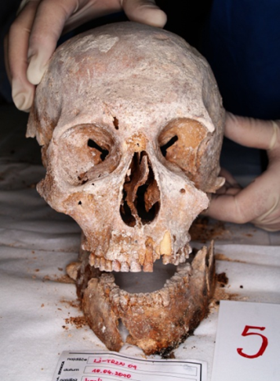
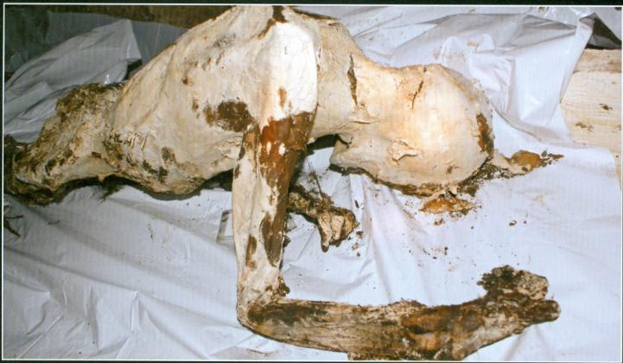
DNA IDENTIFICATION OF ANCIENT SKELETAL REMAINS
IN SLOVENIA
Assist.Prof. Dr. Irena Zupanič Pajnič
Erdogan Oncun BSc (Hons) (Presenter)

Slide 4
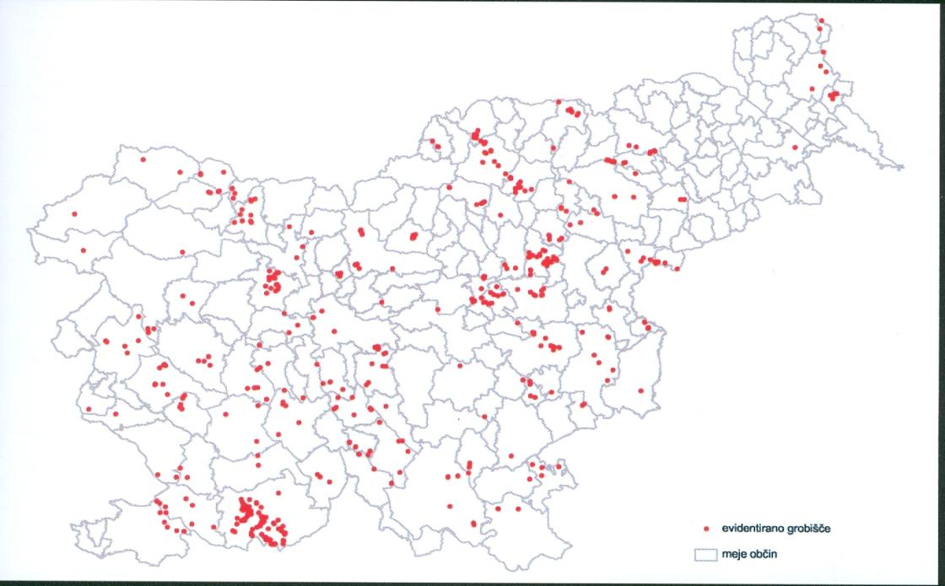
Mass graves in Slovenia
In Slovenia we have about 600 hidden mass graves from WWII (approximatelly 100.000 victims)

Slide 5
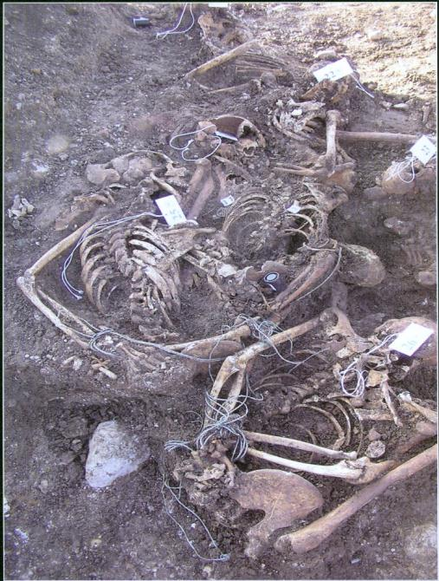
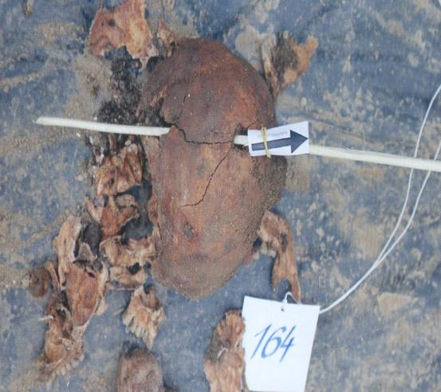
The most common findings
gunshot wounds on skulls
victims were tied with wire
mostly man victims
military clothes (soldiers)

Slide 6
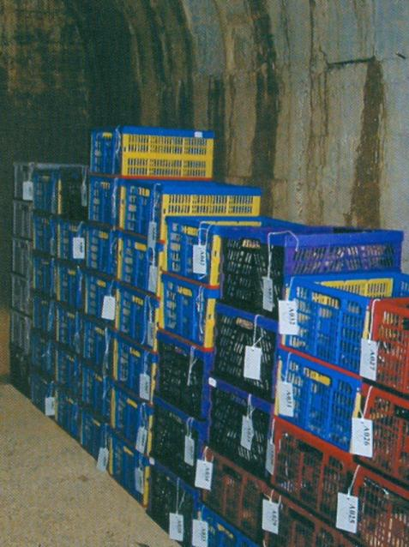
Storage of skeletal remains
Skeletal remains should be stored in aerial boxes. Plastic bags are not suitable, because bones can’t dry in them and the process of decay can start. Boxes with marked skeletal remains should be stored in dry places with low humidity to minimize the possibility for development of microorganisms.

Slide 7
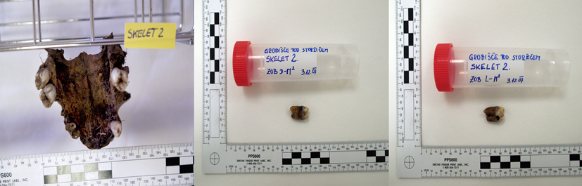
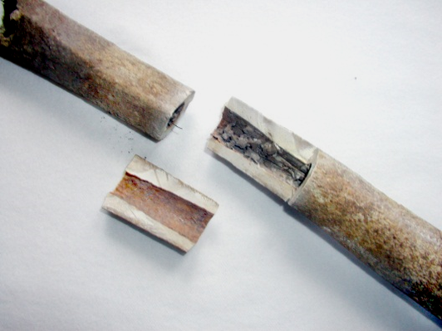
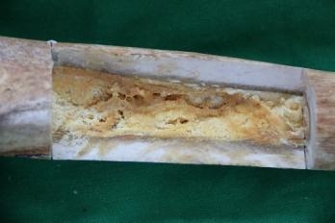
The most appropriate type of bones and teeth for genetic analyses
For molecular genetic identification of the skeletons excavated from the Slovenian WWII mass graves we are sampling one piece of femur and two complete molars per skeleton whenever possible

Slide 8
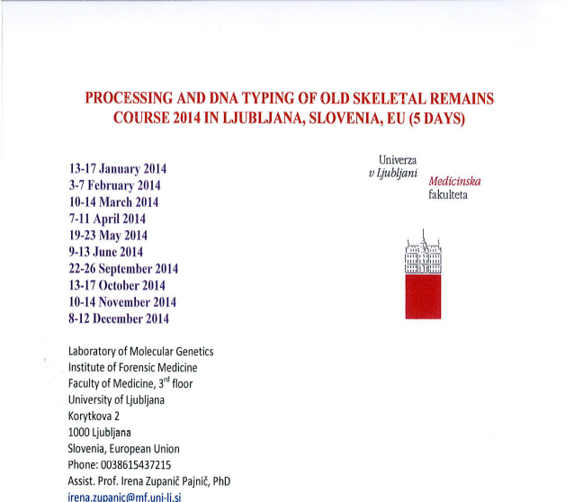
Educational workshops
We would like to present the 5-day training courses “Processing and DNA typing of old skeletal remains” which take place since 2013 every month in the Laboratory of Molecular Genetics at the Institute of Forensic Medicine, Faculty of Medicine, University of Ljubljana, Slovenia – EU, announced on ISFG - International Society of Forensic Genetics homepage

Slide 9
Processing and DNA typing of old skeletal remains Course
The course is designed to deliver advanced level training to experienced laboratory based scientists that are familiar to DNA typing technologies.
The unique training course is performed in the forensic molecular genetic laboratory equipped specially for processing old bones and teeth.
The course using forensic human identification methods and commercially available human ID kits is suitable not only for participants who would like to process old skeletal remains but also those who would like to perform in their laboratories the identification of relatively fresh human remains where no other material than bones or teeth are left for molecular genetic analyses.

Slide 10
Processing and DNA typing of old skeletal remains Course
The training course with maximum of three participants includes experimental individual work with approximately 70 years old bones and provides the participants first-hand knowledge of how to perform bone DNA typing.
Procedures for processing and DNA typing of bone samples are shown on concrete old bone samples and the most of the steps are experimentally performed by the participants.

Slide 11
Extraction procedure
Cleaning of the bones for remove surface contamination and inhibitors:
- Mechanical cleaning (physical removal of bone surface with drilling; in tooth samples radiation with UV). To prevent bone warming during drilling and cutting we frequently use liquid nitrogen
- Chemical cleaning (washing in detergent, water and ethanol)
2. Powdering of the bones
Decalcification and lysis
Purification of genomic DNA

Slide 12
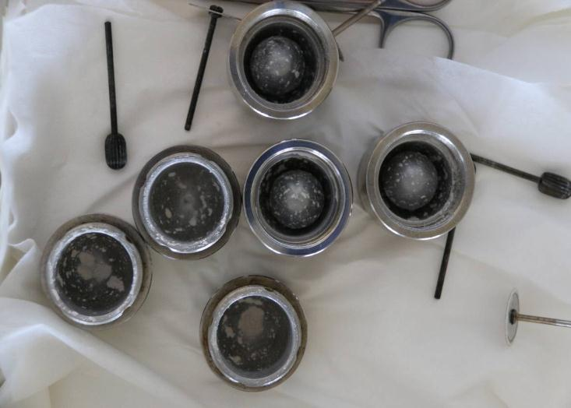
Measures for preventing DNA contamination in laboratory
- Clean all tools for processing of bones and teeth after use with bleach (6% sodium hypochlorite) or with DNA Away
- Wash away the detergent with several washes with water and ethanol and leave tools to air dry

Slide 13
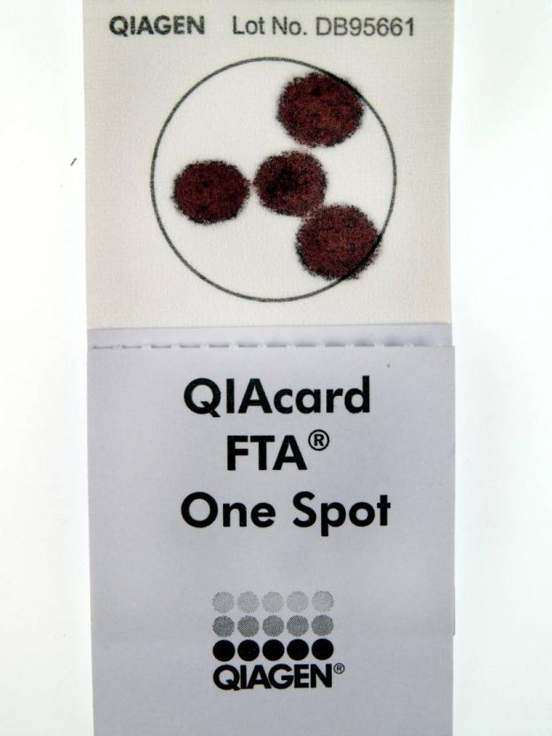
Measures for preventing DNA contamination in laboratory
- We use the room for processing old bones and teeth exclusively for this kind of biological material and not for high-template DNA samples (saliva, blood)

Slide 14
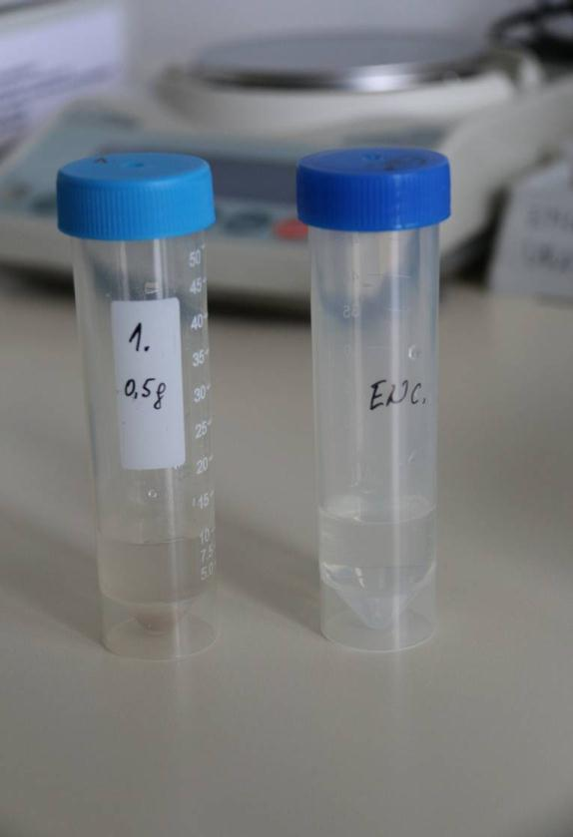
Measures for preventing DNA contamination in laboratory
- For monitoring the cleanliness of the isolation reagents and laboratory plastics, and cross-contamination during the procedure we always use extraction negative control

Slide 15
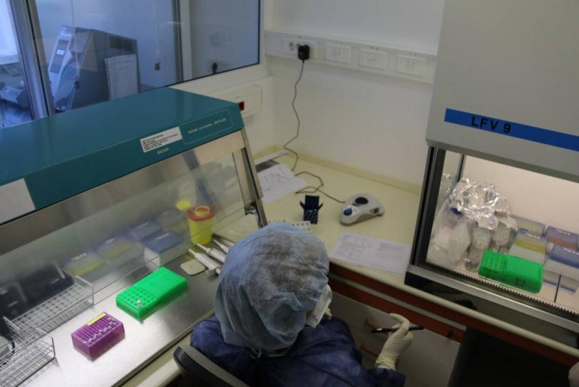
Measures for preventing DNA contamination in laboratory
- The PCR room is used for setup of PCR reagent mix (first hood) and addition of DNA extracts to the PCR (second hood)

Slide 16
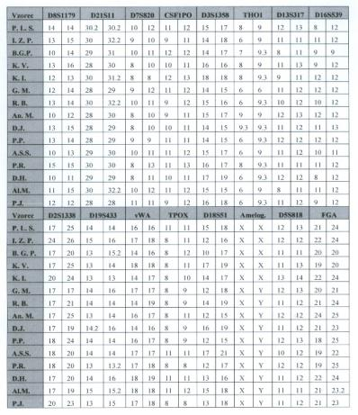
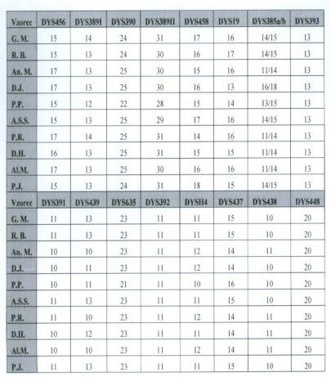
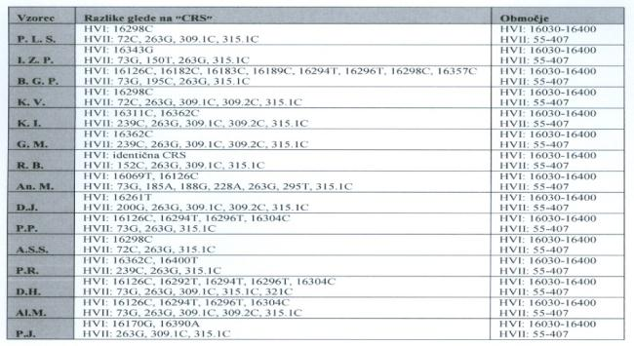
Measures for preventing DNA contamination in laboratory
- All genetic profiles obtained from skeletal remains are compared to elimination database

Slide 17
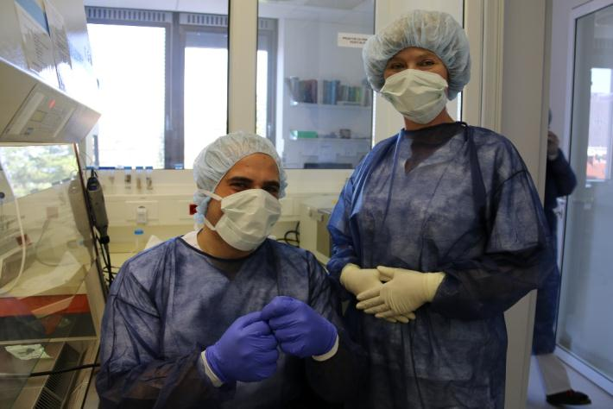
THANK YOU
irena.zupanic@mf.uni-lj.si and irena.zupanic.pajnic@gmail.com
erdogan.oncun@gmail.com

Slide 18
Let Us Meet Again
We welcome you all to our future conferences of OMICS Group International
Please Visit:
www.omicsgroup.com
www.conferenceseries.com

