Slide 1
Efficacy of Colistin in combination with Carbapenem and Tigecycline in patients with pneumonia caused by multidrug-resistant Acinetobacter baumannii
Enty Tjoa¹, Frans Pangalila², Lucky H Moehario¹, Stefanus Lembar³,
Melina Hertanto⁴, Otto Tanujaya¹, Laydy Suryo Gondo¹, Henry Tarigan⁴, Suryanti Haryanto⁴
1Department of Microbiology, Faculty of Medicine Atma Jaya Catholic University of Indonesia, Jakarta, Indonesia. Jl. Pluit Raya no. 2, North Jakarta 14440, Indonesia.
2 Faculty of Medicine Tarumanagara University of Indonesia, Jakarta, Indonesia.
3Department of Clinical pathology, Faculty of Medicine Atma Jaya Catholic University of Indonesia, Jakarta, Indonesia. Jl. Pluit Raya no. 2, North Jakarta 14440, Indonesia.
4Royal Taruma Hospital, Daan mogot, West Jakarta, Indonesia.
Email: entysmi@yahoo.com
Clinical Microbiology Conference 2017
Bangkok, 03-04 July 2017

Slide 2
Background
Acinetobacter baumannii is a Gram-negative, aerobic and commonly found in hospital setting.
Often causes problem in ICU setting
Intrinsically Multidrug-resistance
Gootz TD, Marra A. Acinetobacter baumannii : an emerging multidrug-resistant threat. Expert Rev Anti Infect Ther. 2008;6:309–25.

Slide 3
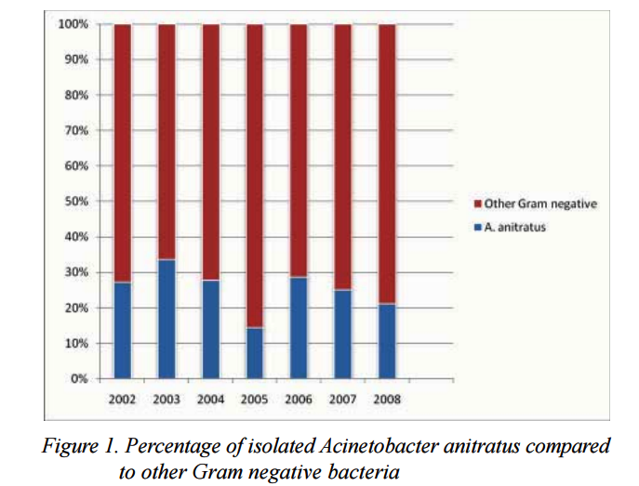
Background (2)
The continuous presence of Acinetobacter baumannii in clinical specimens from hospitalized patients
Figure 1
Lucky H Moehario and Enty Tjoa.
Isolation of environmental microorganisms from clinical specimens: A report of the occurrence of Acinetobacter anitratus in bloodstream from hospitalized patients in Jakarta in 7 year periods from 2002 to 2008. Medical Journal of Indonesia, 2009; 18 (4): 227-232
Figure 2. Percentage of Acinetobacter baumannii (n=224) compared to Other Gram negative bacteria (n=776), isolated from sputum and BAL in a private hospital, West Jakarta, 2011-2015.
[Unpublished data]

Slide 4
The treatment has become difficult
Background (3)
Treatment against multidrug-resistant Acinetobacter baumannii (MDRAB) has now become a challenge.
Carbapenem, Colistin, Tigecycline, Sulbactam, Rifampicin, Minocycline in the form of combination are considered for treating MDRAB
Combination therapy may be more useful than monotherapy in treatment of MDR/XDRAB pneumonia.

Slide 5
Objective
To assess the efficacy of Colistin based combination
in patients with pneumonia with Acinetobacter baumannii isolated from
specimens from low respiratory tract
Colistin in combination with Carbapenem
Colistin in combination with Tigecycline

Slide 6
Susceptibility pattern of Acinetobacter baumannii from ICU, Private hospital, Jakarta, Indonesia, 2015-2016
80

Slide 7
Methods
This is a retrospective and observational study
Conducted in a private hospital in Jakarta, Indonesia (150 bed)
MDRAB were isolated from specimen of lower respiratory tract from patients with pneumonia in intensive care unit (ICU) during 4 year period (2011-2015)

Slide 8
Methods (2)
Clinical parameters:
  Blood leukocyte,
  Differential count,
  Body temperature,
  Pro calcitonin,
The analysis of studied clinical parameters were performed before and after drug administration
  1-3 day before and 2-5 days after drug administration

Slide 9
Methods (3)
Microbiological work up
Isolation : Blood agar, Mac Conkey agar
Identification and Antimicrobial Susceptibility Test : Vitek 2 (Biomeriuex®)
Antimicrobial Susceptibility Test for Carbapenem and Tigecycline : Vitek 2 (Biomeriuex®)
Antimicrobial Susceptibility Test for Colistin : Disc Susceptibility Testing (Kirby Bauer Method)
Colistin disc 10µg
resistant ≤10 mm; susceptible ≥ 14 mm, [Gales et al]
Data collection: WHO-NET 5.6

Slide 10
Samples
Inclusion criteria
  Specimens: sputum* or BAL and revealed MDR Acinetobacter baumannii
  * with >= 25 leucocyte ‘ LPF and < 10 /LPF of squamous ephitelial cells
  Studied antibiotics treatment : Colistin plus Carbapenem/Tigecycline was given > 1 day
    Dose of Carbapenem : 3 x 1-1.5 g
    Dose of Colistin 3 x 1,500,000 unit IV
    Dose of Tigecycline 2 x 50 mg IV (loading dose 100mg)
  Exclusion
  Studied laboratory results on relevant period was incomplete**
  **Lack of < 2 parameters result still accepted

Slide 11
Result
Sixty eight MDRAB were found from various specimens
Fifty nine patients with MDRAB pneumoniae were studied
Colistin-Carbapenem combination therapy was used in 11 patients (15 cases period)
Colistin-Tigecycline combination was administered in 9 patients (11 cases period)
Other (37) were administered with antibiotics other than regimen studied

Slide 12
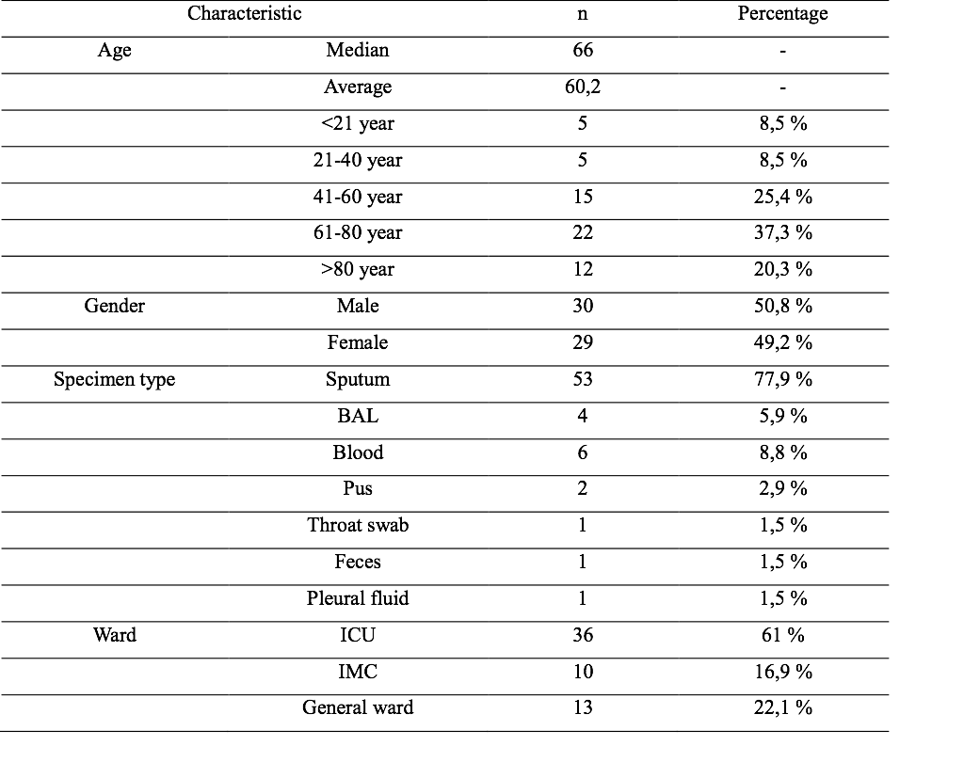
Patients characteristic with positive culture of Acinetobacter baumannii (n=59)

Slide 13
Efficacy of Colistin plus Carbapenem
to several inflammatory parameters (n=15)
Mean | Before | After | p
Blood leucocyte (mean; / ul) | 21053 | 17000 | 0.008
Blood Basofil count (median; %) | 0 | 0 | 0.48
Blood Eosinofil count (mean; %) | 1.8 | 2.67 | 0.274
Blood neutrofil count (mean; %) | 82.27 | 79.93 | 0.37
Blood Limfosit count (median; %) | 8 | 8 | 0.75
Blood Monosit count (mean; %) | 6.93 | 7.4 | 0.4
PCT (median; ng/ml) | 0.83 | 0.67 | 0.67
Body temperature (median; °C) | 37.9 | 37.3 | 0.003

Slide 14
Efficacy of Colistin plus Tigecycline
to several inflammatory parameters (n=11)
Mean | Before | After | p
Blood leucocyte (mean; / ul) | 21772,73 | 17936,36 | 0.149
Blood Basofil count (median; %) | 0.36 | 0.36 | 1
Blood Eosinofil count (mean; %) | 2 | 1,45 | 0,389
Blood neutrofil count (mean; %) | 82.82 | 84.91 | 0.356
Blood Limfosit count (median; %) | 7.64 | 7.09 | 1
Blood Monosit count (mean; %) | 7.18 | 6.18 | 0.041
PCT (median; ng/ml) | 1.012 | 3.31 | 0.104
Body temperature (median; °C) | 37.58 | 37.12 | 0.000

Slide 15
Efficacy of Colistin plus
Carbapenem /Tigecycline
Both combination therapies showed efficacy in lowering body temperature after drug administration (p<0.05)
Blood leukocyte count also significantly decreased in patients’ with Colistin-Carbapenem regimen (p<0.05)
    Carbapenem used is Meropenem

Slide 16
Discussion
Low sample size due to incomplete data, limited number of patient with Colistin usage
About Colistin in Indonesia
  Colistin: Intravenous route are not widely available in Indonesia, only oral is available
  Colistin used in this study : Colisthimethate sodium
MIC of Meropenem to A. baumannii in this study were 8-32 mg/L
Still consider to use in combination with other agent
Inhibition zone of Colistin against A. baumannii were all showed sensitive (≥ 14 mm)

Slide 17
Discussion (2)
The addition of Colistin based combination with meropenem indicate a synergistic effect
This result consistent with research of Bing fan et al
Colistin plus meropenem administration displayed synergistic effects after both 24 h and 48 h of treatment
Colistin as monotherapy still debatable
  Colistin monotherapy was as good as in combination (metaanalyses of Zhijin)
  Colistin monotherapy, six studies involving 491 patients were analyzed and the results were in concordance with the findings of the colistin-based combination therapy group. [Zhijin, et all ]
Bing Fan et al . Activity of Colistin in Combination with Meropenem, Tigecycline, Fosfomycin, Fusidic Acid, Rifampin or Sulbactam against Extensively Drug-Resistant Acinetobacter baumannii in a Murine Thigh-Infection Model. PLoS One 2016; 11(6): e0157757.
Zhijin, et all. Meta-analysis of colistin for the treatment of Acinetobacter baumannii infection. Sci Rep. 2015; 5: 17091.

Slide 18
Conclusion
Colistin-Carbapenem and Colistin-Tigecyline combination therapy can be an option for treating patients with pneumonia caused by multidrug-resistant Acinetobacter baumannii

Slide 19


