Slide 1


ALLUVIAL AND RIPARIAN SOILS AS MAJOR SOURCES OF LEAD EXPOSURE IN YOUNG CHILDREN IN THE PHILIPPINES: THE ROLE OF FLOODS
.
Enrique Ostrea, Jr., M.D ¹, Angelo Ostrea, BS ², Ma. Esterlita Villanueva-Uy, MD ², Dawn Bielawski, PhD ^{1,} Sarah Birn, BS ¹.
¹Pediatrics, Wayne State U, Detroit, MI, United States;
² University of the Philippines, Manila National Institutes of
Health (Institute of Child Health and Human Development), Manila, Philippines.

Slide 2
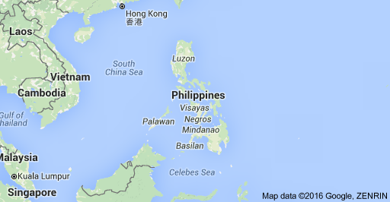

Slide 3
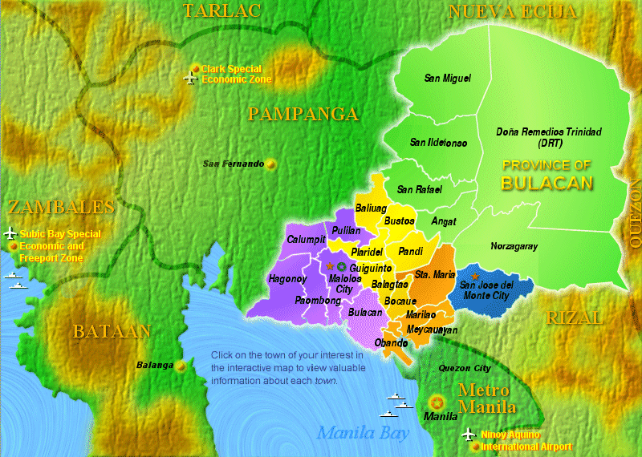

Slide 4
Background: In an NIH funded 10 year study of pesticide exposure among 4-6 year old children in Bulacan (N=667), we have found a high rate of lead exposure in the children.

Slide 5
Lead analysis of the children’s hair and teeth at ages 4 and 6 years
 | Hair 4 years old | Hair 6 years old | Teeth 6 years old
N | 667 | 641 | 686
Percent positive | 88.9% | 67.2% | 45.3%
Mean (µg/g) | 0.01819 | 0.00647 | 0.05297
Median (µg/g) | 0.01120 | 0.00360 | 0.00001
Std. Dev (µg/g) | 0.03867 | 0.01022 | 0.333083
Minimum (µg/g) | 0.000 | 0.000 | 0.000
Maximum (µg/g) | 0.596 | 0.120 | 5.822

Slide 6
Aim:
To epidemiologically determine the potential sources of lead (Pb) exposure in children living in Bulacan, a province of the Philippines
To determine the role of alluvial and riparian soils and flood as major sources of lead exposure.

Slide 7
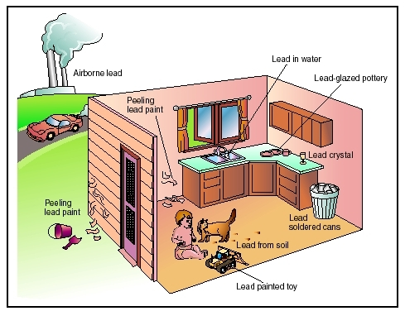
Notes:
Ito ang iba’t ibang paraan kung paano nakukuha ng bata ang tingga sa kapaligiran.

Slide 8
Design and Methods
A subgroup of 6-7 year old children and their caregivers (N=150) from an ongoing NIH funded study cohort in Bulacan were revisited in their homes.
A small piece of the children’s hair and their previously collected deciduous teeth were analyzed for Pb.
Potential sources of Pb exposure in the children were determined by interview of the caregiver, using an in depth questionnaire, and Pb analysis of the yard soil, household water, river water and environmental air.
Note: The use of lead in gasoline has been discontinued in the Philippines since 2005
Pb analysis was done by atomic absorption spectrophotometry (AAS) and by inductively coupled plasma optical emission spectrometry (ICP-OES).

Slide 9
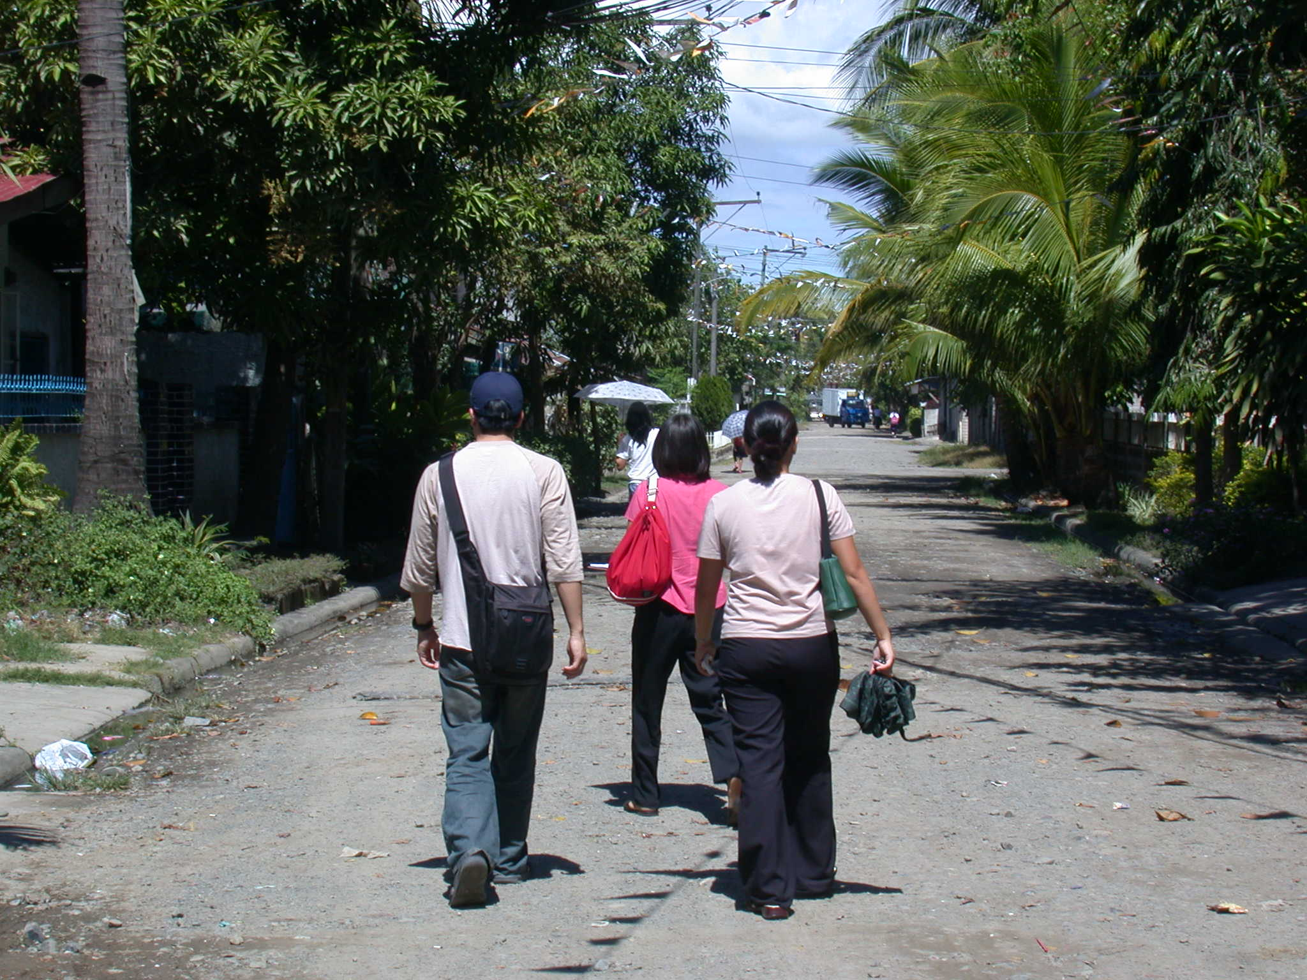
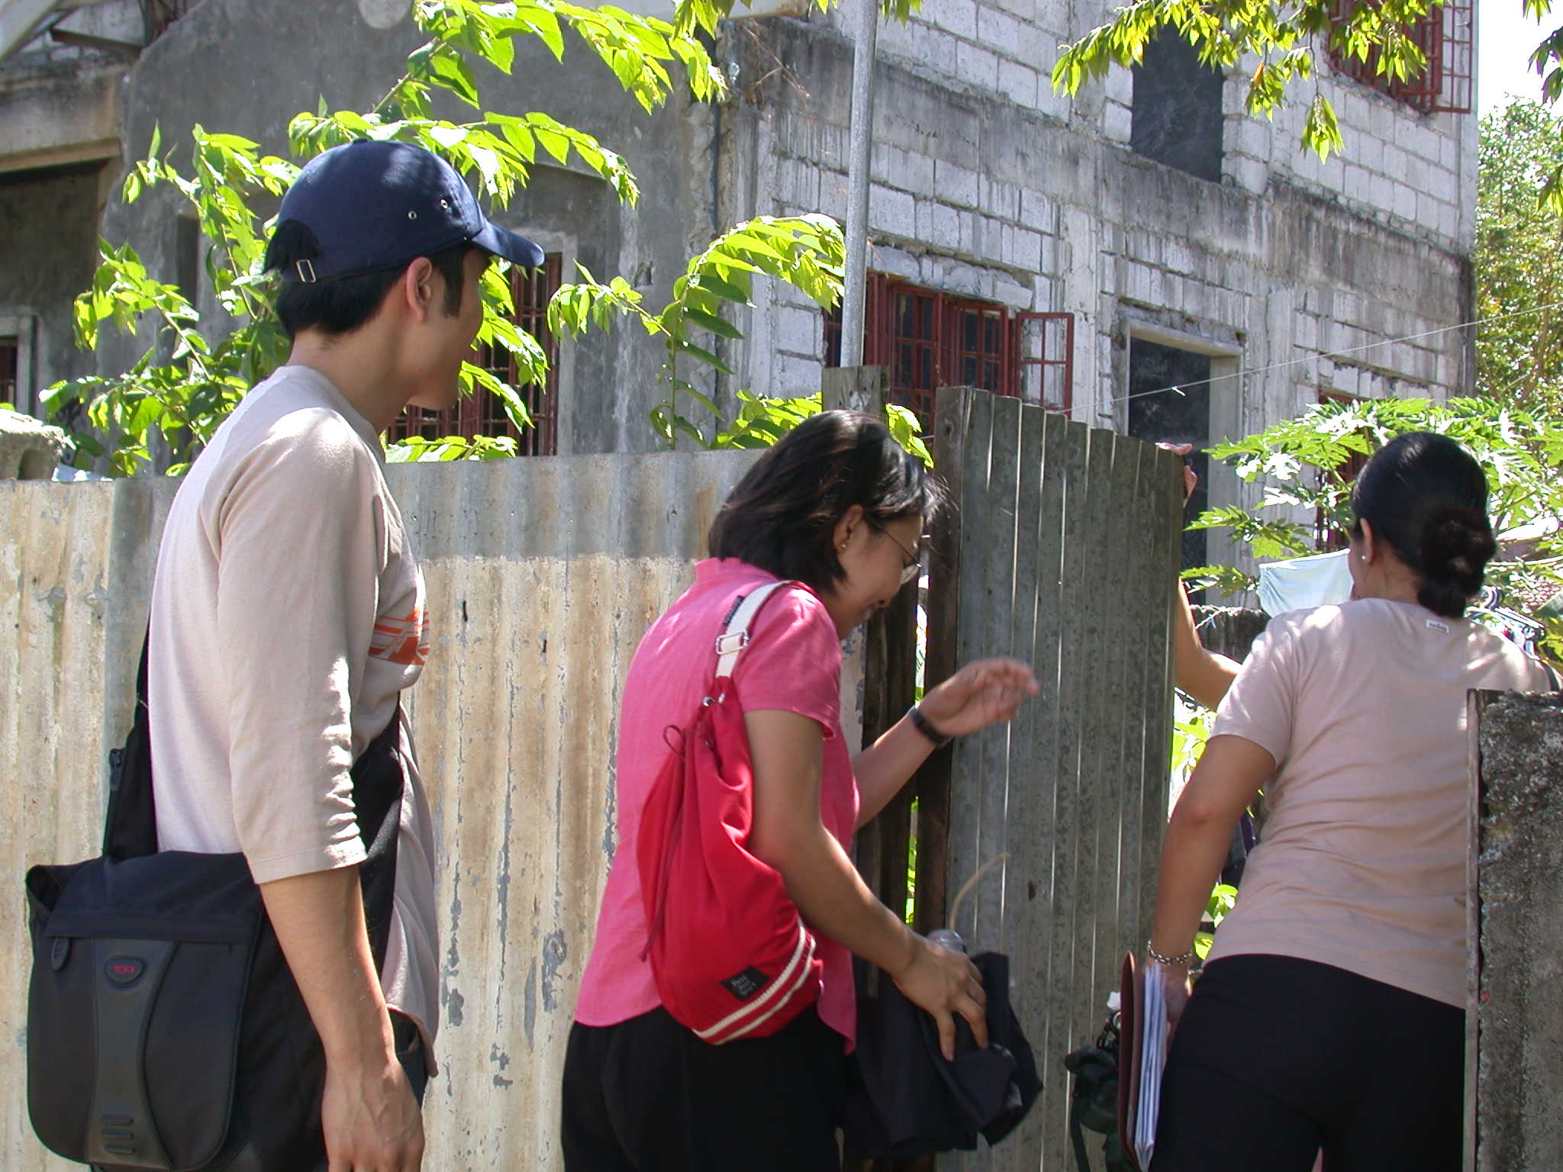
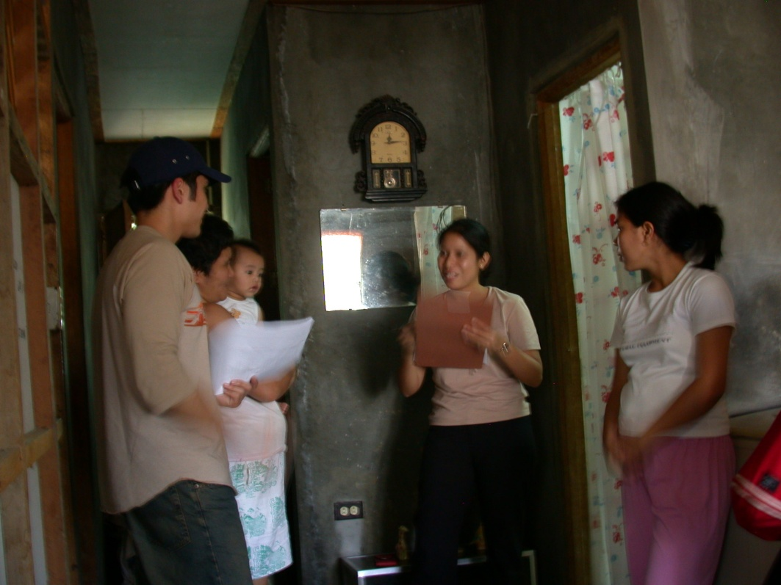
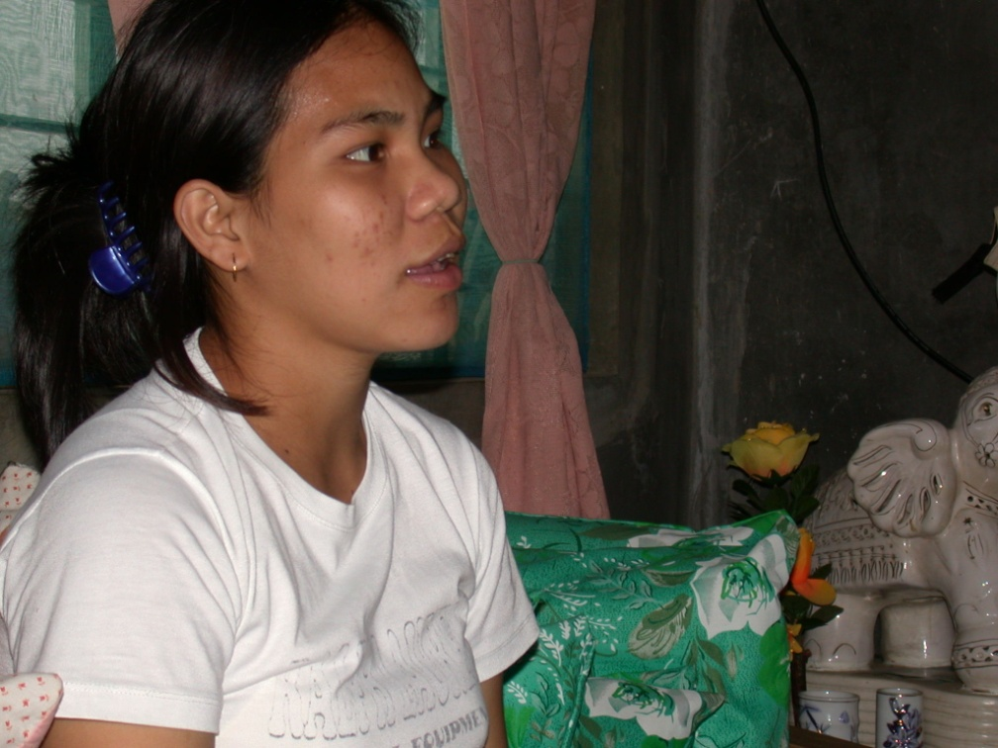

Slide 10
1. What is the age of the dwelling the child has lived in during past year? _________ yrs
2. What is the general condition of the dwelling (circle): a. Great b. Good c. Fair d. Poor
3. Does your child live in a house with peeling or chipping paint built before 1960? (This could include a day care center, preschool, the home of a babysitter or a relative, etc.) Yes No
4. Does your child regularly visit a house with peeling or chipping paint built before 1960? (This could include a day care center, preschool, the home of a babysitter or a relative, etc). Yes No
a. If yes: Were there any attempts made to peel off the lead-based paint on the walls? Yes No
b. If yes (circle): i. Own home ii. House visits often iii. Day care/preschool iv. Other
5. Did your child ever live in a house built before 1960 with recent, ongoing, or planned renovation or remodeling? Yes No When: ____________________________________
6. Did your child ever regularly visit a house built before 1960 with recent, ongoing, or planned renovation or remodeling? Yes No When: ____________
7. Does your child have a brother or sister, housemaid, or playmate being followed or treated for blood lead greater than or equal to 10 µg/dL? Yes No
If yes: who is it (circle)? a. Sibling b. someone else in house c. playmate
Questionnaire

Slide 11
8. Does your child live with a child or an adult whose job or hobby involves exposure to:
 | Activity | No | Yes | In the past (what age?)
a. | Smelting and refining metals | 0 | 1 | 2
b. | Storage batteries (lead batteries) factory or recycling | 0 | 1 | 2
c. | Building/home renovation | 0 | 1 | 2
d. | Welding metal structures | 0 | 1 | 2
e. | Wire cable cutting | 0 | 1 | 2
f. | Valve and pipe fittings (except plumber's brass goods) | 0 | 1 | 2
g. | Plumbing fixture fittings and trim (brass goods) | 0 | 1 | 2
h. | Brass/copper foundry | 0 | 1 | 2
i. | Glass products, made of purchased glass (stained, ceramics making/glazing) | 0 | 1 | 2
j. | Motor vehicle parts and accessories | 0 | 1 | 2
k. | Firing range worker | 0 | 1 | 2

Slide 12
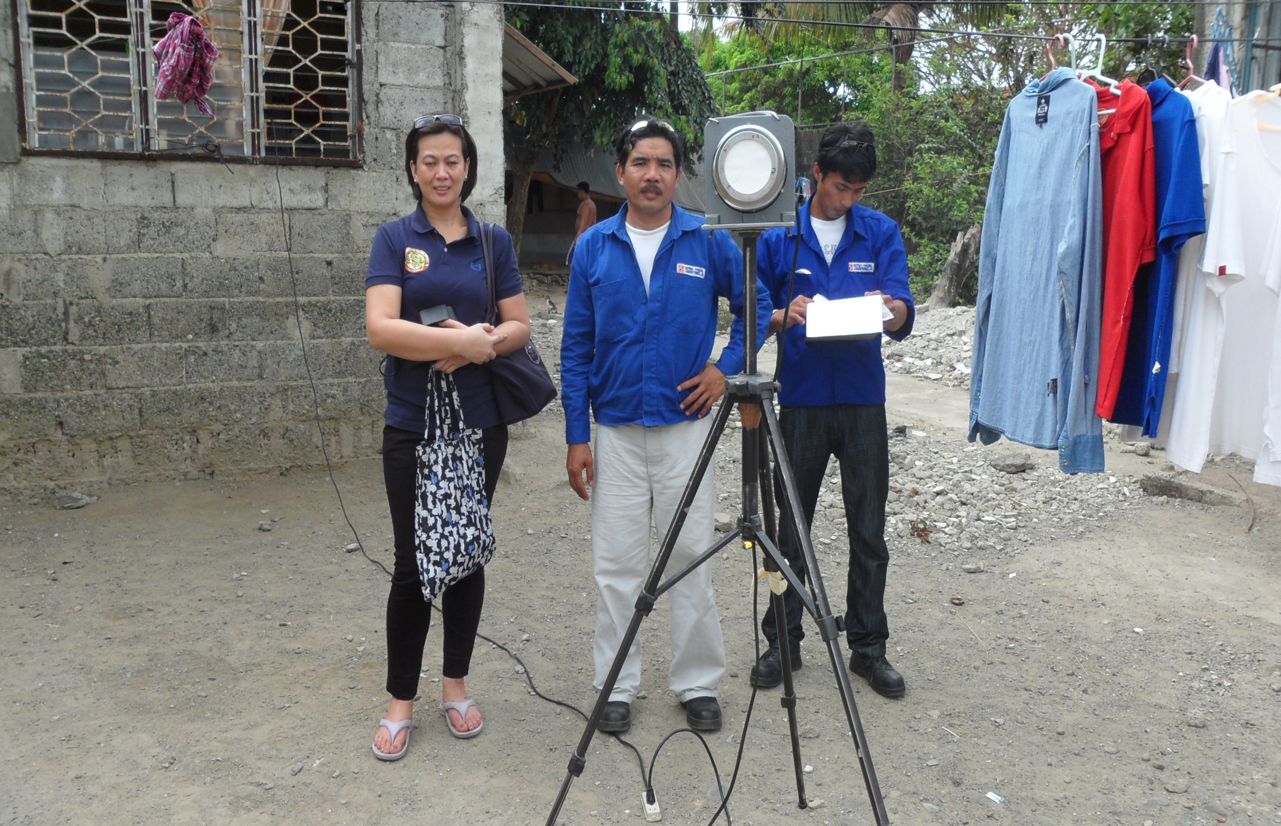
Air was collected by an air collector according to standardized method of air sampling (EPA 1977).

Slide 13
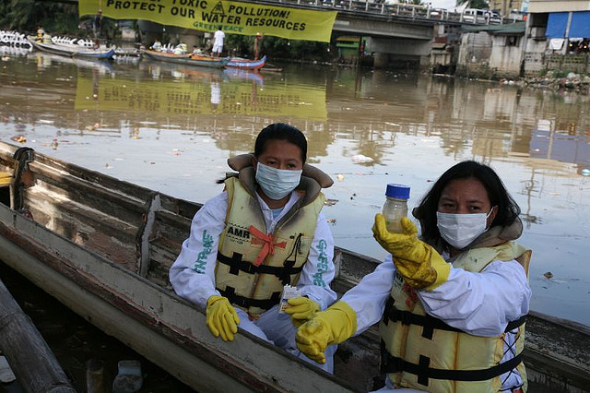

Slide 14
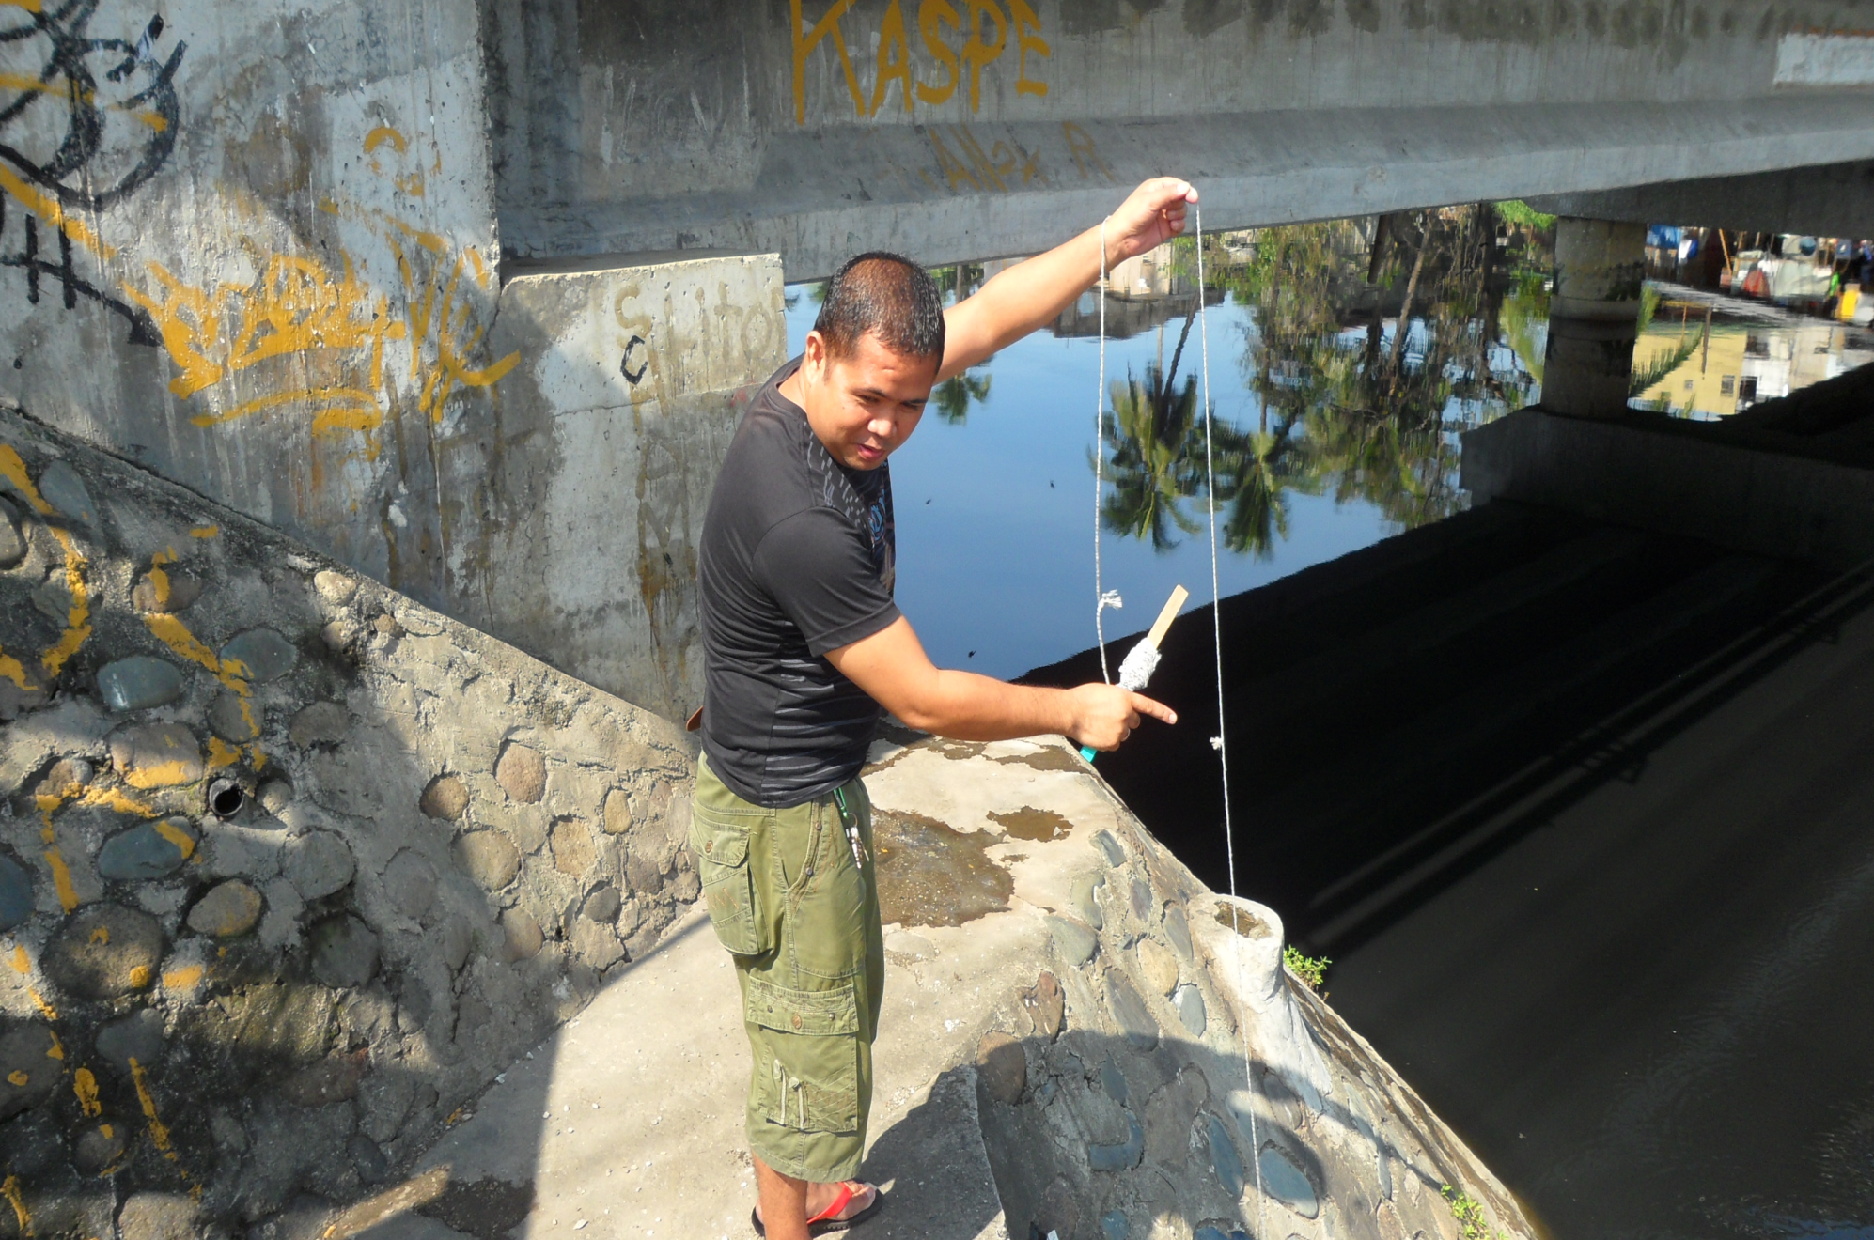

Slide 15
Summary of questionnaire results
Results
None of the homes were near active Pb smelter nor Pb battery recycling plants.
Only 2.7% of homes had peeling or chipping paint and 19% had Pb plumbing.
None of the children nor siblings were treated for high blood lead levels.
None of the children lived with an adult whose job involved significant exposure to Pb (storage battery factory, valve and pipe fitting, pottery, painters, junkshop, garbage dumpsite, etc).
About 8% of the children lived near a well travelled road.
About 22.7% of the children had hand to mouth habit and 10% of these children had a habit of eating soil, jewelry, toys and crayons.
Children were often (30.7% of the time) out in the yard unsupervised

Slide 16
Table 1. Prevalence and concentration of lead (Pb) in the children’s hair and teeth
and in yard soil (N=150)
 | N | % positive | Mean conc in positive samples | SD | Median | Minimum | Maximum
Pb in hair (ppm) | 150 | 91.3% | 11.27 | 7.39 | 9.65 | 0 | 38.29
Pb in soil (mg/kg) * | 150 | 100% | 55.90 | 117.89 | 27.06 | 3.05 | 1155.80
Pb in teeth (ppm) | 48 | 0%
*48% of the lead in soil were within World Bank level of natural lead concentration in soil
(5-25 mg/kg). However, 15 or 10 % of the soil samples were greater than WHO maximum
tolerable limits (> 100 mg/kg).
The correlation between children’s hair and soil was significant (r=0.217, p=0.008).

Slide 17
Table 2. Lead (Pb) levels in environmental air, household water and
river water.
 | N | % Positive | Mean conc in positive samples | SD | Median | Minimum | Maximum
Pb in air (ng/Ncm) | 20 | 20% | 17.0 | 35.1 | 0 | 0 | 100.0
Pb in household water (ppb) | 150 | 2.7% | 27.5 | 9.57 | 27.5 | 0 | 40
Water in river (ppb) | 7 | 100% | 59.13 | 21.98 | 64.30 | 30 | 90

Slide 18
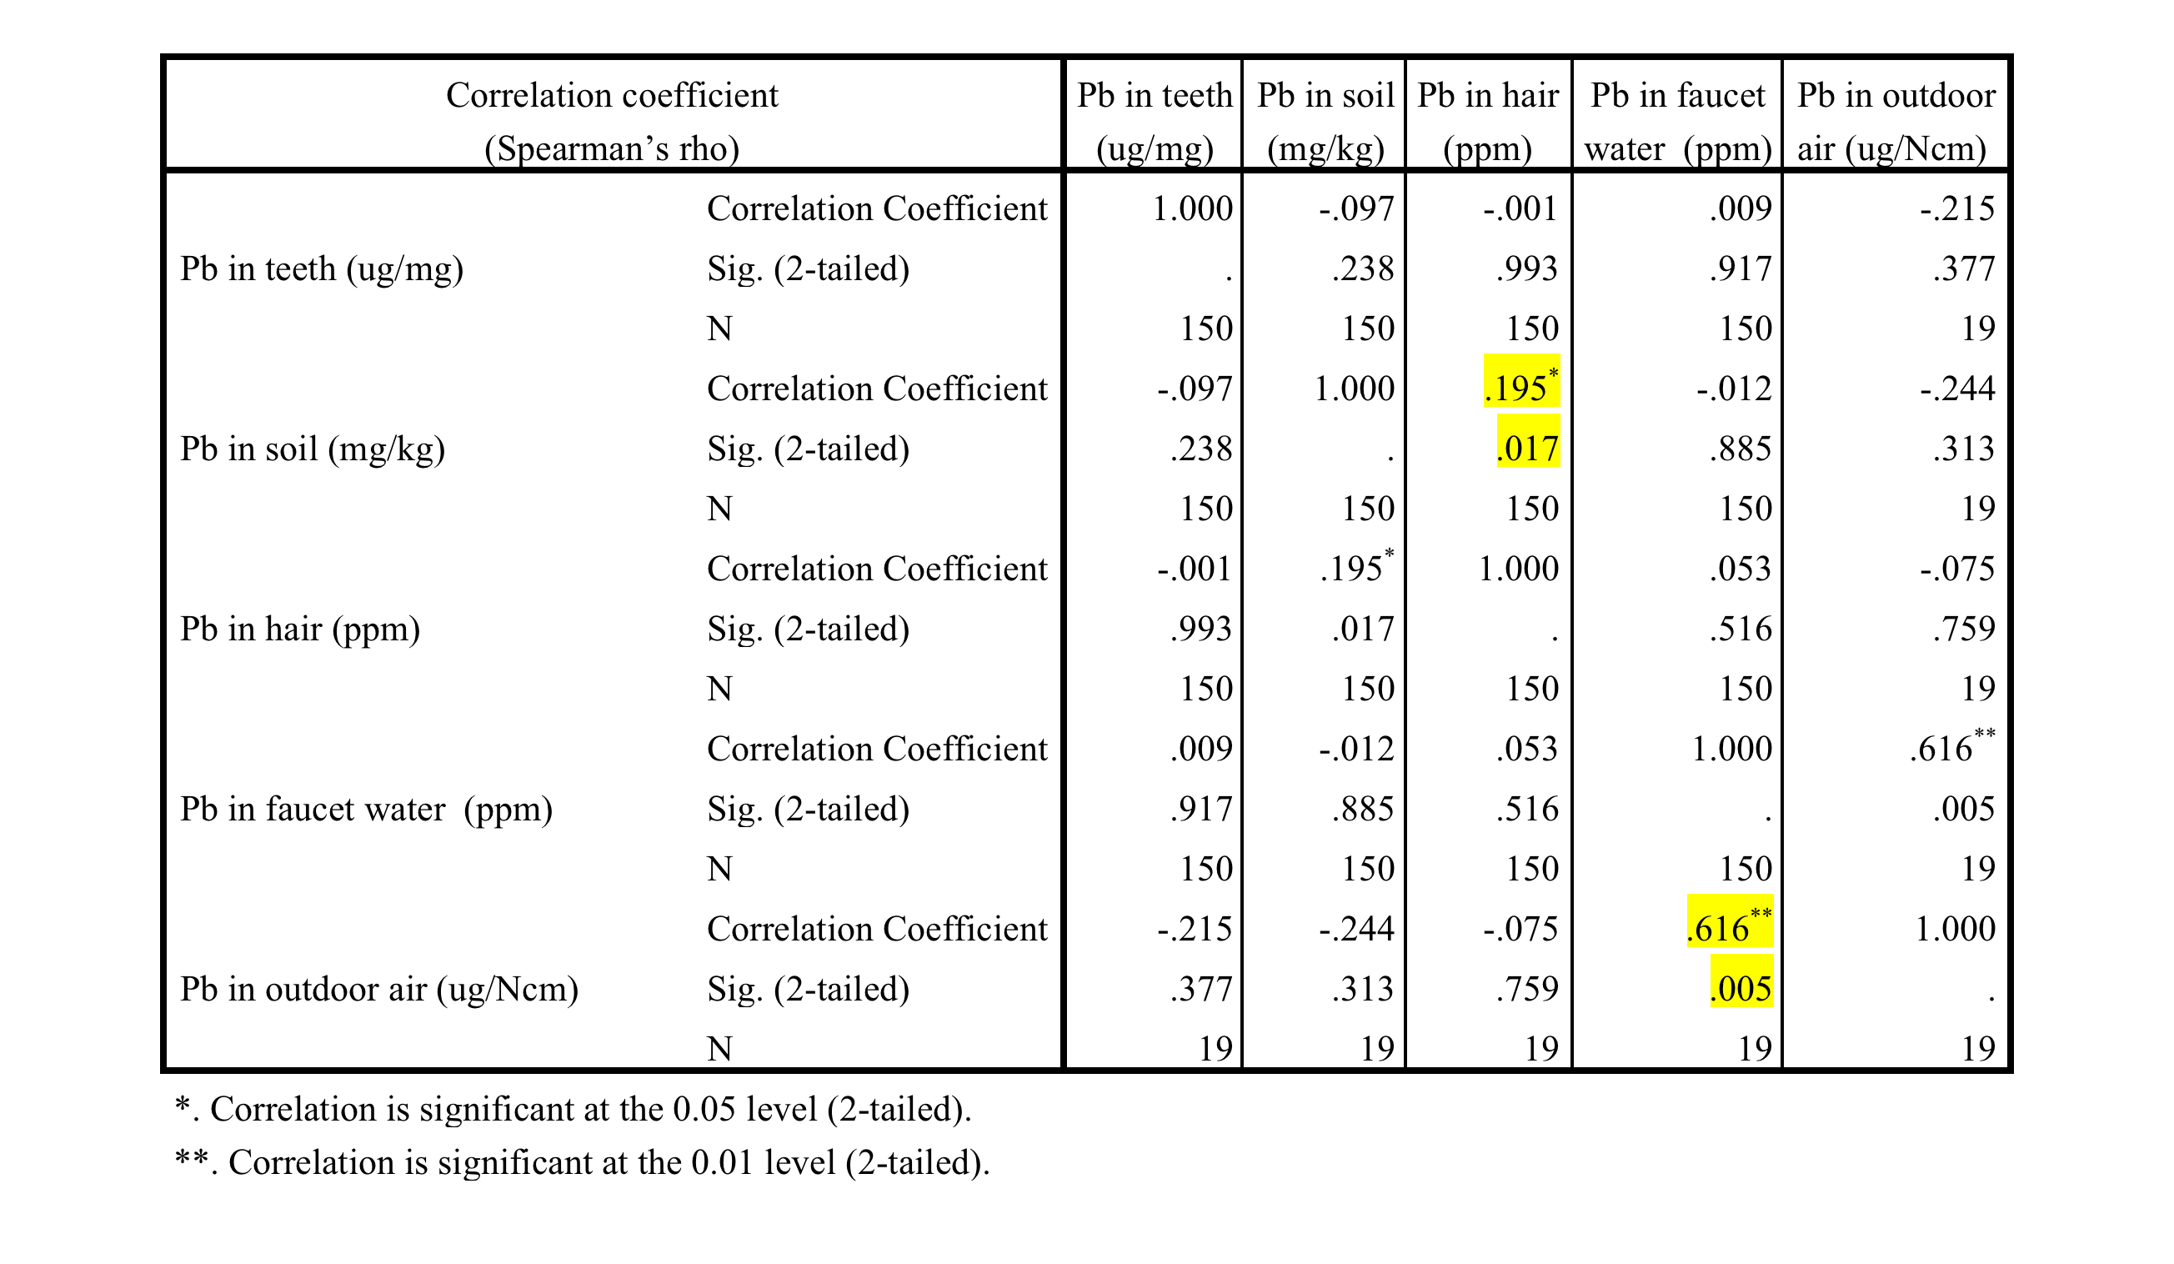
Table 3. Correlation between Pb (lead) concentration in children’s hair and teeth, Pb in soil, faucet water and outdoor air (Spearman’s rho)

Slide 19
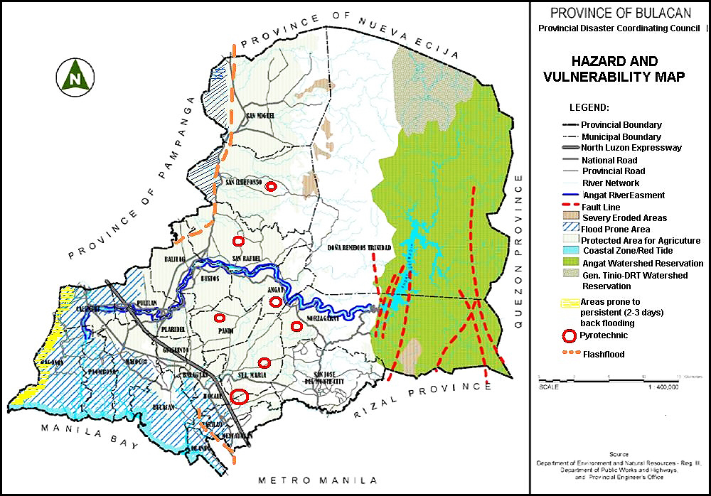
Baliuag river
Plaridel river
Location of the surveyed homes in relation to the river.
Scale
Malolos river
Marilao river
PROVINCE OF BULACAN

Slide 20
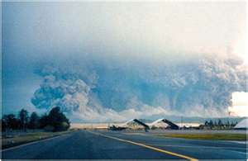
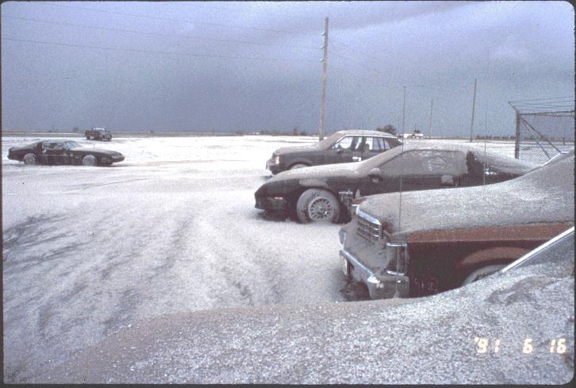
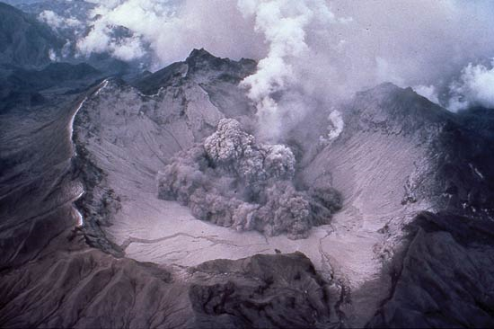
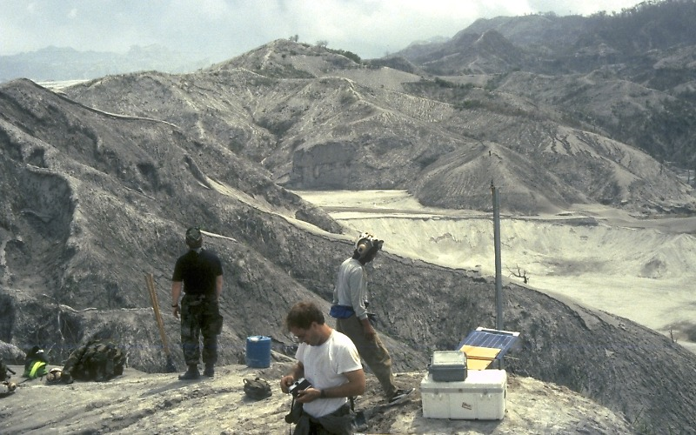
Potential sources of Lead contamination of the Soil
Volcanic eruption: In 1991 – Mt Pinatubo erupted in Pampanga province with spread of
volcanic ashes in neighboring areas including Bulacan, nationwide and worldwide

Slide 21
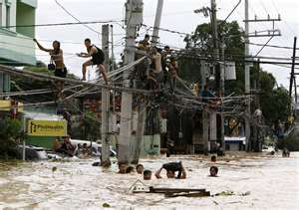
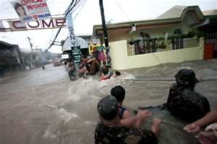
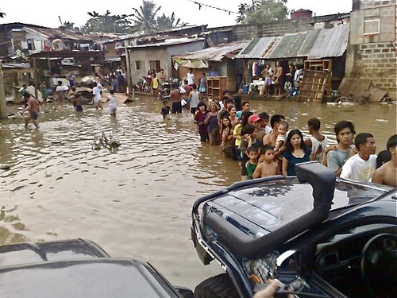
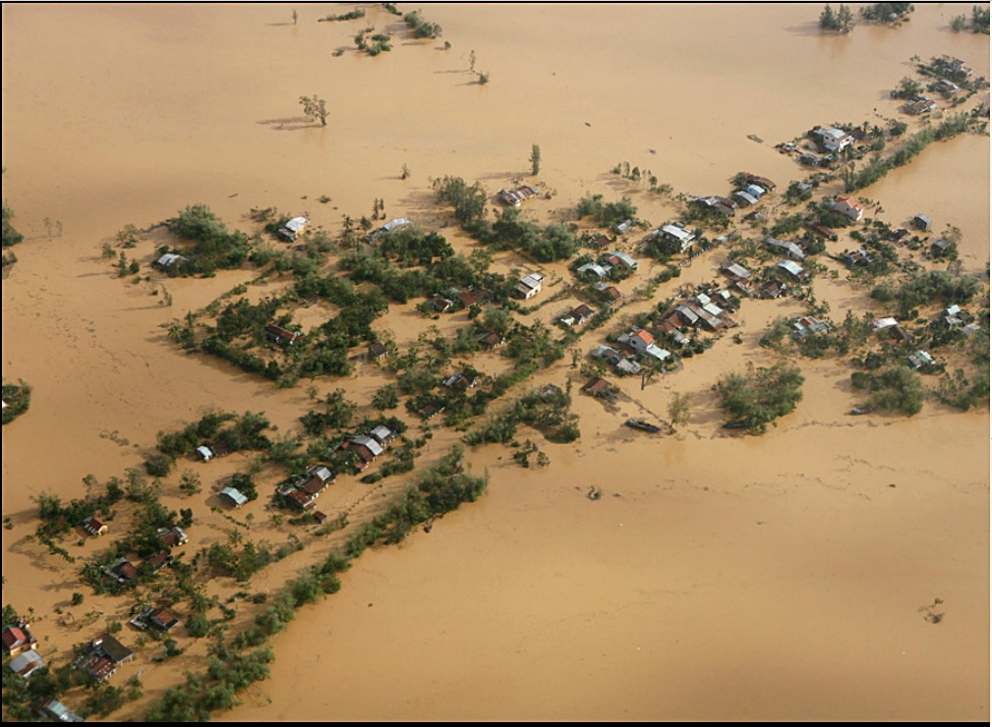
In 2009 – Typhoon Ondoy caused massive flooding in Manila and neighboring provinces
including Bulacan, causing many areas to be flooded and contaminated with river overflow

Slide 22
Discussion
For many years, the ingestion of leaded paint had been the primary cause of elevated blood leads and lead poisoning in children living in deteriorated housing.
However, lead contaminated house dust and soil have now become a major source of lead exposure in children compared to lead ingested from lead paint.
Our study is consistent with the reports that soil lead is an important source of lead exposure in the children.
Rivers are an important source of heavy metal contamination of riparian soil and alluvial or floodplains particularly during flooding.
Riparian soil is the interface between land and a river and alluvial or floodplain is a largely flat landform created by the deposition of sediment over a long period of time by one or more rivers.

Slide 23
Soils contaminated with hydrocarbons, lead and other heavy metals were found in the banks of two major rivers in southern Québec and alluvial soils were contaminated over a distance of 100 kilometers
The maximum concentration of Pb (149.13 mg/kg) in soils of the riparian zone was found to be twelve times higher than the average Pb concentration found in a natural state
Saint-Laurent D, Hähni M, St-Laurent J, Baril F. Comparative assessment of soil contamination by lead and heavy metals in riparian and agricultural areas (southern Québec, Canada). Int J Environ Res Public Health. 2010;7:3100-14.
Elsokkary I, Amer M, Shalaby E. Assessment of inorganic lead species and total organo-alkyllead in some Egyptian agricultural soils. . Environ Pollut. 1995;87:225-33.
Martin CW. Heavy metal storage in near channel sediments of the Lahn River, Germany. Geomorphology. 2004;61:275–285.

Slide 24
Conclusion
There is a high exposure rate of children to lead in Bulacan based on analysis of their hair for lead (91.3%).
The high Pb exposure of the children is likely due to their contact with Pb contaminated soil.
Major sources of the Pb contamination of soil may be due to overflow of water from Pb contaminated rivers in Bulacan brought about by a recent major flooding in the area and possibly lead remnants from air residue deposited by a volcanic eruption 20 years ago.
Soil is therefore a major source of lead and should be considered when instituting preventive measures to lessen children’s exposure to lead.
This study is supported by grants from NIH/NICHD (R01HD039428), US Environmental Protection Agency (RFA 2001-STAR-H1. No. R829395) and EHS Center Grant P30 ES06639 from NIH/NIEHS, Wayne State University, Detroit, Michigan

