Slide 1
DEFINITION & CLASSIFICATION OF LBP
ETHIOLOGY
EVOLUTION
Pain without nerve injury
Nociceptive back pain
Somatic referred pain
Pain with nerve injury
  Radicular pain
  Radiculopathy
Acute LBP
Sub-Acute LBP
Chronic LBP
Failed Surgery LBP*
Notes:
History studies have classified LBP as chronic if the painful symptoms persist longer than three months (6). However, classifications based exclusively on duration fail to discriminate among key clinical factors, such as the presence of a pars fracture or neurocompressive lesions. Expert guidelines and policymakers often group specific CLBP syndromes, those cases defined by anatomic factors, such as stenosis or localizing neurologic deficits, separately from axial syndromes in which pain defies clinical localization.
A significant number of CLBP syndromes clearly begin with localized tissue injury or strain within spinal structures and an inflammatory mechanism.
however, much LBP results from the cumulative effects of muscle fatigue and strain in the absence of a single precipitating event. For those patients it is essential to investigate further for an underlying structural etiology. The timing of this evaluation must be adjusted in accord with clinical features.
The extent to which nerve injury and neuropathic mechanisms account for the chronicity of LBP syndromes remains poorly understood:
Radicular pain Occurs when inflamed nerve roots are compressed, frequently by disc herniation. The distinctive pain derives from involvement of the dorsal root or its ganglion and is described as lancinating, shocking, or electric.
Radiculopathy Occurs when conduction is blocked along a spinal nerve or its roots, resulting in numbness. Neurological signs define radiculopathy, which can occur with or without radicular pain.
According with Bogduk warns that frequent confusion between radicular pain and radiculopathy has led to overestimation of prevalence data on radicular pain.

Slide 2
Planteamiento General
Presentacion:
Concepto y Clasificacion LBP
Prevalencia y Costes:
LBP por si mismo
LBP por el incremento de tto quirurgico
LBP Beneficio-Costes de la Neuromodulacion
Proyecto COST B13
Intencion: disminucion variabilidad y costes
Descripcion: bastract trabajo dolor
Guia de PC Europea basada en evidencias
La guia: papel de Neuromodulación y recomendaciones
La IASP SIG on Neuromodulation:
Propositos, politica, lugar de la evidencia
Proyectos para justificar técnicas
Tecnicas y publicaciones en 4 años
Futuro: estimulacion cerebral, local externa, subcutanea, de ganglio raiz dorsal…

Slide 3

E Latorre Marques, MD
SIG on Neuromodulation, Chair of NL Committee
The Management of Back Pain Based on Scientific Evidence:
The Role of Neuromodulation Techniques
Cost-Efectivity and Outcomes
International Conference and Exhibition on Pain Medicine
June 08-10, 2015 Chicago
Notes:
Low back pain (LBP) is one of most prevalent and controversial diseases for clinical management by multiple factors. There is great variability in medical practice, even within developed countries, which can worsen the outcome of the treatment, unjustifiably increase the risk of iatrogenic, and healthcare costs.
LBP is a leading health and socioeconomic problem across industrialized nations.Also The trend of rising CLBP prevalence is associated with high rates of disability.
There are significant geographic variations, duration and chronicity also disputes, 90% of attacks are resolved in 6 weeks, 5-10% of patients develop persistent pain, however despite believing that there will be more episodes, are frequent relapses (4-10%)
Neurostimulation introduced by Shealy in the 60s of past century, is primarily implanted in the United States for failed back surgery syndrome (FBSS) and complex regional pain syndromes (CRPS) .
Neuromodulation might be a reasonably effective therapy for patients suffering from neuropathic pain for which there is no other alternative therapy.
It has several advantages compared with re-operation: 1) a screening trial can predict the outcome of NE, while no such trial is available to predict the outcome of re-operation; 2) It is designed to be reversible and adjustable, whereas the effects of re-operation are permanent; and 3) It is less invasive than re-operation. Despite
these attributes, is often reserved for patients who have failed multiple, and indeed all possible, re-operations—a strategy that might reduce a patient’s chance of successful treatment with Neurostimulation.

Slide 4
THE PREVALENCE OF LOW BACK PAIN (LBP)
Special Eurobarometer 272e/Wave 66.2 requested by Directorate General SANCO European Commission
Notes:
The “Eurobarometer” is a part of European Commission Health Strategy and analiyzes various aspects of European citizens health. Musculoskeletal problems (bone, muscles and joints) affects 22 per cent population, a third of respondents (32%) had experienced some pain week prior to the survey. Pain most common type was low back, affects 67 million Europeans, became apparent factors demographic. The 55 age group are the most likely to say they experienced restrictive pain (44%).
Each year one in five adults have low back pain, (Cassidy JD, 2005) to the silent suffering back is the second location more frequent of pain (Watkins et al.,2006). However 5-15% of acute cases with an established cause should be identified, chronic pain lasts more than 3 months and affects 10% of cases.
Low back pain is the most common cause and orthopedic, industrial, face of disability of workers under 45. Those who have medical care 25-40% have radiated pain and only 2% have strong findings of good surgical results forecasts for the nerve root decompression.
Those with signs of disk herniation, one in half will recover suitable tolerance of daily activities so dismiss the surgery.

Slide 5
PAIN IN EUROPE: Eurobarometer 2007 & Low Back Pain
One-Quarter of adults
One Day of Acute LBP
Three-Month period
10% will develop Chronic Low Back Pain (CLBP)
Expensive Health Cost
5% of patients with disability, generates 75% of healthcare costs
Findings Neuroimaging Studies lack sensitivity and specificity for acute or chronic LBP
Special Eurobarometer 272e/Wave 66.2 requested by Directorate General SANCO European Commission
Notes:
LBP at work affects more frequently to the agriculture, fisheries, and construction people. The most common location in the body is the back.
The costs generated are high, Around 5% of population with disability, generates 75% of healthcare costs for low back pain.
There are significant geographic variations, duration and chronicity also disputes, 90% of attacks are resolved in 6 weeks, 10% of patients develop persistent pain, however despite believing that there will be more episodes, are frequent relapses (4-10%).
On the other hand there are many options for evaluation and treatment of back pain, but little consensus regarding the appropriate use on diagnostic and treatment.
There is an excessive variation for indication of surgery, in USA is five times higher than Europe . Few technologies have often proved or be effective and even damaging, some based on studies with few benefits.

Slide 6
PHYSIC & PSYCHIC DISABITLITY
Patients remain active demonstrated an increased Recovery at one year
Psychologic distress mediates 30% of the relationship between LBP and disability
Stress and Depression at six weeks after baseline influenced future disability
High degree of functional impairment at baseline predicts ongoing pain
Genetic factors: important role in the development of chronic pain
Notes:
Those who attend care doctor however achieve rapid intensity improvements of pain (58%), disability (58%) and ease returning to work (2%) . But relapses are very frequent, 75% of patients may present at least one of year.
Deyo published one interesting research which examines all aspects related to low back pain and its impact in labor, health, economic and social system that nowadays is entering in crisis.

Slide 7
EVOLUTION OF HEALTHCARE COST IN LBP
1,000,000
Surgical Int.
Lumbar Fusion
500%
400,000 Instrumented
47% of Total Expending in LBP
Total Expending 2010
482 million $
Total Expending 2000
75 million $
Wenger DR. Spine 2007; 32:2158-2165.
Deyo RA, Mirza SK. Clin Orthop Relat Res 2006; 443:139-146.
Notes:
Medicare spending for in-patient back surgery more than doubled over the decade, with an increase for lumbar fusion representing 47% of total spending for back surgery.
Similarly, increases in spinal cord implants over a 10-year period have been reported in the Medicare population.
Management of post lumbar surgery syndrome with numerous modalities of treatments including interventional techniques, results in moderate improvement, yet leaves a proportion of patients in intractable pain.

Slide 8
EVOLUTION OF HEALTHCARE COST IN LBP *
Manchikanti L . Pain Physician 2010; 13(4): E215-64
Straus BN. Chronic pain of spinal origin: The costs of intervention. Spine 2002;27:2614-2619.
Notes:
On another hand From 1990 to 2010 costs generated have been increasing, medical treatment is estimated between 9000 and 19000 $ per patient per year, and interventions around 19000 to 35,000
Developed countries had an increase of interventionist techniques to 235% parallel to a rise in the prevalence of pain due to an improvement of diagnostic means, and progress new surgery and injection techniques guided by fluoroscopy, Echography or Magnetic Resonance including Neuro-navigation.
On the other hand there are many options for evaluation and treatment of back pain, but little consensus regarding the appropriate use if diagnostic and treatment media, excessive variation for example indication of surgery, in USA is five times higher than Europe. Few technologies have often proved or ineffective and even damaging, some based on studies with few benefits.

Slide 9
CLINICAL PRACTICE GUIDELINES & MANAGEMENT OF LBP
1987 The Quebec Task force on Spinal Disorders
1994 U.S. Agency for Health Care and Policy Research (AHCPR) management of Acute Low Back Pain
1999 U.S. Guideline by the Veterans Affairs/Department of Defense (VA/DoD)
1999 Guideline of Royal College of General Practicioners (RCGP)
2005 The European Multinational COST b 13 program (Revised).
2009 American Pain Society (APS)
2010 American Society of Interventional Pain Physicians
Notes:
The European Multinational COST b 13 program was developed by The European Commission Directorate of General Research Political Co-Ordination and Strategy branch under the title “Low Back Pain: Guidelines for its management”. Since 1999 to 2005 were reviewed clinical practice guidelines and eigth hundred and seventy one (871) Systematic Reviews, Randomized control trials (RCT´) and Prevention studies. Involving a total of forthy nain (49) experts including Epidemiologists, Public Health, Chiropractors, Psicologists, Physiotherapists, Ergonomists, Physiologists, and Medical Specialists (Primary Care, Anesthesiology, Pain Terapy, Rheumatology, Traumatology, Neurosurgery, Pathology, Rehabilitation, Radiology, Sports Medicine, Emergency Medicine and Occupational Medicine.).
The main difference with previous guides is that COST B13 Guide includes recommendations for management Acute, Chronic and prevention of LBP.
In 2009 the American Pain Society published one guide that recommended limiting the use of Interventional techniques(APS) because reaffirm previous recommendations (see COST B13 Guide) that avoid invasive therapies and showing benefits of non-invasive (stay active, intensive rehabilitation and cognitive/behavioural emphasis). However controversy is served because In contrast the American Society of interventional Pain Physicians published a critical review of Interventional Techniques for chronic and acute LBP that differs from APS Guidelines including caudal epidural injections, lumbar facet joint nerve blocks, radiofrequency neurotomy, and percutaneous adhesiolysis as appropriate methodology.
Probably better designed studies obtain a balance between non-invasive and Interventional therapies.

Slide 10

COST B13 Project:
The Management of LBP Based on Scientific Evidence
Pan-European, multidisciplinary
Based on Scientific Evidence
Without parcipation of Industry
Comprehensive Management & Prevention
Acute, Sub-acute & Chronic LBP
Technologies Recommended:
Type of Patients, Evidence, Efficiency & Safety
AGREE Criteria & Conflict Interest
Memorandum of Understanding, COST ACTION B13: “Low back pain : guidelines for its management”. European Commission. Brussels, 1999 - 2005.
Notes:
The COST B13 Guide is a pan-European, multidisciplinary, based on scientific evidence, funded without participation of the industry or profit institutions. It provides comprehensive management of acute, chronic low back pain and its prevention. In the Spanish adaptation, recommendations related to acute and chronic low back pain were merged into a single temporal sequence, in order to improve clinical practice application, ordering implementation of technologies recommended depending on type of patients and scientific evidence, efficacy, effectiveness and efficiency, and safety. Also we Added a conflict of interest declaration by its members, and applying AGREE criteria to improve quality.

Slide 11
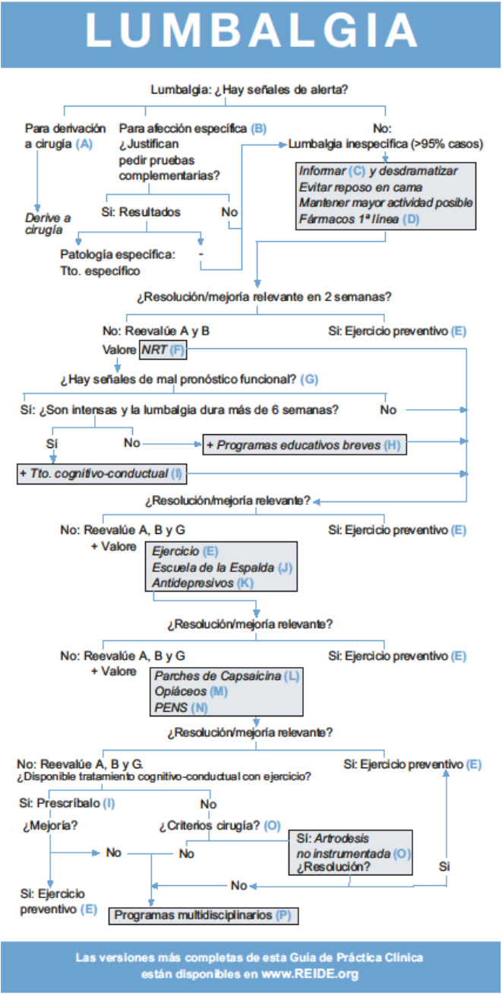
EUROPEAN CLINICAL GUIDELINE EVIDENCE BASED OF LBP MANAGEMENT (COST B13)
Three-stage development process
Recommendations derived Systematic Reviews
Comparaison of national guidelines
Recommendations from Cochrane & Discussion
Grading System for stregth of Evidence
Systematic Reviews including
not-English Literature
Recommendations for future search
Latorre Marques E, et al. The Spanish version of COST B13 Guide: A Clinical Guideline for back pain based on scientific evidence. Dolor 2008;23:7-17
Notes:
The systematic reviews were identified using the results of validated search strategies in the Cochrane Library,
Medline, Embase and, if relevant, other electronic databases, performed for Clinical Evidence, a monthly, updated directory of evidence on the effects of common clinical interventions, published by the BMJ Publishing Group (www.evidence.org).
A three-stage development process was undertaken. First, recommendations were derived from systematic reviews. Secondly, existing national guidelines were compared and recommendations from these guidelines summarised. Thirdly, the recommendations from the systematic (Cochrane) reviews and guidelines were discussed by the group. A section was added to the guidelines in which the main points of debate are described.
The recommendations are set in a clinical relevant order; recommendations regarding diagnosis have a letter D, treatment T.
A grading system was used for the strength of the evidence and levels of evidence recommended in the method guidelines of the Cochrane Back Review group. Several systematic reviews have included non-English language literature, usually publications in French, German, Spanish, Dutch and sometimes also Danish, Norwegian, Finnish and Swedish language. The Working Group aimed to identify gaps in the literature and included recommendations for future research.

Slide 12
EUROPEAN CLINICAL GUIDELINE EVIDENCE BASED OF LBP MANAGEMENT (COST B13)
EVOLUTION
ETHIOLOGY
Adapted from Van Tulder , 2006
Notes:
The distribution of the cause of LBP are by frequency: Common low back pain 90%, symptomatic herniated disk 4%, ankylosis (0.3 - 5%), compression fractures 4%, and spinal 30 malignancy 0.7% (Van Tulder, 2006).
Pain can occur in different ways:
Episodes acute last less than 3 months in more than 90% of the cases, which are usually benign, and they can be treated with simple steps, usually this corresponds to the type "Non specific”" but the rest of the cases may be due to other causes and therefore must diagnose and treat "specifically" and quickly.
Chronic pain lasts more than 3 months and constitutes about 10% of cases, but generates higher costs.
This classification may seem simplistic since in many cases the pain yields around 6 weeks, why is has introduced the term sub-Acute to see episodes that reach between 6 and 12 weeks.

Slide 13
EUROPEAN CLINICAL GUIDELINE EVIDENCE BASED OF LBP MANAGEMENT (COST B13)
Course of LBP | Red Flags | Yellow Flags
Acute (< 6 weeks) Information Rule out red flags No routine Radiology Stay active + Analgesics Muscle relaxants (optional) Aware Yellow Flags Subacute (6-12 weeks) Expectations of patient Regular Re-assessment Active treatments Cognitive behavioral therapy Multidisciplinary Occupational program for workers? Chronic (> 12 weeks) Low disability: simple therapies Severe disability: biopsychosocial Neuromodulation* | Systemic disease: Pain < 20 or > 50 age. Thoracic spine pain Deficit Neurologic Deformity, not flexion of 5th Bad general state, fever Trauma or Neoplasms Use of corticosteroids Addictions Inmunodeficiency, AIDS Surgery Urgent : Paresis, loss of control of sphincters, "saddle" anesthesia Consultation: 6 Weeks of treatment, limitation of ambulation. Radicular pain > 6 months + image of spinal stenosis | Emotional problems Depression, low morale, and social withdrawal Use /Abuse of Psicho-mimetics Inappropriate attitudes and beliefs about pain "pain is harmful or disabling" "passive, rather than active, treatment will be beneficial" Inappropriate pain behavior Fear and reduced activity levels Social & Financial problems Labour disputes
Current status and management of LBP and warning signs changed (adapted from Van Tulder & Araksinen)
Notes:
The key to preventing the acute pain onset and chronicity is implementation of preventive measures
Can be integrated into low back pain clinical course; diagnostic, therapeutic and preventive actions so optimize long term results
This classification may seem simplistic since in many cases the pain yields around 6 weeks, why this reason it has introduced the term “sub-acute” to see episodes that reach between 6 and 12 weeks and are warning signs called “Yellow flags” need new evaluations and treatments.

Slide 14
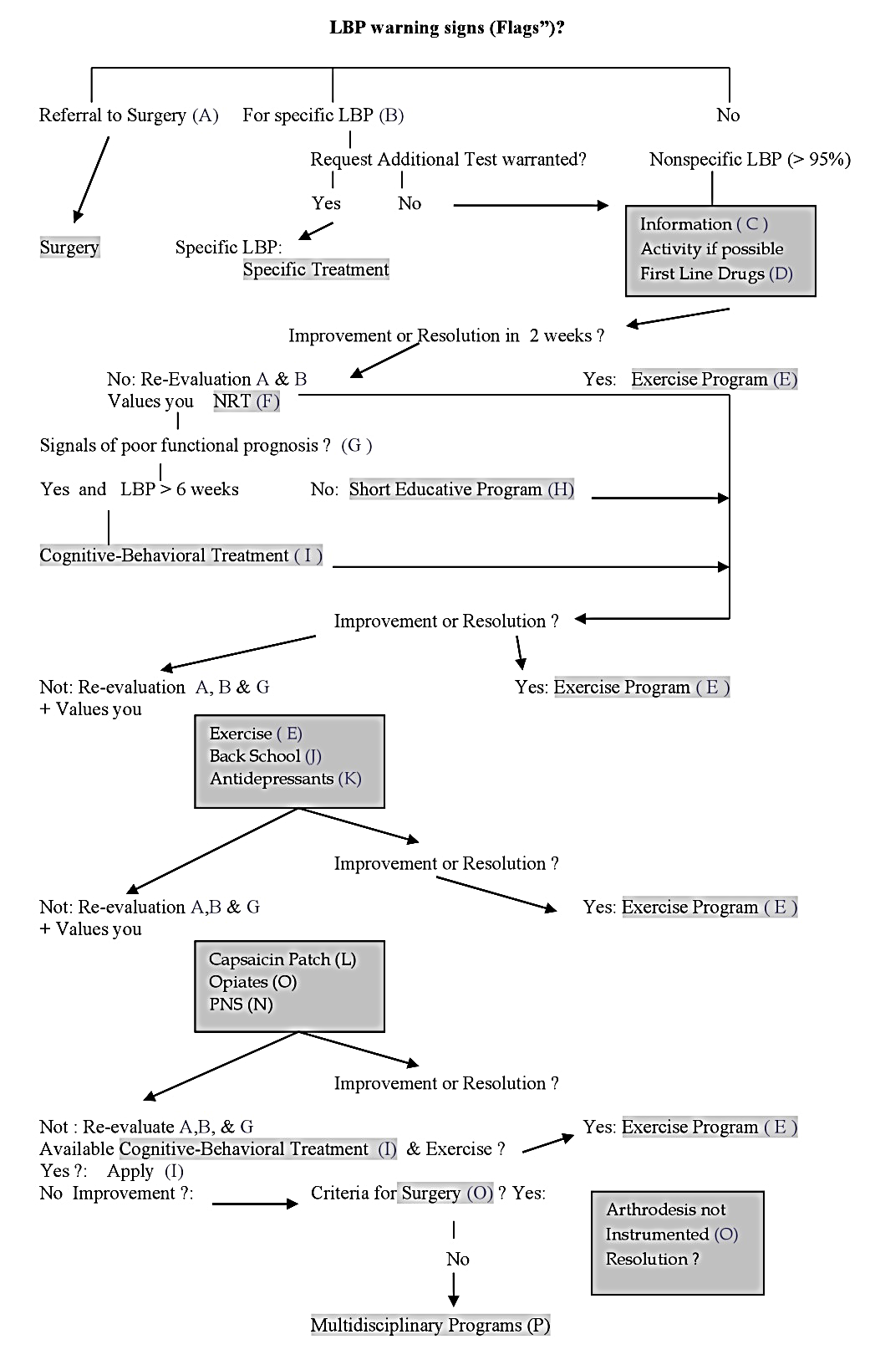
NEUROMODULATION AND EUROPEAN CPG COST B 13
In absence of serious spinal pathology, specific causes of non-spinal origin or progressive neurologic deficit, management should focus on patient education, self-care, analgesics and exercise.
Radiating & Somatic Pain
Short term relief :
Epidural blockade
Facet blocks
Long Term Relief:
Peripheral Neuromodulation (PNS)
Neuroreflex Therapy (NRT)
Surgery*
Based on Figure 1 (Management Algorithm) Low Back Pain: Chapter 2: 13-14. & CPG Spanish version pocket guide, disposable in www.REIDE.org
Notes:
In absence of serious spinal pathology, specific non-spinal ethiology or progressive neurologic deficit, management should focus on patient education, self-care, analgesics and exercise.
Short term relief in radiating pain may be obtained with epidural blockade with local anesthetics and steroids ?, or facet blocks in selected cases. According to to Scientific Evidence, Peripheral Neuromodulation (PNS) and Neuroreflex-therapy (NRT) can offer good results in LBP avoiding surgery and providing functional recovery.

Slide 15
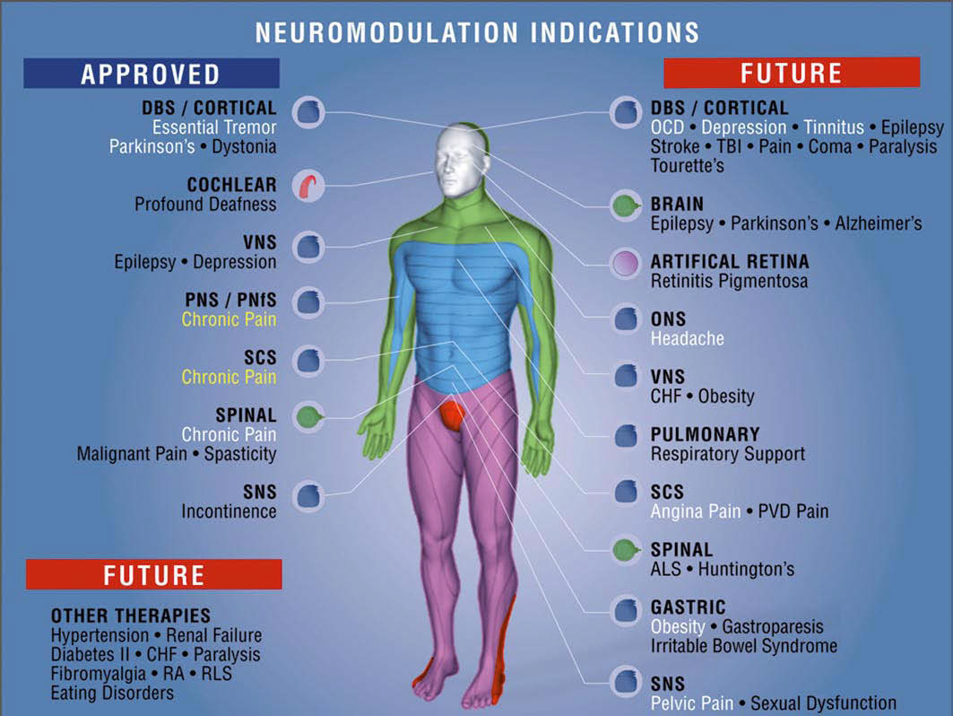
SIG on Neuromodulation
Promote interdisciplinary Collaboration
Inter-professional Education and Training
Application of Emergent Neuromodulatory Techniques
Development of Evidence-Based practices and policies
Notes:
On the another hand
The purpose and mission of the SIG on Neuromodulation is to:
promote interdisciplinary collaboration among scientists, clinicians and other professionals within the health-care networks world-wide in research and clinical application of neuromodulatory treatment strategies;
facilitate inter-professional education and training in the field of neuromodulation with particular attention to the clinical application of emergent neuromodulatory techniques for pain and symptom management; and
establish a platform and forum for on-going professional discourse in order to address emerging issues and to navigate the development of evidence-based practices and policies.

Slide 16
Systematic Reviews of the long-term benefits of Neuro-Stimulation
Study | Study Characteristics | Methodological Quality Scoring | Patients | Pain Relief 12 m | Results 12 m
Kumar et al. | R | 55 | 100 | 58% | +
North et al. | R | 56 | 254 | 46% | +
Van Buyten et al. | O | 53 | 182 | 68% | +
De la Porte & van der Kelf | O | 58 | 78 | 58% | +
North et al. | O | 62 | 50 | 53% | +
Burchiel et al. | O | 57 | 219 | 55% | +
Notes:
In this way, our SIG has been promoted Cost-Efectiveness research and clinical application of neuromodulatory treatment strategies.
Cost-effectiveness was evaluated in 2 systematic reviews and 3 studies with positive results.
Really The addition of Neurostimulation in patients with neuropathic leg and back pain results in higher costs to the health system, but also generates important improvements in patients’ functional and health status over the same period.
During the first 2 years, the cost for SCS was higher than conventional pain therapy owing to the initial high cost of implantable devices. After this period, however, the cost for SCS remained significantly lower than that for conventional pain therapy, whereas quality of life results showed a 27% improvement compared with a 12% improvement for the conventional pain therapy. Sixty percent of patients reported being very satisfied with therapy, whereas 28% were satisfied and only 12% were unsure.
In contrast, 15% of the SCS group returned to work, whereas none of the conventional pain therapy group did.
If a societal perspective were considered, Neurostimulation would be more cost-effective as more people return to work compared with those treated with conventional pain therapy.
Of the 2 randomized trials evaluating SCS, both showed positive results for short- and long-term relief.
Of the 9 observational studies meeting the inclusion criteria with methodologic quality assessment of 50 or higher, all of them showed positive results for short- and long-term relief, except for Kumar and Toth.

Slide 17
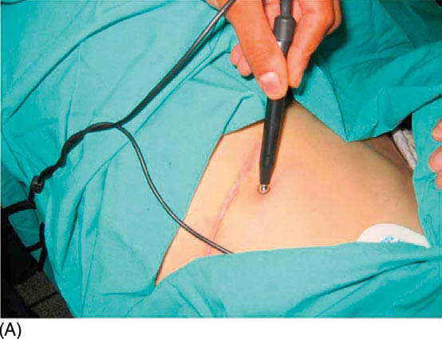
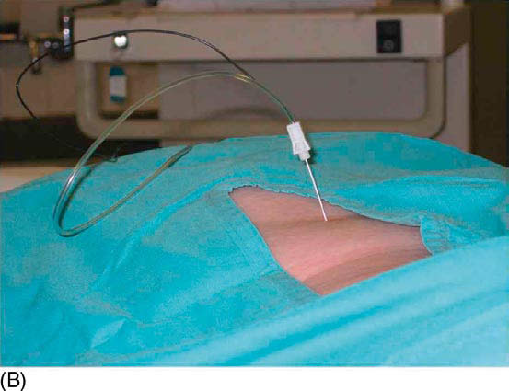
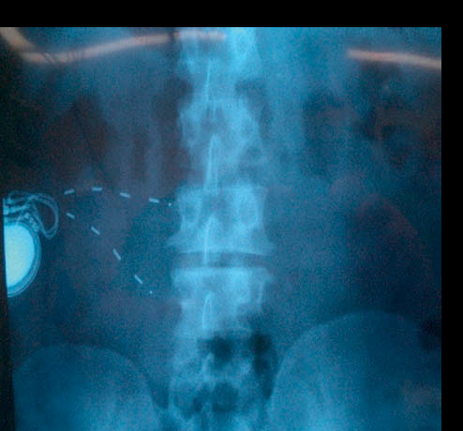
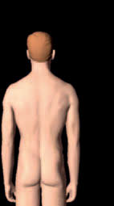
NEW APPROACHES IN LBP WITH NEUROMODULATION: t DCS & PN
Peripheral Neurostimulation PeNS:
Peripheral Field Neurostimulation (PFNS)
Peripheral Nerve Stimulation (PNS)
Notes:
Particulary our SIG make attention to the clinical application of emergent neuromodulatory techniques for pain and symptom management.
In January of 2000, Dr Goroszeniuk introduced a stimulating monoelectrode percutaneously near the ulnar nerve in the forearm of a patient suffering from a neuropathic pain syndrome. To our surprise, short stimulation using a low frequency of 2 Hz resulted in 11 weeks of complete pain relief for the patient. This experience initiated the development of a simplified version of the therapeutic and diagnostic neurostimulation test using a single stimulating needle applied directly to single nerves and plexuses. EN should not be confused with transcutaneous nerve stimulation (TENS), in that the effects of EN do not correlate with TENS applied externally over the same area. Although EN creates a local electrical field as does TENS, the field is narrower and produces a higher current density.
This staged stimulation algorithm of care is as follows: Stage I: external neuromodulation → Stage II: needle neuromodulation → Stage III: temporary catheter trial → Stage IV: permanent neuromodulating implant.
evidence that this therapy has some clinical efficacy in a wide range of disorders including pain within the post-sternotomy scar, post-mastectomy pain syndrome, post-herpetic neuralgia, ostochondritis, back pain, coccycodynia, CRPS and abdominal wall pain.
It is our practice, for initial testing, to use the simple Stimulong monoelectrode. It is emerging from reported material, that the pattern of stimulation with low frequencies (2–10 Hz) and wide pulse widths offers the most optimal programming for this technique. adjust amplitudes of stimulation to below those that produce motor stimulation, usually between 2 and 20 volts.
Outcomes: Effective stimulation to pains of non-dermatomal distribution proved to be equally successful for achieving pain control to the stimulation provided to definitive neural structures such as nerves or plexuses. Overall
levels of pain relief were reported to be equal to or more than 80% in all cases, with varying durations of relief
from several hours to up to 3 months. Subsequent to implantation of the permanent stimulation systems, analgesic medication was discontinued in all patients.
(Paicius et al., 2007) published their recent report on patients with chronic back pain who failed conventional therapies. All patients decreased pain intensities and use of pain medications and an increase in their level of activity. These available data are indicative of the effectiveness of this new technique and emphasize its simplicity. It appears that stability of the implanted leads does not present a problem. The “out-of-favor,” older RF systems are likely to return to favor for TS as they do offer an attractive, relatively inexpensive solution to spiralling costs of healthcare for pain syndromes, especially when neuromodulation devices are used. Of equal importance to the general acceptance of this procedure is that uncomplicated initial testing with EN and the use of basic and inexpensive testing leads should allow better selection of patients and will generally expand its applications.
PNfS is becoming utilized sometimes as a first, minimally invasive, neurostimulation procedure if the pain is limited to a relatively small and well-defined.
The principle of PNfS is that the lead should be placed within or as near as possible to the painful area. Each electrical contact spreads a circumferential electrical field which is about 2 cm in diameter (personal observation). The number, spacing, and distribution of the electrical contacts should therefore be carefully planned according to the size and shape of the painful area. Larger areas might require several leads placed strategically. It is crucial to carefully map the transition zone between the allodynic and non-allodynic area and place the lead exactly in that zone. Around the most common indications is included:
● Intractable axial lumbar pain (whether the patient has received surgical intervention or not) including neuropathic radiated pain.

Slide 18
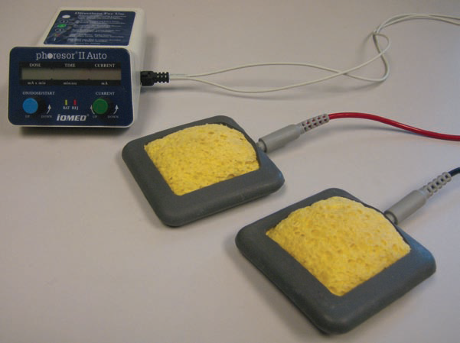
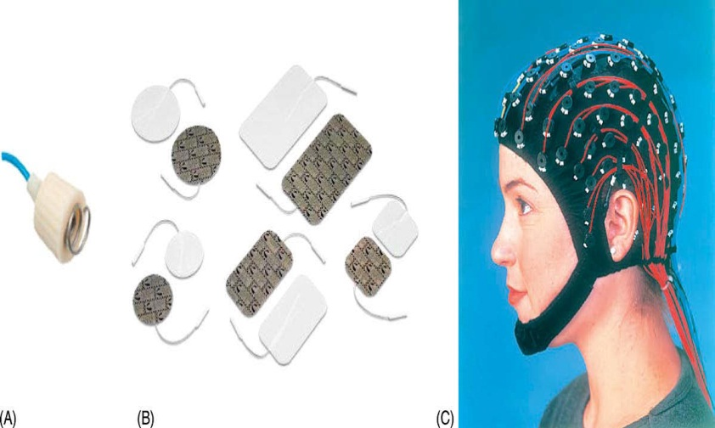
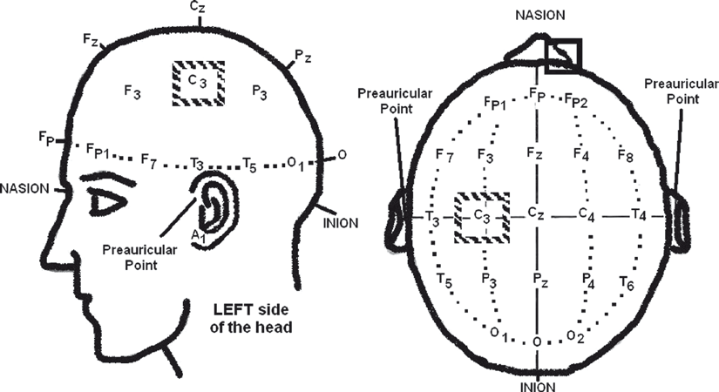
NEW APPROACHES IN LBP WITH NEUROMODULATION: t DCS & PeNS
Notes:
tDCS
Pain in certain pain syndromes (e.g., complex regional pain syndrome/reflex sympathic dystrophy, phantom-limb pain) is associated with a functional reorganization and hyperexitability of the somatosensory and motor cortex. Studies showing that the reversal of cortical reorganization in patients with spontaneous or provoked pain is accompanied by pain relief stimulated the search for novel alternatives how to modulate the cortical excitability as a strategy to relieve pain. Recently, non-invasive brain stimulation techniques such as transcranial magnetic stimulation (TMS) and transcranial direct current stimulation (tDCS) were proposed as suitable methods for modulation of cortical excitability Analgesic effects induced by tDCS outlast the period of stimulation and are cumulative, transient and site-specific. PET scans performed in patients with neuropathic pain after motor cortex stimulation showed significant increase in cerebral blood flow in the ventral-lateral thalamus, medial thalamus, anterior cingulate/orbitofrontal cortex, anterior insula and upper brainstem (65). All of these areas are known to be involved in various mechanisms of transmission of pain.
the activation of the motor cortex in the hemisphere contralateral to the painful limb may trigger thalamic activity directly via cortico-thalamic projections, and this in turn might modulate the ascending nociceptive pathways, such as spinothalamic tract, which is considered to be the predominant pain-signaling pathway.
Safety of tDCS has been evaluated in animal studies (41–44), as well as human studies (45–53, 71) involving healthy volunteers, and patients with various disorders.

Slide 19
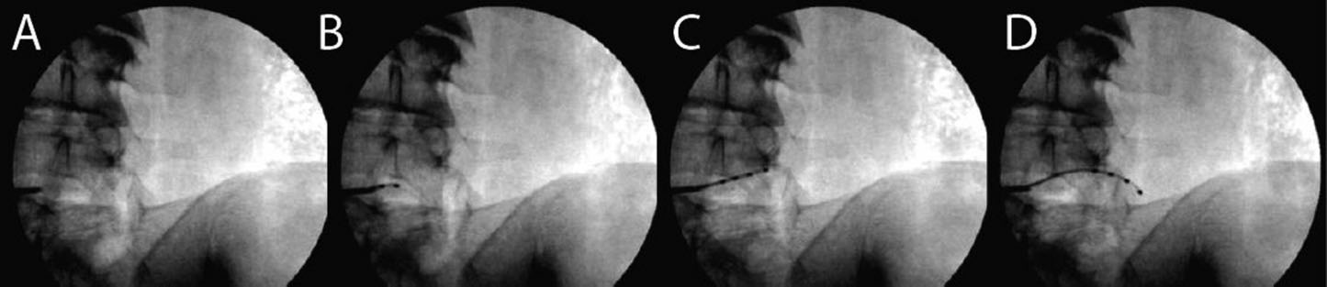
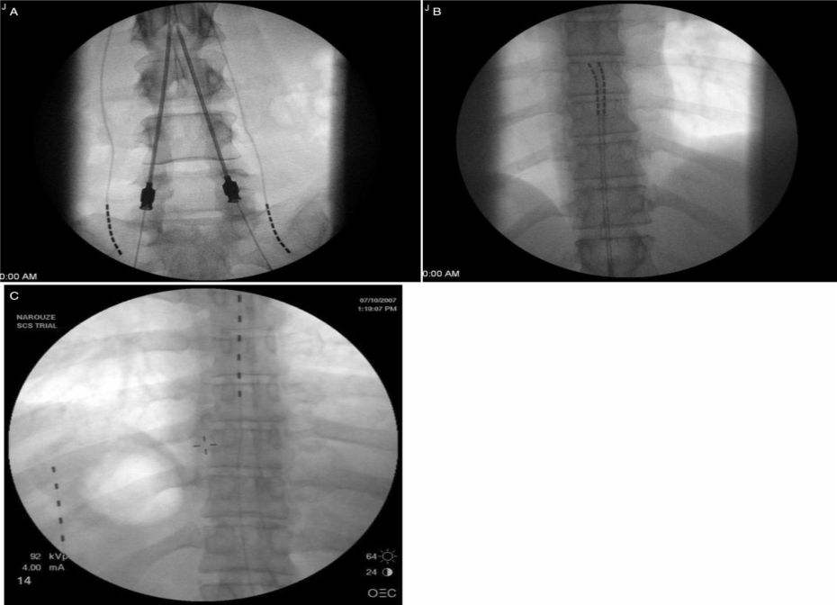
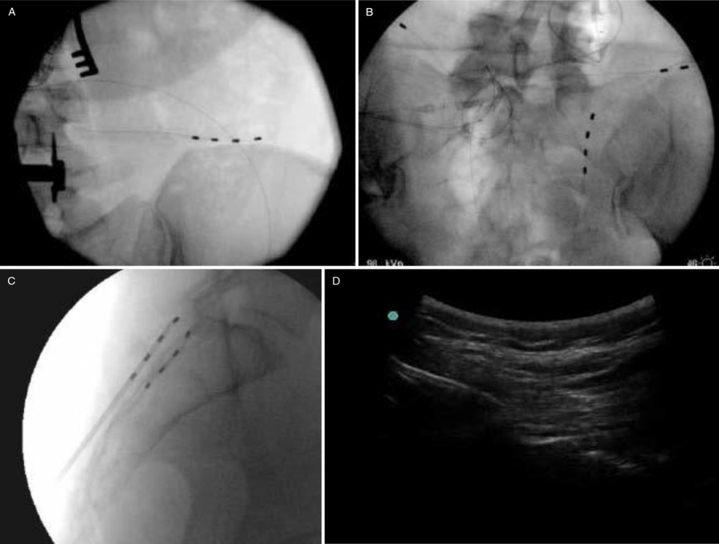
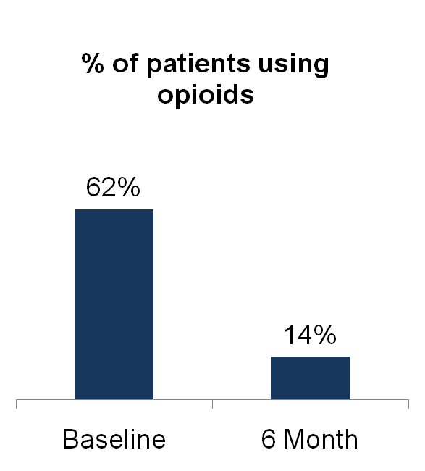
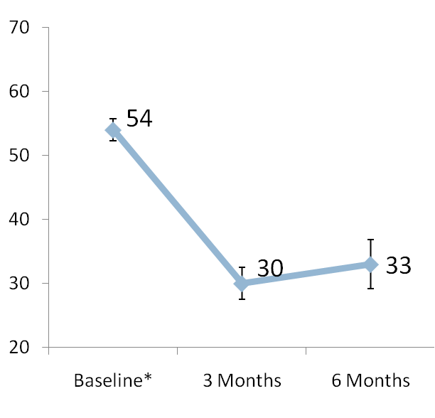
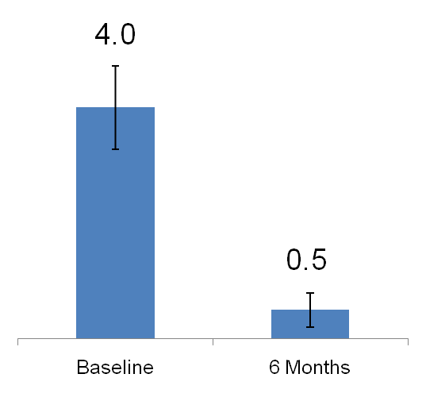
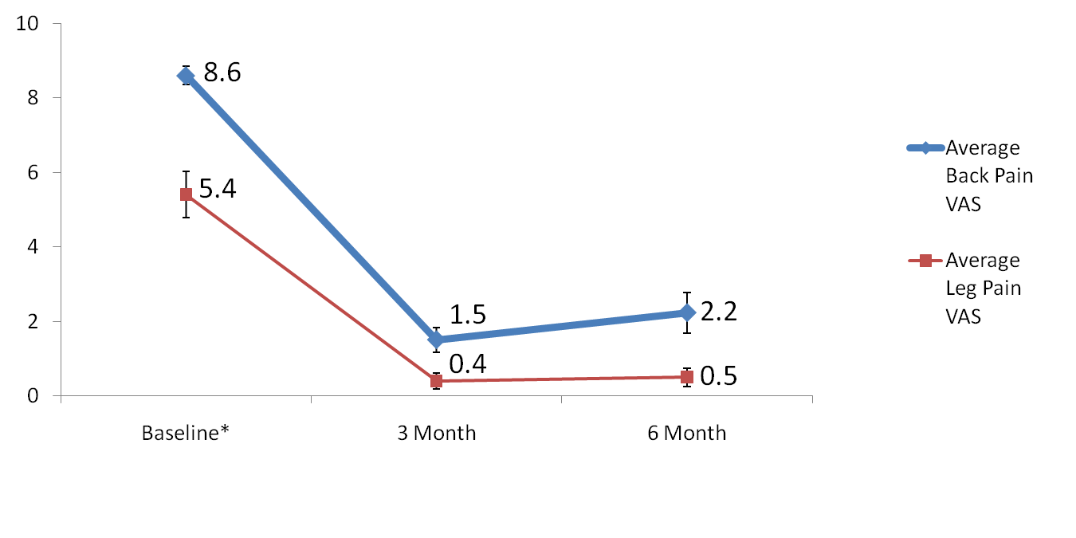
NEW APPROACHES IN LBP WITH NEUROMODULATION: t DCS & PeNS
Dorsal Root Ganglion Stimulation
Superior and Middle Cluneal Nerve Stimulation
with/without Spinal Cord Stimulation
Average Visual Analog Scale (VAS) for Pain
(mean +/- SEM)
Average Oswestry Disability Index
(mean +/- SEM)
Number of Sleep Disturbances per Night
(mean +/- SEM)
Adapted from Iris Smet, Jean-Pierre Van Buyten, Adnan Al-Kaisy . Nikolas Hospital , Belgium . St Thomas & Guy´s, London UK
Notes:
Axial back pain demonstrated a statistically significant reduction in pain as measured by a visual analog scale (94). This registry was used as supporting evidence in the successful application for CE Mark approval of PNfS in the European Union.
Courtney et al. recently presented data describing superior and middle cluneal nerve stimulation with or without spinal cord stimulation in the treatment of axial pain in patients with failed back surgery syndrome (95). The superior cluneal nerve is reliably found at the level of the iliac crest (Fig. 5a), whereas the medial cluneal nerves are cutaneous branches arising from the dorsal rami of S1 through S3 just lateral to the neuroforamena (Fig. 5b), traveling near the posterior superior iliac spine (PSIS) (96). Between the years of 2007 and 2011, 60 patients underwent a trial of superior cluneal nerve stimulation with or without middle cluneal nerve stimulation and/or spinal cord stimulation for FBSS (Fig. 5c) Eighty-three percent of patients had a successful trial and underwent the permanent implantation. As reported, the patients continued to have a dramatic reduction in BPI pain scores and significantly improved Oswestry Disability Scores.
Recent reports have appeared using epidural stimulation in combination with PNfS (Fig. 7a). Termed “triangulation” by Krames, this method can be more efficacious than either technique used alone.
New Developments in Neurostimulation for Axial Back Pain
Dorsal Root Ganglion Stimulation
Motor Cortex Stimulation and Deep Brain Stimulation, chronic stimulation of the periaqueductal and periventricular gray matter (PAG/PVG).

Slide 20
SIG on Neuromodulation
Development of Evidence-Based Practices and Policies
2014-2015 Global Year Against Neuropathic Pain
Clinical Guidelines Neuropathic Pain Management
Ongoing Trials
Finnerup et al. 2015
Failed Back Surgery Syndrome PROMISE
Short-term RCT´s of new SCS techniques (High frequency / Burst)
The studies on t-DCS
Attal and Bouhassira 2015
European Academy of Neurology (former EFNS)
North American Neuromodulation Society, NANS
International Neuromodulation Society, INS
International Association for Study of Pain, IASP
Notes:
IASP announced the period 2014-2015 as Global Year against neuropathic pain. Which consequences of this announcement are implicated by our SIG?
Neuropathic pain is defined as pain that arises as a direct consequence of a lesion or diseases affecting the somatosensory system, including , lumbar or cervical radiculopathy and chronic postsurgical pain.
Recent guidelines (Attal and Bouhassira, 2015, Finnerup et al. 2015) were published according to the Grading of Recommendations Assessment, Development and Evaluation (GRADE) system (Guyatt et al. 2008)
Nevertheless these recommendations, it is well known that still many patients with neuropathic pain are not adequately treated (Attal et al, 2010, Baron et al 2010, Moulin et al. 2014)
On the other hand it is well known that neuromodulation techniques can be very helpful especially in neuropathic pain syndromes.
Also ongoing trials for Neurostimulation in Failed Back Surgery Syndrome (eg. PROMISE), the Multicenter Study by Rigoard and colleagues and short-term RCT´s of new SCS techniques (High frequency and Burst stimulation) most likely will be considered. R-TMS also is given a weak recommendation for transient pain relief in central and peripheral neuropathic pain.
The studies on t-DCS are still inconclusive yet.

Slide 21
The Management of Back Pain Based on Scientific Evidence:
The Role of Neuromodulation Techniques
Cost-Efectivity and Outcomes
Investigation of structural etiology & symptoms can indicate a Systemic Process.
CLBP may originate in Dysfunctional Nociceptive Processing within the central nervous system.
Misattribution of pain to direct Peripheral Nerve Injury may lead to poor clinical outcomes.
Neuromodulation will be an important role in selected patients, avoiding surgery.
International Conference and Exhibition on Pain Medicine
June 08-10, 2015 Chicago
Notes:
In summary:
It is essential to investigate further for an underlying structural etiology and assess whether these painful symptoms indicate a systemic process
An emerging evidence base: Suggests that CLBP may originate in dysfunctional nociceptive processing within the central nervous system
Misattribution of pain to direct peripheral nerve injury (radiculopathy with associated motor, sensory, and reflex deficits) may lead to poor clinical outcomes.
For this reason it seems Neuromodulation offers emergent possibilities related to these findings.
In the future Neuromodulation will be an important role in management of diseases, . New efforts are made by the International Association for Study of Pain, International Neuromodulation Society, the North American Neuromodulation Society and the European Academy of Neurology (former EFNS) to publish new recommendations with regard to neuromodulation techniques.
In order to get access with neuromodulation techniques into therapeutic algorithms for neuropathic pain, members of our SIG are called upon to initiate well designed studies in homogenous patient groups with a control group for invasive and non-invasive stimulation techniques. SIGN can serve as network for all of us to create and perform such studies.

Slide 22



Acknowledgements

