Slide 1



Recycled Aggregates for Concrete: Progress and Problems
by Enric Vazquez i Ramonich
Professor Emeritus
of the
Universitat Politecnica de Catalunya

Slide 2
Possible CDW Recycling Advantages
CDW = Construction and Demolition Waste
1. Diminishment of the use of natural aggregates.
2. Avoid problematic landfills.
3. Possible Steel recycling.
CONDITIONS
➔ Less CO₂ emissions.
➔ Reduction of the energy related with the processing and transportation
➔ Reduction of contamination.

Slide 3
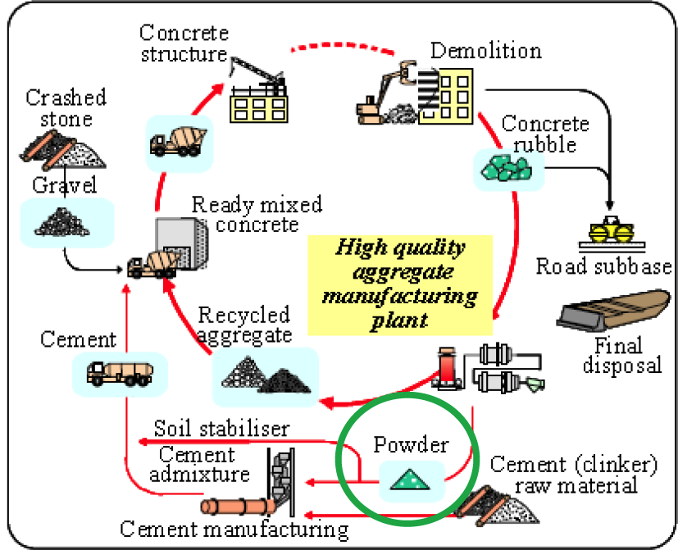
Concrete Cycle
Shima 2005

Slide 4
Closing the Cycle
Schulz, R.R., (1988), Concrete with recycled rubble – Developments in West Germany. RILEM Reuse of Demolition Waste, Vol. Two, 508
“If recycling building materials is regarded as a closed loop system, all valuable constituents in the waste may not be dissipated by applications of secondary importance (e.g. land fill). As far as it can be afforded from an economical point of view, processed rubble should be employed on the highest possible level of utilisation. The re-use of building waste as aggregate for concrete seems to be especially prosperous and may be regarded as the highest level of refining “

Slide 5
Why limited utilization of RA in structural concrete?
Predominant volumes of mixed debris with much ceramic ( MIXED RECICLED AGGREGATES) ➔ It is easier to use it in roads as sub base.
Inhomogeneity
Durability
Publications sustain that RA posses worse technical characteristics than conventional aggregates.
In Europe only coarse aggregate >4mm is used in concrete. In some countries >2mm.

Slide 6
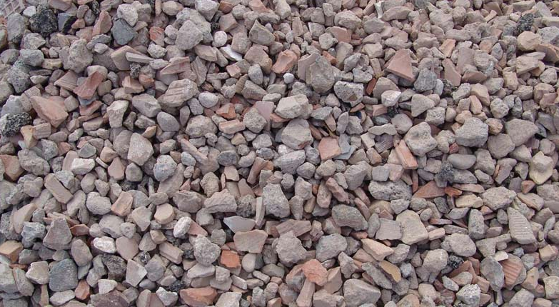
Recycled Mixed Aggregate

Slide 7
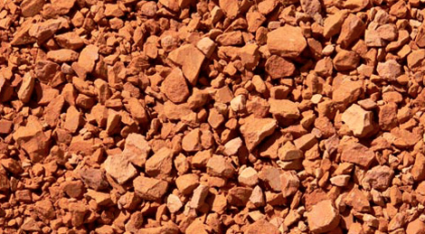
Ceramic Recycled Aggregate

Slide 8
Ceramic Recycled Aggregate
Very high porosity.
No real ITZ.(No bleeding)
Lower strength and modulus.
Different pore structure in the concrete.
  Problems with Durability and Strength

Slide 9
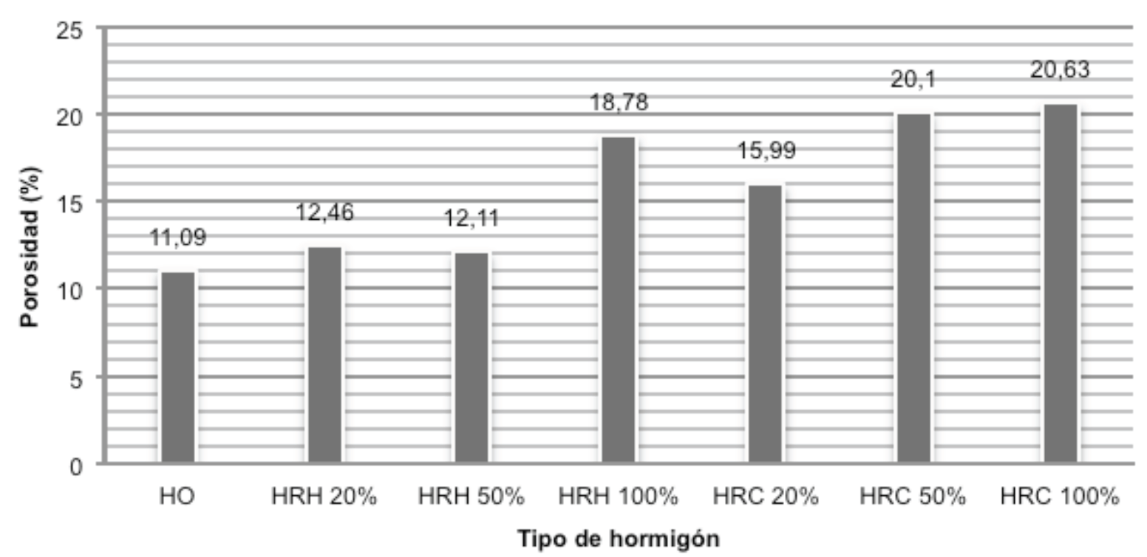
Mercury Intrusion Porosity

Slide 10
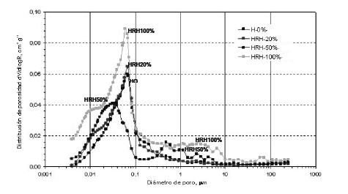
Porosity Distribution in HRH

Slide 11
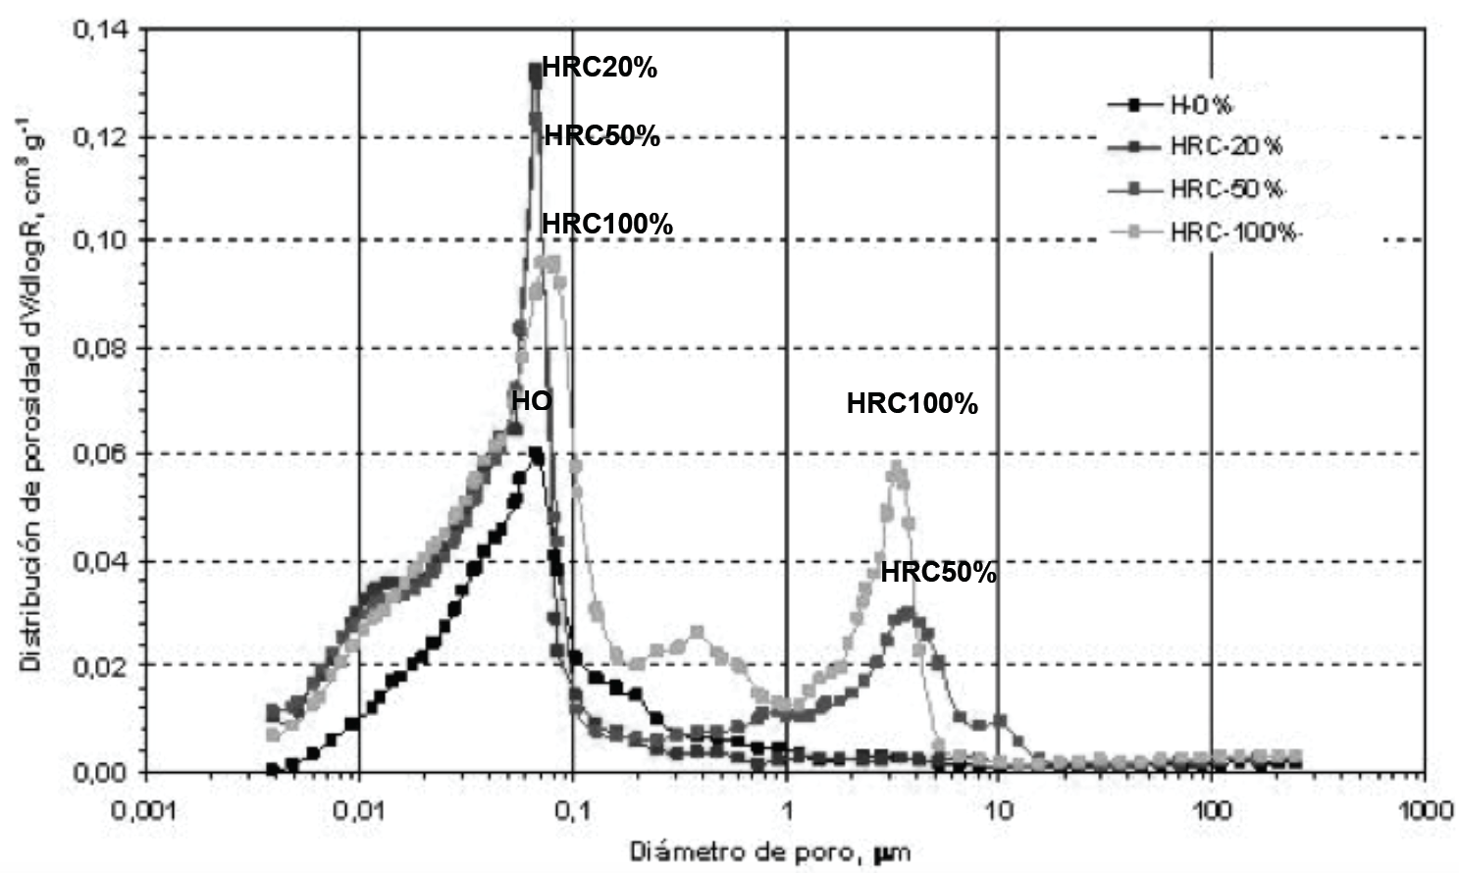
Porosity Distribution in HRC

Slide 12
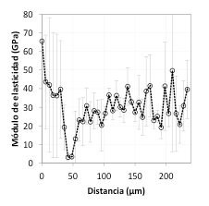
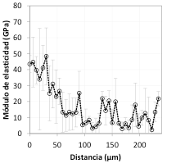
Interfacial Transition Zone
Concrete:
Natural and Ceramic Aggregates

Slide 13
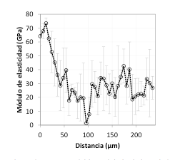
ITZ Concrete with Natural and Concrete Aggregates

Slide 14
Problems in Concrete with Ceramic Aggregates
Higher w/c related with higher absorption
Lower compressive strength
Lower Elasticity Modulus
Higher drying shrinkage
DURABILITY:
Freeze and Thaw
Possible Sulfates

Slide 15
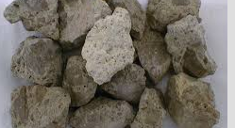
Recycled Concrete Aggregates

Slide 16
Influence of attached mortar
Higher Porosity and absortion
Chlorides Penetration
Inhomogeneity
Freeze and Thaw
Two ITZ

Slide 17
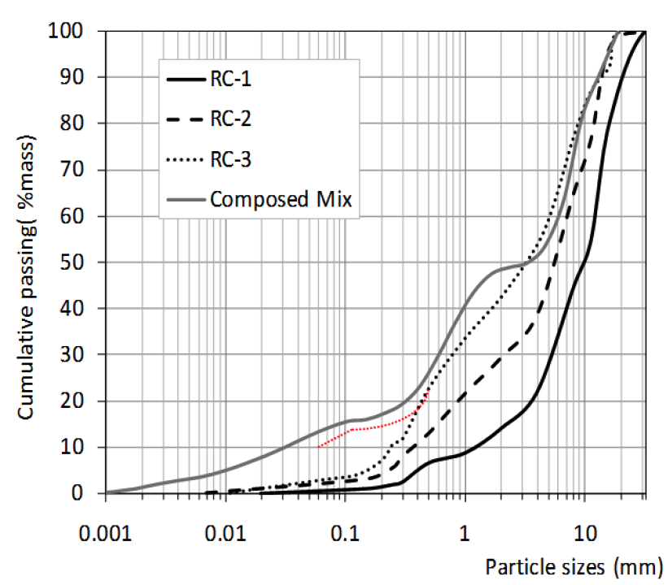
Smart crusher
(Florea, Ning, Browers 2013)
RC1 Jaw crusher 1 time
RC2 Jaw crusher 10 times
RC3 Jaw and smart crusher

Slide 18
Attached Mortar and Quality
Many studies arrive to the conclusion that for structural concrete “good”RCA can replace NA(Fully or partially).
Sanchez,A.,Alaejos,P.-Study on the influence of attached mortar content on the properties of recycled concrete aggregate
Concluded that only recycled aggregates with mortar content under 44% could be used in structural concrete. With this criterion, aggregates with bulk specific density higher than 2160 kg/m³, water absorption lower than 8% and Los Angeles abrasion loss under 40%, are obtained.

Slide 19
Solutions
Many papers reflect the need of more cement to compensate worst properties, compared to concrete with natural aggregates.
Problem of sustainability ➔ more CO₂emissions
CO₂ ➔ 408 kg/t Clinker (5% of total emission)

Slide 20
Pozzolanic Admixtures
It is found that the surface-coated pozzalanic particles can consume CH crystals accumulated in the ITZ and the pores of the attached mortar to form new hydration products, which can improve the microstructure of the ITZ, thus the strength and durability of the concrete

Slide 21
PVA-impregnated recycled concrete aggregates
(Polivinil Alcohol)
Properties of concrete prepared with PVA-impregnated recycled concrete aggregates
Shi-Cong Kou, Chi-Sun Poon
The results show that there was not only an improvement in the mechanical properties of the concrete made with PI-RCA, but also the shrinkage of PI-RCA decreased while the resistance to chloride-ion penetration of the concrete produced increased.

Slide 22
Carbonation
Seidemann,M.,Müller,A.,Ludwig, HM (2013)
Selective Carbonation of Recycled Aggregates from Concrete
Verbesserung der Performance von Betonrezykaten durch CO₂ Speicherung in der Zement stein matrix(2012)
Gezielte Karbonatisierung Verbesserte Qualität von Betonrezyklate durch Bindung von Kohlendioxid(2012)

Slide 23
Cl⁻ penetration versus binding capacity
Villagran-Zaccardi et alt.(2008)
Conclude that recycled aggregate incorporation causes two opposed effects on concrete: it increases its chloride penetration rate (porosity) and chloride binding capacity.
Vázquez,E., Barra,M., Aponte,D., Jiménez,C., Valls,S. (2013)
A chloride binding phenomenon is detected in RAC which may compensate the RCA higher permeability. According to chloride diffusion results, high RCA content lead to an improvement of durability in RAC with sufficiently low w/c ratio, in terms of chlorides presence.

Slide 24
Cl⁻ binding
Chloride binding in concrete can be due to a chemical reaction between chlorides and hydrated cement aluminates, or to physico- chemical adsorption in the CSH .
Friedel’s salt formation is detected and the chloride binding in a CSH plaque was verified.

Slide 25
Equivalent Mortar Volume
Conventional Mix Design treats RCA as one phase material (as one aggregate) we have the attached mortar + fresh mortar. Excessive quantity of mortar.
Equivalent Mortar Volume method (Fathifazl 2009), starts from
RA = NA + attached mortar (2 phases).

Slide 26
LCA of Recycled Concrete Aggregates Concrete
Jiménez,C., Barra,M., Josa,A., Valls,S.
have environmentally evaluate three concrete design methods through a Life Cycle Assessment using the methodology of the Institute of Environmental Sciences (CML), from Leiden University, one of the most commonly applied in practice.

Slide 27
EMV Method
The new concrete has to have the same quantity of mortar as a reference concrete with natural aggregate.
1.The quantity of attached mortar is determined.
2.The proportions of natural aggregate and mortar in the reference concrete are calculated.
3.In the new concrete x % of NA is replaced by RCA and fresh mortar is added (attached mortar+fresh mortar=mortar in reference concrete).

Slide 28
Life Cycle Assesment
Cement is, by far, the most influencing material in almost impact categories of the studied concretes in terms of its released emissions.
After cement, natural aggregates and facilities are the most significant contributors to the majority of impact categories.
Chemical admixtures emissions influence are rather small.
The EMV method accomplishes better environmental performances than conventional methods for design RCA.

Slide 29
EMV
The results of applying this new method demonstrated that 24% of cement could be saved compared to the results of the ACI method. The EMV method reduced slump. The use of air entraining admixtures partially solved the problems related with workability in fresh state, only lowering the plastic viscosity.

Slide 30
Jimenez, C. et al. (12) adapted the EMV method to the Bolomey method
Jimenez used air entrainer that reduced the plastic viscosity, and super plasticizer in high dosages that decreased the yield strength value.
The reduction in cement content was of 8%.
The durability measured by Chloride penetration and permeability was equivalent to the reference concrete.

Slide 31
LCA of Recycled Concrete Aggregates Concrete
Concretes studied:
Bolomey reference
ACI reference
Bolomey EMV
ACI EMV
W/C : 0,45 and 0,55

Slide 32
LCA
Transport is the first point to consider.
Cement is, by far, the most influencing material in almost impact categories of the studied concretes in terms of its released emissions.
After cement, natural aggregates and facilities are the most significant contributors to the majority of impact categories.
Chemical admixtures emissions influence are rather small.
The EMV method accomplishes better environmental performances than conventional methods for design RCA.

Slide 33
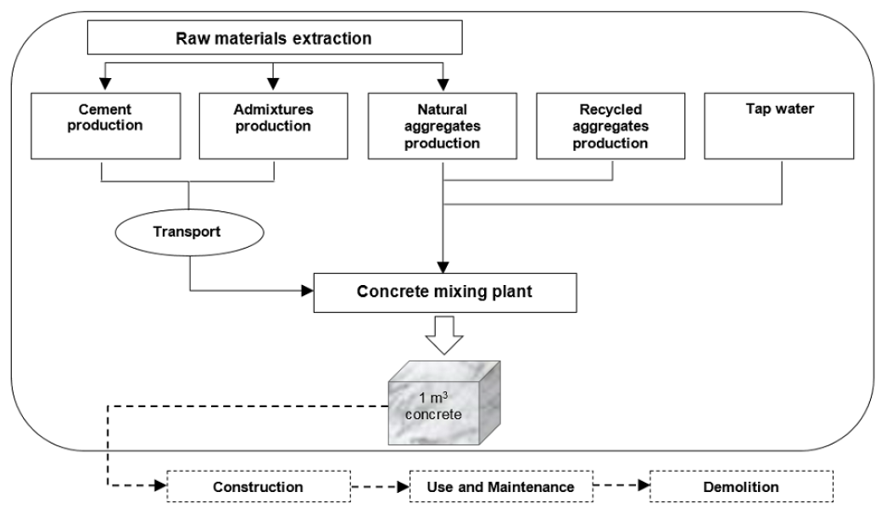
System boundaries

Slide 34
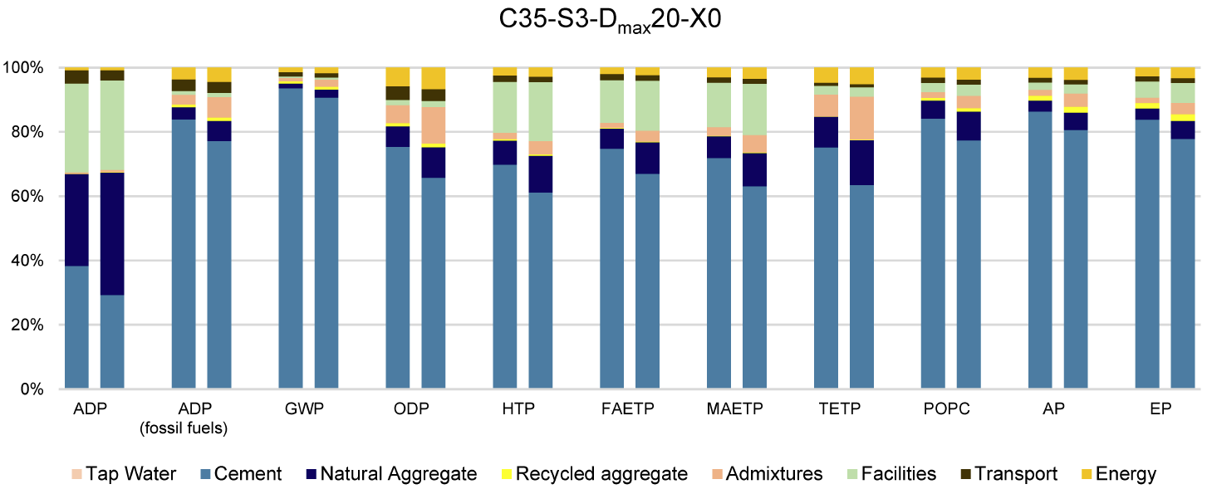

Slide 35
Final Conclusion
Several solutions will be proposed to make the recycled concrete sustainable, from the combined use of mineral additions and chemical admixtures, smart crushers, or new mix design methods that can achieve equal performance in fresh state, strength and durability.
If we want to extend it to include countries with easy and cheap access to natural aggregates, we have to apply environmentally sustainable solutions that would produce materials that are competitive not only in strength but also in durability.
In any case we have to consider the leaching behavior of the recycled aggregates and from the new recycled concrete

Slide 36
REFERENCES
Sidorova, A., Vazquez, E., Barra, M., Roa, J. J., Jiménez, E (2014). Study of the recycled aggregates nature’s influence on the aggregate-cement paste interface and ITZ. Construction and Building Materials, 68, 677 – 684
Varela, E. (2012), Evaluación de la sostenibilidad ambiental de hormigones con áridos reciclados procedentes de RCD, PhD. Thesis, UPC.
Fathifazl, G.; Abbas, A.; Razaqpur, A. G.; Isgor, O. B.; Fournier, B.; Foo, S.. (2009), New Mixture Proportioning Method for Concrete Made with Coarse Recycled Concrete Aggregate, Journal of Materials in Civil Engineering, (2009), pp. 601-611. D.O.I.: 10.1061/(ASCE)0899-561(2009)21:10(601)
Jiménez, C.; Barra, M.; Valls, S.; Aponte, D.; Vazquez, E. (2013), Equivalent Mortar (EMV) method for proportioning recycled aggregate concrete: Validation under the Spanish context and its adaptation to Bolomey methodology for concrete proportioning. Mater. Construction, s. n., (2013). DOI 10.3989/mc.2012.01112.
C. Jimenez, M. Barra, A. Josa and S. Valls (2015) LCA of Recycled and conventional concretes designed using the Equivalent Mortar Volume and classic methods. Construction& Building Materials, conbuildmat 2015.03.051

