Slide 1
Lifestyle-related factors and burden of cardiovascular diseases in Japan
Enbo Ma, MD, PhD
Faculty of Medicine, University of Tsukuba
WCPHN, Madrid, March 10, 2016
Notes:
Thank you Chairmen, Dr. for your introduction. Good afternoon everyone! I would like to introduce about the CVd control and prevention through lifestyle factors identified in Japan. The topic is….

Slide 2
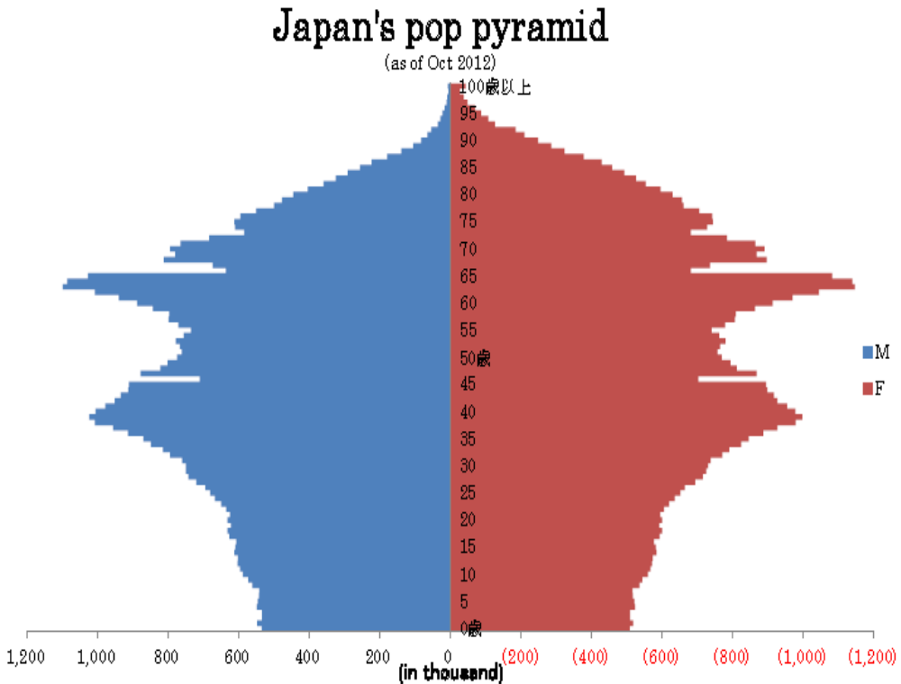
Ageing population
Population in Sep 2015:
126,876,000; 0.21% ↓
>65y, 33,792,000, 2.7% ↑
Life expectancy in 2013：
80.2y in men
87.2y in women.
Men
Women
Notes:
As we know that Japan has the highest LE in the world both for men and women (Salomon JA Lancet 2012). In 2013, the LE is …. This is the Japanese population pyramid. More than 65 y of age have big proportion and women is higher than men.
Compared to 2014, the Japanese population in 2015 reduced 0.21% vs. 2014; but 65y 2.7% increase 2.7%.

Slide 3
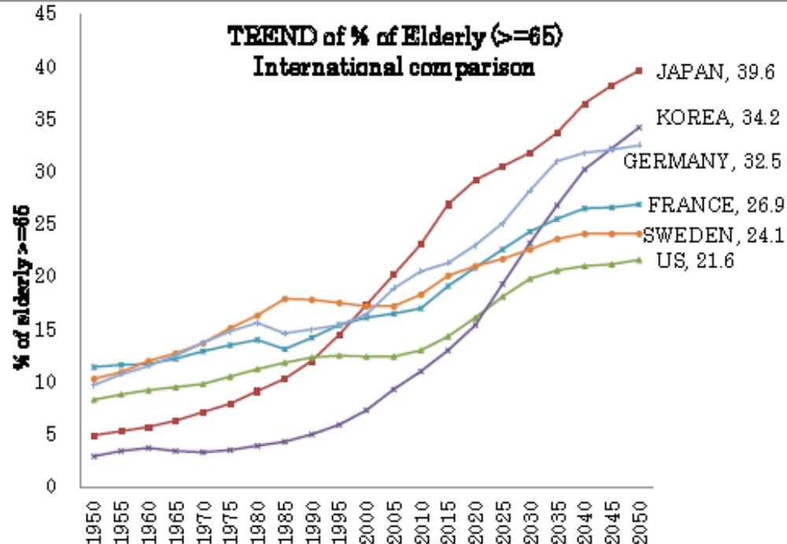
58,820 (87% F) centenarians
Ministry of Health survey at the Day of Respecting the Elderly 「敬老の日」 in 2013:
1963 | 1998 | 2012
153 | 10,000 | >50,000
News of Japan Economics 2014/9/12
Notes:
The ageing population, >65 y increases faster than other countries (indicate). The Japan Economic News reported in 2014 that there had more than 58 thd of centenarians in Japan in 2013. Recent years, annual increase is about 3000-4000/y.
Centenarian adj. 百岁或逾百岁以上的。 n. 百岁或逾百岁以上的人

Slide 4
Burden of CVD in Japan
Global Burden of Disease Study 2013 showed that the mortality of stroke in 2010 is the highest rate of causes of death in Japan (GBD, Lancet 2013).
In 2013, the rank of mortality
 | Total | Men | Women
Cancer | 1 | 1 | 1
Heart disease | 2 | 2 | 2
Pneumonia | 3 | 3 | 5
Cerebrovascular disease | 4 | 4 | 3
(Ministry of Health, Labor and Welfare (MHLW). 2015/2016).
Notes:
Let’s firstly see the CVD burden in Japan. GBD 2013 showed …in 2010. The rank in 2013 was… HD, stroke and cancer was accounting for 60% of death in Japan in 2011; HP related diseases 9,070,000, DM 2,700,000, stroke 1,240,000, cancer 1,530,000 in 2011. Health cost 1874 billion for HP related diseases, DM 1208.8b, CHD 742.1b, stroke 1777.2b, cancer 3326.7b, in total 8928.8b JY in 2012 (JHWS 2015/2016).

Slide 5
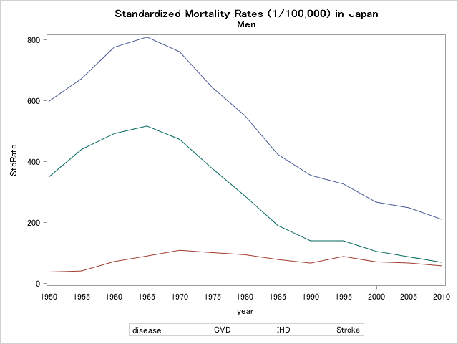
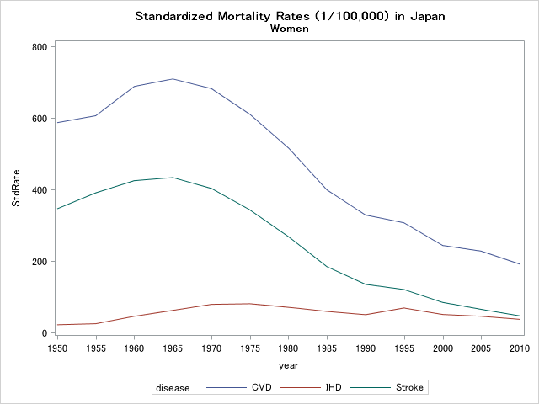
Age-standardized mortality rates
CVD, cardiovascular disease;
CHD, coronary heart disease (ischemic heart disease);
Standardized by the world population in 2010
Notes:
The national campaigns for reducing salt intake, together with other hypertension control programs, resulted in the great reduction of stroke mortality since 1960s.
World age-standardized death rates were 21.2% for CVD, 24.6% for stroke, and 19.5% for IHD, (which year??)

Slide 6
Coronary heart disease
CHD risk in Western countries
  High total and low density lipoprotein (LDL)-cholesterol
  Low high density lipoprotein (HDL)-cholesterol
  High triglycerides
  Hypertension
  Glucose abnormality
Low prevalence of hypercholesterolemia and glucose abnormality make CHD mortality 20 to 30% lower than it in US (Iso H Circulation 2008).
Notes:
There were some estimations that 20-30% of CHD mortality risk was attributed to the low prevalence of hypercholesterolemia and glucose abnormality in Japan, comparing with Western countries (Iso H Circulation 2008)

Slide 7
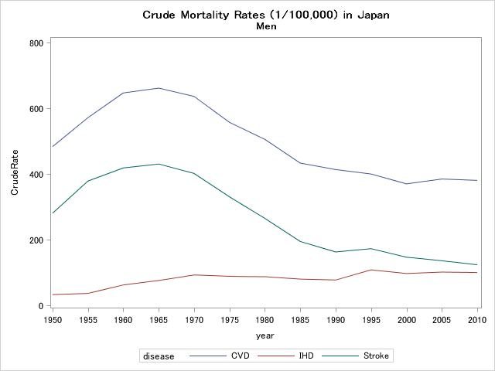
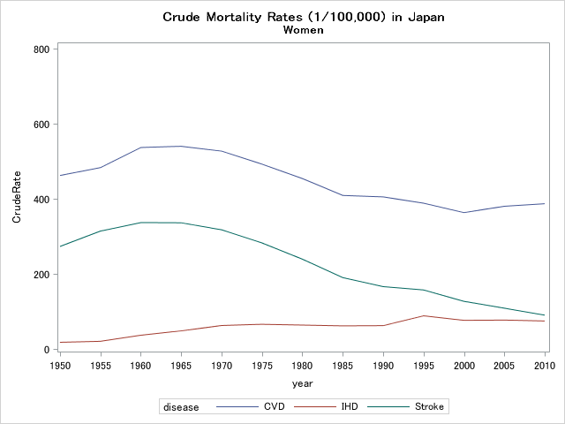
Crude mortality rates
CVD, cardiovascular disease;
CHD, coronary heart disease (ischemic heart disease).
Notes:
However, because of the westernization of lifestyles such as high-fat diets and sedentary work patterns associated with socioeconomic development, there has a possible increase in the incidence of and mortality from coronary heart disease in big cities in Japan.

Slide 8
Average of YLLs
YLL, Years of Life Lost Estimated by the World Standard Life Expectancy, the Global Burden of Disease study.
AYLL=total YLLs/ total deaths from the cause

Slide 9
YLLs rates, 1/100,000
YLL rates =
total YLLs / total population *100000
Notes:
However, because of the westernization of lifestyles such as high-fat diets and sedentary work patterns associated with socioeconomic development, there has a possible increase in the incidence of and mortality from coronary heart disease in Japan.

Slide 10
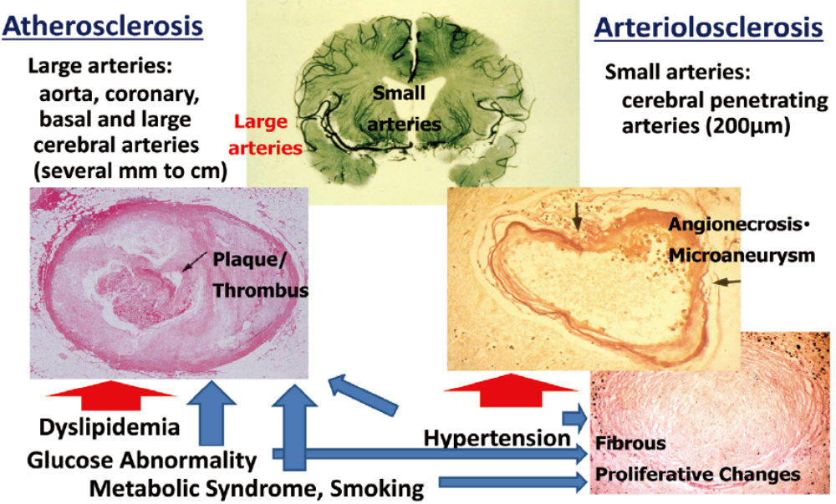
Vascular pathology
Iso H. JA 2011
Notes:
Atherosclerosis, a large vascular pathology, is characterized by lipid accumulation with proliferative changes leading to plaque formation (left side). Arteriolosclerosis, on the other hand, a small vascular pathology, is characterized by the necrosis n. 坏死；坏疽；骨疽or apoptosis n. 细胞凋亡；细胞死亡of smooth muscle cells within the media血管中层；, leading to the formation of microaneurysms微动脉瘤（ (intra parenchymal adj. 薄壁组织的；主质的 hemorrhage) and fibrous proliferative changes (lacunar adj. 有花格平顶的stroke) (right side.
Atherosclerosis is typically observed in the aorta n. [解剖] 主动脉, coronary adj. 冠的；冠状的；arteries n. [解剖] 动脉, carotid n. 颈动脉arteries and basal cerebral adj. 大脑的，脑的arteries, while arteriolosclerosis usually occurs in small penetrating arterioles n. [解剖] 小动脉； in basal ganglions 神经节of the brain (top). Major risk factors for atherosclerosis are dyslipidemia n. 血脂异常, glucose abnormality and metabolic syndrome as well as hypertension and smoking while those for arteriolosclerosis are primarily hypertension, and secondarily glucose abnormality, metabolic syndrome and smoking (Konishi M Arteriosclerosis 1990; Konishi M Stroke 1993). Atherosclerosis is very common in western populations and is reflected in high CHD mortality, while the same holds true for arteriolosclerosis in Japanese and is reflected in high stroke mortality.

Slide 11
Vascular pathology
In Japan, 20% is for large artery occlusive infarction, 20-30% for intracerebral hemorrhage and 40% for lacunar infarction, while 40%, 5-10% and 20% in the western populations (Kitamura A, Stroke 2006).
Atherosclerosis may increase among Japanese subpopulations, as the CHD incidence in urban middle-age men showed a rising (Kitamura A, Am Coll Cardiol 2009).
Notes:
Similar，In China, subtypes of stroke ranged 43.7-78.9% for ischemic stoke and 18.8-49.0% for hemorrhagic stroke (Jiang B, Stroke 2006).

Slide 12

National Health and Nutrition Surveys, Japan
Since 1945, through stratified random samples, 8000-10,000, during 2003-2013, have provided the prominent information for health promotion strategies.
2006, child physical activity.
2009, adult dental health, eating habit, weight management, dietary intake; child eating on sweat foods and drinks.
2012, people suffering from diabetes, which has been performed every five years since 1997, targeting 23,750 households and about 61,000 people over 1y for the 475 districts.
Notes:
FFQ
Before move to the next introduction, I should mention firstly. The Japan national health and nutrition surveys since 1945 have provided the prominent information for health promotion strategies issued by the health ministry.

Slide 13
Large cohort studies in Japan, 7/1000 population
Japan Public Health Center-based prospective Study I/II (JPHC, 140,000)
The Japan Collaborative Cohort Study (JACC, 110,000)
The Miyagi Cohort Study (47,000)
Ohsaki National Health Insurance Cohort Study (52,000)
The Three Prefecture Study Aichi/Miyagi/Osaka (100,000)
Takayama Study (31,000)
Lifespan study (120,000)
Circulatory Risk in Communities Study (CIRCS, 35,000)
NIPPON DATA (21,000)
Ibaraki Prefectural Health Study (IPHS, 150,000)
Komo-Ise Gunma Cohort Study (11,000)
Japan Epidemiologic Association, 2016
Notes:
Each study more than 10,000 and followed up at least 5 yrs. In total, the study population take account of 7/1000 total population. These studies provide lots of evidences for chronic disease control and prevention; and many studies were put into the international meta-analysis.

Slide 14
Blood pressure and salt intake
National Health and Nutrition Survey (MHLW 1995-2012)
Notes:
The early management of hypertension and primary prevention of high blood pressure are important to reduce further the incidence of stroke in Japan (Ohira T, Circ J 2013).

Slide 15
Hypertension control in Japan
Annual systematic cardiovascular screening, referral of high risk individuals to local clinics for antihypertensive medication, health education for hypertensive patients at blood pressure screening sites and during home visits by public health nurses, and community-wide media-disseminated education to encourage participation in blood pressure screening and reducing salt intake (Iso H, Stroke 1998).
Notes:
The mortality decline trends were believed the blood pressure control and salt intake decline. Two components of community based intervention programs.

Slide 16
Japan dietary pattern
A diet with adequate total calories and increased intake of fish and plant foods, but decreased intake of refined carbohydrates and animal fat, a so-called Japan diet, appears to be quite effective for prevention of CHD (Tada N JAT 2011).
In Japan, most (63%) dietary sodium came from soy sauce (20%), commercially processed fish/seafood (15%), salted soups (15%), and preserved vegetables (13%) (NHNS, 2009).

Slide 17
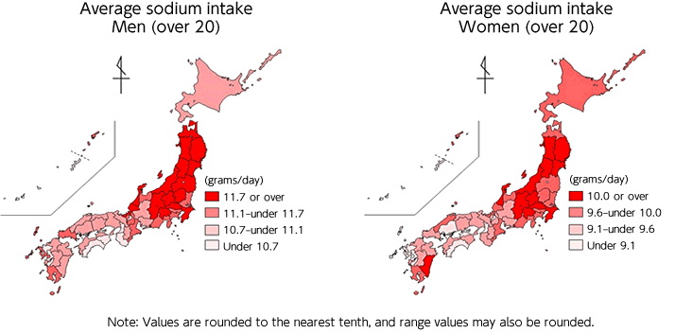
National Health and Nutrition Survey (MHLW 2013).
Sodium intake was positively associated with mortality from total stroke, ischemic stroke, and total CVD in middle-aged Japanese (Umesawa M, AJCN 2008).
Notes:
Sodium/potassium, JACC, 40-79y, 13y flup, 58730 subj.
Sodium intake as a whole salt equivalent may not increase the risk of cancer but may increase the risk of CVD. Salt food intake may increase the risk of cancer – differential influences in the development of cancer and CVD (Takachi R AJCN 2010).

Slide 18
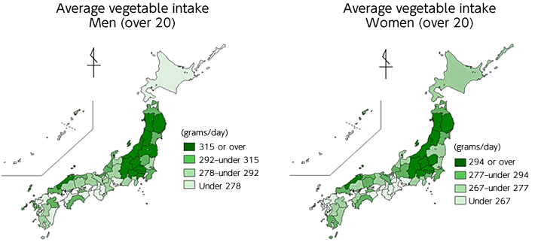
In 2012, average intake of total vegetable, green and yellow vegetables, and other vegetable was 286.5g, 90.9g, and 195.6g per day, respectively.
Notes:
Whole country adjustment values.

Slide 19
Findings from large cohorts
‘Vegetable’ and ‘dairy product’ patterns were associated with lower mortality from CVD, while the ‘animal food’ pattern was not among Japanese (Maruyama K, NMCD 2013).
Frequent intake of citrus fruit may reduce the incidence of CVD, especially cerebral infarction, in men and women (Yamada T JE 2011).
Healthy dietary pattern (high in vegetables and fruit) may be associated with suppressed inflammation (hs-CRP) in Japanese men and women, independently of BMI and other factors (Nanri H JE 2011).
Notes:
Intakes of plant-based foods, particularly fruit intake, were associated with reduced mortality from CVD and all causes among Japanese men and women (Nagura J BJN 2009).

Slide 20
Cont.1
The dietary energy intake was positively associated the CHD mortality risk both in Japanese men and women (Masato N JAT2015).
Total 25.5, 19.9 and 13.1-g/d increment in total protein intake, animal protein, and plant protein was associated with a decrease in SBP/DBP 1.14/0.65, SBP/DBP 1.09/0.41, and DBP 0.57 mmHg, respectively (Umesawa M AJCN 2009).
Dietary intake of saturated fatty acids inversely associated with stroke incidence (deep intraparenchymal hemorrhage and lacunar infarction) and positively associated with myocardial infarction (Yamagishi K, Euro Heart J 2013).
Notes:
A total 7704, 29-year-follow study, the dietary energy intake was positively associated the CHD mortality risk both in Japanese men and women (Masato N J Atheroscler Thromb 2015).

Slide 21
Cont. 2
Higher total dietary fiber was associated with reduced the incident risk of CVD in Japanese non-smokers (Kobubo Y EJCN 2011).
Low-carbohydrate diets were associated with a significantly higher risk of all-cause mortality, but not with a risk of CVD mortality and incidence (Noto H PLoSOne 2013).
Moderate diets lower in carbohydrate and higher in protein and fat are significantly inversely associated with CVD and total mortality in women (Nakamura Y, BJN 2014).

Slide 22
Cont. 3
Habitual intake of coffee is associated with lower risk of total mortality and death from cancer, CVD and CHD in Japan (Saito E, AJCN 2015).
Green tea consumption is associated with a reduced risk of total stroke incidence, cerebral infarction and cerebral hemorrhage (Tanabe N IJE 2008).
Everyday beverage intake is associated with higher risk of ischemic stroke for women (Eshak E, AJCN 2012).
Notes:
Coffee amount: Also in a meta-analysis, Je Y, Gioannucci E BJN 2014.
Mechanism: Reported that coffee consumption was inversely associated with arterial stiffness independent of known atherosclerotic risk factors, and this association was partly mediated by reduced circulating triglycerides (Uemura H EJCN 2013).
2. SFA, JPHC (140420), 45-74, 81931 subj, flup 15y, amt, 16.3g/d.
3. Soft drink, JPHC, flup 18y, 39786 subj, soft drink freq, never/1-2/wk/3-4/wk/almost everyday.

Slide 23
Cont. 4
Soy products was not significantly associated all-causes of mortality (Yamasaki K APJPH 2015).
Rice consumption is not associated with risk of CVD morbidity or mortality (Eshak E AJCN 2014).
Moderate meat consumption, up to -100g/d, was not associated with increased mortality from CHD, stroke or total CVD among either gender (Nagao M EJCN 2012).
Notes:
Last year WHO reported that eating red meat increase the risk of cancer. In japan, … We believe that the cooking method and the eating amount is more important.

Slide 24
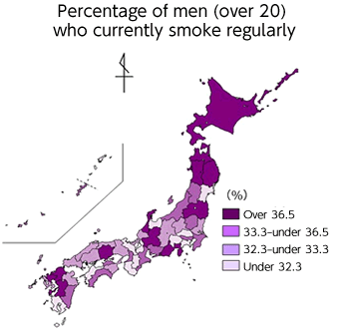
Current smoker
(NHNS 1965-2010, 2013)
Notes:
. International comparison

Slide 25
Current smoker (cont.)
Smoking increase the incidence risk of CHD (Baba S EJCPR 2006), subhemorrhage and ischemic stroke in men and women; and dose-response relations were seen in ischemic stroke, lacunar infarction, large artery infarctions, but not embolic infarction (Mannami T Stroke 2005).
Notes:
Mannami T Stroke 2005. JPHC, 40-59y, 11y flwp, 41282 total. HR=1.27, 3.60 and 1.66 for total stroke, subhaemorraghe, and ischemic stroke in men, and HR=1.98, 2.70, and 1.57 for those in women.

Slide 26
Current alcohol drinking
Alcohol is strongly associated with CHD risk (Ikehara S ACIR 2009).
450g/w alcohol vs. social drink increased stroke incidence risk, especially hemorrhage stroke (HR=2.15). 1-149g/w vs. social drink, there reduces ischemic stroke and lacunar infarction stroke, but increase hemorrhage stroke risk (Iso H Stroke 2004).
Mean of ethanol intake:
men 169.8g/d, women 41.8g/d in 2012.
Notes:
Ikehara S, ACIR 2009.
Iso H Stroke 2004. JPHC, 19544 men. 1-149g/w vs. social drink. HR=0.59 for ischemic stroke,0.43 for lacunar stroke,and 1.73 for haemorrage stroke. 490g/w vs. social drink, increase total stroke, mainly for haemorraghe stroke,, HR=2.15

Slide 27
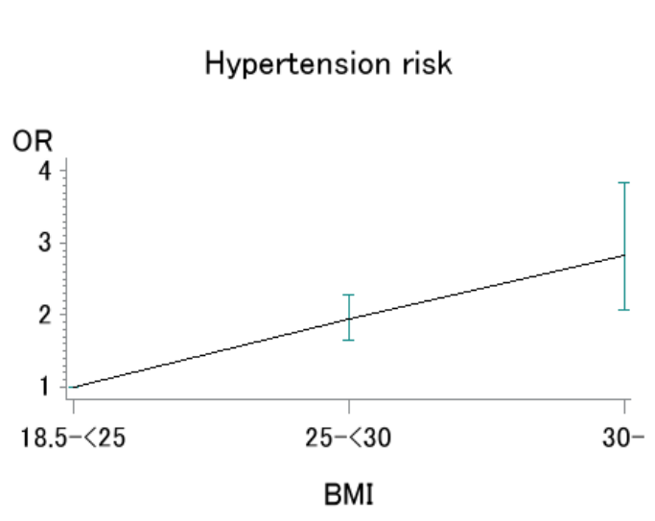
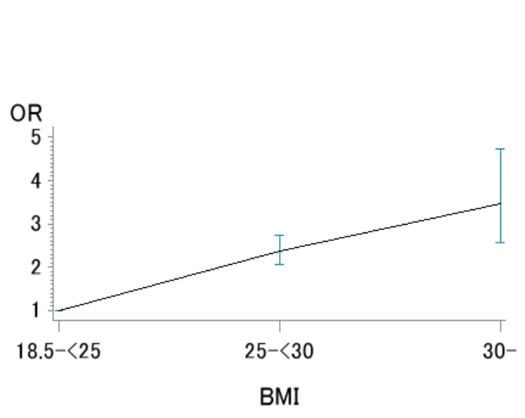
Overweight
Men
Women
NHNS 2013
Nagai M Hypertens Res 2015
Notes:
OR for hypertension was 1.9 (1.6-2.3) in overweight vs. normal BMI and 2.8 (2.1-3.8) in obese vs. normal BMI in men in 2010 compared to normal BMI. Study size???

Slide 28
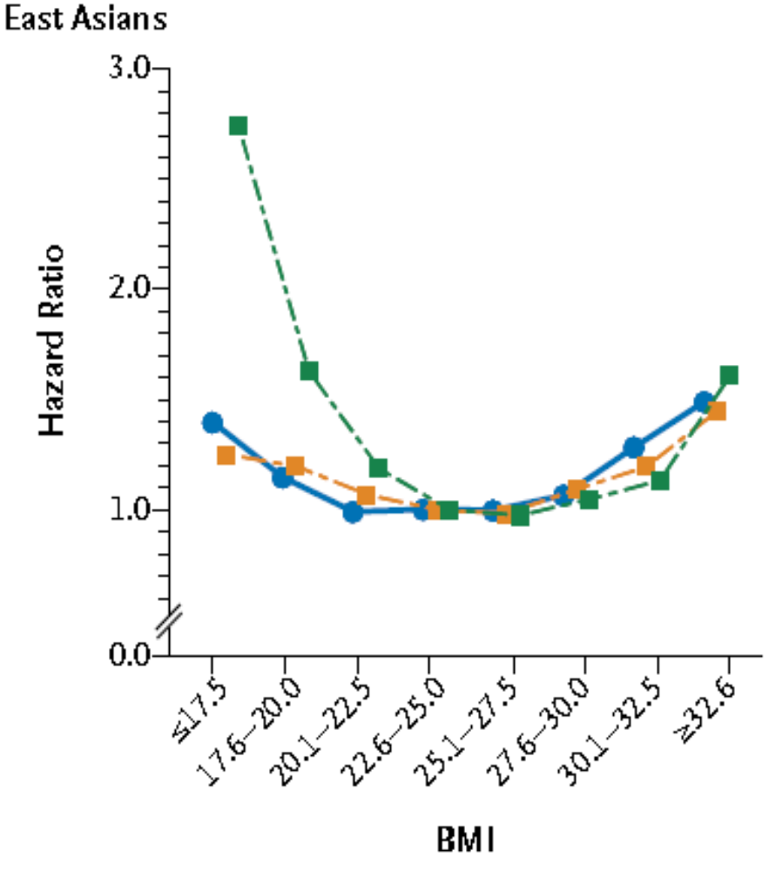
Body mass index (kg/m²)
Mortality risk of CHD was higher in BMI >27 men (HR=2.05) and women (HR=1.58); of total stoke, intra-hemorrhage stroke in BMI<18.5 in men (HR=1.22) and in women (HR=1.92), comparing with normal BMI persons (Cui R Stroke 2005).
CHD incidence risk was 2 times higher in persons (BMI <21.7, >20y) with weight gain 10kg vs. no weight change persons (Chei CL IJO 2008).
Blue: CVD death
Yellow: cancer
Green: other
Zheng W NEJM 2011
Notes:
Cui R Stroke 2005, JACC
Chei CL IJO 2008, JPHC.

Slide 29
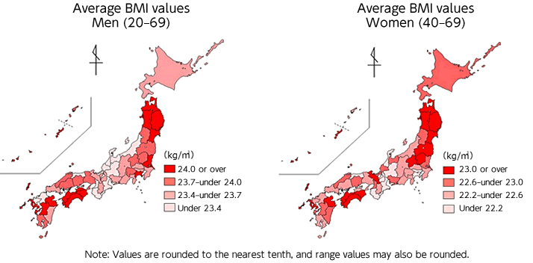
In 2012, waist circumstance ≥85cm 51.8% in men; ≥90cm 18.1% in women. BMI ≥25 and waist circumstance ≥85cm 27.5% in men; BMI ≥25 and waist circumstance ≥90cm 13.1% in women.
Notes:
The mean BMI increased in Japanese men with an increment of 0.44 kg/m² between 1976 and 1995.
Japanese are slim in body size, keeping slowly increases.

Slide 30
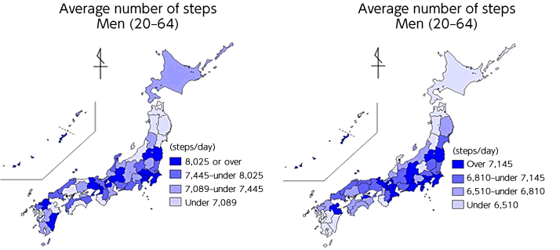
In 2009, the physical activity (>30 min/d, ≥2 times/w, continuous ≥ 1y) was 32.2% in men and 27% in women. In ≥20y, walk steps/d was about 7214 in men and 6352 in women.
Walking >1h/d or sports >5h/w had lower CVD mortality and incidence risk of CVD, CHD, and ischemic stroke, vs. 0.5 h/d or sports 1-2 h/w (Noda H JACC 2005).
Notes:
Noda H JACC 2005, JACC, 40-79y, highest vs. lowest, HR=0.71 for ischemic stroke, 0.84 for CHD, and 0.84 for CVD.

Slide 31
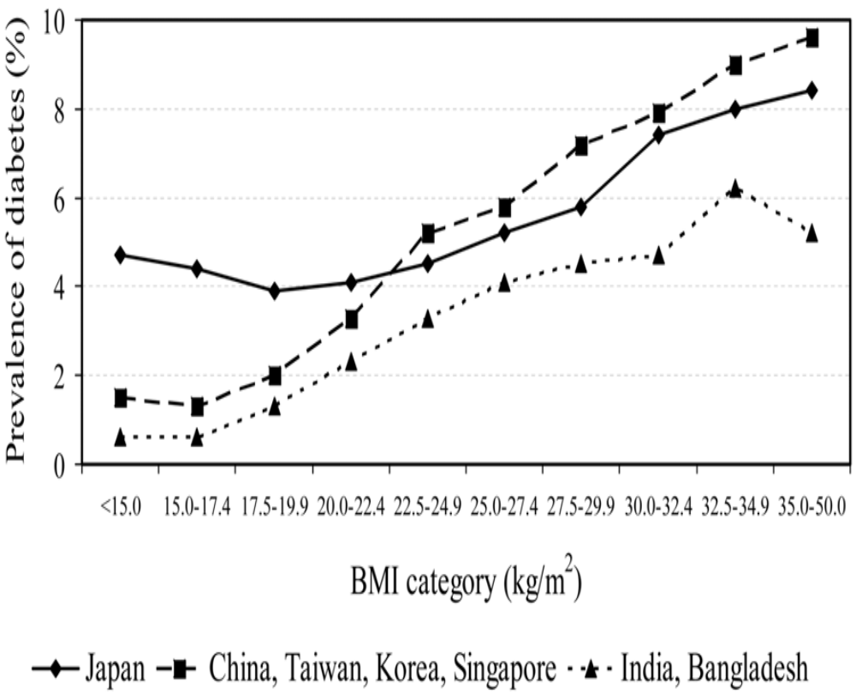
Metabolic factors
Age-adjusted prevalence of diabetes by geographic region (Boffetta P PLoS One 2011.
Notes:
The prevalence of DM according to BMI patterns was different from Asian countries. In Japanese population, the prevalence of DM was also higher in the group with lower BMI <20, which was different from east and southeast Asian.

Slide 32
Comorbidity
Increased dietary fiber, particularly soluble fiber, and vegetables and fruits were associated with lower incident stroke but not CHD inpatients with type 2 diabetes (Tanaka S DC 2013).
Low dietary vitamin D intake had higher risk of mortality among hypertensive persons (Kojima G JACN 2015).
Leisure-time physical activity is a significant predictor of stroke and total mortality in Japanese patients with type 2 diabetes (Sone H Diabetologia 2013).
Exercise and diet interventions have a beneficial impact on all-cause mortality in patients with coronary artery disease (Suzuki T AHJ 2012).
Notes:
A systematic review: greater dietary fiver intake is significantly associated with lower risk of first stroke (Threapleton DE stroke 2013).

Slide 33
Ageing society
Japan has the world's fastest aging society and is characterized by a rapid increase in the prevalence of metabolic disorders, such as obesity and diabetes mellitus, due to the westernization of the lifestyle. These situations might affect the risk of cardiovascular disease in Japanese.
Healthy lifestyle behaviors includes intake of fruits, fish, and milk; exercise; avoidance of smoking; moderate alcohol intake; and moderate sleep duration. Lifestyle modification may be beneficial in the prevention of CVD mortality for persons who are and are not overweight (Eguchi E Prev Med 2014).

Slide 34
Targets of Health Japan 21
/100,000
mmHg
Notes:
Article 7 of the Health Promotion Act. Revised in 2012.
Socioeconomic status (SES) is an independent determinant of salt intake and blood pressure, in order to lower the risk of hypertension, the efforts to narrow the social status gaps should be considered by the health policy-makers (Miyaki K IJERPH 2013).
It will be much helpful for the government to evaluate the achievements of the health policies and make the plan for the next years to the targets.

Slide 35
Targets of Health Japan 21 (cont.)
Specific health check-up implementation to be increased from 41.3% in 2009 to 70%.
Specific health care guidance conduct to be increased from 12.3% in 2009 to 45%.
34.2% current smokers who want to quit will quit smoking.
In 20-40y, the proportion of energy from fat reduce to <25% (the ratio >30% was 20% in men and 28% in women in 2012).
Notes:
Slim, MHLW 2009

Slide 36
Targets of Health Japan 21 (cont.)
The mean of total cholesterol was 195.3 mg/dl of men and 204.1 mg/dl of women in 2012 (NHNS 2013)
Journal of Health and Welfare Statistics 2015/2016
Notes:
The prevalence of high total cholesterol (≥220 mg/dL) increased from 15% to 27% for men and 19% to 35% for women ??.

Slide 37
Targets of Health Japan 21 (cont.)
In 2015, 25% metabolic syndrome and potential metabolic syndrome population to be reduced (14 million in 2008).
20-60y overweight men reduce 15%, 40-60y overweight women reduce 20% and 20y slim women reduce 15%.
Physical activity, >30 min/d, ≥2 times/w, continuous ≥ 1y , will increase to 39% in men and 35% in women (5% increase from2012). Walk steps/d will be 9200 in men and 8300 in women (1000 steps increase).

Slide 38


Slide 39


Slide 40
Summary
The decreasing trends in the incidence of ischemic stroke slower down, and there was no clear change in the incidence of acute myocardial infarction, probably because of the increasing metabolic risk factors. The intensive management of these factors and to reduce the smoking rate and to achieve strict blood pressure control are needed for further prevention of CVD in Japanese (Hata J, Circulation 2013).
Notes:
The incidence and mortality of stroke in both sexes declined as a result of the improvement of hypertension management or the reduction in the smoking rate (and other factors). But, blood pressure control in hypertensive participants is still insufficient, and the smoking rate in men is still much high (Maekay J, WHO 2002).
Lowering cardiometaboic risks through dietary, behavioral, and pharmacological interventions should be a part of the global response to
Are the treatment and prevention margins have been fully achieved for CVD, any more can we try? Questions have be leaving for health system of Japan for taking efforts and actions continually. Thank you for your listening.

Slide 41
Acknowledgements
Professor Hiroyasu Iso, Osaka University
Professor Yukiko Wagatsuma, University of Tsukuba
Professor Hideto Takahashi, Fukushima Medical University
Grant-in-aids, Japanese Society of Promoting Sciences, 23590777/15K08800.

Slide 42
Thank you for your listening!

Slide 43
Cont. 4
Potassium was inversely associated with mortality from IHD and total CVD (Umesawa M, AJCN 2008).
Dietary calcium intake was inversely associated with mortality from (Umesawa M, Stroke 2006) and incidence (Umesawa M, Stroke 2008) of total and subtypes of stoke.
Notes:
Calcium, JPHC, 41526.
JPHC, amount rather than concentrations of sodium in the diet has an adverse effect on stroke risk.

Slide 44
YLL, Years of Life Lost
Estimated by the World Standard Life Expectancy, the Global Burden of Disease study.
Notes:
YLD in 2010, world, CVD: 1990-2010, 271-319/100,000, increased 17.7%; stroke 44-63/100,000, increased 43.65; (Vos T Lancet 2012).
Japan?

