Slide 1
Big Data Analysis and Approximations in Information Systems
En-Bing Lin
Central Michigan University USA
4th International Conference on BigData Analysis and Data Mining September 07-08, 2017 Paris, France
USA
or

Slide 2
Outline
Introduction
USA
or
2 / 1

Slide 3
Outline
Introduction Overview
USA
or
2 / 1

Slide 4
Outline
Introduction Overview
Rough Set Theory
USA
or
2 / 1

Slide 5
Outline
Introduction Overview
Rough Set Theory Big Data Analysis
USA
or
2 / 1

Slide 6
Outline
Introduction Overview
Rough Set Theory Big Data Analysis Concluding Remarks
USA
or
2 / 1

Slide 7
Big Data
106 bytes = 1 megabyte
USA
or
3 / 1

Slide 8
Big Data
106 bytes = 1 megabyte
109 bytes = 1 gigabyte
USA
or
3 / 1

Slide 9
Big Data
106 bytes = 1 megabyte
109 bytes = 1 gigabyte 1012bytes = 1 terabyte
USA
or
3 / 1

Slide 10
Big Data
106 bytes = 1 megabyte
109 bytes = 1 gigabyte 1012bytes = 1 terabyte 1015bytes= 1 petabyte
USA
or
3 / 1

Slide 11
Big Data
106 bytes = 1 megabyte
109 bytes = 1 gigabyte 1012bytes = 1 terabyte 1015bytes= 1 petabyte
A zettabyte is 1,000 000,000,000,000,000,000 bytes 10²¹
USA
or
3 / 1

Slide 12
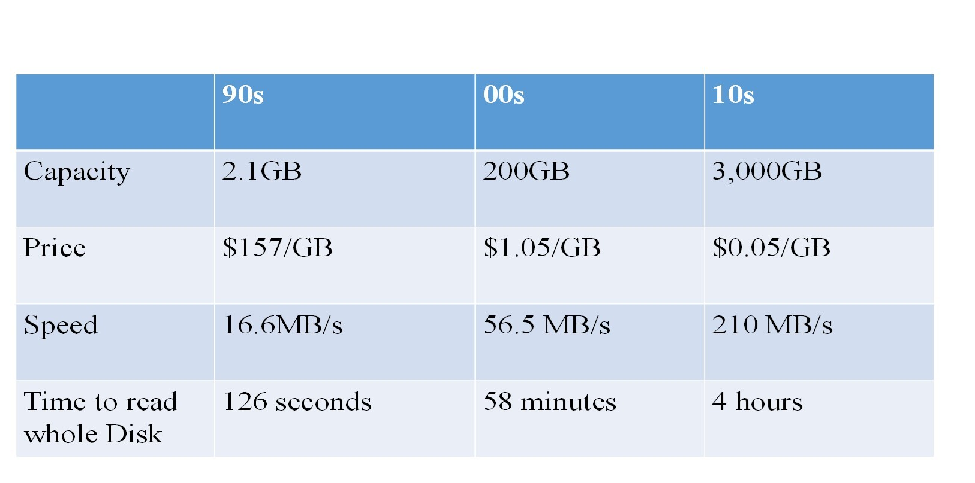
Technology Growth
Figure:Storage capacity has improved so much that collecting data is cheaper than ever
USA
or

Slide 13
The amount of data in our world has been exploding!
$600 to buy a disk drive that can store all of the world’s music
USA
or
5 / 1

Slide 14
The amount of data in our world has been exploding!
$600 to buy a disk drive that can store all of the world’s music 5 billion mobile phones in use in 2016
USA
or
5 / 1

Slide 15
The amount of data in our world has been exploding!
$600 to buy a disk drive that can store all of the world’s music 5 billion mobile phones in use in 2016
30 billion pieces of content shared on Facebook every month
USA
or
5 / 1

Slide 16
The amount of data in our world has been exploding!
$600 to buy a disk drive that can store all of the world’s music 5 billion mobile phones in use in 2016
30 billion pieces of content shared on Facebook every month 40% projected growth in global data generated per year vs. 5% growth in global IT spending
USA
or
5 / 1

Slide 17
The amount of data in our world has been exploding!
$600 to buy a disk drive that can store all of the world’s music 5 billion mobile phones in use in 2016
30 billion pieces of content shared on Facebook every month 40% projected growth in global data generated per year vs. 5% growth in global IT spending
235 terabytes data collected by the US Library of Congress by 2011 (74 terabytes online)
USA
or
5 / 1

Slide 18
The amount of data in our world has been exploding!
$600 to buy a disk drive that can store all of the world’s music 5 billion mobile phones in use in 2016
30 billion pieces of content shared on Facebook every month 40% projected growth in global data generated per year vs. 5% growth in global IT spending
235 terabytes data collected by the US Library of Congress by 2011 (74 terabytes online)
$600 billion potential annual consumer surplus from using personal location data globally
USA
or
5 / 1

Slide 19
The amount of data in our world has been exploding!
$600 to buy a disk drive that can store all of the world’s music 5 billion mobile phones in use in 2016
30 billion pieces of content shared on Facebook every month 40% projected growth in global data generated per year vs. 5% growth in global IT spending
235 terabytes data collected by the US Library of Congress by 2011 (74 terabytes online)
$600 billion potential annual consumer surplus from using personal location data globally
140,000–190,000 more deep analytical talent positions, and
1.5 million more data-savvy managers needed to take full advantage of big data in the United States
USA
or
5 / 1

Slide 20
The amount of data in our world has been exploding!
$600 to buy a disk drive that can store all of the world’s music 5 billion mobile phones in use in 2016
30 billion pieces of content shared on Facebook every month 40% projected growth in global data generated per year vs. 5% growth in global IT spending
235 terabytes data collected by the US Library of Congress by 2011 (74 terabytes online)
$600 billion potential annual consumer surplus from using personal location data globally
140,000–190,000 more deep analytical talent positions, and
1.5 million more data-savvy managers needed to take full advantage of big data in the United States
Leaders in every sector will have to grapple with the implications of big data, not just a few data-oriented managers
USA
or
5 / 1

Slide 21
The amount of data in our world has been exploding!
$600 to buy a disk drive that can store all of the world’s music 5 billion mobile phones in use in 2016
30 billion pieces of content shared on Facebook every month 40% projected growth in global data generated per year vs. 5% growth in global IT spending
235 terabytes data collected by the US Library of Congress by 2011 (74 terabytes online)
$600 billion potential annual consumer surplus from using personal location data globally
140,000–190,000 more deep analytical talent positions, and
1.5 million more data-savvy managers needed to take full advantage of big data in the United States
Leaders in every sector will have to grapple with the implications of big data, not just a few data-oriented managers
The increasing volume and detail of information captured by enterprises, the rise of multimedia, social media, and the Internet of Things will fuel exponential growth in data for the foreseeable
future.
USA
or
5 / 1

Slide 22
Big Data Trends
Big data becomes fast and approachable
USA
or
6 / 1

Slide 23
Big Data Trends
Big data becomes fast and approachable Big data no longer just Hadoop
USA
or
6 / 1

Slide 24
Big Data Trends
Big data becomes fast and approachable Big data no longer just Hadoop
Organizations leverage data lakes from the get-go to drive value
USA
or
6 / 1

Slide 25
Big Data Trends
Big data becomes fast and approachable Big data no longer just Hadoop
Organizations leverage data lakes from the get-go to drive value Architectures mature to reject one-size-fits all frameworks
USA
or
6 / 1

Slide 26
Big Data Trends
Big data becomes fast and approachable Big data no longer just Hadoop
Organizations leverage data lakes from the get-go to drive value Architectures mature to reject one-size-fits all frameworks Variety, not volume or velocity, drives big-data investments
USA
or
6 / 1

Slide 27
Big Data Trends
Big data becomes fast and approachable Big data no longer just Hadoop
Organizations leverage data lakes from the get-go to drive value Architectures mature to reject one-size-fits all frameworks Variety, not volume or velocity, drives big-data investments Spark and machine learning light up big data
USA
or
6 / 1

Slide 28
Big Data Trends
Big data becomes fast and approachable Big data no longer just Hadoop
Organizations leverage data lakes from the get-go to drive value Architectures mature to reject one-size-fits all frameworks Variety, not volume or velocity, drives big-data investments Spark and machine learning light up big data
The convergence of IoT, cloud, and big data create new opportunities for self-service analytics
USA
or
6 / 1

Slide 29
Big Data Trends
Big data becomes fast and approachable Big data no longer just Hadoop
Organizations leverage data lakes from the get-go to drive value Architectures mature to reject one-size-fits all frameworks Variety, not volume or velocity, drives big-data investments Spark and machine learning light up big data
The convergence of IoT, cloud, and big data create new opportunities for self-service analytics
Self-service data prep becomes mainstream as end users begin to shape big data
USA
or
6 / 1

Slide 30
Big Data Trends
Big data becomes fast and approachable Big data no longer just Hadoop
Organizations leverage data lakes from the get-go to drive value Architectures mature to reject one-size-fits all frameworks Variety, not volume or velocity, drives big-data investments Spark and machine learning light up big data
The convergence of IoT, cloud, and big data create new opportunities for self-service analytics
Self-service data prep becomes mainstream as end users begin to shape big data
Rise of metadata catalogs helps people find analysis-worthy big data
USA
or
6 / 1

Slide 31
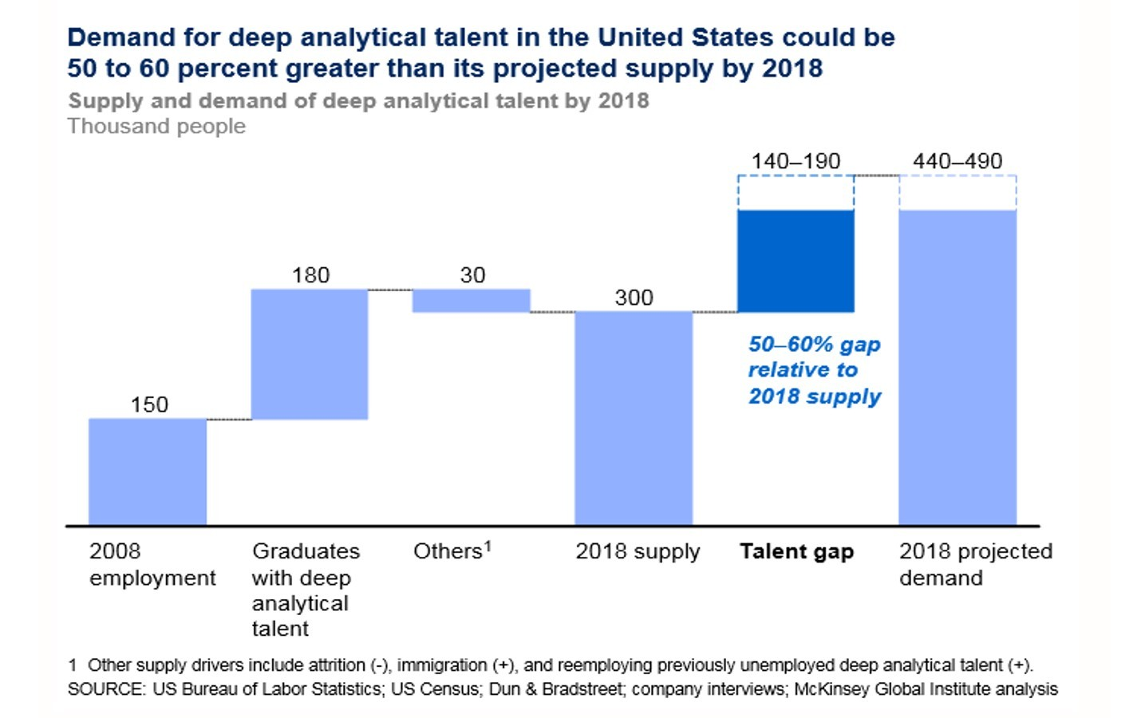
Demand of talent
Figure:Supply and demand of deep analytic talent
USA
or

Slide 32
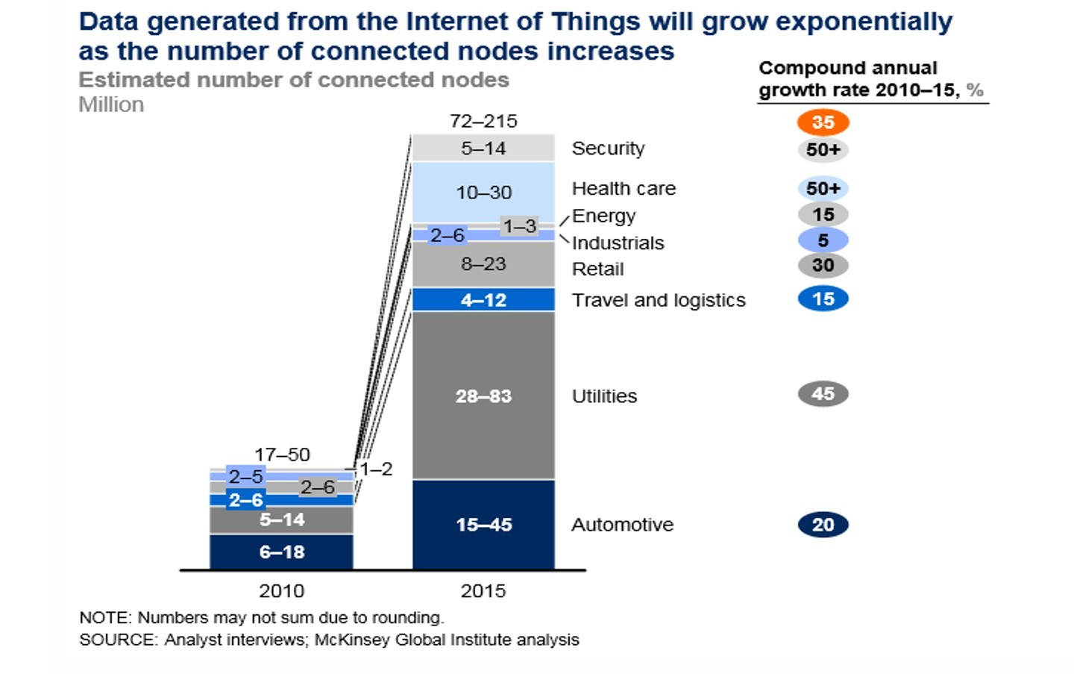
Intenet of Things
Figure:IOT
USA
or

Slide 33
new types of observations and measurements
Data is now available faster, has greater coverage and scope, and includes new types of observations and measurements that previously were not available.
USA
or
9 / 1

Slide 34
new types of observations and measurements
Data is now available faster, has greater coverage and scope, and includes new types of observations and measurements that previously were not available.
Growing technological ability to capture, aggregate, and process an ever-greater volume, velocity, variety, value and veracity of data.
USA
or
9 / 1

Slide 35
new types of observations and measurements
Data is now available faster, has greater coverage and scope, and includes new types of observations and measurements that previously were not available.
Growing technological ability to capture, aggregate, and process an ever-greater volume, velocity, variety, value and veracity of data.
Large, diverse, complex, longitudinal, and/or distributed datasets generated from instruments, sensors, Internet transactions, email, video, click streams, and/or all other digital sources available today and in the future.
USA
or
9 / 1

Slide 36
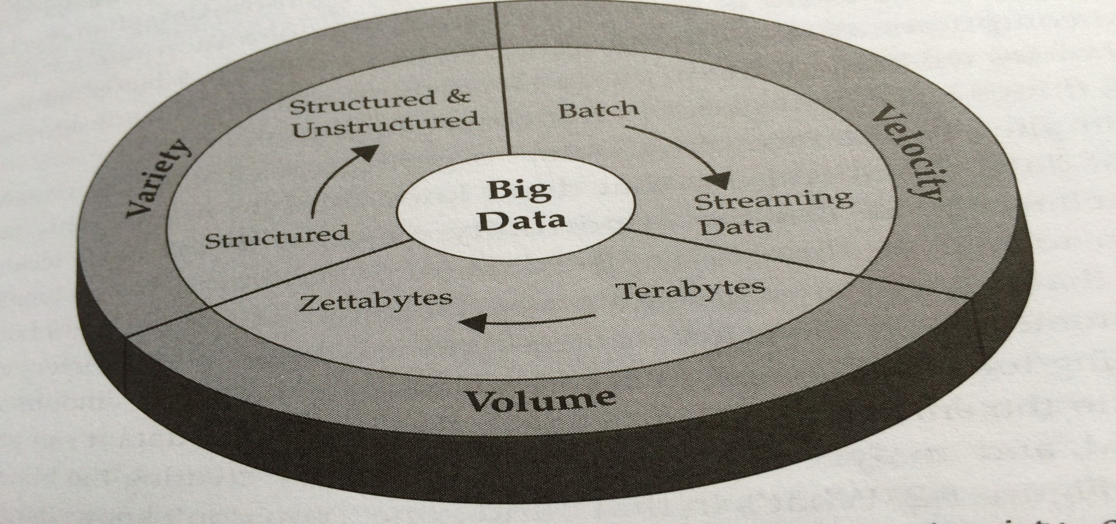
Value, Veracity, Viability, Visualization, Vulnerability
Figure:8V
USA
or
10 / 1

Slide 37
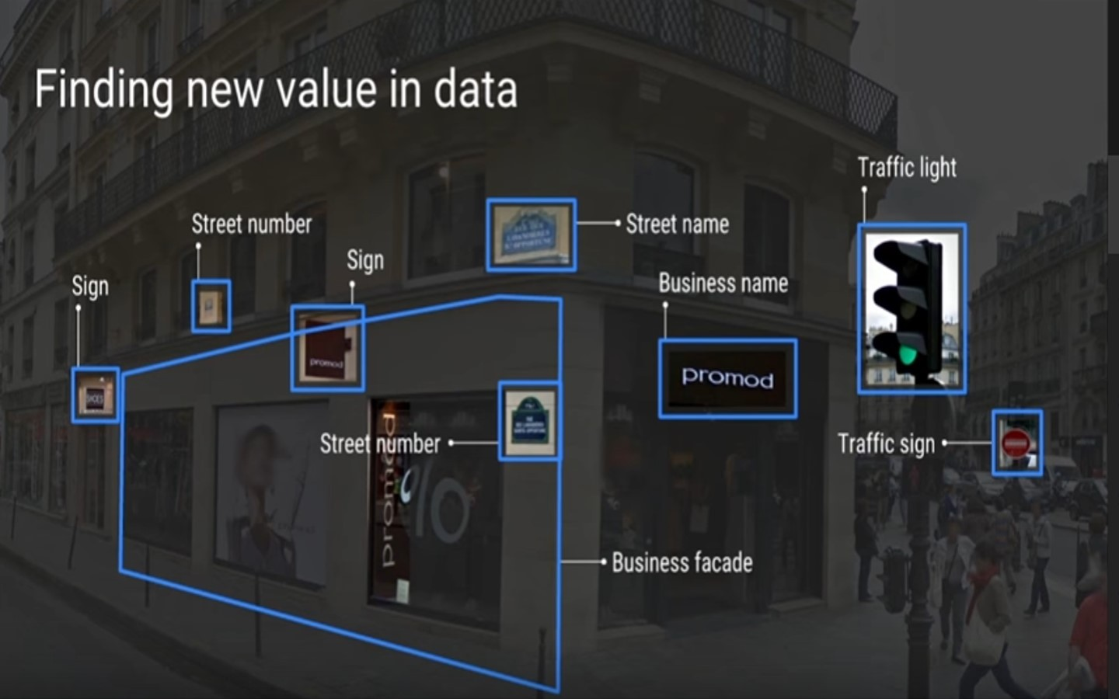
Finding new value in Data
Figure:knowledge discovery
USA
or

Slide 38
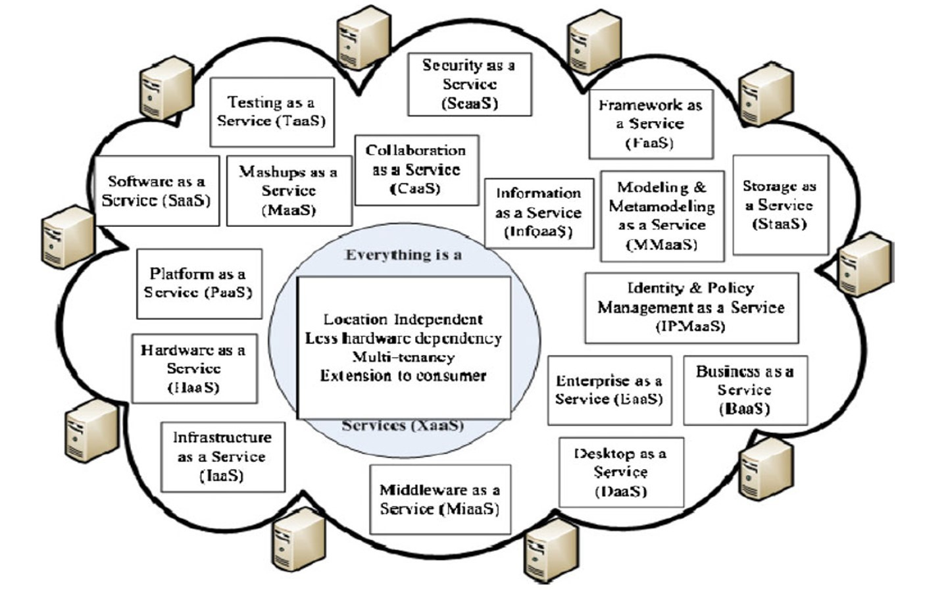
Service
Figure:As a Service
USA
or

Slide 39
Characteristics, models
A model of service delivery- scalable and virtualized resources are provided as a service over the internet
USA
or
13 / 1

Slide 40
Characteristics, models
A model of service delivery- scalable and virtualized resources are provided as a service over the internet
Five characteristics- rapid elasticity
measured service
USA
or
13 / 1

Slide 41
Characteristics, models
A model of service delivery- scalable and virtualized resources are provided as a service over the internet
Five characteristics- rapid elasticity
measured service
on-demand self-service
USA
or
13 / 1

Slide 42
Characteristics, models
A model of service delivery- scalable and virtualized resources are provided as a service over the internet
Five characteristics- rapid elasticity
measured service
on-demand self-service ubiquitous network access
USA
or
13 / 1

Slide 43
Characteristics, models
A model of service delivery- scalable and virtualized resources are provided as a service over the internet
Five characteristics- rapid elasticity
measured service
on-demand self-service ubiquitous network access
location-independent resource pooling
USA
or
13 / 1

Slide 44
Characteristics, models
A model of service delivery- scalable and virtualized resources are provided as a service over the internet
Five characteristics- rapid elasticity
measured service
on-demand self-service ubiquitous network access
location-independent resource pooling
Four development models-
public cloud
USA
or
13 / 1

Slide 45
Characteristics, models
A model of service delivery- scalable and virtualized resources are provided as a service over the internet
Five characteristics- rapid elasticity
measured service
on-demand self-service ubiquitous network access
location-independent resource pooling
Four development models-
public cloud private cloud
USA
or
13 / 1

Slide 46
Characteristics, models
A model of service delivery- scalable and virtualized resources are provided as a service over the internet
Five characteristics- rapid elasticity
measured service
on-demand self-service ubiquitous network access
location-independent resource pooling
Four development models-
public cloud private cloud community cloud
USA
or
13 / 1

Slide 47
Characteristics, models
A model of service delivery- scalable and virtualized resources are provided as a service over the internet
Five characteristics- rapid elasticity
measured service
on-demand self-service ubiquitous network access
location-independent resource pooling
Four development models-
public cloud private cloud community cloud hybrid cloud
USA
or
13 / 1

Slide 48
Hadoop
Hadoop is an open source framework for writing and running distributed applications that process large amounts of data.
USA
or
14 / 1

Slide 49
Hadoop
Hadoop is an open source framework for writing and running distributed applications that process large amounts of data.
Accessible
USA
or
14 / 1

Slide 50
Hadoop
Hadoop is an open source framework for writing and running distributed applications that process large amounts of data.
Accessible Robust
USA
or
14 / 1

Slide 51
Hadoop
Hadoop is an open source framework for writing and running distributed applications that process large amounts of data.
Accessible Robust Scalable
USA
or
14 / 1

Slide 52
Hadoop
Hadoop is an open source framework for writing and running distributed applications that process large amounts of data.
Accessible Robust Scalable Simple
USA
or
14 / 1

Slide 53
Hadoop
Hadoop is an open source framework for writing and running distributed applications that process large amounts of data.
Accessible Robust Scalable Simple
HDFS
Hadoop Distributed File System
MapReduce
USA
or
14 / 1

Slide 54
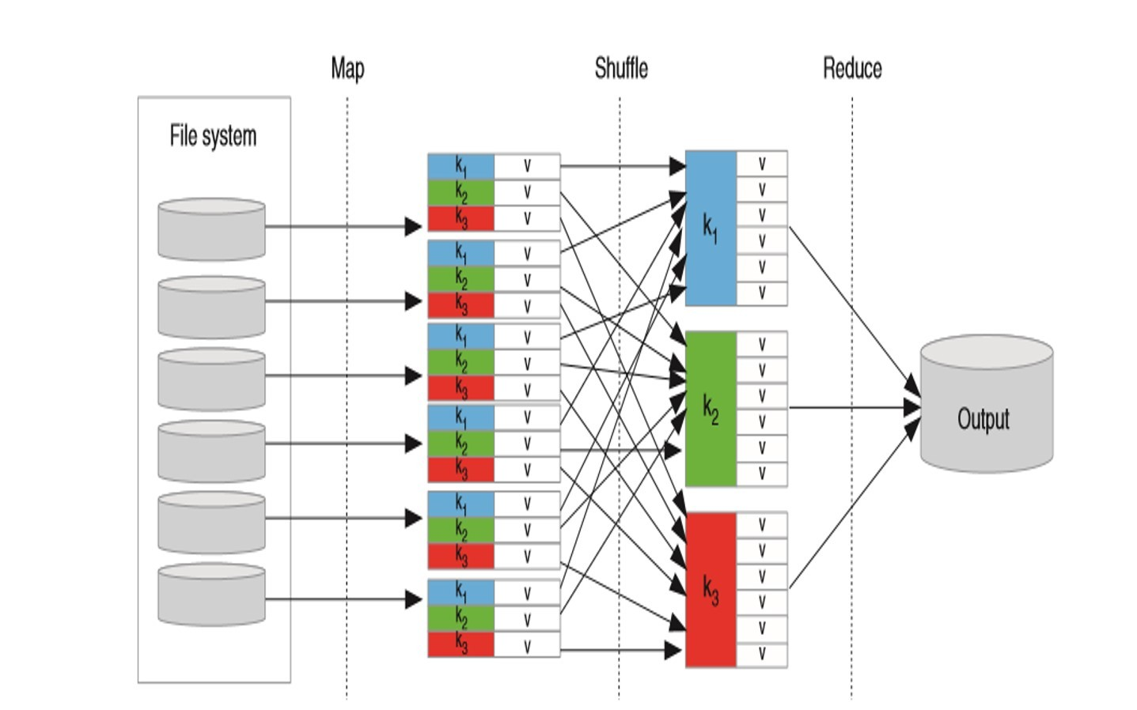
The flow of data in a simple MapReduce job
Figure:Map Reduce
USA
or

Slide 55
Need a New Programming Model?
MapReduce greatly simplified big data analysis But as soon as it got popular, users wanted more:
USA
or
16 / 1

Slide 56
Need a New Programming Model?
MapReduce greatly simplified big data analysis But as soon as it got popular, users wanted more:
More complex, multi-stage applications (e.g. iterative graph algorithms and machine learning)
USA
or
16 / 1

Slide 57
Need a New Programming Model?
MapReduce greatly simplified big data analysis But as soon as it got popular, users wanted more:
More complex, multi-stage applications (e.g. iterative graph algorithms and machine learning)
More interactive ad-hoc queries
USA
or
16 / 1

Slide 58
Need a New Programming Model?
MapReduce greatly simplified big data analysis But as soon as it got popular, users wanted more:
More complex, multi-stage applications (e.g. iterative graph algorithms and machine learning)
More interactive ad-hoc queries
Both multi-stage and interactive apps require faster data sharing across parallel jobs
USA
or
16 / 1

Slide 59
Spark
Not a modified version of Hadoop
USA
or
17 / 1

Slide 60
Spark
Not a modified version of Hadoop Separate, fast, MapReduce-like engine
USA
or
17 / 1

Slide 61
Spark
Not a modified version of Hadoop Separate, fast, MapReduce-like engine
In-memory data storage for very fast iterative queries
USA
or
17 / 1

Slide 62
Spark
Not a modified version of Hadoop Separate, fast, MapReduce-like engine
In-memory data storage for very fast iterative queries General execution graphs and powerful optimizations
USA
or
17 / 1

Slide 63
Spark
Not a modified version of Hadoop Separate, fast, MapReduce-like engine
In-memory data storage for very fast iterative queries General execution graphs and powerful optimizations Up to 40x faster than Hadoop
USA
or
17 / 1

Slide 64
Spark
Not a modified version of Hadoop Separate, fast, MapReduce-like engine
In-memory data storage for very fast iterative queries General execution graphs and powerful optimizations Up to 40x faster than Hadoop
Compatible with Hadoop’s storage APIs
Can read/write to any Hadoop-supported system, including HDFS, HBase, SequenceFiles, etc.
USA
or
17 / 1

Slide 65
Rough Set Theory (RST)
Rough Sets theory was introduced by Z. Pawlak (1982) as a mathematical tool for data analysis. Rough sets have many applications in the field of Knowledge Discovery: discretization process, data imputations and create decision Rules.
Often, information on the surrounding world is
USA
or
18 / 1

Slide 66
Rough Set Theory (RST)
Rough Sets theory was introduced by Z. Pawlak (1982) as a mathematical tool for data analysis. Rough sets have many applications in the field of Knowledge Discovery: discretization process, data imputations and create decision Rules.
Often, information on the surrounding world is
Imprecise
USA
or
18 / 1

Slide 67
Rough Set Theory (RST)
Rough Sets theory was introduced by Z. Pawlak (1982) as a mathematical tool for data analysis. Rough sets have many applications in the field of Knowledge Discovery: discretization process, data imputations and create decision Rules.
Often, information on the surrounding world is
Imprecise Incomplete
USA
or
18 / 1

Slide 68
Rough Set Theory (RST)
Rough Sets theory was introduced by Z. Pawlak (1982) as a mathematical tool for data analysis. Rough sets have many applications in the field of Knowledge Discovery: discretization process, data imputations and create decision Rules.
Often, information on the surrounding world is
Imprecise Incomplete uncertain
USA
or
18 / 1

Slide 69
Rough Set Theory (RST)
Rough Sets theory was introduced by Z. Pawlak (1982) as a mathematical tool for data analysis. Rough sets have many applications in the field of Knowledge Discovery: discretization process, data imputations and create decision Rules.
Often, information on the surrounding world is
Imprecise Incomplete uncertain
We should be able to process uncertain and/or incomplete information.
USA
or
18 / 1

Slide 70
Rough Set Theory (RST)
Rough Sets theory was introduced by Z. Pawlak (1982) as a mathematical tool for data analysis. Rough sets have many applications in the field of Knowledge Discovery: discretization process, data imputations and create decision Rules.
Often, information on the surrounding world is
Imprecise Incomplete uncertain
We should be able to process uncertain and/or incomplete information.
feature selection, decision making, rule mining, data prediction, , environment, banking, medicine, bioinformatics, pattern recognition, data mining, machine learning and others.
USA
or
18 / 1

Slide 71
Tasks
Find a minimal subset of the attribute set that may be used to identify all the concepts.
USA
or
19 / 1

Slide 72
Tasks
Find a minimal subset of the attribute set that may be used to identify all the concepts.
Compute a family of sets of attribute-value pairs to identify all concepts.
USA
or
19 / 1

Slide 73
Tasks
Find a minimal subset of the attribute set that may be used to identify all the concepts.
Compute a family of sets of attribute-value pairs to identify all concepts.
Lower approximations, local and global, are the maximal sets that are locally and globally definable, respectively, and contained in the approximated set X.
USA
or
19 / 1

Slide 74
Tasks
Find a minimal subset of the attribute set that may be used to identify all the concepts.
Compute a family of sets of attribute-value pairs to identify all concepts.
Lower approximations, local and global, are the maximal sets that are locally and globally definable, respectively, and contained in the approximated set X.
Similarly, upper approximations, local and global, are the minimal sets that are locally and globally definable, respectively, containing the approximated set X.
USA
or
19 / 1

Slide 75
Tasks
Find a minimal subset of the attribute set that may be used to identify all the concepts.
Compute a family of sets of attribute-value pairs to identify all concepts.
Lower approximations, local and global, are the maximal sets that are locally and globally definable, respectively, and contained in the approximated set X.
Similarly, upper approximations, local and global, are the minimal sets that are locally and globally definable, respectively, containing the approximated set X.
RST —– Variable Precision Generalized Rough Set model (VPGRS)
USA
or
19 / 1

Slide 76
Tasks
Find a minimal subset of the attribute set that may be used to identify all the concepts.
Compute a family of sets of attribute-value pairs to identify all concepts.
Lower approximations, local and global, are the maximal sets that are locally and globally definable, respectively, and contained in the approximated set X.
Similarly, upper approximations, local and global, are the minimal sets that are locally and globally definable, respectively, containing the approximated set X.
RST —– Variable Precision Generalized Rough Set model (VPGRS)
Fuzzy Rough Set Approximation (FRSA)
USA
or
19 / 1

Slide 77
Tasks
Find a minimal subset of the attribute set that may be used to identify all the concepts.
Compute a family of sets of attribute-value pairs to identify all concepts.
Lower approximations, local and global, are the maximal sets that are locally and globally definable, respectively, and contained in the approximated set X.
Similarly, upper approximations, local and global, are the minimal sets that are locally and globally definable, respectively, containing the approximated set X.
RST —– Variable Precision Generalized Rough Set model (VPGRS)
Fuzzy Rough Set Approximation (FRSA) FRSA and VPGRS
USA
or
19 / 1

Slide 78
Basic concepts
Information system
USA
or
20 / 1

Slide 79
Basic concepts
Information system IS=(U,A)
USA
or
20 / 1

Slide 80
Basic concepts
Information system IS=(U,A)
U is the universe ( a finite set of objects)
USA
or
20 / 1

Slide 81
Basic concepts
Information system IS=(U,A)
U is the universe ( a finite set of objects) U=x₁, x₂, . . . .., x_{m}
USA
or
20 / 1

Slide 82
Basic concepts
Information system IS=(U,A)
U is the universe ( a finite set of objects) U=x₁, x₂, . . . .., x_{m}
A is the set of attributes (features, variables)
USA
or
20 / 1

Slide 83
Basic concepts
Information system IS=(U,A)
U is the universe ( a finite set of objects) U=x₁, x₂, . . . .., x_{m}
A is the set of attributes (features, variables)
V_{a} is the set of values a, called the value set of attribute a.
USA
or
20 / 1

Slide 84
Basic concepts
Information system IS=(U,A)
U is the universe ( a finite set of objects) U=x₁, x₂, . . . .., x_{m}
A is the set of attributes (features, variables)
V_{a} is the set of values a, called the value set of attribute a. a: U −→ V_{a}
USA
or
20 / 1

Slide 85
Equivalence Relation
Let X be a set and let x, y, and z be elements of X.
USA
or
21 / 1

Slide 86
Equivalence Relation
Let X be a set and let x, y, and z be elements of X.
An equivalence relation R on X is a Relation on X such that:
USA
or
21 / 1

Slide 87
Equivalence Relation
Let X be a set and let x, y, and z be elements of X.
An equivalence relation R on X is a Relation on X such that: Reflexive Property: xRx for all x in X.
USA
or
21 / 1

Slide 88
Equivalence Relation
Let X be a set and let x, y, and z be elements of X.
An equivalence relation R on X is a Relation on X such that: Reflexive Property: xRx for all x in X.
Symmetric Property: if xRy, then yRx.
USA
or
21 / 1

Slide 89
Equivalence Relation
Let X be a set and let x, y, and z be elements of X.
An equivalence relation R on X is a Relation on X such that: Reflexive Property: xRx for all x in X.
Symmetric Property: if xRy, then yRx. Transitive Property: if xRy and yRz, then xRz.
USA
or
21 / 1

Slide 90
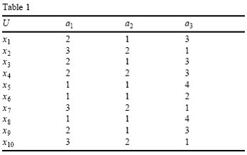
There are some identical objects in the following data set. For instance, objects x₁ and x₃ cannot be distinguished.
Figure:
USA 4th Inter_{Objects}national Conf_{in}erence_{a univ}on BigData_{erse}
or

Slide 91
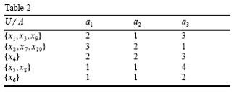
Equivalence classes
Figure:Each class is an elementary set of the universe U associated with A, U/A
USA
or

Slide 92
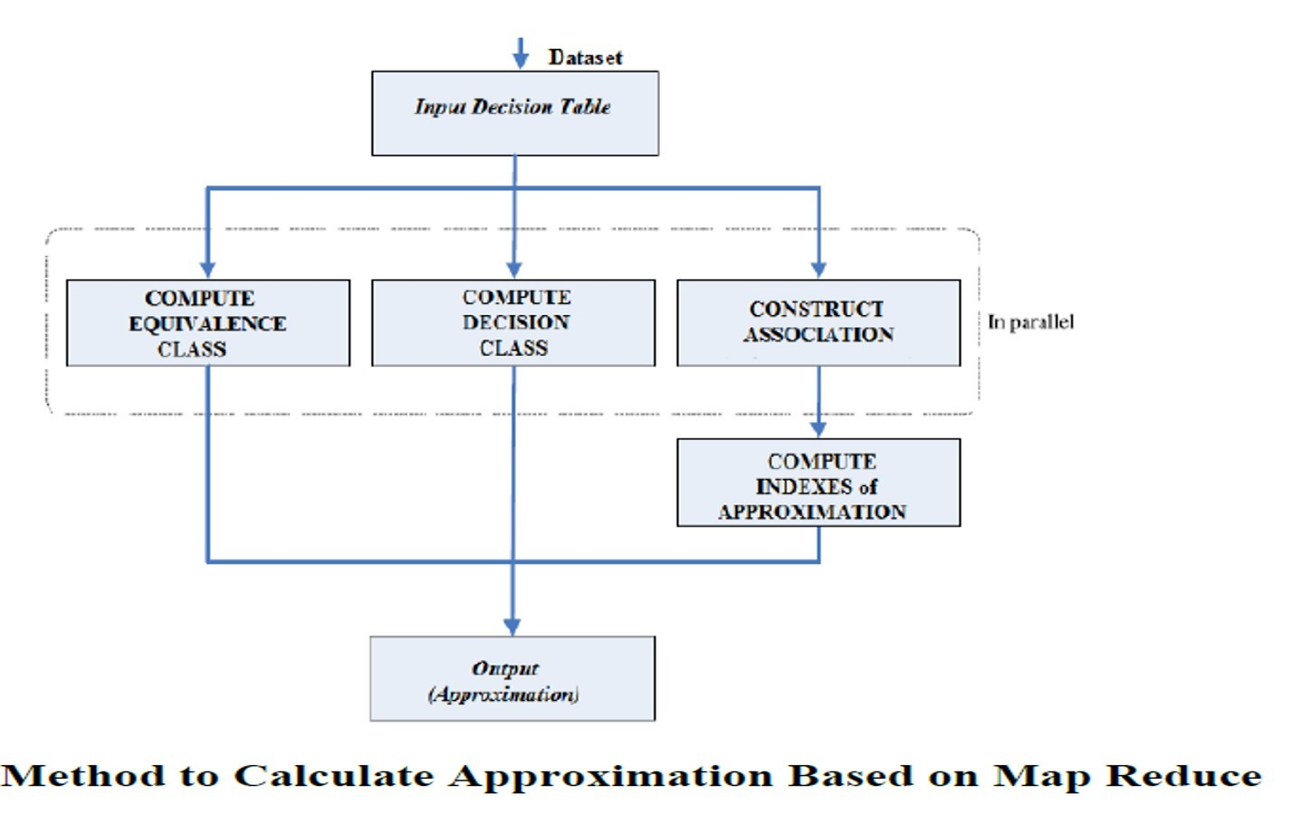
Speed up – number of nodes; Scale up – distributed file system; Size up – larger system
Figure:Calculate approximation
USA
or

Slide 93
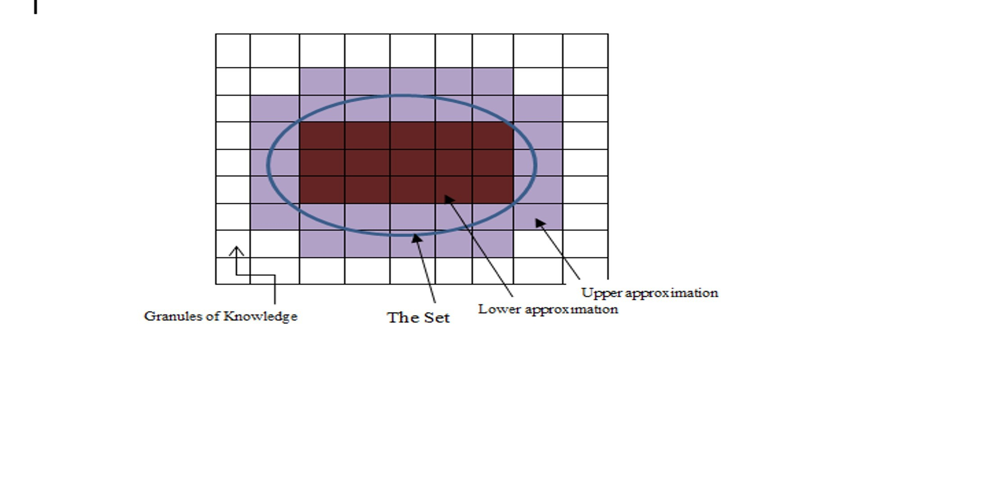
Approximation
Figure:lower and upper approximations
USA
or

Slide 94
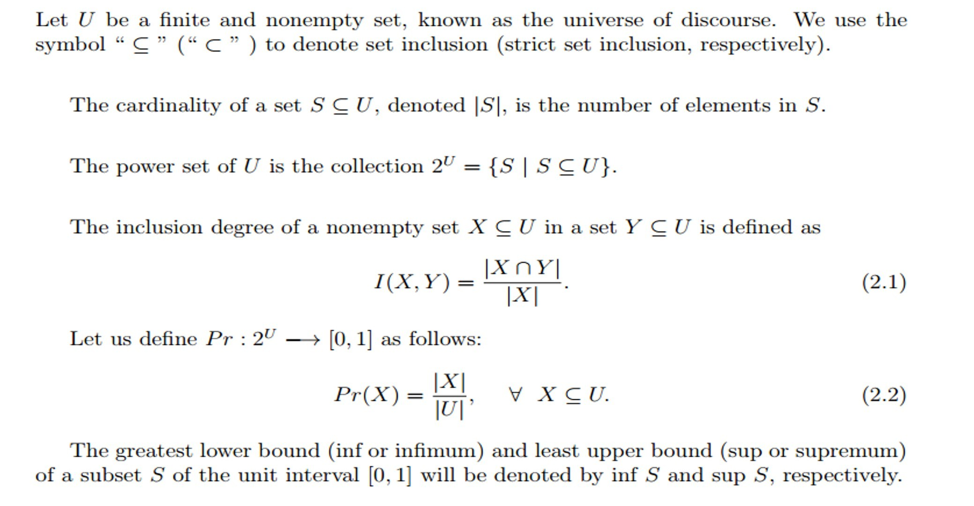
Inclusion degree
Figure:X and Y
USA
or

Slide 95

Inclusion degree
USA
or
27 / 1

Slide 96
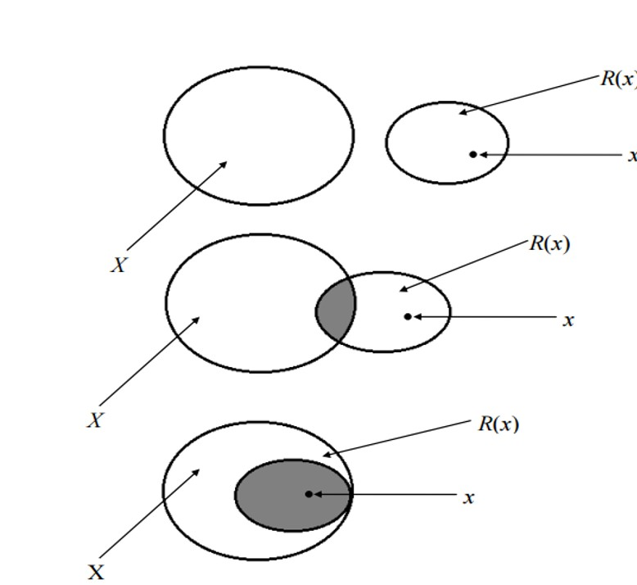
Inclusion degree
USA
or
27 / 1

Slide 97
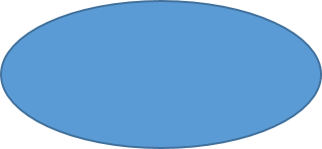
Inclusion degree
USA
or
27 / 1

Slide 98
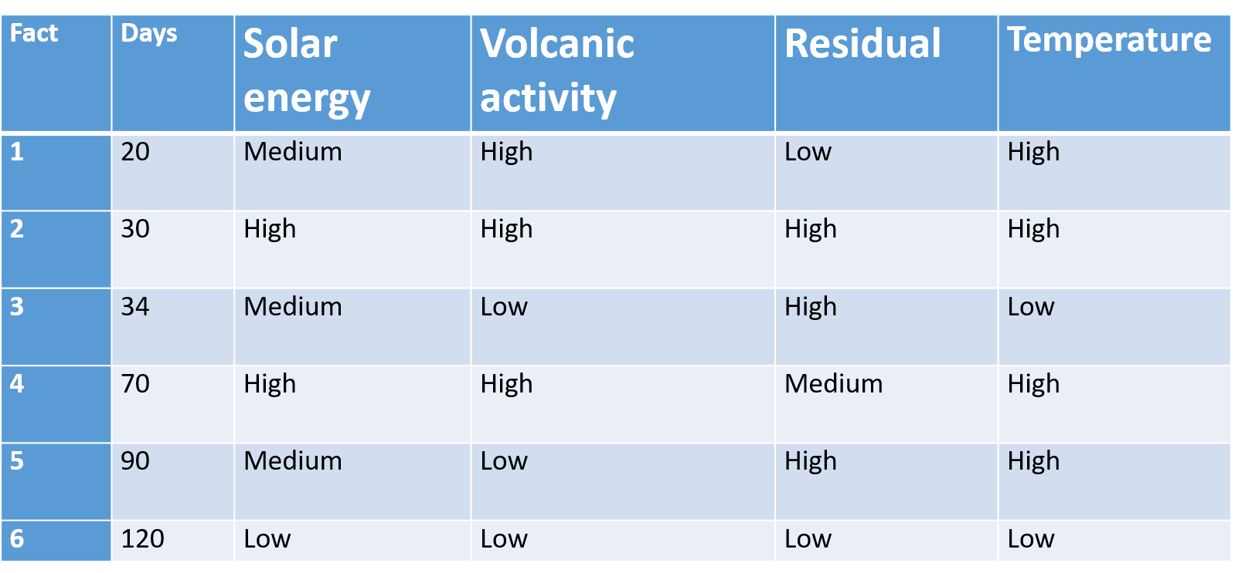
Decision Table
USA
or

Slide 99
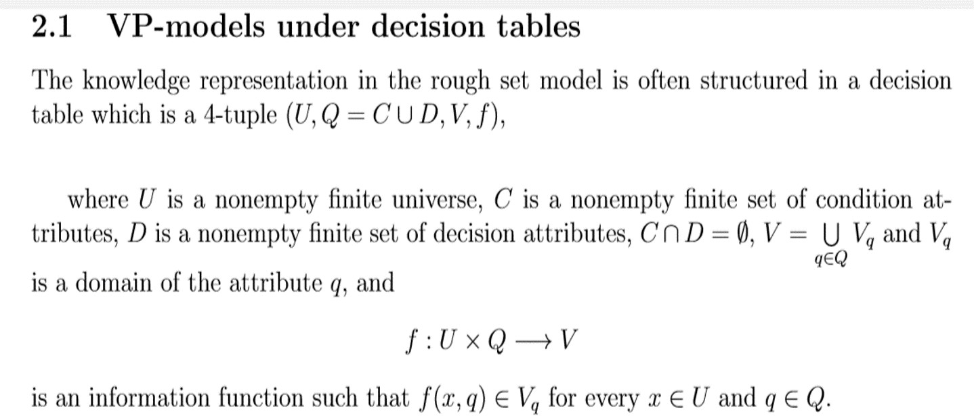
Inclusion degree
USA
or
29 / 1

Slide 100
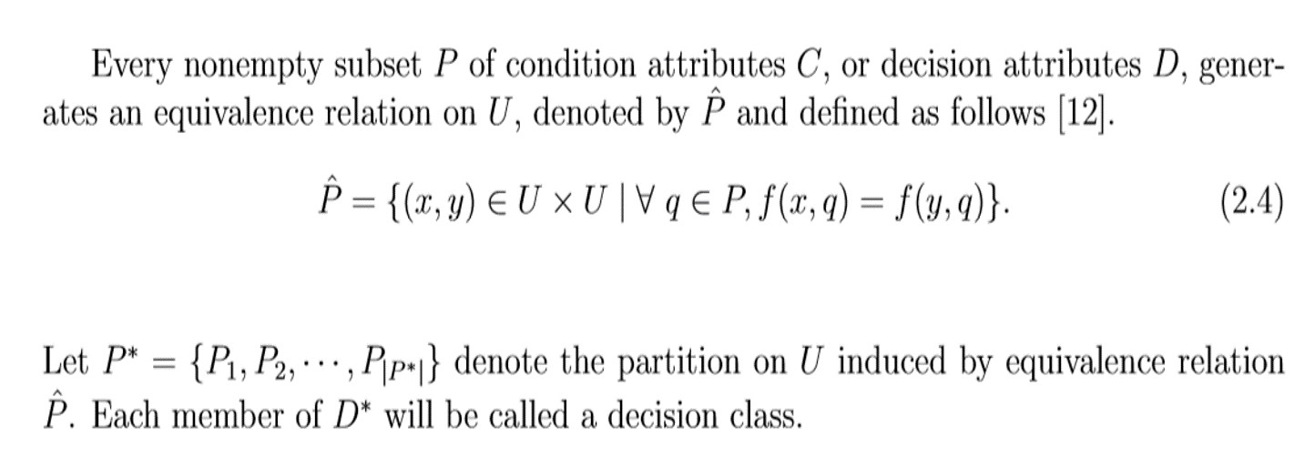
Inclusion degree
USA
or
29 / 1

Slide 101
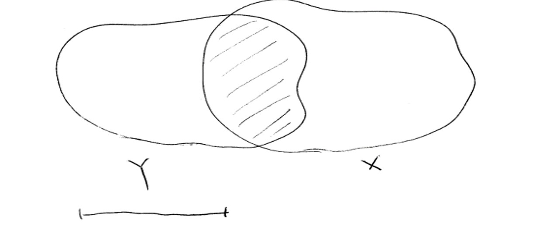
Inclusion degree
USA
or
30 / 1

Slide 102
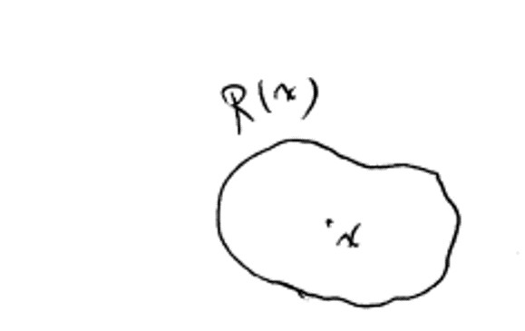
Inclusion degree
USA
or
30 / 1

Slide 103
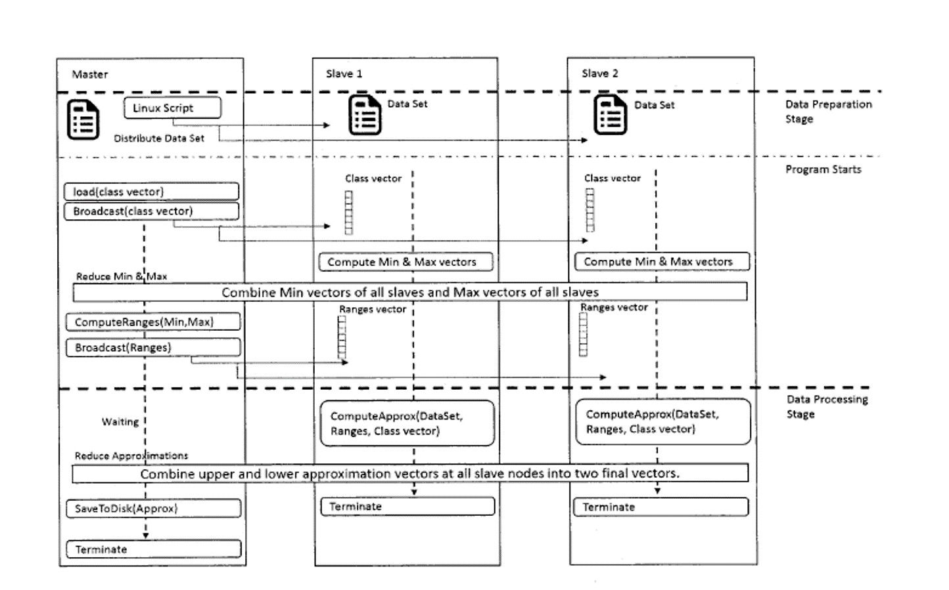
Process
USA
or

Slide 104
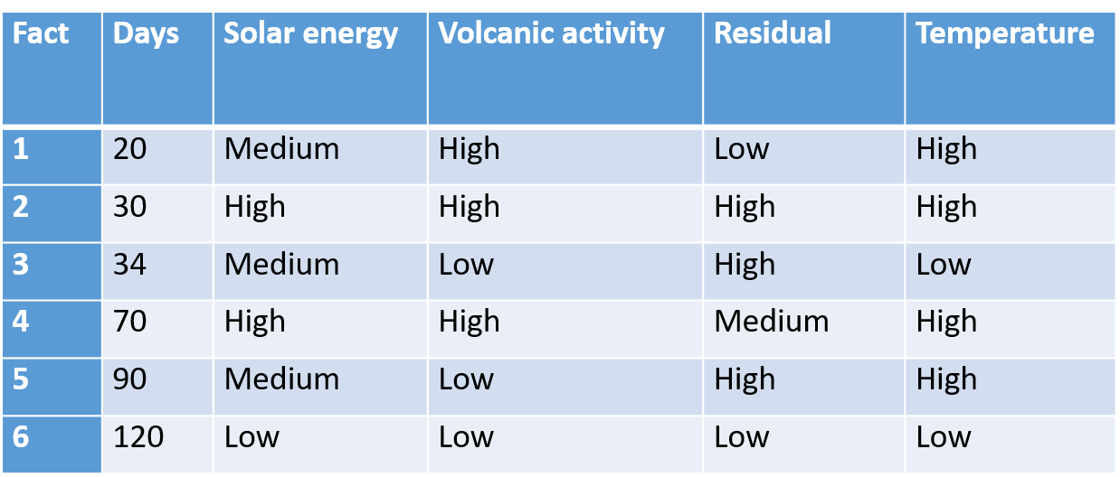
Example
Low solar energy certainly causes low temperature;
USA
or
32 / 1

Slide 105
Example
Low solar energy certainly causes low temperature;
Medium solar energy and high volcanic activity or high solar energy certainly causes high temperature.
USA
or
32 / 1

Slide 106

Map Reduce
USA
or

Slide 107
Concluding Remarks
VPGRST
USA
or
34 / 1

Slide 108
Concluding Remarks
VPGRST
VPGRST and its -reduct
USA
or
34 / 1

Slide 109
Concluding Remarks
VPGRST
VPGRST and its -reduct FRST
USA
or
34 / 1

Slide 110
Concluding Remarks
VPGRST
VPGRST and its -reduct FRST
FRST and VPGRST
USA
or
34 / 1

Slide 111
Concluding Remarks
VPGRST
VPGRST and its -reduct FRST
FRST and VPGRST PrAS
USA
or
34 / 1

Slide 112
Concluding Remarks
VPGRST
VPGRST and its -reduct FRST
FRST and VPGRST PrAS
Bayesian RST
USA
or
34 / 1

Slide 113
Concluding Remarks
VPGRST
VPGRST and its -reduct FRST
FRST and VPGRST PrAS
Bayesian RST
VPGRS-incomplete decision tables
USA
or
34 / 1

Slide 114
Conclusions
By using customer journey analytics, you can get a much more solid idea of what’s going on across your various channels and try to bridge gaps between them to improve the overall customer experience.
USA
or
35 / 1

Slide 115
Conclusions
By using customer journey analytics, you can get a much more solid idea of what’s going on across your various channels and try to bridge gaps between them to improve the overall customer experience.
We’re witnessing the begining of a massive, culturally saturated feedback loop where our behavior changes the product and the product changes our behavior.
USA
or
35 / 1

Slide 116
Conclusions
By using customer journey analytics, you can get a much more solid idea of what’s going on across your various channels and try to bridge gaps between them to improve the overall customer experience.
We’re witnessing the begining of a massive, culturally saturated feedback loop where our behavior changes the product and the product changes our behavior.
There’s the supply chain aspect of manufacturing and shipping products. Analytics can be used to monitor fuel efficiency, calculate optimal optimization for delivery fleets, and improve inventory management.
USA
or
35 / 1

Slide 117
Conclusions
By using customer journey analytics, you can get a much more solid idea of what’s going on across your various channels and try to bridge gaps between them to improve the overall customer experience.
We’re witnessing the begining of a massive, culturally saturated feedback loop where our behavior changes the product and the product changes our behavior.
There’s the supply chain aspect of manufacturing and shipping products. Analytics can be used to monitor fuel efficiency, calculate optimal optimization for delivery fleets, and improve inventory management.
With data analytics, researchers have the ability to look at more patient characteristics in a shorter amount of time, develop profiles for them, and then use those profiles to find potential trial candidates.
USA
or
35 / 1

Slide 118
Conclusions
A strong vulnerability management approach should include continuous monitoring and integration with patch and configuration management.
USA
or
36 / 1

Slide 119
Conclusions
A strong vulnerability management approach should include continuous monitoring and integration with patch and configuration management.
"informed improvement”, "continuous consideration" , predict student outcomes, should ensure that students have "open futures" .
USA
or
36 / 1

Slide 120
Conclusions
A strong vulnerability management approach should include continuous monitoring and integration with patch and configuration management.
"informed improvement”, "continuous consideration" , predict student outcomes, should ensure that students have "open futures" .
Big data transform our lives – optimizing, improving, making more efficient, and capturing benefits.
USA
or
36 / 1

Slide 121
USA
or
37 / 1

