Slide 1
Personalized Approach in Acute and Chronic Leukemias
11/03/14
_{Emmanuel C. Besa, M.D.}
_{Professor of Medical Oncology}
_{Hematologic Malignancies}

Slide 2
The Perfect Storm in Hematologic Malignancy in Acute and Chronic Leukemias
Discovery of the Philadelphia Chromosome as a specific diagnostic marker led to its molecular mechanism in Chronic Myelogenous Leukemia (CML)
Translocation led to discovery of BCR-ABL translocation gene which proved to be pathogenetic fusion protein (tyrosine kinase)
Designed tyrosine kinase inhibitor (TKI) imatinib blocks specific protein results in reversing CML at the molecular level
Change the natural course of the disease resulting in possible cure and eliminating risky bone marrow transplantation as only curative therapy.

Slide 3

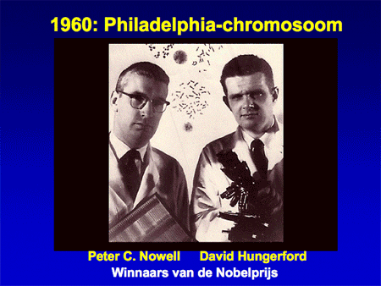

Slide 4

Philadelphia Chromosome Translocation in CML Results in BCR-ABL Oncogene
₉
₉
Stem cell disorder
Characterized by myeloproliferation
Well-described clinical course
_{Ph}
_{22q-}
₂₂
_{Translocation}
_{BCR}
_{BCR}
_{ABL}
_{ABL}
_{Transcription and translation}
_{BCR-ABL fusion}
_{protein}
_{Inhibition by}
_{TKI}
_{Constitutive tyrosine kinase}
Phosphorylation of multiple substrates
Mitogenic signaling and genomic instability increased
Apoptosis and stromal regulation decreased
_{CML}

Slide 5
Natural Course of CML
Accumulation of immature myeloid cells
_{New cytogenetic changes}
 | Chronic Phase | Accelerated Phase | Blast Phase
Duration | If untreated, 3-5 yrs | Varies | Median survival of several mos
Prognosis | Responsive to treatment | Decreased responsiveness | Resistant to treatment
Symptoms | Asymptomatic OR Fatigue Weight loss Abdominal pain or discomfort Night sweats | Progressive splenomegaly Myelofibrosis | Bleeding complications Infection complications
Radich JP, et al. Proc Natl Acad Sci U S A. 2006;103:2794-2799. Sawyers CL. N Engl J Med. 1999;340:1330-1340. Druker B, et al. Chronic leukemias. In: Cancer, principles, and practice of oncology. 17th ed. 2005.

Slide 6
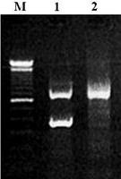
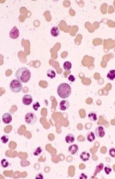
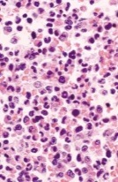
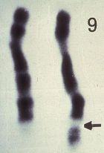
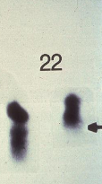
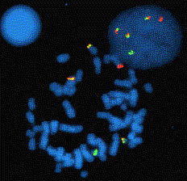
Diagnosis of CML
_{Sensitivity}
_{Hematologic}
_{Cytogenetic}
_{Molecular}
_{Karyotype}
_{(Ph chromosome)}
_{FISH}
_{PCR}
_{(BCR-ABL fusion)}
_{Peripheral blood}
_{(with myeloid cells)}
_{Bone marrow}
_{(with myeloid hyperplasia)}
_{Chromosomal translocation}
_{t(9;22)(q34;q11)}
_{Abnormal BCR-ABL}
_{Red: BCR}
_{Green: ABL}
_{Yellow: fusion}
_{Abnormal BCR-ABL}
_{Lane 1: BCR-ABL+}
_{Lane 2: BCR-ABL-}
Courtesy of Neil Shah, MD, PhD.

Slide 7
Criteria for Hematologic, Cytogenetic, and Molecular Response
Response | Criteria
Complete hematologic response | Complete normalization of PB counts, leukocyte count < 10 x 10⁹/L Platelet count < 450 x 10⁹/L No myelocytes, promyelocytes, or blasts in PB No palpable splenomegaly No disease symptoms
Cytogenetic response
Complete | No Ph+ metaphases
Partial | 1% to 35% Ph+ metaphases
Major | 0% to 35% Ph+ metaphases (complete + partial)
Minor | > 35% Ph+ metaphases
Molecular Response
Major | ≥ 3 log reduction in BCR-ABL mRNA or BCR-ABL/ABL ≤ 0.1% by QPCR (International Scale)
Complete (CMR or MR^{4.5}) | No detectable BCR-ABL mRNA using assay with sensitivity at least 4.5 logs below standardized baseline
NCCN. Clinical practice guidelines in oncology: chronic myelogenous leukemia. v3.2014.

Slide 8
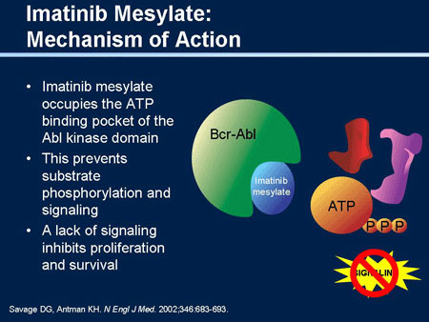
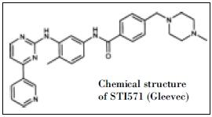


Slide 9
Imatinib Changed the Therapeutic Landscape for Patients With Ph+ CML
Best available therapy 5-Yr OS, %
_{Imatinib* 93}
_{IFN-α or SCT +}
_{second-line imatinib}† ₇₁
_{IFN-α or SCT}‡ ₆₃
_{IFN-α 53}
_{Hydroxyurea 46}
_{Busulfan 38}
_{1.0}
₂₀₁₀
_{0.9}
_{2002-2008, imatinib*}
_{0.8}
₂₀₀₀
_{0.7}
_{0.6}
_{1997-2008, IFN-α or SCT}
_{plus second-line imatinib}†
_{Survival Probability}
_{(All Ph+ CML Disease Phases)}
₁₉₉₀
_{0.5}
_{0.4}
_{1995-2008, IFN-α or SCT}‡
_{0.3}
₁₉₈₀
_{0.2}
_{1986-2003, IFN-α}
_{1983-1994, hydroxyurea}
_{0.1}
₁₉₇₀
₀
_{1983-1994, busulfan}
₀
₂
₄
₆
₈
₁₀
₁₂
₁₄
₁₆
₁₈
₂₀
₂₂
_{Yrs After Diagnosis}
₁₉₆₀
_{*CML IV.} †_{CML IIIA.} ‡_{CML III.}

Slide 10
IRIS 8-Yr Update: OS (ITT) With Imatinib Treatment in CML
₁₀₀
₈₀
₆₀
_{Estimated OS at 8 yrs: 85%}
(93% considering only CML-related deaths)
_{OS (%)}
₄₀
₂₀
₀
₀
₁₂
₂₄
₃₆
₄₈
₆₀
₇₂
₈₄
₉₆
₁₀₈
_{Mos Since Randomization}
Deininger M, et al. ASH 2009. Abstract 1126.

Slide 11
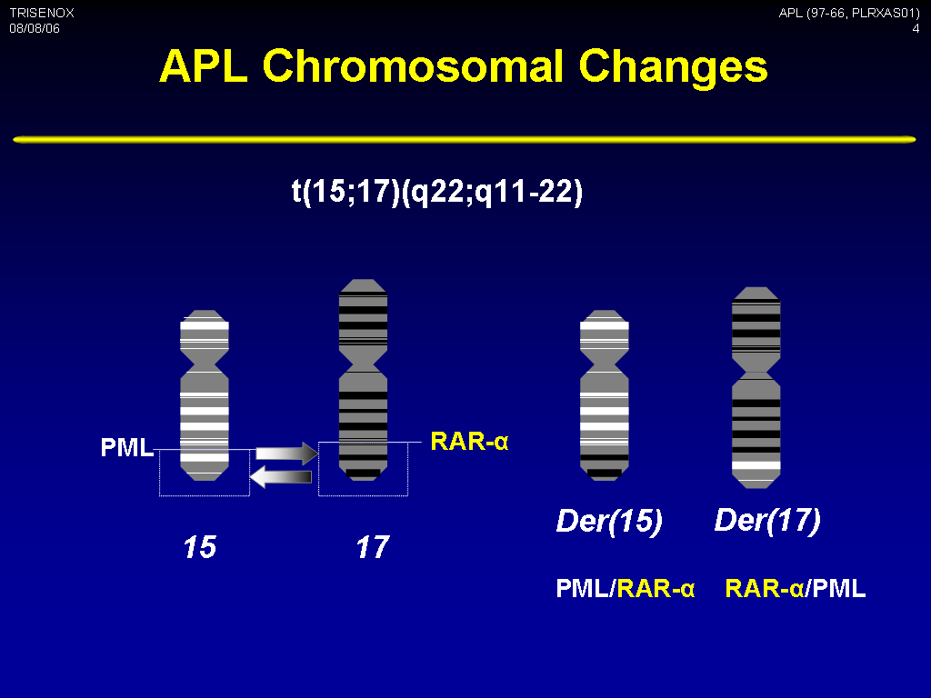

Slide 12
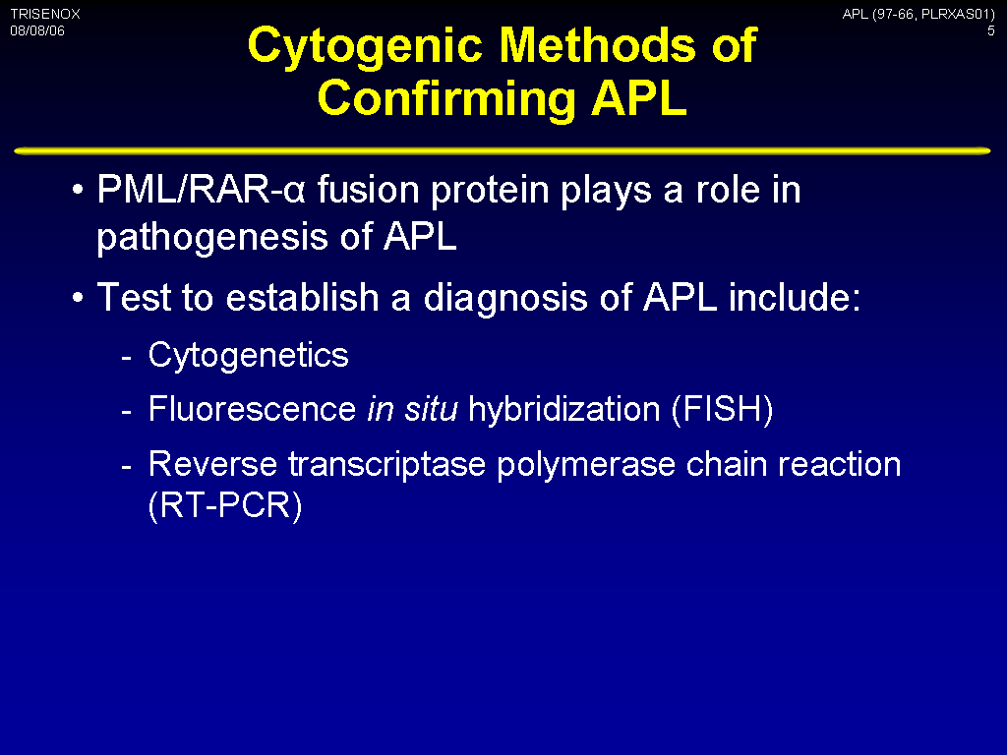

Slide 13
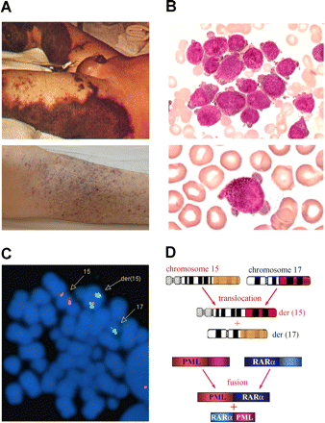
Acute Promyelocytic Leukemia (M-3)
A) a severe bleeding tendency due to fibrinogenopenia and disseminated intravascular coagulation
(B) accumulation of abnormal promyelocytes in bone marrow and chromosomal translocation t(15;17)(q22;q21)
(C) with the resultant fusion transcripts between PML and RAR detected by FISH using PML-RAR dual-color, dual-fusion translocation probes
D) Schematics representing the formation of 15;17 reciprocal chromosomal translocations and fusion transcripts

Slide 14
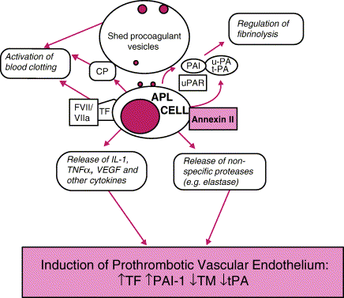
Mechanism of DIC in APL

Slide 15
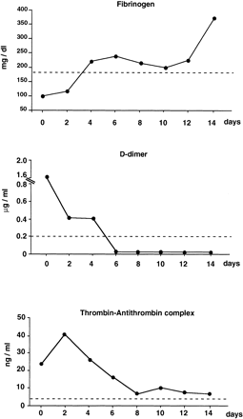
Reversal of Coagulopathy by differentiation with
ATRA or
ATO

Slide 16
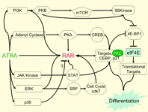
Mechanism of Action ATRA

Slide 17
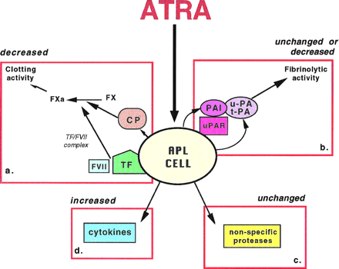
Mechanism of ATRA for reversal of DIC & induce Retinoid Syndrome

Slide 18
Differentiation Syndrome due to Increased Cytokines (Cytokine Storm)
• High WBC counts as leukemic cells differentiates promotes expressions of one or more adhesion molecules with high incidence of vascular complications and early mortality
• Clinical features of Retinoid syndrome are:
_{- unexplained fever,}
_{- weight gain,}
_{- respiratory distress,}
- interstitial pulmonary infiltrates,
- pleural and pericardial effusions,
_{- episodic hypotension}
_{- acute renal failure.}

Slide 19
Special supportive care during induction of APL
• Once APL is suspected by morphology or presence of DIC the patient should be treated as an emergency.
• Start ATRA and supportive measures even before the molecular diagnosis of PML-RARa is available to lower risk of life-threatening _{hemorrhage.}
• Reversal of on-going coagulopathy should be based on liberal Tx of FFP and fibrinogen to keep levels >1.5 g/L (150 mg/dL)
• Thrombocytopenia should be treated with aggressive platelet support _{by} keeping platelet counts > 30-50,000/µl until coagulopathy resolves.
• Awareness of the APL differentiation syndrome which are weight gain, SOB, increasing WBC leading to ARDS which is life-threatening by starting early in course dexamethasone 10 mg bid IV. Do not stop ATRA unless life-threatening and adding chemotherapy does not help.
Ref: Sanz MA. ASH Educ Book Hematology 2006, page 147.

Slide 20
ATRA as a differentiation therapy for APL: first model of targeted therapy
Chinese medicine based on Confucius philosophy of guiding bad elements instead of killing them led to differentiation approach to AML supported by shift in Western medicine.
In vitro evidence of cellular differentiation of leukemic cells by retnoic acid and ATRA was better than 13 CRA
First APL patient treated with ATRA was a 5-year-old girl who received medical care in Shanghai Children's Hospital in ₁₉₈₅
_{CR of 85% can be achieved in} APL with ATRA alone, continuous treatment of APL with ATRA will cause progressive resistance to the drug and reduction of its plasma concentration because of accelerated clearance, resulting in relapse usually within 3 to 6 months requiring additional chemotherapy for cure.

Slide 21
ATRA- Chemo Combinations
AIDA- ATRA + Idarubicin (GIMEMA)
ATRA was administered orally beginning on the first day of induction at the dosage of 45 mg/m2/d until complete remission (CR), wheras IDA was administered intravenously at the dosage of 12 mg/m2/d on days 2, 4, 6, and 8 of the induction. Patients who achieved CR were consolidated with 3 courses of chemotherapy without ATRA; thereafter, they were followed up for molecular and hematologic CR
The overall survival and event-free survival durations are 85% and 69% respectively; moreover, 14 of 18 (78%) patients who achieved a CR are still alive and in first molecular (RT-PCR) and hematologic CR.
Although the majority of patients with APL are potentially cured by treatments combining all-trans retinoic acid (ATRA) and chemotherapy (CHT), a sizable proportion (around 30%) will relapse during follow-up.
Ref: Diverio D et al. Blood 92:784, 1998

Slide 22
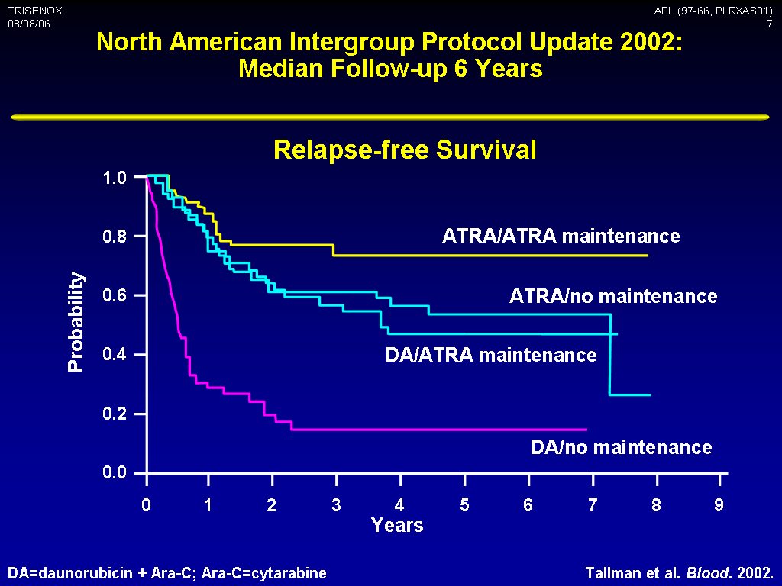

Slide 23
Use of ATO in the treatment of APL: taming an evil with a toxic agent
Arsenic a common naturally occurring substance is one of the oldest drugs in both Western (Hippocrates, 460 BC) and Chinese (NeiJing, 263 BC) medicine for treatment of malaria and CML
Sun et.al treated first APL with ATO resulting in 30% survival at 10 yr
Multicenter studies show ATO as highly effective as a single agent resulting in long term remissions with 3 yr DFS of 87%
AS4S4, another arsenic compound is also highly effective as shown by Lu et al (2002) show a 80% CR rates in newly diagnosed APL
A composite natural Realgar-indigo tablet has a 98% CR rates in 60 APL patients
Mechanism of action is different in that ATO exerts a dose-dependent activity; ie.differentiation in lower doses and apoptosis in higher doses thru mitochondrial apoptotic pathways
Combining ATRA and ATO is synergistic

Slide 24
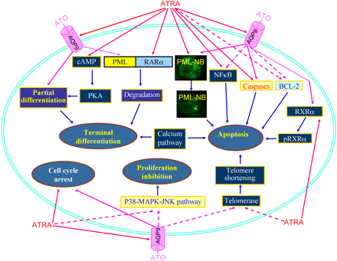
Schematic representing synergic/additive effects of ATRA and ATO.

Slide 25
Oral Arsenic Trioxide ± Chemotherapy in Patients with Relapsed APL
Treatment (N=50): oral AS2O3 10 mg/day until CR, ff by consolidation therapy w/ Idarubicin 6 mg/m2/d ove 3 months.
Maintenance therapy (n=27): AS2O3 10 mg/d x 14 + ATRA
Response | Patients (N=50)
CR, n (%) | 49 (98)
• Still in remission at median 61-mo ff-up, n | 27
• Relapse after achieving CR, n | 22*
• CR re-established in relapsed pts, n | 19†
4-year OS, n | 71
EFS, % | 53
*13 with maintenance, 9 without maintenance
†8 remain in remission at median 88-month follow-up
Au WY, et.al ASH 2008, Abstract 2958

Slide 26
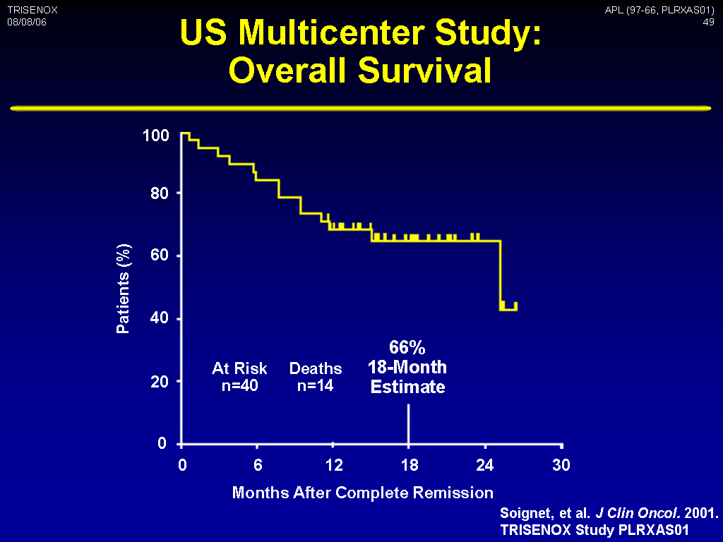

Slide 27
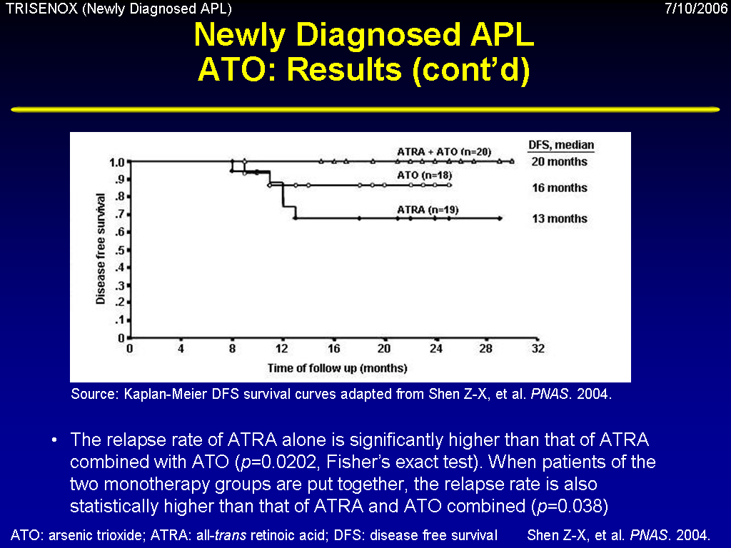

Slide 28
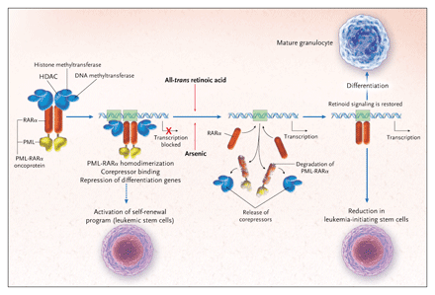
Countering an Oncoprotein

Slide 29
Core Binding factor (CBF) in AML Rx
In primary adult AML, the highest CR rate (90%) and the longest DFS (50% at 5 yrs) have been associated with presence of CBF [t(8;21)(q22;q22) and inv(16)(p13q22) or t(16;16)(p13;q22)]
Superior outcome of CBF gene rearrangement vs other AML may be attributed to increased sensitivity of blast cells to cytarabine and anthracyclines (backbone of AML Tx).
  CALGB compared three consolidation using High (3 g/m2), Intermediate (400 mg/m2) or Low (100 mg/m2) Ara-C after first CR.
  7 yr ff up, show estimated patients in CR at 5 yrs was 42% after HDAC, 33% Intermediate DAC, 17% Low DAC consolidation.
  The best results is using HDAC for consolidation in CBF AML.

Slide 30
Outcome Prediction in CBF AML using Gene Profile (CALGB Study)
FLT3 mutations did not predict outcome in CBF AML
Patients with predicted poor outcome in CBF AML had higher expression of genes with leukemogenic potential
  _{WT1 in t(8;21) and inv(16)}
  _{CCNA1 in t(8;21)}
  _{MYCN in inv(16)}
Gene expression profiling improves outcome prediction among patients with CBF AML.
Mutations in the KIT, FLT3, JAK2 and RAS genes, haploinsufficiency of the putative tumor suppressor genes TLE1 and TLE4
^{Ref: Paschka, P, eta.} Outcome prediction in adult core binding factor (CBF) acute myeloid leukemia (AML) with gene ex
pression profiling: A Cancer and Leukemia Group B (B) study. _{Abstract ASCO 2007.}

Slide 31
Summary of Molecular Markers in AML
High Risk | Favorable Risk
FLT3/ITD mutations (high AR) | NPM (nucleophosmin) mutations
KIT mutations in CBF AML | CEBPα mutations
MLL PTD mutations
Poor response to therapy (MRD) by flow
High WT1, BAALC, ERG expression
Gene expression profiles | Gene expression profiles

Slide 32
Role of genotype-based approach in the clinical management of adult AML with normal cytogenetics
AML is the most common form of acute leukemia affecting adults.
Nearly 50% of patients exhibit a normal karyotype (CN-AML) with an intermediate cytogenetic risk.
Recurrence of genomic aberrations ie. mutations of FLT3, CEBPA, NPM1, RUNX1, TET2, IDH1/2, DNMT3A, ASXL1, MLL and WT1
Provides novel insights into biology of this tumor, furnishes accurate prognostic markers as well as useful tools for selecting the most appropriate treatment option.
Good prognostic markers such as CEBPA and NPM1 separates the good from rest of the intermediate group patients.
The bad prognostic markers such as FLT3 suggest a poor response to standard therapy and justify more aggressive approach.
Notes:
this approach can be used to improve survival and treatment of AML patients.

Slide 33
Rearrangement of ALL1 (MLL) in acute myeloid leukemia with normal cytogenetics
45% of adults with acute myeloid leukemia (AML) have normal cytogenetics and therefore lack structural abnormalities that can assist in the localization and characterization of molecular defects.
The partial tandem duplication of the ALL1 (MLL) gene has been found in several such cases of AML, yet its frequency and clinical significance are unclear.
Found in ~11% ± 5% of patients making it a frequent molecular defect with shorter duration of CR and thus require new therapeutic approaches.
More studues are necessary to refine our treatment options in AML with normal cytogenetics.

Slide 34
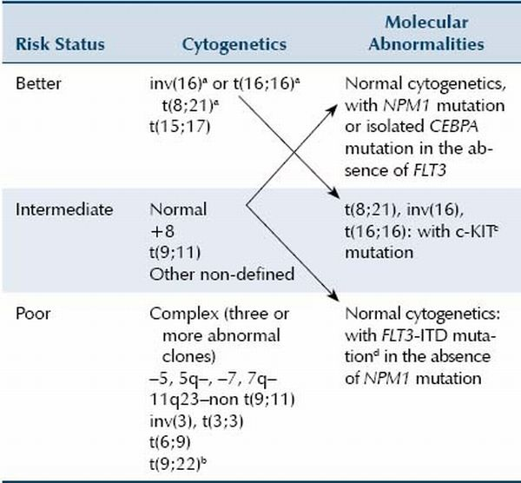
Combined Cytogenetic and molecular markers in AML

Slide 35
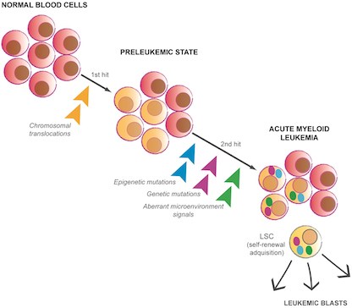
Evolution of Acute Leukemia

Slide 36
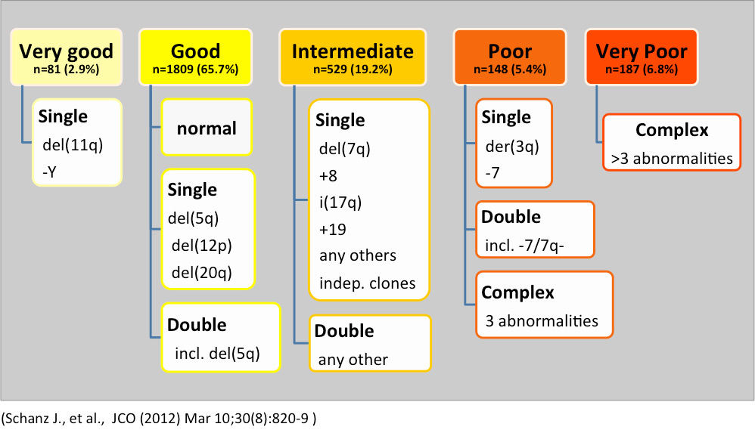
Revised Survival of individual Cytogenetic in Preleukemic States such as Myelodysplastic Syndrome (MDS)

Slide 37
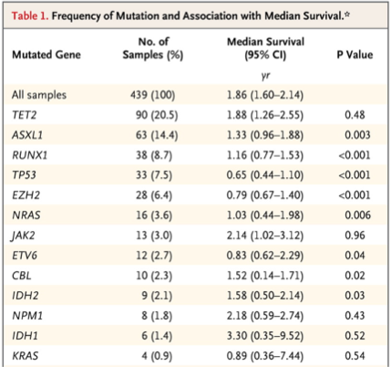
Bejar R et al. N Engl J Med 2011;364:2496-2506.
Frequency of Mutation and Association with Median Survival.

Slide 38
Classes of somatically acquired driver mutation in MDS, MDS/MPN and MPN
Signaling | Epigenetic | mRNA Splicing | Transcription | Cohesin | Cyto
TKI fusions Jak2 MPL CBL NF1 NRAS KRAS CSF3R RIT2 PTPN11 FLT3 KIT SETBP1 | TET2 DNMT3A IDH1/2 EZH2 ASXL1 PHF6 CREBBP EP300 | SF381 SRF2 U2AF1 ZRSR2 LUC7L2 PPRF2 | RUNX1 P53 ETV6 BCOR CUX1 | STAG2 SMC1A SMC3 RAD21 | 5q- -7/7q +8 +19 t(17q) del(11q) del(12p) Del(20q) Inv(3q) t(3.3)

Slide 39
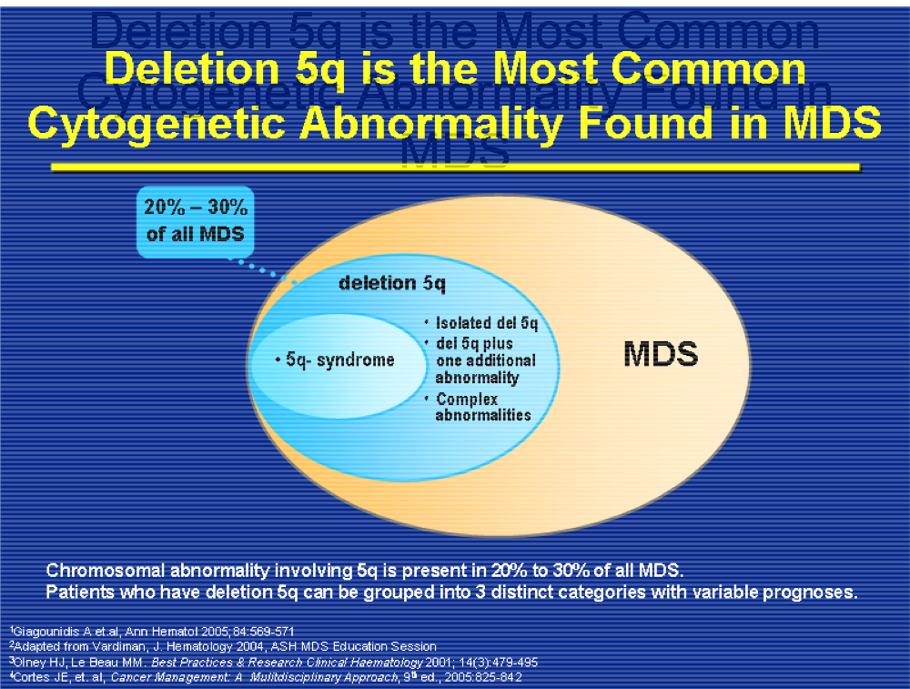

Slide 40
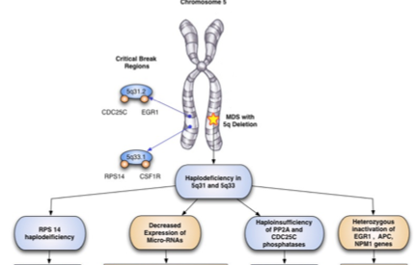
Del(5q) MDS is a Ribosomopathy

Slide 41

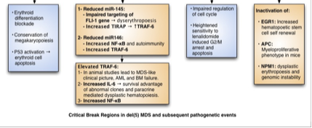
Importance of micro-RNA in the del(5q-) and p53 Apoptosis

Slide 42
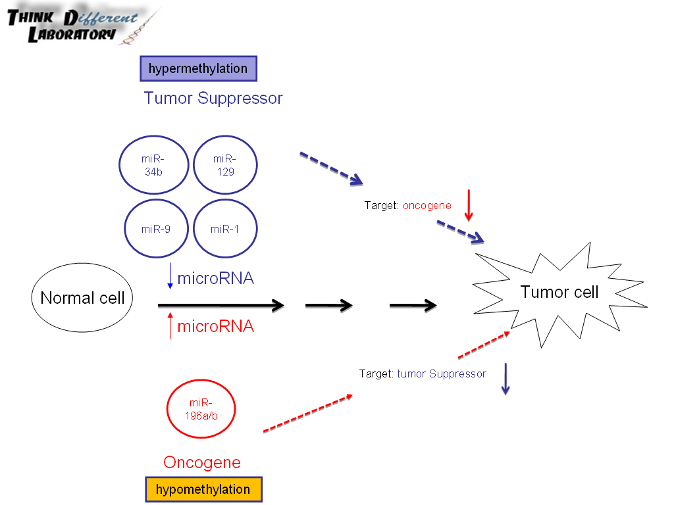

Slide 43
MDS-002/003: LEN Treat – Erythroid Response at 24 wk (Final Report)
 |  |  | MDS-002 non-del(5q) (n=215) | MDS-003 del(5q) (n=148)
Erythroid Resp | Transfusion indep |  | 54 (33%) | 99 (67%)*
 |  | Minor (>50% ↓) | 30 (18%) | 13 (9%)
 |  | Transfusion indep + minor | 84 (51%) | 112 (76%)
Median Duration of Transfusion Independence |  |  | 41 wk | >47 wk†
Median Hgb rise |  |  | 3.2 g/dL [1.0-9.8] | 5.4 g/dL [1.1–11.4]
Median Time to response |  |  | 4.5 wk [0.3-39.1] | 4.6 wk [3.6–5.3]
List AF et al. J Clin Oncol. 2005;23(suppl 16S):2s [abstract 5]
List AF et al. N Engl J Med 2006;355>1456-1465]
_{*P<0.001;} †Not reached at median follow-up of 58 wk
No significant differences in erythroid response or time to response between 2 dosing regimens

Slide 44
MDS-003/002: Frequency of Cytogenetic Response to LEN
Complexity | Pts Evaluable | CytogeneticResponse | CCR
Isolated 5q- n(%) | 64 | 49 (77) | 29(45)
5q- + 1 abn- n(%) | 15 | 10 (67) | 6 (40)
Complex (>3 abn)- n(%) | 6 | 3 (50) | 3 (50)
Non-5q- group* | 20 | 9 (45%) | n.a.
* Data on file. Celgene Corporation
List AF et al. N Engl J Med 2006;355>1456-1465]

Slide 45
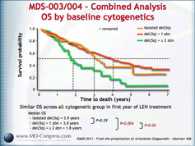
A pooled analysis of MDS 003/004

Slide 46
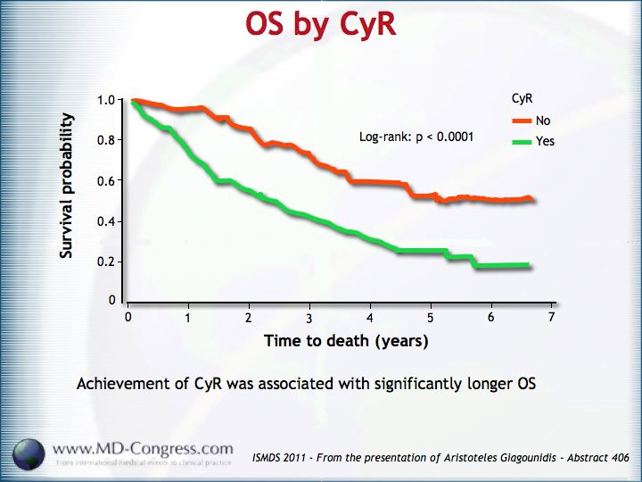
Overall Survival of del(5q) MDS patients by Cytogenetic Response

Slide 47
TP53 suppression promotes erythropoiesis in del(5q) MDS, a targeted therapeutic strategy in lenalidomide-resistant patients
Anemia characteristic of del(5q) MDS arises from ribosomal protein insufficiency, resulting in erythroid-specific activation of p53.
8 lower-risk, LEN-refractory del(5q) MDS patients treated with LEN/DEX, a glucocorticoid receptor-dependent antagonist of p53, transfusion independence was restored in 5/8 patients, with in vivo expansion of erythroid precursors without clonal suppression.
Inhibition of p53 may be a unique therapeutic strategy in patients with lenalidomide-resistant del(5q) MDS.

Slide 48
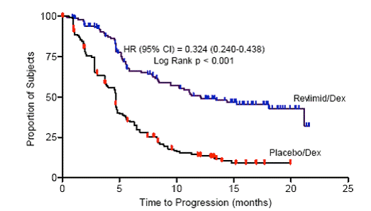
Overall Survival between Len/Dex vs Placebo/Dex

Slide 49
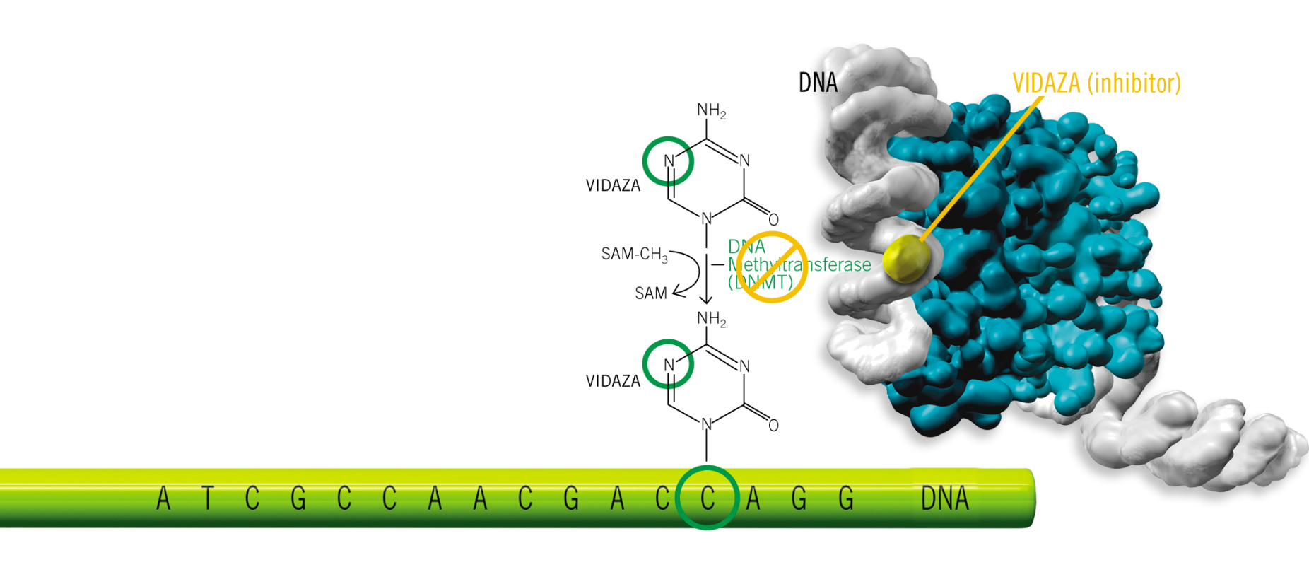
Mechanism of Action of DMA in DNA or RNA function
By inhibiting hypermethylation, DMA may restore normal function, or expression, to genes that are critical for cell differentiation and proliferation.
DMA a also causes the death of rapidly dividing cells, including cancer cells that are no longer responsive to normal growth control mechanisms.
Cells that do not divide rapidly are relatively insensitive to DMA
Notes:
The importance of epigenetic aberrations in the pathogenesis of leukemias has been revealed by recurrent gene mutations that highlight epigenetic pathways as well as by the clinical success of therapies like 5-azacytidine and decitabine that work through epigenetic mechanisms.

Slide 50
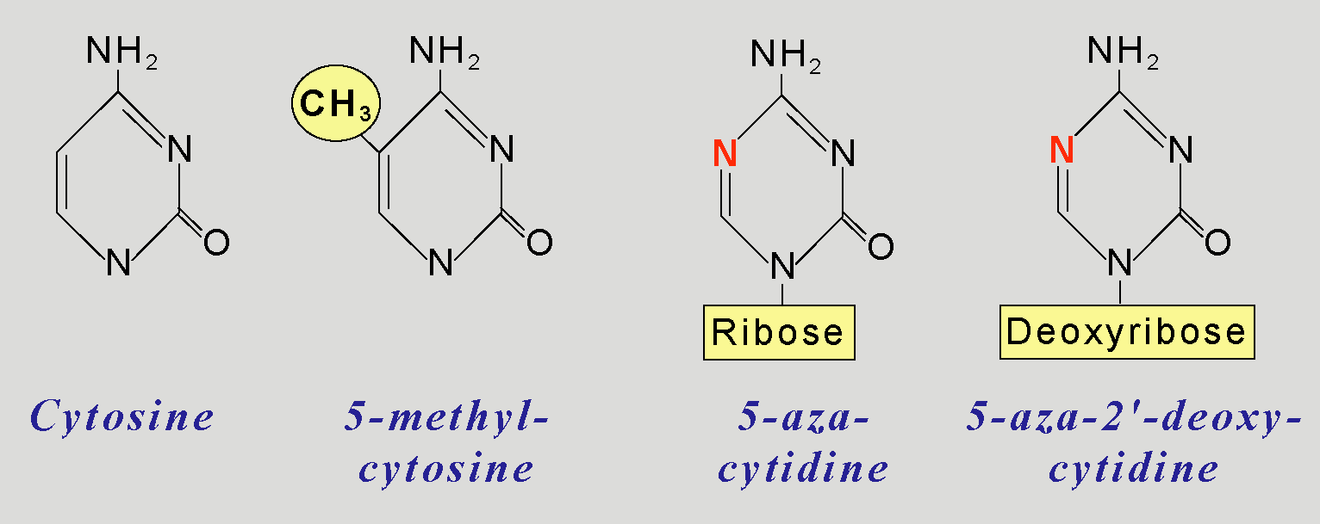
Hypomethylating Cytosine Analogs
Leone G, et al. Haematologica. 2002;87:1324-1341

Slide 51
Mechanism of Action of DMA in DNA or RNA function
Notes:
Cytosine methylation. DNMTs (1, 3A, 3B) use S-adenosyl-l-methionine (SAM, AdoMet) as a donor of a methyl-group (CH3-) to catalyze the formation of a covalent bond between the methyl group and the 5-carbon atom of the cytosine ring. AdoMet is converted to S-adenosyl-l-homocysteine (AdoHcy). DNA methyltransferase (DNMT) enzymes, DNMT1, DNMT3A, and DNMT3B, catalyze the transfer of a methyl group to cytosine.

Slide 52
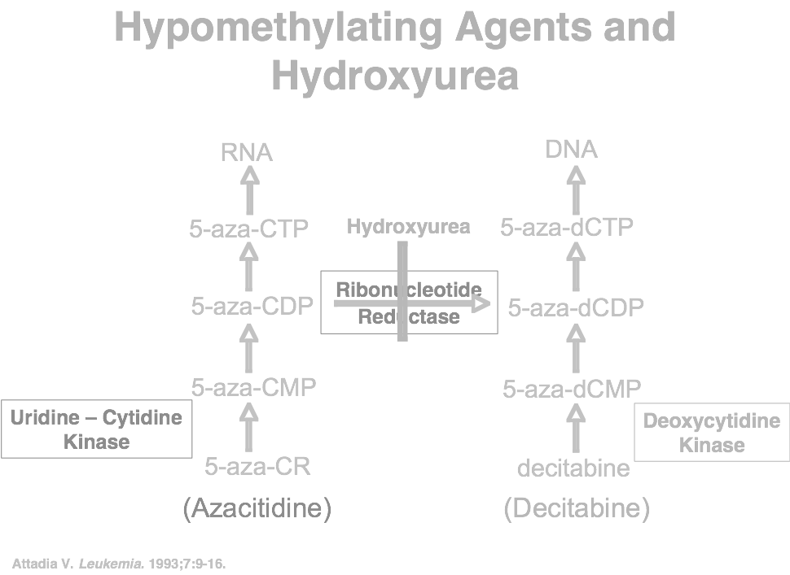
Notes:
However, precise mechanisms of how gene mutations lead to leukemias and how epigenetic therapies induce clinical remissions are elusive. Current scientific inquiries that take advantage of techniques that can distinguish among the various covalent cytosine modifications at single base resolution are likely to shed light on the ways epigenetic pathways drive leukemogenesis as well as how the hypomethylating drugs induce clinical remissions.

Slide 53
Mechanism of Action of DMA in DNA or RNA function
Notes:
The proposed mechanism of action of cytidine analogs. After cellular uptake by equilibrative nucleoside transporter ENT-1 and potentially by other transporter protein, AZA (5-aza-CR) and DAC (5-aza-dCR) are monophosphorylated, by uridine-cytidine kinase (URD-Cyd) and deoxycytidine kinase (dCyd), into 5-aza-cytidine-monophosphate (5-aza-CMP) and 5-aza-2′deoxycytidine-monophosphate (5-aza-dCMP), respectively. Approximately 10–20% of 5-aza-CDP is then converted to 5-aza-2′-deoxy-cytidine-diphosphate (5-aza-dCDP), a step limited by ribonucleotide reductase, while 100% of 5-aza-dCMP undergoes downstream phosphorylation into the active nucleotide for DNA incorporation, 5-aza-2′-deocycytidine-5’-triphosphate (5-aza-dCTP). 5-aza-dCTP then incorporates directly into DNA where it binds and traps DNMTs, which results in direct DNA damage as well as overall decrease in DNMTs and over time decreased DNA methylation and increased gene expression. It is postulated that the remaining 80–90% of AZA is incorporated into RNAs, including tRNA, where it is able to bind and trap DNMT2. It is unclear whether AZA incorporates into mRNA and rRNA and whether its activity in tRNA results in decreased protein synthesis.

Slide 54
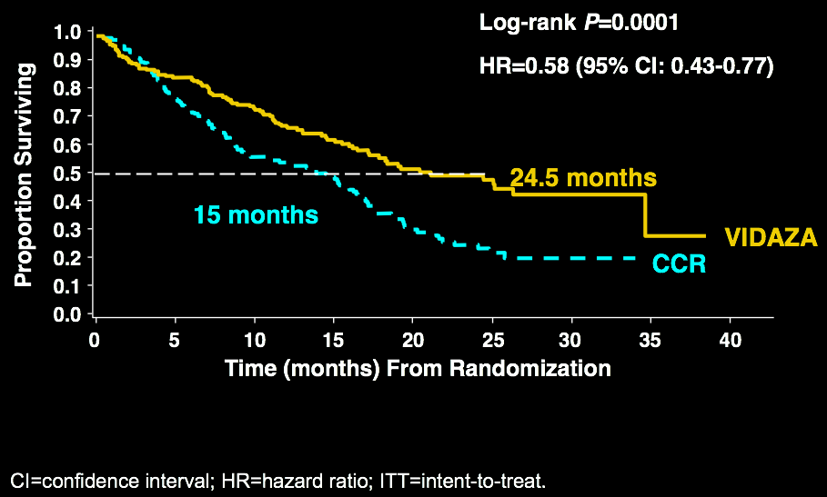
AZA-001 Trial: VIDAZA® Significantly
Improves Overall Survival (OS)
CI=confidence interval; HR=hazard ratio; ITT=intent-to-treat.

Slide 55
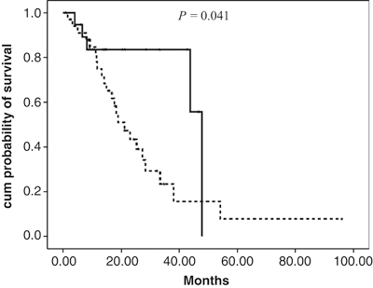
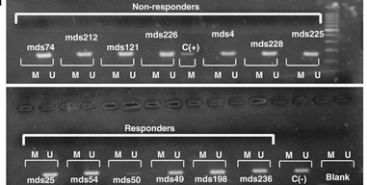
Overall Survival of Aza-Rx MDS patients by UCK1 expression
Notes:
The hope is that these studies will also reveal which patients are likely to respond to epigenetic therapies. Thus, the future is likely to bring a new wave of diagnostic and prognostic tools that probe the epigenomics of leukemia to help clinicians in their management of patients.

Slide 56
Personalized Approach to Diagnosis & Treatment in MDS & AML
Research in the molecular mechanism of malignancy and in leukemias have opened up a new personalized approach to complex diseases in cancer.
A diagnosis cannot determine appropriate therapy since there are multiple variations within a disease.
Hematologic malignancy is an ideal field for this approach since the blood and bone marrow is readily accessible for testing.
Clinical trials and cooperative groups using databases of multiple countries and cancer trial groups have improved our understanding of the clinical significance of cytogenetics and genomic markers.
The future looks bright in solving and curing this formidable disease.
Notes:
If the prevailing model of how the hypomethylating agents work—via depletion of DNMT levels through protein degradation—is correct, then one might expect that the hypomethylating agents might be less effective in DNMT3A-mutant leukemias, if they are already hypomethylated. Emerging data also suggest that hypermethylation of CpG islands and island shores are associated with miRNA gene silencing and miRNA dysregulation in malignant cells. Therefore, hypomethylation of these regions may increase the expression of miRNAs that act as tumor suppressors or negatively regulate oncogenes. Finally, it is worth noting that the activity of AZA is not limited to DNA hypomethylation, and some evidence suggests that it may have different effects on cell viability, protein synthesis, the cell cycle and gene expression compared with DAC.

