Slide 1
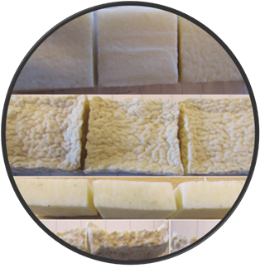


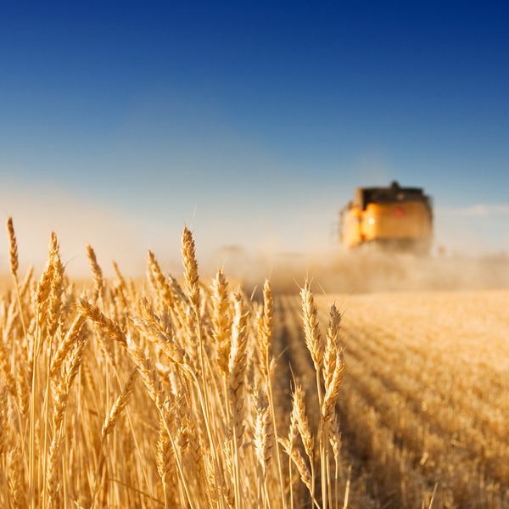

Modeling the drying and sorption behaviour of yam (Dioscoreaceae rotundata)
E.A. Amankwah, K.A. Dzisi, G. van Straten, A.J.B. van Boxtel
3rd International Conference and Exhibition on Food Processing and Technology, Las Vegas, USA
July 21-23, 2014

Slide 2
Drying of yam
Yam is an important food crop for many people in the yam zone of West Africa
MC: about 70%
Uses: when boiled, roasted or fried
Losses: 10-50%
Production: Ghana is a main producer (third to Nigeria)
Export: Ghana is leading in West Africa

Slide 3
Yam as a food product
Nutrition:
  4 times more protein as in cassava
  the only root crop that exceeds rice in protein
  overall rating of essential amino acids relatively high and superior to sweet potato
Drying into powders may increase its variability of uses
    In soups
    composite products
    baby foods

Slide 4
Drying properties
Moisture fits: Classical empirical/black-box models are often used
  High R-square values
The challenge: To understand moisture transport
Is a mass driven equation an option?

Slide 5
Sorption isotherms
Indicates equilibrium conditions of a food product under varying conditions of RH and temperature
  useful for optimization
  design of drying equipment
  predictions of quality parameters
  shelf-life study
  storage investigations.
How is it affected by temperature?

Slide 6
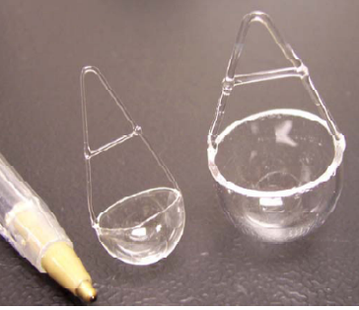
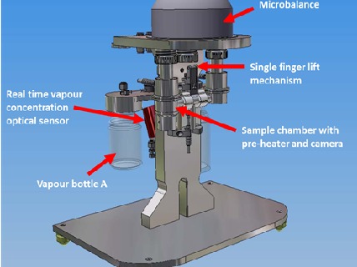
Dynamic Vapour Sorption analyser (DVS)

Slide 7
Sorption model
Sorption
  Henderson, Halsey, Oswin and GAB equations
  The GAB equation is
$$X_{e}=C_{1}C_{2}C_{3}RH{\left[\left(1−C_{2}RH\right)(1−{C_{2}RH+C}_{2}C_{3}RH) \right]}^{−1}$$

Slide 8
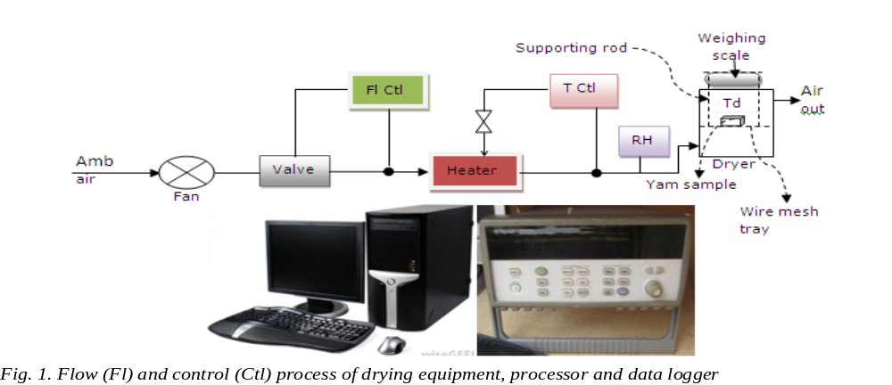
Drying rate measurements
Yam variety and cultivar: D. rotundata, Dente
  Cut size: 3x3x1 cm
Drying procedure/ equipment

Slide 9
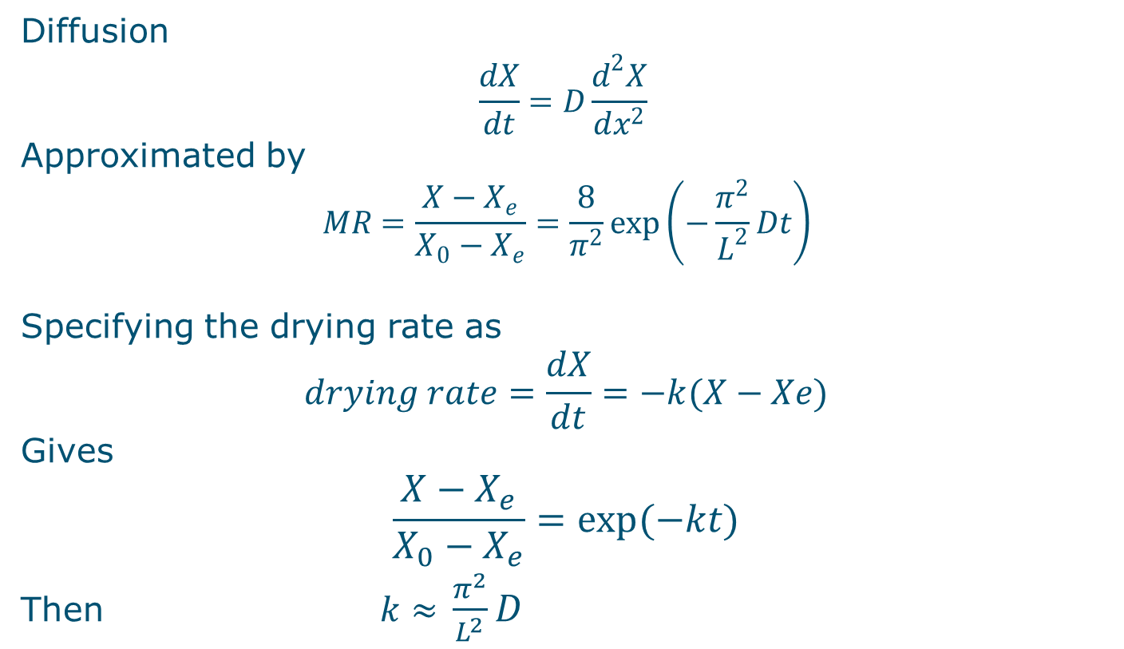
Drying model
Diffusion
$$\frac{dX}{dt}=D\frac{d^{2}X}{dx^{2}}$$
Approximated by
$$MR=\frac{X−X_{e}}{X_{0}−X_{e}}=\frac{8}{π^{2}}\exp\left(−\frac{π^{2}}{L^{2}}Dt\right)$$
Specifying the drying rate as
      $$drying rate=\frac{dX}{dt}=−k(X−Xe)$$
      Gives
      $$\frac{X−X_{e}}{X_{0}−X_{e}}=exp(−kt)$$
      Then $k≈$ $\frac{π^{2}}{L^{2}}D$

Slide 10
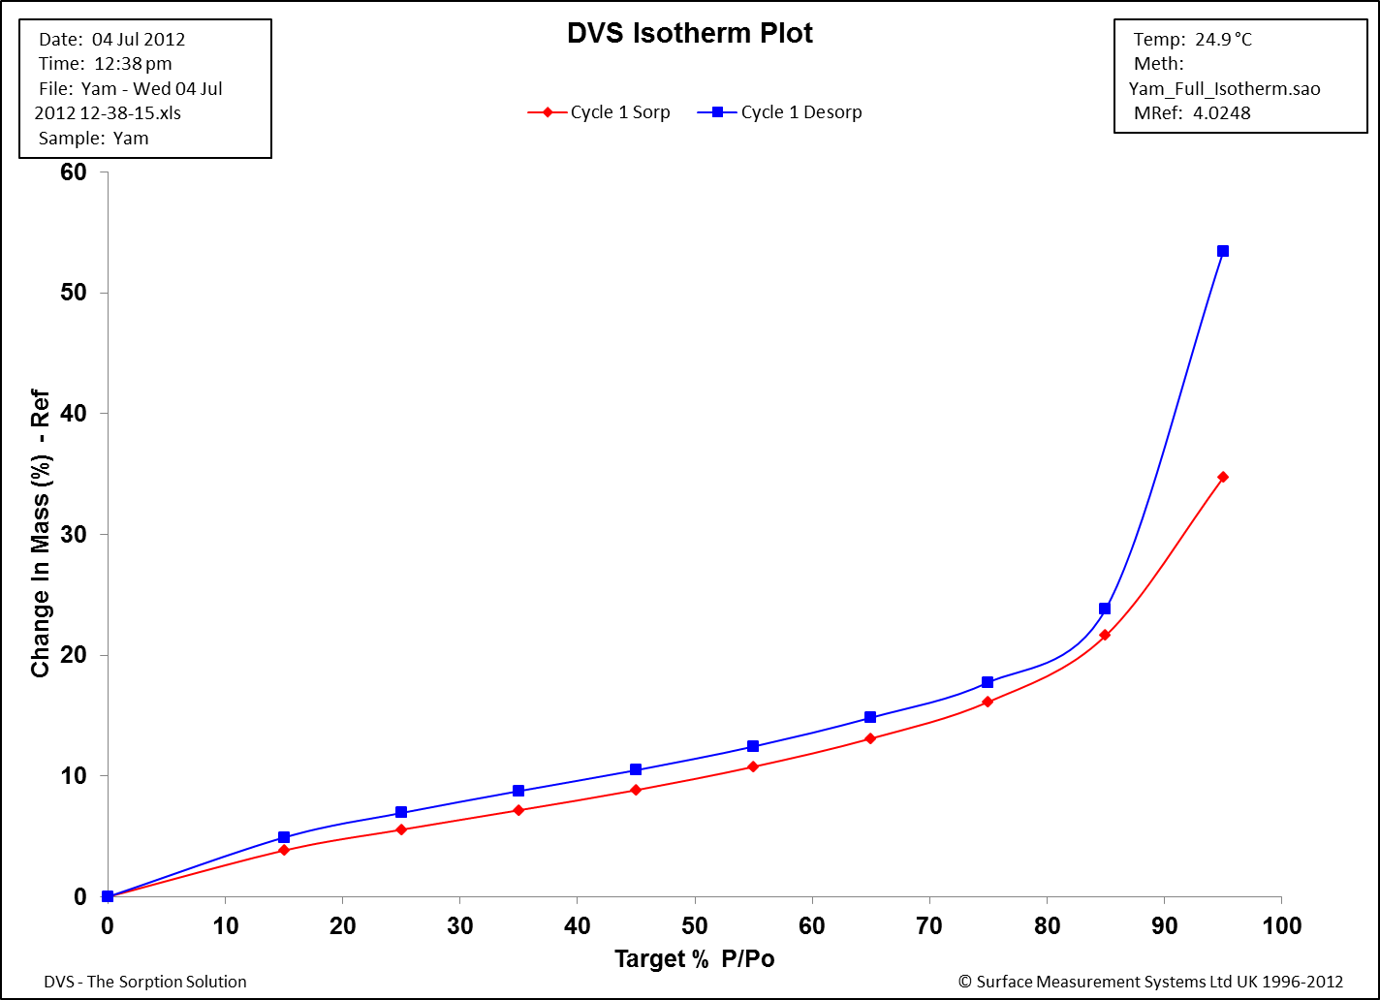
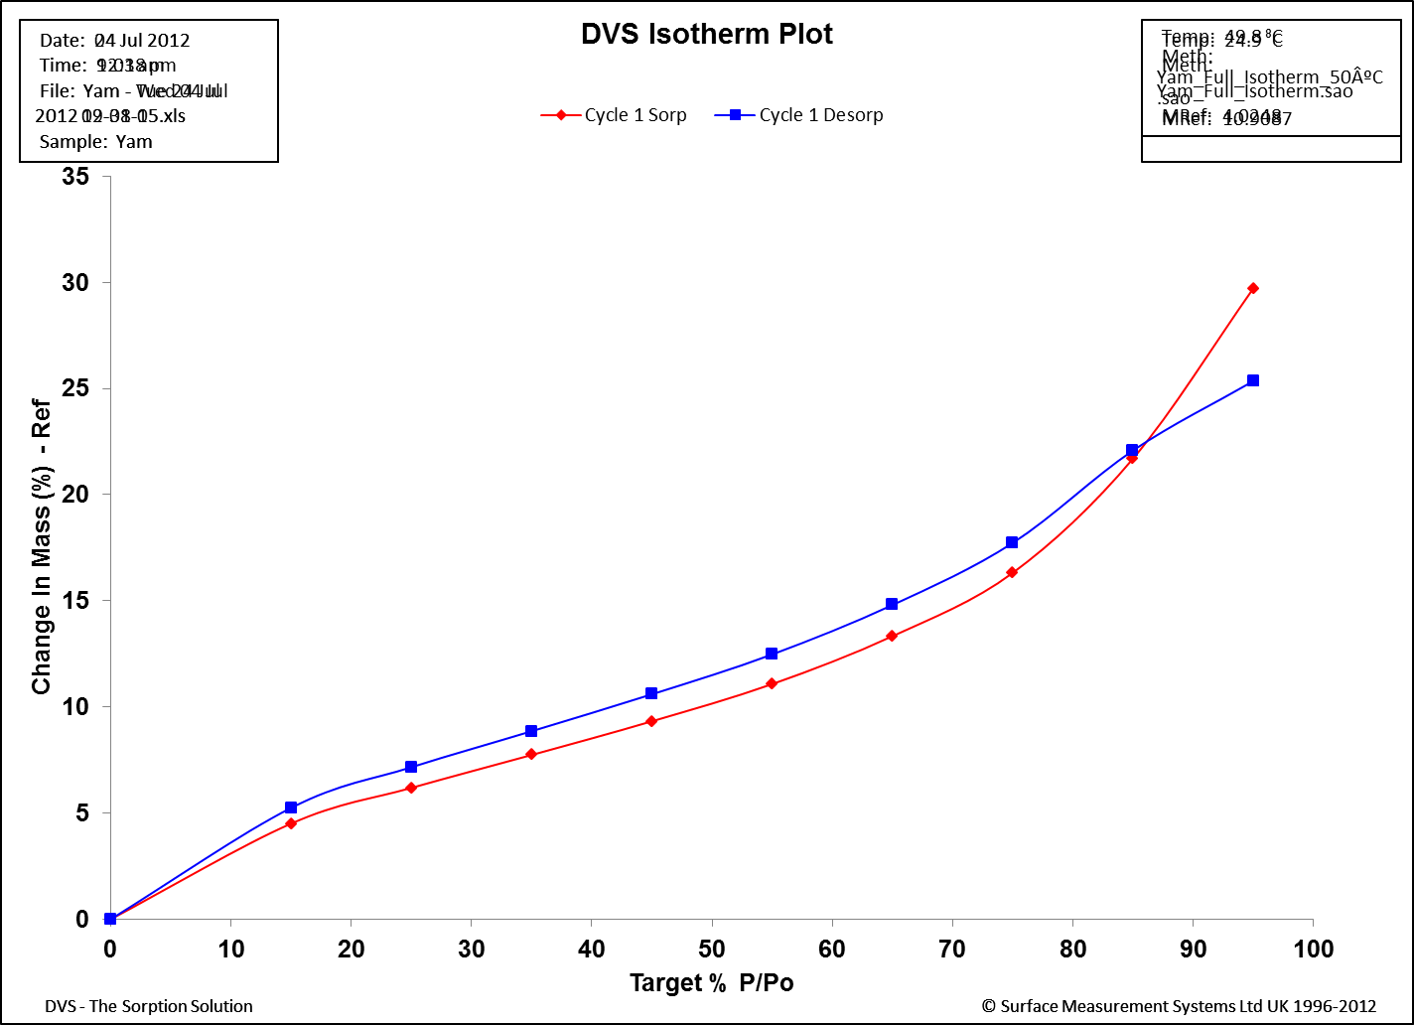
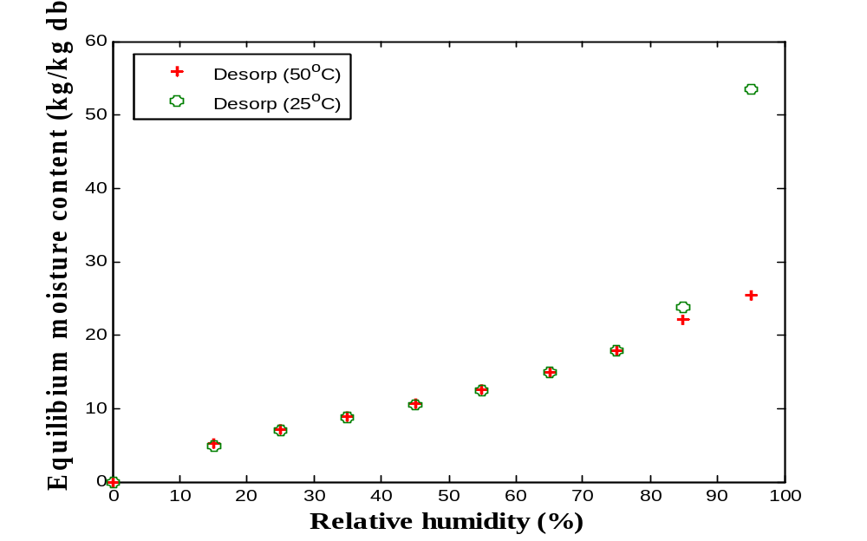
Results on sorption isotherms
25°C
desorption
50°C
desorption
sorption
sorption
RH
RH

Slide 11
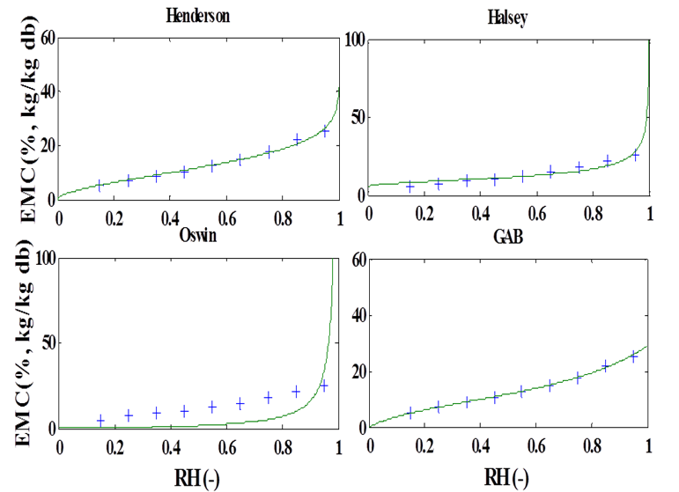
Sorption curve model
At 50°C | C₁ | C₂ | C₃ | K | n | MSe
GAB | 8.28 | 0.76 | 10.14 | - | - | 0.0027
Henderson | - | - | - | 0.012 | 1.65 | 0.09

Slide 12
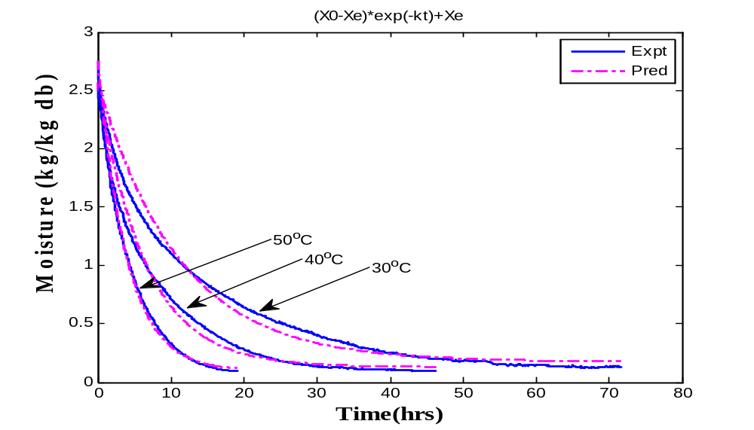
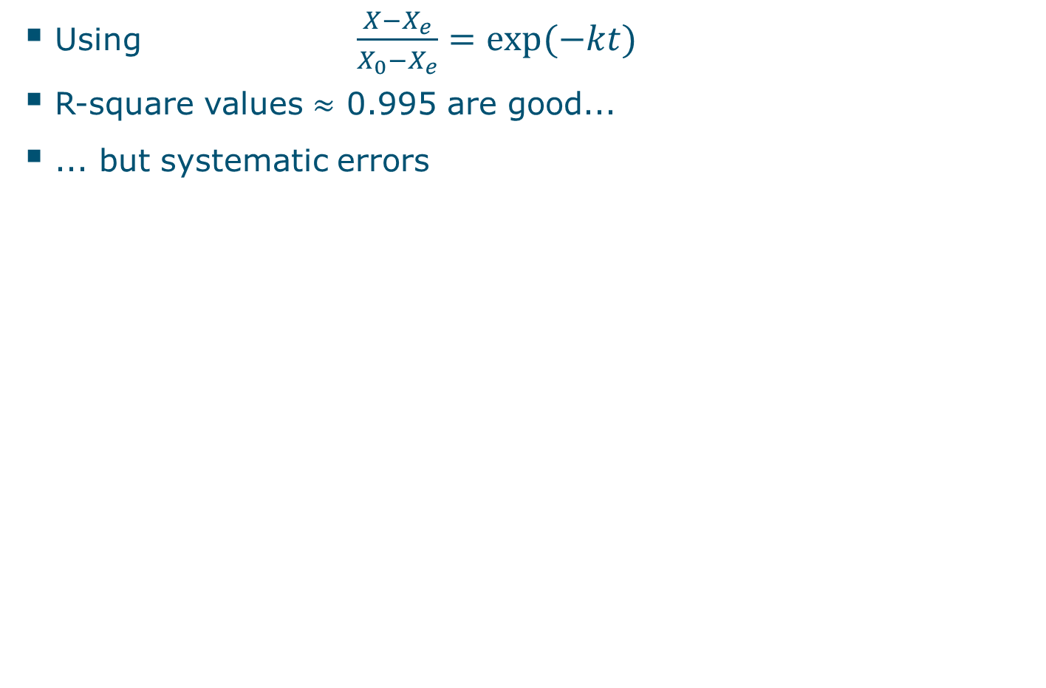
Drying model
      Using $\frac{X−X_{e}}{X_{0}−X_{e}}=exp(−kt)$
R-square values $≈$ 0.995 are good...
... but systematic errors

Slide 13
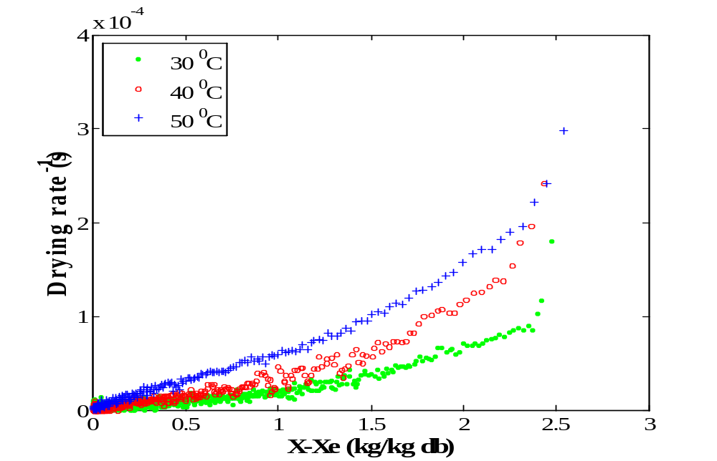
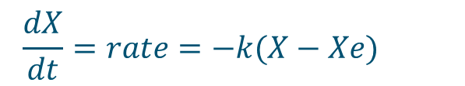
Drying rate Vs moisture
      $$\frac{dX}{dt}=rate=−k(X−Xe)$$

Slide 14
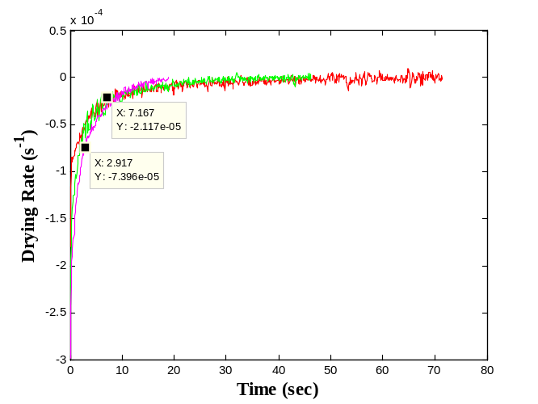
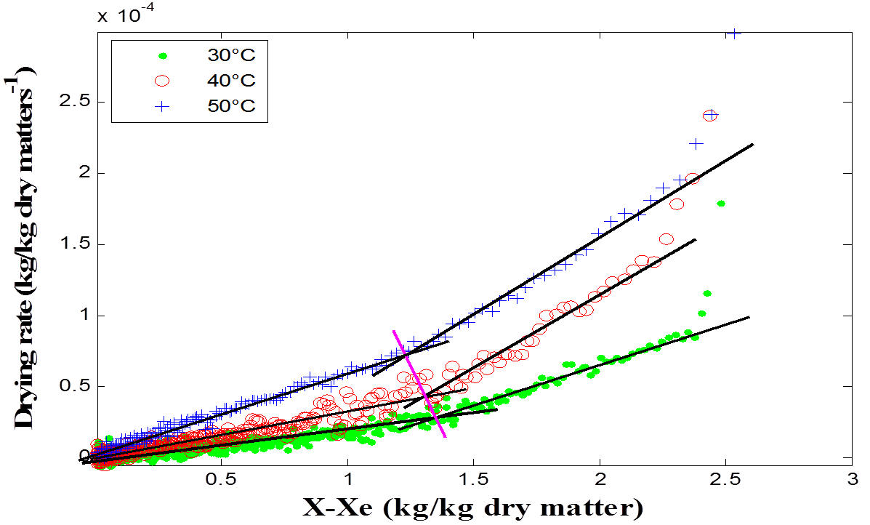

Drying rate Vs moisture
      $$\frac{dX}{dt}=rate=−k(X−Xe)$$

Slide 15
Cont. drying rate
Rate, k is not constant
This behaviour could not be detected by the empirical models
Region of phase transition is well defined
Probably may be the glass transition region coupled with shrinkage
There is progressive increase in temp with decreased moisture content

Slide 16
Conclusion
The present work reveals that:
Both drying rate and diffusion approximation models exhibit two drying phases with a shift between 1.2-1.3 kg water/kg dry matter.
This can be explained from shrinkage behavior of yam during drying
There was no shift in EMC at different temperatures as reported in literature.
The GAB model fitted well the sorption isotherms

Slide 17
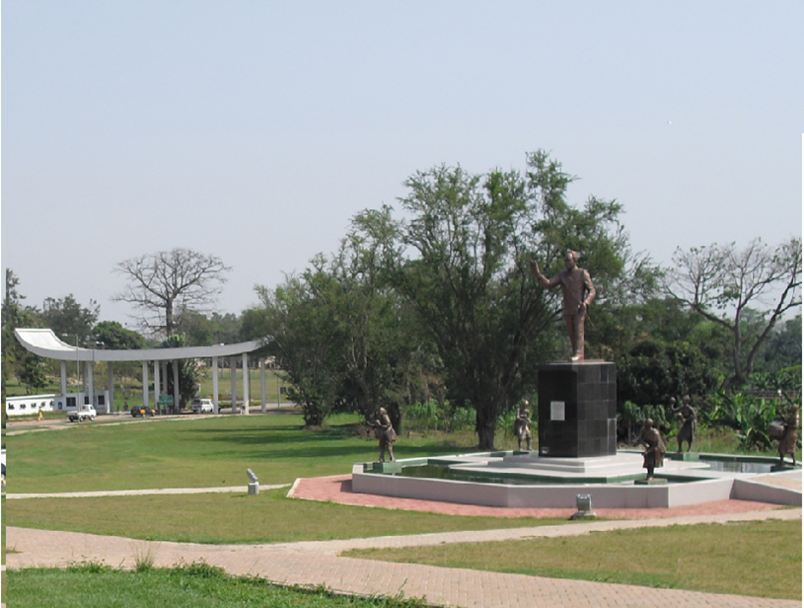
Thanks for your attention
This work is sponsored by Wageningen University Research Center (WUR), The Netherlands and in colaboration with Kwame Nkrumah University of Science and Technology (KNUST), Ghana

