Slide 1
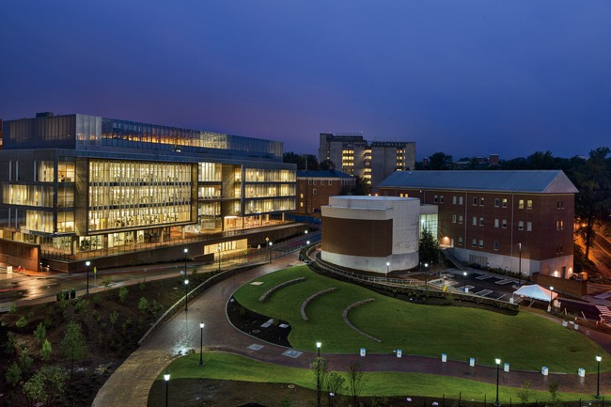
Analysis of circulating free DNA in peripheral blood
Piotr Mieczkowski
University of North Carolina at Chapel Hill
Genomics2014

Slide 2
Next Generation Sequencing for Clinical Care of Cancer Patients - UNCseq
UNCseq Status Summary
1064 consented
300 active 113 sample failure | 436 completed 248 mutations reported 188 no reportable mutations
Sample Distribution
Tumor | Normal
215/300 distributed | 227/300 distributed
35/300 pending distribution | 4/300 pending distribution
49/300 not yet collected | 26/300 not yet collected
0/300 not initiated | 43/300 not initiated
Production Summary Report
Tue Apr 15 23:39:36 2014
requested by dnhayes

Slide 3
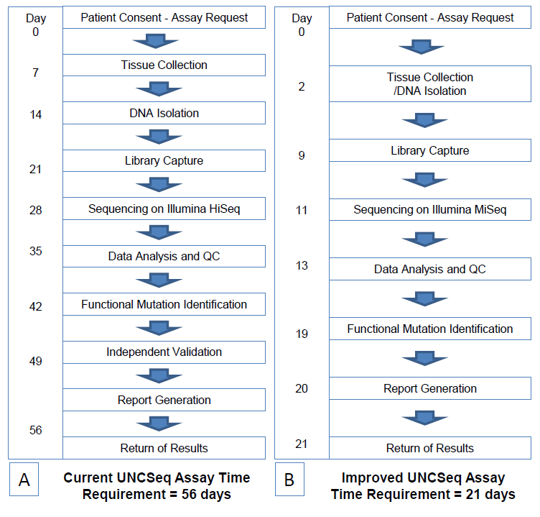
Ideal Schematic Production Timeline
Time to Completion Stats
Early Study
Total patients = 400
Physician Perception Consent to Phone Message time (344) Range: .4 - 16months Average: 6months
Consent to Discussion (344) Range: 1.9 - 12.5months Average: 4.6months
Sample Collection to Phone Message time (344) Range: -.5 - 12.7months Average: 4.6months
Processing Time Sample Collection to Discussion (344) Range: -.8 - 11.9months Average: 3.3months
Active Study
Total patients = 539
Physician Perception Consent to Phone Message time (180) Range: 1.6 - 6.5months Average: 3.6months
Consent to Discussion (180) Range: 1.6 - 5.8months Average: 2.9months
Sample Collection to Phone Message time (180) Range: 1.1 - 5.7months Average: 2.8months
Processing Time Sample Collection to Discussion (180) Range: .5 - 4months Average: 2.1months

Slide 4
How to monitor progress of treatment?
How to monitor patients after treatment?
How to screen population to detect early stages of cancer?
Liquid Biopsies

Slide 5
Ceppellini, R., E. Polli, and F. Celada. A DNA reacting factor in serum of a patient with lupus erythematosus diffusus. Proc. Soc. exp. Biol. (N .Y.) 1957, 96, 572.
Tan, E. M., P. H. Schur, R. I. Carr, and H. G. Kunkel. 1966. Deoxyribonucleic acid (DNA) and antibodies to DNA in the serum of patients with systemic lupus erythematosus. J. Clin. Invest. 45: 1732-1740.
Steinman CR. Free DNA in serum and plasma from normal adults. J Clin Invest. 1975 Aug;56(2):512-5. PubMed PMID: 1150882; PubMed Central PMCID: PMC436612.

Slide 6
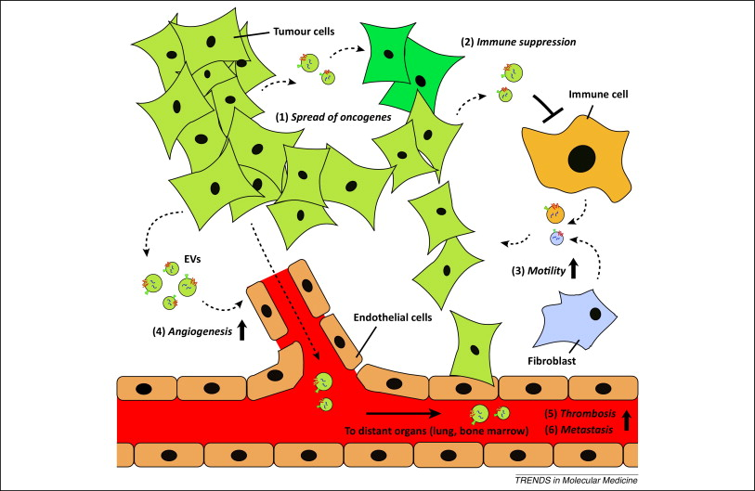
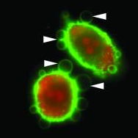
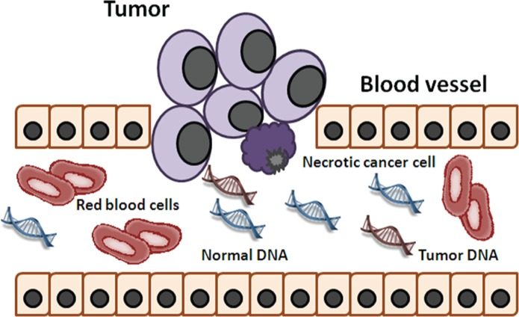
Source of circulating tumor DNA
DNA released in oncoexosomes
DNA released to plasma after necrosis or from apoptotic cells

Slide 7
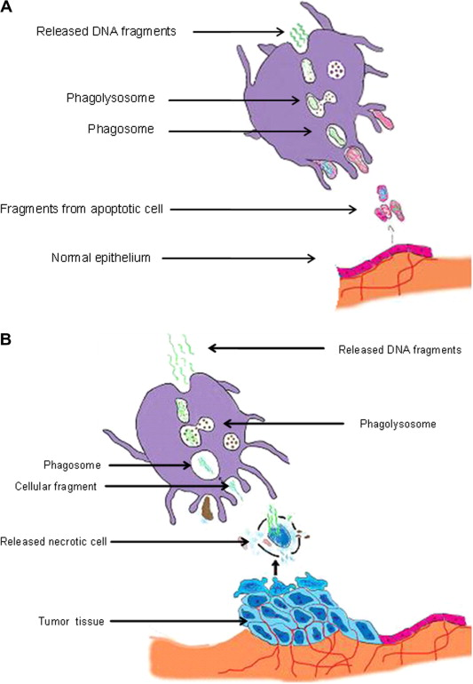
Alternative mechanisms of cfDNA release during phagocytosis.
Unequally sized DNA fragments result from phagocytosis of a necrotic cell (A), whereas uniformly sized DNA fragments are released by macrophage from apoptotic cell (B).
L. Benesova , B. Belsanova , S. Suchanek , M. Kopeckova , P. Minarikova , L. Lipska , M. Levy , V. Visokai , M. ...
Mutation-based detection and monitoring of cell-free tumor DNA in peripheral blood of cancer patients
Analytical Biochemistry, Volume 433, Issue 2, 2013, 227 - 234
http://dx.doi.org/10.1016/j.ab.2012.06.018

Slide 8
Plasma
Cell
Source of DNA and RNA contamination for tests
exosome
miRNA
mRNA
(onco-exosomes) DNA
proteins
miRNA
proteins
DNA
DNA from 7-14 mln cells is circulating in our bodies now (50-100ug).

Slide 9
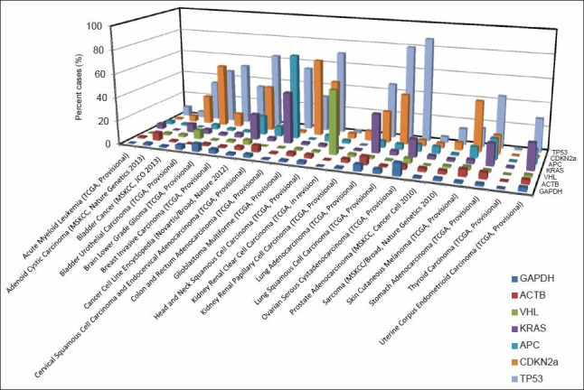
Why we are interested in analysis of circulating free DNA from plasma?
Cancer research
Abundance of mutated genes corresponds to tumor burden.
Mining genome sequencing data to identify the genomic features linked to breast cancer histopathology
Zheng Ping, Gene P. Siegal, Jonas S. Almeida, Stuart J. Schnitt, Dejun Shen J Pathol Inform. 2014; 5: 3. Published online 2014 January 31.doi: 10.4103/2153-3539.126147 PMCID: PMC3952399
Prenatal testing
Circulation of fetal DNA gives opportunity for easy screening for chromosomal aberrations.
Other

Slide 10
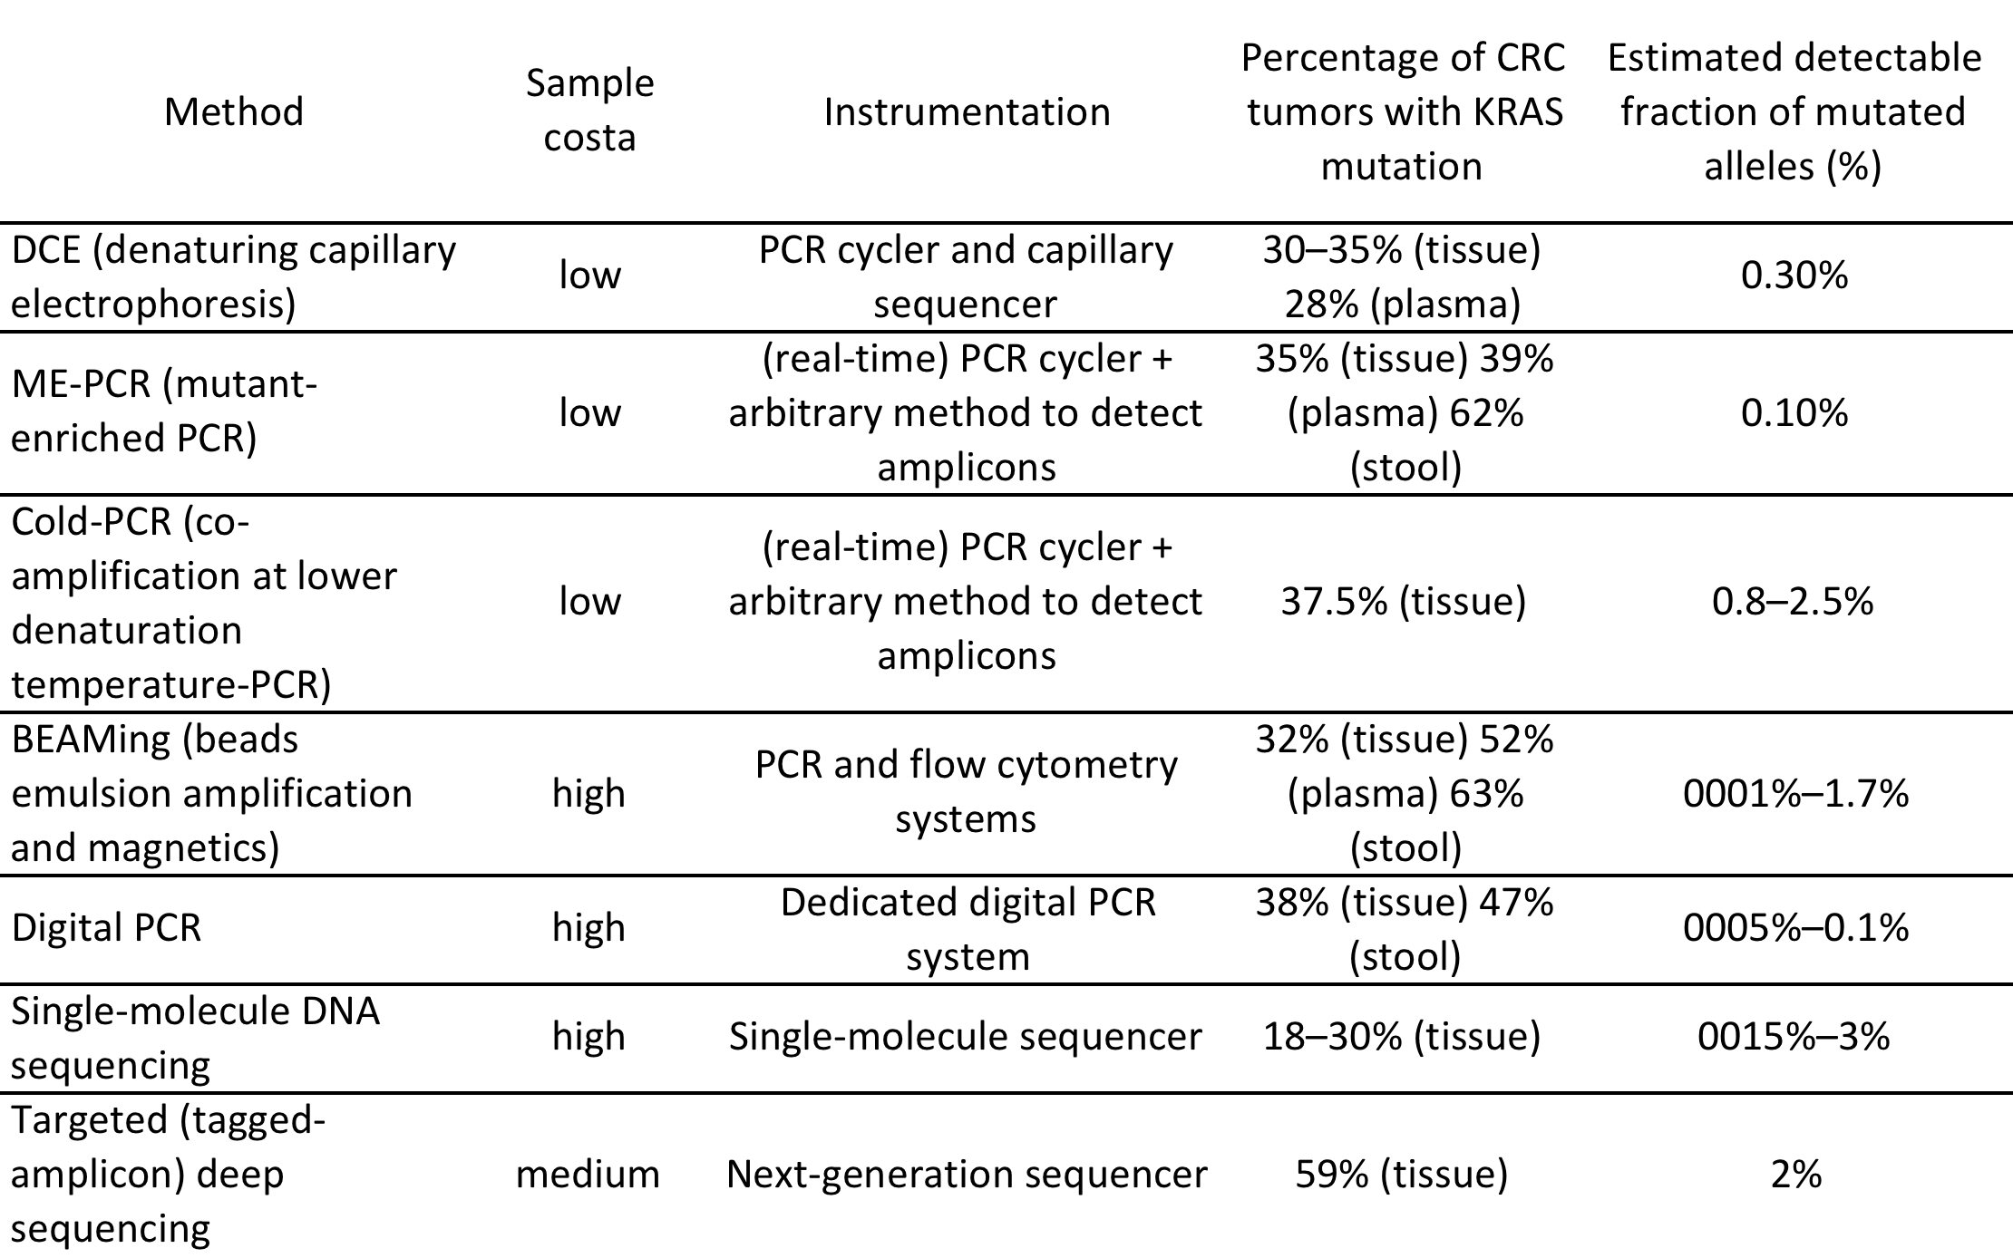
Overview of techniques used for detection of cfDNA in plasma of cancer patients.
L. Benesova , B. Belsanova , S. Suchanek , M. Kopeckova , P. Minarikova , L. Lipska , M. Levy , V. Visokai , M. ...
Mutation-based detection and monitoring of cell-free tumor DNA in peripheral blood of cancer patients
Analytical Biochemistry, Volume 433, Issue 2, 2013, 227 - 234
http://dx.doi.org/10.1016/j.ab.2012.06.018

Slide 11
Calculation of assay sensitivity
10ng of human DNA – 3000 single haploid genomes (C-value – 3.3pg per haploid genome)
We would like to have 60-80% efficiency of tagging what corresponds – around 2000 genomes.
We need depth of sequencing 10,000 -15,000x to saturate system- each molecule must have around 5 copies .
Exome Capture
If our panel has 3 Mb of sequence – we need 45 Gb of sequence. We should get around 30-40 Gb from one/two lanes PE 2x100. We need to use HiSeq2500 for exome capture project.
Amplicon
MiSeq can be use for amplicons – 15mln reads – 500 amplicons

Slide 12
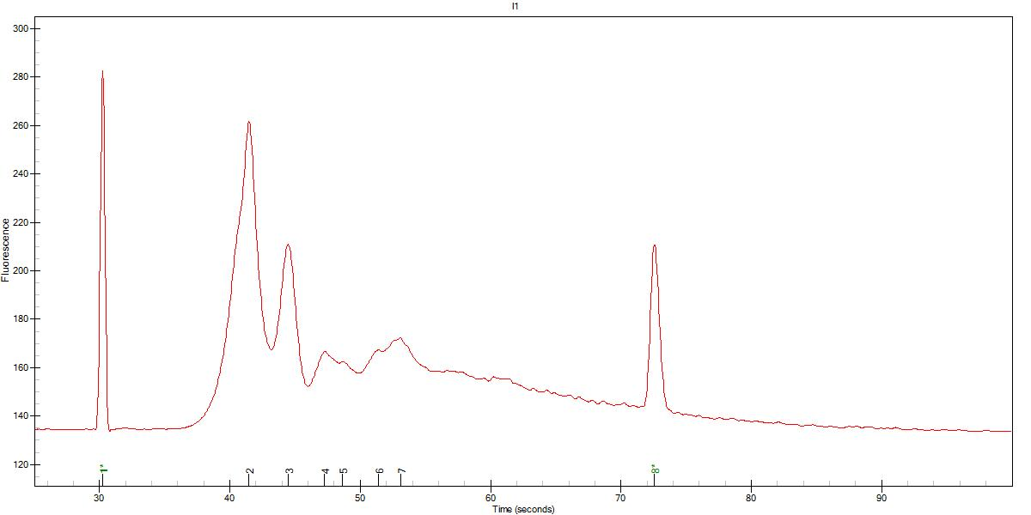
Pattern of DNA size suggests that Histones are involved in DNA protection
280bp
360bp
448bp
643bp
Experion 15K chip
DNA library for Illumina sequencing was prepared from 2 ng cfDNA.
We used Rubicon Genomics ThruPLEX kit for library prep.
The Bioanalyzer traces suggest substantial fragmentation of the circulating DNA.
The size of the dominant pick is similar to the size of DNA wrapped around histone proteins.
Therefore, our working hypothesis predicts the release of chromatin from dead cells and fragmentation by circulating nucleases in the plasma. Fragments of DNA interacting with histones are protected.

Slide 13
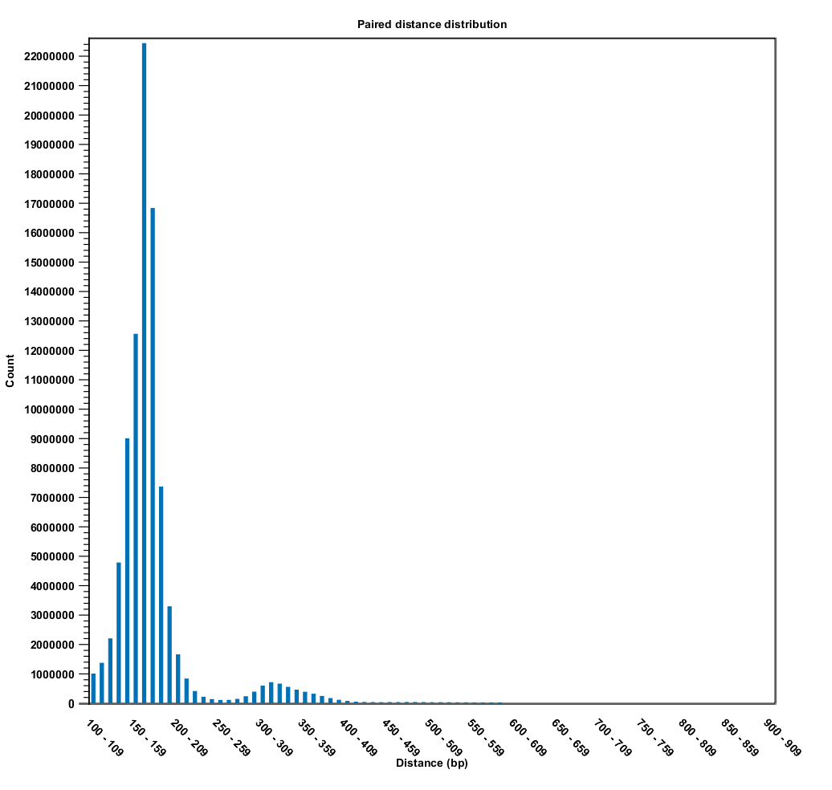
Prepared cf_1 library was subject for Illumina Pair End 2x100 cycles sequencing.
Analysis of the sequencing data was performed using CLC Genomic Workbench 6.01. Insert size distribution confirmed previous observation.
150bp

Slide 14
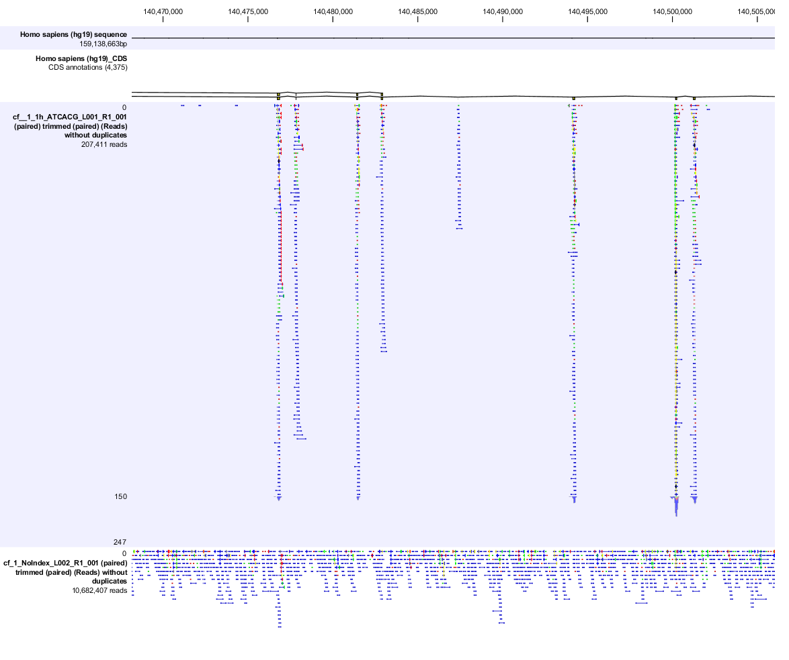
BRAF exomes
Exome Capture
WGS

Slide 15
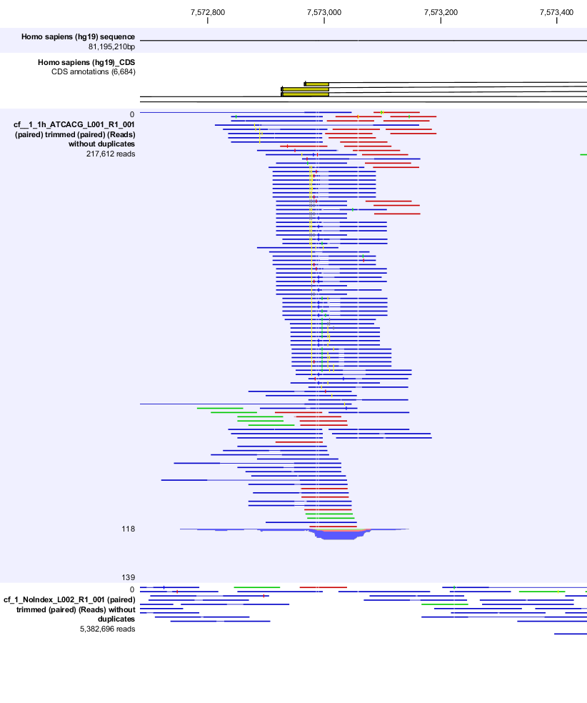
Exome Capture
Exome of p53
WGS

Slide 16
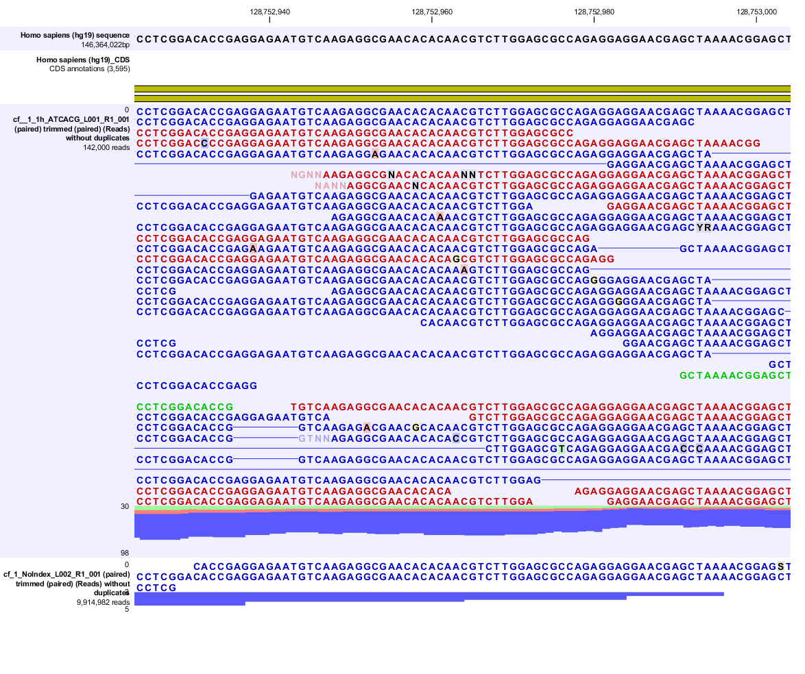
Summary from capture:
We have substantial number of duplicate reads after capture. We can increase input DNA for library prep from 2 to 10ng.
We can improve quality of the reads by implementation of the Molecular Tags Molecular Unique Identifiers) into protocol and overlap sequencing and collapsing into consensus read.

Slide 17
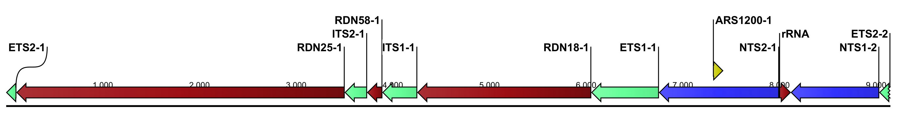
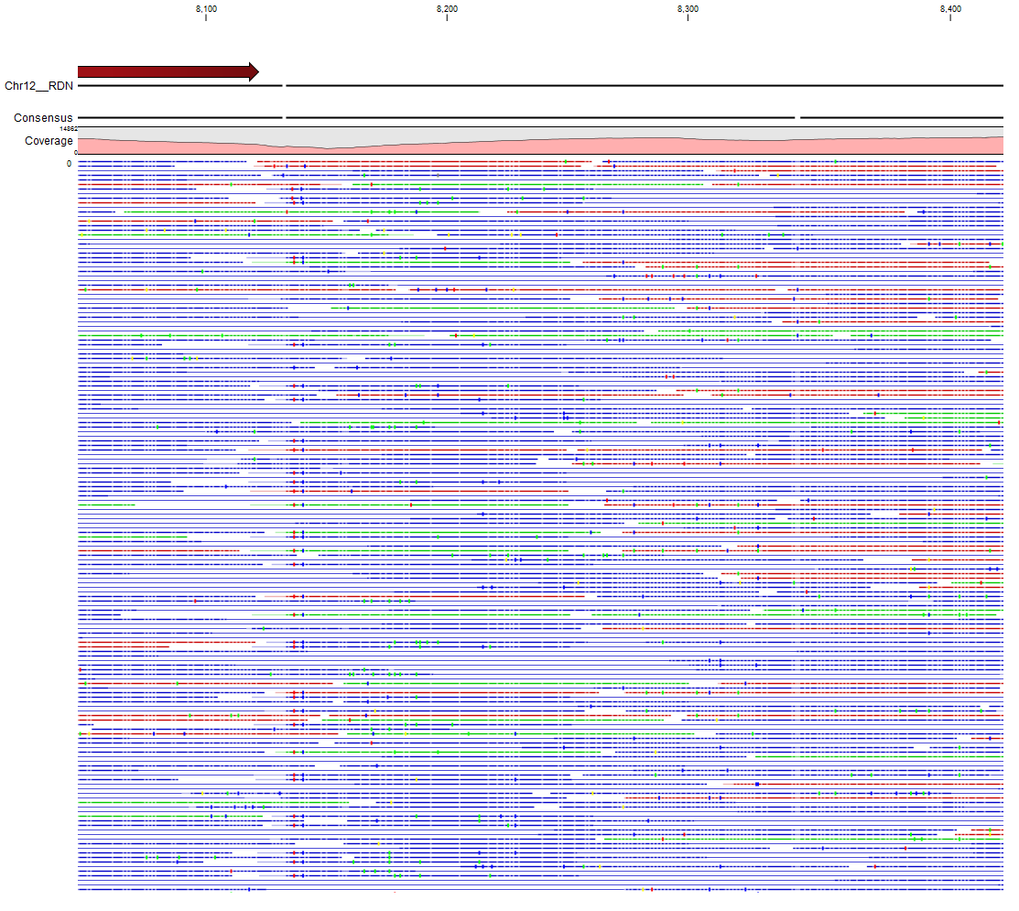
RFB
20,000x coverage

Slide 18
Errors in the system
normal mutant
normal mutant
PCR bias
PCR errors
normal mutant
normal mutant

Slide 19
Bottlenecks
Standard Protocol
Molecular Tagging
10ng of DNA
3000 genomes
10ng of DNA
3000 genomes
10-40%
Ligation
10-40%
Ligation
1300 genomes
copies
1300 genomes
copies
10,000-15,000x
coverage
10,000-15,000x
coverage
Sequencing
Sequencing
Duplicate reads
MT calculations
Consensus from Duplicates
Reduction of sequencing error
Sequencing error rate
0.05%
??????? genomes
1,300 genomes

Slide 20
We can use a library containing Molecular Tags (Molecular Unique Identifiers) for both Exome Capture and Amplicon Sequencing to increase sensitivity of mutation detection
Prepare MT Sequencing Libraries
Duplex adapters *
Modified TruSeq adapters
Single stranded DNA assay
Amplicon sequencing of selected targets
Detection of ultra-rare mutations by next-generation sequencing
Michael W. Schmitt, Scott R. Kennedy, Jesse J. Salk, Edward J. Fox, Joseph B. Hiatt, Lawrence A. Loeb
Proc Natl Acad Sci U S A. 2012 September 4; 109(36): 14508–14513. Published online 2012 August 1. doi: 10.1073/pnas.1208715109
PMCID: PMC3437896

Slide 21
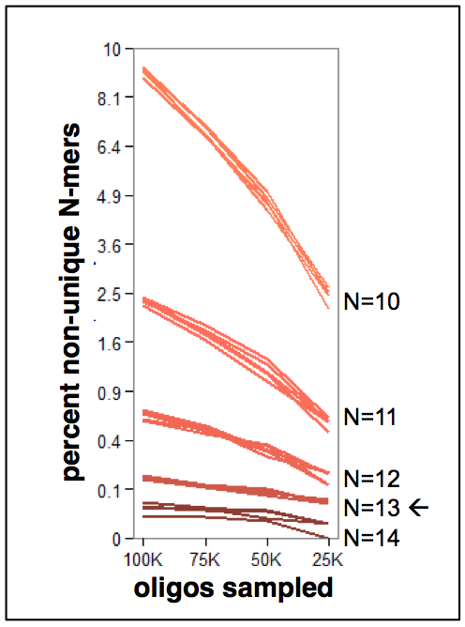
Molecular Tags (MT) – Amplicon Strategy
1)
→
sequencing primer MT/FS 515F
GCCTCCCTCGCGCCATCAGAGATGTGTATAAGAGACAG NNNNNNNN GAGTGCCAGCMGCCGCGGTAA
1)
806R MT/FS sequencing primer
TAATCTWTGGGVHCATCAGGCA NNNNN TCTAGCCTTCTCGTGTGCAGACTTGAGGTCAGTG
→
Duplicate tags
  Tag individual DNA templates with a random oligo before PCR and sequencing
  Reduces sequencing errors and PCR bias
GGTC
ATAGGTCAGAT
GGTC
ATAGGTCGGAT
GGTC
ATAGGTCAGAT
GGTC
ATAGGTCAGAT
The birthday paradox concerns the probability that, in a set of n randomly chosen people, some pair of them will have the same birthday. The probability reaches 100% when the number of people reaches 367 (since there are 366 possible birthdays, including February 29). However, 99% probability is reached with just 57 people, and 50% probability with 23 people.

Slide 22
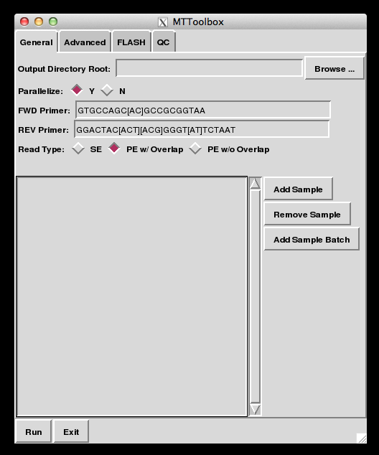
MTToolbox
https://sites.google.com/site/moleculetagtoolbox/
Parallelizable
  A 96 sample run takes ~1 hour
GUI
Extended Edition
  Build OTUs (OTUpipe)
  Remove host contaminants
  (BLAST+)
  OTU taxonomy assignments
  (RDP Classifier/QIIME)

Slide 23

Preprocess PE reads
Categorize by MT
Final Consensi
ATTCGTAGAG
ATAGTTTCAC
Correct and Merge Pairs
ATTCGTAGAGTTTCAC
ATTC-TCAC
ATTCGTATAG
ATAGTTTCAC
ATTC-TCAC
GTAGAGTT
ATTCGTAGAGTTTCAC
GTAGAGTT
GTAGAGTT
ATTCGTATAG
GTAGAGTA
ATAGTATCAC
ATTCGTAGAGTATCAC
GCATACGTGG
GCAT-CCAG
GTGGTGCCAG
GCAT-CCAG
GCATACGTGGTGCCAG
ACGTGGTG
ACGTGGTG
GCATACGTGG
ACGTGGTG
GTGGTGCCAG
GCATACGTGGTGCCAG
Notes:
Supp Figure B: MTToolbox PE reads with overlap workflow example with five reads
In a preprocessing step PE reads are merged using FLASH. Read 1 shows that FLASH corrects discrepancies between merged reads by choosing the base with the highest quality score. Reads are then categorized by their MT. Discrepancies between reads with the same MT are corrected based on the majority base. In the event of a tie the base with the highest average quality score is used. A high quality consensus sequence is generated from each MT category.

Slide 24
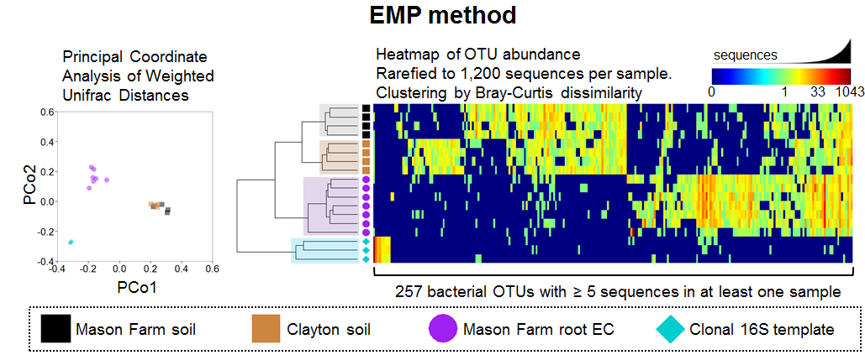
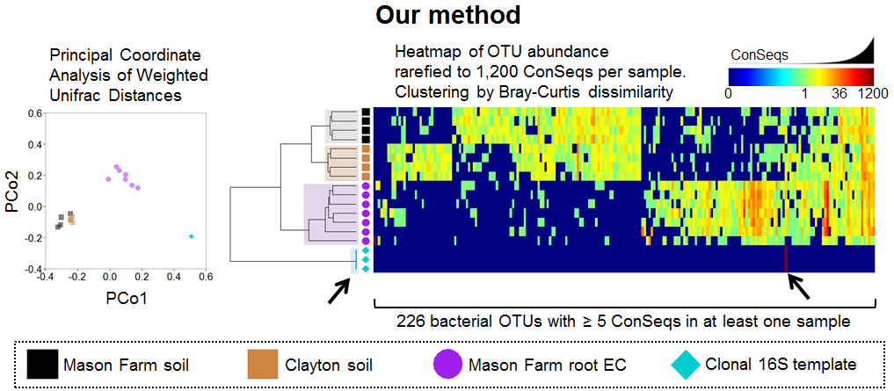
Amplicon Strategy

Slide 25
Bottlenecks - Exome Capture Strategy
Standard Protocol
Molecular Tagging
10ng of DNA
3000 genomes
10ng of DNA
3000 genomes
10-40%
Ligation
10-40%
Ligation
1300 genomes
copies
1300 genomes
copies
10,000-15,000x
coverage
10,000-15,000x
coverage
Sequencing
Sequencing
Duplicate reads
MT calculations
Consensus from Duplicates
Reduction of sequencing error
Sequencing error rate
0.05%
??????? genomes
1,300 genomes

Slide 26
Adapters containing Molecular Tags (MT) used for experiment
Ligation
T
MT
A
Duplex MT Adapter
Detection of ultra-rare mutations by next-generation sequencing
Michael W. Schmitt, Scott R. Kennedy, Jesse J. Salk, Edward J. Fox, Joseph B. Hiatt, Lawrence A. Loeb
Proc Natl Acad Sci U S A. 2012 September 4; 109(36): 14508–14513. Published online 2012 August 1. doi: 10.1073/pnas.1208715109
PMCID: PMC3437896
MT
index
A
TruSeqPMT Adapter
T
MT
MT
index
A
PMT1 Adapter
T
MT

Slide 27
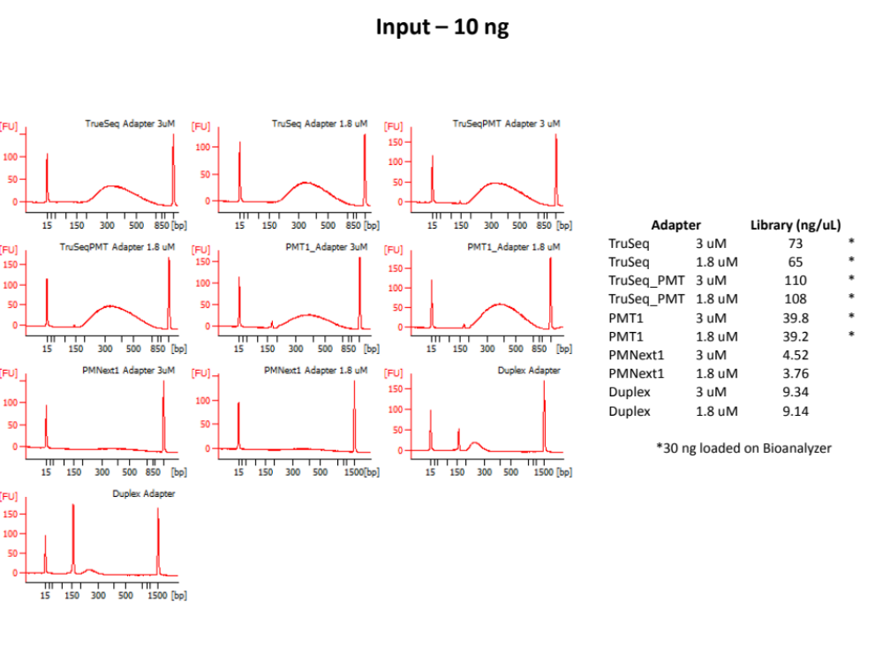
Efficiency of Library construction using different types of adapters
Library prep performed using KAPA Hyper Library prep kit
DNA input 10ng

Slide 28
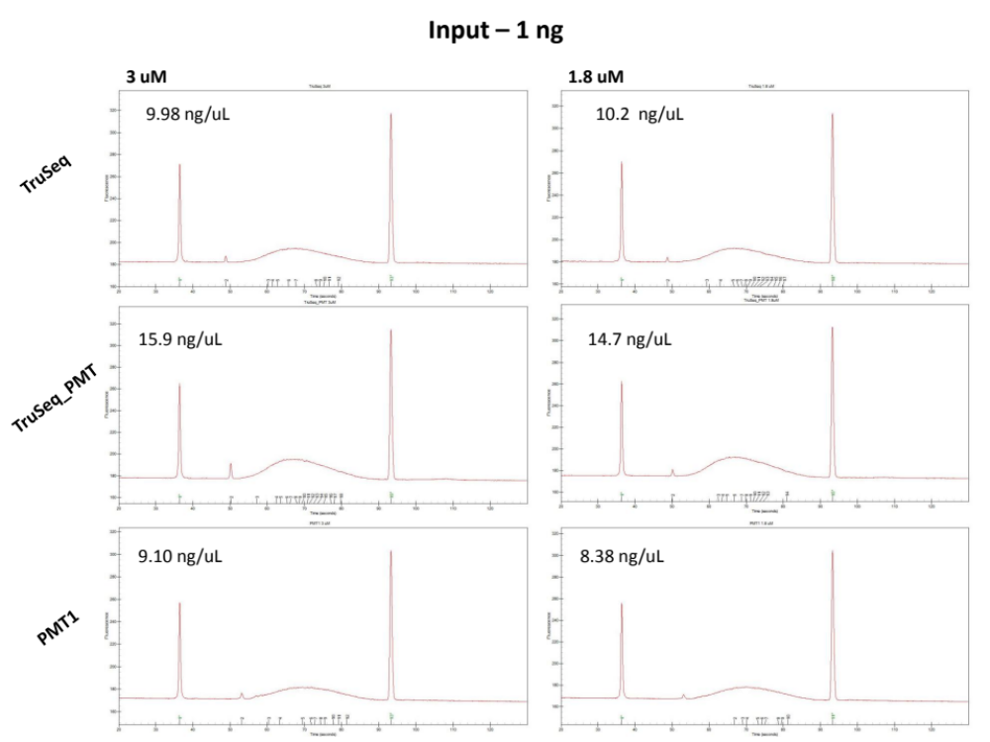

Slide 29


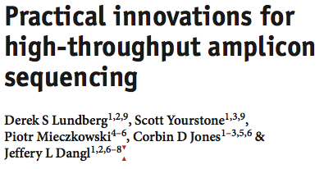
Acknowledgements
Mieczkowski Lab + HTSF
Ewa Malc
Donghui Tan
Liz Sheffield
Maryam Clausen
Alicia Brandt
Nick Schuch
Uma Veluvolu
Scot Waring
Tara Skelly
Hemant Kelkar
Tristan De Buysscher
Corbin Jones
Margaret L. Gulley
Tomasz Kozlowski
The UNCseq Team
(Earp, Hayes, Sharpless, Grilley-Olson)
Over 30 individuals involved at LCCC

