Slide 1
Respiratory Rate as a Predictor of Weaning from Mechanical Ventilation (VM)
Emídio Lima
MD, PhD

Slide 2
Mortality Increases with the Duration of Mechanical Ventilation and Weaning Failure

Slide 3
Weaning Failure
The Average Rate is 30%
Increases Mortality (43%) and Morbidity

Slide 4
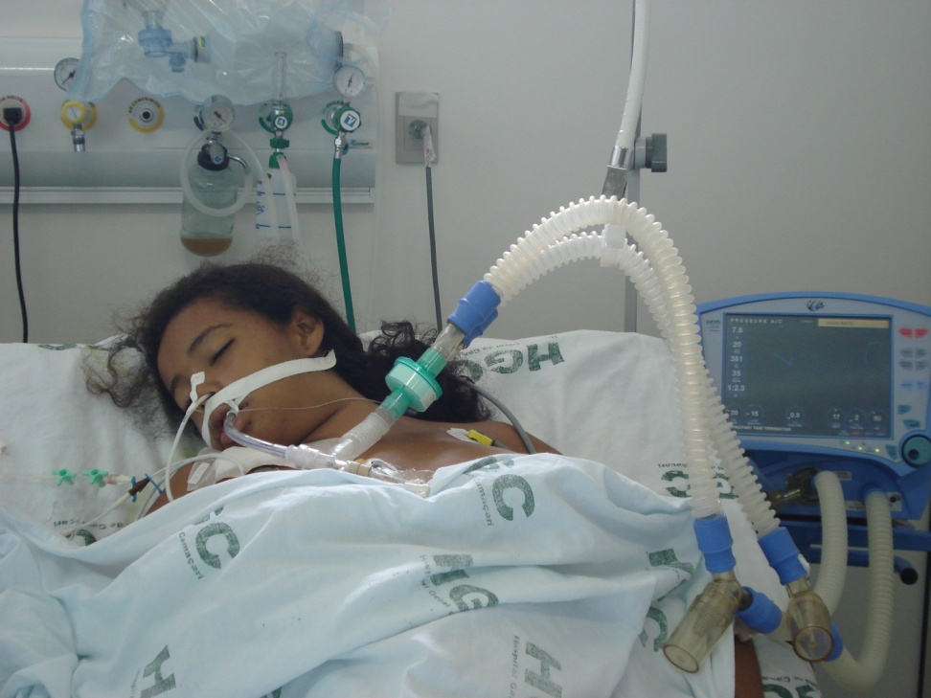
The Size of the Problem
46% of the Critical Patients Require MV

Slide 5
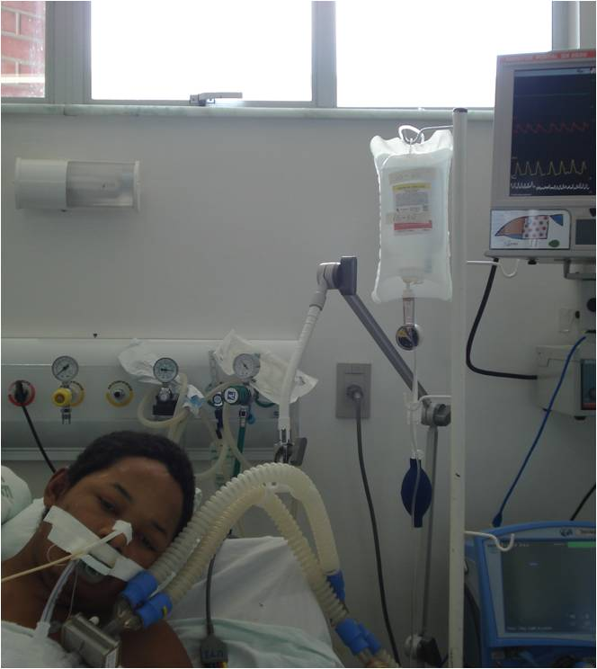

We need Successfully Weaning Patients
Mechanical Ventilation
Weaning Success

Slide 6
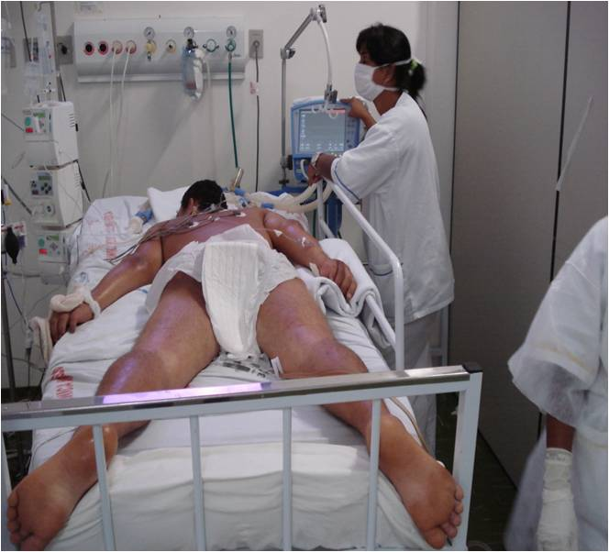
Our Solution
We Studied 166 Patients
During Weaning
Age over 18 y

Slide 7
Inclusion and Weaning Criteria
Improvement
Vigil/Calm
No fever
Hemodynamic stability
Metabolic stability

Slide 8
Inclusion and Weaning Criteria
PaO2/FiO2 > 200
Tidal Volume (VT) > 5 ml/Kg
Respiratory Rate (RR) ≤ 35 bpm
RR/VT < 105 b.m.L

Slide 9
Additional Measures
Static Compliance (Cst)
Maximum Inspiratory Pressure (MIP < 20 cmH2O)

Slide 10
Spontaneous Breathing Trial (SBT)
30 Minutes
PSV 7 cmH2O
FiO2 ≤ 40%
PEEP 5 cmH2O

Slide 11

Weaning Success = SBT success, extubation and Spontaneous Breathing > 48 hours
MV
Weaning Success

Slide 12
Weaning Failure = SBT Failure
RR > 35 bpm
RR/VT > 105
SaO2 < 90%
Arrhythmias
Dyspnea
Psychomotor Agitation

Slide 13
Extubation Failure:
Reintubation within 48 h after Extubation

Slide 14
Results:
166 Patients
Mean Age 53 y
94 Males
Mean Duration of MV 4 days

Slide 15
Causes of MV:
Postoperative 25.9%
Pneumonia 13.8%
Coma 10.2%
Pulmonary Edema 9.6%
Sepsis 7.8%
Exogenous Intoxication 7.2%
Aspiration 4.8%
Seizures 4.2%

Slide 16
166 Patients:
Mortality 29 Patients (17.5%)
Survival 137 Patients (82.5%)
Weaning Success 127 Patients (76.5%)

Slide 17
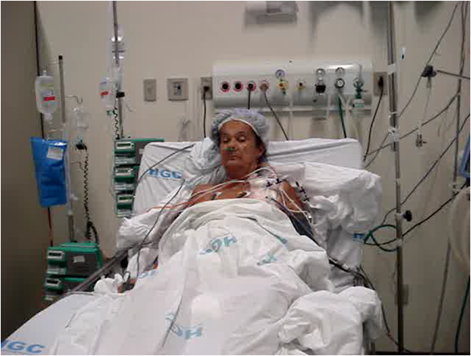
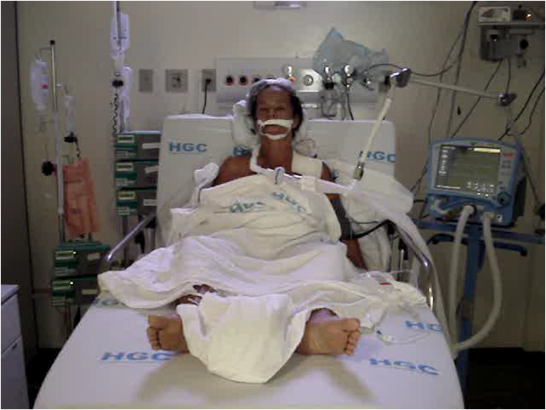
Weaning Success
SBT
Weaning Success

Slide 18
166 Patients
Weaning Failure (SBT Failure) 29 Patients (17.5%)
Extubation Failure 10 Patients (6%)

Slide 19
Extubation Failure Causes:
Pulmonary Edema 50%
Bronchospasm 30%
Laryngeal Edema 10%
Respiratory Infection 10%

Slide 20
Mortalities:
12.6% in Weaning Success
20.7% in Weaning Failure
70% in Extubation Failure

Slide 21
Patients with Extubation Failure had the Highest Mortality
(p = 0.0001)

Slide 22
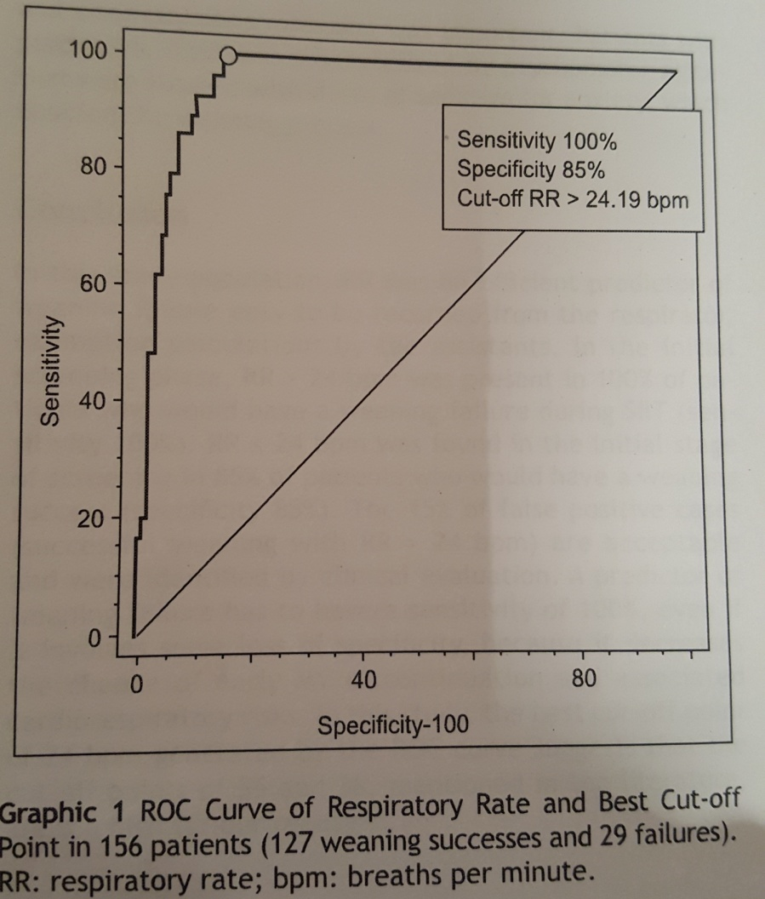
Respiratory Rate, > 24 bpm, as a Predictor of Weaning Failure

Slide 23
Respiratory Rate > 24 bpm
Sensitivity 100%
Specificity 85%
NPV 100%
PPV 60%
LR+ 6.68
LR- 0.0

Slide 24
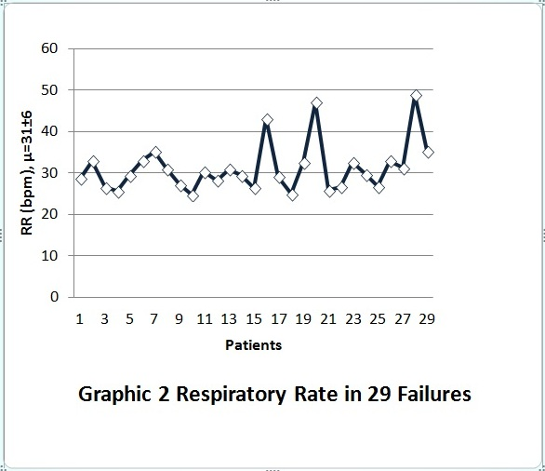
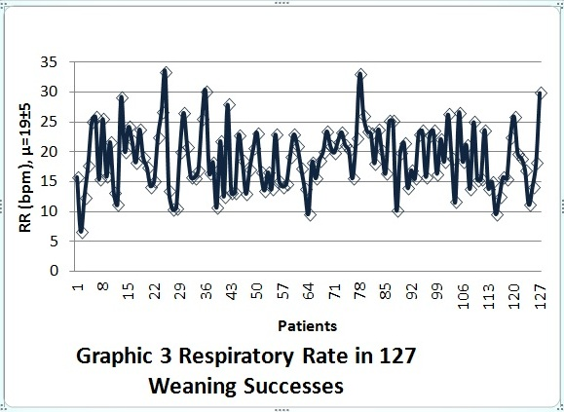
Respiratory Rate in Weaning Failure and Success: Accuracy 88%, p < 0.0001

Slide 25
No Difference in RR Behavior among Extubation Failures Compared to the Successes
p = 0.7313

Slide 26
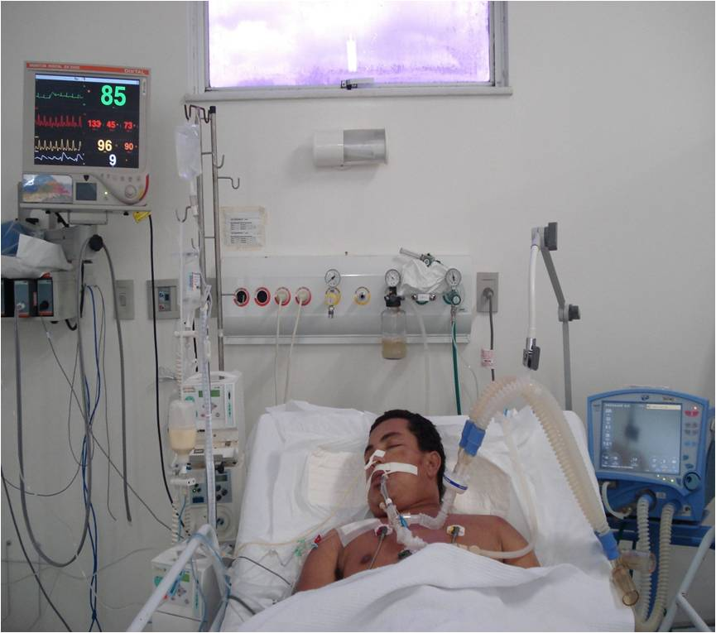

Conclusion: RR an Efficient, Practical Predictor of Weaning Failure (Cut-off > 24)
MV
Weaning Success

Slide 27
Questions

Slide 28
Thank for Your Attention
Emídio Lima
MD, PhD
Laureate International Universities

