Slide 1

Inhibition of Terrestrial Snails Glutamate decaboxylase (GAD) by Abamectin and Emamectin benzoate
Presented by
Elsayed A.M. Abdallah
Prof. of Pesticide Chemistry & Toxicology
Chemistry & Technology of Pesticides Dept.
Fac. Agric., Alexandria Univ.
EGYPT

Slide 2
Introduction

Slide 3
Introduction
The aim of this research is to assess the molluscicidal activity as well as biochemical impact of non conventional pesticides as Abamectin and its deoxy-4'–epi- methylamine derivative (Emamectin benzoate) as well as standard conventional molluscicide methomyl against two species of the terrestrial snails brown garden snail (BGS) Eobania vermiculata and white garden snail (WGS) Theba pisana.

Slide 4
Introduction
In Egypt, land snails are known as dangerous pests to field crops, vegetables, orchards and ornamental plants. Damage caused by snails is mainly due to feeding and contamination with their bodies, feces or the exudated slime material, leading to deterioration of the product quality besides the financial loss.

Slide 5
Introduction
Land snails attack leaves, flowers, roots, buds, and even the trunk of trees causing great damage to the several types of cultivated plants.

Slide 6
Introduction
Glutamate decarboxylase (GAD, EC 4.1.2.5) has been shown to play an important role in the regulation of brain excitability through the synthesis of γ-aminobuteric acid (GABA) the major inhibitory neurotransmitter in the central nervous system and is considered a specific marker for GABAergic neurons and their processes

Slide 7
Introduction
In Mollusca, GABA has been shown to elicit both inhibitory and excitatory actions in the central neurons.

Slide 8
Introduction
In vivo effects of abamectin, emamectin benzoate and methomyl were investigated against the activities of Eobania vermiculata (BGS) and Theba pisana (WGS) glutamate decaboxylase (GAD).

Slide 9
Introduction
GAD activity was evaluated by measuring the formed GABA after derivatization to phenylthio carbamoyl GABA (PTC-GABA) using HPLC with UV absorbance detection at 245 nm.

Slide 10
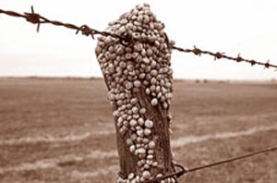
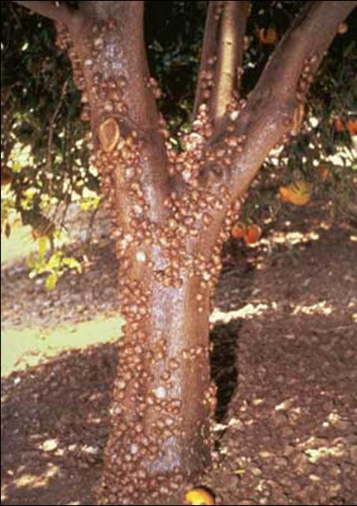

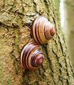
Introduction

Slide 11
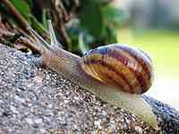
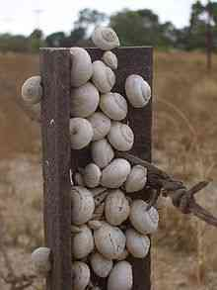
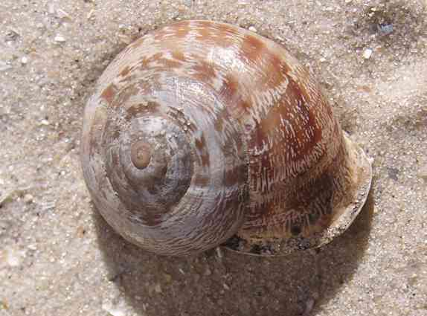
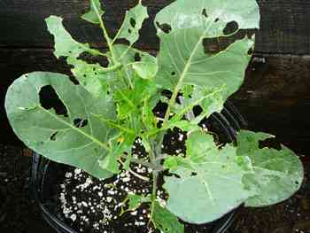
Introduction

Slide 12
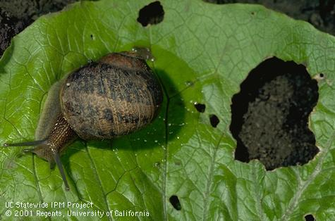
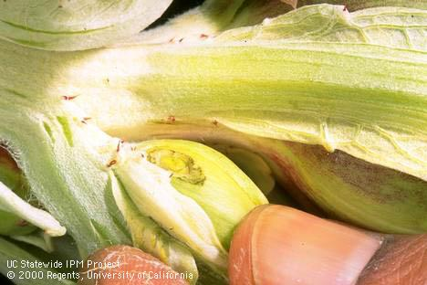
Introduction

Slide 13
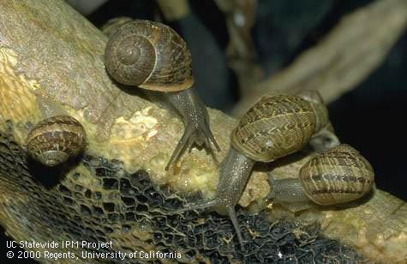
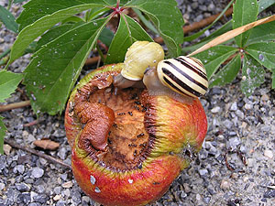
Introduction

Slide 14
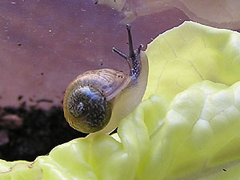
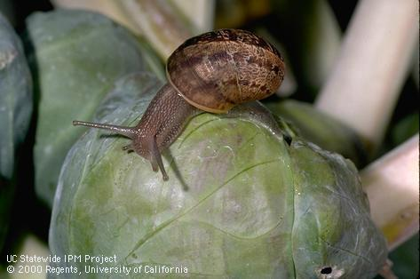
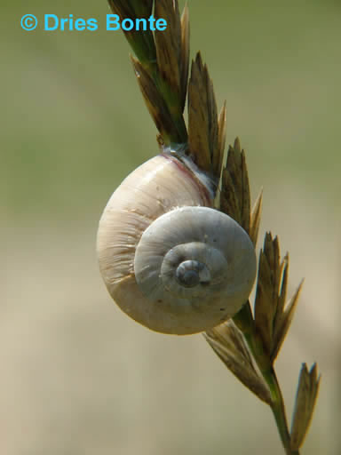
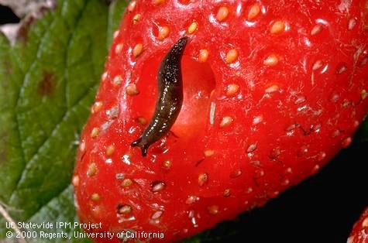
Introduction

Slide 15
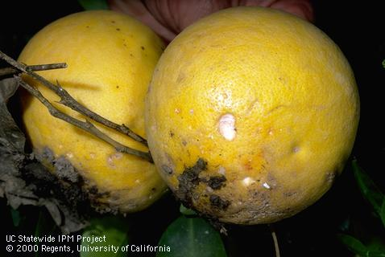
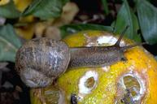
Introduction

Slide 16
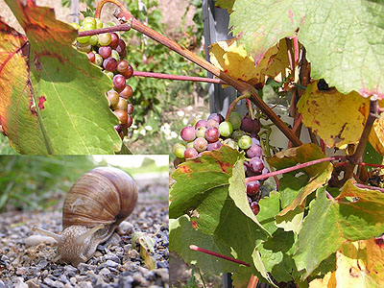
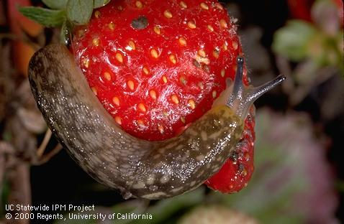
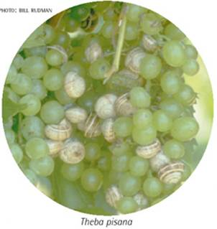
Introduction

Slide 17

Materials & Methods

Slide 18
Materials & Methods
I- Tested Pesticides
II- Tested Snails
III- Biochemical Studies
Emamectin benzoate
Eobania vermiculata
Theba pisana
GABAergic
Abamectin
Methomyl
GAD

Slide 19
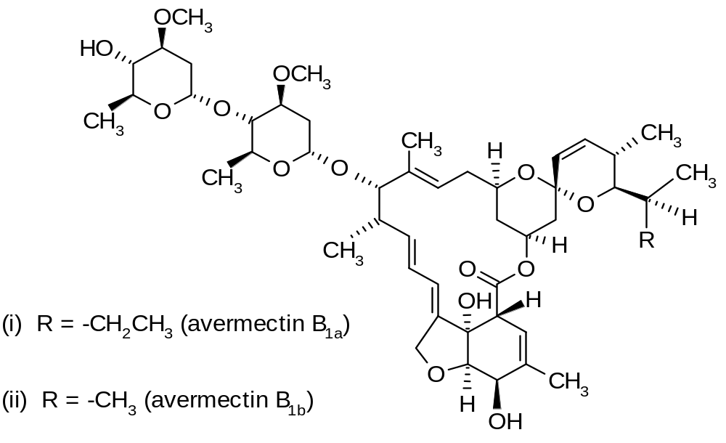
Chemical structure of Abamectin
Chemical name
5-O-demethylavermectin A1a (i) mixture with 5-O-demethyl-25-de(1-methylpropyl)-25-(1-methylethyl)avermectin A1a (ii)

Slide 20
Biochemistry
Acts by stimulating the release of γ-aminobutyric acid, an inhibitory neurotransmitter, thus causing paralysis. See M. J. Turner & J. M. Schaeffer in Ivermectin and Abamectin, W. C. Cambell ed., Springer-Verlag, New York (1989) p. 73.
Mode of action
Insecticide and acaricide with contact and stomach action. Has limited plant systemic activity, but exhibits translaminar movement.
Uses
Control of motile stages of mites, leaf miners, suckers, Colorado beetles, etc. on ornamentals, cotton, citrus fruit, pome fruit, nut crops, vegetables, potatoes, and other crops. Application rates are 5.6 to 28 g/ha for mite control, 11 to 22 g/ha for control of leaf miners. Also used for control of fire ants.

Slide 21
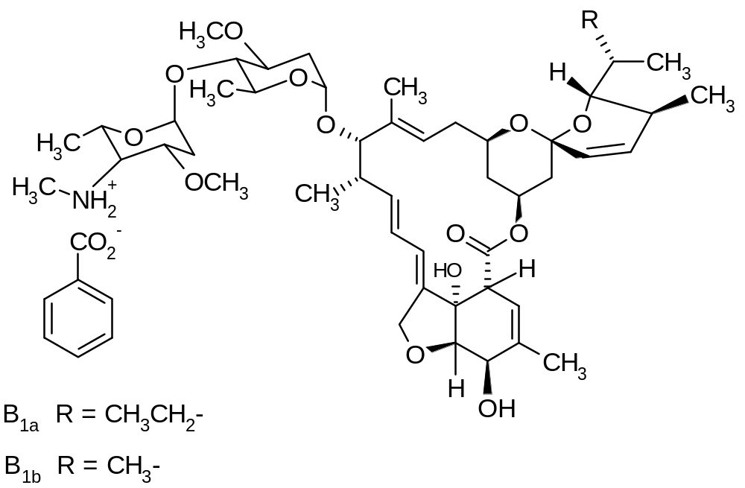
Chemical structure of Emamectin benzoate
Chemical name
(4"R)-5-O-demethyl-4"-deoxy-4"-(methylamino)avermectin A1a + (4"R)-5-O-demethyl-25-de(1-methylpropyl)-4"-deoxy-4"-(methylamino)-25-(1-methylethyl)avermectin A1a (9:1)

Slide 22
Mode of action
Non-systemic insecticide which penetrates leaf tissues by translaminar movement.
Uses
For control of lepidoptera on vegetables, brassicas and cotton, at up to 16 g/ha, and in pine trees at 5-25 g/ha.

Slide 23
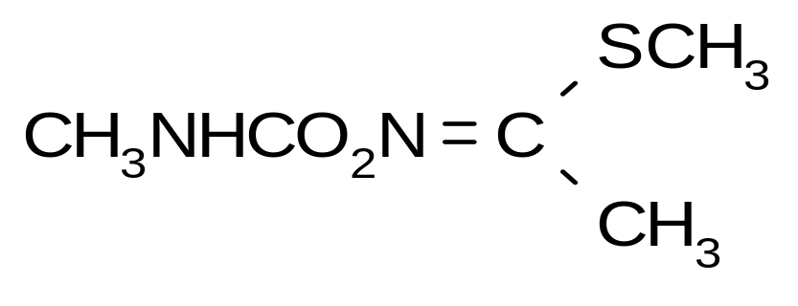
Chemical structure of Methomyl
Chemical name
methyl N-[[(methylamino)carbonyl]oxy]ethanimidothioate

Slide 24
Biochemistry
Cholinesterase inhibitor.
Mode of action
Systemic insecticide and acaricide with contact and stomach action.
Uses
Control of a wide range of insects (particularly Lepidoptera, Hemiptera, Homoptera, Diptera and Coleoptera) and spider mites in fruit, vines, olives, hops, vegetables, ornamentals, field crops, cucurbits, flax, cotton, tobacco, soya beans, etc. Also used for control of flies in animal and poultry houses and dairies.

Slide 25
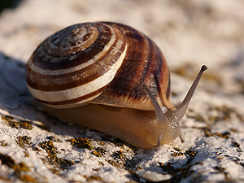
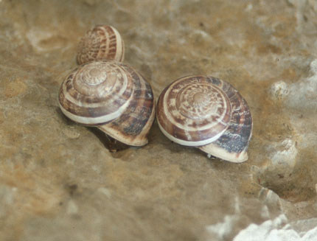
Tested mollusca
Order : Stylommatophora
Super family : Helicoidea
Family : Helicidae
Species
Sub family : Helicinae
Genus : Eobania
Eobania vermiculata

Slide 26

Tested mollusca
Order : Stylommatophora
Super family : Helicoidea
Family : Helicidae
Sub family : Helicinae
Species
Genus : Thepa
Theba pisana

Slide 27
Materials & Methods
Bioassy
Topical Application technique
The collected snails were adapted to the laboratory conditions for two weeks before they were treated.
Dimethyl sulfoxide (DMSO) solutions of Abamectine, Emamectin benzoate and Methomyl were applied topically on the terrestrial snails Theba pisana and Eobania vermiculata and the mortality percentages were recorded after 24, 48 and 72 hours.

Slide 28
Biochemical Studies
Snails were initially treated with ¹/₁₀ LD₅₀, ¹/₅ LD₅₀ and ¹/₂ LD₅₀ of tested pesticides
After 24, 48 and 72 h Snails were collected.
Homogenate
GABAergic
GAD
Materials & Methods

Slide 29
III- Biochemical Studies
Materials & Methods
Glutamic acid decarboxylase (GAD)
Assay principle
(According Allen and Griffiths (1984). Glutamate decarboxylase or glutamic acid decarboxylase (GAD) is an enzyme that catalyzes the decarboxylation of glutamate to GABA and CO₂. GAD uses PLP as a cofactor. The reaction proceeds as follows:

Slide 30
Materials & Methods
Glutamic acid Decarboxylase (GAD)
Allen and Griffiths (1984).
snails were homogenized in 200 mM potassium phosphate buffer, pH 6.8
Centrifuged at 5000 rpm for 30 min at 4 ^{O}C
Supernatant served as enzyme source
100 µl
Enzyme source
0.5 ml
200 mM potassium phosphate buffer, pH 6.8
15 µl
50 mM L-Glu
55 µl
0.2 mM pyridoxal-5'-phosphate (PLP)
incubation for 20 min at 37°C
3 ml absolute ethanol was added to terminate the reaction.
The suspension was centrifuged at 1500 rpm (10 min, 0°C).

Slide 31
Derivatization of GABA and Glutamic acid to Phenylthiocarbamyl-GABA (PTC- GABA) and Phenylthiocarbamyl-Glutamic (PTC- GLU)
According to Gunawan et al. (1990).

Slide 32
Derivatization of GABA to phenylthiocarbamyl-GABA (PTC- GABA) Gunawan et al. (1990).
A 100 µl aliquot of supernatant (or of standard solution of GABA)
Standard solutions of GABA & Glu. (0.125, 0.25, 0.50 and 0.75 mM GABA & Glu. ).
dried under vacuum
The residue was dissolved in 20 µl of ethanol-water- triethylamine (2:2:1) and evaporated to dryness under vacuum
Add 30 µl volume of ethanol-water- triethylamine-PITC (7:1 : 1 : 1)
React for 20 min at room temperature to form PTC-GABA or Glu. and the excess reagent was then removed under vacuum
the dry residue dissolved in 100 µl of mobile phase

Slide 33
HPLC operating conditions.
Type | : HPLC system ( Agilent 1100 )
Column. | : 250 mm. × 4.6 mm. I.D. stainless steel Zorbax SB C18
Temperature | : 30 ⁰C
Detector | : HP 1100 UV variable wave length detector.
Wave length | : 245 nm
Injector volume | : Injection loop -20 µl
Mobile phase | :80% solution A (aqueous solution of 8.205 g sodium acetate, 0.5 ml triethylamine, 0.7 ml acetic acid and 5.0 ml acetonitrile in 1000 ml) :20% solution B [Acetonitrile-water (60:40)] :Adjusted to pH 5.8.
Flow rate | : 0.6 ml/min

Slide 34
Results

Slide 35

Table (1): Effect of Abamectin against Eobania vermiculata (BGS) and Theba pisana (WGS) snails using topical application technique, shown as mortality percentage % and LD₅₀ values, at 24, 48 and 72 hr.
Slope | Conf. Limits 95% |  | LD₅₀ μg/ Snail | Dose μg/ Snail |  |  |  |  |  |  | Hours
 | Lower | Upper |  | 50 | 25 | 20 | 15 | 10 | 5 | 2.5
Eobania vermiculata
0.813 | 3.706 | 7.742 | 5.738 | 77.78 | 71.11 | 68.89 | 60.00 | 55.56 | 51.11 | 37.78 | 24
0.716 | 0.504 | 2.777 | 1.552 | 86.67 | 80.00 | 77.78 | 75.56 | 71.11 | 68.89 | 53.33 | 48
0.782 | 0.251 | 1.816 | 0.927 | 93.33 | 88.89 | 84.44 | 80.00 | 75.56 | 71.11 | 66.67 | 72
Slope | Conf. Limits 95% |  | LD₅₀ μg/ Snail | Dose μg/ Snail |  |  |  |  |  |  | Hours
 | Lower | Upper |  | 2.5 |  | 1.25 | 0.625 | 0.25 | 0.125
Theba pisana
1.923 | 0.358 | 0.498 | 0.421 | 100 |  | 82.22 | 62.22 | 33.33 | 15.56 |  | 24
1.804 | 0.125 | 0.199 | 0.163 | 100 |  | 95.56 | 86.67 | 62.22 | 42.22 |  | 48
1.881 | 0.119 | 0.189 | 0.155 | 100 |  | 95.56 | 86.67 | 66.67 | 42.22 |  | 72

Slide 36
Table (2): Effect of Emamectin benzoate against Eobania vermiculata (BGS) and Theba pisana (WGS) snails using topical application technique, shown as mortality percentage % and LD₅₀ values, at 24, 48 and72hr.
Slope | Conf. Limits 95% |  | LD₅₀ μg/ Snail | Dose μg/ Snail |  |  |  |  |  |  | Hours
 | Lower | Upper |  | 50 | 25 | 20 | 15 | 10 | 5 | 2.5
Eobania vermiculata
0.888 | 30.636 | 73.866 | 43.013 | 57.78 | 40.00 | 37.78 | 28.89 | 26.67 | 22.22 | 15.56 | 24
0.887 | 9.76 | 16.296 | 12.615 | 77.78 | 60.00 | 55.56 | 44.44 | 44.44 | 33.33 | 33.33 | 48
0.962 | 1.82 | 6.944 | 4.808 | 93.33 | 71.11 | 66.67 | 64.44 | 60.00 | 51.11 | 44.44 | 72
Slope | Conf. Limits 95% |  | LD₅₀ μg/ Snail | Dose μg/ Snail |  |  |  |  |  |  | Hours
 | Lower | Upper |  | 25 | 12.5 | 10 | 7.5 | 5 | 2.5 | 1.25
Theba pisana
1.088 | 2.204 | 3.771 | 2.997 | 100 | 77.78 | 71.11 | 66.67 | 55.56 | 46.67 | 35.56 | 24
1.165 | 0.394 | 1.212 | 0.799 | 100 | 93.33 | 88.89 | 84.44 | 82.22 | 77.78 | 55.56 | 48
1.358 | 0.249 | 0.991 | 0.63 | 100 | 100 | 100 | 93.33 | 88.89 | 77.78 | 66.67 | 72

Slide 37
Table (3): Effect of Methomyl against Eobania vermiculata (BGS) and Theba pisana (WGS) snails using topical application technique, shown as mortality percentage % and LD₅₀ values, at 24, 48 and 72 hr.
Slope | Conf. Limits 95% |  | LD₅₀ μg/ Snail | Dose μg/ Snail |  |  |  |  |  |  | Hours
 | Lower | Upper |  | 50 | 25 | 20 | 15 | 10 | 5 | 2.5
Eobania vermiculata
1.059 | 58.037 | 186.2 | 89.507 | 37.78 | 28.89 | 26.67 | 22.22 | 11.11 | 11.11 | 4.44 | 24
0.926 | 37.265 | 97.787 | 53.772 | 44.44 | 44.44 | 33.33 | 33.33 | 22.22 | 15.56 | 11.11 | 48
0.812 | 19.48 | 40.096 | 26.148 | 53.33 | 51.11 | 51.11 | 44.44 | 33.33 | 33.33 | 15.56 | 72
Slope | Conf. Limits 95% |  | LD₅₀ μg/ Snail | Dose μg/ Snail |  |  |  |  |  |  | Hours
 | Lower | Upper |  | 25 | 12.5 | 10 | 7.5 | 5 | 2.5 | 1.25
Theba pisana
0.886 | 38.55 | 221.87 | 70.39 | 31.11 | 24.44 | 24.44 | 22.22 | 17.78 | 8.89 | 4.44 | 24
0.572 | 13.431 | 59.069 | 21.839 | 51.11 | 44.44 | 44.44 | 37.78 | 33.33 | 33.33 | 22.22 | 48
0.777 | 3.487 | 6.426 | 4.853 | 66.67 | 62.22 | 60.00 | 55.56 | 55.56 | 51.11 | 22.22 | 72

Slide 38
Table (4): Comparative toxicity of tested pesticides against Eobania vermiculata (BGS) and Theba pisana (WGS) snails using topical application technique under laboratory conditions.
Methomyl |  |  |  | Emamectin benzoate |  |  |  | Abamectin |  |  |  | Hours
Slope | Conf. Limits 95% |  | LD₅₀ μg/snail | Slope | Conf. Limits 95% |  | LD₅₀ μg/snail | Slope | Conf. Limits 95% |  | LD₅₀ μg/snail
 | Lower | Upper |  |  | Lower | Upper |  |  | Lower | Upper
Eobania vermiculata
1.059 | 58.037 | 186.2 | 89.507 | 0.888 | 30.636 | 73.866 | 43.013 | 0.813 | 3.706 | 7.742 | 5.738 | RTI | 24
100 |  |  |  | 208.1 |  |  |  | 1559.8
0.926 | 37.265 | 97.787 | 53.772 | 0.887 | 9.76 | 16.296 | 12.615 | 0.716 | 0.504 | 2.777 | 1.552 | RTI | 48
100 |  |  |  | 426.2 |  |  |  | 3464.6
0.812 | 19.48 | 40.096 | 26.148 | 0.962 | 1.82 | 6.944 | 4.808 | 0.782 | 0.251 | 1.816 | 0.927 | RTI | 72
100 |  |  |  | 543.8 |  |  |  | 2820.7
Theba pisana
0.886 | 38.55 | 221.87 | 70.39 | 1.088 | 2.204 | 3.771 | 2.997 | 1.923 | 0.358 | 0.498 | 0.421 | RTI | 24
100 |  |  |  | 2348.6 |  |  |  | 16719.7
0.572 | 13.431 | 59.069 | 21.839 | 1.165 | 0.394 | 1.212 | 0.799 | 1.804 | 0.125 | 0.199 | 0.163 | RTI | 48
100 |  |  |  | 2733.2 |  |  |  | 13398.1
0.777 | 3.487 | 6.426 | 4.853 | 1.358 | 0.249 | 0.991 | 0.63 | 1.881 | 0.119 | 0.189 | 0.155 | RTI | 72
100 |  |  |  | 770.3 |  |  |  | 3130.9
Relative Toxicity index (RTI): (LD₅₀ of the Methomyl / LD₅₀ of tested compounds * 100) at each time interval.

Slide 39
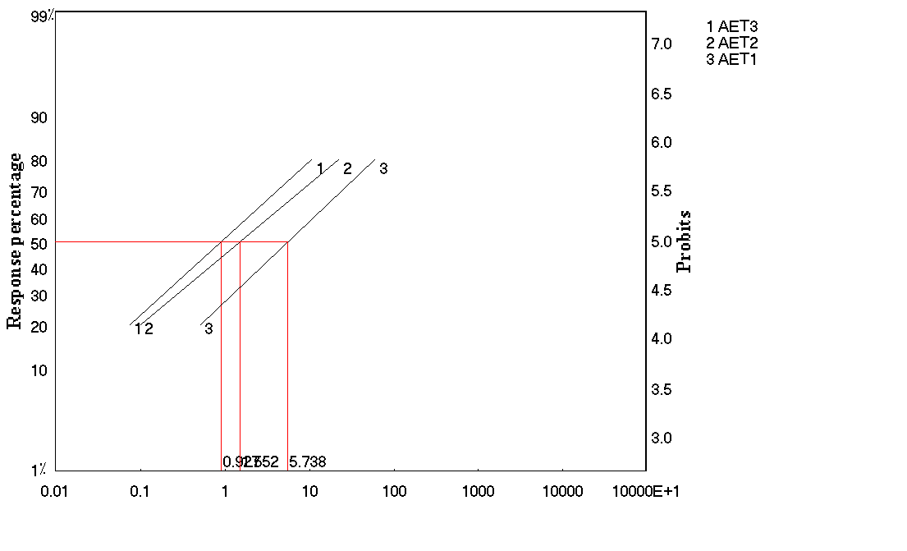
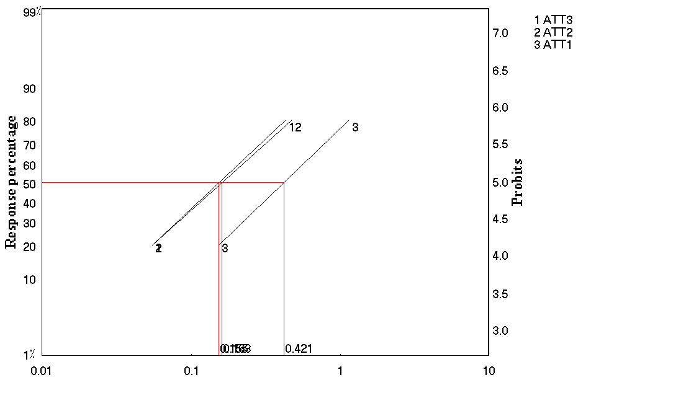
A- Eobania vermiculata
    -72 hr
-48 hr
-24 hr
B- Theba pisana
    -72 hr
-48 hr
-24 hr
Probits
Probits
Fig. (1): Probit regression lines representing the effect of Abamectin topical application against terrestrial snails: A- Eobania vermiculata (BGS) and B- Theba pisana (WGS).

Slide 40
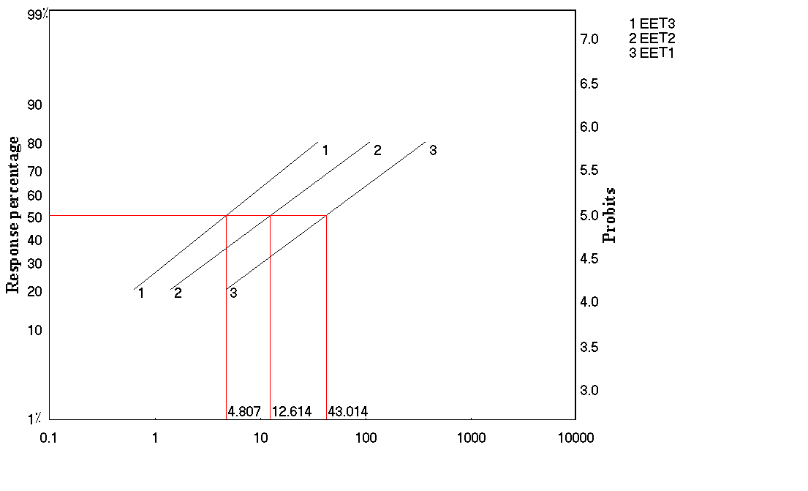
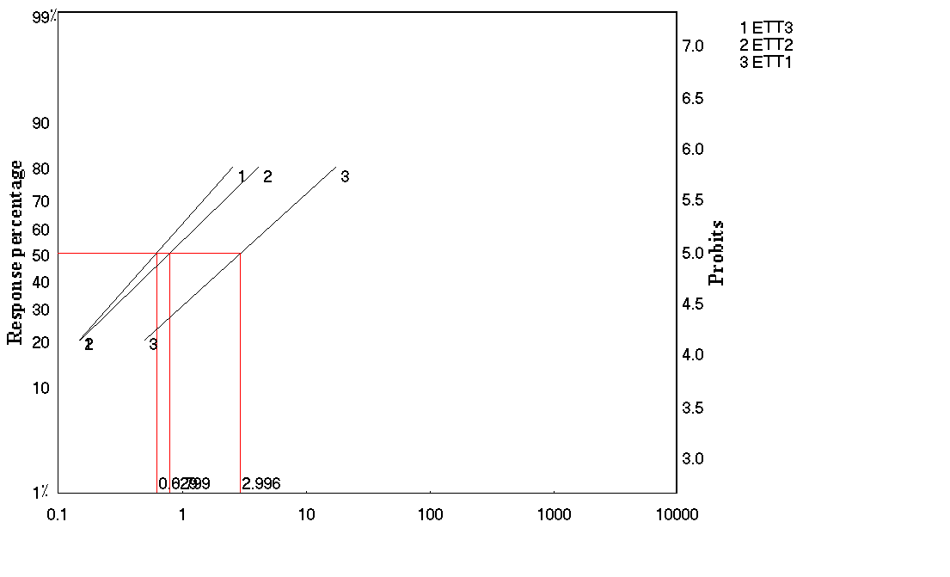
A- Eobania vermiculata
    -72 hr
-48 hr
-24 hr
B- Theba pisana
    -72 hr
-48 hr
-24 hr
Probits
Probits
Fig. (2): Probit regression lines representing the effect of Emamectin benzoate topical application against terrestrial snails: A- Eobania vermiculata (BGS) and B- Theba pisana (WGS).

Slide 41
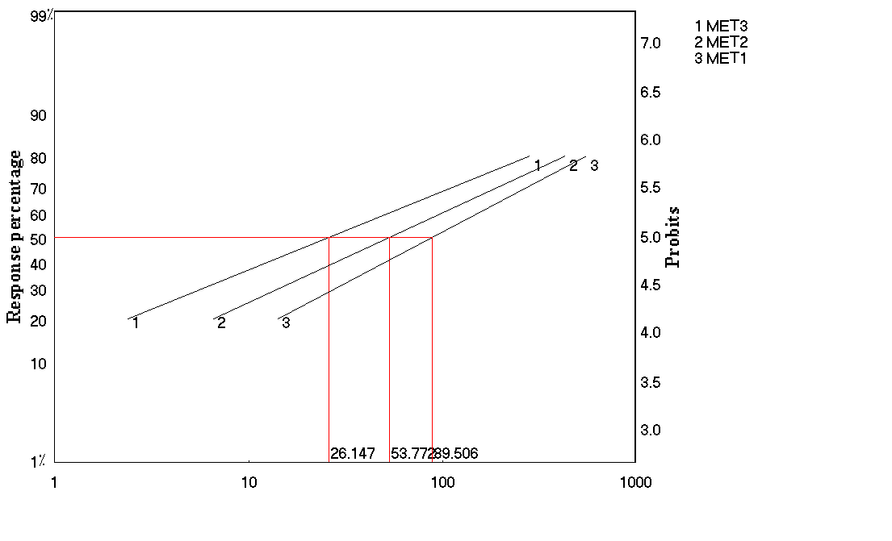
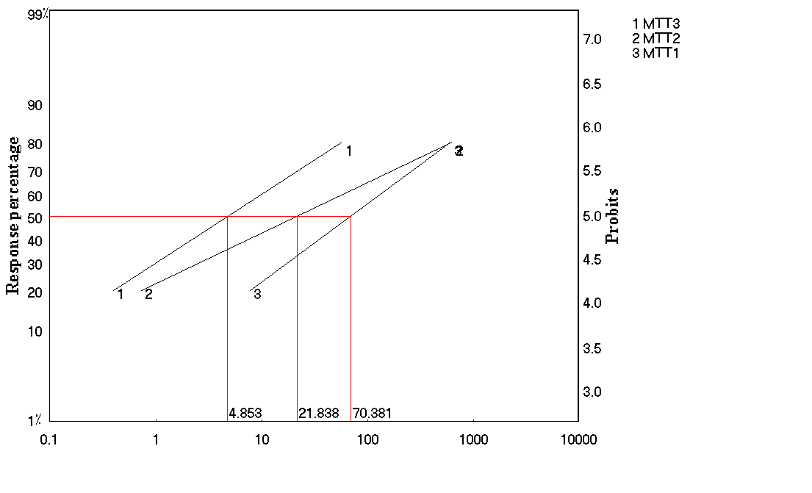
A- Eobania vermiculata
    -72 hr
-48 hr
-24 hr
B- Theba pisana
    -72 hr
-48 hr
-24 hr
Probits
Probits
Fig. (3): Probit regression lines representing the effect of Methomyl topical application against terrestrial snails: A- Eobania vermiculata (BGS) and B- Theba pisana (WGS).

Slide 42
Results of
Biochemical studies

Slide 43
Results of the effects of abamectin, emamectin benzoate and methomyl on γ-aminobuteric acid (GABA) formation that considered an endogenous neurotransmitter to the central nervous system of both vertebrate and invertebrates will be introduced.

Slide 44
Results
GABAergic
Glutamic Acid Decarboxylase Activity
GAD

Slide 45
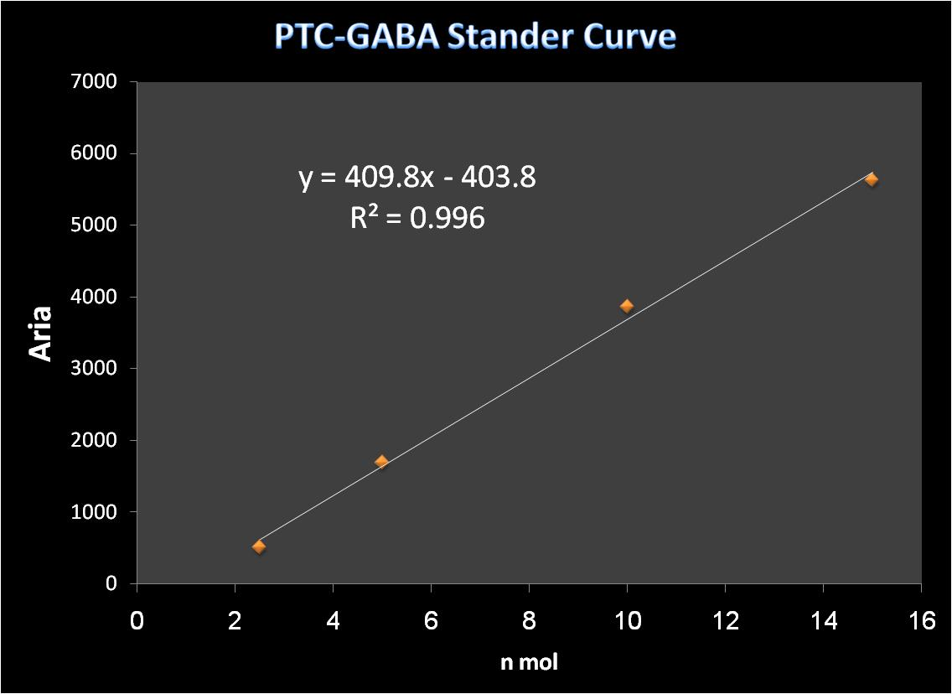

Slide 46
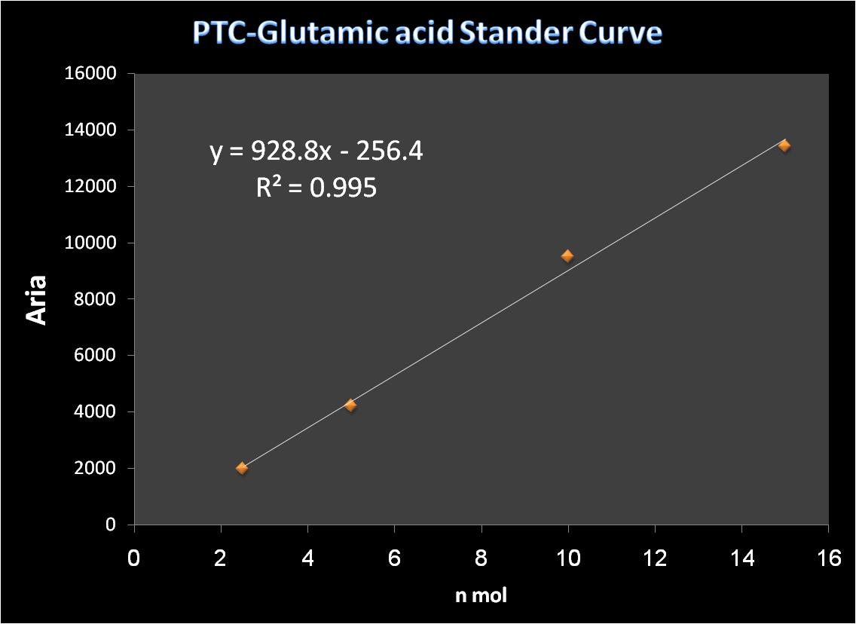

Slide 47
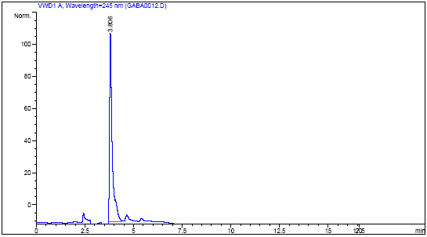
PTC-GABA
Fig. (4) HPLC chromatogram of PTC-GABA standard

Slide 48
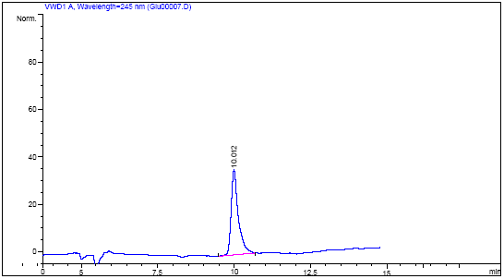
PTC-Glu
Fig. (5): HPLC chromatogram of PTC-Glutamic acid standard

Slide 49
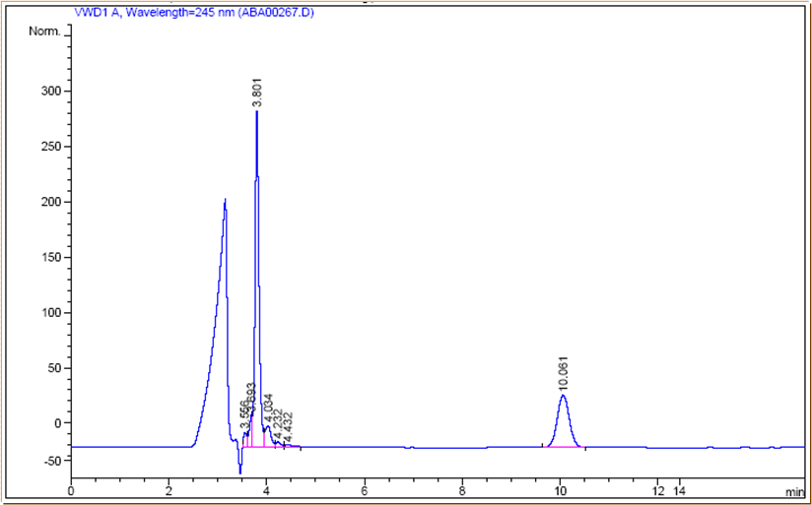
PTC-GABA
PTC-Glu
Fig. (6): Spectrum of PTC-GABA and PTC-Glutamic acid derivatives HPLC separation
due to Abamectin treatments of Eobania vermiculata after 24 hours.

Slide 50
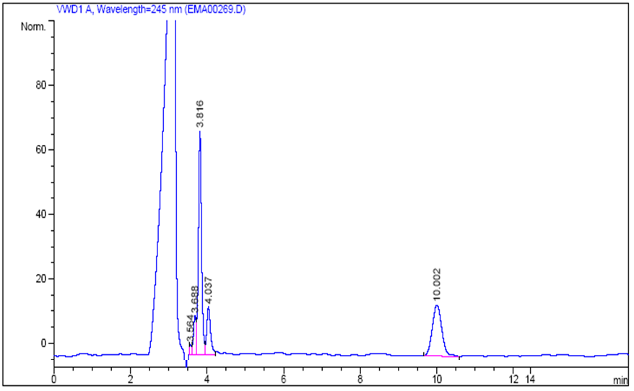
PTC-GABA
PTC-Glu
Fig. (7): Spectrum of PTC-GABA and PTC-Glutamic acid derivatives HPLC separation
due to Emamectin benzoate treatments of Eobania vermiculata after 24 hours.

Slide 51
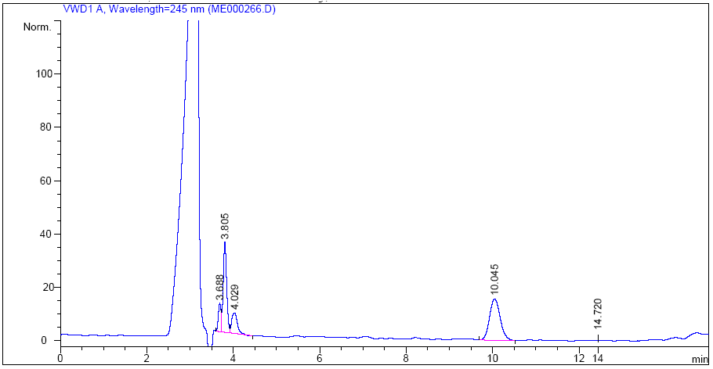
PTC-GABA
PTC-Glu
Fig. (8): Spectrum of PTC-GABA and PTC-Glutamic acid derivatives HPLC separation
due to Methomyl treatments of Eobania vermiculata after 24 hours.

Slide 52
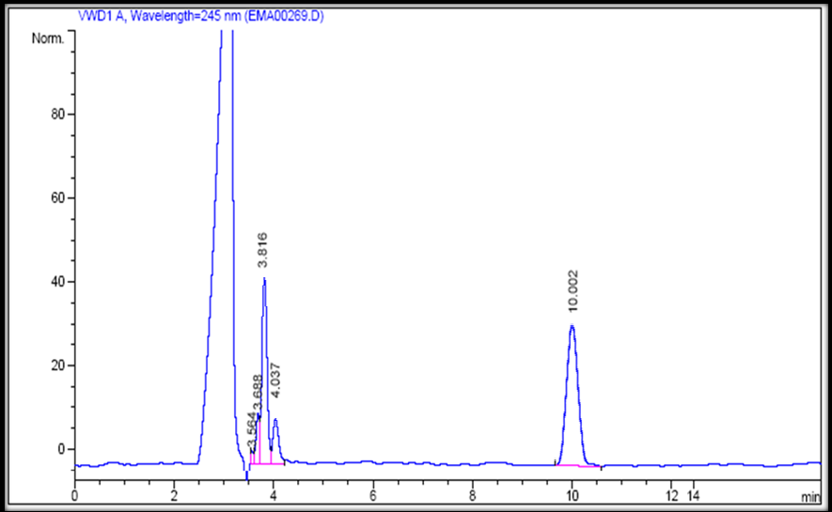
PTC-GABA
PTC-Glu
Fig. (9): Spectrum of PTC-GABA and PTC-Glutamic acid derivatives HPLC separation due to Control treatments of Eobania vermiculata after 24 hours.

Slide 53
Table (5): Effect of in vivo Abamectin, Emamectin benzoate and Methomyl interactions on Eobania vermiculata (BGS) glutamic acid decarboxylase (GAD) activities.
Methomyl |  | Emamectin benzoate |  | Abamectin |  | Dose
Activity % | S.A (nM glu./mg protein/min) ± SD | Activity % | S.A (nM glu./mg protein/min) ± SD | Activity % | S.A (nM glu./mg protein/min) ± SD
63.86 | 7.544±0.74* | 162.71 | 19.222±0.79* | 162.88 | 19.243±1.02* | 1/2 | LD₅₀ at 24 hr
69.65 | 8.229±0.92* | 142.65 | 16.852±0.99* | 138.45 | 16.356±1.04* | 1/5
85.80 | 10.137±0.99* | 129.14 | 15.257±0.38* | 125.31 | 14.804±0.49* | 1/10
0.911 |  | 1.058 |  | 1.165 |  | LSD _{0.05}
52.01 | 6.144±0.64* | 187.69 | 22.173±1.07* | 192.71 | 22.766±1.10* | 1/2 | LD₅₀ at 48 hr
56.23 | 6.643±0.38* | 152.06 | 17.964±0.66* | 177.30 | 20.945±0.94* | 1/5
70.43 | 8.321±0.71* | 145.23 | 17.157±0.51* | 151.84 | 17.938±0.67* | 1/10
1.026 |  | 1.106 |  | 1.206 |  | LSD _{0.05}
64.95 | 7.672±0.82* | 142.45 | 16.829±0.92* | 143.81 | 16.989±0.49* | 1/2 | LD₅₀ at 72 hr
95.85 | 11.323±0.74 | 130.89 | 15.463±0.33* | 124.64 | 14.724±0.72* | 1/5
97.20 | 11.483±0.55 | 117.12 | 13.836±0.63* | 125.61 | 14.839±0.38* | 1/10
0.815 |  | 1.014 |  | 1.188 |  | LSD _{0.05}
* Control specific activity of untreated snail (GAD) is 11.814 ± 0.62( nMglu/mg protein/min) ± SD.

Slide 54
Table (6): Effect of in vivo Abamectin, Emamectin benzoate and Methomyl interactions on Theba pisana (WGS) glutamic acid decarboxylase (GAD) activities
Methomyl |  | Emamectin benzoate |  | Abamectin |  | Dose
Activity % | S.A (nM glu./mg protein/min) ± SD | Activity % | S.A (nM glu./mg protein/min) ± SD | Activity % | S.A (nM glu./mg protein/min) ± SD
62.84 | 3.864±0.39* | 158.95 | 9.774±0.42* | 176.04 | 10.824±0.91* | 1/2 | LD₅₀ at 24 hr
72.48 | 4.457±0.51* | 111.28 | 6.843±0.18* | 137.26 | 8.440±0.83* | 1/5
93.81 | 5.768±0.63 | 116.73 | 7.178±0.22* | 158.17 | 9.725±0.74* | 1/10
0.702 |  | 0.792 |  | 0.759 |  | LSD _{0.05}
73.59 | 4.525±0.72* | 172.97 | 10.636±0.97* | 187.66 | 11.539±0.86* | 1/2 | LD₅₀ at 48 hr
70.00 | 4.304±0.57* | 167.96 | 10.328±0.62* | 195.79 | 12.038±0.88* | 1/5
95.49 | 5.871±0.26 | 121.48 | 7.470±0.49* | 116.15 | 7.142±0.43* | 1/10
0.616 |  | 0.841 |  | 0.991 |  | LSD _{0.05}
74.45 | 4.578±0.28* | 127.59 | 7.846±0.28* | 161.03 | 9.901±0.86* | 1/2 | LD₅₀ at 72 hr
94.84 | 5.832±0.56 | 126.31 | 7.767±0.19* | 170.43 | 10.479±1.07* | 1/5
83.14 | 5.112±0.33* | 107.51 | 6.611±0.84 | 144.14 | 8.863±0.73* | 1/10
0.984 |  | 0.757 |  | 1.159 |  | LSD _{0.05}
* Control specific activity of untreated snail (GAD) is 6.149±0.78 ( nMglu/mg protein/min) ± SD.

Slide 55
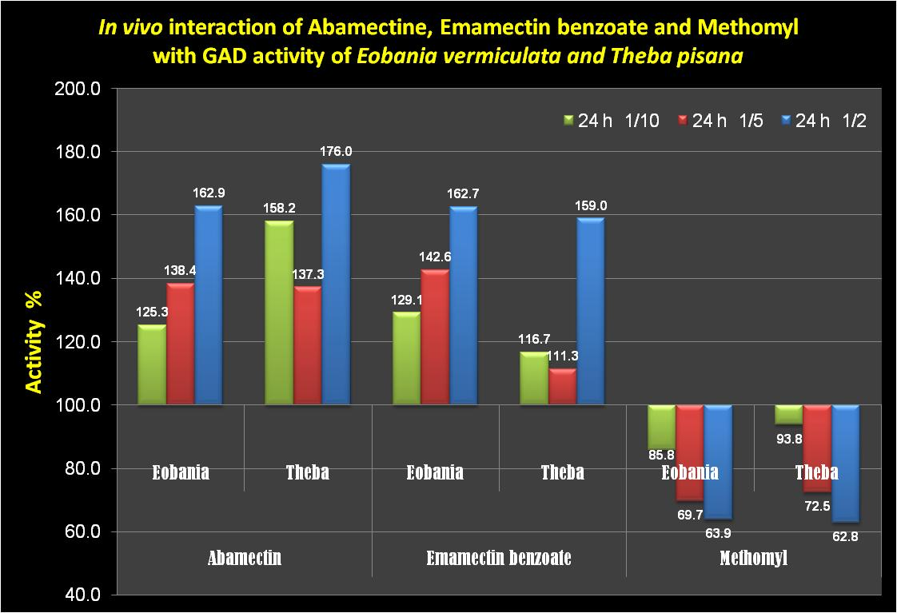

Slide 56
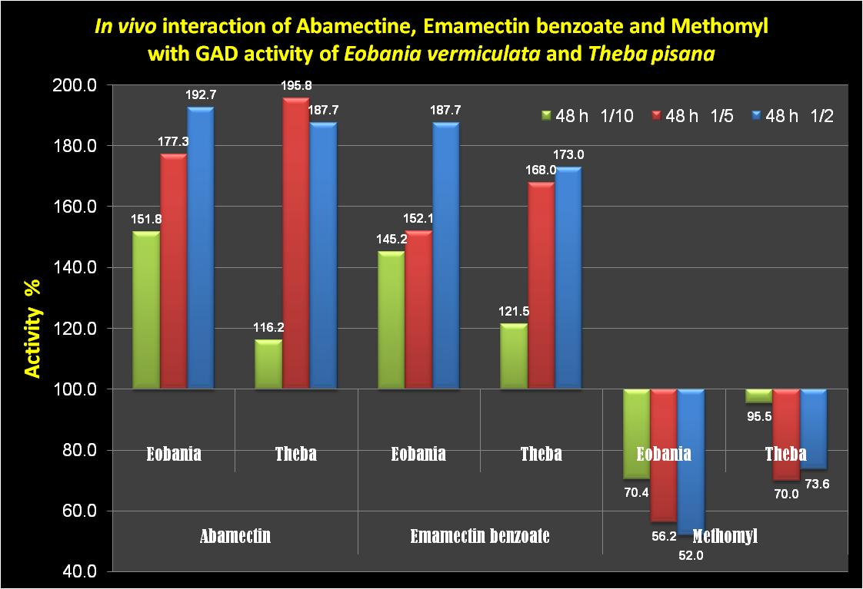

Slide 57
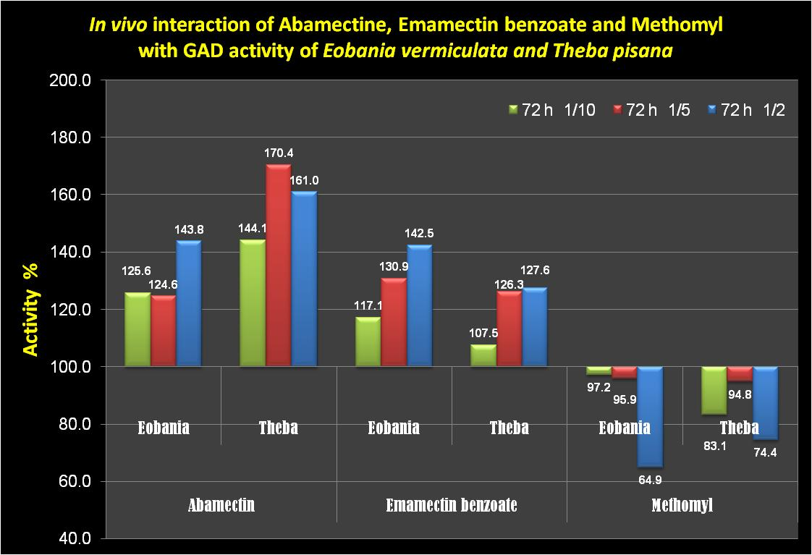

Slide 58
1-Same type of response was noticed between both types of the snails BGS and WGS. While methomyl clearly inhibited GAD activity, abamectin and emamectin benzoate stimulated markedly the GAD activity in both types of the used land snails.

Slide 59
2- The inhibitory effect of methomyl was dose dependent manner. That the activity of GAD enzyme increased by decreasing the dose treatments in both types of snails. However, the inhibition of GAD activity was more pronounced with BGS than WGS.

Slide 60
3- Natural fermentation products of Streptomyces avermitilis, avermectin B1 (abamectin) and its 4-deoxy-4-epi-methylamine derivative (emamectin benzoate) induced a significant GAD stimulatory effect for both type of snails BGS and WGS as indicated in Tables (9 and 10).

Slide 61
4- Abamectin interaction with GAD activity was higher than emamectin benzoate especially in the case of WGS when the stimulatory effect on GAD activity was less than BGS.

Slide 62
5- Both compounds abamectin and emamectin benzoate caused similar degree of GAD stimulation of BGS. The stimulation was dependent, however the stimulatory effect decreased by time, the lowest stimulation obtained for BGS was at 72 hr with the least concentration used 1/10 of LD₅₀.

Slide 63
6- While abamectin and emamectin benzoate caused equal degree of GAD activation with BGS, Abamectin effect was significantly higher in its stimulatory effect on GAD-WGS than GAD-BGS as shown in (Table 10).

Slide 64
7- Specific activity value of GAD-BGS was higher than the value of GAD-WGS indicating more participation of GABAergic system of Eobania vermiculata compared with Theba pisana in this respect.

Slide 65
8- These findings could illustrate how abamectin and emamectin benzoate induces the level of GABA neurotransmitter in E. vermiculata and T. pisana land snails, as it activates the biosynthesis of GABA and inhibit its degradation.

Slide 66



Slide 67
Same type of response was noticed between both types of the snails BGS and WGS. While methomyl clearly inhibited GAD activity, abamectin and emamectin benzoate stimulated markedly the GAD activity in both types of the used land snails

Slide 68
Abamectin and emamectin benzoate induced a significant GAD stimulatory effect for both type of snails BGS and WGS.

Slide 69
Abamectin interaction with GAD activity was higher than emamectin benzoate especially in the case of WGS when the stimulatory effect on GAD activity was less than BGS.

Slide 70
acknoledgment

Slide 71

Thanks
See you in the other meetings
elsayedabdallah@yahoo.com

Slide 72
Thanks

