Slide 1


Non-Classical androgen actions in Sertoli cell membrane
Eloísa da Silveira Loss
Department of Physiology
ICBS – Federal University of Rio Grande do Sul
Porto Alegre RS - Brazil

Slide 2
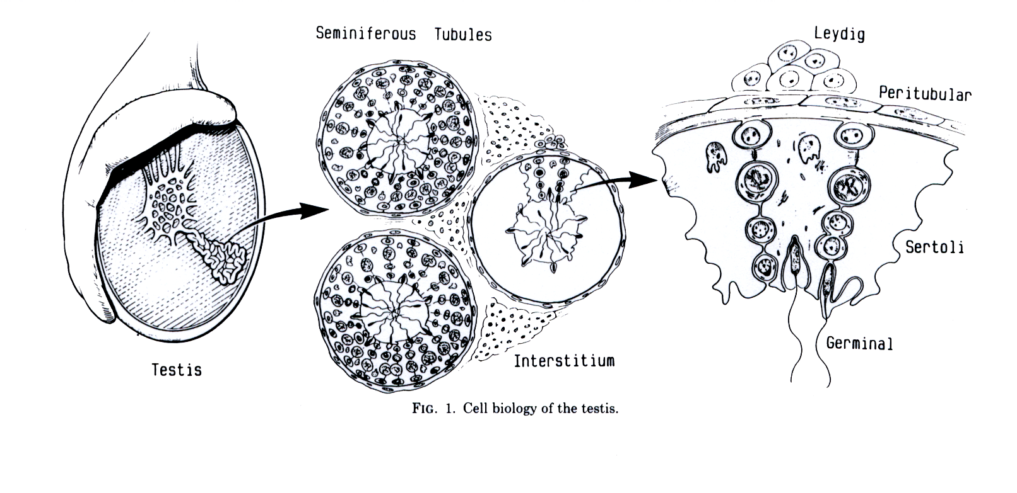
TESTIS Seminiferous epithelium
Seminiferous tubules
Leydig
Peritubular
Sertoli
Germinal
Testis
Interstitium
-The interaction among the different cells of this tissue is a very dynamic and an extremely elaborate process.
-Germ cells, Sertoli cells, peritubular, and Leydig cells have an elaborate network for cell-cell communication that occurs via hormones, autocrine or paracrine factors, and signalling molecules. This allows the Sertoli cells, as nursing cells, to provide developing germ cells with the required nutrients and biological factors.
-Sertoli cells also present gap junctions, and these junctions provide communications alongside the seminiferous ephitelium. It occurs between Sertoli-Sertoli cells as well as between Sertoli-germ cell, giving the necessary support for the spermatogenic wave process.
Notes:
The interaction among the different cells of this tissue is a very dynamic and extremely elaborate process. The unique strategic position of the Sertoli cells allows them to receive from, integrate, and emit to the extratubular compartment all of the signals required for spermatogenesis. Therefore, germ cells, Sertoli cells, peritubular, and Leydig cells have an elaborate network for cell-cell communication that occurs via hormones, autocrine or paracrine factors, and signalling molecules. This allows the Sertoli cells, as nursing cells, to provide developing germ cells with the required nutrients and biological factors.

Slide 3
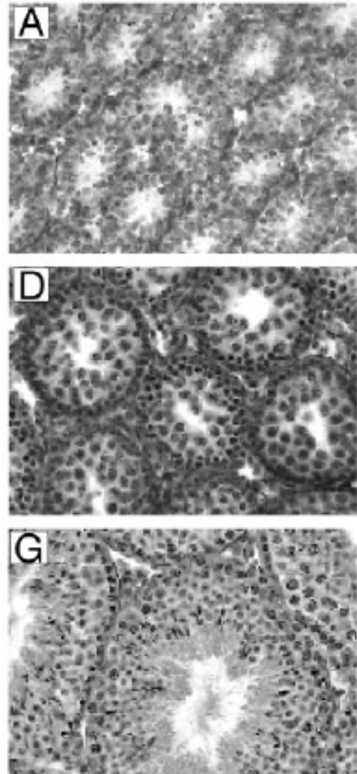
Immature Sertoli cells
Rat testes
Maturational development:
Sertoli cells are in proliferative and growth process.
The maturational progression is regulated by several hormones and growth factors.
Follicle-stimulating hormone (FSH) and testosterone are the two major endocrine signals that act in the testis to regulate development and spermatogenisis efficiency in adult.
5 day-old
20 day-old
Adult

Slide 4
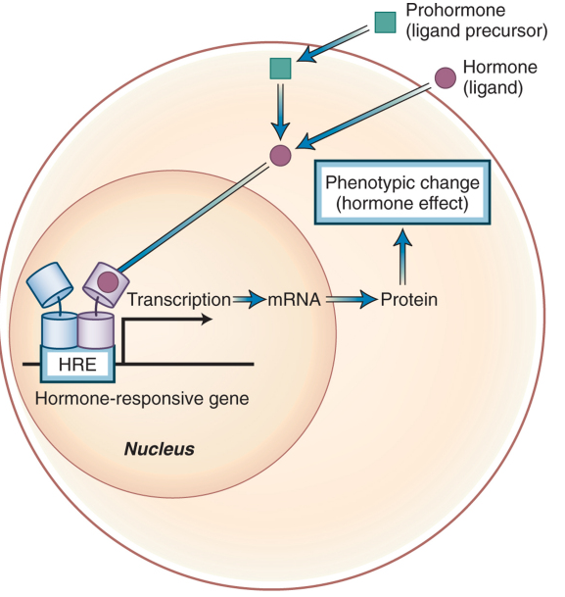
Androgenic actions
Classical X Non-classical
Classical
Non-classical
Intracellular Androgen Receptor (iAR) or nuclear androgen receptor
Membrane Receptor
Effects only seconds or minutes after the steroid application
Androgen exert non-classical actions in a variety of cell types
This receptor have not been identified.
Probable involvement of G protein receptor and corresponding downstream signaling.
Such effects take a time lag of
hours or even days

Slide 5
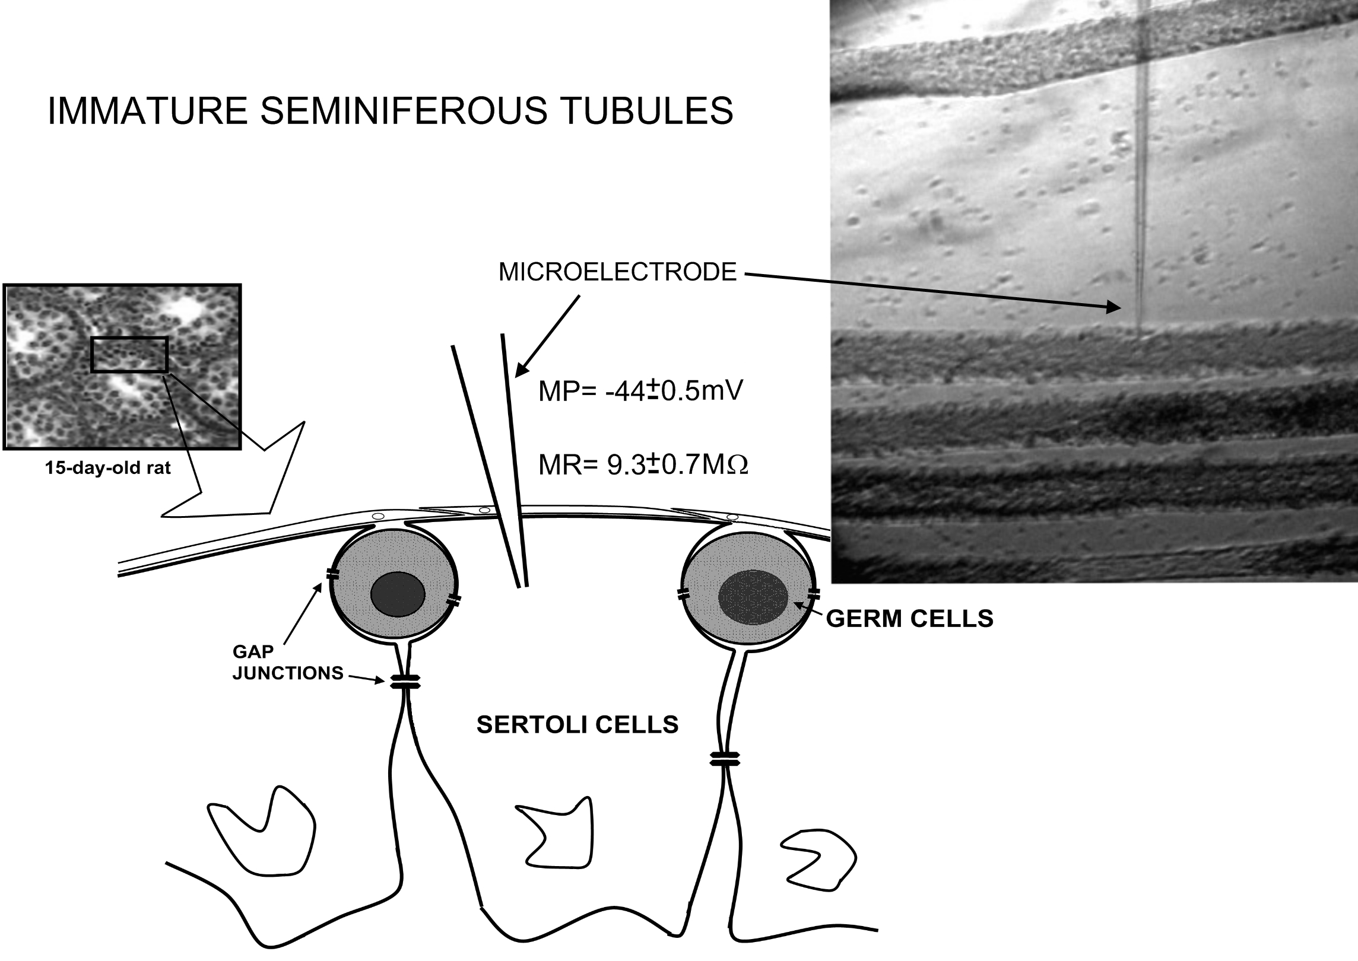
Sertoli cells membrane potential recording
Loss ES, Jacobus AP, Wassermann GF. Rapid signaling responses in Sertoli cell membranes induced by follicle stimulating hormone and testosterone: calcium inflow and electrophysiological changes.
Life Sci 2011;89:577–83.

Slide 6
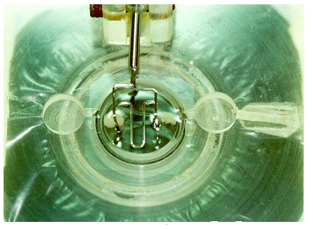
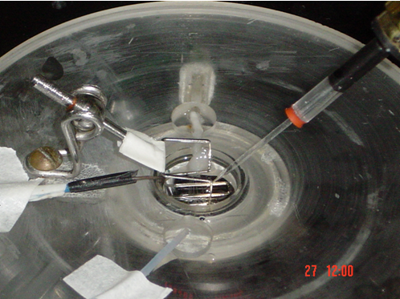
Electrophysiological method Standard single microelectrode recording
Perfusion chamber
1 ml with flow 1 ml/sec
Register electrode
Microelectrode borosilicate pipets was filled with KCl (3mM) and had a tip resistance of 15 to 25 MΩ
This resistance is appropriate for the preferential impalement of cells with a size similar to that of Sertoli cells. This tip diameter makes it difficult to impale smaller cells, such as peritubular myoid cells.

Slide 7
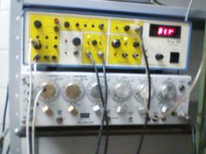
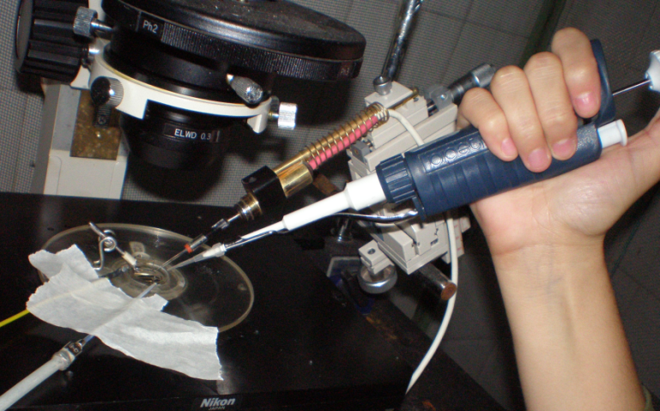
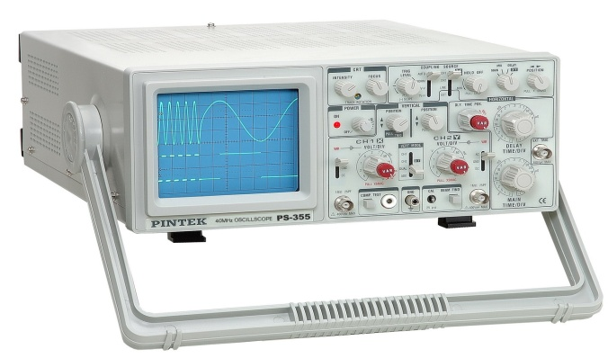
Standar single microelectrode recording
Intracellular recording was amplified using an Intra 767 WPI amplifier .
Grass Stimulator - Square current pulses of 0.5 nA, 0.5 Hz and 250 ms duration, applied through the intracellular electrode to estimate membrane input resistance (R₀).
Application of hormones or drugs
Register recording
Oscilloscope Tektronix and its softwere (Wavestar Lite Version 1.0.10)

Slide 8
Membrane potencial of Sertoli cells
Resting potential of Sertoli cells in seminiferous tubules from 12- to 15-day-old rats is very stable.
The resting membrane potential average was -44±0.5 mV (n=124).
Membrane resistance average was 9.3 ± 0.7 MΩ (n=124).
To avoid working with germ cells, only cells with membrane potential lower than -35 mV are included in the experiments, because this membrane potential is commonly found in Sertoli cells from normal or Sertoli-cell-enriched seminiferous tubules from immature rats.

Slide 9
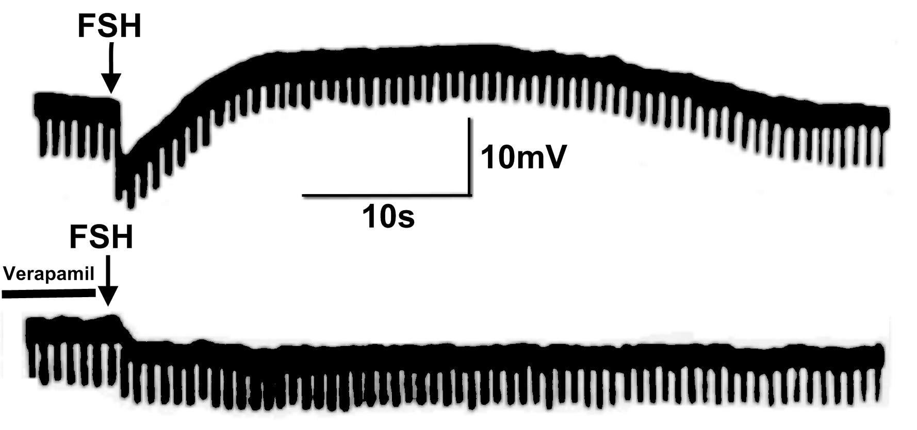
FSH action on membrane of Sertoli cells
Wassermann, G.F., Monti Bloch L, Grillo ML, Silva FR, Loss ES, McConnell LL. Electrophysiological changes of Sertoli cells produced by the acute administration of amino acid and FSH. Hormone and metabolic research, 1992, 24(7), pp.326–8.

Slide 10
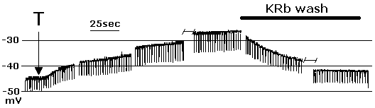
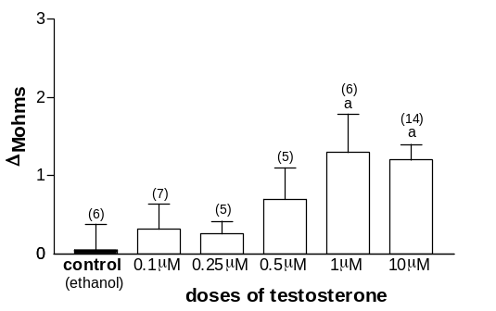
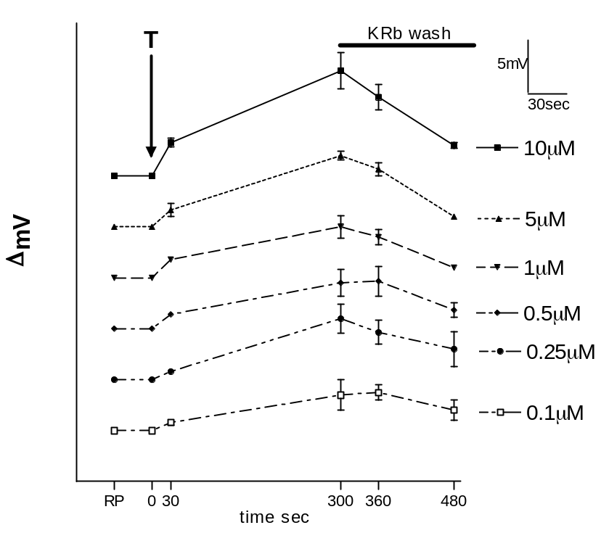
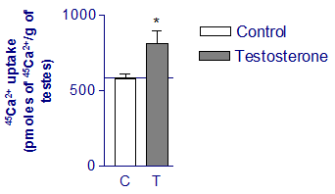
Testosterone produces depolarization on membrane potential of Sertoli cells
Testosterone effect at different doses on membrane potential and on membrane resistance of Sertoli cells.
Testosterone (1 µM) increases 45Ca2+ uptake within 5 min of incubation in whole rat testes (n=5)
Von Ledebur, EICF, Almeida JP, Loss ES, Wassermann GF. Rapid effect of testosterone on rat Sertoli cell membrane potential. Relationship with K+ATP channels. Hormone and metabolic research, 2002, 34(10): 550–5.

Slide 11
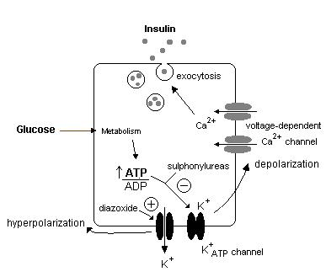
Pancreatic beta-cell
VOCC
-operated

Slide 12
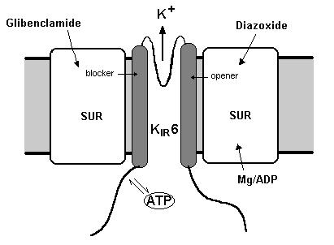
ATP sensitive K⁺ channels (K⁺_{ATP})
Sulphonylurea receptor (SUR) subunits generate the regulatory subunit. Inward rectifier K+ channel Kir6 subunits generate the channel pore.

Slide 13
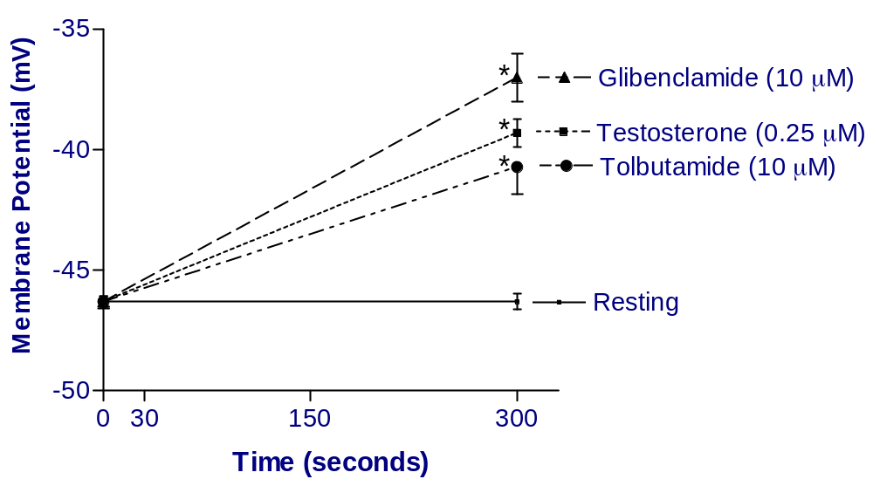
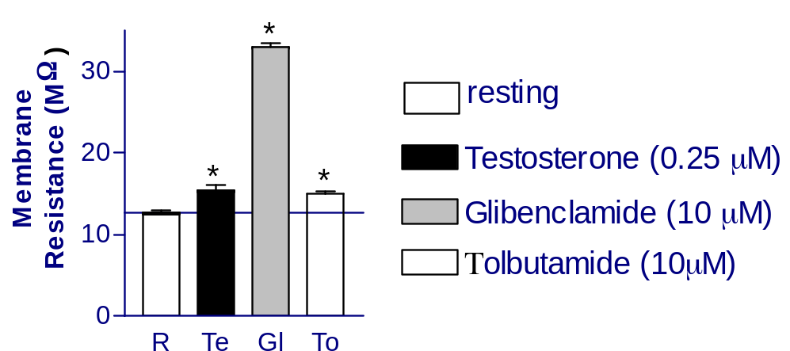
K⁺_{ATP} channel inhibitors glibenclamide and tolbutamide mimicked testosterone action on membrane of Sertoli cells
Von Ledebur, EICF, Almeida JP, Loss ES, Wassermann GF. Rapid effect of testosterone on rat Sertoli cell membrane potential. Relationship with K+ATP channels. Hormone and metabolic research, 2002, 34(10), pp.550–5.

Slide 14
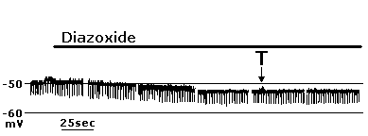
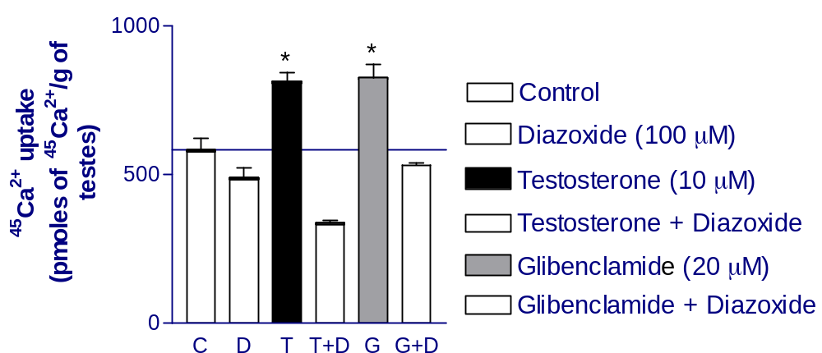
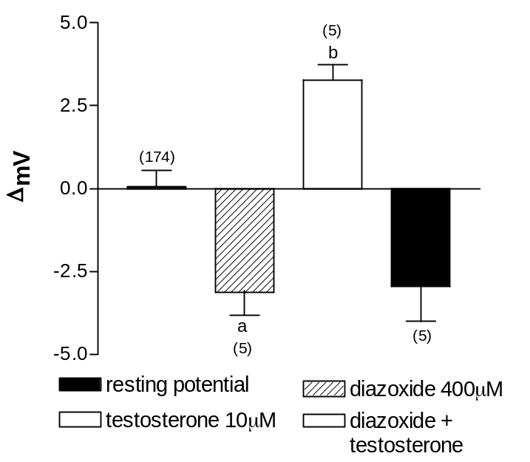
Effect of diazoxide, a K⁺_{ATP} channel opener, on the testosterone actions
Von Ledebur, E.I.C.F. et al., 2002. Rapid effect of testosterone on rat Sertoli cell membrane potential. Relationship with K+ATP channels. Hormone and metabolic research, 34(10), pp.550–5.

Slide 15
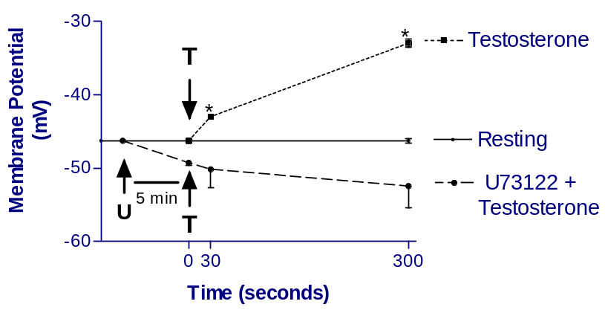
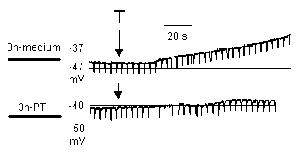
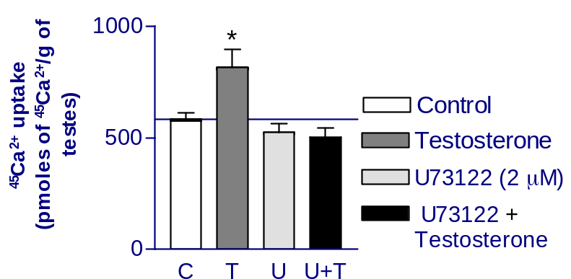
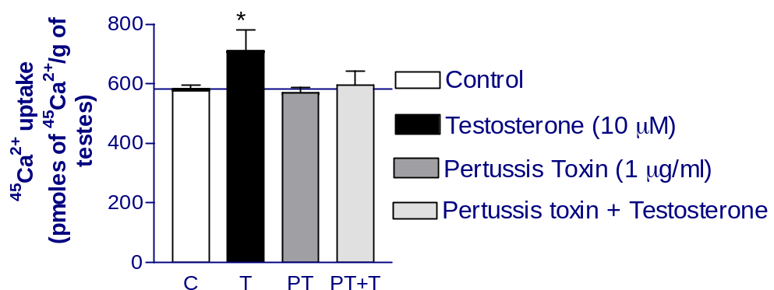
Phospholipase C (PLC) inhibitor U73122 and G-protein inhibitor pertussis toxin block testosterone actions on membrane of Sertoli cells
Loss, E.S. et al., 2004. Testosterone modulates K(+)ATP channels in Sertoli cell membrane via the PLC-PIP2 pathway. Hormone and metabolic research, 36(8), pp.519–25.

Slide 16
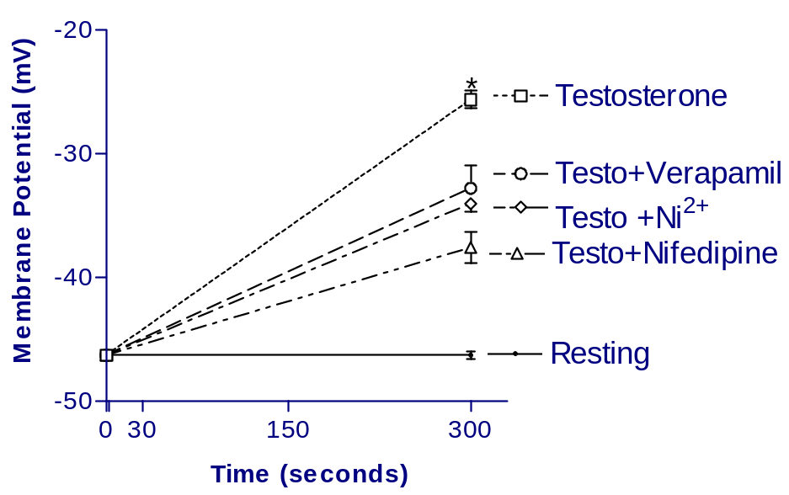
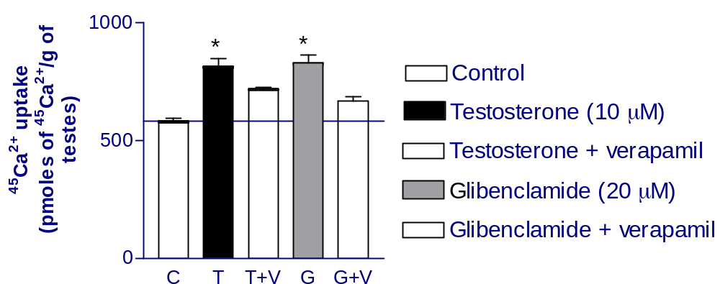
Effect of Ca²⁺ channels blockers on the testosterone action
Calcium channel (VOCC) blockers: verapamil, nifedipine or Ni²⁺ parcialy block testosterone action on membrane potential and on the ⁴⁵Ca²⁺ uptake.
Testosterone increase ⁴⁵Ca²⁺ uptake in 5 minutes of incubation.
Loss, E.S. et al., 2004. Testosterone modulates K(+)ATP channels in Sertoli cell membrane via the PLC-PIP2 pathway. Hormone and metabolic research, 36(8), pp.519–25.

Slide 17
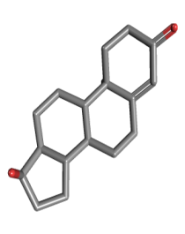
Membrane Androgen Receptor
Testosterone
Glibenclimide
Tolbutamide
Ca²⁺
K⁺_{ATP} channel
VOCC
R?
β
Gq
PLC
ϒ
-
-
-
DAG
-
-
open
PIP2
ATP
Diazoxide
U 73122
Pertussis toxin (PTX)
Verapamil
-
-
-
-
-
IP3
K⁺

Slide 18
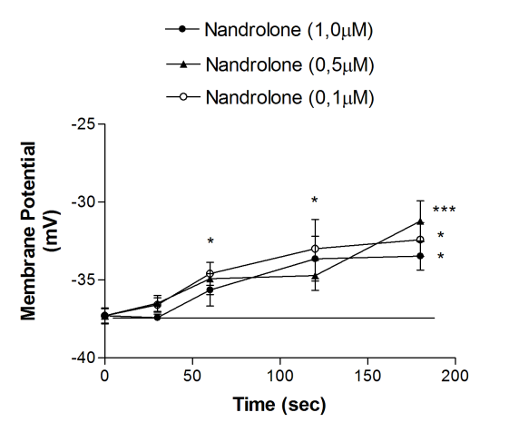
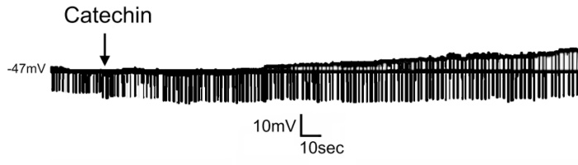
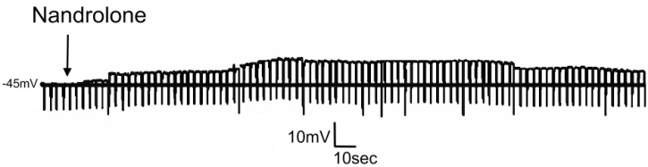
Action of catechin and nandrolone at different concentrations on membrane potential
Cavalari, F.C. et al., 2012. Non-classic androgen actions in Sertoli cell membrane in whole seminiferous tubules: effects of nandrolone decanoate and catechin. Steroids, 77(1-2), pp.118–25.

Slide 19
The depolarizing effect of nandrolone, catechin and testosterone did not change on the presence of flutamide
Cavalari, F.C. et al., 2012. Non-classic androgen actions in Sertoli cell membrane in whole seminiferous tubules: effects of nandrolone decanoate and catechin. Steroids, 77(1-2), pp.118–25.

Slide 20
The depolarizing effects of nandrolone and catechin were blocked by Diazoxide, a K⁺_{ATP} channel opener, and by U73122 (2μM), an inhibitor of PLC, both 10 minutes before the topical application of the steroid and the flavonol
Cavalari, F.C. et al., 2012. Non-classic androgen actions in Sertoli cell membrane in whole seminiferous tubules: effects of nandrolone decanoate and catechin. Steroids, 77(1-2), pp.118–25.

Slide 21
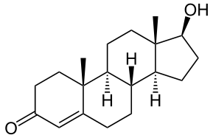
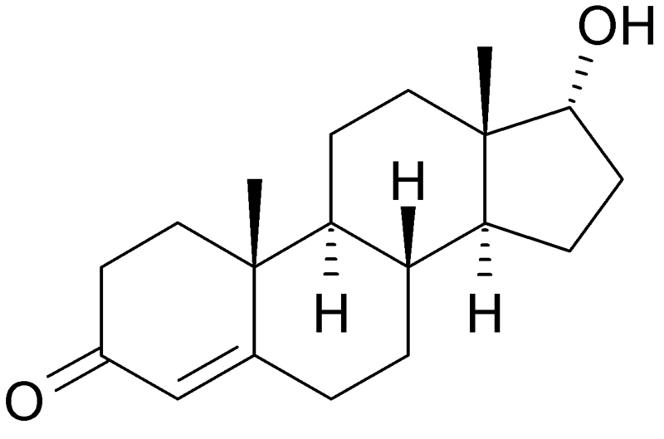
Epitestosterone
(17α-hydroxy-4-androsten-3-one)
Epitestosterone is the 17α-epimer of testosterone.
It has been found at similar level as testosterone in human biological fluids.
This steroid has thus been used as a natural internal standard for assessing testosterone abuse in sports.
It was found to possess antiandrogenic activity as well as neuroprotective effects.
Testosterone
Epitestosterone

Slide 22
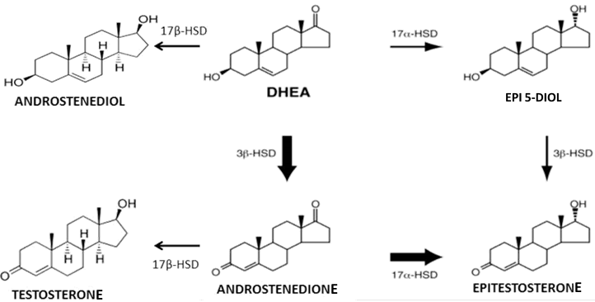
Testosterone x Epitestosterone synthesis
Bellemara, V et al. 2005. Characterization of 17α-hydroxysteroid dehydrogenase activity (17α-HSD) and its involvement in the biosynthesis of epitestosterone. BMC Biochemistry, 6:12.

Slide 23
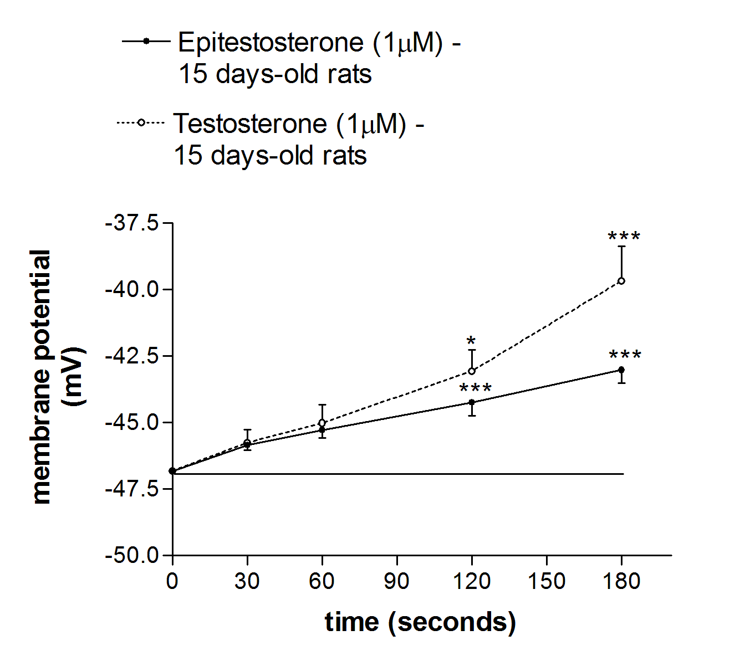
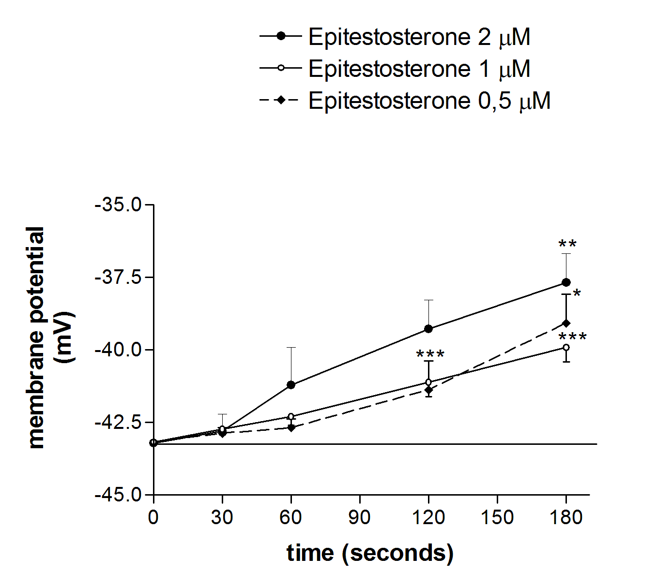
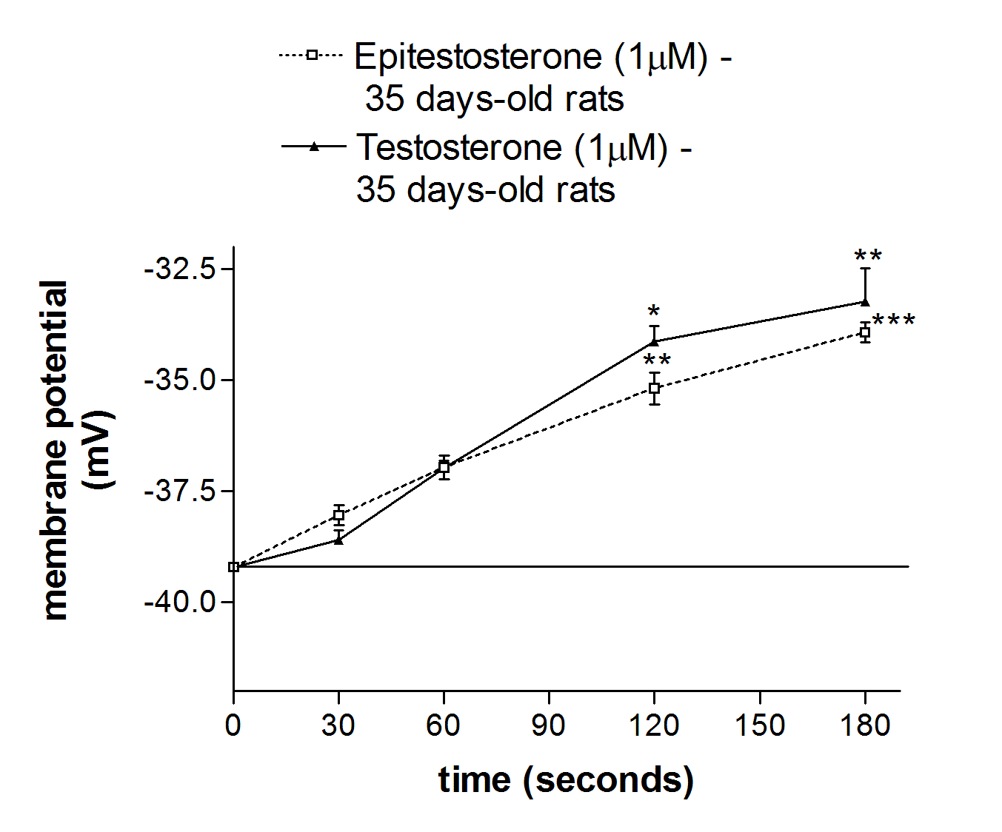
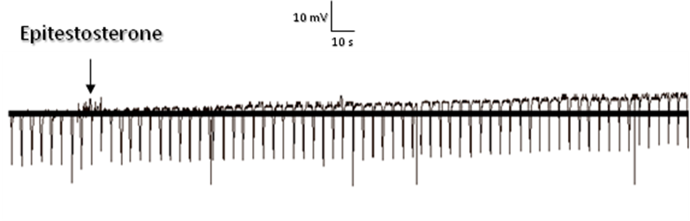
Epitestosterone effect on membrane potential of Sertoli cells is similar to the testosterone effect.
De Castro, A. et al. 2013. Epitestosterone and Testosterone have similar nonclassical actions on membrane of Sertoli cells in whole seminiferous tubules. Hormone and Metabolic Research, 45: 15-21.

Slide 24
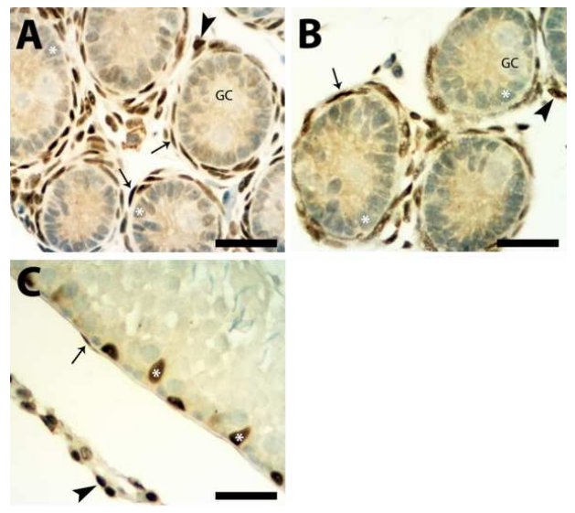
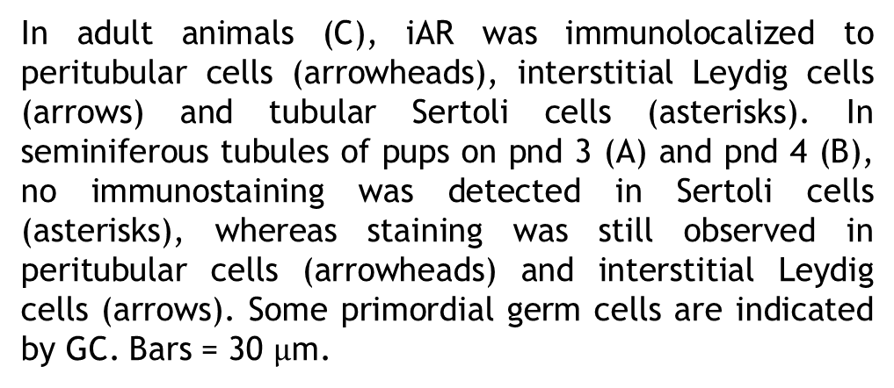
Photomicrographs of transverse sections of seminiferous tubules comparing the iAR-positive staining pattern on pnd 3 (A), pnd 4 (B) and adult (C) Wistar rats.
In adult animals (C), iAR was immunolocalized to peritubular cells (arrowheads), interstitial Leydig cells (arrows) and tubular Sertoli cells (asterisks). In seminiferous tubules of pups on pnd 3 (A) and pnd 4 (B), no immunostaining was detected in Sertoli cells (asterisks), whereas staining was still observed in peritubular cells (arrowheads) and interstitial Leydig cells (arrows). Some primordial germ cells are indicated by GC. Bars = 30 $µ$m.

Slide 25
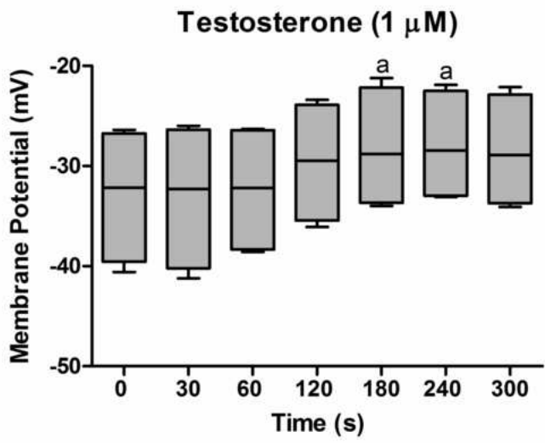
Testosterone and epitestosterone effect on calcium uptake in whole testis from neonate rats and testosterone effect on membrane potential of Sertoli cells from rats at 5thpostnatal day
da Rosa LA, Escott GM, Cavalari FC, Schneider CMM, de Fraga LS , Loss ES. Non-classical effects of
androgens on testes from neonatal rats. Steroids, 2014 (in press)

Slide 26
Crosstalk between electrophysiological actions of testosterone, epitestosterone and FSH.
da Rosa LA, Escott GM, Cavalari FC, Schneider CMM, de Fraga LS , Loss ES. Non-classical effects of
androgens on testes from neonatal rats. Steroids, 2014 (in press)

Slide 27
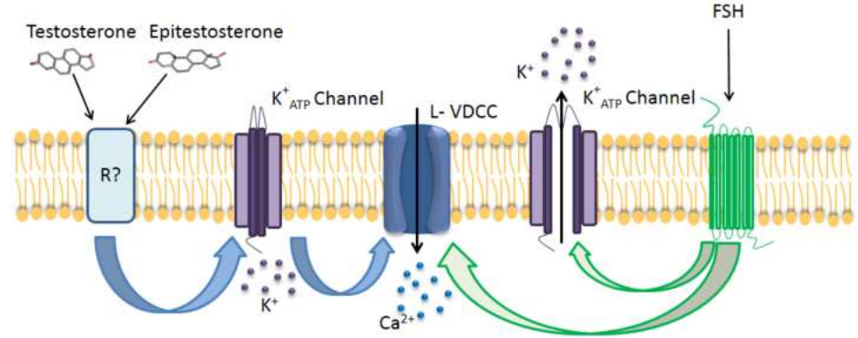
Crosstalking effects of testosterone/ epitestosterone and FSH

Slide 28
CONCLUSIONS
The non-classical effect of anodrogens occurs in the membrane of Sertoli cells
This non-classical effect is through a different receptor than the iAR,
The relative importance of this receptor must be considered and further evaluated.

Slide 29
LABENEX

