Slide 1


The clinical and epidemiological risk factors of infections due to multi-drug resistant bacteria in an adult intensive care unit of University Hospital Center (UHC) in Marrakesh-Morocco
Presented by :
Adel ELMEKES
Directed by :
Pr M. Barakate
Pr K. Zahlane
Epidemiological and bacteriological findings
(March 2015 –March

Slide 2
Introduction
I . Material and methods
PLAN
II . Results
III . Discussion
Conclusion

Slide 3


Slide 4
Introduction
Multi-drug resistant ( MDR) bacterial infections are a major public worldwide health problem.
In intensive care ( ICU), this healthcare issue, is the result of several factors influence the rapid spread of multidrug-resistant pathogens: precariousness and immunocompromised patients, invasive procedures, Broad spectrum antibiotics,…

Slide 5
Introduction
As consequences of this factors: long period of stay, important rise in healthcare costs (antibiotic treatment), increase of morbidity and mortality rate,…

Slide 6
Introduction
Aims of the study:
Isolate bacteria from clinical samples taken from ICU hospitalized patients.
To study the level of antibiotic resistance of all isolated bacteria;
To evaluate the epidemiology, the clinical and epidemiological risk factors responsible for infections with MDR bacteria in ICU.

Slide 7


Slide 8
Material and methods
Prospective study, carried out for 1 year (March 2015 - March 2016).
The microbiological analyzes were realized in The hospital laboratory;
Laboratory of microorganisms biology and biotechnology of sciences faculty;
The medical microbiology laboratory of the medical faculty.
8

Slide 9
Material and methods
Clinical samples
Urine: Cytobacteriological study of urine.
Bronchial samples: Protected distal aspiration PDP, Bronchial suction liquids,,,
Blood: Bacteriological study of blood;
Catheters : Different catheters.
Pus : Pus takenon infected wounds by the swabs or suction method.
Cerebrospinal fluid: Cytobacteriological study of cerebrospinal fluids.
9

Slide 10
Material and methods
Bacterial species identification :
Cultural Characteristics of bacteria;
Morphological Characteristics;
Antigenic Characteristics;
Biochemical Characteristics (Complete identification: Api 20 E gallery)
10

Slide 11


Material and methods
Antibiotic susceptibility :
Method of diffusion on agar media according to the recommendations of:
Antibiogram Committee of the French Microbiology Society
EUCAST 2015.

Slide 12
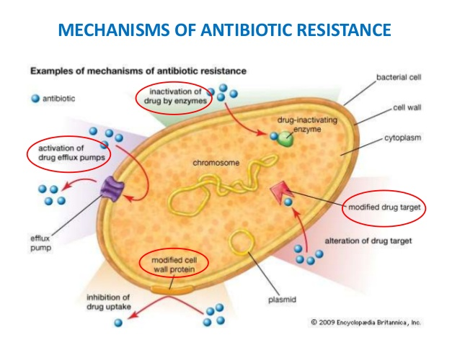
Material and methods

Slide 13
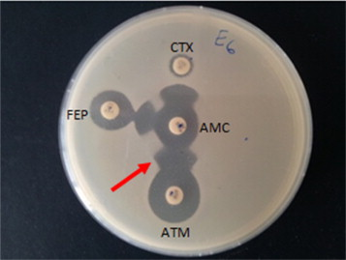
Material and methods
Synergy test of ESBL ( EUCAST 2015 recommendations)
The production of extended spectrum beta-lactamase (ESBL) was detected by:
    The synergistic test between a central disk of amoxicillin + clavulanic acid
    Removal of cefotaxime, ceftazidime, cefepime and aztreonam discs of 30 mm.
    The presence of ESBL is noted by "champagne cork" appearance.
13

Slide 14
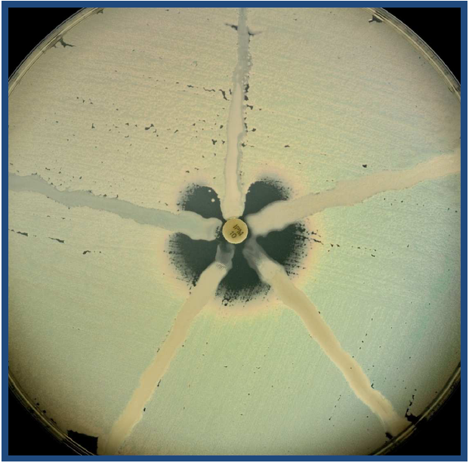
Material and methods
Search of carbapenemase (According to EUCAST 2015)
An ertapenem disk 10 μg
A susceptible reference strain of E. coli ATCC 25922.
A suspicious strain to produce carbapenemase
A control strain (eg, positive control K. pneumoniae ATCC BAA-1705 carbapenemase producer KP-2 and negative control K. pneumoniae ATCC BAA-1706 non-carbapenemase producing)
In the case of deformation of the inhibition zone of the reference strain along the streak of the control strain +.
If a similar deformation is observed with the suspect test strain, this may be considered as producing a carbapenemase.

Slide 15
Material and methods
Cloxacillin test:
Susceptibility intermediate or resistant to Fox and / or Caz and / or Atm in the absence of synergy between these molecules and clavulanic acid, the antibiogram is carried out on MH supplemented with cloxacillin 250 mg / L to detect a BLSE optionally masked by a cephalosporinase.

Slide 16
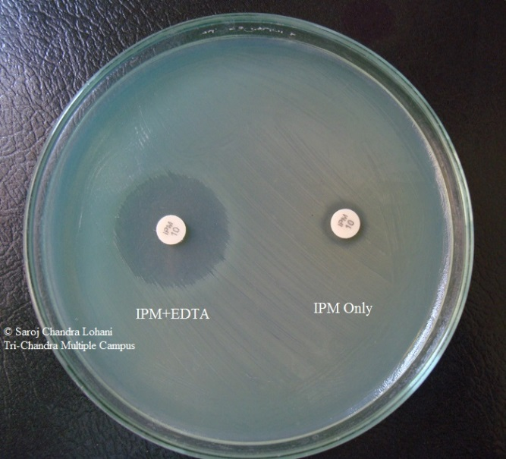
Material and methods
EDTA
For the EDTA-disk synergy test, an overnight culture of the test strain was suspended to the turbidity of a McFarland no. 0.5 tube and used to swab inoculate a Mueller–Hinton agar plate. After drying, a 10-µg imipenem disk (BBL, Cockeysville, MD) and a blank filter paper disk were placed 10 mm apart from edge to edge, and 10 µL of 0.5 M EDTA solution was then applied to the blank disk, which resulted in approximately 1.5 mg/disk. After overnight incubation, the presence of an enlarged zone of inhibition was interpreted as EDTA-synergy test positive.

Slide 17
Material and methods
Search of MRSA
The resistance to betalactamins of strains of Staphylococcus aureus was detected by a cefoxitin disk (30 μg).
Search of PLP2a
To check the resistance to methicillin (when the diameter of inhibition is less than 25 mm) with the search of PBP2a: an immunological technique using an anti-antibody bound to PBP2a latex particles.

Slide 18
Material and methods
Data collection
Was done mainly through the use of sheets,
Statistical analysis
Were analyzed by using the statistical package for social sciences (SPSS v 23, Chicago, USA)

Slide 19


Slide 20
Results
1- Bacteriological results

Slide 21
Results
Distribution of bacterial strains (n = 305)

Slide 22
Results

Slide 23
Results
Level of resistance to β-lactams

Slide 24
Results
Prevalence of isolated MDR in ICU

Slide 25
Results
Classification and prevalence of multiresistant Enterobacteriaceae

Slide 26
Results
Distribution of extended Spectrum β-lactamase producing Enterobacteriaceae

Slide 27
Results
Resistance "co-resistance" profile of the ABRI to antibiotics

Slide 28
Results
Resistance "co-resistance" profile of the EBLSE producing Enterobacteriacae to antibiotics (n = 25)

Slide 29
Results
"co-resistance" profile of MRSA to antibiotics (n = 7)

Slide 30
Results
"co-resistance" profile of PARI to antibiotics ( n= 7)

Slide 31
Results
Prevalence of Multidrug resistant bacteria within clinical samples

Slide 32
Results
Distribution of enterobacteria Carbapenemase positive
All the Carba + Enterobacteriaceae are K. Pneumoniae

Slide 33
Results
2- Epidemiological findings

Slide 34
Results

Slide 35
Results

Slide 36
Results

Slide 37
Results

Slide 38
Results

Slide 39
Results

Slide 40
Results
Consumption of antibiotics in ICU

Slide 41
Results

Slide 42
Results

Slide 43
Results
Patients rate mortality due to Healthcare acquired infections in ICU

Slide 44
Results
3- Statistical analysis results

Slide 45
Risk factors | P Value | Conclusion
Age | 0,036 | NS
Sex | 0,314 | NS
Comorbidities | 0,02 | Sign
Admission diagnosis | 0,114 | NS
With polytrauma | 0 | Sign
Protective patients isolation | 0 | Sign
Septic patients isolation | 0,017 | Sign
Antibiotherapy | 0 | Sign
Directed curative antibiotic therapy | 0 | Sign
Probabilistic curative antibiotic | 0 | Sign
Preventive antibiotic of prophylaxis | 0,371 | NS
Monotherapy | 0,003 | Sign
Bitherapy | 0,173 | NS
Triple therapy | 0 | Sign
Quadritherapy | 0 | Sign
Stay period in ICU | 0 | Sign
Invasive procedures | 0,018 | Sign
Urinary catheter | 1 | NS
Peripheral venous catheter | 0,607 | NS
Central venous catheter | 0,111 | Sign
Mechanical ventilation | 0,001 | Sign
Nasogastric intubation | 0 | Sign
Patients feeding | 0,001 | Sign
Antibiotic treatment duration | 0,018 | Sign
ICU stay before infection | 1 | NS

Slide 46
Risk Factors | OR | 95% CI | Test Wald | P value
classe age (years) | 0.266 | (0.066 - 1.067 ) | 3.490 | 0.062
Comorbidities | 0.310 | (0.12 - 0.755 ) | 6.644 | 0.010
Admission diagnosis | 2.271 | ( 1.409- 5.256) | 8.888 | 0.003
Patients isolation | 7.500 | ( 3.931 - 14.309 ) | 37.362 | 0.000
Probabilistic curative antibiotic | 2.566 | ( 1.015-6.487 ) | 3.967 | 0.46
Monotherapy | 1.922 | ( 0.827 - 4.464 ) | 2.308 | 0.129
Bitherapy | 1.810 | ( 0.695 - 4.715 ) | 1.475 | 0.225
Quadritherapy | 5.596 | ( 1.276 - 24.545 ) | 5.212 | 0.022
Stay period in ICU | 0.378 | ( 0.256 - 0.558 ) | 23.844 | 0.000
Mechanical ventilation | 4.926 | 1.513 - 16.041 ) | 7.006 | 0.008
Nasogastric intubation | 0.619 | ( 0.054 - 7.064 ) | 0.149 | 0.70
Patients feeding | 1.097 | (0.091 - 13.207 ) | 0.005 | 0.942
Antibiotic treatment duration | 0.564 | ( 0.019 - 16.667) | 0.110 | 0.740

Slide 47


Slide 48
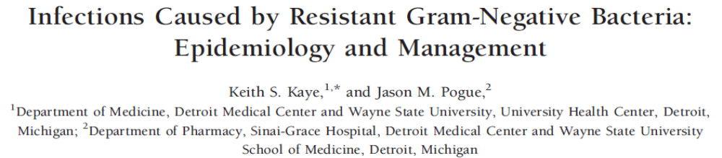
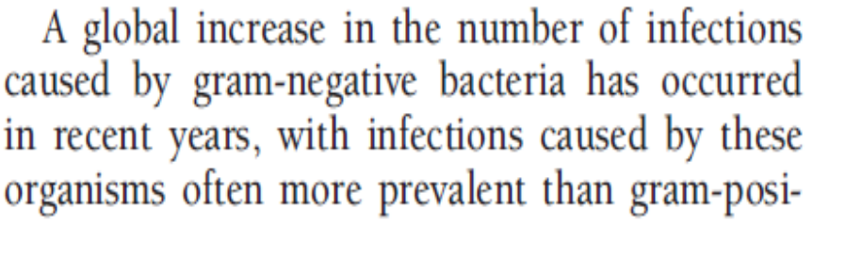
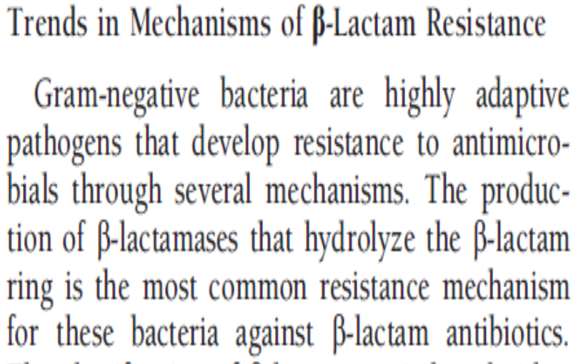
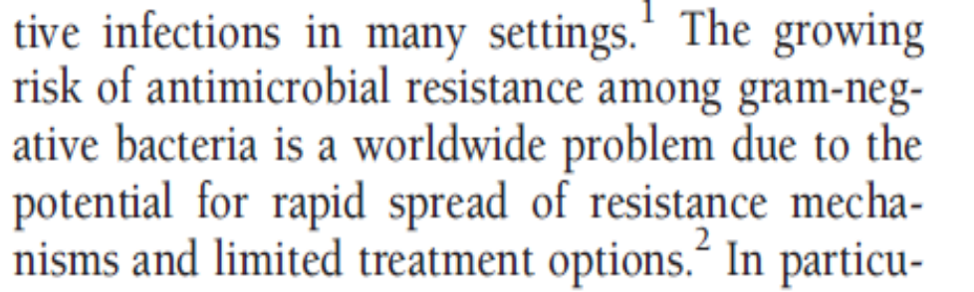
Discussion
1- Distribution of bacterial strains

Slide 49
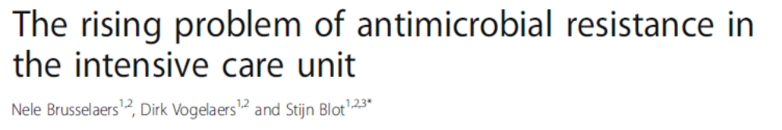
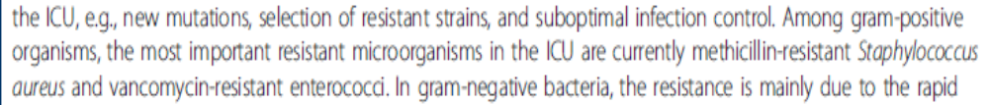
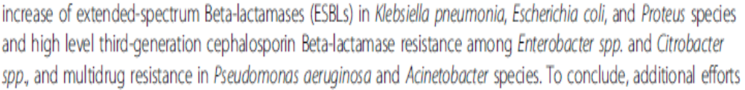
Discussion
1- Distribution of bacterial strains

Slide 50
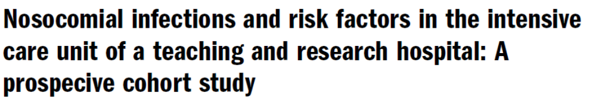
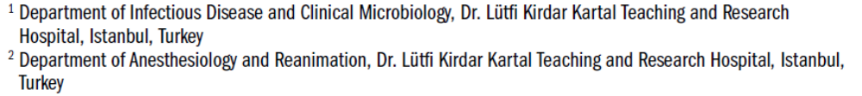
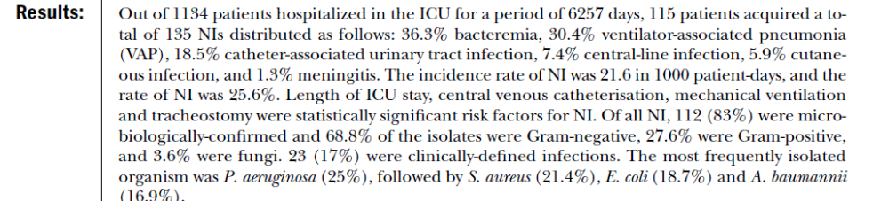
Discussion
1- Distribution of bacterial strains

Slide 51
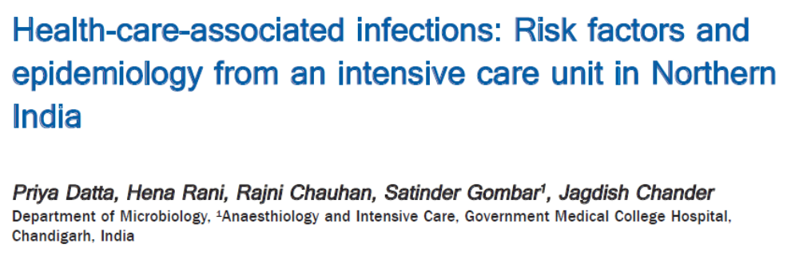
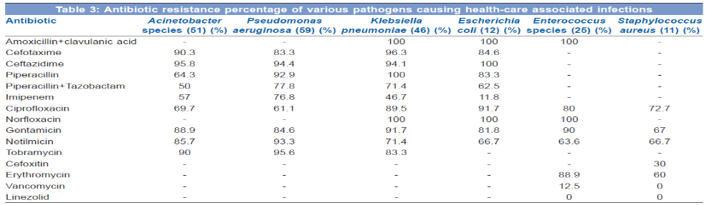
Discussion
2- Bacterial strains Antibiotic resitance

Slide 52
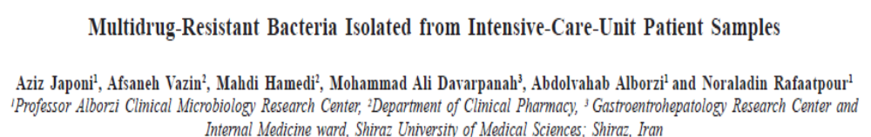
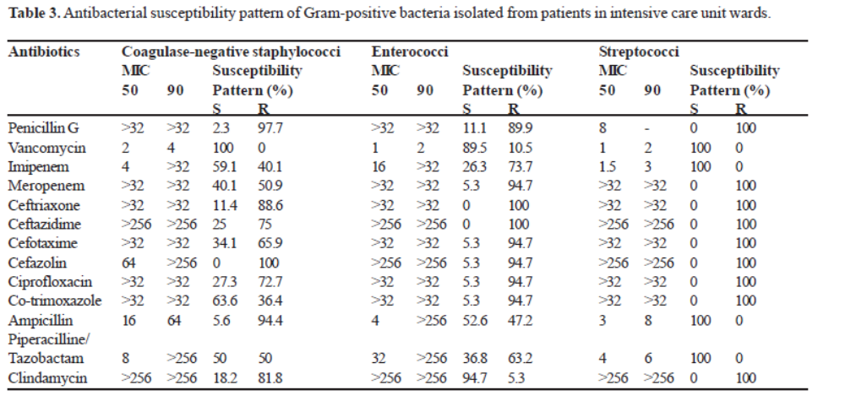
Discussion
2- Bacterial strains Antibiotic resitance

Slide 53
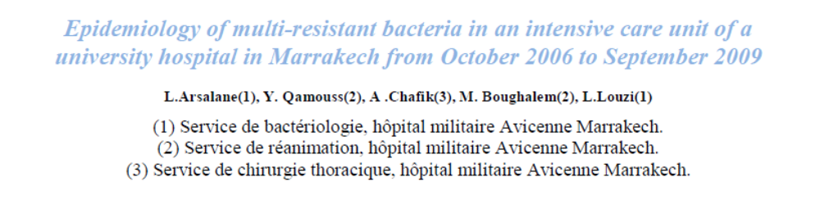
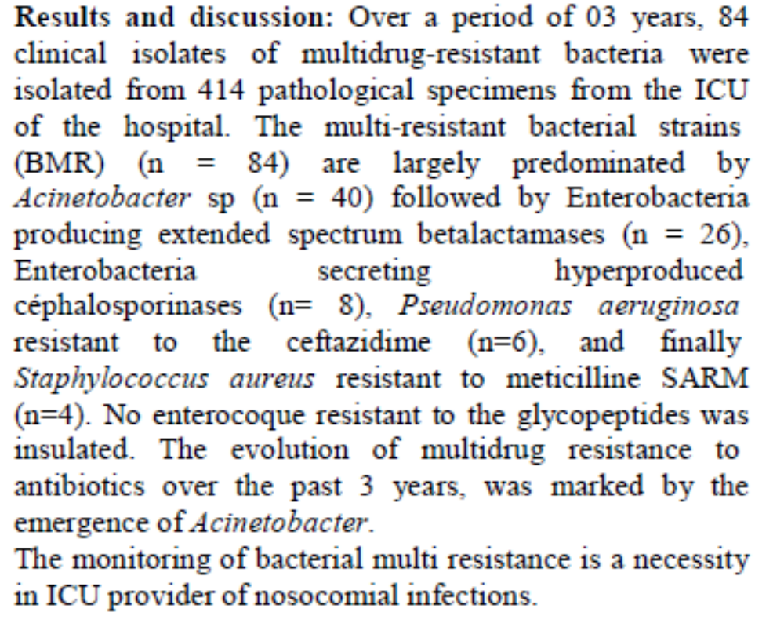
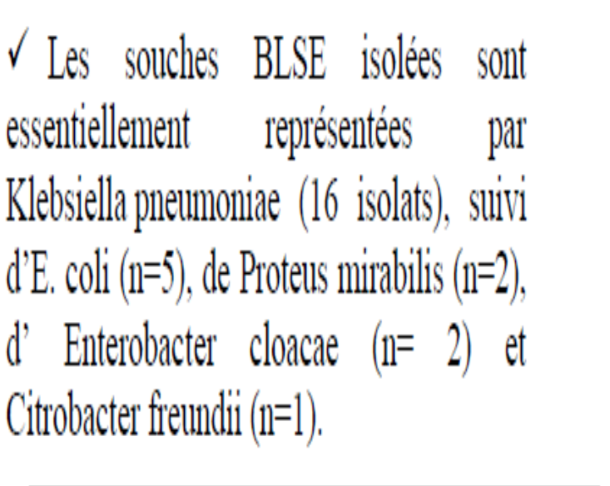
Discussion
3- Multidrug resistant bacteria

Slide 54
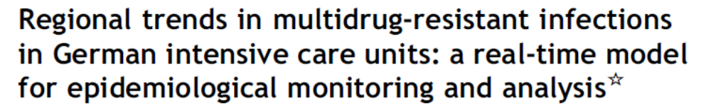
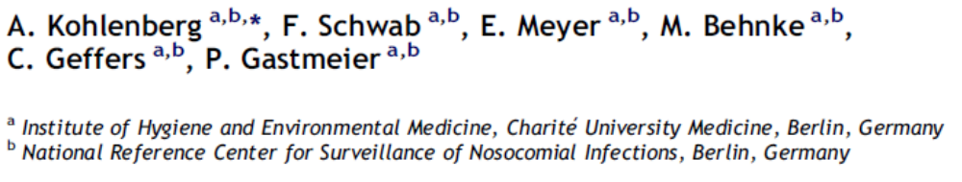
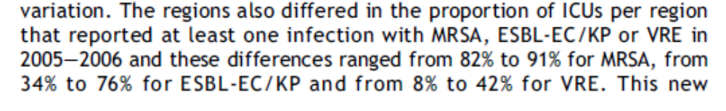
Discussion
3- Multidrug resistant bacteria

Slide 55
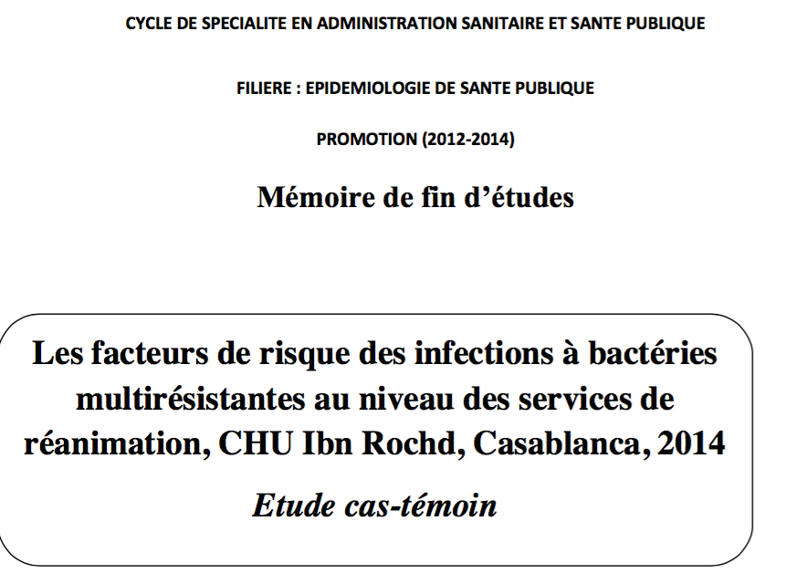
Discussion
4- Risk factors for acquiring MDR bacteria

Slide 56
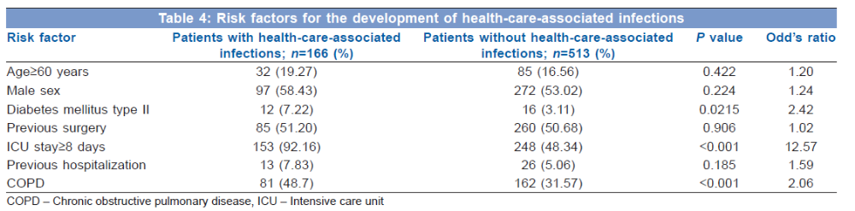
Discussion
4- Risk factors for acquiring MDR bacteria

Slide 57
Discussion
4- Risk factors for acquiring MDR bacteria

Slide 58


Slide 59
Conclusion
The alarming presence of MDR bacteria is strongly related to patients isolation, inappropriate therapy, mechanical ventilation, admission diagnosis of patients with polytrauma , the stay period, presence of comorbidities at the admission, as main risk factors, to be colonized or infected with MDR bacteria.

Slide 60
Acknowledgments
Photo du laboratoire à insérer + remerciements de toute l’équipe ( Hôpital+ FSSM+FSTG)

