Slide 1





Enhancement of the Immunostimulatory Functions of Ex Vivo–Generated Dendritic Cells from Early-Stage Colon Cancer Patients by Consecutive Exposure to Low Doses of Sequential-Kinetic-Activated IL-4 and IL-12.
Elisabetta Radice, Graziella Bellone, Vincenzo Miranda
Prof. Elisabetta Radice, MD
Department of Surgical Sciences
University of Turin - Italy
August 8-10, 2016 Birmingham, UK

Slide 2
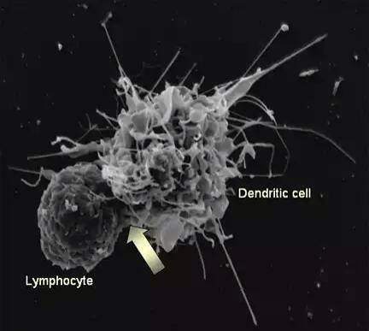
DENDRITIC CELLS – SENTINELS OF IMMUNITY
Dendritic cells (DCs) were originally considered to be the most potent professional antigen-presenting cells (APCs), which can uptake, process, and present, via a major histocompatibility complex (MHC), i.e different types of antigens to antigen-specific naïve T CD4⁺ helper (h) cells, linking the innate and adaptive immune systems.
August 8-10, 2016 Birmingham, UK
E. Radice

Slide 3
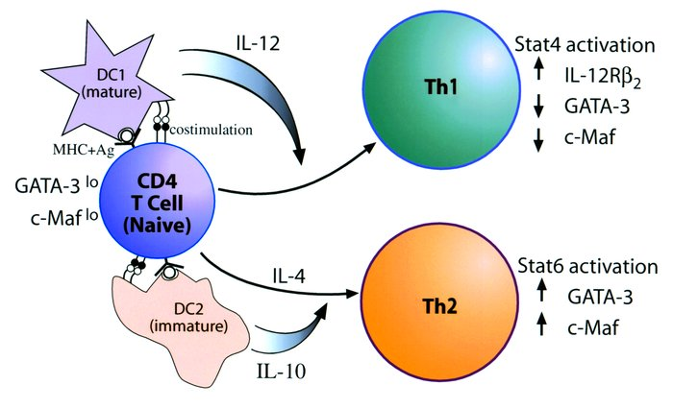
DENDRITIC CELL SUBSETS
DCs are heterogeneous and dynamic cells with high functional plasticity, which express immunostimulating or immunosuppressive potential, or both, depending on the consequence and combination of soluble and cellular microenvironmental stimuli affecting their differentiation, maturation, activation, and polarization.
Multiple DC subsets have been identified, each displaying a distinct phenotype, carrying out distinct functions, and collaboratively enabling adaptive T-cell immune response.
In particular:
DC1 _{CD11c/BDCA1-3} (myeloid DCs/ conventional DCs)
Anti-cancer effective response
Anti-cancer NON effective response
DC2 _{CD123/BDCA2-4} (plasmacytoid DCs)
August 8-10, 2016 Birmingham, UK
E. Radice

Slide 4
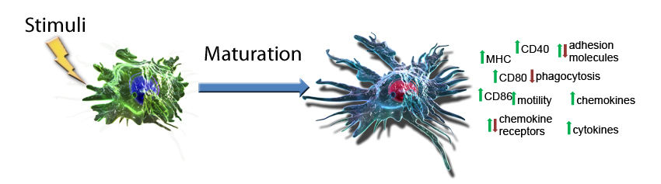
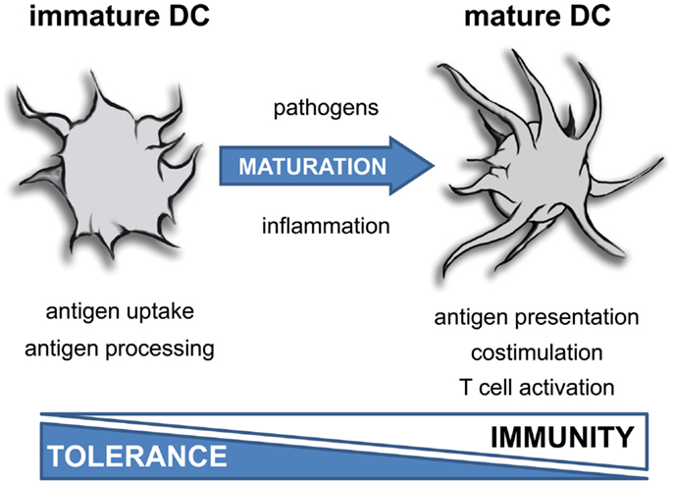
DENDRITIC CELL MATURATION STATE
The functional properties of DCs are maturation-dependent.
Immature DCs:
are unable to process/to present antigens efficiently to T-cells TOLERANCE
Mature DCs:
express higher levels of surface MHC-II and co-stimulatory molecules (CD40, CD80, CD86)
are potent activators of T-cells IMMUNITY.
August 8-10, 2016 Birmingham, UK
E. Radice

Slide 5
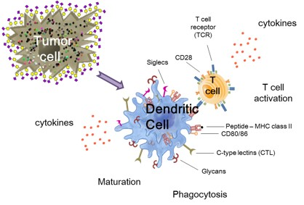
DENDRITIC CELLS IN TUMORS
Dendritic cells (DCs) play a relevant role in tumor by exerting differential pro-tumorigenic and anti-tumorigenic functions, depending on the local milieu. Quantitative and functional impairments of DCs have been widely observed in several types of cancer, including CRC, representing a tumor-escape mechanism employed by cancer cells to elude host immunosurveillance.
In the context of cancer immunotherapy Th1 polarization is considered conditio sine qua non for the induction of anti-tumor cytotoxic immune responses.
August 8-10, 2016 Birmingham, UK
E. Radice

Slide 6
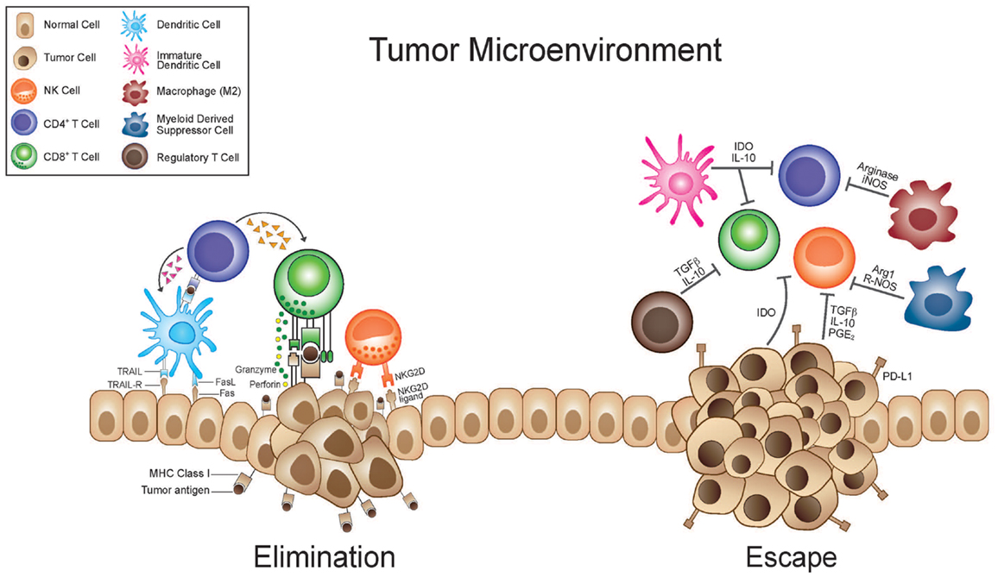
TUMOR IMMUNE ESCAPE
Tumors dodge the immune system by using a variety of mechanisms:
inhibition of dendropoiesis (switching the differentiation of monocytes to macrophages rather than DCs)
inhibiting DC maturation by secreting interleukin (IL)-10 and TGF-β₁ which leads to antigen-specific anergy
inducing apoptosis in DCs precursors and DCs
inducing “pro-tumor growth” DCs (CCL2, CXCL1, CXCL5, VEGF)
immune-checkpoint expression (IDO, PD1, CTLA4, LAG1, GITR, TIM3)
August 8-10, 2016 Birmingham, UK
E. Radice

Slide 7
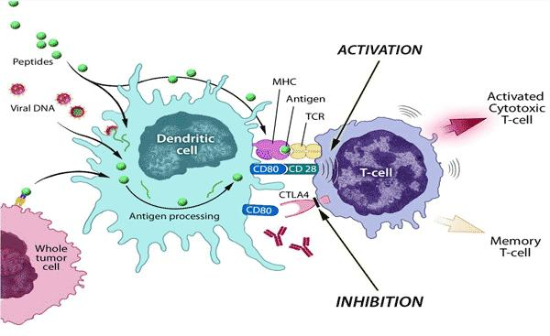
IMMUNOGENIC DENDRITIC CELLS IN CANCER THERAPY
Because of their ability to conduct all of the elements of the “immune orchestra”, DCs have long been considered a fundamental target and tool for cancer immunotherapy.
Cancer cells are not immunologically silent: they can express a wide range of common tumor-associated antigens, which raise both CD4⁺ and CD8⁺ T-cells.
The question remains how DCs can be functionally conditioned in order to express more effectively immunostimulatory cytokines (IL-12p70) and co-stimulatory molecules in parallel with antigen presentation to improve anti-tumor immune response and, possibly, to overcome the tumor immunosuppressive microenvironment.
August 8-10, 2016 Birmingham, UK
E. Radice

Slide 8
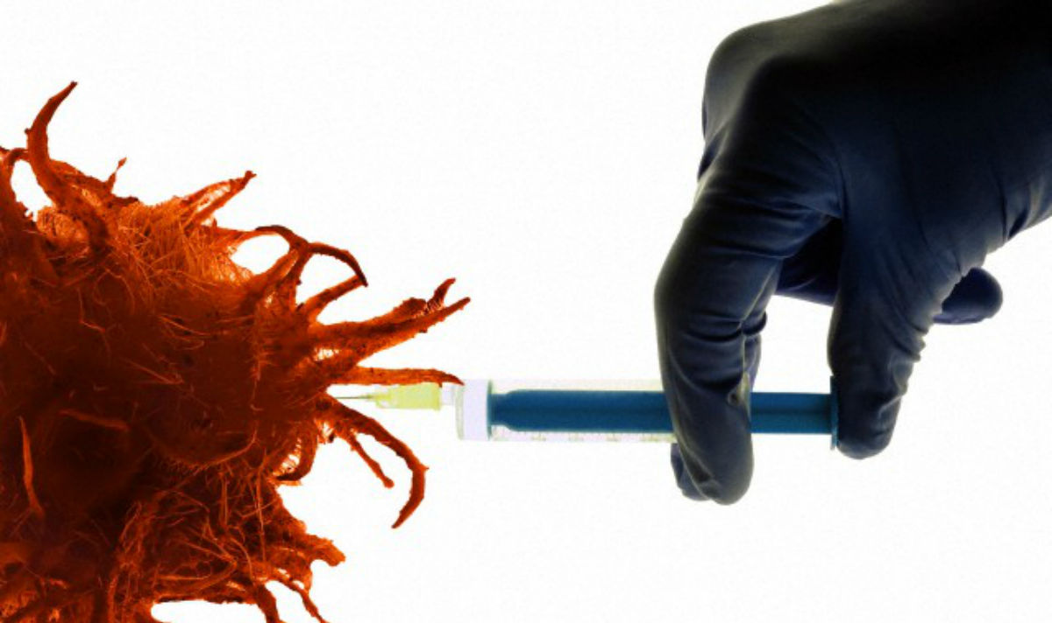
IMMUNOGENIC DENDRITIC CELLS IN CANCER THERAPY
Vaccines containing immunogenic DCs have been used during the last decade in many clinical studies in order to bring out an anti-cancer immunity.
In an attempt to improve the efficacy and outcome of DC-based cancer vaccines, the therapeutic use of DC cell activators, such as IL-12, IL-15, IL-18, IL-21, and interferons (IFNs), has also been applied in a clinical context.
Up to now, in-vivo manipulation of DCs via cytokines has unfortunately been associated with a severe degree of toxicity and with the generation of counterregulatory (i.e. immunosuppressive) measures that limit their overall usefulness as a cancer therapy.
August 8-10, 2016 Birmingham, UK
E. Radice

Slide 9
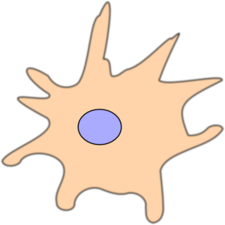
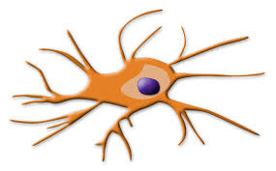
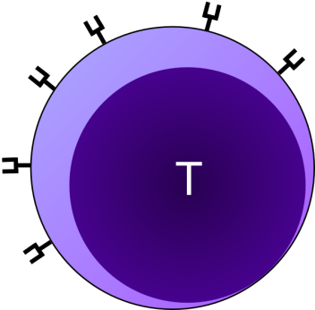
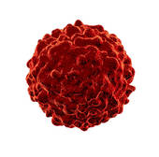
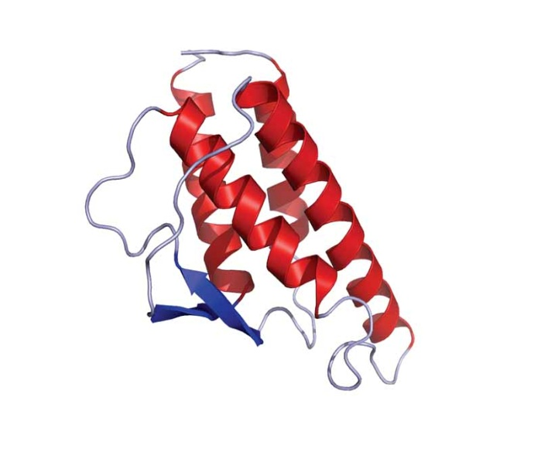
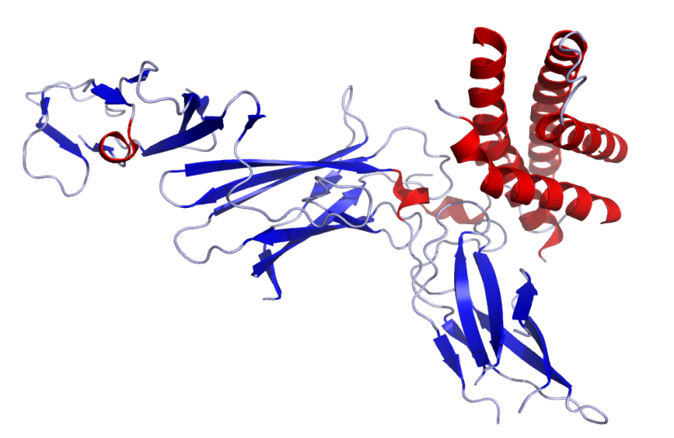
STUDY HYPOTHESIS
ACTIVATION
Cancer cell
Immature DC
Mature DC
ANTI CANCER
Th1 RESPONSE
IL-4
IL-12
IL-4 is a growth and maturation factor of DCs with opposite effects depending on the time of application and on the concentration.
IL-12 is produced primarily by professional APCs, including monocytes/macrophages and DCs.
It helps Th1 differentiation and the production of IL-2, IFN-γ, TNF-α.
It induces and increases the specific cell-mediated response and cytotoxic activity (NK cells and CD8⁺ cells)
August 8-10, 2016 Birmingham, UK
E. Radice

Slide 10
STUDY HYPOTHESIS
Several lines of evidence suggest that low-dose cytokines are adequate for modulating the immune response in many different models.
In particular, cytokines activated by the pharmaceutical preparation process known as “Sequential Kinetic Activation” (SKA) have been found to retain their functional activities even at physiological low-dose concentrations both in a murine model of allergic asthma and in an ex-vivo study of the cytotoxicity of natural killer (NK) cells from Colorectal Carcinoma (CRC) patients.
ACTIVATION
Cancer cell
Immature DC
Mature DC
ANTI CANCER
Th1 RESPONSE
SKA IL-4
SKA IL-12
Gariboldi S, Palazzo M, Zanobbio L, et al. (2009). Low dose oral administration of cytokines for treatment of allergic asthma. Pulm Pharmacol Ther 22, 497–510.
Radice E, Miranda V, and Bellone G.(2014). Low-doses of sequential-kinetic-activated-interferon-γ enhance the ex vivo cytotoxicity of peripheral blood natural killer cells from patients with early-stage colorectal cancer. A preliminary study. Int Immunopharmacol 19, 66–73.
E. Radice

Slide 11
COLORECTAL CARCINOMA (CRC)
Despite advances in screening and preventative strategies, CRC remains one of the leading causes of cancer-related death in the Western world.
Approximately 30% of patients are diagnosed with metastatic disease on first presentation, and an additional 25% to 30% of patients will subsequently develop advanced disease, primarily with metastases to the liver and lungs.
The median survival for all patients with metastatic CRC is approximately 22 to 24 months, with 5-year survival still <5%
Despite some preclinical evidence of efficacy, clinical trials using immunomodulatory cytokines have been generally disappointing, and the treatment is poorly tolerated.
Radical surgical resection of the primary colorectal lesions, combined with adjuvant chemotherapy and radiotherapy, when indicated, still remains the mainstay of therapy.
August 8-10, 2016 Birmingham, UK
E. Radice

Slide 12
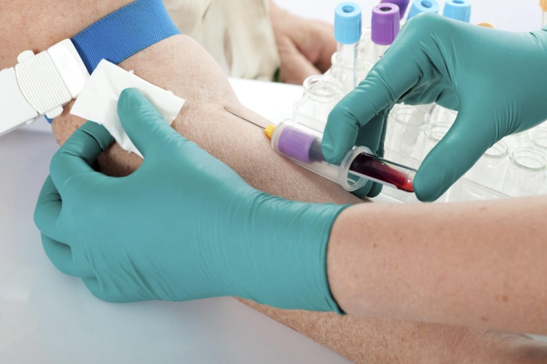
EX-VIVO STUDY PROJECT
The study used ex vivo-generated MoDCs (by culturing monocytes in GM-CSF plus IL-4), from CRC patients in comparison with healthy donors to assess whether single or sequentially combined exposure to very low doses of SKA IL-4 and/or SKA IL-12 might enhance the DCs’ antigen presentation capacity compared with the normally administered conventional dose of recombinant human (rh)IL-4 and rhIL-12, using Primary Allogeneic One-Way Mixed Lymphocyte Reaction (MLR).
SKA IL-4 and SKA IL-12 are prepared by GUNA Laboratories (GUNA S.p.a, Milan, Italy) using a standardized method. Cytokines, sequentially diluted in saline solution (serial dilution 1:100), are kinetically energized by a mechanically applied force (shaking process). The preparations are supplied at a concentration of 10⁻⁸ μg/ml.
August 8-10, 2016 Birmingham, UK
E. Radice

Slide 13
EX-VIVO STUDY PROJECT
16 patients
(10 males, 6 females; average age 73; range 57-83)
with CRC diagnosis
2 Dukes A
9 primary CRC
7 Dukes B ₁₋₂
16
Dukes C ₁₋₂
with lymph node metastasis
7 metastatic CRC
12 subjects
(7 males, 5 females; average age 64; range 37-85)
healthy donors
12
Healthy donors
August 8-10, 2016 Birmingham, UK
E. Radice

Slide 14
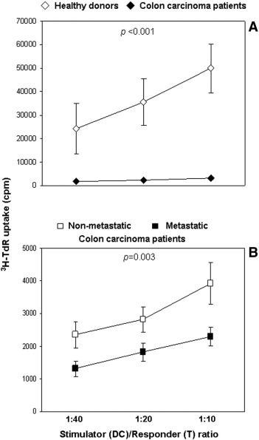
RESULTS
Basal MoDC allostimulatory activity status
in patients with CRC and in healthy donors.
Normal naïve CD4⁺ T-lymphocytes, after co-incubation with MoDCs from CRC patients in MLR, exhibited a significantly lower proliferative response than did those stimulated with normal MoDCs (P ≤ .001).
CRC patients thus demonstrated a marked defect in DCs functional activity.
0
Figure 1. (A) MoDC allostimulatory activity of CRC patients (n = 16) versus healthy donors (n = 12).
August 8-10, 2016 Birmingham, UK
E. Radice

Slide 15
RESULTS
Basal MoDC allostimulatory activity status
in patients with non-metastatic (Dukes’ A+B)
and metastatic (Dukes’C) CRC
MoDC-induced T-cell proliferation in the primary MLR assay was significantly lower in CRC patients with locally advanced disease (Dukes’ C, n = 7) than it was in patients with early stage CRC (Dukes’ A + B, n = 9) (P = .003).
Moreover, a significant correlation was found between antigen presenting activity of DCs and Dukes’ stage (expecially at DC/T ratio = 1:40, R = 0.533, P = .033, Sperman correlation test).
The naïve CD4⁺ T-lymphocytes after incubation with normal MoDCs show an about 10 times higher proliferative response, highlighting the marked functional defect of MoDCs in CRC patients.
Figure 1. (B) MoDC allostimulatory activity of non-metastatic (n = 9) versus metastatic (n = 7) CRC patients. MoDCs, generated by culturing PB CD14⁺ cells from tumor and normal subjects in the presence of rhGM-CSF and rhIL-4 for 6 days, were incubated with 1 × 10⁵ allogeneic naïve CD4⁺ T-cells at 1:40, 1:20, and 1:10 ratios for 5 days followed by a 6-hour pulse of ³H-TdR. Results are expressed as mean ± SE cpm of triplicate co-cultures. Statistical significance was determined using one-way ANOVA.
August 8-10, 2016 Birmingham, UK
E. Radice

Slide 16
RESULTS
Control
rhIL-4 (50 ng/ml)
rhIL-12 (1 ng/ml)
rhIL-4/rhIL-12 (50 ng/ml / 1 ng/ml)
Control
SKA-IL-4 (0.5 fg/ml)
SKA-IL-12 (2 fg/ml)
SKA-IL-4/SKA-IL-12 (0.5 fg/ml / 2 fg/ml)
rh
SKA
In non-metastatic CRC patients the allostimulatory activity of MoDC pre-treated with rhIL-12 (1 ng/ml) increased significantly (p = 0.026).
None of the concentrations of SKA-IL-12 used affected APC capacity.
In healthy donors the highest concentration of SKA IL-12 evaluated (2 fg/ml) significantly increased the allostimulatory activity of MoDC in comparison with untreated MoDC (p = 0.034), even if the effect of the standard dose of rhIL-12 was more marked (p = 0.001).
Colon carcinoma patients
Colon carcinoma patients
***
**
*
³H-TdR uptake (cpm)
Healthy donors
Healthy donors
***
The poor functional response of MoDC in non-metastatic CRC patients to low-dose SKA-IL-12-mediated stimulation may be due to a defective expression of IL-12R complex, which nevertheless is sufficient for pharmacological doses of IL-12 to induce partial correction of MoDC allostimulatory activity.
***
*
*
*
*
1:40 1:20 1:10
1:40 1:20 1:10
Stimulator (DC) / Responder (T) ratio
August 8-10, 2016 Birmingham, UK
E. Radice

Slide 17
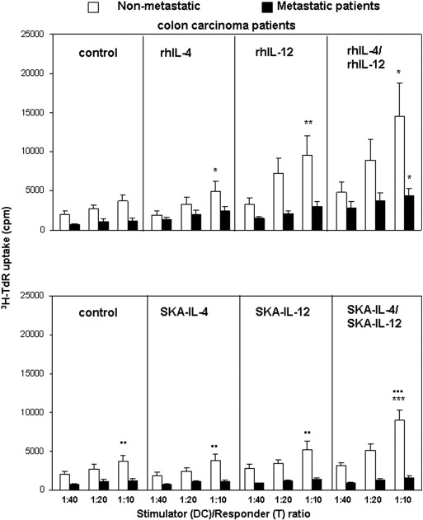
RESULTS
rh
Effect of the rhIL-4 and rhIL-12 used as single agents or sequentially, on MoDC allostimulatory activity in non-metastatic and metastatic CRC patients
Significant increase in MoDC functional activity in MLR of rhIL-4, rhIL-12, as single agent, or rhIL-4 and rhIL-12 sequentially combined pre-treated MoDCs from early-stage CRC patients (n = 6, Dukes’ A and B) was observed in comparison with untreated cells (P = 0.034, P = 0.002, and P = 0.019, respectively).
Antigen-presenting activity of MoDCs from CRC patients with metastatic lymph nodes (n = 7, Dukes’ C) was enhanced only after exposure to rhIL-4 followed by rhIL-12 (P = .011). MLR response levels in the presence of MoDCs pre-treated with rhIL-4 and rhIL-12 as single agents, or with rhIL-4 and rhIL-12 in subsequent association, were significantly lower in CRC patients with metastatic lymph nodes than in those with locally early tumors (Dukes’ A + B, n = 6) (P = 0.003, P = 0.006, P = 0.004, and P = 0.023, respectively).
Figure 2. Effects of standard-dose rhIL-4 and/or rhIL-12 on APC activity in MLR of MoDCs in non-metastatic CRC patients (n = 6) and from metastatic CRC patients (n = 7). MoDCs were untreated or pre-treated with rhIL-4 (48 hours) and rhIL-12 (24 hours) as single agents or sequentially and subjected to MLR with allogeneic naïve T-cells in different MoDC-to-T-cell ratios. The figure shows the mean percentages ± SE of 3H-TdR incorporation in cpm. Statistical significance was determined using one-way ANOVA. Rh cytokine pre-treated non-metastatic/metastatic CRC MoDCs versus untreated non-metastatic/metastatic CRC MoDCs: *P =0.05 and **P = 0.01.
August 8-10, 2016 Birmingham, UK
E. Radice

Slide 18
RESULTS
rh
Effect of the SKA-IL-4 and SKA-IL-12 used as single agents or sequentially, on MoDC allostimulatory activity in non-metastatic and metastatic CRC patients
After sequential SKA-IL-4 and SKA-IL-12 exposure, MoDCs from early-stage disease (Dukes’ A + B) CRC patients, but not those from metastatic disease (Dukes’ C), promoted a significant proliferative response in allogeneic MLR in comparison with untreated cells (P=0.001 and P=0.076, respectively), although their functional recovery did not reach levels of those in normal subjects (P ≤ 0.001).
The same cytokines used singly did not affect functional activity of MoDCs from non-metastatic CRC patients.
SKA
Figure 2. Effects of low dose SKA-IL-4 and/or SKA-IL-12 on APC activity in MLR of MoDCs from non-metastatic CRC patients (n = 6) and from metastatic CRC patients (n = 7). MoDCs were untreated or pre-treated with SKA-IL-4 (48 hours) and SKA-IL-12 (24 hours) as single agents or sequentially in parallel to the rh cytokines, and subjected to MLR with allogeneic naïve T-cells in different MoDC-to-T-cell ratios. The figure shows the mean percentages ± SE of 3H-TdR incorporation in cpm. Statistical significance was determined using one-way ANOVA.
August 8-10, 2016 Birmingham, UK
E. Radice

Slide 19
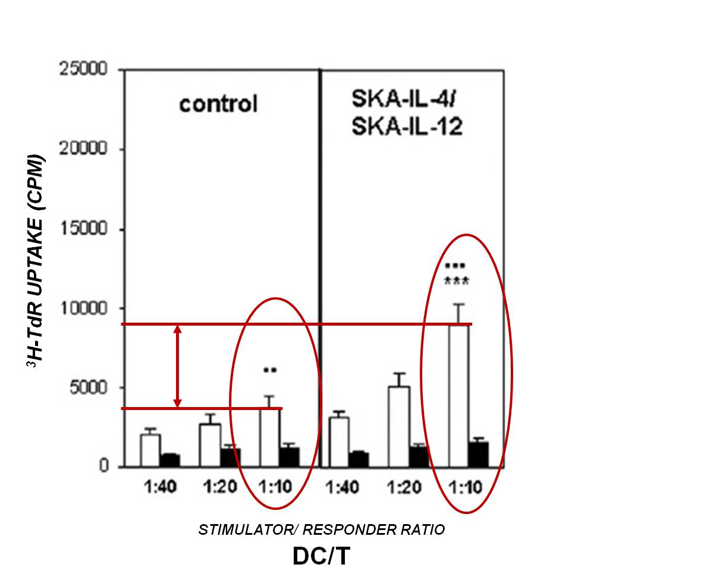
IN DETAIL SKA-IL-4/SKA-IL-12 vs CONTROL
The sequential treatment with SKA-IL-4 and SKA-IL-12 significantly improves
the functional properties (in terms of allostimulatory capacity) of MoDCs in
non-metastatic CRC patients.
Statistical significance was determined using one-way ANOVA. SKA cytokine pre-treated non-metastatic CRC MoDCs versus metastatic CRC MoDCs: ●● P =0.01 and ●●●P =0.0001.
August 8-10, 2016 Birmingham, UK
E. Radice

Slide 20
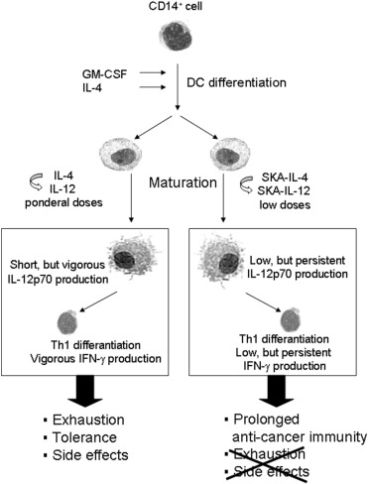
CONCLUSIONS
Compared to sequential treatment with conventional concentration of rhIL-4 e rhIL-12, the sequential DCs exposition to
SKA-IL-4 e SKA-IL-12 leads to:
prolonged anti-cancer activity
No cell exhaustion
No tolerance
No side effects
Figure 6. Schematic representation of the hypothetical mode of action and consequences of sequential exposure to low dose SKA-IL-4 and SKA-IL-12 in comparison with ponderal doses of rhIL-4 and rhIL-12 on DC IL-12p70 secretory activity.
Translational Oncology 2015 8, 327-338DOI:(10.1016/j.tranon.2015.06.005)
August 8-10, 2016 Birmingham, UK
E. Radice

Slide 21
CONCLUSIONS
IN VIVO
SKA IL-4 (10 fg/ml) SKA IL-12 (10 fg/ml)
A NEW OPPORTUNITY FOR
CANCER IMMUNOTHERAPY?
Figure 6. Schematic representation of the hypothetical mode of action and consequences of sequential exposure to low dose SKA-IL-4 and SKA-IL-12 in comparison with ponderal doses of rhIL-4 and rhIL-12 on DC IL-12p70 secretory activity.
Translational Oncology 2015 8, 327-338DOI:(10.1016/j.tranon.2015.06.005)
August 8-10, 2016 Birmingham, UK
E. Radice

Slide 22

Disclosure Information
Prof. Elisabetta Radice, MD
Grants/Research Support:
GUNA S.p.a. Milan, Italy

