Slide 1

Methanol contamination in indigenous fermented alcoholic beverages
Dr. Elijah I. Ohimain
Biological Sciences Department
Niger Delta University
Wilberforce Island, Nigeria
Food Safety & Regulatory Measures International conference
17 -19 August 2015 Birmingham, UK

Slide 2
Incidences of methanol contamination
Beverage ethanol production via fermentation is an age-long tradition in many parts of the world.
In the tropical world, indigenous/rural people including women are involved in the value chain of traditional alcoholic fermentation
In Africa, Asia and South America, there are increasing incidences of methanol contamination in traditionally fermented alcoholic drinks
For instance, in 2008, more than 180 people were killed in Bangalore and in 2009, 136 people were killed in Gujarat (India)
In 2009, 25 persons died in Indonesia after consuming fermented palm wine containing methanol.
130 Indian villagers die from alcohol poisoning in 2011
In June 2015, 27 persons died after consuming toxic alcohol in India.
Between April and June 2015, 89 persons died in Nigeria following the consumption of alcohol beverage produced from palm wine

Slide 3
WHO (2014) Report
There have been numerous outbreaks of methanol poisoning in recent years in several countries, including Cambodia, Czech Republic, Ecuador, Estonia, India, Indonesia, Kenya, Libya, Nicaragua, Norway, Pakistan, Turkey and Uganda. The size of these outbreaks has ranged from 20 to over 800 victims, with case fatality rates of over 30% in some instances.
Concentrations of 6-27 mg/L have been measured in beer and 10-220 mg/L in spirits. In these concentrations methanol is not harmful.
The informal and illicit production of alcoholic drinks is practiced in many parts of the world, including countries where alcohol is banned. Some common names for these drinks include: hooch/ moonshine (USA), chang’aa/kumi kumi (Kenya), tonto/waragi (Uganda), tuak/tapai (Malaysia), samogon (Russia), and talla (Ethiopia).

Slide 4
Symptoms of methanol poisoning
Blurred vision, blindness
Loss of consciousness
Weight loss
Headache, weakness, dizziness
Breathing difficulties
Abdominal pains, nausea, diarrhoea, vomiting
Source: Methanol Institute (2013)

Slide 5
Regulatory limits of methanol in beverages
Country | Maximum methanol value* | Reference
Brazil | 0.5% (0.5 ml/100ml) | Mendonca et al (2011
Thailand | 0.024% (240 mg/l) | Chaiyasut et al (2013)
Australia/ New Zealand | 0.8% (8 g/l) | Chaiyasut et al (2013)
USA | 0.1% | FDA (Federal Food, Drug and Cosmetic Act 21 USC 34 (a)(2)(C)
Vietnam | 0.3% | Socialist Republic of Vietnam (2010)
Nigeria | 0.0005% (5 mg/l) | NAFDAC 2005
*concentration of methanol in ethanol

Slide 6
Possible sources of methanol in fermented beverages?
unscrupulous vendors might have deliberately spiked the beverages with methanol to increase the alcohol content,
methanol might have been produced by contaminating microbes during fermentation.
Methanol could be produced by microbes during the fermentation of fruits high in pectins
Methanol could also be produced during fermentation in unclean containers

Slide 7
Traditionally/informally fermented beverages 1
Beverage | Feedstock | Fermenting organism | Countries | Alcohol content | Remarks (Reference)
Palm wine | oil palm, Raffia palms, date palm, the palmyra, jaggery palm, kithul palms, or nipa palms. coconut palms, Borassus | Yeast (Saccharomyces cerevisiae, Saccharomyces ludwigii, Candida parapsilosis, Candida fermentati, Pichia fermentans, Schizosaccharomyces romyces pombe, Schizosaccharomyces romyces bailli, Kluvyeromyces africanus, Hansenula auvarum, Kloeckera apiculata, Torulaspora delbrueckii) & Lactic Acid Bacteria (Lactobacillus, Leuconostoc, Pediococcus, Lactococcus, and Streptococcus), acetic acid bacteria (Acetobacter, Aerobacter) | Most African and Asian countries | >10% | Ogbulie et al (2007, Rokosu and Nwisienyi, 1980), Karamoko et al (2012)
Local gin (ogogoro) | Palm wine | (Saccharomyces cerevisiae) & Bacteria (Lactobacillus) | Most African and Asian countries | 40-60% Ethanol | Ohimain et al (2012)

Slide 8
Traditionally/informally fermented beverages 2
Beverage | Feedstock | Fermenting organism | Countries | Alcohol content | Remarks (Reference)
Arak | Grape | Yeast | Israel, Lebanon, Iraq Syria Jordan Palestine, Cambodia, | 40-63%
Plum wine | Japanese Plum (Prunus salicina Linn) | Yeast | India | 175mg/l Methanol | (Joshi et al 2009)
Cholai | rice, sugar-cane, juice of date tree, molasses, and fruit juice (pineapple and jackfruits) | Sacharomyces cerevisiae | India | 14.5% alcohol | Islam et al(2014)

Slide 9
Traditionally/informally fermented beverages 3
Beverage | Feedstock | Fermenting organism | Countries | Alcohol content | Remarks (Reference)
Cachaca (banana pulp wine) | Banana | Sacharomyces cerevisiae | Brazil | Ethanol (5.34-7.84%), methanol (0.65-0.189%) | Mendonca et al (2011)
Cachaca | Sugarcane | Sacharomyces cerevisiae and wild yeasts (Pichia sp & Dekkera bruxelensis) | Brazil | Methanol (0-0.5%) | Dato et al (2005)
Noni | Morinda trifolia | Lactobacillus plantarum & L. casei | Thailand | 853 mg/l methanol | Chaiyasut et al (2013)

Slide 10
Traditionally/informally fermented beverages 4
Beverage | Feedstock | Fermenting organism | Countries | Alcohol content | Remarks (Reference)
Pito (local beer) | Sorghum or maize | Bacteria (Pediococcus halophilus, Lactobacillus) & yeast (Saccharomyces cerevisiae, Candida tropicalis, Schizosaccharomyces romyces pombe, Kluvyeromyces africanus, Hansenula anomala, Kloeckera apiculata, Torulaspora delbrueckii) | West Africa | 2-3% Ethanol | Orji et al (2003), Sefa-Dedeh et al (1999); Iwuoha and Eke (1996)
Burukutu | Sorghum | Sacharomyces cerevisiae, Streptococcus, Lactobacillus, Aspegillus, Fusarium, Penicillium | Nigeria, Ghana | 1.63% ethanol | Eze et al (2011); Iwuoha and Eke (1996)

Slide 11
Traditionally/informally fermented beverages 4
Beverage | Feedstock | Fermenting organism | Countries | Alcohol content | Remarks (Reference)
Ogi | Maize, sorghum or millet | Sacharomyces cerevisiae, Lactobacillus plantarum, streptococcus lactis | Nigeria | ? | Iwuoha and Eke (1996)
Kwunu-zaki | Millet | Sacharomyces cerevisiae | Nigeria | ? | Iwuoha and Eke (1996)
Cocoa sap wine | Cocoa sap | Sacharomyces cerevisiae | Nigeria | ? | Iwuoha and Eke (1996)

Slide 12
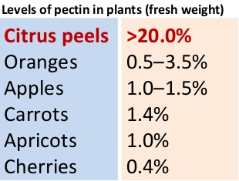
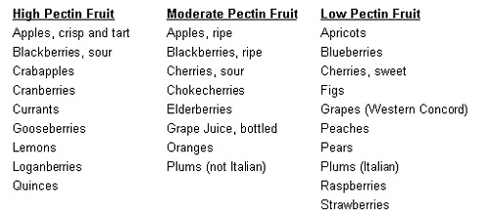
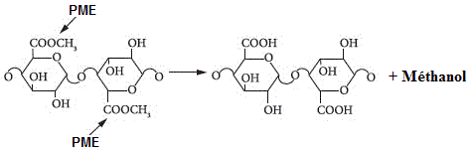
Pectins
Pectin is a structural hetero-polysaccharide contained in the primary cell walls of terrestrial plants.
It is used in food as a gelling agent, particularly in jams and jellies. It is also used in fillings, medicines, sweets, as a stabilizer in fruit juices and milk drinks, and as a source of dietary fiber (Wikipedia).
PME hydrolyses pectin to polygalactoronic acid and methanol.

Slide 13
Microbial production of methanol
Methanol production in traditional fermented beverages can be linked to the activities of pectinase producing yeast, fungi and bacteria.
Microbes producing pectin methyl esterase are able to produce methanol from fruits/juices containing pectin
Under traditional/informal fermentation, alcoholic beverages produced by mixed microbial consortium probably lead to the production of mixed alcohols
Microbes can also produce methanol via the oxidation of methane (biogas)

Slide 14
Microbial production of methanol (Siero et al 2012)
Pectin enzymes are widely distributed in nature and are produced by yeast, bacteria, fungi and plants
Proteolytic enzymes are classified into esterases and depolymerase (lyases and hydrolyses)
Hydrolyses of pectin by lyases produces oligo- or mono-galacturonate
Hydrolysis of pectin by esterases produces pectic acid and methanol

Slide 15
Literature /Research highlights 1
Methanol is produced during fermentation by the hydrolysis of naturally occurring pectin in the wort (Tomoyuki et al 2000; Mendonca et al 2011)
Alcohols made from mangoes, pears, banana and melon have been shown to contain methanol (Mendonca et al 2011)
The total alcohol (ethanol and methanol) produced from orange juice was 3.19 % w/v with S. cerevisiae var. ellipsoideus and 6.80% w/v) with S. carlsbergensis (Okunowo and Osuntoki 2007).
Chaiyasut et al (2013) reported factors affecting the methanol production in fermented beverages including raw material size and age, sterilization temperature, pectin content and pectin methyl esterase (PME) activity (Note that PME activity is optimal at 50-60ºC).
During ripening, pectin in fruits is broken down by PME resulting in the formation of methanol (Chaiyasut et al, 2013: Michel 2001).
PME (EC: 3.1.1.11) de-esterify pectin to low –methoxyl pectins resulting in the production of methanol (Chaiyasut et al, 2013: Michel 2001)

Slide 16
Literature / Research highlights 2
Chaiyasut et al (2013) compared pectin levels in fermented beverage containing Morinda citrifolia (9.89%) with that of other fruits including guava (4.36%), tomato (0.3%), apple (0.5%), carrot (0.8%) and cherries (0.4%)
During the production of sugarcane beverage called cachaca in Brazil, Saccharomyces cerevisiae produced no methanol while contaminating yeasts (Pichia silvicola and P. anomata) produced 0.5% methanol (Dato et al 2005)
Pichia methanolica is able to utilize, pectin, polygalacturonic acid and methanol as sole carbon sources (Nakagawa et al 2005)
Stringini et al (2009) studied yeast diversity during tapping and fermentation of oil palm wine from Cameroon and found Saccharomyces cerevisiae, Saccharomyces ludwigii, Schizosaccharomyces bailli, Candida parapsilosis, Pichia fermentans, Hanseniaspora uvarum and Candida fermentati in addition to lactic acid bacteria and acetic acid bacteria

Slide 17
Literature / Research highlights 3
Pectin is typically found in the intracellular regions and cell walls of most fruits and vegetables, with its greatest abundance in citrus particularly orange, grape, limes and lemons (Siragusa et al 1988)
Citrus contains 7-10% pectin (Siragusa et al 1988)
Human colonic bacteria, Erwinia carotovora is able to degrade pectin releasing methanol (Siragusa et al 1988)
Anaerobic bacteria, Clostridium particularly C.butyricum, C. therocellum, C. multifermentans, and C. felsineum produce methanol from pectin (Ollivier and Garcia, 1990)
Nakagawa et al (2000) found that Candida boidinii can grow on pectin or polypalactoronate as a carbon source producing methanol
Schink and Zeikus (1980) reported various pectinolutic strains of Clostridium, Erwinia and Pseudomonas

Slide 18
Methanol contamination: the Nigerian case
In the Nigerian methanol poisoning case, fermented alcoholic beverage was found to contain 16.3 % methanol
The blood methanol concentration of victims was found to be 1500-2000 mg/l.

Slide 19
Possible sources of methanol in fermented beverages?
unscrupulous vendors might have deliberately spiked the beverages with methanol to increase the alcohol content,
methanol might have been produced by contaminating microbes during fermentation.
Methanol could be produced by microbes during the fermentation of fruits high in pectins
Methanol could also be produced during fermentation in unclean containers

Slide 20
Price of alcohols
Locally produced gin of 40-60% ethanol content costs N20 per shot of 30ml i.e. N670/litre i.e. £ 1.97/litre (£ 1.00= N340)
25 litre pure 99.85% methanol is £37.95 i.e. £1.52/litre (excluding importation and duty costs). The landing cost could be more than double
Methanol is not currently produced in Nigeria (but there are at least 2 methanl plants under construction)

Slide 21
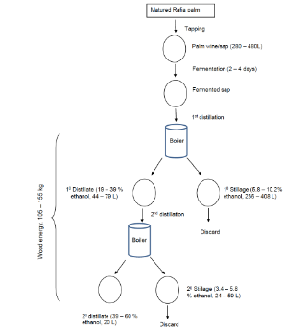
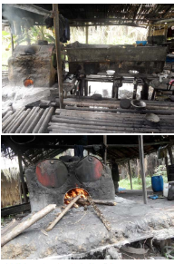
Traditional production of beverage ethanol from raffia palm (Ohimain et al 2012)

Slide 22
Physical properties of methanol, ethanol and gasoline (Modified from Kamboj and Karimi (2014), Methanol Institute (2011))
Property | Methanol | Ethanol | Gasoline
Chemical formula | CH3OH | C2H5OH
Molecular weight(Kg/kmol) | 32.04 | 46.07
Oxyzen present (wt %) | 49.9 | 34.8
Density (g cm-1) | 792 | 789 | 740
Freezing point at 1 atm (0C) | -97.778 | -80.0
Boiling temperature at 1 atm (0C) | 64.9 (65) | 74.4 (78)
Auto-ignition temperature (0C) | 463.889 | 422.778
Latent heat of vaporization at 200C (KJ/Kg) | 1103 | 840
Stoichiometric air/fuel ratio (AFR) | 6.47 | 9.0
Lower heating value of the fuel (MJ/kg) | 19.7 | 26.9 | 43.9
Research octane number (RON) | 111 | 108 | 92
Motor octane number (MON) | 92 | 92
Fuel equivalence | 0.48 | 0.677 | 1

Slide 23
Alternative uses of methanol
Fuel use (direct fuel use, reagent for the production of biodiesel, synthesis of other carriers e.g. DME & MTBE, Direct Methanol fuel cells, fuel additives)
Pesticide synthesis
Chemical synthesis
Solvent

Slide 24
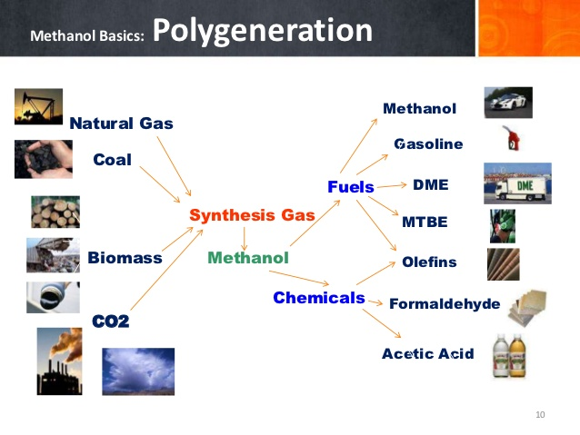
Methanol Economy
Methanol Sources
Methanol Uses
http://www.slideshare.net/EMA_SIEW/dom-lavigne-methanol-fuels-safe-efficient-affordable-mature downloaded 18 Aug 2015

Slide 25

Alcohol fuels
http://www.thecuttingedgenews.com/index.php?article=74973 downloaded 18 Aug 2015

Slide 26
Conclusion
contaminated alcoholic beverages be converted for fuel use rather than out rightly banning the age –long traditional alcohol fermentation.

Slide 27
Future research directions & request for collaboration on:
Physicochemical analysis of palm wine to detect the presence of pectins
Microbial diversity of raffia palm wine using 16S rRNA gene sequencing and ITS2 rRNA region
Assessment of methanol producing microbes in fermented beverages
Genetic analysis to assess if Sacharomyces cerevisiae have picked up or developed capability to produce methanol
Possible use of mixed alcohols (ethanol and methanol) for bioenergy applications (transportation or cooking fuel)

