Slide 1

Infection control
The science of a profession
Elias Tannous
Infection Control Officer
Cleveland Clinic Abu Dhabi

Slide 2
Disclosures
Nothing to disclose.

Slide 3

Learning objectives
At the end of this session, attendees should be able to:
Understand the essential elements of Infection prevention and control functions.
Identify and describe the science behind the IC profession.
Recognize three challenges in the IC practice and ways to tackle them.
To be asked later.

Slide 4


Infection Control: The Science
of a Profession
Role overload
Role ambiguity
Engagement and consciousness
Adaptability and passion
Role dvlpt: entry, transition, confirmation
Multiple roles
Role conflict
Value: first do no harm
Competencies :APIC
Pre-requisites: qualification-CBIC
Structure: SENIC-DELPHI- Others.

Slide 5
Major functions of an IC professional
Prevention
Surveillance
Education
Research

Slide 6
Healthcare Associated Infections HAIs
    Infection occurring during the process of care.
    Not present or incubating at the time of admission.
    Infections acquired in the health-care facility but appearing after discharge.
    Occupational infections among health-care workers of the facility.
Source: WHO

Slide 7
Classification of HAIs
Infectious diseases
Procedures related infections
Devices related infections
Occupational exposures
Infections related to the misuse of antimicrobials

Slide 8
The impact of HAIs
  More serious illnesses
  Prolongation of stay in a health-care facility
  Long-term disability
  Excess deaths
  High additional financial burden
  High personal costs on patients and their families
Source: WHO

Slide 9

1st analogy: the Iceberg analogy
The rationale behind standard precautions

Slide 10
Standard Precautions include:
Hand hygiene
Use of personal protective equipment
Respiratory hygiene and cough etiquette
Safe injection practices
Safe handling of potentially contaminated equipment or surfaces in the patient environment
Healthcare Infection Control Practices Advisory Committee (HICPAC) 2007 Guideline for Isolation Precautions: Preventing Transmission of Infectious Agents in Healthcare Settings

Slide 11
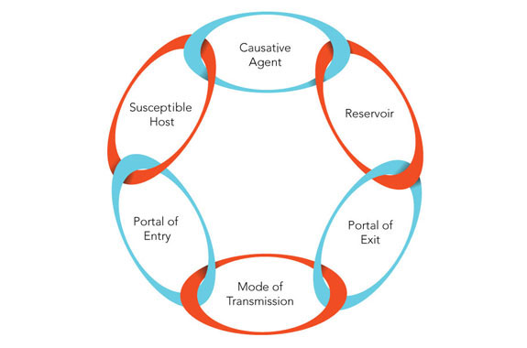
2nd analogy: the chain analogy
The rationale behind using specific infection control measures

Slide 12
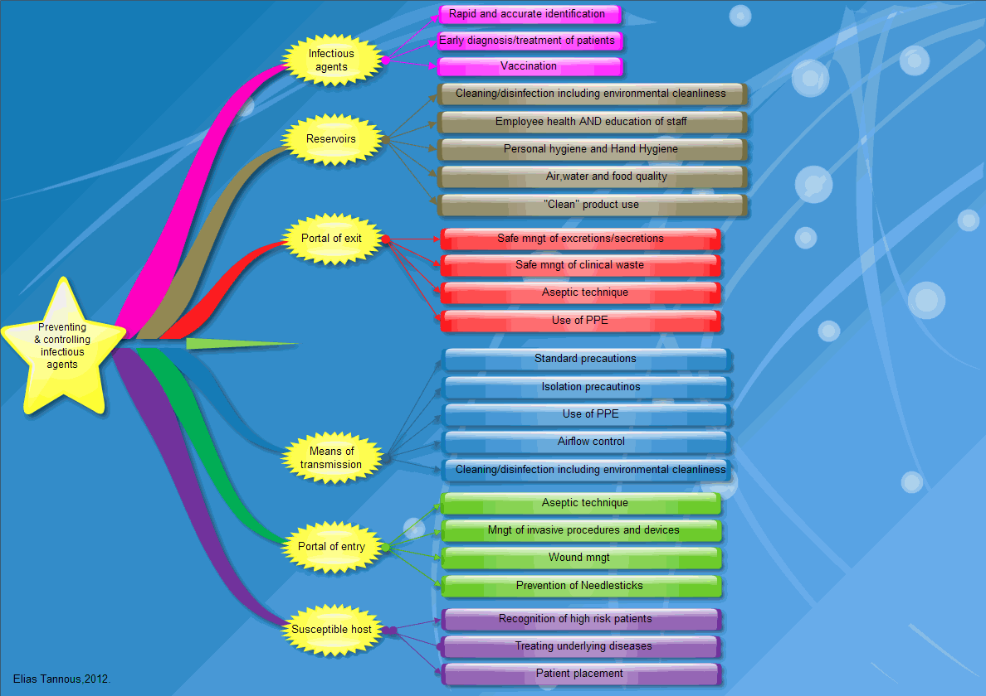

Slide 14
Other preventative strategies:
Institute for Healthcare Improvement (IHI) bundles and beyond.
Antimicrobial Stewardship Programs (ASPs).

Slide 15
A bundle is more than a list of the right things to do for a given patient …
A bundle has specific elements that make it unique:
All necessary.
Based on randomized controlled trials (level 1A)
All-or-nothing measurement.

Slide 16
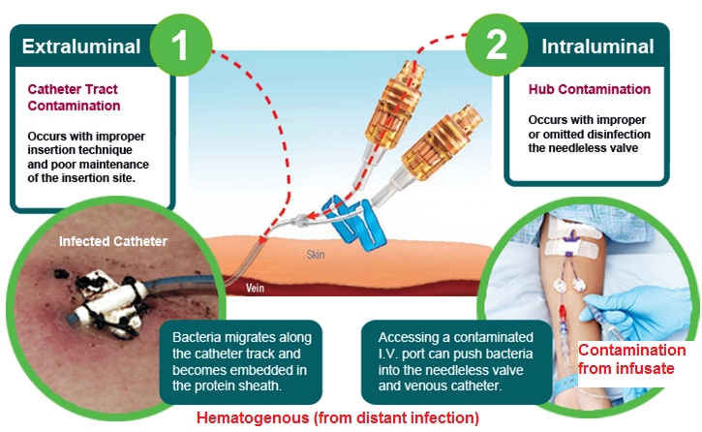
Pathogenesis of CLABSI

Slide 17
The IHI Central Line Bundle
Hand hygiene
Maximal barrier precautions upon insertion
Chlorhexidine skin antisepsis
Optimal catheter site selection, with avoidance of the femoral vein for central venous access in adult patients
Daily review of line necessity with prompt removal of unnecessary lines

Slide 18
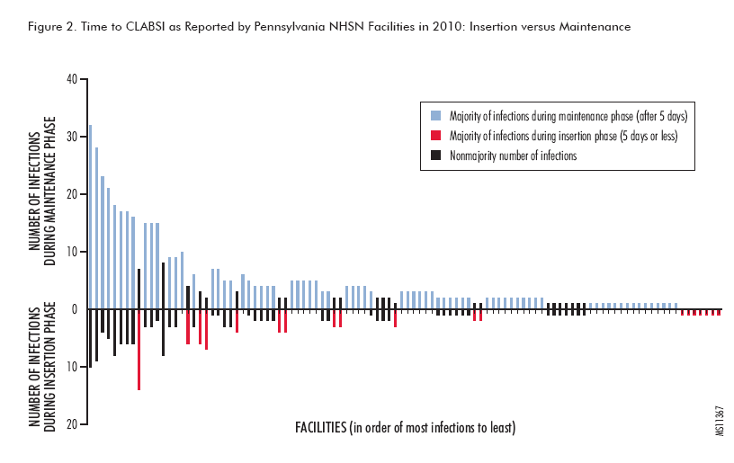
Most infections are related to maintenance !!
J Davis. Central-Line-Associated Bloodstream Infection: Comprehensive, Data-Driven Prevention. Pennsylvania Patient Safety Advisory: Focus on infection prevention. Vol. 8, No. 3—September 2011.

Slide 19
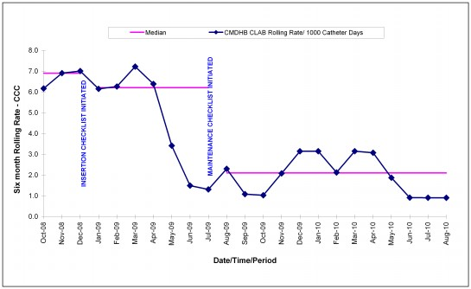
M E Seddon, C J Hocking, P Mead, C Simpson. Aiming for zero: decreasing central line associated bacteraemia in the intensive care unit, New Zealand Medical Association, July 2011, 124 (1339)

Slide 20
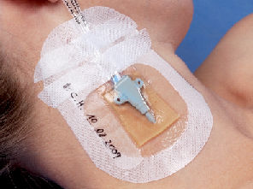
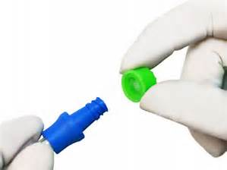
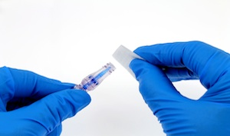
Elements of a CL bundle to include the maintenance and care elements
  Hand Hygiene
  Catheter site inspection: Daily observation of catheter site for signs of infection
  Integrity of Dressings
  Scrub the hub
  Administration set replacement

Slide 21
Elements of the ventilator bundle
  Daily sedation interruptions and assessment of readiness to extubate, as clinically indicated.
HOB at 30 degrees.
Oral care with CHG
PUD prophylaxis.
DVT prophylaxis.

Slide 22
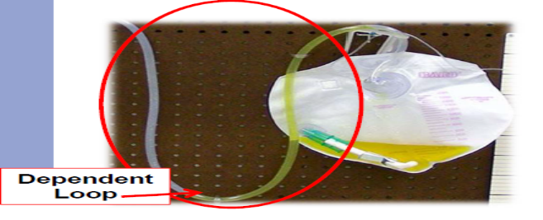
Elements of the urinary catheter bundle
  Aseptic technique at insertion
    Maintain unobstructed urine flow
    Maintain a closed drainage system.
    Perform daily meatal care.
    Secure indwelling catheter to leg.
    Review urinary catheter necessity daily and remove promptly.

Slide 23
Antimicrobial Stewardship Programs
Improve and measure the appropriate use of antimicrobials by promoting:
The selection of the optimal antimicrobial drug regimen.
The appropriate dose.
The duration of therapy.
The route of administration.
Source: http://www.idsociety.org/Stewardship_Policy/ accessed 22/11/2016.

Slide 24
Surveillance activities
Definitions, protocols, results displayed as rates, benchmarking
Collection of infection control metrics (ongoing and systematic)
Analysis
Interpretation
Dissemination to those who need to know
(Timely)
Application

Slide 25
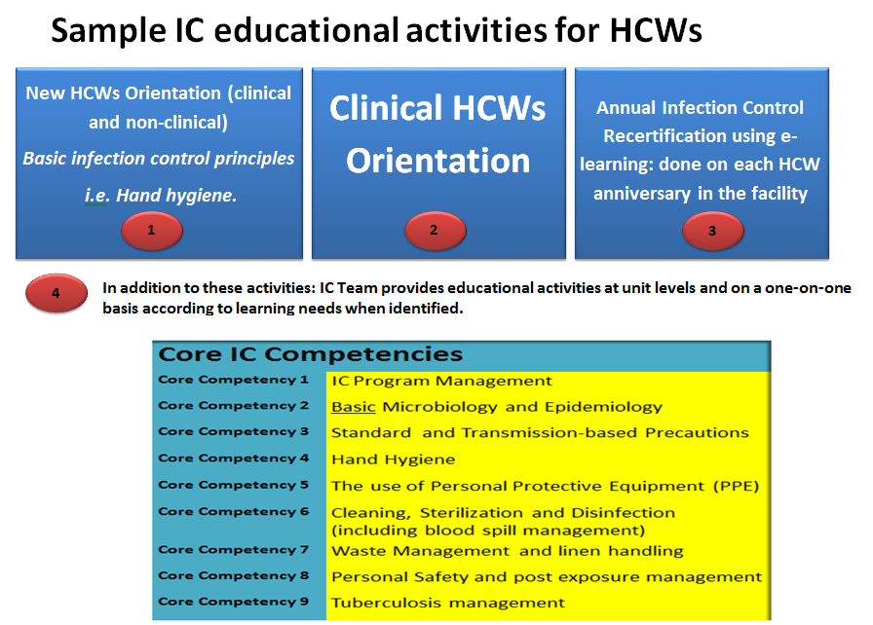

Slide 26
Infection Control: The Science
of a Profession
Role overload
Role ambiguity
Engagement and consciousness
Adaptability and passion
Role dvlpt: entry, transition, confirmation
Multiple roles
Role conflict
Value: first do no harm
Competencies :APIC
Pre-requisites: qualification-CBIC
Structure: SENIC-DELPHI- Others.

Slide 27

Infection control: the science
of a profession
Role overload
Role ambiguity
Engagement and consciousness
Adaptability and passion
Role dvlpt: entrée, transition, confirmation
Multiple roles
Role conflict
Value: first do no harm
Competencies :APIC
Pre-requisites: qualification-CBIC
Structure: SENIC-DELPHI- Ohters.

Slide 28
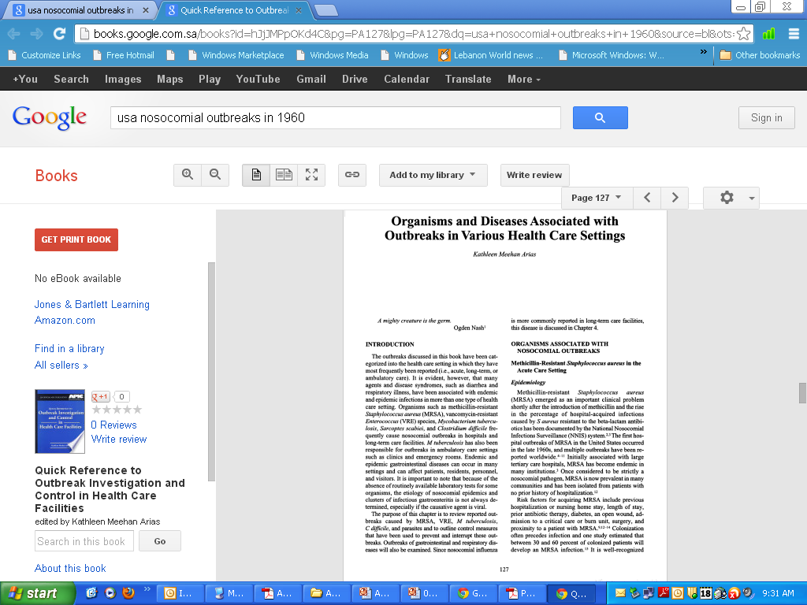
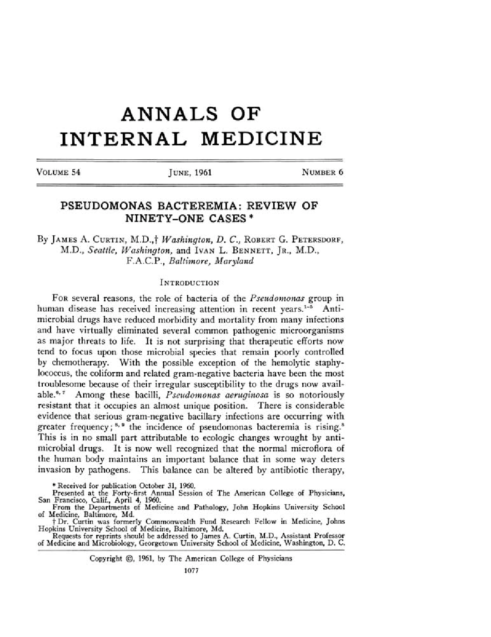
Historical perspective
The 50s & 60s pandemics in the US and Britain.
1959: In Britain, infection control sister (role: to document the incidence of infections, advising on preventative measures and assessing the efficacy of these interventions).
1963: In USA, infection control nurse (role: surveillance of infections, supervision of isolation techniques, education of staff and advisement of the infection control committee)
The "hospital epidemiologist" in U.S. hospitals, 1976-1977: a description of the head of the infection surveillance and control program. Report from the SENIC project. Infect Control. 1980 Jan-Feb;1(1):21-32.
WENZEL K : The role of the infection control nurse. Nurs Clin North Am. 5::89.--98

Slide 29

The need for a scientific context…
Did the creation of a position solve the issue?
Concerns of the American Hospital Association (AHA), the National Communicable Disease Centre and the Joint Commission on Accreditation of Hospitals (JCAH).
Infection control requires a balance between surveillance, education and consultation.

Slide 30
Study on the Efficacy of Nosocomial Infection Control (SENIC Project)
Nationwide study by the CDC (3-phased project 1974-1983)
Aim:
To evaluate approaches to infection control.
Haley RW, Quade D, Freeman HE, Bennett JV, et al. Study on the Efficacy of Nosocomial Infection Control (SENIC Project): Summary of study design. American Journal of Epidemiology 1980;111(5);472‑85.

Slide 31
Three primary objectives:
Do IC programs lower infection rate.
To describe the current status of IC program and current Infection rates.
To demonstrate the relationships among characteristics of hospitals and patients, components of ISCPs, and changes in the infection rate.

Slide 32
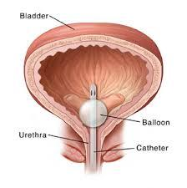
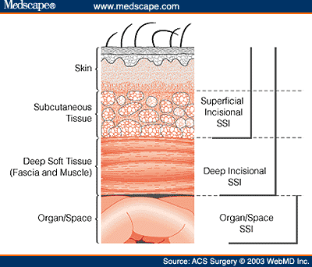
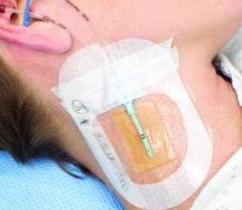
Results
32% of nosocomial infections could be prevented.
Infection prevention and control programs are not only clinically effective but also cost-effective.

Slide 33
Results cont’d
Infection Control Practitioners, many of them nurses, were essential components of an effective program.
Having one ICP per 250 occupied beds was associated with an effective program.
Haley RW, et al. Update from the SENIC project. Hospital infection control: recent progress and opportunities under prospective payment. Am J Infect Control 1985;13:97-108.

Slide 34
Results cont’d
Trained hospital epidemiologist is an essential component of an effective hospital infection control program.
Hospital epidemiologists (during the study) were clinicians with training in internal medicine or pediatrics and in infectious diseases.

Slide 35

Delphi project (1985)
Drivers: Change
The structures of the health care system
Patient populations
Expectations about the work of infection prevention and control programs

Slide 36
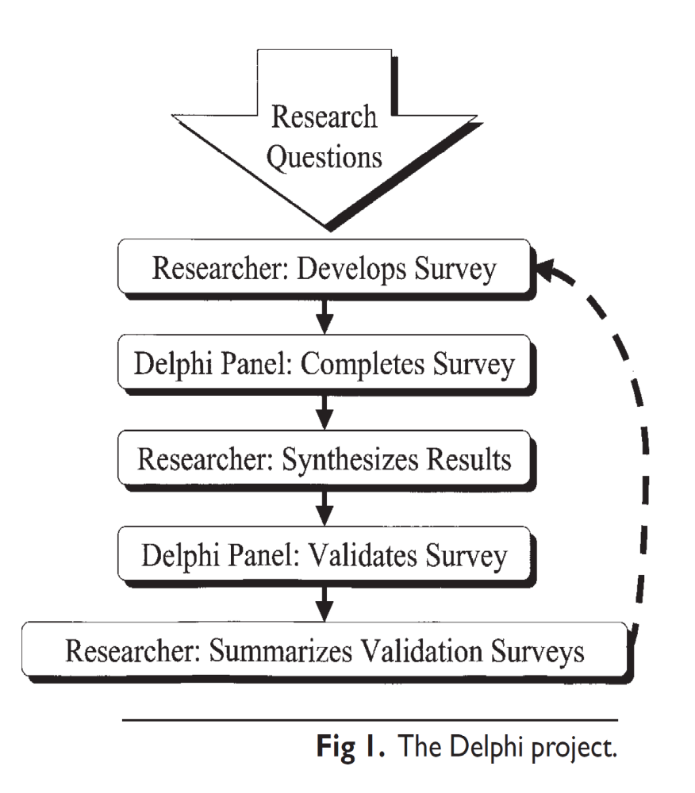
Method

Slide 37
Results
39% of IPs time was spent on surveillance and identifying infections
The most frequently cited reasons for non-performance of essential infection control tasks:
Competing responsibilities
Lack of adequate resources

Slide 38
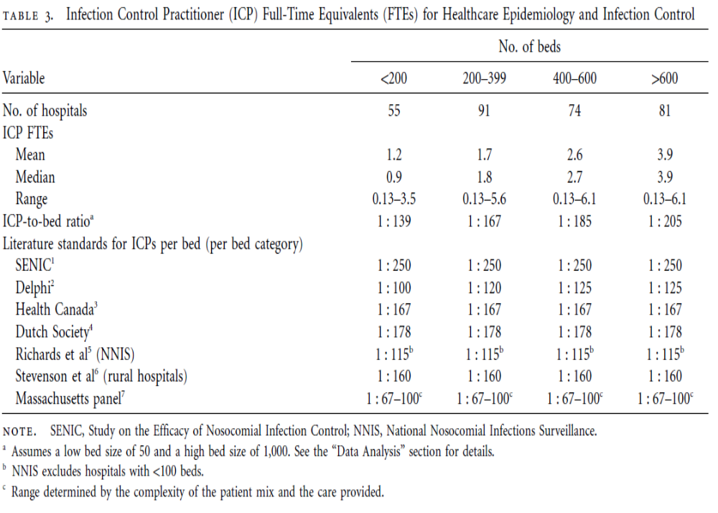
The Delphi panel suggested that 0.8–1.0 ICP FTEs for every 100 occupied acute care beds was adequate staffing. The authors suggested that recommendations for staffing must consider not only the number of occupied beds but also the scope of the program, the complexity of the healthcare facility, the characteristics of the patient population, and the unique or urgent needs of the facility and community.
Infection control and hospital epidemiology February 2010, vol. 31, no. 2

Slide 39
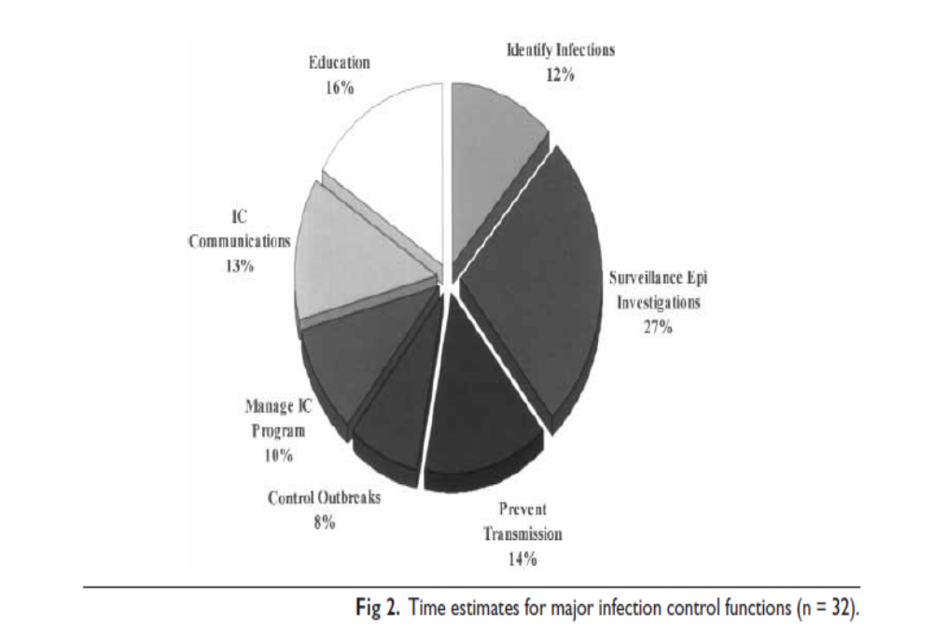
Staffing requirements for infection control programs in US health care facilities: Delphi project. O’Boyle, Jackson, and Henly Vol. 30 No. 6

Slide 40
Staffing and structure of infection prevention and control
Objective: to provide a snapshot of the staffing and structure of hospital-based infection prevention and control programs in the United States.
Method:
A Web-based survey
441 hospitals that participate in the National Healthcare Safety Network.
Patricia W. Stone, et al. Staffing and structure of infection prevention and control Am J Infect Control. 2009 June ; 37(5): 351–357.

Slide 41
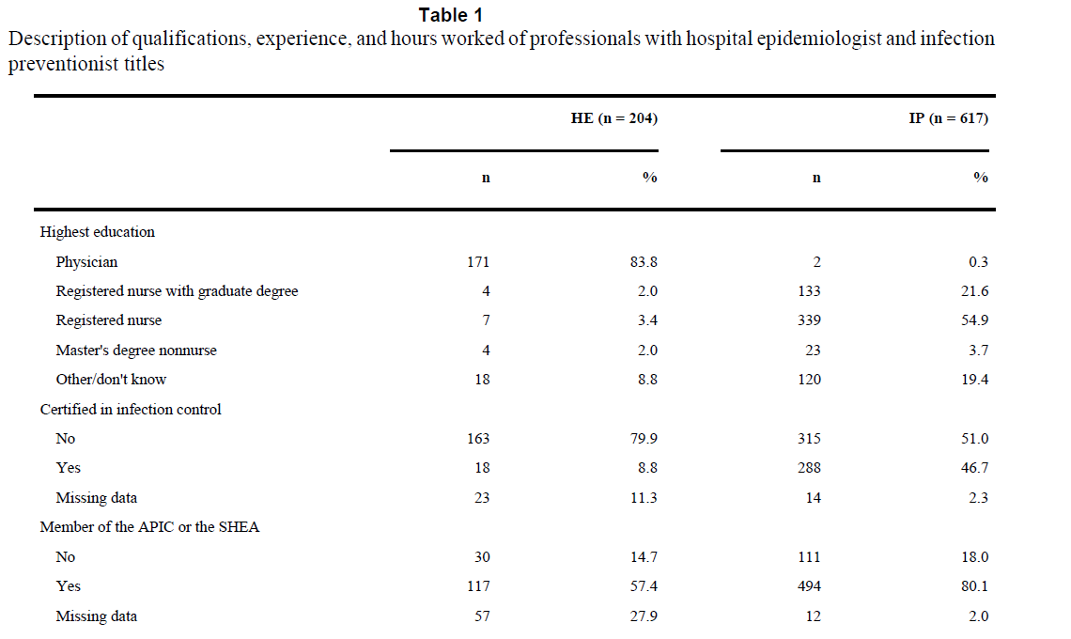

Slide 42
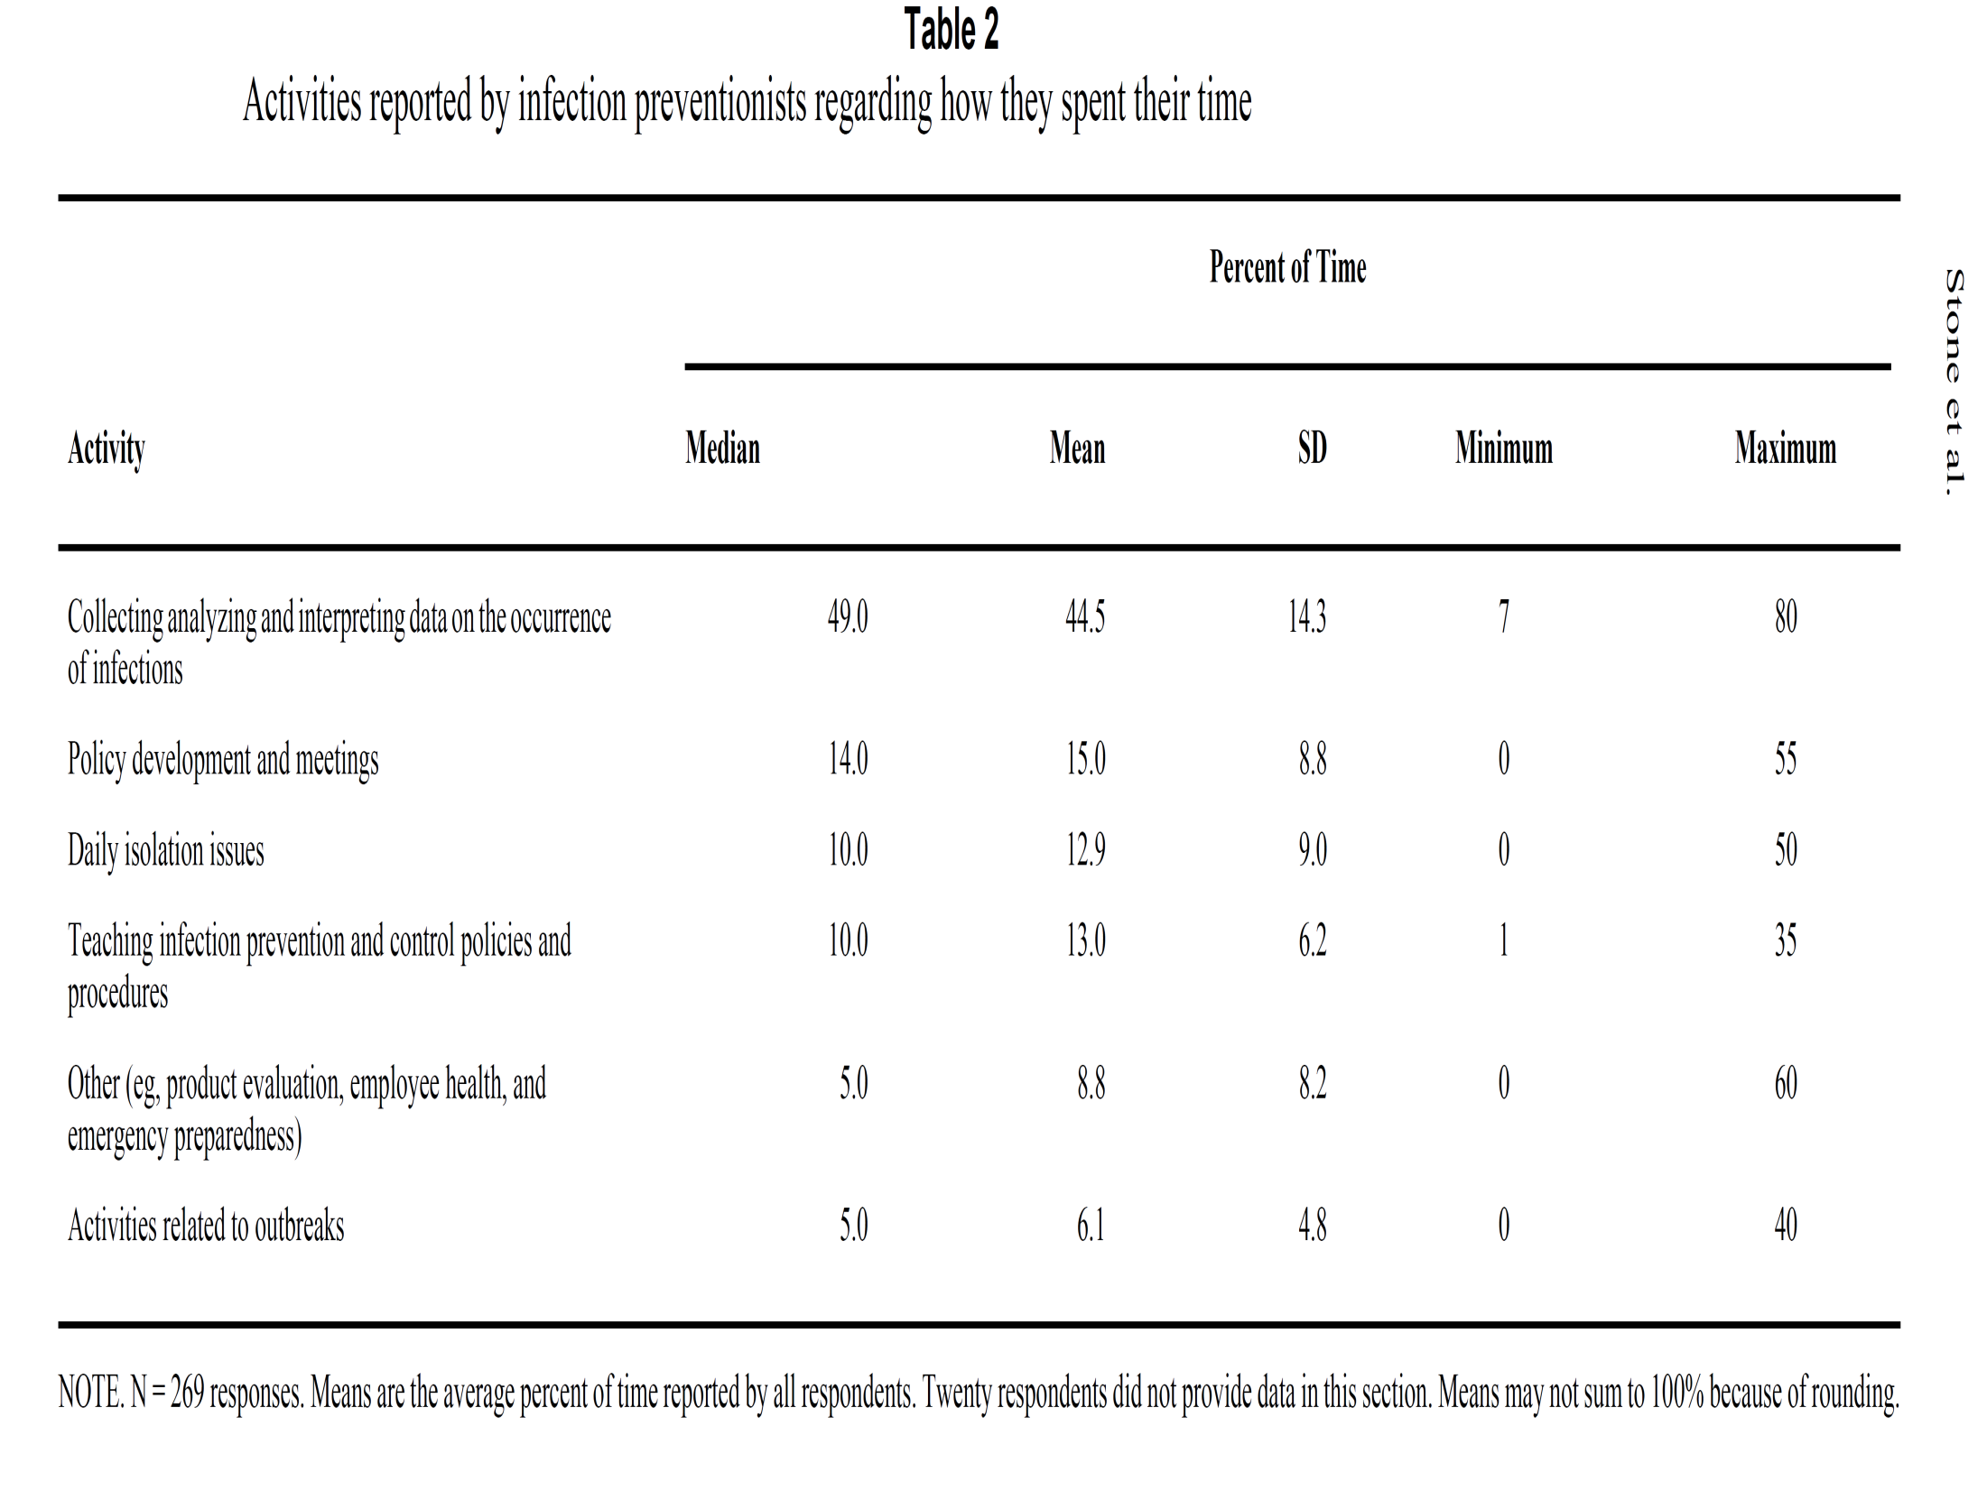

Slide 43
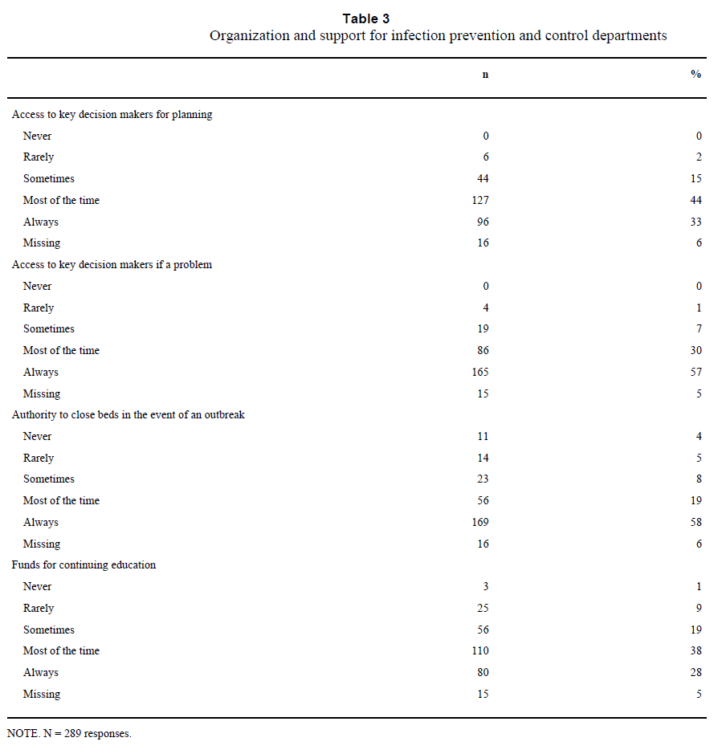

Slide 44
APIC Competencies

Slide 45
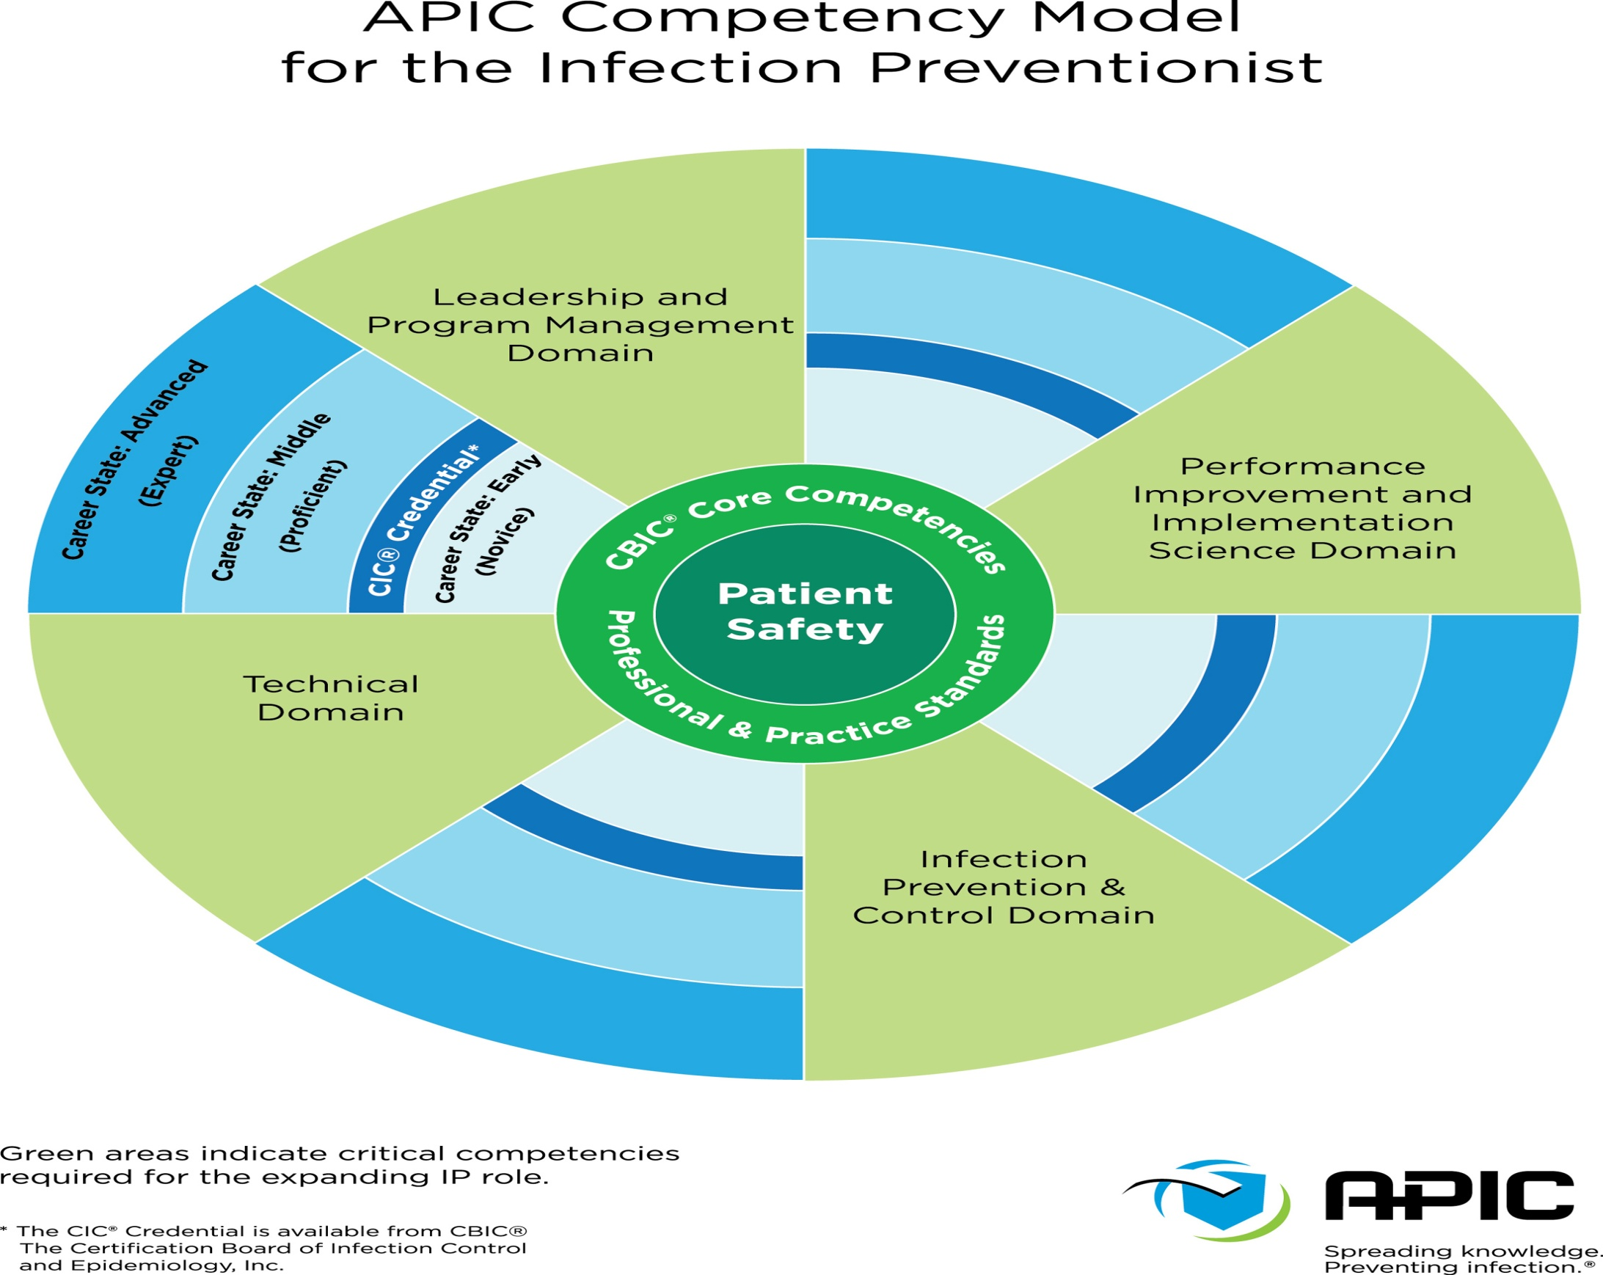

Slide 46
CBIC profile of Infection Control Professionals

Slide 47
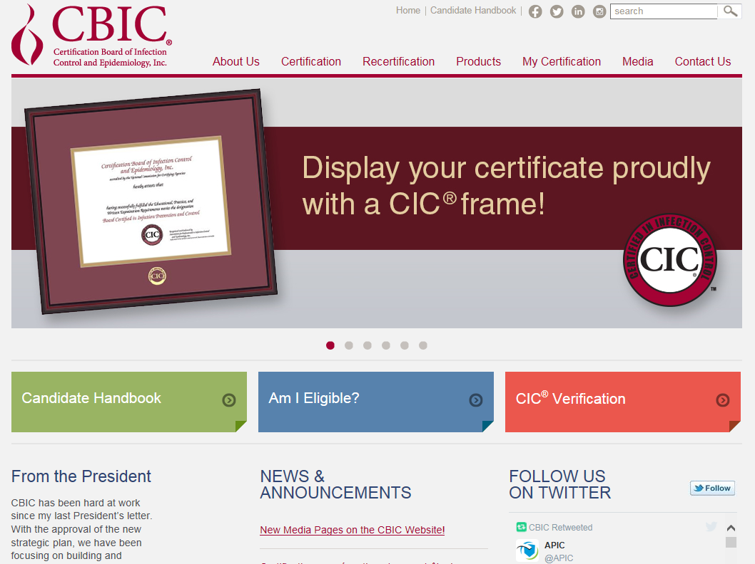

Slide 48
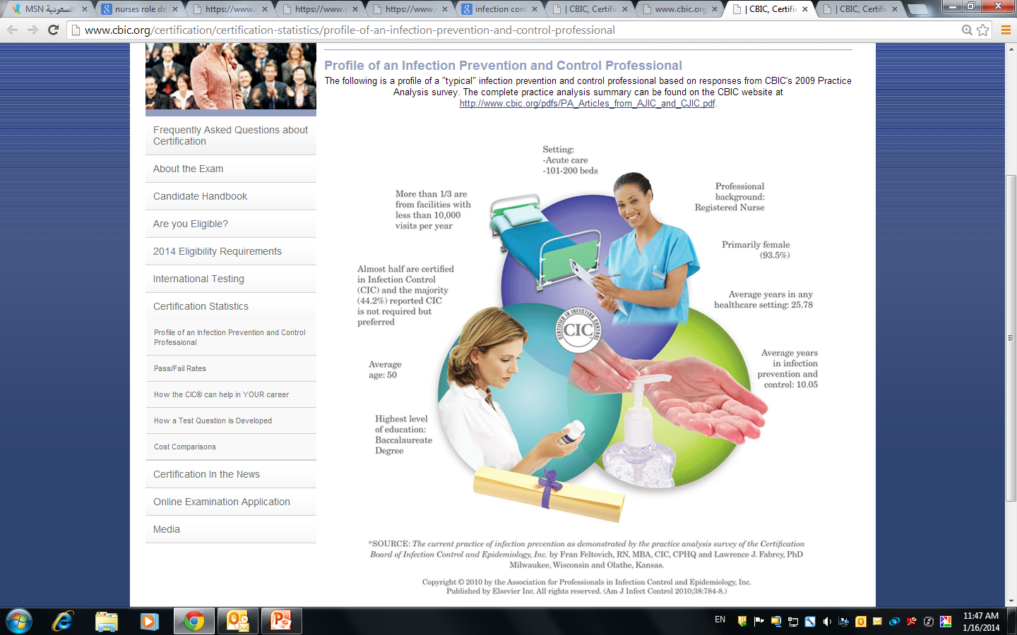

Slide 49
Infection control: the science
of a profession
Role overload
Role ambiguity
Engagement and consciousness
Adaptability and passion
Role dvlpt: entry, transition, confirmation
Multiple roles
Role conflict
Value: first do no harm
Competencies :APIC
Pre-requisites: qualification-CBIC
Structure: SENIC-DELPHI- Others.

Slide 50
Role development process
3 phases:
Role identification: purpose and objective
Role transition: implementation
Role confirmation: recognized by others
Identification: philosophy of the role
Transition: Implementation based on available skills
Confirmation: Perceived as the professional
Oda D., Specialised role development: a three phase process, Nurse Outlook, 25(6) 374-377

Slide 51
Important concepts in the role development process of ICPs
Overt social behavior: role is convincing and appropriate.
1- Is the conduct appropriate to the position?
2- Is the enactment proper?
3- Is the enactment convincing?
Theodore R. Sarbin (1954) Role theory. In G. Lindzey (Ed.), Handbook of social psychology. Vol. I. Theory and method (pp. 223-258). Cambridge, MA: Addison-Wesley Publishing Company.

Slide 52
Important concepts in the role development process of ICPs
IC profession: a profession with multiple roles

Slide 53

Critical thinking: essential skill in the medical field.
Popeye comes to you with Melena.
What do you do?

Slide 54
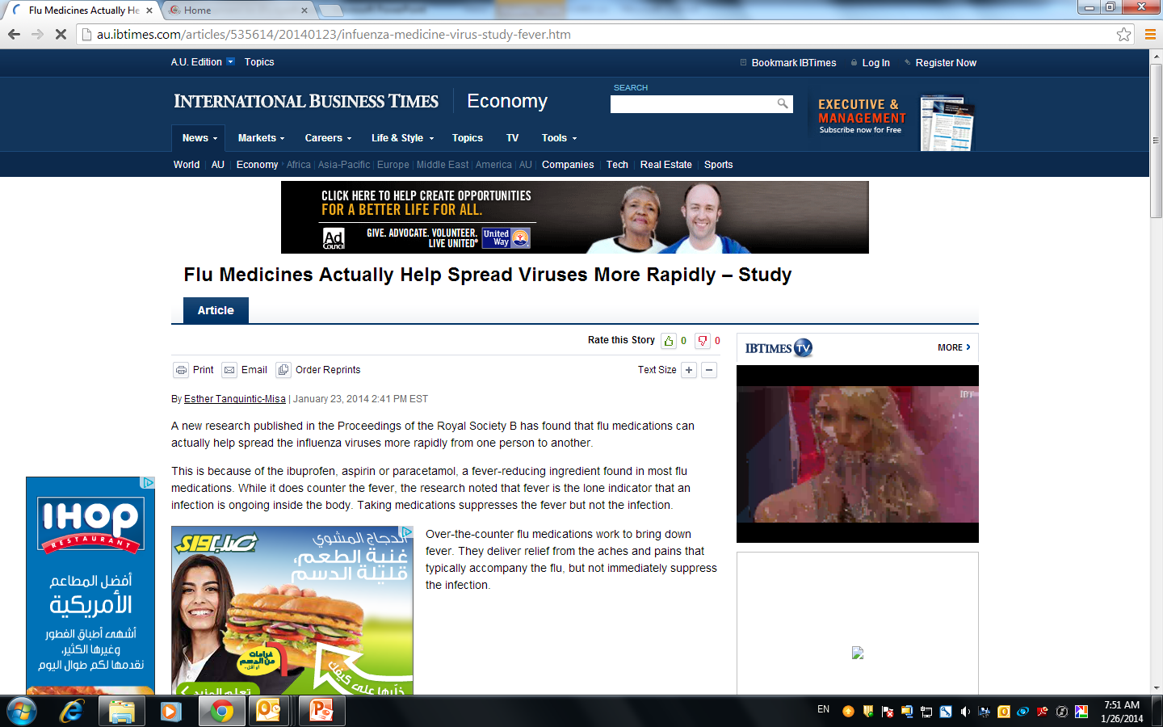

Science sans conscience n’est que ruine de l’Âme (Rabelais).
i.e.
People tend to publish positive results more than the negative ones.
Science says no antibiotics for flu, though, lots are still prescribing them.

Slide 55
Three challenges in IC
Implementing the science.
Not adopting a multimodal approach.
Not scanning the culture and environment before start implementing the science.

Slide 56
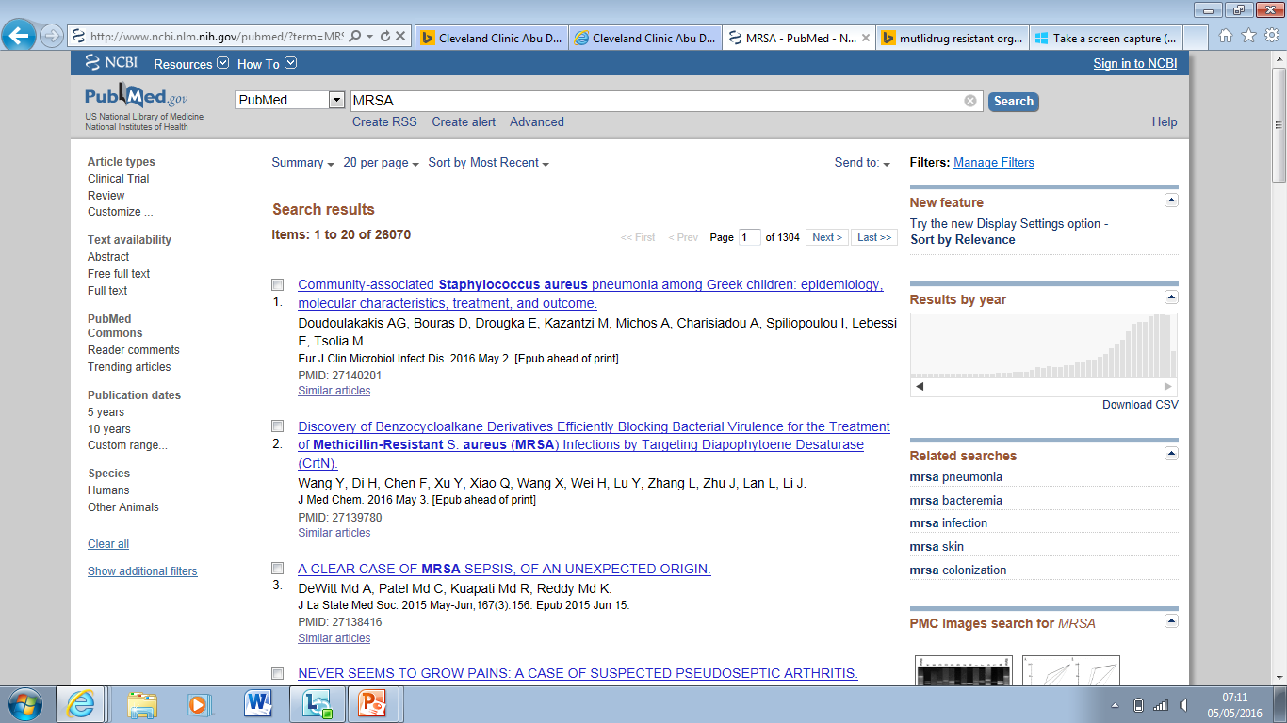
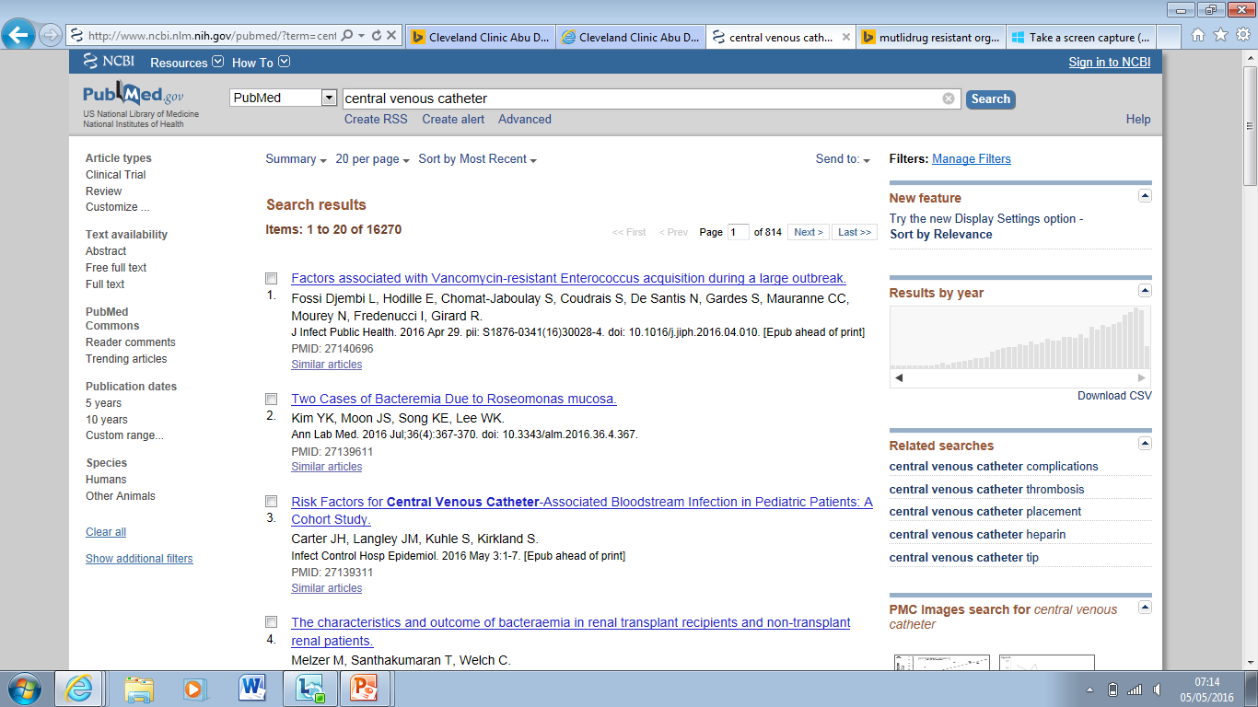
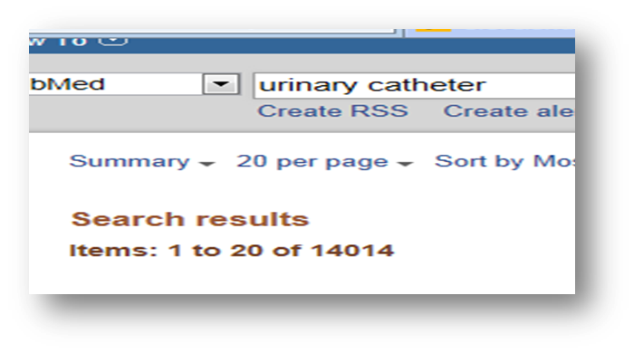
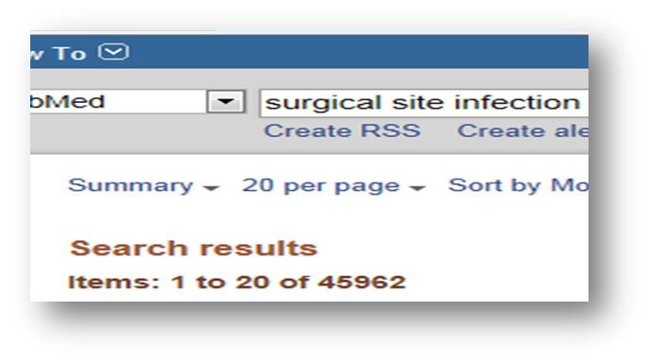
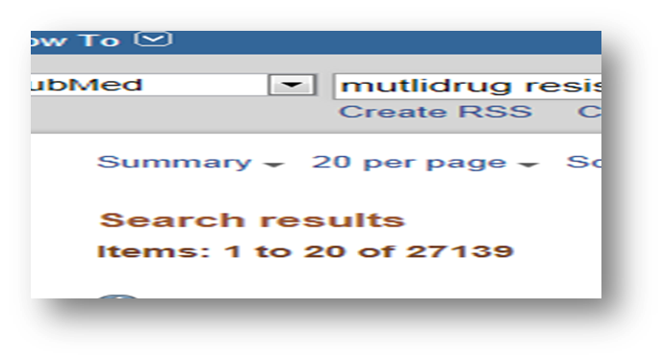
Is this knowledge?
Are we lacking the good science?
Implementation of the science???

Slide 57
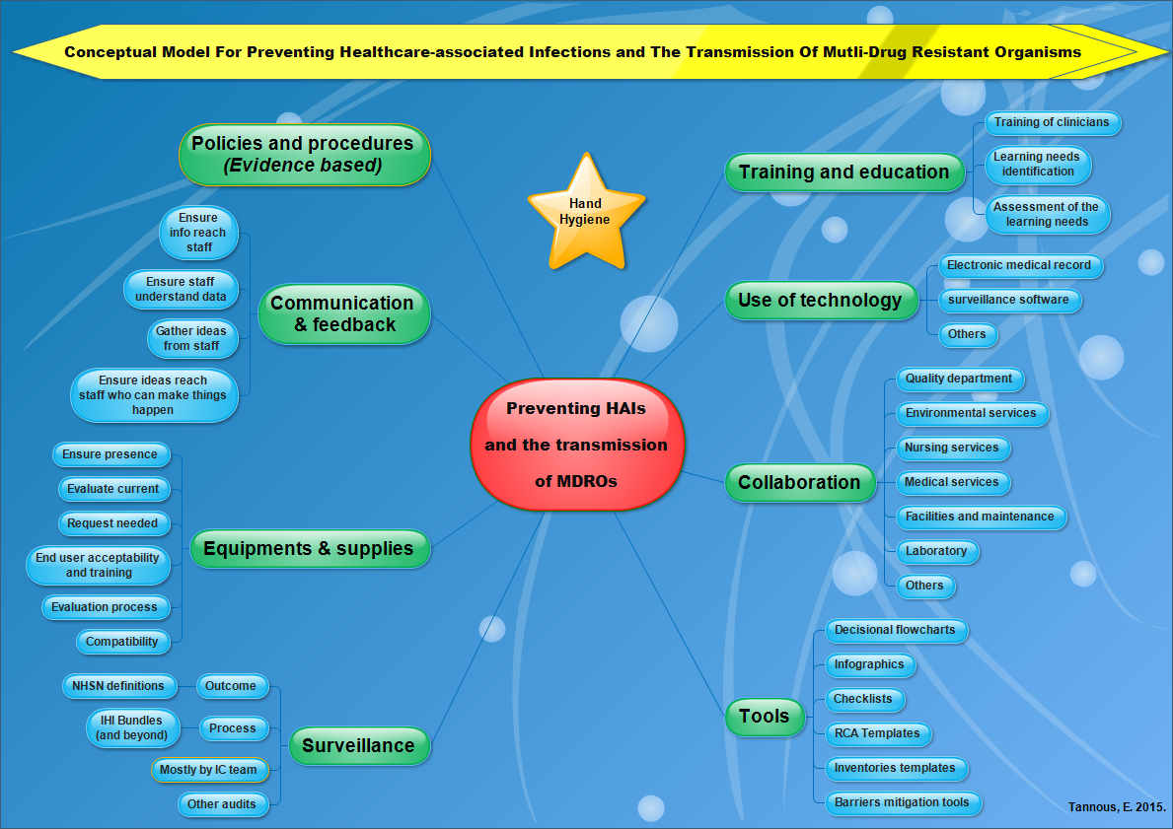

Slide 60
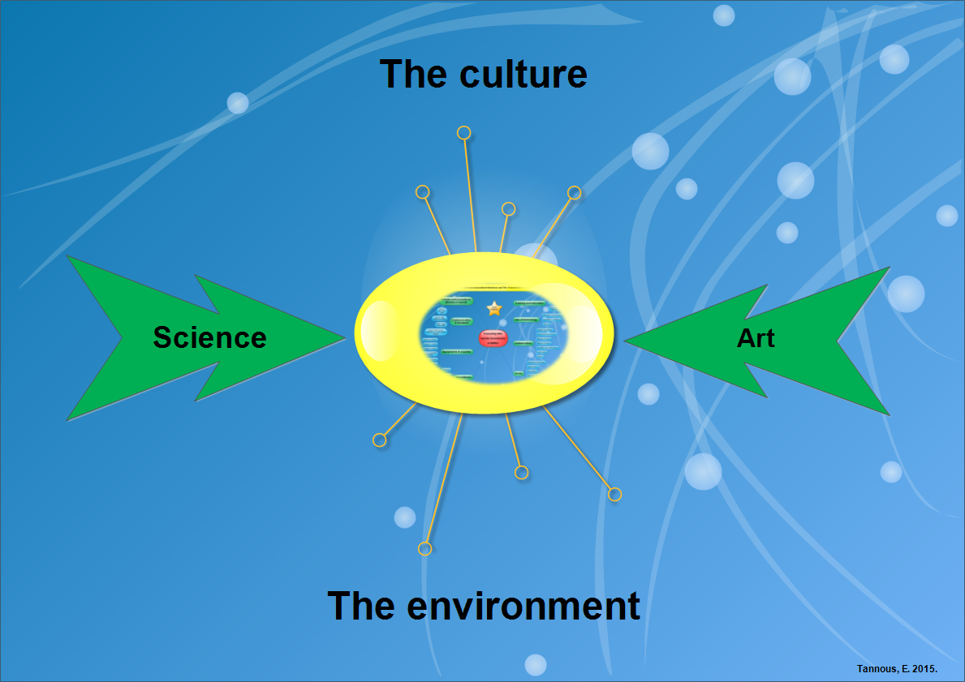
The super duper IC professional who knows only IC is just an “idiot savant”

Slide 61
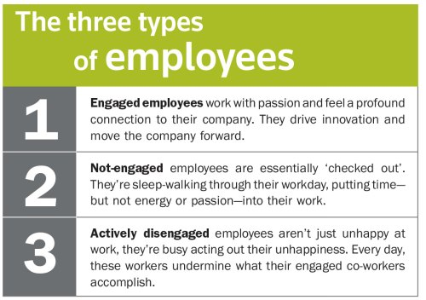
Get engaged and engage others

Slide 62

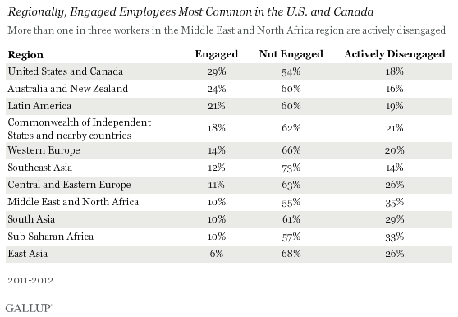
Source: www.gallup.com/ accessed 15/05/2016

Slide 63
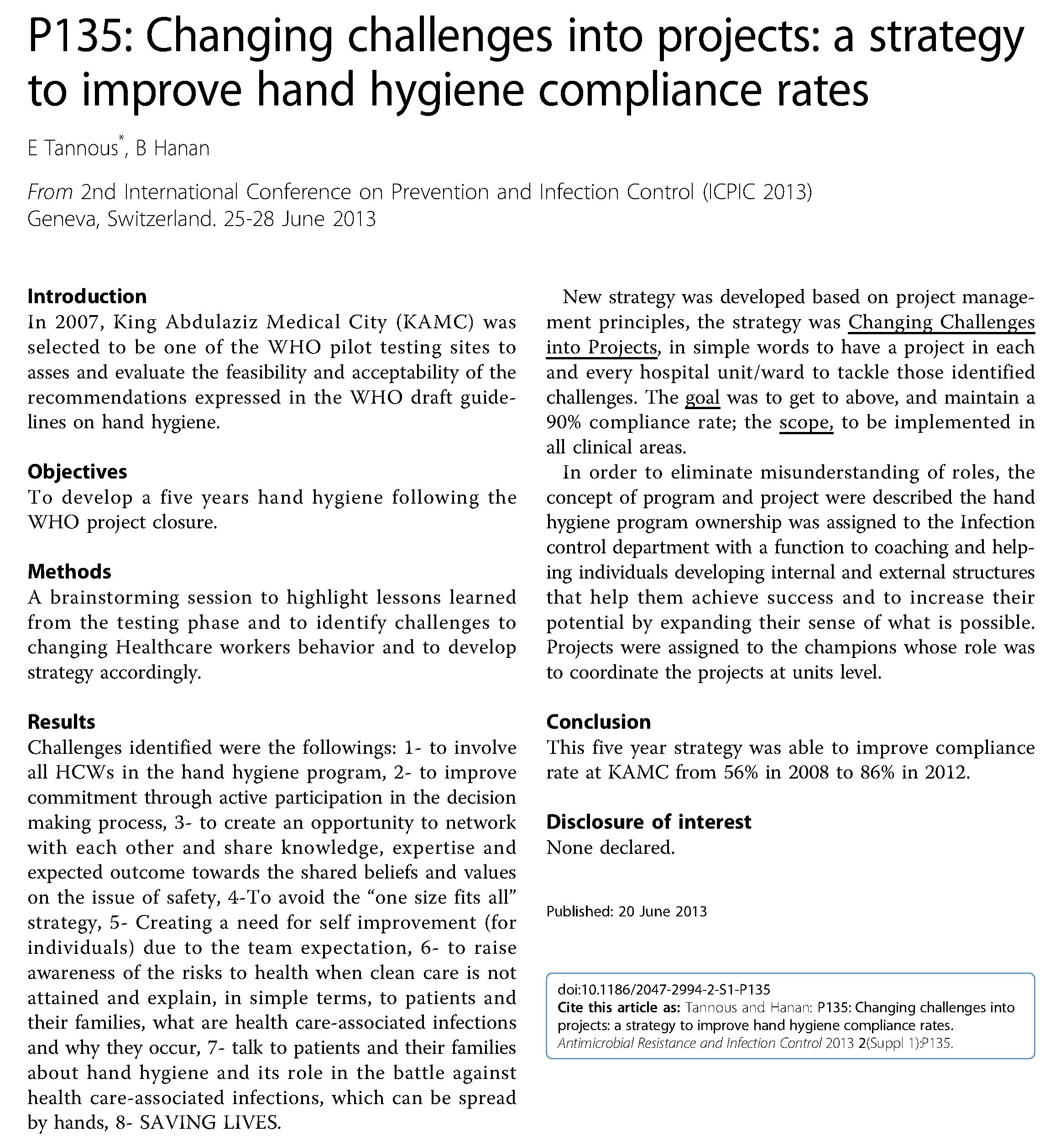
Tannous and Hanan: P135: Changing challenges into projects: a strategy to improve hand hygiene compliance rates. Antimicrobial Resistance and Infection Control 2013 2(Suppl 1):P135.

Slide 64
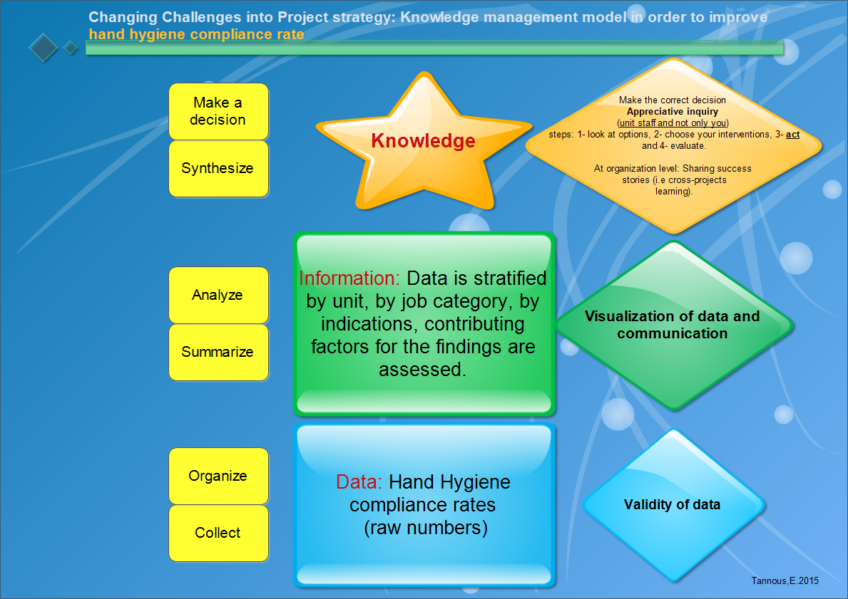

Slide 65
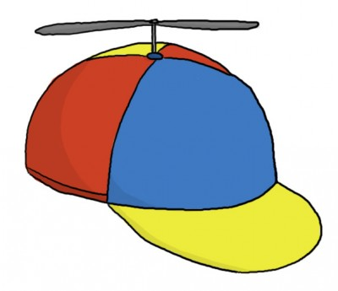

Final thoughts
Put that CAP on.
Consciousness
Adaptability
Passion
Start working with your 3Hs
Head
Heart
Hand

Slide 66
Infection Control: The Science
of a Profession
Role overload
Role ambiguity
Engagement and consciousness
Adaptability and passion
Role dvlpt: entry, transition, confirmation
Multiple roles
Role conflict
Value: first do no harm
Competencies :APIC
Pre-requisites: qualification-CBIC
Structure: SENIC-DELPHI- Others.

Slide 67
Learning objective #4
At the end of this session and the congress, each attendee should be able to answer the question:
Knowing what I now know, how can I use this new knowledge acquired from this congress to save lives.

Slide 68
Thank you

