Slide 1
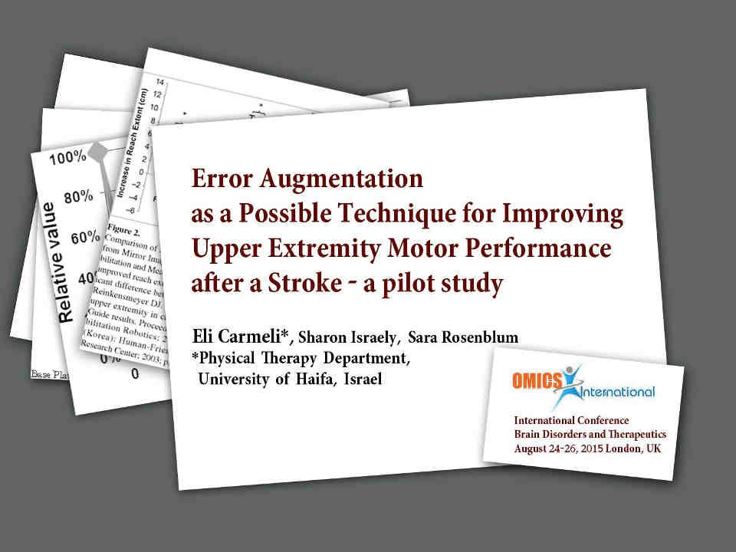

Slide 2

Background
In the United Kingdom, strokes affect 150,000 people each year.
Only 33% to 70% of patients recover useful arm function (Huang & Krakauer 2009).
Conventional neuro-rehabilitation seems to have little impact on the
impairment beyond the spontaneous biological recovery.
Neuro-rehabilitation is mainly improve motor control of proximal segment and lower limb, with some improvement of the proximal segment of upper limb (Kordelaar J et al 2013).

Slide 3
Background
Kinematic impairments of reaching movements are related to abnormal reaching performance in post-stroke subjects.
increased in movement duration decreased velocity
increased variability in path trajectory
leading to restricted use or even non-use of the affected
hand.

Slide 4

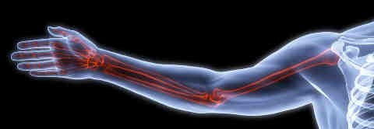
New treatment approach
Error Augmentation, instead of neuro facilitation, is proposed as a possible Technique for Improving Upper Extremity Motor Performance.
This system uses the error enhancement method, in which movement errors are temporarily magnified to encourage learning.

Slide 5
Background
Error augmentation (EA) utilizes erroneous sensory feedback (e.g., tactile/vision) to enhance motor recovery after neurological damage.
The computer singles out the patient’s hand movement, every moment, from a specific desired trajectory, thus it provides a proportional sensory feedback (i.e., incorrect, mistaken, amplified, and exaggerated) to magnify the errors in proportional manner.
The presence of this error in the haptic systems, forces patients to strengthen their control as they counteract the error-driven disturbance to the movements.

Slide 6

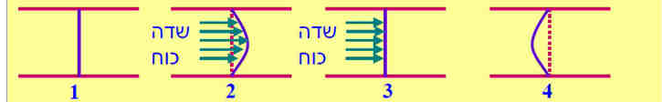
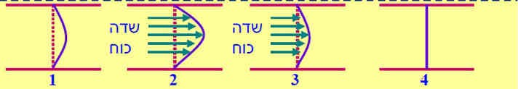
Why adaptation leads to learning?
A. Effect of error augmentation on correct movement trajectory- adaptation
Force Field
Force
Field
B. Effect of error augmentation on erroneous movement trajectory
Force Field
Force Field

Slide 7
Rational
Motor learning is based on “making movement errors during practice”.
Therefore, manipulation of error signals during practice is believed to be central to movement adaptation.
Intrinsic feedback mechanisms are often impaired, providing augmented
feedback by making errors are more noticeable to the senses.
Larger errors increase motivation to learn.
Machine-assisted training is precise; sustained for long time; measure progress automatically; and produce a wide, monitored range of forces and motions.

Slide 8

Principles during
‘error augmentation’ therapy
Many repetitions.
High intensities.
Variability of practice
Advanced practice
Bowden et. al. 2013, krakauer 2005

Slide 9
Research
question
Can error enhancement of the velocity component improve motor performance
and
functional abilities?

Slide 10
Research/Pilot
study aims
Primary
to measure the effect of error augmented therapy.
Secondary
to compare outcomes between sEMG results and Fugel Myere score.
to evaluate association between writing skill and arm reach.

Slide 11
Participants
Stroke (n =5), males
Control (n =5) age-and-gender matched
Inclusion criteria: basic understanding, partial UE
active movement,
ability to open/close fingers 5 times.
Exclusion criteria: apraxia, agnosia, spasticity, shoulder subluxation /pain of UE.

Slide 12
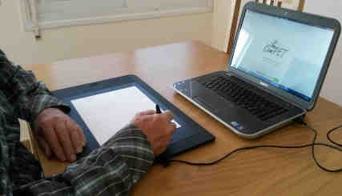
Outcome measure (1)
Digital plate + software
Writing speed
Pressure
Off-time
On-time to- off-time time ratio
(Rosenblum S et al., 2013)

Slide 13

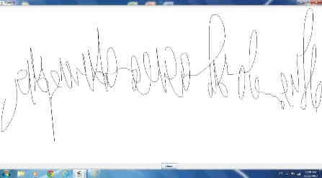
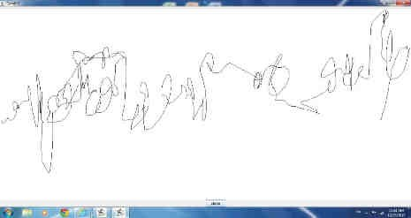
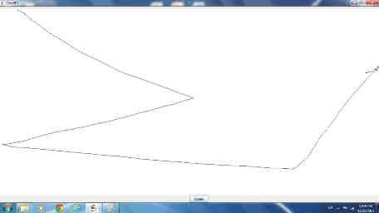
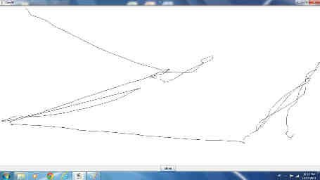
Decoding writing and connecting dots in healthy individuals
compared to stroke patients using ComPET
Healthy control Stroke
5
1
4
3
2

Slide 14
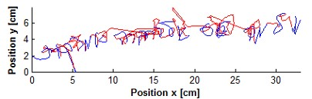
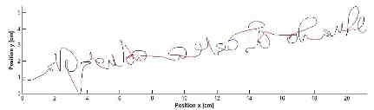
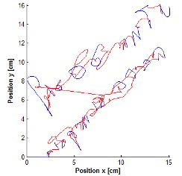
Decoding writing and connecting dots
B1. Pre treatment: “characteristics on-off-
time” - Stroke
A: “characteristics on/off-time” - healthy control
B2. Post-treatment: “characteristics
on-off-time” - Stroke
The red lines represent the course of pen movements during their stay in the air (off- time).
A1. Stroke patient has vague movements, jerky rather than smooth in compare to A2

Slide 15
Fugl Meyer (2)
Motor assessment of the upper extremity Consists of 33 items.
A 3-point scale:
0 - inability to complete the test item 1 - partial ability
2 - full completion
Assessing DTR Movement synergy Movement isolation Grasping
Fugl Meyer A, Jasko L, Leyman I, Olsson S, Steglind S. Scand J Rehabil Med 1975;7(1):13-31.

Slide 16
FM- Validity & Reliability
Construct validity (spearman`s rho): Vs. Box and Blocks test 0.921
Vs. Action Research Arm Test 0.925
ICC inter-rater 0.99
ICC intra-rater 0.95
Standard Error Measurement (SEM) 3.6 points
Smallest Real Difference (SRD) 5.2 points Minimal Clinically Important Difference 10 points

Slide 17
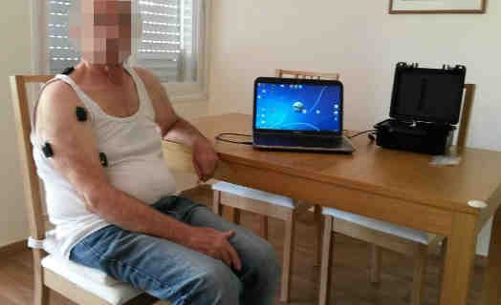
Outcome measure (3)
sEMG, wireless system, Trigno Lab, Delsys, USA
Muscle amplitude
analysis (%MIVC*)
Muscle onset
Co-activation Index
*MIVC – Maximum Isometric Voluntary Contraction

Slide 18
Data analysis - sEMG
0.00015
0.0001
5e-005
0
-5e-005
-0.0001
[Volts]
-0.00015
-0.0002
0 5 10 15 20 25

Slide 19
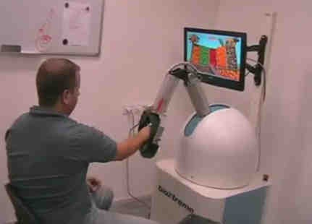
Outcome measure (4) and
Intervention - 4 weeks/3Wk
Robotic system, ROBOTEACHER-2, Bioxtreme, ISRAEL
Average error (in cm).
Total score (points).

Slide 20
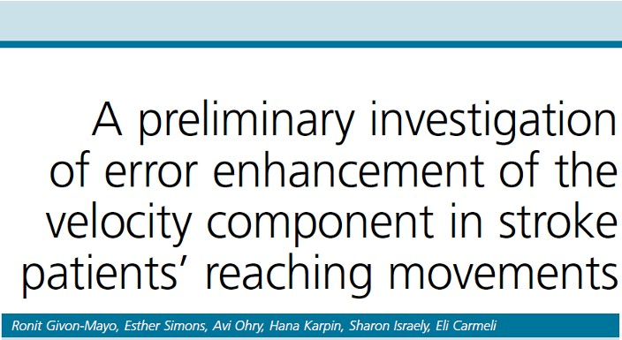

Slide 21
Results
 | Study Group | Control Group
Gender (Male) | 5 | 5
Age (Years) | 57.2 ±8.2 | 54.8 ±7.8

Slide 22
Study group (N =5)
Pre Post
Control (N =5)
Pre Post
51.8 55.7*
2960 3574*
2.3 0.6*
Fugel-Meyer (points) 36.4
Total “accuracy” score (points) 2328 Average error (cm) 6.2
44.2*
2802*
3.7*

Slide 23

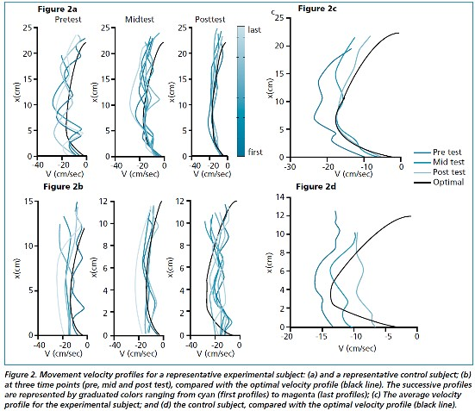
Velocity profile of 2 representative patients after stroke
“troke (“Control”) Without error augmentation
Givon-Mayo et. al.
(2014)

Slide 24
Results “Reaching” – (sEMG)
1. Stroke patients use higher MIVC% than control
in Deltoid and Trapezius ms (p<0.05).
2. Stroke patients use all UE muscles relatively late than control (p<0.05).

Slide 25
Write indices correlation between sEMG indices during reaching
Muscular activation delay in reaching is correlated
to slow pace of writing (0.568<r<0.911, p<0.05).
Efficient use of Deltoid muscle (i.e., MIVC% is low) during reaching is highly correlated in applying high writing pressure (0.636<r<0.8).

Slide 26
Discussion and Conclusions
Writing - Stroke patients are slower writers, put less pressure on the writing plate and spend more time in the air (‘OFF’) during the writing compared to healthy subjects.
‘‘eaching’ in patients with stroke is characterized by inefficient activation of muscles (i.e., high MIVC%) , and a delay in activating muscles (delayed onset).
Treatment error augmentation is preferable than treating without error
augmentation.

Slide 27
Thank you

