Slide 1
Is the Spanish energy sector’s Open Data maturity sufficiently high to enable the successful deployment of a Circular Economy (CE) strategy?
Elena Pérez-Miñana
CENSUI
elena.perezminana@btinternet.com

Slide 2

CONTENT
Circular Economy (Information is crucial)
Open Data Portal Initiative an essential tool to manage information in a CE context
Spanish OD Portal – evaluation results (EU)
Energy sector contribution to the Spanish OD Portal – practical experience

Slide 3
Circular Economy (Information is key)
Circular Economy - Guiding Principles (BS-8001 framework) (http://environmentjournal.online/articles/moving-circular-economy/)
  Systems thinking
  Innovation
  Stewardship
  Collaboration
  Value optimisation
  Transparency
Closing the loop: EU Action Plan for the Circular Economy (https://ec.europa.eu/growth/industry/sustainability/circular-economy_en)
  Production (product design, production process, consumption)
  Waste management
  From waste to resources (secondary raw materials): turning recycled raw materials into business opportunities, sharing products or infrastructure (e.g. water reuse)
  Specific materials and sectors (plastics, food value chain, critical raw materials, construction and demolition, biomass & bio-based products)
  Innovation, investment and other cross-cutting issues
Transition to a circular economy demands opportunities for social discourse

Slide 4
Open Data Initiative (OD)
Contributes to a country’s political, economic and social sustainability
but… what does OD really mean?
Open Data refers to the information collected, produced or paid for by public bodies which can be freely used, modified, and shared by anyone for any purpose.
  “Open means anyone can freely access, use, modify, and share for any purpose (subject, at most, to requirements that preserve provenance and openness)”
https://theodi.org/
https://okfn.org/projects/global-open-data-initiative/

Slide 5
The “Open Data” Initiative
Open Data enables the assessment of the Sustainable Development Goals (SDGs) in three main ways
  It is a facilitator of standards​
  A tool for accountability
  An evidence base for impact assessment
The World Bank (Open Government Data Toolkit)
European Data Portal

Slide 6
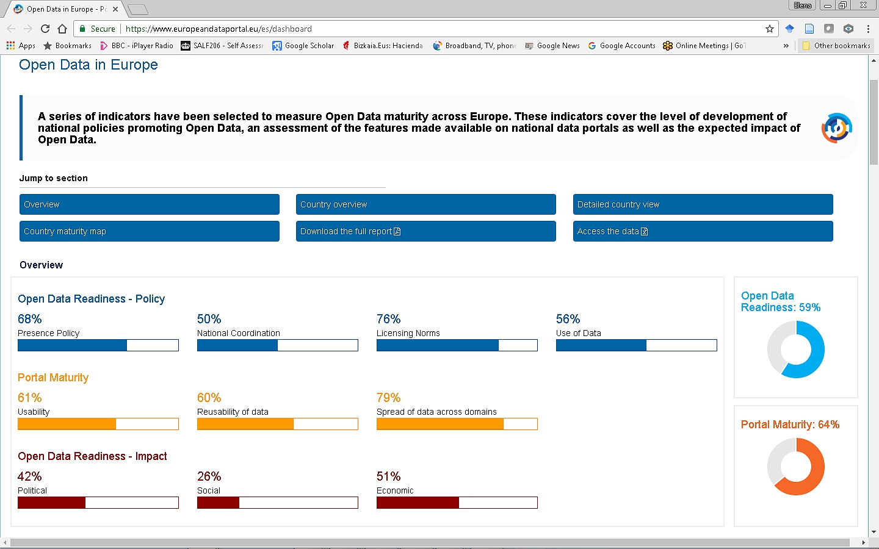
59.62
64.40
42.33
https://www.europeandataportal.eu/es/dashboard

Slide 7
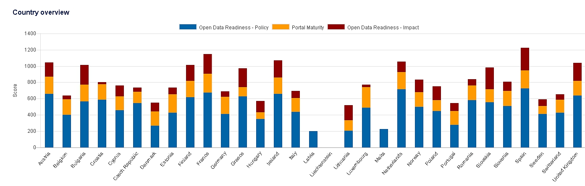
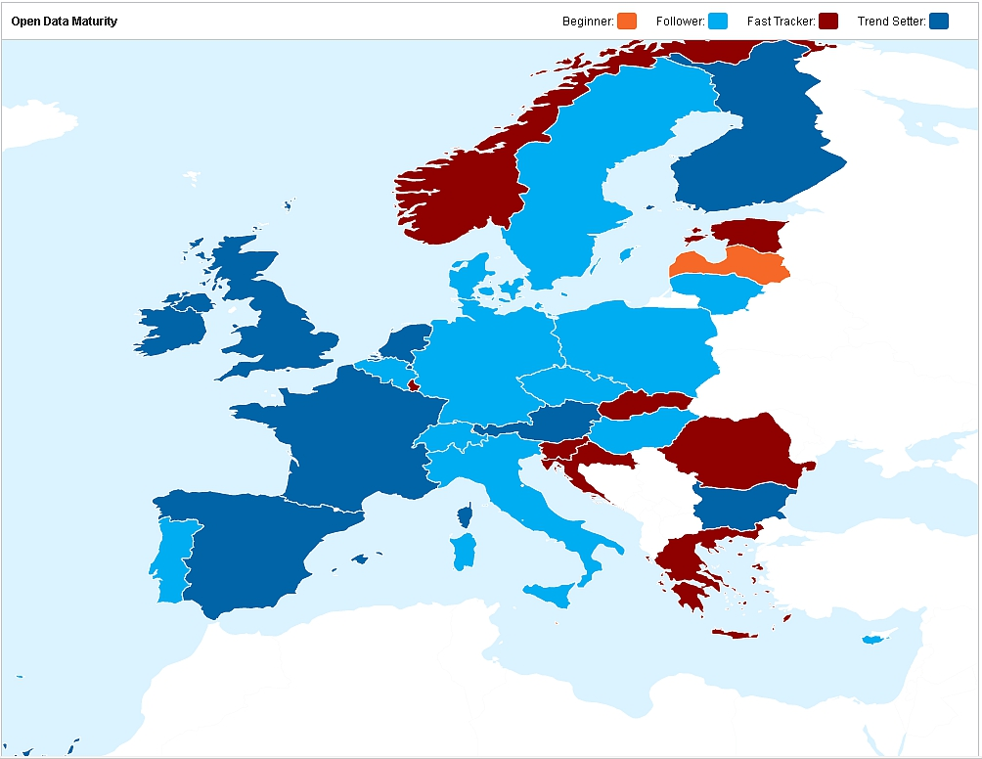
Indicators Number
# OD Readiness 41
1 Open Data policy 23
1.1 OD Policies 15
1.2 Licensing norms 3
1.3 Coordination at national level 5
2 Use of the data 9
3 OD Impact 9
3.1 Political Impact 3
3.2 Social Impact 2
3.3 Economic Impact 4
# Portal Maturity 13
4 Portal Usability 4
5 Portal Re-usability 6
6 Spread of data across domains 3
https://www.europeandataportal.eu/es/dashboard

Slide 8
Beginner
Follower
Fast Tracker
Trend setter
https://www.europeandataportal.eu/es/dashboard

Slide 9
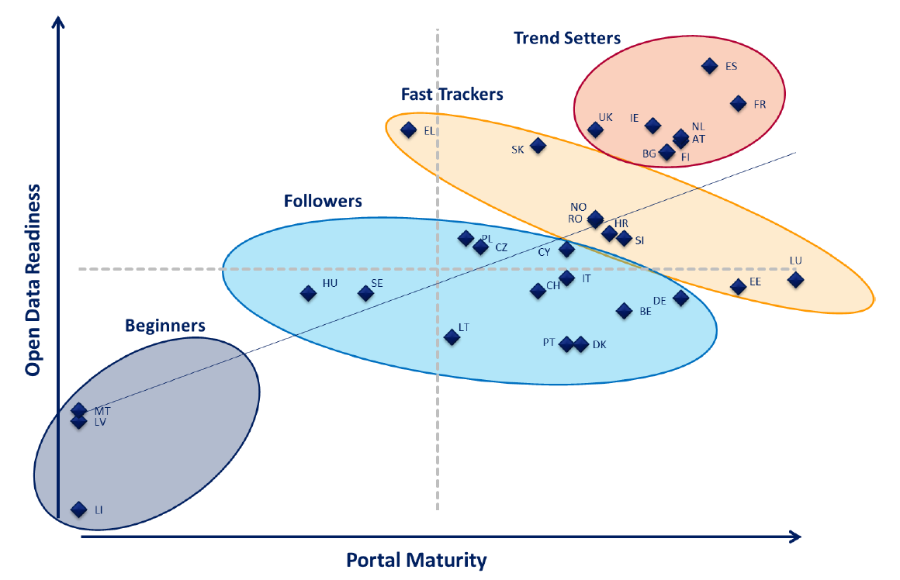
8
12
8
3
https://www.europeandataportal.eu/es/dashboard

Slide 10
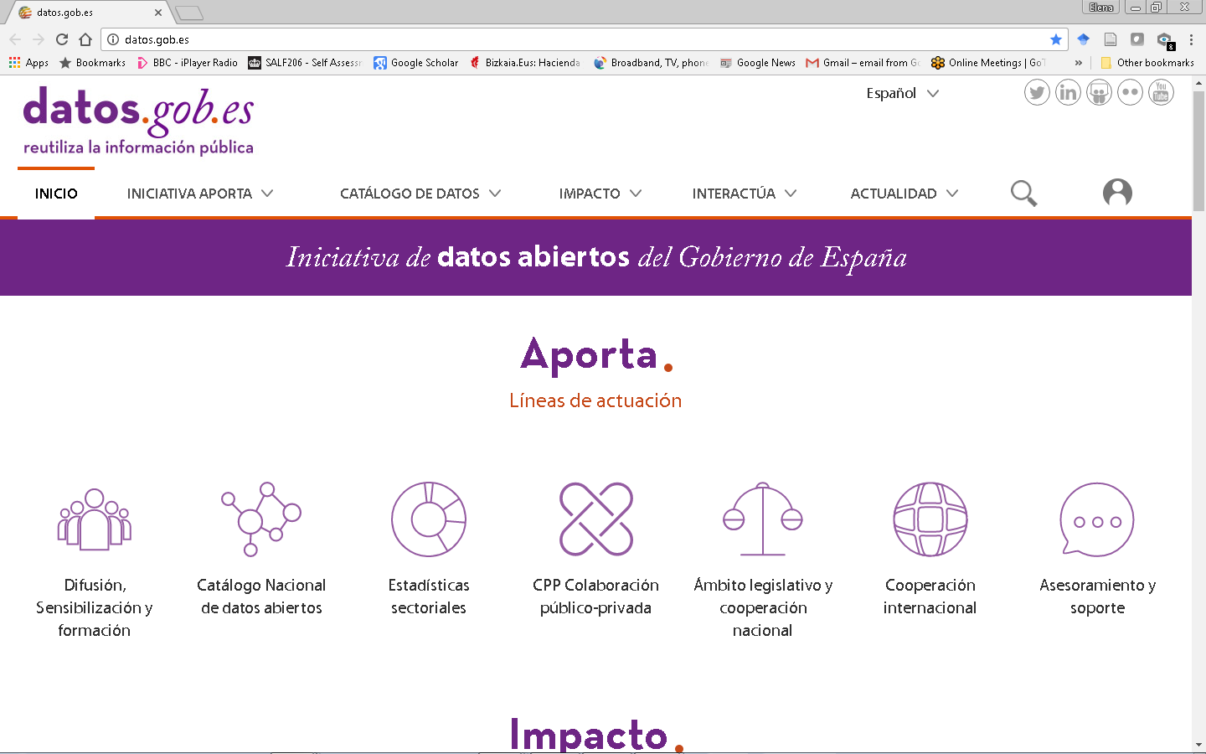
https://www.datos.gob.es/

Slide 11
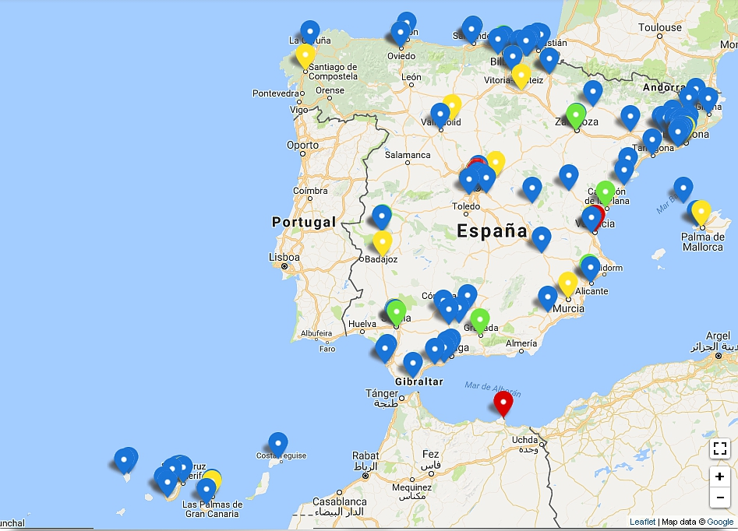
APORTA OD Initiatives (http://datos.gob.es/es/iniciativas )
Local Administration (92)
State Administration (34)
Regional Administration (17)
Universities (10)

Slide 12
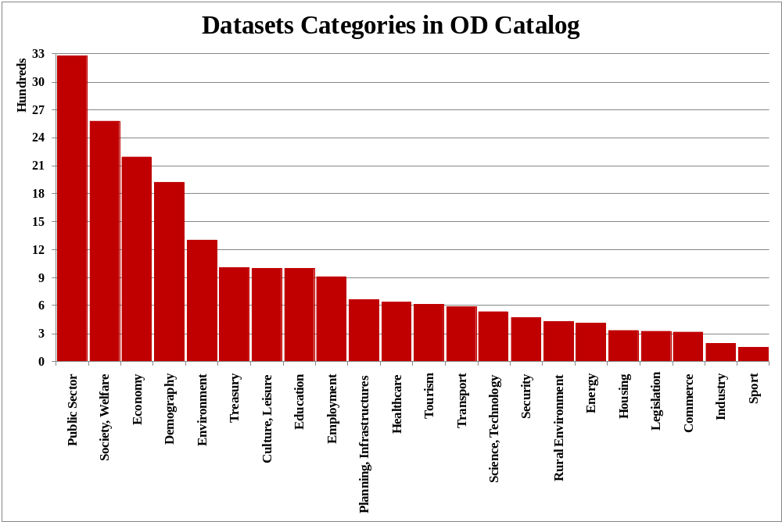
497

Slide 13
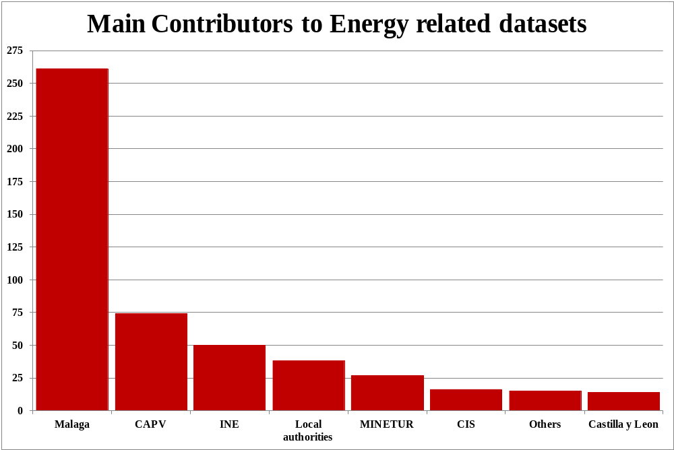
Notes:
1 university
Others all contributors with < 10 datasets
MINETUR Ministerio de Energía, Turismo y Agenda Digital

Slide 14
CAN bioenergy make a significant contribution to the CE efforts in spain?

Slide 15
Where/how could bioenergy contribute to this effort
Energy is consumed in 3 areas:
  Electricity
  Transport
  Heating/cooling
How can it be used to enable efforts to reduce, reuse, recycle?
  Providing better ways of reducing/reusing waste
  Providing ways to reduce GHG emissions
  Providing ways to reduce environmental impacts linked to the generation/use of energy

Slide 16
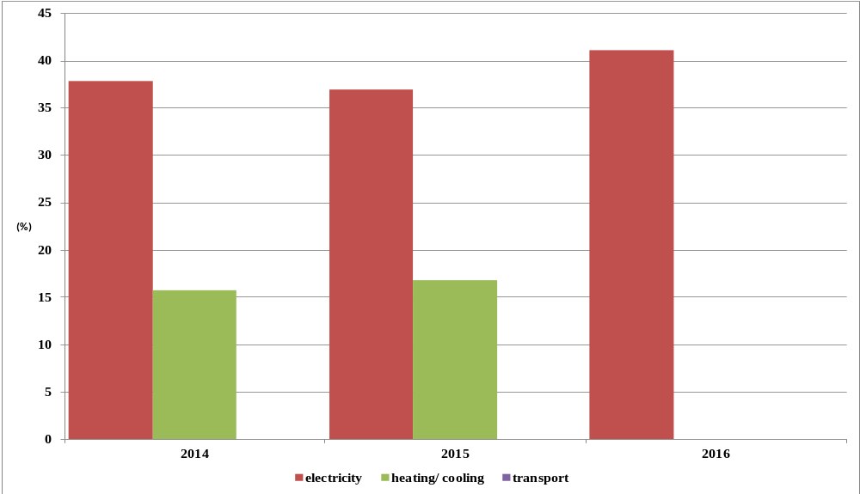
RE use distribution in Spain since 2014
Data source: http://ec.europa.eu/eurostat

Slide 17
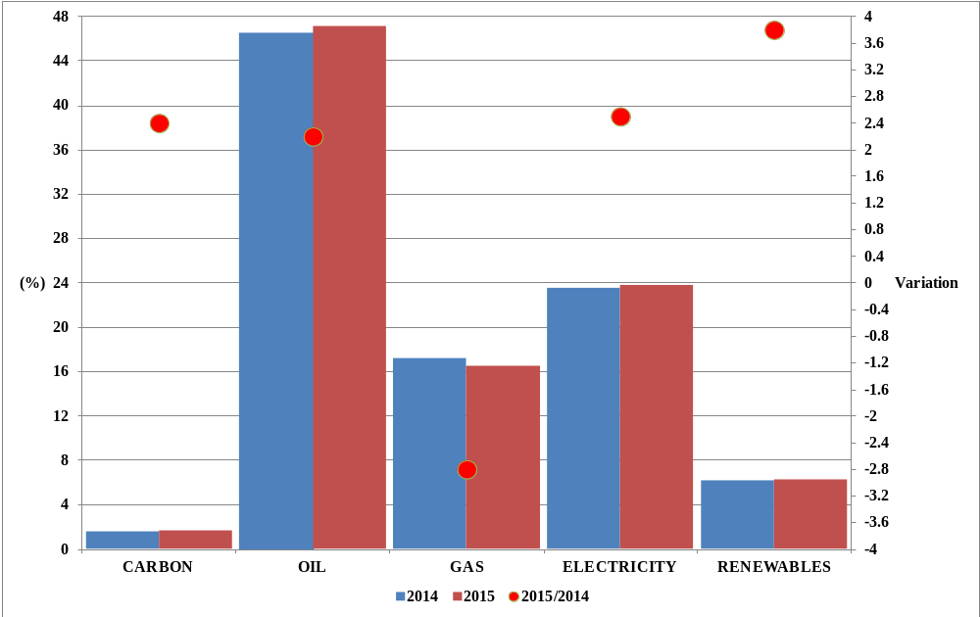
Distribution of Energy sources in SPAIN - 2015
Data source: http://informeestadistico.idae.es/t2.htm

Slide 18
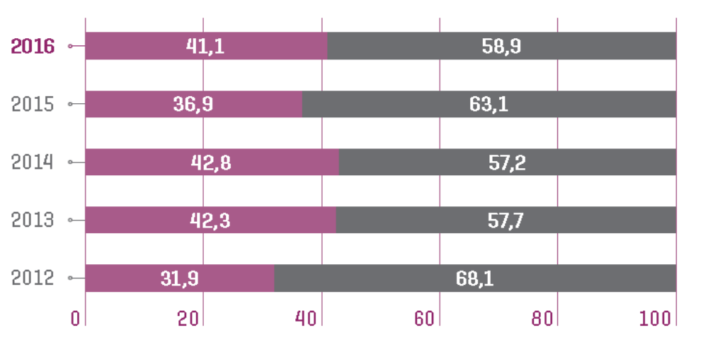
Evolution of Renewable Energy Use – Electricity Generation in SPAIN (%)
Renewables: hydraulic, wind, solar PV, solar thermal, other renewables and 50% solid urban waste
Non renewable: nuclear, carbon, fuel/gas
http://www.ree.es/es/estadisticas-del-sistema-electrico-espanol/informe-anual/avance-del-informe-del-sistema-electrico-espanol-2016

Slide 19
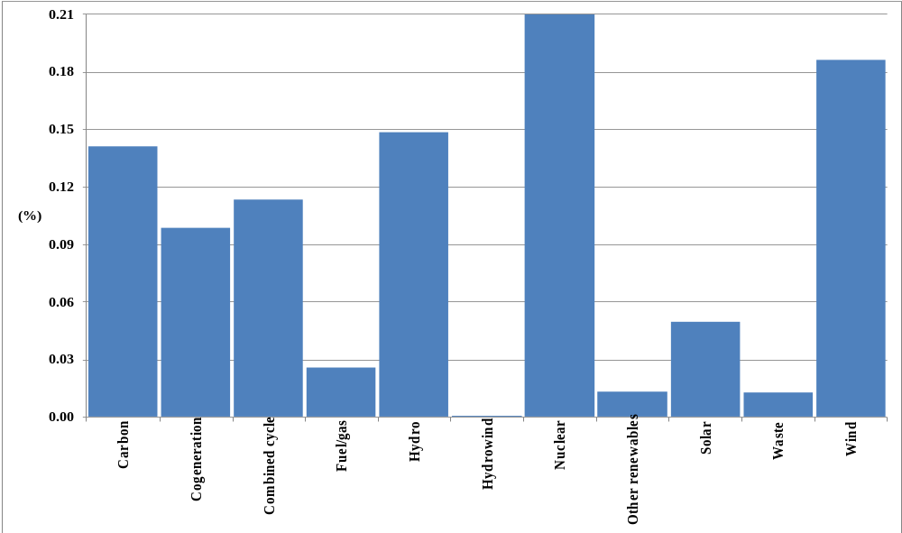
Distribution of Electricity by Energy Sources in SPAIN (2016)
http://www.ree.es/es/estadisticas-del-sistema-electrico-espanol/informe-anual/avance-del-informe-del-sistema-electrico-espanol-2016
Other renewables: biogas, biomass, marine-hydro , geothermal

Slide 20
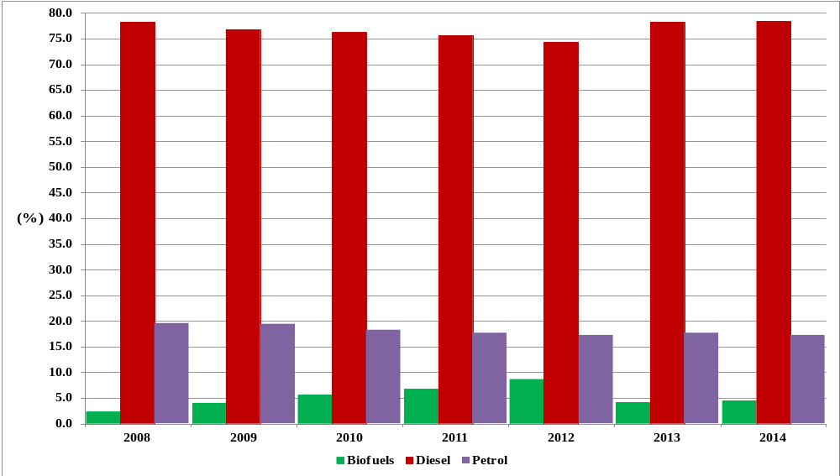
Transport fuel consumption in Spain – distribution according to types
Source: Espejo et al., 2016

Slide 21
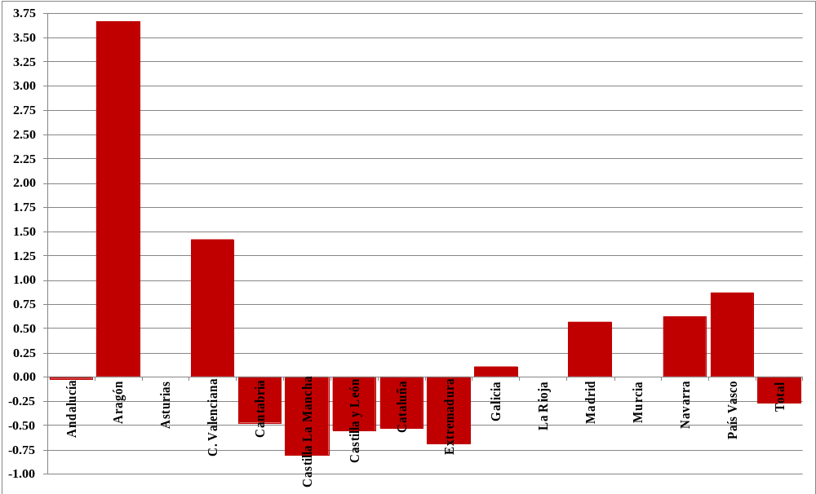
Evolution Biofuels – CA Provision points (2007-2015)
Source: Espejo et al., 2016

Slide 22
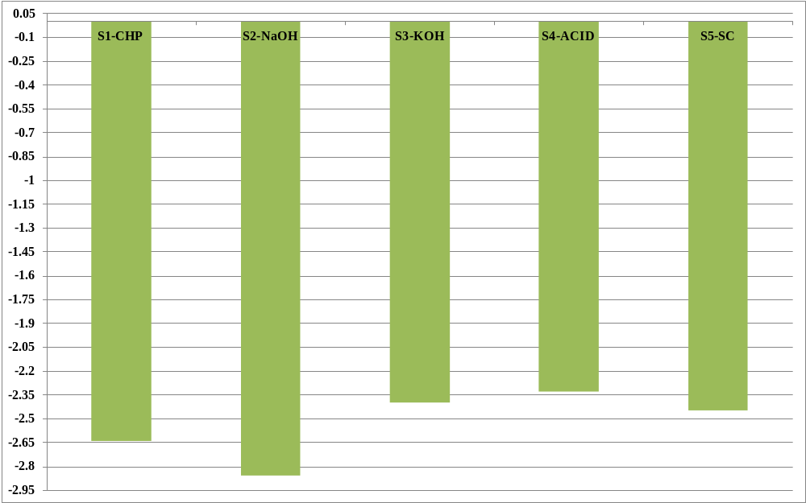
Lifecycle Assessment (GWP of 1 t of UCO re-use)
Lombardi et al., 2017 http://www.sciencedirect.com/science/article/pii/S0301479717304760

Slide 23
Conclusions – Bioenergy and OD
Significant difference between the various OD platforms managed by local authorities (regional level)
Significant differences in data quality and quantity associated to the Energy sector supplied by each CA (national and regional portals)
Important differences in the temporality of the datasets available
Many URIs associated with datasets at National platform do not work or difficult to use
Low contribution from energy sector including: research centres, governmental bodies, businesses

Slide 24
Conclusions – Bioenergy and CE
Use of Bioenergy to support Electricity generation and for Transport has a lot of potential in Spain
There is almost no data in the OD portal, the sector should work harder to resolve this gap (research centres, governmental bodies, industry)
The sector can help the transition to a CE through different ways
  Transform waste to Energy (e.g. potential of reusing cooking oil)
  Provide more data to the OD portal and enable society to be more involved
  Drive government to generate policies to help the community (e.g. provision of more supplier points, reduce the import of raw materials to produce biofuels)
THANK YOU FOR YOUR ATTENTION
elena.perezminana@btinternet.com

