Slide 1

Sustainable Campus as a Living Learning Lab for Environmental Studies and Climate Change Education:
Example of
Elena Lioubimtseva, Geography and Planning Department
Environmental Studies Program,
Grand Valley State University, Allendale, MI, USA

Slide 2
GVSU facts
Total students 24,654, one of 100 largest universities in the US, the 5th largest in MI
The 9th top college based on June 30, 2014 ranking by Forbes!
AASHE STARS GOLD ranking (top 45)
One of the highest rankings by the Princeton Review
the 16th in the nation for sustainable practices based on the Green Metric World University Ranking.
392 undergraduate and graduate courses address sustainability-related issues.

Slide 3
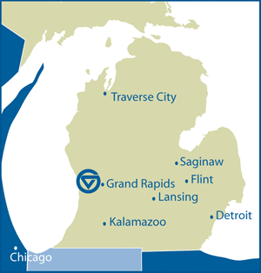

Slide 4
Sustainability at GVSU
First Sustainability Indicator Report issued in 2005, covered 18 Triple-Bottom-Line impact areas and used 76 sustainability indicators to determine sustainable practices on campus.
In 2008, GVSU joined the American College and University Presidents Climate Agreement (ACUPCC) and became a charter member of the American Association for Sustainability in Higher Education (AASHE) Sustainability Tracking Assessment and Reporting System (STARS).
Sustainability became a value in the University’s 2010-2015 Strategic Plan.
Achieved AASHE STARS Gold Rating in 2013.

Slide 5
University-wide integration of environment and sustainability
Curriculum
Faculty and student research
Campus infrastructure and operations
Student organizations
Community-based projects/service learning
Local, regional and international partnerships

Slide 6
Sustainable Campus is a system
Teaching and Learning
Infrastructure
Community

Slide 7
Teaching and learning
Sustainability curriculum
Faculty and Student Research
broader community education and service

Slide 8
Campus Infrastructure
Energy Systems
Food Systems
Buildings and Materials
Water Management
Transportation Systems

Slide 9
Campus Community
governance
wellness
Management of campus resources

Slide 10
1. Sustainable Food Systems
  Purchased:
    930,500 lbs of local food ($2.2 MM)
    164,000 lbs of MI Brand local food ($221K)
    1100 lbs of certified seafood ($6K)
    11,000 lbs of fair trade coffee ($77K)
  Increased the number of sustainability certified vendors:
    23 local farms
    31 local suppliers
    2 seafood vendors
    3 organic vendors
    1 cage free egg supplier.
  Sustainable Agriculture Project

Slide 11
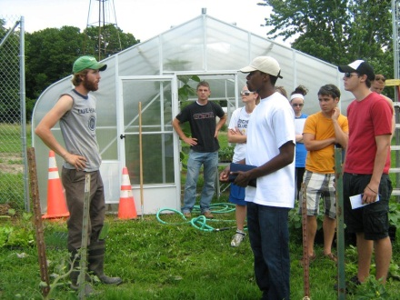
ENS401
ENS401 Environmental Problem Solving at GVSU

Slide 12
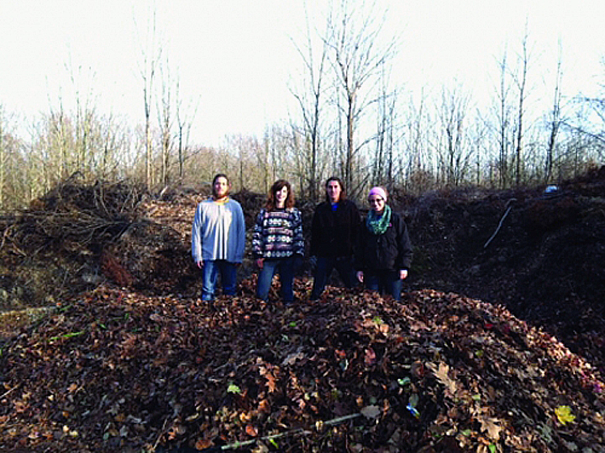
Student Environmental Coalition, a class called "Food For Thought", SCDI, and Campus Facilities collaborated to capture the yard waste, sort it, and windrow it for compost.
This process will enable the Sustainable Agriculture Project to avoid their annual compost purchase and free up $3000 for additional internships.

Slide 13
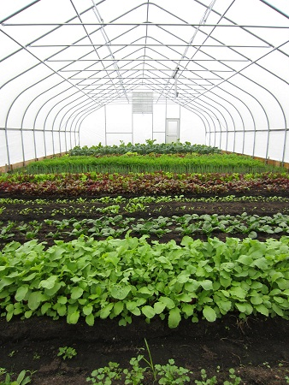
The Sustainable Agriculture Project started in 2008 from a student project in ENS401 Environmental Problem Solving.
Two unheated hoop houses have been added to extend growing seasons to about 50 weeks a year.
Interns sell the produce on campus each Wednesday every week.
Proceeds from sales are used to hire additional interns.

Slide 14
SAP highlights
Formal partnerships have been developed with Our Kitchen Table, a Grand Rapids Food Justice Non-profit organization; Baxter Community Neighborhood Center, and Grand Rapids Public School District to assist with growing techniques and education.
2013 will mark the fifth year of involvement with the Upward Bound TRiO organization during their summer stay at GSVU.
The SAP Farm now has one acre under cultivation with plans to expand to 2 acres within 3 years.
The SAP Farm employs 2 students part-time to help at the farm.

Slide 15
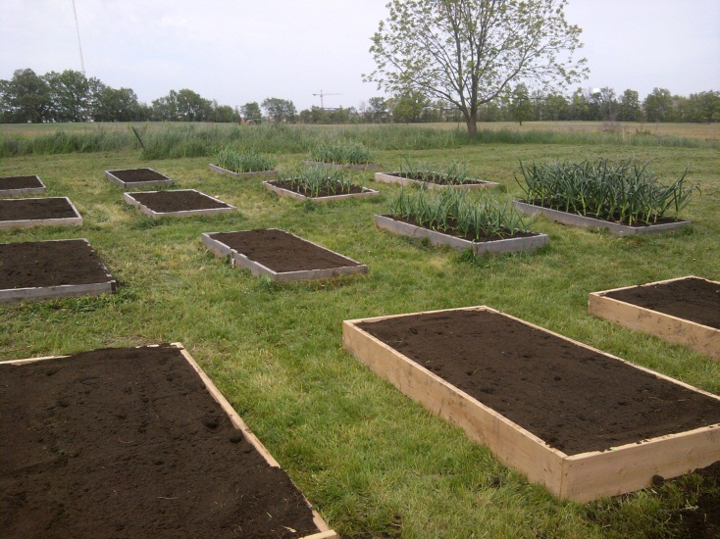
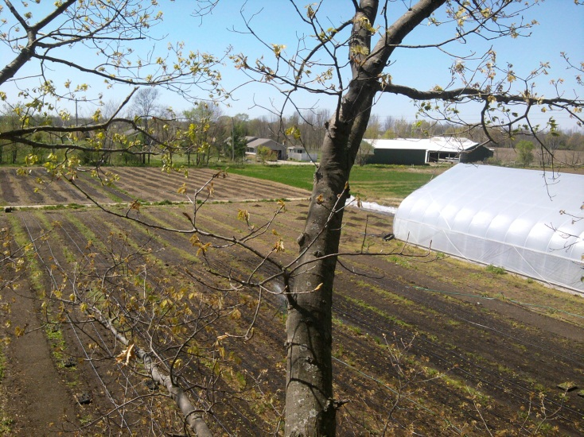
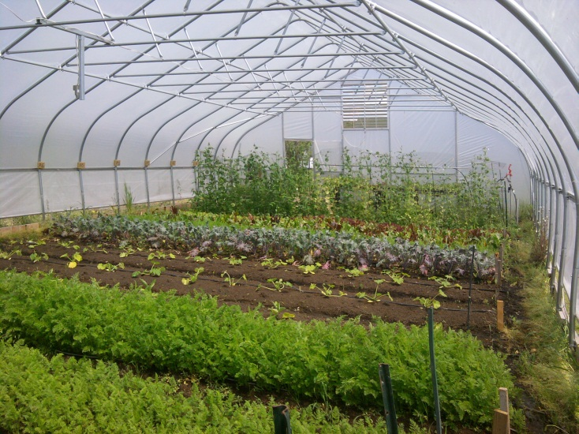
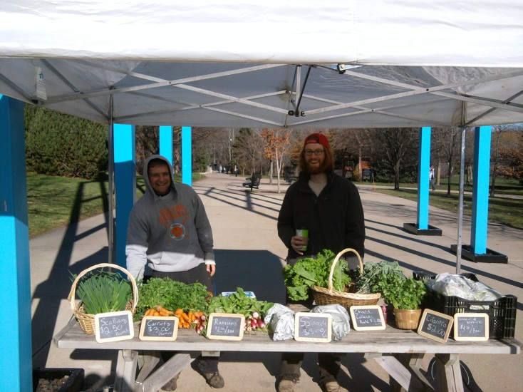

Slide 16
2. Recycling and Waste Minimization
  Generated 2357 tons of total waste with a landfill disposal rate of 57.4%
  Recycled 1005 tons of paper, cardboard, glass, plastic, scrap metal, computers, batteries, pallets, food waste, and light bulbs for a recycling rate or waste diversion rate of 42.5% ($30K savings)
  Composted 234 tons of food waste and 10,000 pizza boxes
  “Zero Waste” football game
  Water bottle filling stations

Slide 17

Eco-reps: peer-to-peer education program called the Eco-reps.
The students worked with SCDI, Facilities, and Housing to remove the boxes and direct them to our compost dumpsters.
In 15 months the students diverted over 25,000 pizza boxes.

Slide 18
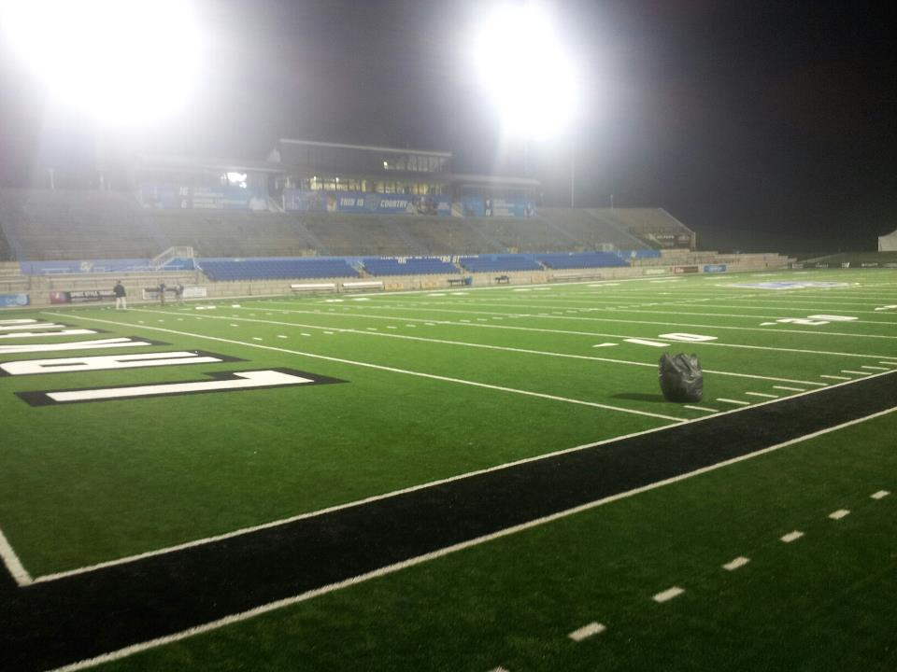
61% of waste composted or recycled. Within the stadium, the landfill from 15,000 fans was stuffed into one garbage bag! The game ranked number one in composting for all Division 2 & 3 events in the country.

Slide 19
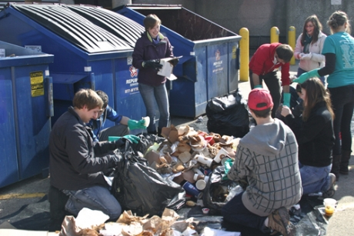
The Student Environmental Coalition collaborated with the Campus Dining, Facilities, and SCDI to identify waste stream problems.
The effort was to find ways to improve upon our 42% diversion rate.
By conducting a series of waste audits, problems are identified and re-education efforts are implemented.

Slide 20
3. Energy Efficiency and Optimization
  Invested $2,689,744 in energy projects and achieved $1,640,301 in annual energy cost avoidance
  One time cost avoidance projects have saved $1.3mm over last 12 years
  Reduced housing community energy costs by $10,760 per year since 2006

Slide 21
4. Water Conservation
  Going tray-less in campus dining saves 2.5 gallons of water per person, or 1,482,749 gallons of water ($9K)
  University reduced water consumption by 25mm gallons from 2007-2011 ($163K savings)
  Irrigation and retention ponds accounted for 15mm gallons of water

Slide 22
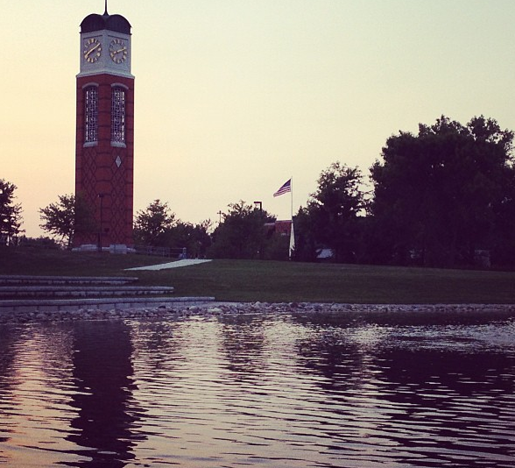
A Storm-water Management Plan is being implemented to take the run-off map back to the way it was before the campus was created.
Wetlands have been developed and retention ponds created.
Natural Resource Management Faculty and Students work with Facilities to monitor progress and implement change. Last year the university consumed 25 million fewer gallons of water than it did in 2005.

Slide 23
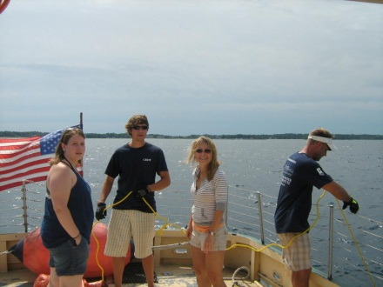
GVSU and NMC students are conducting bathymetry study in the Traverse Bay

Slide 24
5. Alternate Transportation and Fuel
  Recycled 3,000 gallons of cooking oil which was used as feedstock for biodiesel fuel
  Achieved 3MM bus rides
    Avoided 36,737,480 passenger vehicle miles ($21.3mm savings automobile cost)
    Avoided 1,836,874 gallons of fuel ($6.4mm cost savings)
    Avoided 15,864 MT CO₂E
    Reduced parking passes by 15%
  Bike Transit
  WeCar Services

Slide 25
6. Sustainable Purchasing
Achieved $49,437,444 in sustainable supplies:
$6K for the fair trade coffee and tea
$40K Adidas apparel (FLA member)
$911K apparel (Worker Rights consortium member)
$211K recycled paper products
$46.2MM LEED building and construction products
$2.1MM minority owned vendor purchases

Slide 26
7. Green and LEED Buildings
15 LEED certified buildings (957,845 square feet)
$32MM invested for new and remodeled facilities that created 700 trade and construction jobs
Estimated savings of $800K for LEED buildings in energy, operations, water, and waste cost avoidance

Slide 27

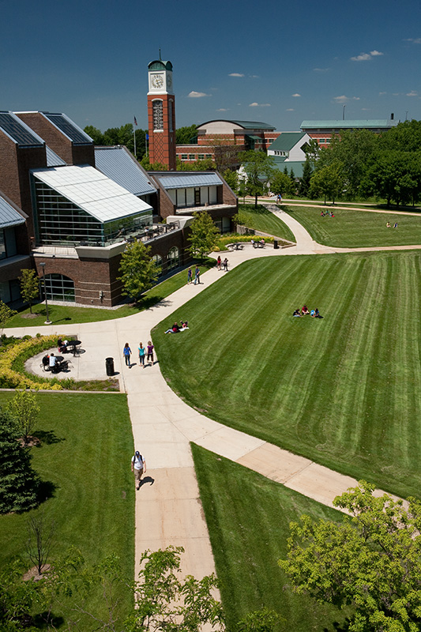
Sustainable Campus is an Integrated System
www.gvsu.edu/sustainability
-Sustainability Guide
-Talloires Declaration
-ACU President’s Climate Change Agreement
-AASHE STARS Project
-Accountability Report
-2010-2015 Strategic Plan
-Campus Sustainability Reporting
-Campus Dining
-LEED Building
-Energy Projects
-Bus Ridership
-Sustainability Emphasis
-Environmental Studies Minor
-Sustainability Themes
-Sustainability Certificates
-Education for Sustainability Curriculum
Administration, Campus Dining,
and Facilities Services
Education for Sustainability
GVSU
Sustainability Initiative
Student
Involvement
Community
Engagement
-Sustainability Guide
-Student Ambassadors
-Sustainability Pledge
-Campus Sustainability
Year Activities
-How Green Are You?
-Recyclemania
-Eco Reps
-Service Learning Projects
-Student Environmental Coalition (SEC)
-Community
Sustainability Partnership (www.grpartners.org)
-UNU RCE designation
-Seeds of Promise
(www.seedsofpromise.net)
University Resources
Adapted:
Tony Cortese, Second Nature

Slide 28
Acknowledgements:
Norman Christopher – Sustainable Community Development Initiative, GVSU
Bart Bartels, Zero Waste Coordinator at University of Illinois at Urbana-Champaign
GVSU Student Environmental Coalition Members

