Slide 1
By THE N AME
OF ALLH
بسم الله الرحمن الرحيم

Slide 2
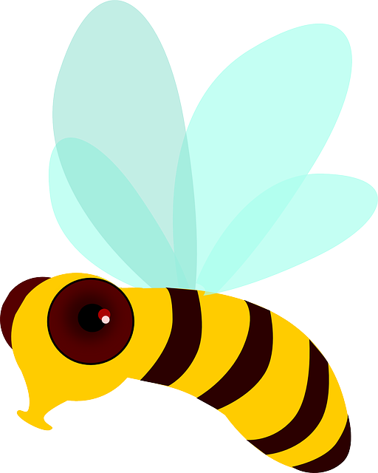
ANTIOXIDANT PROPARTY OF HONEY
BY
Prof.Dr EITEDAL M. Daoud
Prof. Of Childhealth &Consultant of Clinical
Nutrition ,National Research Centre ,Egypt

Slide 3
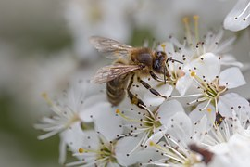
Honey is an aqueous solution of sugars containing a few secondary metabolites.

Slide 4
It is the only insect-derived natural product with therapeutic, traditional, spiritual, nutritional, cosmetic, and industrial value. In addition to having excellent nutritional value, honey is a good source of physiologically active natural compounds,

Slide 5
HONEY
Honey has been used by humanity for thousands of years for nutrition and curative purposes. The traditional knowledge of honey and modern science are merged in “apitherapy,” which denotes the medical use of honey and bee products.

Slide 6
Carbohydrates are the main componantes of honey and contribute 95 to 97% of its dry weight. In addition to carbohydrates, honey contains numerous compounds, such as organic acids, proteins, amino acids, minerals, and vitamins .Pure honeys were also reported to contain polyphenols, alkaloids,, cardiac glycosides, flavonoids, reducing compounds, and volatile compounds

Slide 7
Honey also contains a lot of minerals such as calcium, copper, iron, magnesium, manganese, zinc phosphorus and potassium

Slide 8
Reactive oxygen species (ROS) are chemically reactive molecules containing oxygen. Examples include peroxides. superoxide, hydroxyl radical, and singlet oxygen. ROS are formed as a natural by product of the normal metabolism of oxygen and have important roles in cell signaling and homeostasis.

Slide 9
Oxidative stress reflects an imbalance between the systemic manifestation of reactive oxygen species and a biological system's ability to readily detoxify the reactive intermediates or to repair the resulting damage.

Slide 10
Honey is recognized as having different biological properties, including antioxidant effects or pharmacological
activities—ranging from anti-inflammatory, antioxidant, antibacterial, antihypertensive to hypoglycemic effects

Slide 11
Mechanism of action:

Slide 12
Honey inhibit the formation of free radicals, a potential to exert antioxidant activity.
Superoxide formed during inflammation is un-reactive, this is then converted to hydrogen
peroxide a much less reactive peroxide radical generated .

Slide 13
Formation of the oxidant peroxide radical is then catalysed by metal ions (e.g.; iron and copper). Sequestration of these metal ions in complexes with organic molecules is an important antioxidant defense system .
Flavonoids and other polyphenols, common constituents of honey, will do this.

Slide 14
Reactive Oxygen Species (ROS) is a phrase used to describe a number of reactive molecules and free radicals derived from molecular oxygen.
Glutathione (GSH) is an important cellular antioxidant that limits cell damage by ROS

Slide 15
The role of free radicals such as superoxide radicals, hydroxyl radicals and others have been implicated in a number of diseases including cancer, cardiovascular diseases, cataracts, macular degeneration, impaired wound healing, gastrointestinal inflammatory diseases and many other inflammatory processes.

Slide 16
Antioxidant activity, or simply antioxidant capacity of honey is its ability and potential of it to reduce oxidative reactions within the food systems and human health

Slide 17
The Anti -Oxidant system
Natural honey contains many flavonoids ,phenolic acids ,ascorbic acid, tocopherols, catalase, superoxide dismutase, reduced glutathione, and peptides, most of which work together to provide a synergistic antioxidant effect .

Slide 18
The anti-oxidant content of Honey is measured
by:
its capacity to scavenge free radicals, and
its capacity to inhibit the generation of superoxide radicals. Or due to the combined activity of these minor components through synergistic effects .

Slide 19
It is noticed that the botanical origin of honey has the greatest influence on its anti-oxidant activity, while processing, handling and storage affects its anti-oxidant capacity only to a minor degree

Slide 20
So ,the antioxidant capacities, of honey is useful for the prevention of chronic inflammatory process like : atherosclerosis, diabetes mellitus , cardiovascular diseases ,some immunological diseases and cancer.

Slide 21
This ability of honey to neutralize free radicals has been demonstrated . Via a clinical trial of honey dressing on burns has been indicated that the way in which honey initiates healing in burns is the control of free radicals by the antioxidant activity of honey (Subrahmanyam, 2003).

Slide 22
In humans, after honey is consumed, an increase in plasma antioxidants has been reported, and the antioxidants give protection in the blood stream and within cells (Schramm et al., 2003), demonstrating that the bioavailability and bioactivity of honey gives a high efficiency antioxidant transfer from honey to plasma

Slide 23
The occurrences of human diseases, which are linked to oxidative stress, have led to the application of antioxidants to treat diseases. Small molecule dietary antioxidants such as vitamin C, vitamin E and carotenoids have generated particular interest as defenses against degenerative diseases. However, some studies have indicated that organic compounds such as flavonoids and phenolics are considerably more potent antioxidants. The use of honey in the treatment of chronic wounds, diabetic ulcers, cataracts and other eye ailments, peptic ulcers and gastric ailments have been well documented.

Slide 24
honeys had revealed that in addition to C and E vitamins and catalase, the honeys also contain flavonoid and phenolic compounds. The antioxidant activities of these organic compounds were determined in terms of their anti radical power (ARP) as assessed by DPPH radical scavenging assay and their total antioxidant power (TAP), as measured by FRAP assay. A high correlation between the honey phenolics and the hydrogen peroxide level in honey is another new finding. It indicates that honey phenolics play a role in determining hydrogen peroxide level in honey

Slide 25


