Slide 1
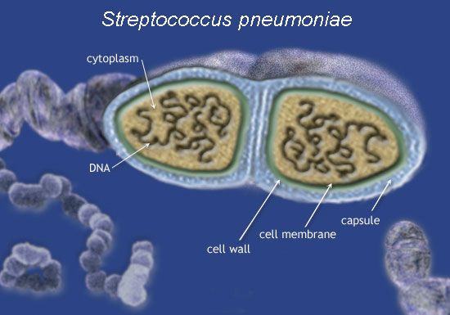
Pneumococcal conjugate vaccines: overview of a decade from Kuwait
Eiman Mokaddas, MD, FRCPath
Professor of Clinical Microbiology
Faculty of Medicine
Kuwait University

Slide 2
Outline
Introduction
Burden of pneumococcal disease
Pneumococcal vaccines:
Impact on:
  Burden of Disease
  Serotype distribution
  Coverage of PCV’s
  Penicillin resistance
Data from Kuwait

Slide 3
Introduction

Slide 4
1. Burden of Pneumococcal Disease

Slide 5
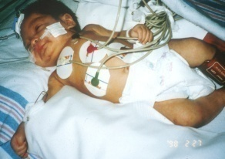
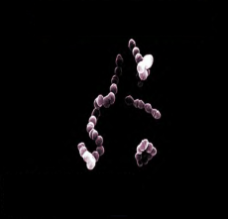
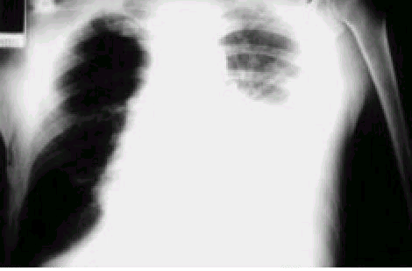
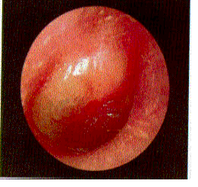
Pneumococcal disease burden in childhood
For each case of pneumococcal meningitis in a year:
Invasive
Meningitis
X 10
Prevalence
Bacteremia
Disease severity
X 100 to 1000
Pneumonia
X 1000 to 10,000
Non-invasive
Otitis media
Adapted from Abramson JS, et al. Pediatrics 2000;106(2):362-6

Slide 6
Data from Kuwait

Slide 7
The prevalence and clonal diversity of penicillin-resistant Streptococcus pneumoniae in Kuwait
Ahmed K, Martinz G, Wilson R, Yoshida R, Dahar R, Mokaddas E, Kohno S, Rotimi VO, Nagatake T
Epidemiology& Infection 2000, 125, 573-581

Slide 8
Prevalence of penicillin-resistant Streptococcus pneumoniae in Kuwait
Mokaddas E, Wilson S, Sanyal SC
Journal of Chemotherapy, 2001; 13: 154-160

Slide 9
2. Pneumococcal Vaccines

Slide 10
Data from Kuwait

Slide 11
Children < 2 years
With Catch up program for children < 4 years
PCV-7
August, 2006
Children < 2 years
And
Finished
Catch up program for children < 4 years
PCV-13
August, 2010

Slide 12
3. Serotype Distribution

Slide 13
Data from Kuwait

Slide 14
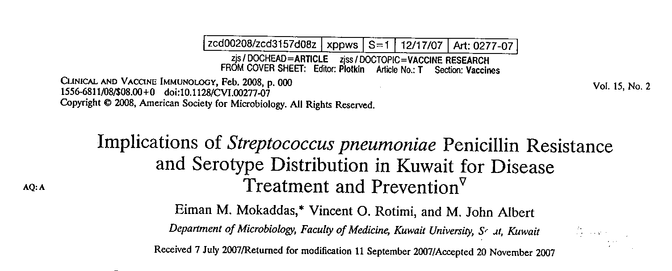

Slide 15

Most Common Serotypes Causing Pneumococcal Disease
(Kuwait)
Serotypes of S. pneumoniae, 204 Isolates (Invasive and Noninvasive),
2004-2005; Kuwait
A total of 397 isolates from patients of all ages were investigated in this study. For the total study population, the most common serotypes among the penicillin-resistant strains were 23F, 19F, 6B, 14, and 9A.
Mokaddas EM et al. Clin Vaccine Immunol. 2008;15(2):203-207.
Notes:
15
Key Point
Mokaddas and colleagues collected data on the most prevalent serotypes of S. pneumoniae in Kuwait and their susceptibility to penicillin. A total of 397 isolates (invasive and noninvasive) were examined; 97 isolates were from lower respiratory sites of infection. A majority (61%) of serotypes from the lower respiratory tract were resistant to penicillin.
A total of 204 isolates came from patients aged 16 years or more. The serotype distribution for this
group of patients is shown. Serotype 6A was the most common serotype, followed by serotypes 9V, 11 A, and 6 B.
The investigators also noted that their study showed that invasive diseases were more common at the extremes of age: 41% of invasive isolates were from children younger than 15 years and 43% were from patients older than 65 years.
Reference
Mokaddas EM, Rotimi VO, Albert MJ. Implications of Streptococcus pneumoniae penicillin resistance and serotype distribution in Kuwait for disease treatment and prevention. Clin Vaccine Immunol. 2008;15(2):203-207.

Slide 16
Age (yr) and vaccine |  | S.pneumoniae serotype |  |  | % coverage by vaccine
≥ 2, 23-valent |  | All |  |  | 64
 |  | Invasive |  |  | 82
 |  | Penicillin resistant |  |  | 76
<2, 7-valent |  | All |  |  | 72
 |  | Invasive |  |  | 55
 |  | Penicillin resistant |  |  | 82
<5, 7-valent |  | All |  |  | 69
 |  | Invasive |  |  | 62
 |  | Penicillin resistant |  |  | 80
Coverage calculated with autoagglutinating strains excluded Mokaddas etal, 2008

Slide 17
4. Penicillin Resistance in S.pneumoniae

Slide 18
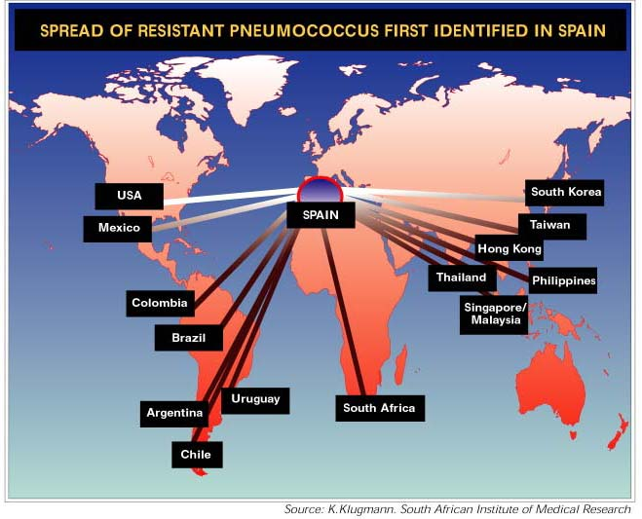
www.who.int

Slide 19
Data from Kuwait

Slide 20
In Kuwait
1999-2000
A study of SP from all over Kuwait
250 SP isolates
52.8 intermediately-resistant
1.6 high-level resistant
Mokaddas et al, 2001
A study in a general Hospital
457 SP isolates:
20.6% intermediately-resistant
No high-level resistance
Johny et al, 1992
1985-1988
1995-1996
A study from 3 large hospitals
128 SP isolates:
46% intermediately-resistant
9% high-level resistant
Ahmed etal, 2000
E.Mokaddas

Slide 21
PRSP in Kuwait over 20 years
E.Mokaddas

Slide 23
Burden of CAP in the MENA Region: Antibiotic Resistance Among S. pneumoniae Isolates (Kuwait)
¹
²
³
1995-1996
2001-2004
1999-2000
e
f
a
b
c
d
ª Erythromycin
^{b} Amoxicillin clavulinate
^{c} Cefotaxime
^{d} Imipenem
^{e} Levofloxacin
^{f} Ciprofloxacin
TMP/SMX=trimethoprim/sulfamethoxazole
Ahmed K et al. Epidemiol Infect. 2000;125(3):573-581.
Mokaddas EM et al. Microb Drug Resist. 2007;13(4):227-233.
Mokaddas EM et al. J Chemother. 2001;13(2):154-160.
.
Notes:
Key Points
The rate of resistance of S. pneumoniae isolates to penicillin is high in Kuwait, as shown.
Ahmed and colleagues evaluated 128 strains isolated between 1995 and 1996 from various clinical samples of patients seen at 3 major hospitals in Kuwait.¹ A total of 55% of the isolates were resistant to penicillin; multidrug resistance was observed in 24 of 59 penicillin-intermediate and in all (11 of 11) fully penicillin-resistant strains.
From 2001 to 2004, Mokaddas and colleagues studied 824 consecutive isolates of S. pneumoniae from teaching hospitals and primary care centers serving all of Kuwait.² A total of 63% of the isolates were resistant to penicillin; of these, 55% demonstrated intermediate resistance. The investigators concluded that the regions should be considered hyperendemic for penicillin-resistant S. pneumoniae like Spain, South Africa, and France. (Mokaddas p231 col2 para3 sent1)
In an earlier study (1999-2000) Mokaddas and colleagues observed penicillin resistance in 53.6% of
S. pneumoniae isolates.³ A total of 60% of penicillin-resistant strains (intermediate and full) were resistant to 1 or more beta-lactams and approximately 40% demonstrated resistance to non―beta-lactam agents.
References
Ahmed K, Martinez G, Wilson S, et al. The prevalence and clonal diversity of penicillin-resistant Streptococcus pneumoniae in Kuwait. Epidemiol Infect. 2000;125(3):573-581.
Mokaddas EM, Rotimi VO, Albert MJ. Increasing prevalence of antimicrobial resistance in Streptococcus pneumoniae in Kuwait: implications for therapy. Microb Drug Resist. 2007;13(4):227-233.
Mokaddas EM, Wilson S, Sanyal SC. Prevalence of penicillin-resistant Streptococcus pneumoniae in Kuwait. J Chemother. 2001;13(2):154-160.

Slide 24
Data from Kuwait
Review

Slide 25
Review
Impact of pneumococcal conjugate vaccines on burden of invasive pneumococcal disease and serotype distribution of Streptococcus pneumoniae isolates: An overview from Kuwait
Eiman Mokaddas, M. John Albert
Department of Microbiology, Faculty of Medicine, Kuwait University, Jabriya 35153, Kuwait

Slide 26


Slide 27
Objectives
The objective of this study was to evaluate the impact of vaccination on vaccine and non vaccine serotype distribution in invasive and noninvasive S. pneumoniae isolates obtained in Kuwait from August 2006 through December 2011, as compared with previously published data
The susceptibility of all the isolates to penicillin was also evaluated.

Slide 28
Methods
The study included all cases of noninvasive and invasive pneumococcal diseases (IPD) in children and adults among all age groups during this period. All isolates
were serotyped using the Quellung reaction antisera and their susceptibility to penicillin was determinedusing the E test method.

Slide 29
Results
A total of 395 pneumococcal isolates were included in the study.
After vaccine introduction, 23% of isolates were from children ≤5 years of age and 49% of cases in this age group were invasive, while 46% of isolates were from adults >50 years of age and 27% of cases in this age group were invasive. Two of 13 cerebrospinal fluid isolates and only one of 266 respiratory isolates obtained were penicillin resistant.

Slide 30
Results
For the post-vaccine period, the predominant serotypes in children ≤5 years were 19F, 19A, 6A, 8 and 15B for invasive isolates and 19F and 23F for noninvasive isolates and the predominant serotypes in adults >50 years of age were 14, 3, 1, 19F and 8 for invasive isolates and 19F, 23F, 6B, 14 and 19A for noninvasive isolates.
Among children <2 years of age, coverage with PCV7, PCV10, and PCV13 was 34.6%, 38.5% and 61.5%, respectively, in the period post-vaccine introduction.
Among children 2–5 years of age, corresponding coverage rates were 42.1%, 47.4% and 63.1%, respectively. A similar trend was noticed in adults, with coverage rates in the 51- to 65-years age group of 45.8%, 62.5% and 70.8% respectively.

Slide 31
Conclusion
Compared with previously published findings, from the period prior to vaccine introduction, this represented an increased incidence in some non-PCV7 serotypes that are included in PCV13 (serotypes 1, 6A, and 3).

Slide 32
Data from Kuwait
10- Year Surveillance

Slide 33
Objectives
To evaluate the impact of PCV7 and PCV13 on epidemiology, serotype distribution and antimicrobial resistance of both invasive and non invasive S.pneumoniae isolates, and to estimate the vaccine coverage rate in all age groups over the 10-year study period

Slide 34
Methods
The study included all cases of invasive pneumococcal disease (IPD) and non-invasive pneumococcal disease in children and adults among all age groups from August 2003 to July 2013. The isolates were serotyped using Quellung reaction antisera and their susceptibility to penicillin was determined using the Etest method

Slide 35
Results
934 pneumococcal isolates were included in the study
Divided into 2 periods:
From August 2003 till July 2006 (pre-vaccination period)
  There were 345 isolates (63 of them (18%) were invasive isolates and 16 out of them (25%) were from children ≤5 years)
From August 2006 till July 2013 (post-vaccination period)
  There were 598 isolates ( 156 of them (26%) were invasive isolates and 44 of them (28%) were from children ≤5 years).

Slide 36
Age distribution of Invasive pneumococci and their resistance to Penicillin
Age group (years) | Blood isolates |  | CSF isolates
 | Pre-vaccination period | Post-vaccination period | Pre-vaccination period | Post-vaccination period
 | Number of isolates (number of resistant to penicillin) | Number of isolates (number of resistant to penicillin) | Number of isolates (number of resistant to penicillin) | Number of isolates (number of resistant to penicillin)
<2 | 9(8) | 18(9) | 0(0) | 4(3)
2-5 | 6(2) | 21(14) | 1(1) | 1(0)
6-50 | 13(7) | 40(18) | 0(0) | 4(2)
51-65 | 23(11) | 25(13) | 2(2) | 6(3)
>65 | 8(5) | 37(10) | 1(0) | 0(0)
Total | 59(33) | 141(64) | 4(3) | 15(8)
* Pre-vaccination period Three years( Aug 2003- Jul 2006)
** Post-vaccination period Seven years (Aug 2006- Jul 2013)

Slide 37
Age Distribution and Source Of Invasive Pneumococcal Isolates
Study year (Number of isolates) | Blood |  |  |  |  | CSF
 | <2 | 2-5 | 6-50 | 51-65 | >65 | <2 | 2-5 | 6-50 | 51-65 | >65
Prevaccination Period
Aug 2003- Jul 2004 (17) | 2 | 4 | 4 | 5 | 1 | 0 | 1 | 0 | 0 | 0
Aug 2004- Jul 2005 (28) | 5 | 1 | 9 | 6 | 6 | 0 | 0 | 0 | 1 | 0
Aug 2005- Jul 2006 (18) | 2 | 1 | 0 | 12 | 1 | 0 | 0 | 0 | 1 | 1
Total (63) | 9 | 6 | 13 | 23 | 8 | 0 | 1 | 0 | 2 | 1
Post Vaccination Period
Aug 2006- Jul 2007 (32) | 5 | 4 | 5 | 5 | 9 | 1 | 0 | 1 | 2 | 0
Aug 2007- Jul 2008 (30) | 3 | 6 | 9 | 4 | 7 | 0 | 0 | 0 | 1 | 0
Aug 2008- Jul 2009 (36) | 3 | 5 | 11 | 7 | 7 | 2 | 1 | 0 | 0 | 0
Aug 2009- Jul 2010 (13) | 3 | 0 | 5 | 2 | 0 | 1 | 0 | 1 | 1 | 0
Aug 2010- Jul 2011 (16) | 3 | 5 | 5 | 0 | 2 | 0 | 0 | 0 | 1 | 0
Aug 2011- Jul 2012 (16) | 0 | 0 | 2 | 5 | 7 | 0 | 0 | 1 | 1 | 0
Aug 2012- Jul 2013 (13) | 1 | 1 | 3 | 2 | 5 | 0 | 0 | 1 | 0 | 0
TotaL (156) | 18 | 21 | 40 | 25 | 37 | 4 | 1 | 4 | 6 | 0
16 In children < 5 years (25%)
44 In children < 5 years (28%)

Slide 38
Serotypes of Invasive Pneumococci in different age sample
Study year (number of isolates) | Serotypes ( number )
 | <2 | 2-5 | 6-50 | 51-65 | >65
Prevaccination Period
Aug 2003- Jul 2004 (17) | 14(1), 33D(1) | 1(1), 6B(1), 19F(2), 23A(1) | 2(2), 8(1), 9V(1) | 1(2), 6A(1), 8(1), 23F(1) | 9N(1)
Aug 2004- Jul 2005 (28) | 7F(1), 10A(1), 14(1), 19F(1), 23F(1) | 19A(1) | 4(1), 5(1), 8(1), 10A(1), 19A(1), 19F(3), NT(1) | 4(1), 7C(1), 19A(1), 19F(1), 22A(1), 23F(1) | 9V(2), 11A(1), 14(1), 18C(1), 19F(1)
Aug 2005- Jul 2006 (18) | 19F(1), NT(1) | 23F(1) | 0 | 1(1), 9A(1), 9V(3), 14(3), 19A(1), 19F(1), 23F(2), NT(1) | 1(1), 19F(1)
Post Vaccination Period
Aug 2006- Jul 2007 (32) | 8(1), 9V(1), 15F(1), 19F(2), 18C(1) | 9V(1), 19F(2), 23F(1) | 1(1), 3(1), 6A(1), 9L(1), 9V(1), 23A(1) | 1(2), 3(1), 14(2), 19F(1), 23F(1) | 1(1), 3(1), 5(1), 8(4), 14(1)
Aug 2007- Jul 2008 (30) | 5(1), 15C(1), 18C (1) | 5(1), 6A(1), 9V(1), 15C(1), 19A(1), 19F(1) | 1(2), 3(1), 5(1), 9V(1),14(1), 15C(2), 15F(1) | 1(1), 4(1), 14(1), 18A(1) | 3(2), 6B(1), 12F(1), 15F(1), 33D(1), NT(1)
Aug 2008- Jul 2009 (36) | 6B(1), 6A(2), 15B(1) | 15A(2), 9V(2), 15B(1), 19A(1) | 3(1), 15B(1), 8(2),11A(2), 15F(1), 9V(1), 12B(1), 18C(1), 23F(1) | 8(2), 19F(1), 3(1), 15A(1), 1(1) | 14(2),22F(1),20(1), 6A(1), 6B(1), 9V(1), 23A(1)
Aug 2009- Jul 2010 (13) | 19A(1), 8(1), 19F(1), 6A(1) | 19A(1), 8(1), 2(1), 3(1), 19C (1), 23A(1) | 19A(1), 8(1), 2(1), 3(1), 19C(1), 23A(1) | 14(1), NT(1) | 0
Aug 2010- Jul 2011 (16) | NT(1), 15B(1), 19A(1) | 20(1), 19A(2), NT(1), 12B(1) | 33D(1), 17F(1), 9L(1), 6A(2) | 19F(1) | 33A(1), NT(1)
Aug 2011- Jul 2012 (16) | 0 | 0 | 20(1), 6A(1), 9L(1) | 8(1), 12F(2), 15F(1), 19A(1), 7F(1) | 20(1), 15A(1), 17F(1), 19A(1), 22F(1), 9V(1), 8(1)
Aug 2012- Jul 2013 (13) | 23F(1) | 15B(1) | 15B(2), 33D(2) | 12F(1), 8(1) | NT(2), 10A(1), 3(1),23A(1)
* PCV7 introduced in Aug 2006, PCV13 in Aug 2010 both in children <2 years of age.
* NT : Non- typeable.

Slide 39
Distribution of Vaccine serotypes among the Invasive Pneumococci during 3- years Pre-vaccination period (August 2003- July 2006)*
Vaccine Serotypes | Number of Vaccine Serotype/ Total number of Serotypes in different age groups
 | <2y | 2-5y | 6-50y | 51-65y | >65y | All age groups | Vaccine Coverage
(PCV7)
14 | 2/9 | 0/7 | 0/13 | 3/24 | 1/7 | 6/60
6B | 0/9 | 1/7 | 0/13 | 0/24 | 0/7 | 1/60
19F | 1/9 | 2/7 | 3/13 | 1/24 | 1/7 | 8/60
18C | 0/9 | 0/7 | 0/13 | 0/24 | 1/7 | 1/60
23F | 1/9 | 1/7 | 0/13 | 4/24 | 0/7 | 6/60
4 | 0/9 | 0/7 | 1/13 | 1/24 | 0/7 | 2/60
9V | 0/9 | 0/7 | 1/13 | 3/24 | 2/7 | 6/60
Total | 4/9 | 4/7 | 5/13 | 12/24 | 5/7 | 30/60 | 50%
+
(PCV10)
1 | 0/9 | 1/7 | 0/13 | 3/24 | 1/7 | 5/60
5 | 0/9 | 0/7 | 1/13 | 0/24 | 0/7 | 1/60
7F | 1/9 | 0/7 | 0/13 | 0/24 | 0/7 | 1/60
Total | 5/9 | 5/7 | 6/13 | 15/24 | 6/7 | 37/60 | 62%
+
(PCV13)
3 | 0/9 | 0/7 | 0/13 | 0/13 | 0/7 | 0/60
6A | 0/9 | 0/7 | 0/13 | 1/13 | 0/7 | 1/60
19A | 0/9 | 1/7 | 1/13 | 2/13 | 0/7 | 4/60
Total | 5/9 | 6/7 | 7/13 | 18/24 | 6/7 | 42/60 | 70%
Total | 55% | 86% | 54% | 75% | 86% | 70%
*No Vaccine administered

Slide 40
Distribution of Vaccine serotypes among the Invasive Pneumococci during 4 - years post-vaccination period (August 2006- July 2010)*
Vaccine Serotypes | Number of Vaccine Serotype/ Total number of Serotypes in different age groups
 | <2y | 2-5y | 6-50y | 51-65y | >65y | All age groups | Vaccine Coverage
(PCV7)
14 | 0/17 | 0/22 | 1/32 | 4/19 | 1/23 | 6/113
6B | 1/17 | 0/22 | 0/32 | 0/19 | 2/23 | 3/113
19F | 3/17 | 2/22 | 0/32 | 2/19 | 0/23 | 7/113
18C | 2/17 | 0/22 | 0/32 | 0/19 | 0/23 | 2/113
23F | 0/17 | 1/22 | 1/32 | 1/19 | 0/23 | 3/113
4 | 0/17 | 0/22 | 0/32 | 1/19 | 0/23 | 1/113
9V | 1/17 | 4/22 | 3/32 | 0/19 | 1/23 | 9/113
Total | 7/17 | 6/22 | 5/32 | 8/19 | 4/23 | 30/113 | 27%
+
(PCV10)
1 | 0/17 | 0/22 | 3/32 | 4/19 | 1/23 | 8/113
5 | 1/17 | 1/22 | 1/32 | 0/19 | 1/23 | 4/113
7F | 0/17 | 0/22 | 0/32 | 0/19 | 0/23 | 0/113
Total | 8/17 | 7/22 | 9/32 | 12/19 | 6/23 | 42/113 | 37%
+
(PCV13)
3 | 0/17 | 0/22 | 3/32 | 2/19 | 3/23 | 8/113
6A | 3/17 | 1/22 | 1/32 | 0/19 | 1/23 | 6/113
19A | 0/17 | 3/22 | 1/32 | 0/19 | 0/23 | 4/113
Total | 11/17 | 10/22 | 14/32 | 14/19 | 10/23 | 59/113 | 52%
Total | 65% | 45% | 44% | 74% | 43% | 52%
*Vaccine administered was PCV7

Slide 41
Distribution of Vaccine serotypes among the Invasive Pneumococci during 3 - years post-vaccination period (August 2010- July 2013)*
Vaccine Serotypes | Number of Vaccine Serotype/ Total number of Serotypes in different age groups
 | <2y | 2-5y | 6-50y | 51-65y | >65y | All age groups | Vaccine Coverage
(PCV7)
14 | 0/4 | 0/5 | 0/12 | 0/9 | 0/14 | 0/45
6B | 0/4 | 0/6 | 0/12 | 0/9 | 0/14 | 0/45
19F | 0/4 | 0/6 | 0/12 | 1/9 | 0/14 | 1/45
18C | 0/4 | 0/6 | 0/12 | 0/9 | 0/14 | 0/45
23F | 1/14 | 0/6 | 0/12 | 0/9 | 0/14 | 1/45
4 | 0/4 | 0/6 | 0/12 | 0/9 | 0/14 | 0/45
9V | 0/4 | 0/6 | 0/12 | 0/9 | 1/14 | 1/45
Total | 1/4 | 0/6 | 0/12 | 1/9 | 1/14 | 3/45 | 7%
+
(PCV10)
1 | 0/4 | 0/6 | 0/12 | 0/9 | 0/14 | 0/45
5 | 0/4 | 0/6 | 0/12 | 0/9 | 0/14 | 0/45
7F | 0/4 | 0/6 | 0/12 | 1/9 | 0/14 | 1/45
Total | 1/4 | 0/6 | 0/12 | 2/9 | 1/14 | 4/45 | 9%
+
(PCV13)
3 | 0/4 | 0/6 | 0/12 | 0/9 | 1/14 | 1/45
6A | 0/4 | 0/6 | 3/12 | 0/9 | 0/14 | 3/45
19A | 1/4 | 2/6 | 0/12 | 1/9 | 1/14 | 5/45
Total | 2/4 | 2/6 | 3/12 | 3/9 | 3/14 | 13/45 | 29%
Total | 50% | 33.3% | 25% | 33.3% | 21% | 29%
* Vaccine administered was PCV13

Slide 42
Prevalence of Vaccine serotypes* during pre-vaccination and post-vaccination period in different age groups
Period | Number of Vaccine Serotypes/ Total number of Serotypes (%) in different age groups
 | <2y | 2-5y | 6-50y | 51-65y | >65y | All age groups
Pre- vaccination period | 5/9 (55.5) | 6/7(85.7) | 7/13(53.9) | 18/24(75.0) | 6/7(85.7) | 42/60(70.0)
(Aug2003- Jul 2006)
Post-vaccination period** | 11/17(64.7) | 10/22(45.5) | 14/32(43.8) | 14/19(73.7) | 10/23(43.5) | 59/113(52.2)
(Aug2006- Jul 2010) | [0.69]**** | [0.09] | [0.74] | [1.00] | [0.08] | [0.03]
Post-vaccination periods*** | 2/4(50.0) | 2/6(33.3) | 3/12(25.0) | 3/9(33.3) | 3/14(21.4) | 13/45(28.9)
(Aug 2010-Jul 2013) | [1.00] | [0.10] | [0.22] | [0.04] | [0.01] | [0.0001]
Both Post- vaccination periods | 13/21(61.9) | 12/28(42.9) | 17/44(38.6) | 17/28(60.7) | 13/37(35.1) | 72/158(45.6)
Aug 2006- Jul 2013) | [1.00] | [0.08] | [0.35] | [0.37] | [0.03] | [0.001]
*Serotypes present in PCV13
**Vaccine given was PCV 7
*** Vaccine given was PCV 13
**** Indicates P value compared with data for Pre-vaccination period

Slide 43
Prevalence of Non-Vaccine serotypes* during pre-vaccination and post-vaccination period in different age groups
Period | Number of Vaccine Serotypes/ Total number of Serotypes (%) in different age groups
 | <2y | 2-5y | 6-50y | 51-65y | >65y | All age groups
Pre- vaccination period | 4/9(44.5) | 1/7(14.3) | 6/13(46.2) | 6/24(25.0) | 1/7(14.3) | 18/60(30)
(Aug2003- Jul 2006)
Post-vaccination period** | 6/17(35.3) | 12/22(54.5) | 18/32(56.3) | 5/19(26.3) | 13/23(56.5) | 54/113(47.8)
(Aug2006- Jul 2010) | [0.69]**** | [0.09] | [0.74] | [1.00] | [0.08] | [0.03]
Post-vaccination periods*** | 2/4(50.0) | 3/6(50.0) | 9/12(75.0) | 6/9(66.7) | 11/14(78.6) | 32/45(71.1)
(Aug 2010-Jul 2013) | [1.0] | [0.26] | [0.22] | [0.04] | [0.20] | [0.0001]
Both Post- vaccination periods | 8/21(38.1) | 15/28(53.6) | 27/44(61.4) | 11/28(39.3) | 24/37(64.9) | 86/158(54.4)
Aug 2006- Jul 2013) | [1.0] | [0.10] | [0.36] | [0.37] | [0.03] | [0.001]
Serotypes present in PCV13
**Vaccine given was PCV 7
*** Vaccine given was PCV 13
**** Indicates P value compared with data for Pre-vaccination period

Slide 44
Penicillin Resistance

Slide 45
Age distribution of Invasive pneumococci and their resistance to Penicillin
Age group (years) | Blood isolates |  | CSF isolates
 | Pre-vaccination period | Post-vaccination period | Pre-vaccination period | Post-vaccination period
 | Number of isolates (number of resistant to penicillin) | Number of isolates (number of resistant to penicillin) | Number of isolates (number of resistant to penicillin) | Number of isolates (number of resistant to penicillin)
<2 | 9(8) | 18(9) | 0(0) | 4(3)
2-5 | 6(2) | 21(14) | 1(1) | 1(0)
6-50 | 13(7) | 40(18) | 0(0) | 4(2)
51-65 | 23(11) | 25(13) | 2(2) | 6(3)
>65 | 8(5) | 37(10) | 1(0) | 0(0)
Total | 59(33) | 141(64) | 4(3) | 15(8)
* Pre-vaccination period Three years( Aug 2003- Jul 2006)
** Post-vaccination period Seven years (Aug 2006- Jul 2013)

Slide 46
Penicillin resistance among invasive isolates
(Pre-vaccination period)
Age Group (Years) | No. of invasive isolates | No. of resistant isolates | % resistance
<2 | 9 | 8 | 89%
2-5 | 7 | 3 | 43%
6-50 | 13 | 7 | 54%
51-65 | 25 | 13 | 52%
>65 | 9 | 5 | 56%
Total | 66 | 36 | 55%

Slide 47
Penicillin resistance among invasive isolates
(Post –vaccination period)
Age Group (Years) | No. of invasive isolates | No. of resistant isolates | % resistance | P value
<2 | 22 | 12 | 55% | 0.10
2-5 | 22 | 14 | 64% | 0.40
6-50 | 44 | 20 | 45% | 0.75
51-65 | 31 | 16 | 52% | 1.00
>65 | 37 | 10 | 27% | 0.12
Total | 156 | 72 | 46% | 0.30

Slide 48
Common resistant invasive serotypes
( pre-vaccination period)
 |  |  | August 2006-July 2010
 | <2 years | 2-5 years | 6-50 years | 51-65 years | > 65 years | Total
Serotype ( No) | 7F(1), 14(2), 19F(2), 23F(1), 33D(1), NT(1) | 6B(1), 19F(1), 23F(1) | 8(1),9V(1), 19A(1), 19F(3), NT(1) | 9A(1), 9V(3), 14(1), 19A(2), 19F(1), 22A(2), 23F(3) | 9V(2), 9N(1), 19F(2) | 54
Total | 8 | 3 | 7 | 13 | 5 | 36

Slide 49
Common resistant invasive serotypes
( post-vaccination period)
A. August 2006-July 2010
B. August 2010-July 2013
 |  |  | August 2006-July 2010
 | <2 years | 2-5 years | 6-50 years | 51-65 years | > 65 years | Total
Serotype ( No) | 8(1), 9V(1), 15B(2) 15F(1), 19A(1), 19F(2), 15C(1), 6A(1) | 9V(2), 15B(1), 15C(1) 19A(1), 19F(3), 23F(1) 6A(1), 15A(1) | 9V(3), 14(1), 15B(1) 15F(1), 19A(1), 19F(1), 23F(1), 15C(2), 9L(1), 12B(1), 1(1), 11A(1) | 14(4), 19A(2),19F(1), 15A(1), 1(1) | 6B(2), 9V(1), 14(2), 15F(1), 23A(1), 23F(1) 6A(1) | 54
 |  |  | August 2010-July 2013
Serotype ( No) | <2 years | 2-5 years | 6-50 years | 51-65 years | > 65 years
 | 9A(1), 23F(1) | 19A(1), 20(1) | 33D(2), 6A(1), 9L(2) | 8(1), 15F(1), 19A(1), 19F(1), 12F(2) | 19A(1), 15A(1), 10A(1) | 18
Total | 12 | 13 | 20 | 15 | 12 | 72

Slide 50
Conclusion

Slide 51
Pneumococci are multiple and very adaptable
The most clever bacteria

Slide 52
Surveillance for Invasive and non-invasive PD only tells part of the story

Slide 53
Need for:
1. Disease burden studies

Slide 54
Need for:
2. Surveillance system for pneumococcal disease and serotype distribution: a. Before b. During c. After
Introduction of PCV’s
Need it to continue!!!

Slide 55
Need for:
3. More broad-spectrum Vaccine cover

Slide 56
Squeezing the Baloon

Slide 57
4. Need for more new indications
Adults above 50 years???

Slide 58
Thank You

