Slide 1
2nd World Bio Summit & Expo, Dubai 2016.
"Recent advances in Bio Science"
Molecular Basis of multiple sclerosis explains the disease pathophysiology
Eiman MA Mohammed

Slide 2
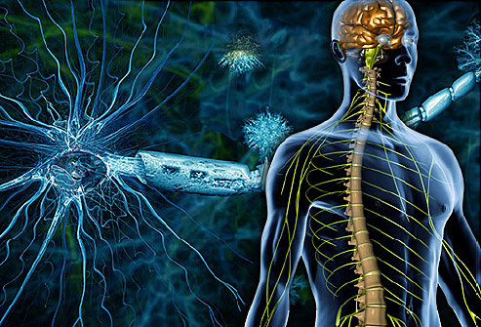
Multiple sclerosis (MS)
Complex, multifactorial autoimmune disorder CNS that causes inflammation, demyelination and neurodegeneration.
Considering the AGCs, data compiled based on Kurtzke's classification system have shown that Dubai (U.A.E), Saudi Arabia, Qatar and Kuwait are considered hotspots of MS (≥30/100,000) [Mohammed, 2016].
Reference: http://www.webmd.com/multiple-sclerosis/

Slide 3

The Aim
AGC share common geographical, ethnical and latitudinal factors
Exploring the molecular basis of MS in relation to disease pathophysiology would facilitate the search for susceptibility factors within the AGCs.
Reference: http://www.shutterstock.com/s/gulf/search.html

Slide 4
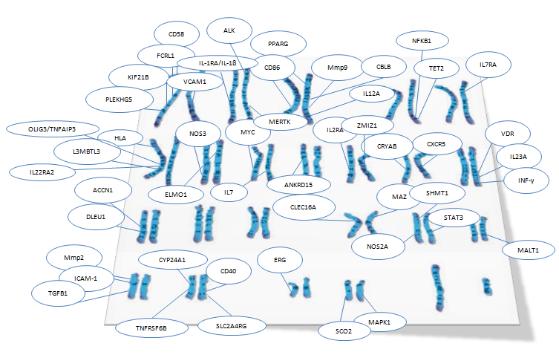

Slide 5
Molecular pathophysiology of MS

Slide 6
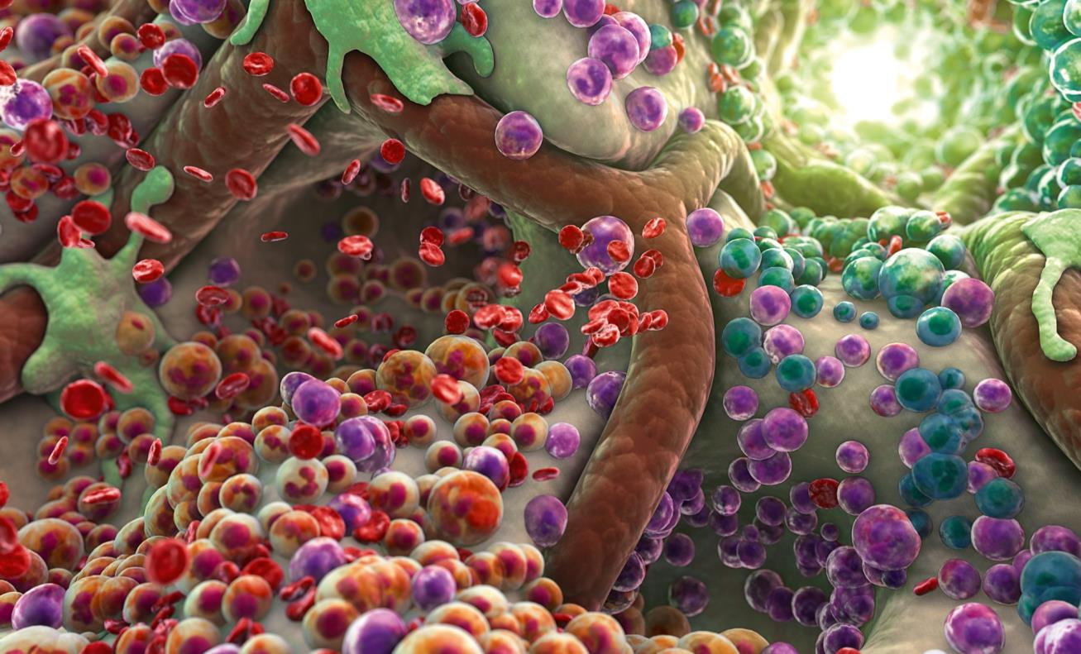
Immune triggering in the peripherally
Ref: http://forums.wdwmagic.com/threads/tafi-brainstorming-series.907735/page-2

Slide 7
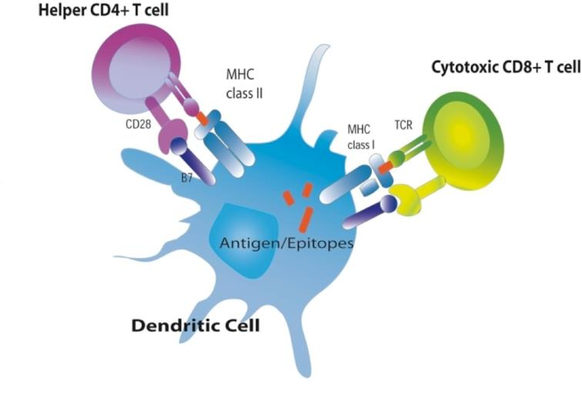
Dendritic cells (DC)
Immature DC presents processed antigens to naive T cells.
Mature DC express major histocompatibility complex (MHC) class I and II and B7 molecules to induce T cells polarization and B cells activation [Boppana, 2011].
Ref: http://sphweb.bumc.bu.edu/otlt/MPH-Modules/PH/Ph709_Defenses/PH709_Defenses_print.html

Slide 8
Major Histocompatibility Complex (MHC)
HLA-DRB1*15:01 (OR=5.8)
HLA-A*02:01 (OR=0.63)
HLA-B*38:01 (OR= 0.36)
HLA-DRB1*13:03 (OR=1.96)
HLA-DRB1*02/HLA-DQB1*06:02 (OR=4.6)
HLA-C*05
HLA-DRB1*03:01 (OR=2.01)
HLA-DPB1*03:01 (OR=1.33)
HLA-DRB1*08:01 (OR=1.63)
[Andlauer , 2016; IMSGC, 2007; Field, 2010; Brynedal, 2007; Yeo, 2007; Haines, 1996].
The most common risk allele.
Protective allele: Negative selection of pathogenic T cells in the thymus [Fugger, 2009].

Slide 9
Susceptible HLA alleles in Kuwaiti population
Trend for association between HLA Class II antigens (DR4, DQ6, DQ7 and DQ8) and MS.
However, the study was performed on a small number of subjects and with low resolution methodology [Al-Shammari, 2004].

Slide 10
Epigenetic of HLA Loci
19 differently methylated CpG sites in the MHC regions and 10 sites in the HLA-DRB1 region alone [Graves, 2014; Aslani, 2016].

Slide 11
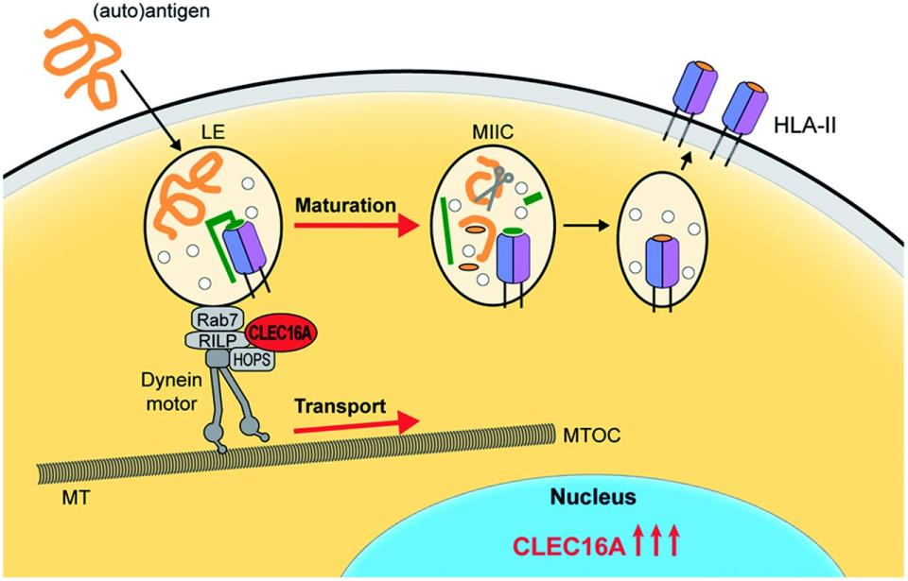
Ref: van Luijn, 2015; DOI: http://dx.doi.org/10.1093/brain/awv080
CLEC16A regulates the pathway of MHC class II endosome formation and trafficking in DCs [Andlauer, 2016; IMSGC, 2011,van Luijn, 2015].
SNP associated | p-value | OR
rs7200786 | 6.30 × 10−14 | 1.15

Slide 12
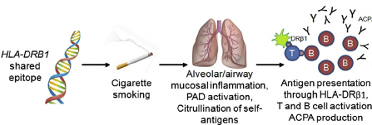
Smoking & HLA
Smoking increases the susceptibility of MS if associated with HLA-DRB1*15 presence and HLA-A*02 absence (from OR=4.9 to OR=13.5) [Hedström, 2011].
In the brain of Lewis rats, cigarette smoke can up-regulate expression of MHC class II, induce inflammation and pro-oxidant markers.
Also, it raises the Th1, Th17 and Treg cell-associated cytokine responses [Khanna, 2013].
Smoking was for long time a raising concern in AGCs [Aden, 2011; Waheedi, 2011; Almutairi, 2014].
Ref: Annu Rev Immunol 2008;26:651–75; with permission. Modified from Figures on Pages 660–2.

Slide 13
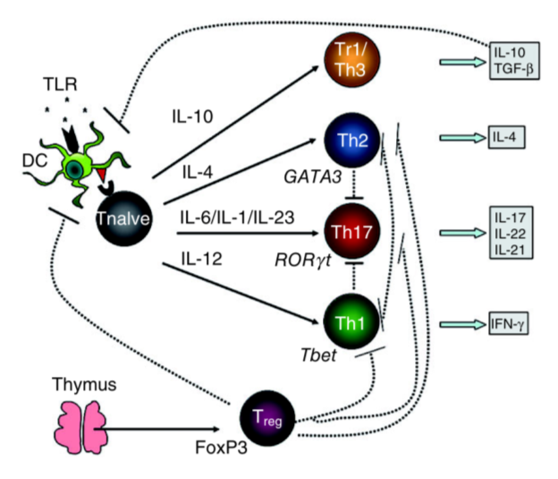
DC trigger immune responses
DCs secret INF-γ and IL-12 which mediate T-bet activation and promote Th1 differentiation.
Secret IL-4 promoting Th2 cells differentiation by activating the transacting T cell–specific transcription factor GATA-3 (GATA-3).
IL-1β and IL-23 stimulating Th17 cells differentiation.
TGF-β cytokine triggering FoxP3+ Treg cells differentiation [Boppana, 2011].
Ref: Fletcher, 2010.

Slide 14


Cytoplasm
VDR
Vit D
VDR
Nucleus
D
VDR
RXR
DC maturation, differentiation & prolifration
Down-regulates inflammatory cytokines
Up-regulates Treg cells
Regulates the transcription of HLA-DRB1*15 allele
Down-regulate CLEC16A

Slide 15

Vit D
VDR
RXR
CAMP
VDR associated SNP | p-value | OR
rs731236 | 0.004 | 0.53
LL-37
Lay in the Taq1 region and may result in mis-regulated VDR expression [Agliardi, 2011].
TLRs

Slide 16
1. Immune Triggering !!

Slide 17
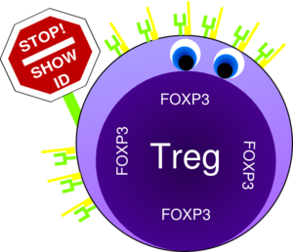
Regulatory traffic ??
Ref: Sci Transl Med. 2014 Jun 18;6(241):241ra78.

Slide 18
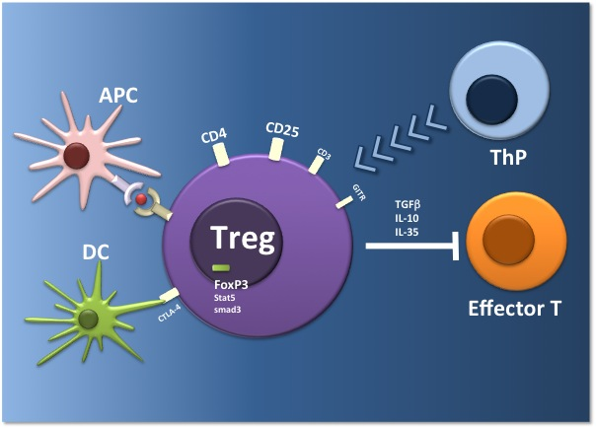
Regulatory T cells (Treg)
Naturally occurring FoxP3+ Tregs arises from the thymus
Adaptive Tregs arises from immune responses extrathymically
Ref:http://www.regimmune.com/technology/

Slide 19
In MS, significant down-regulation of Treg cells is actually reported
In EAE, appearances of those cells in CNS show disease recovery.
Some researchers have suggested that most Treg cells in MS are memory Treg cells which had diminished suppression of mean Ca(2+) influx and lost their inherent suppressive activity [Viglietta, 2004; Schwarz, 2013; Boppana, 2011].

Slide 20
miR-223, which modulates the NF-ĸB pathway, was found to be highly up-regulated in the blood and Treg cells of MS cases [van den Elsen, 2014; Ma, 2014].
Elevation of miR-223 has been previously correlated with lower Tregs in maternal and cord blood of pregnant women [Herberth, 2014].

Slide 21

UVR induce prostaglandin E2 (PGE2) production.
PGE2 in turn bind prostaglandin E receptor subtype 4, thereby signaling an increased receptor activator of NF-κB ligand (RANKL) expression in the epidermis and an elevated influx of Treg cells into the draining lymph nodes [Hart, 2013].
PGE2
PE4
RANKL
Treg
Treg
Treg

Slide 22
UVR mediate the conversion of cis-urocanic acid.
cis-urocanic acid increases anti-inflammatory IL-10 and CD4+CD25+FoxP3+ Treg cell and reduce IFN-γ and antigen presentation capacity [Correale, 2013].
cis-urocanic acid
IFN-γ
APC
IL10
CD4+CD25+FoxP3+ Treg cell

Slide 23
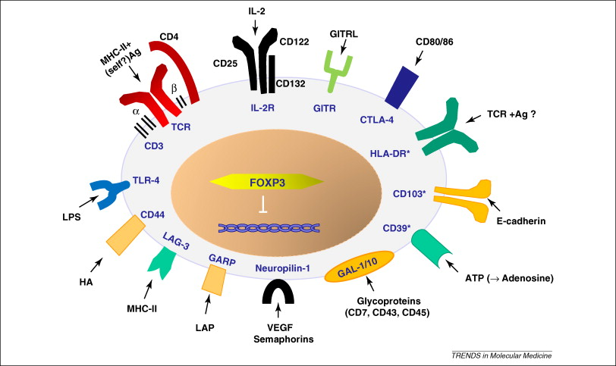
Ref: Trends Mol Med. 2010 Feb;16(2):58-68. doi: 10.1016/j.molmed.2009.12.003.
SNP associated | p-value | OR
rs2104286 | 2.16 × 10−7 | 1.19
rs12722489 | 2.96 × 10−8 | 1.25
rs3118470 | 2.00 × 10−09 | 1.12
rs7090512 | 4.60 × 10−20 | 1.21
decreased serum IL-2RA in both HC and MS
The soluble form of the receptor functions in inhibiting the pro-inflammatory role of IL-2 [IMSGC, 2007; IMSGC, 2011; Fugger, 2009].

Slide 24
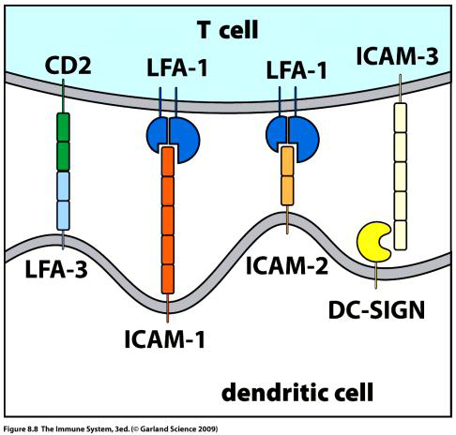

Enhance the expression of FoxP3 in Tregs by binding to CD2.
Patient express higher level of CD58 in remission phase [Andlauer , 2016 IMSGC, 2007; IMSGC, 2011; Hecker, 2015; Fugger, 2009; De Jager, 2009].
CD58
Ref: https://www.studyblue.com/notes/note/n/t-cell-activation-may-1/deck/2687823
rs2300747 AA was reported with lower CD58 expression in the relapsing phases of the disease [De Jager, 2009].
SNP associated | p-value | OR
rs12044852 | 9.71 × 10−4 | 1.48
rs1335532 | 2.00 × 10−9 | 1.18
rs2300747 | 1.1 × 10−6 | 0.82

Slide 25
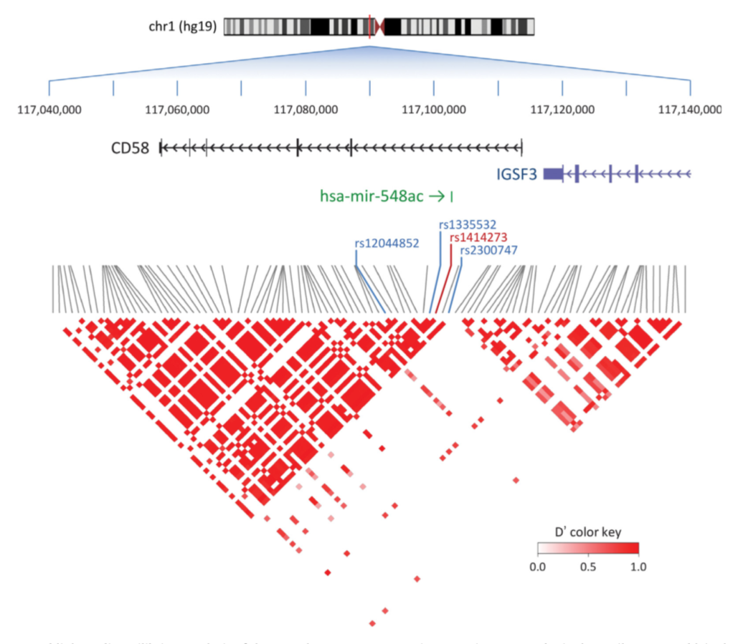
hsa-mir-548ac, present in the first intron of CD58 and function as a post-transcription regulator of gene expression [Hecker, 2015].
Ref: Hecker, 2015 doi:10.1016/j.mrrev.2014.10.002.

Slide 26
2. Treg cells !!

Slide 27
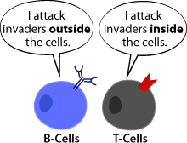
Activation of T- and B-cells:
Ref: https://askabiologist.asu.edu/b-cell

Slide 28
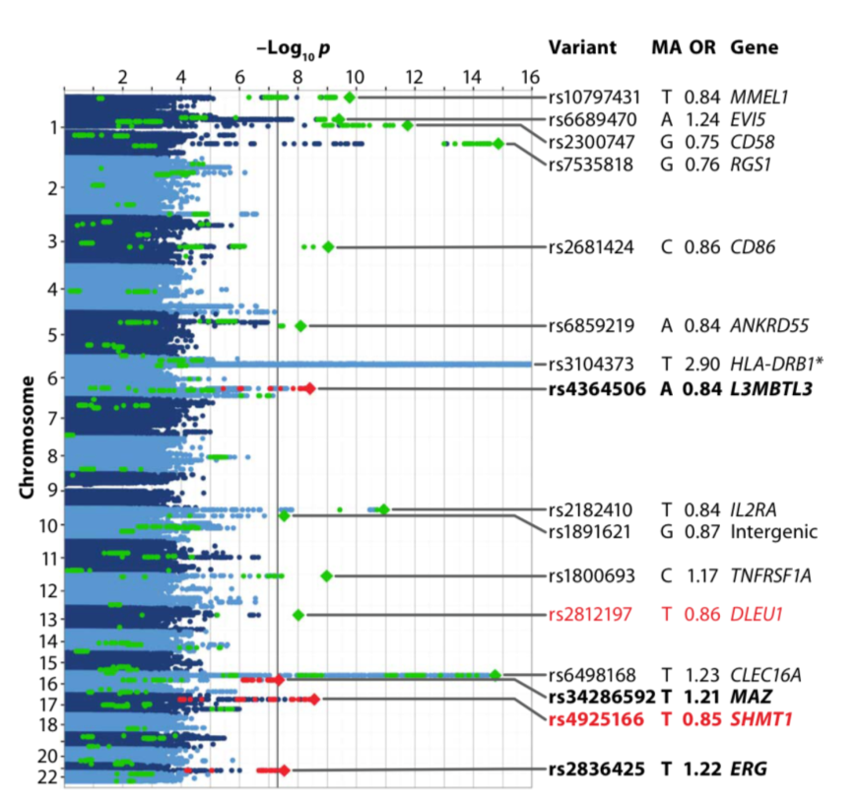
L3MBTL3 encodes a Polycomb group protein that regulates the transcriptional inhibition state of several genes
MAZ regulates cell cycle progression, apoptosis, and cellular transformation.
ERG encodes a member of the erythroblast transformation-specific (ETS) family of transcriptions factors.
SHMT1 plays a critical role in nucleotide and methionine synthesis [Andlauer, 2016].
Ref: Andlauer, 2016

Slide 29
MicroRNA | Function | Levels in MS | References
miR-20a and miR-17 | repress transcription of genes involved in T-cell activation in the Jurkat T-cell line | down-regulated | Reddycherla, 2015
hsa-miR-146a | regulator of T-cell activation | elevated | Koch, 2013
hsa-miR142-3p | immune modulator | elevated | Koch, 2013

Slide 30
3. Activation problem!!

Slide 31
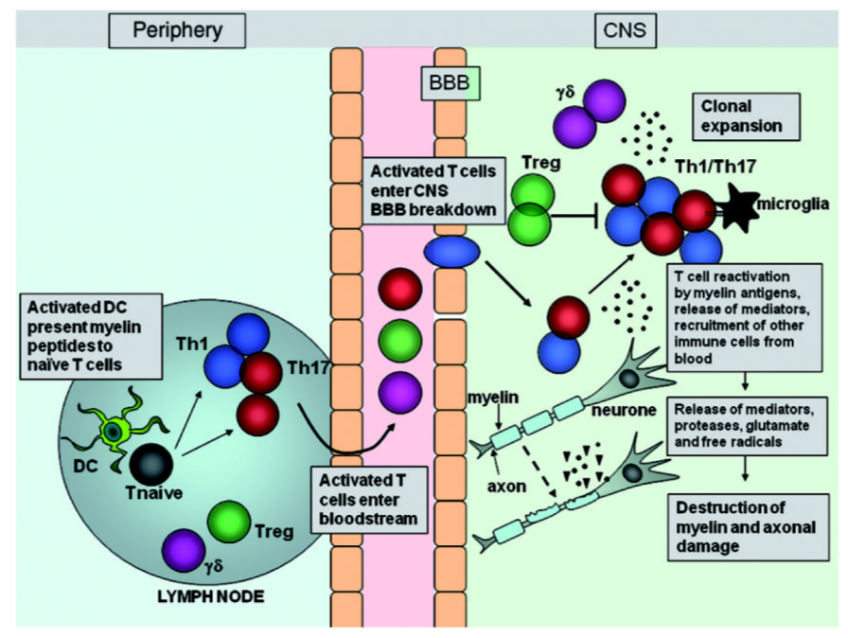
Migration into the CNS
Ref: Fletcher, 2010

Slide 32
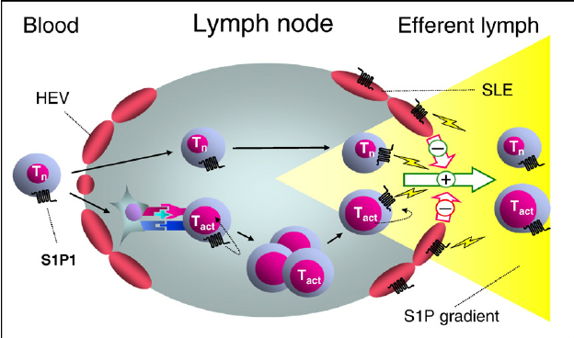
sphingosine 1 phosphate (S1P)
Ref: Brinkmann V. Pharmacol Ther. 2007 Jul;115(1):84-105;
Chun, 2010; Cavanillas, 2011.

Slide 33
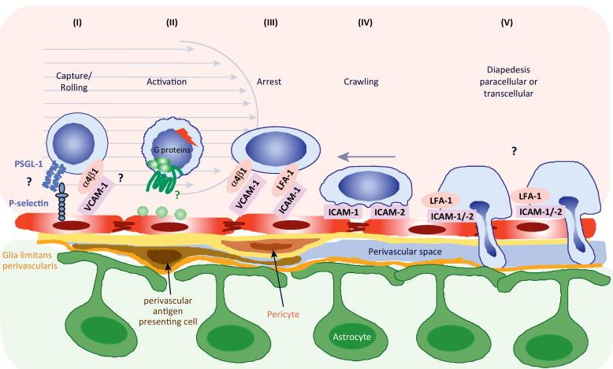

ICAM-1 and VCAM-1
ICAM1:
K469; p = 0.02
VCAM1:
rs11581062 p = 2.50 × 10⁻¹⁰
rs12048904 p=4.00 × 10⁻⁰⁸
Ref:DOI: http://dx.doi.org/10.1016/j.it.2012.07.004
Fletcher, 2010; Mycko, 1998; IMSGC, 2011

Slide 34
eNOS
Endothelial nitric oxide synthase (eNOS) is encoded by NOS3.
It functions as a vasodilator that modulates BBB permeability and CBF.
NOS3 was associated with MS in Kuwaiti population (eNOS-27VNTR; p = 0.002, OR= 2.6) [Alfadhli, 2013].

Slide 35
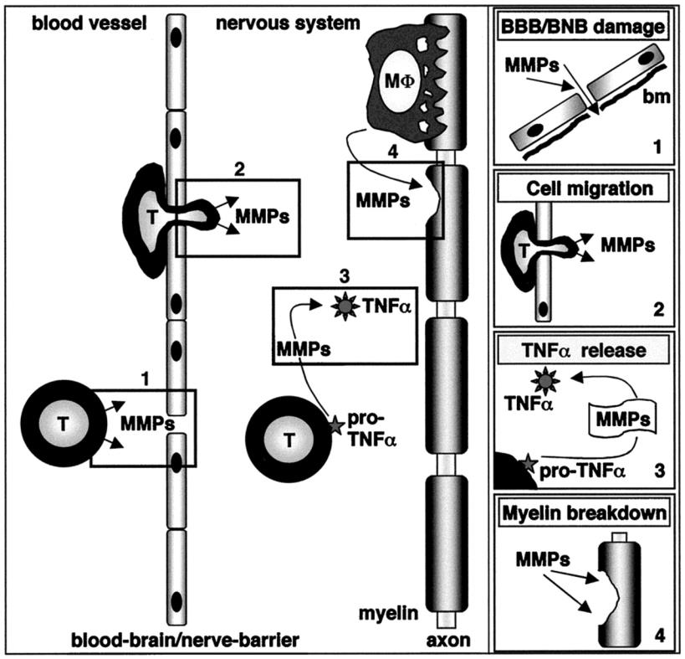
MMPs
MMP-2 and MMP-9 were associated with MS.
They first tunnel the brain endothelial tight junctions and then cleave the receptor transmembrane β-dystroglycan, which anchors astrocytes’ end feet to the basement membrane.
[Rempe, 2016; Benesová, 2008; Gašparović, 2015; Rahimi, 2016; Aksoy, 2016].
Ref: doi: http:/​/​dx.​doi.​org/​10.​1212/​WNL.​53.​1.​20.

Slide 36
4. Infiltration dilemma!!

Slide 37
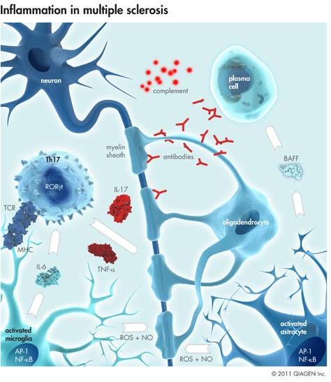

Slide 38
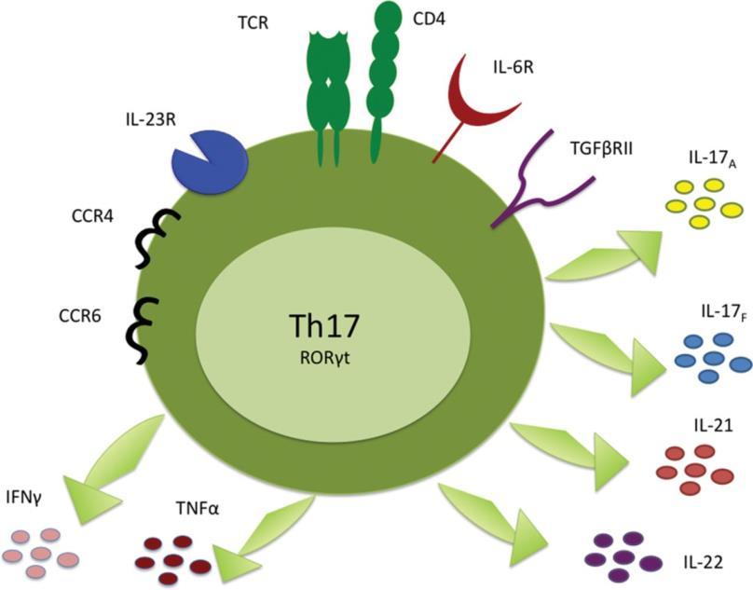
Th17 cells
IL-17:
induction of pro-inflammatory cytokines and chemokines
enhancing DC maturation and
promoting neutrophil functions
increases BBB permeability upon binding to IL-17R [Starnes, 2002Reza Dorosty-Motlagh, 2016].
vitamin D = suppress the production of IL-17A by recruiting histone deacetylase, which results in decreased disease severity [Aslani, 2016].
Ref: DOI: 10.1042/CS20100033

Slide 39
Th17 cells
IL-23:
C2370A in the 3'-UTR of the IL-23 gene has been associated with MS in the Hungarian population (p <0.05, OR=2.072)
[Illes, 2008; Fletcher, 2010].
TGFB1:
T+869C (Leu10Pro) have been associated with MS susceptibility, especially in men (p = 0.031, 0.004, respectively).
T+869C = raised serum TGF-β levels [Schrijver, 2004].
Ref: DOI: 10.1042/CS20100033

Slide 40
Th17 cells
Cigarette smoking
Significantly higher gene expressions of inflammatory cytokines [Khanna, 2013].
Smoking thought to cause hypermethylation of vital genes and induce imbalance in their expression [Burrell, 2011; Koch, 2013].
Smoking thought to affect histone acetylation and miRNA expression patterns [Aslani, 2016].
Ref: DOI: 10.1042/CS20100033

Slide 41
Th17 cells
Recruitment of Th17 cells to the CNS
A function of CCR6.
The expression of CCR6 in Th17 cells is mediated by TGF-β and two nuclear receptors: RORα and RORγ [Fletcher, 2010].
RORγ suppression
Mediated by PPAR-γ molecules [Boppana, 2011].
Association between Pro12Ala in PPARG and the delayed onset of MS (p = 0.006) [Klotz, 2009].
Ref: DOI: 10.1042/CS20100033

Slide 42
Th17 cells
Epigenetics:
hsa-miR-326 and hsa-miR-155 =induce Th17 differentiation ... up-regulated in RRMS cases [Koch, 2013].
miR-20b, = negatively regulates Th17 differentiation by targeting RORγt and STAT3.. down-regulated in MS patients and correlated with EAE pathogenesis [Zhu, 2014].
Ref: DOI: 10.1042/CS20100033

Slide 43
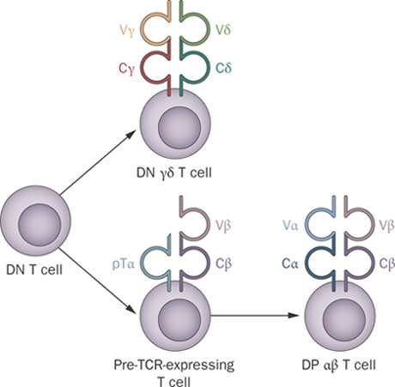
Gamma-Delta T cells (γδ T-cells)
TCR γ-chain expression is affected by signal transduction of (IL7R) [Schlissel, 2000].
IL7R (rs6897932; p = 2.94x10⁻⁷, OR = 1.18) [IMSGC, 2007].
This SNP affects the slicing region of exon 6 of the IL7R, resulting in increased genetic expression of soluble IL7R [Fugger, 2009].
Ref: doi:10.1038/nrclinonc.2009.169

Slide 44
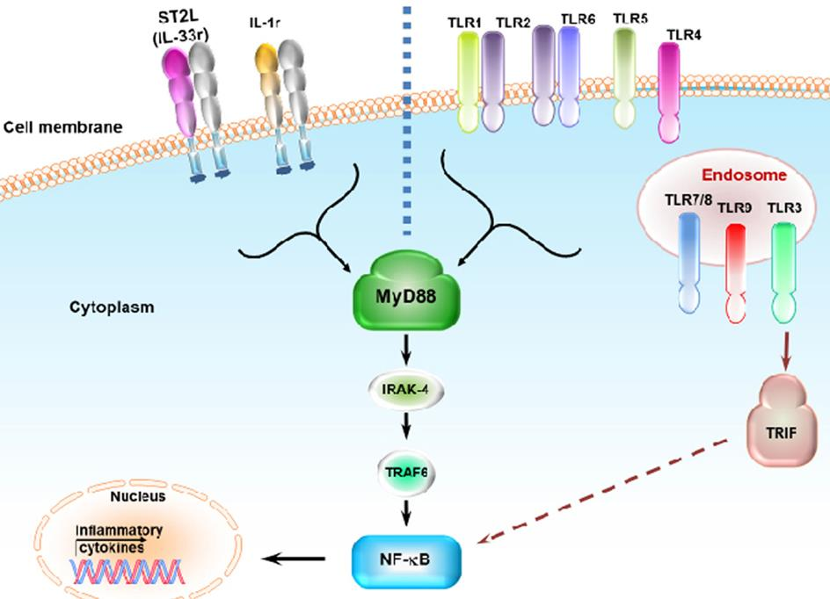
IL-17 produced by γδ T-cells promotes further IL-17 production by CD4⁺ T cells mediates neurotoxicity [Fletcher, 2010].
Ligands specific for microglia TLR-2, TLR-4, TLR-7, or TLR-9, can stimulate MyD88
This in turn can induce production of IL-1β and IL-23
That, in turn, induce γδ T-cell IL-17 secretion [Derkow, 2015].
Gamma-Delta T cells (γδ T-cells)
Ref: http://dx.doi.org/10.3389/fimmu.2015.00014

Slide 45
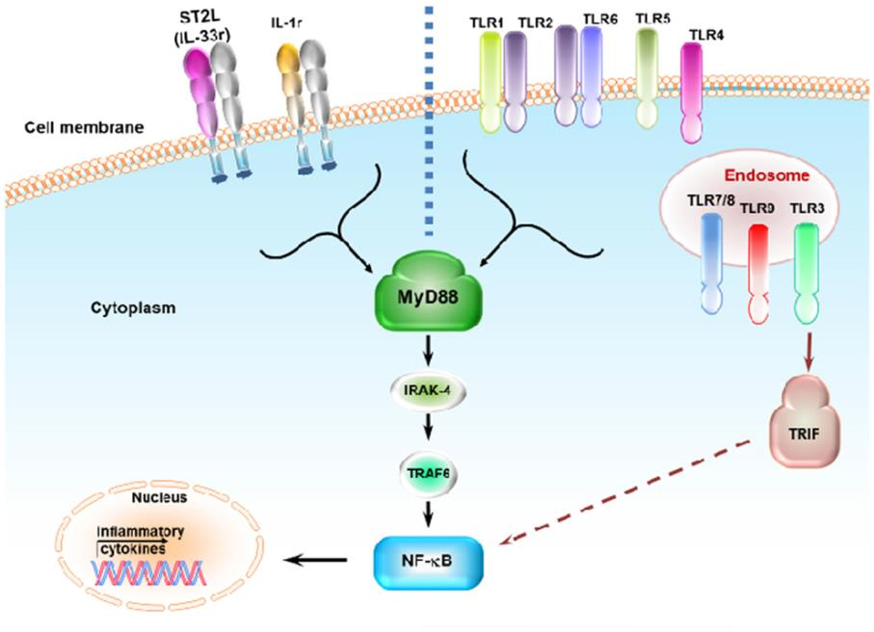
TLRs are down-regulated by LL-37, a member of the cathelicidin family.
LL-37 is a vitamin D-dependent immunomodulator [Grant, 2008].
Gamma-Delta T cells (γδ T-cells)
Ref: http://dx.doi.org/10.3389/fimmu.2015.00014

Slide 46
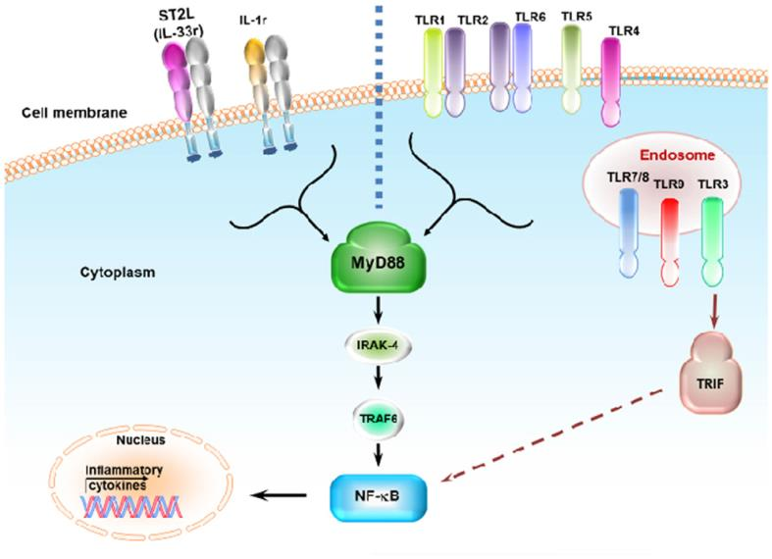
Gamma-Delta T cells (γδ T-cells)
Vitamin D supplementation in EAE:
MyD88 gene suppression
profound decrease in the expression of several TLRs.
reduced IL-1β.
effective reduction in inflammatory cytokine expression in the spinal cord
EAE recovery [Li, 2013].
Ref: http://dx.doi.org/10.3389/fimmu.2015.00014

Slide 47
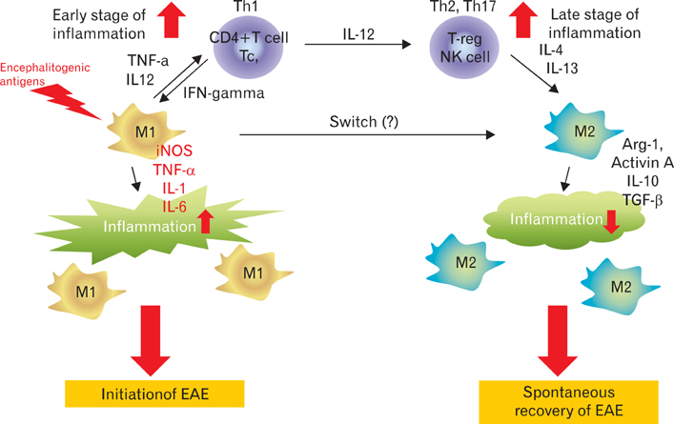
Macrophages
Ref: http://dx.doi.org/10.5115/acb.2012.45.3.141

Slide 48
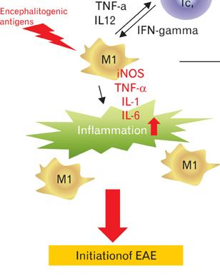
Macrophages
Obese people have decreased serum levels of adiponectin
Adipokine (ADPKO)-knockout EAE had greater levels of TNF-α, INF-γ, and IL-6, and had higher inflammation, demyelination, and axonal injury rates
Indicating a possible inhibitory role for adipokine on the induction of these particular cytokines[Piccio, 2013].
Ref: http://dx.doi.org/10.5115/acb.2012.45.3.141

Slide 49
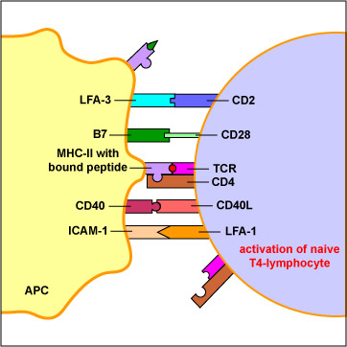
Macrophages
CD40, rs6074022 C, has been shown to enhance CD40 translation, and is associated with MS susceptibility [Rawji, 2013; Boppana, 2011; AZNgene, 2011; Sokolova1, 2013]
Ref: http://www.impe-qn.org.vn/impe-qn/vn/portal/InfoDetail.jsp?area=58&cat=1101&ID=5650

Slide 50
Macrophages
CD58, which strengthens the adhesion between macrophages and T-cells through binding CD2, has been associated with MS (p = 2x10⁻⁹, OR > 1.18) [IMSGC, 2007; IMSGC, 2011].
CD58
Ref: http://www.impe-qn.org.vn/impe-qn/vn/portal/InfoDetail.jsp?area=58&cat=1101&ID=5650

Slide 51
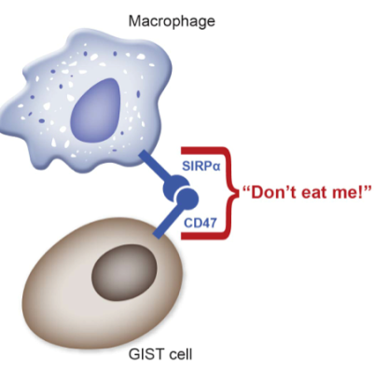
miR34a, miR155 and miR-326 are up-regulated in MS active lesion targets.
Such molecules target CD47, a known inhibitor of macrophage and DC cytokine synthesis.
Consequently, releases macrophages from their inhibitory status and enhances phagocytic activity towards myelin sheaths [van den Elsen, 2014; Brown, 2001; Aslani, 2016].
Ref: https://liferaftgroup.org/2013/10/immunotherapeutic-approaches-cancer/

Slide 52
5. Hypersensitivity of Inflammatory cells!!

Slide 53
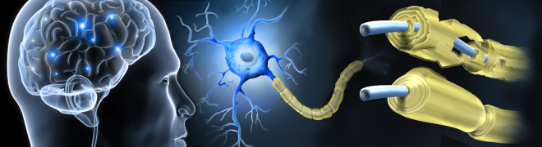
Neurodegeneration
Ref: https://primaryeyecare.net/services/multiple-sclerosis/

Slide 54
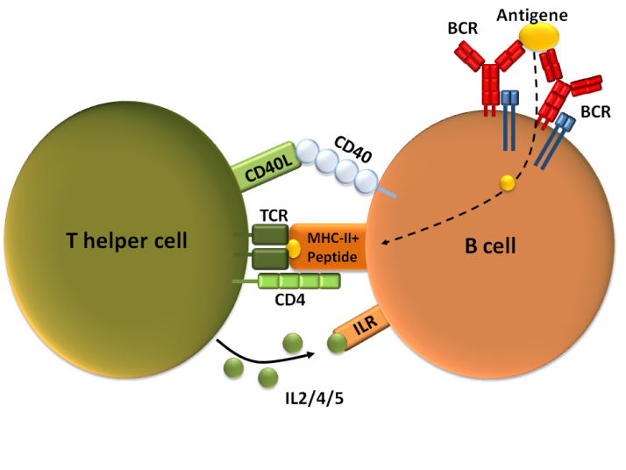
B cells
Activation of naive B-cells:
antigen-specific Ig receptors on B-cells,
CD4⁺ T-cell antigen presentation mediated by CD40-CD40L.
Polymorphisms in the CD40 gene may enhance CD40 translation, thereby enhancing activation of those cells [AZNgene, 2011].
More so, Owens et al. found a significant over-representation of the H and L chains of Ig receptors on B-cells of MS patients. Effectively, this may increase the possibility of Ig recombination and antigen identification [Owens, 2003].
Ref: https://en.m.wikipedia.org/wiki/CD154

Slide 55
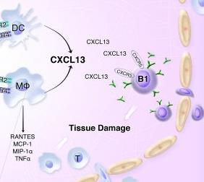
B cells
CSF from MS cases had significantly higher levels of CXCL13, and the levels correlated with B-cell number and increased disease activity [Boppana, 2011].
Additionally, associations were identified between rs630923, located in the CXCR5 locus, and MS (p = 2.80 × 10−07, OR = 1.13) [IMSGC, 2011, IMSGC, 2013].
Ref: http://dx.doi.org/10.1172/JCI42213

Slide 56
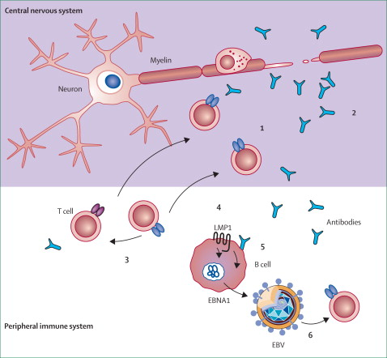
Activation of B cells
Infected cells can secrete BAFF which induces B-cell survival and differentiation.
Also produce large numbers of small RNAs called EBERs that induce apoptotic resistance in B-cells.
Ref: http://dx.doi.org/10.1016/S1474-4422(06)70577-4

Slide 57
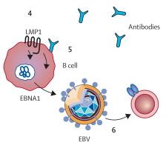
The pentapeptide sequence of the EBV nuclear antigen is homologous to the MBP epitope.
Also, the α-B crystalline surface antigen of EBV is similar to that of an abnormal auto-antigen expressed in the MS brain [Milo, 2010; Zuvicha, 2009; Oksenberg, 2008; van Noort, 2006].
Two SNPs in the gene encoding α-B crystalline (CRYAB–249*G and CRYAB– 652*A) were associated with more inflammatory responses on MRI, MS early age of onset and slower disease progression [van Noort, 2006; van Veen 2003; Stoevring 2007].
Ref: http://dx.doi.org/10.1016/S1474-4422(06)70577-4

Slide 58
Hypomethylation in PAD2 gene promoter was illustrated in MS white matters.
This results in increased citrullination of MBP and myelin instability in MS, and may induce production of anti-MBP in CNS [van den Elsen, 2014].
In Kuwait and the United Arab Emirates (UAE), significant number of patients infected with EBV were found within the MS populations [Al-Salam, 2011; Al-Temaimi, 2015].

Slide 59
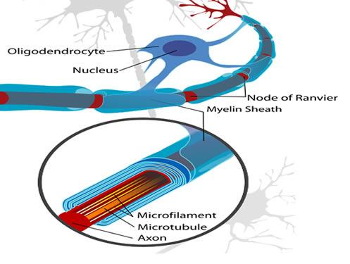
Oligodendrocytes
Demyelination:
MOG- derived T-cell activation [Lalive, 2014]
Ref:http://neurosciencenews.com/how-early-social-deprivation-impairs-long-term-cognitive-function-oligodendrocytes-myelin/

Slide 60
Oligodendrocytes
Remyelination:
stress proteins; Hsp65 or α-B crystallin
insufficient GF (up-regulated miR-155, miR-338 and miR-491 expression which suppress essential neurosteroid production [Noorbakhsh, 2011; Aslani, 2016].
Ref:http://neurosciencenews.com/how-early-social-deprivation-impairs-long-term-cognitive-function-oligodendrocytes-myelin/

Slide 61
Oligodendrocytes
Remyelination:
GF receptor ALK (rs7577363; p =1.14x10⁻⁴, OR = 2.1) [Gouzi, 2005; IMSGC, 2007].
Ref:http://neurosciencenews.com/how-early-social-deprivation-impairs-long-term-cognitive-function-oligodendrocytes-myelin/

Slide 62
Oligodendrocytes
Remyelination:
high levels of histone acetylation (increased levels of transcriptional inhibitors of oligodendrocytes differentiation example:TCF7L2)[Burrell, 2011; van den Elsen, 2014; Aslani, 2016], Lucchinetti, 1996]
Ref:http://neurosciencenews.com/how-early-social-deprivation-impairs-long-term-cognitive-function-oligodendrocytes-myelin/

Slide 63
6. CNS is prone for destruction!!

Slide 64
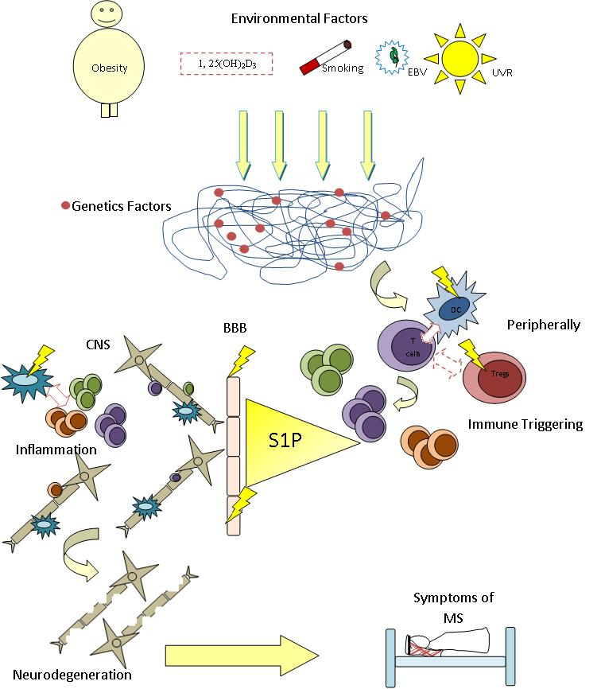
Conclusion
MS is definitely a complex disease.
One must consider molecular, environmental and immunological variables to elucidate the pathogenesis of such a disease.
In AGCs, obesity, vitamin D deficiency and smoking are shockingly popular, providing insight into the rise in the number of MS cases in these countries [Mohammed, 2016].
More studies must be done on the genetics of MS in AGCs.

Slide 65
Thank you

Slide 66
References
Mohammed, EMA. (2016) Multiple sclerosis is prominent in the Gulf states: Review. Pathogenesis. 3(2): 19–38. doi:10.1016/j.pathog.2016.04.001.
Fletcher JM, Lalor SJ, Sweeney CM, Tubridy N, Mills KH. (2010) T cells in multiple sclerosis and experimental autoimmune encephalomyelitis. Clin Exp Immunol. 162(1):1-11. doi:10.1111/j.1365-2249.2010.04143.x.
Boppana S, Huang H, Ito K, Dhib-Jalbut S. (2011) Immunologic aspects of multiple sclerosis. Mt Sinai J Med. 78(2):207-20. doi: 10.1002/msj.20249.
Serafini B, Rosicarelli B, Magliozzi R, Stigliano E, Capello E, et al. (2006) Dendritic cells in multiple sclerosis lesions: maturation stage, myelin uptake, and interaction with proliferating T cells. J Neuropathol Exp Neurol. 65(2):124-41. http://dx.doi.org/10.1097/65.2.124.
Andlauer TF, Buck D, Antony G, Bayas A, Bechmann L, Berthele A, et al. (2016) Novel multiple sclerosis susceptibility loci implicated in epigenetic regulation. Sci Adv.;2(6):e1501678. doi: 10.1126/sciadv.1501678. eCollection 2016.
International Multiple Sclerosis Genetics Consortium (IMSGC), Hafler DA, Compston A, Sawcer S, Lander ES, Daly MJ, et al. (2007) Risk alleles for multiple sclerosis identified by a genomewide study. N Engl J Med. 357(9):851-62. http://www.ncbi.nlm.nih.gov/pubmed/17660530.
Field J, Browning SR, Johnson LJ, Danoy P, Varney MD, et al. (2010) A polymorphism in the HLA-DPB1 gene is associated with susceptibility to multiple sclerosis. PLoS ONE; 5:e13454.
Brynedal B, Duvefelt K, Jonasdottir G, Roos IM, Akesson E, et al. (2007) HLA-A confers an HLA-DRB1 independent influence on the risk of multiple sclerosis. PLoS ONE; 2:e664.
Yeo TW, De Jäger PL, Gregory SG, Gregory SG, Barcellos LF, et al. (2007) A second major histocompatibility complex susceptibility locus for multiple sclerosis. Ann Neurol;61:228–236.
Haines L, Ter-Minassian M, Bazyk A, Gusella JF, Kim DJ, et al. (1996) The multiple sclerosis genetics group. A complete genomic screen for multiple sclerosis underscores a role for the major histocompatability complex. Nat Genet 13:469–471.
Fugger L, Friese MA, Bell JI. (2009) From genes to function: the next challenge to understanding multiple sclerosis. Nat Rev Immunol. 9(6):408-417. doi: 10.1038/nri2554.
Al-Shammri S, Nelson RF, Al-Muzairi I, Akanji AO. (2004) HLA determinants of susceptibility to multiple sclerosis in an Arabian Gulf population. Mult Scler. 10(4):381-386. http://www.ncbi.nlm.nih.gov/pubmed/15327033.
Graves M, Benton M, Lea RA, Boyle M, Tajouri L, et al. (2014). Methylation differences at the HLA-DRB1 locus in CD4? T-Cells are associated with multiple sclerosis. Multiple Sclerosis Journal; 20(8): 1033–1041.
Aslani S, Jafari N, Javan MR, Karami J, Ahmadi M, et al. (2016) Epigenetic Modifications and Therapy in Multiple Sclerosis. Neuromolecular Med. 2016 Jul 6. [Epub ahead of print]. http://www.ncbi.nlm.nih.gov/pubmed/27382982.
International Multiple Sclerosis Genetics Consortium (IMSGC), Wellcome Trust Case Control Consortium 2, Sawcer S, Hellenthal G, Pirinen M, et al. (2011) Genetic risk and a primary role for cell-mediated immune mechanisms in multiple sclerosis. Nature. 476(7359):214–219. http://www.nature.com/nature/journal/v476/n7359/full/nature10251.html.
van Luijn MM, Kreft KL, Jongsma ML, Mes SW, Wierenga-Wolf AF, et al. (2015) Multiple sclerosis-associated CLEC16A controls HLA class II expression via late endosome biogenesis. Brain. 138(Pt 6):1531-47. doi: 10.1093/brain/awv080.
Hedström AK, Sundqvist E, Bäärnhielm M, Nordin N, Hillert J, et al. (2011) Smoking and two human leukocyte antigen genes interact to increase the risk for multiple sclerosis. Brain. 134(3):653–664.
Khanna A, Guo M, Mehra M, Royal W^{3rd}. (2013) Inflammation and oxidative stress induced by cigarette smoke in Lewis rat brains. J Neuroimmunol. 254(1–2):69–75. DOI: http://dx.doi.org/10.1016/j.jneuroim.2012.09.006.
Aden B, Karrar S, Shafey O, Al Hosni F. (2013) Cigarette, water-pipe, and medwakh smoking prevalence among applicants to Abu Dhabi’s pre-marital screening program, 2011. Int J Prev Med. 4(11):1290–5.
Waheedi M, Al-Tmimy AM, Enlund H. (2011) Preparedness for the smoking cessation role among health sciences students in Kuwait. Med Princ Pract. 20(3):237–43. DOI:10.1159/000321273.
Almutairi KM. (2014) Smoking among Saudi students: a review of risk factors and early intentions of smoking. J Community Health 39(5):901–7.
Pierrot-Deseilligny C, Souberbielle JC. (2013) Contribution of vitamin D insufficiency to the pathogenesis of multiple sclerosis. Ther Adv Neurol Disord; 6(2):81–116.
Mahon B, Gordon S, Cruz J, Cosman F, Cantorna M. (2003) Cytokine profile in patients with multiple sclerosis following vitamin D supplementation. J Neuroimmunol. 134:128–132.
Correale J, Ysrraelit M, Gaitan M. (2009) Immunomodulatory aspects of vitamin D in multiple sclerosis. Brain;132:1146–1160.
Kickler K, Ni Choileain S, Williams A, Richards A, Astier A. (2012) Calcitriol modulates the CD46 pathway in T cells. PLoS ONE. 7: e48486.
Agliardi C, Guerini FR, Saresella M, Caputo D, Leone MA, et al. (2011) Vitamin D receptor (VDR) gene SNPs influence VDR expression and modulate protection from multiple sclerosis in HLA-DRB1*15-positive individuals. Brain Behav Immun. 25(7):1460–1467.
Ramagopalan SV, Maugeri NJ, Handunnetthi L, Lincoln MR, Orton SM, et al. (2009) Expression of the multiple sclerosis-associated MHC class II Allele HLA-DRB1*1501 is regulated by vitamin D. PLoS Genet. 5(2) e1000369.
Ramagopalan SV, Heger A, Berlanga AJ, Maugeri NJ, Lincoln MR, Burrell A, et al.(2010) A ChIP-seq defined genome-wide map of vitamin D receptor binding: associations with disease and evolution. Genome Res;20(10):1352–1360.
Handel AE, Ramagopalan SV. (2012) Vitamin D and multiple sclerosis: an interaction between genes and environment. Mult Scler. 18(1): 2–4.
Grant WB. (2008) Hypothesis – ultraviolet-B irradiance and vitamin D reduce the risk of viral infections and thus their sequelae, including autoimmune diseases and some cancers. Photochem Photobiol; 84(2):356–365.
Reza Dorosty-Motlagh A, Mohammadzadeh Honarvar N, Sedighiyan M, Abdolahi M. (2016) The Molecular Mechanisms of Vitamin A Deficiency in Multiple Sclerosis. J Mol Neurosci. [Epub ahead of print].
Abbas AK, Lichtman AH, Pillai S. (2012) Cellular and Molecular Immunology. Seven Edition. Saunders. Elsevier. ISBN: 978-1-4377-1528-6.
Chaudhry A, Samstein RM, Treuting P, Liang Y, Pils MC, Heinrich JM, Jack RS, Wunderlich FT, Brüning JC, Müller W, Rudensky AY. (2011) Interleukin-10 signaling in regulatory T cells is required for suppression of Th17 cell-mediated inflammation. Immunity.;34(4):566-78. doi: 10.1016/j.immuni.2011.03.018.
Viglietta V, Baecher-Allan C, Weiner HL, Hafler DA. (2004) Loss of functional suppression by CD4+CD25+ regulatory T cells in patients with multiple sclerosis. J Exp Med. 199(7):971-9.
Schwarz A, Schumacher M, Pfaff D, Schumacher K, Jarius S, et al. (2013) Fine-tuning of regulatory T cell function: the role of calcium signals and naive regulatory T cells for regulatory T cell deficiency in multiple sclerosis.J Immunol. 190(10):4965-70. doi: 10.4049/jimmunol.1203224.
van den Elsen PJ, van Eggermond MC, Puentes F, van der Valk P, Baker D, Amor S. (2014) The epigenetics of multiple sclerosis and other related disorders. Mult Scler Relat Disord. (2):163-75. doi: 10.1016/j.msard.2013.08.007.
Ma X, Zhou J, Zhong Y, Jiang L, Mu P, et al. (2014) Expression, regulation and function of microRNAs in multiple sclerosis. Int J Med Sci. 11(8):810-8. doi:10.7150/ijms.8647.eCollection2014.
Herberth G, Bauer M, Gasch M, Hinz D, Röder S, et al; Lifestyle and Environmental Factors and Their Influence on Newborns Allergy Risk study group. (2014) Maternal and cord blood miR-223 expression associates with prenatal tobacco smoke exposure and low regulatory T-cell numbers. J Allergy Clin Immunol. 133(2):543-50. doi: 10.1016/j.jaci.2013.06.036.
Hart PH, Gorman S. (2013) Exposure to UV wavelengths in sunlight suppresses immunity. To what extent is UV-induced vitamin D3 the mediator responsible? Clin Biochem Rev; 34(1):3–13.

Slide 67
Correale J, Farez MF (2013) Modulation of multiple sclerosis by sunlight exposure: role of cis-urocanic acid. J Neuroimmunol; 261(1–2): 134–140.
Hecker M, Fitzner B, Blaschke J, Blaschke P, Zettl UK. (2015) Susceptibility variants in the CD58 gene locus point to a role of microRNA-548ac in the pathogenesis of multiple sclerosis. Mutat Res Rev Mutat Res.;763:161-7. doi: 10.1016/j.mrrev.2014.10.002.
De Jager PL, Baecher-Allan C, Maier LM, Arthur AT, Ottoboni L, Barcellos L. (2009) The role of the CD58 locus in multiple sclerosis.Proc Natl Acad Sci U S A.;106(13):5264-9. doi: 10.1073/pnas.0813310106.
Reddycherla AV, Meinert I, Reinhold A, Reinhold D, Schraven B, et al. (2015) miR-20a inhibits TCR-mediated signaling and cytokine production in human naïve CD4+ T cells. PLoS One. Doi:10(4):e0125311. doi: 10.1371/journal.pone.0125311. eCollection 2015.
Koch MW, Metz LM, Kovalchuk O. (2013) Epigenetics and miRNAs in the diagnosis and treatment of multiple sclerosis. Trends Mol Med. 19(1):23-30. doi: 10.1016/j.molmed.2012.10.008.
Keller A, Leidinger P, Lange J, Borries A, Schroers H, et al. (2009) Multiple sclerosis: microRNA expression profiles accurately differentiate patients with relapsing-remitting disease from healthy controls. PLoS One. 4(10):e7440. doi: 10.1371/journal.pone.0007440.
Götte M, Mohr C, Koo CY, Stock C, Vaske AK, et al. (2010) miR-145-dependent targeting of junctional adhesion molecule A and modulation of fascin expression are associated with reduced breast cancer cell motility and invasiveness. Oncogene. 29(50):6569-80. doi: 10.1038/onc.2010.386.
Chun J, Hartung HP. (2010) Mechanism of action of oral fingolimod (FTY720) in multiple sclerosis. Clin Neuropharmacol; 33(2):91–101.
Cavanillas ML, Fernández O, Comabella M, Alcina A, Fedetz M, et al. (2011) Replication of top markers of a genome-wide association study in multiple sclerosis in Spain. Genes Immun. 12: 110–115.
Leussink VI, Zettl UK, Jander S, Pepinsky RB, Lobb RR, et al. (2002) Blockade of signaling via the very late antigen (VLA-4) and its counterligand vascular cell adhesion molecule-1 (VCAM-1) causes increased T cell apoptosis in experimental autoimmune neuritis. Acta Neuropathol.;103(2):131-6.
Mycko MP, Kwinkowski M, Tronczynska E, Szymanska B, Selmaj KW. (1998) Multiple sclerosis: the increased frequency of the ICAM-1 exon 6 gene point mutation genetic type K469. Ann Neurol. 44: 70–75.
Alfadhli S, Mohammed EM, Alshubaili A. (2013) Association analysis of nitric oxide synthases: NOS1, NOS2A and NOS3 genes, with multiple sclerosis. Ann Hum Biol; 4:368–375.
Rempe RG, Hartz AM, Bauer B. (2016) Matrix metalloproteinases in the brain and blood-brain barrier: versatile breakers and makers. J Cereb Blood Flow Metab. pii: 0271678X16655551. [Epub ahead of print]
Benesová Y, Vasků A, Stourac P, Hladíková M, Beránek M, et al. (2008) Matrix metalloproteinase-9 and matrix metalloproteinase-2 gene polymorphisms in multiple sclerosis. J Neuroimmunol. 205(1-2):105-9. doi: 10.1016/j.jneuroim.2008.08.007.
Gašparović I, Čizmarević NS, Lovrečić L, Perković O, Lavtar P, et al. (2015) MMP-2 -1575G/A polymorphism modifies the onset of optic neuritis as a first presenting symptom in MS? J Neuroimmunol. 286:13-5. doi: 10.1016/j.jneuroim.2015.06.014.
Rahimi Z, Abdan Z, Rahimi Z, Razazian N, Shiri H, Vaisi-Raygani A, Shakiba E, Vessal M, Moradi MT. (2016) Functional Promoter Polymorphisms of MMP-2 C-735T and MMP-9 C-1562T and Their Synergism with MMP-7 A-181G in Multiple Sclerosis. Immunol Invest.:1-10. [Epub ahead of print]
Aksoy D, Ateş Ö, Kurt S, Çevik B, Sümbül O. (2016) Analysis of MMP2-1306C/T and TIMP2G-418C polymorphisms with relapsing remitting multiple sclerosis. J Investig Med. pii: jim-2016-000111. [Epub ahead of print]
Starnes T, Broxmeyer HE, Robertson MJ, Hromas R (2002). Cutting edge: IL-17D, a novel member of the IL-17 family, stimulates cytokine production and inhibits hemopoiesis. Journal of Immunology. 169 (2): 642–6. doi:10.4049/jimmunol.169.2.642.
Oliveira SR, Simão AN, Kallaur AP, de Almeida ER, Morimoto HK, et al. (2014) Disability in patients with multiple sclerosis: influence of insulin resistance, adiposity, and oxidative stress. Nutrition. 30(3):268-73. doi: 10.1016/j.nut.2013.08.001.
Martínez A, Rubio A, Urcelay E, Fernández-Arquero M, De Las Heras V, et al. (2004) TNF-376A marks susceptibility to MS in the Spanish population: a replication study. Neurology. 62:809–810.
Heggarty S, Sawcer S, Hawkins S, McDonnell G, Droogan A, Vandenbroeck K, et al. (2003) A genome wide scan for association with multiple sclerosis in a N. Irish case control population. J Neuroimmunol. 143:93–96.
Illes Z, Safrany E, Peterfalvi A, Magyari L, Farago B, Pozsonyi E, Rozsa C, Komoly S, Melegh B. (2008) 3'UTR C2370A allele of the IL-23 receptor gene is associated with relapsing-remitting multiple sclerosis. Neurosci Lett.;431(1):36-8. doi: 10.1016/j.neulet.2007.11.015.
Schrijver HM, Crusius JB, García-González MA, Polman CH, Peña AS, Barkhof F, Uitdehaag BM. (2004) Gender-related association between the TGFB1+869 polymorphism and multiple sclerosis. J Interferon Cytokine Res.;24(9):536-42.
Burrell AM, Handel AE, Ramagopalan SV, Ebers GC, Morahan JM. (2011) Epigenetic mechanisms in multiple sclerosis and the major histocompatibility complex (MHC). Discov Med. 11:187–196.
Reboldi A, Coisne C, Baumjohann D, Benvenuto F, Bottinelli D, Lira S, Uccelli A, Lanzavecchia A, Engelhardt B, Sallusto F. (2009) C-C chemokine receptor 6-regulated entry of TH-17 cells into the CNS through the choroid plexus is required for the initiation of EAE. Nat Immunol.;10(5):514-23. doi: 10.1038/ni.1716.
Yamazaki T, Yang XO, Chung Y, Fukunaga A, Nurieva R, et al. (2008) CCR6 regulates the migration of inflammatory and regulatory T cells. J Immunol. 181(12):8391-401.
Szalardy L, Zadori D, Tanczos E, Simu M, Bencsik K, et al. (2013) Elevated levels of PPAR-gamma in the cerebrospinal fluid of patients with multiple sclerosis. Neurosci Lett. 554:131-4. doi: 10.1016/j.neulet.2013.08.069.
Klotz L, Schmidt S, Heun R, Klockgether T, Kölsch H. (2009) Association of the PPARgamma gene polymorphism Pro12Ala with delayed onset of multiple sclerosis. Neurosci Lett. 449(1):81-3. doi: 10.1016/j.neulet.2008.10.066.
Zhu E, Wang X, Zheng B, Wang Q, Hao J, et al. (2014) miR-20b suppresses Th17 differentiation and the pathogenesis of experimental autoimmune encephalomyelitis by targeting RORγt and STAT3. J Immunol. 192(12):5599-609. doi: 10.4049/jimmunol.1303488. Epub 2014 May 19.
Guerau-de-Arellano M, Smith KM, Godlewski J, Liu Y, Winger R, et al. (2011). Micro-RNA dysregu- lation in multiple sclerosis favours pro-inflammatory T-cell- mediated autoimmunity. Brain. 134(12): 3578–3589.
Soleimani M, Jameie SB, Mehdizadeh M, Keradi M, Masoumipoor M, et al. (2014) Vitamin D3 influence the Th1/Th2 ratio in C57BL/6 induced model of experimental autoimmune encephalomyelitis. Iran J Basic Med Sci. 17(10):785-92.
Planas R, Metz I, Ortiz Y, Vilarrasa N, Jelčić I, et al. (2015) Central role of Th2/Tc2 lymphocytes in pattern II multiple sclerosis lesions. Ann Clin Transl Neurol. 2(9):875-93. doi: 10.1002/acn3.218.
Schlissel MS, Durum SD, Muegge K. (2000) The interleukin 7 receptor is required for T cell receptor gamma locus accessibility to the V(D)J recombinase. J Exp Med. 191(6):1045-50.
Derkow K, Krüger C, Dembny P, Lehnardt S. (2015) Microglia Induce Neurotoxic IL-17+ γδ T Cells Dependent on TLR2, TLR4, and TLR9 Activation. PLoS One. 10(8):e0135898. doi: 10.1371/journal.pone.0135898. eCollection 2015.
Luz A, Fainstein N, Einstein O, Ben-Hur T. (2015) The role of CNS TLR2 activation in mediating innate versus adaptive neuroinflammation. Exp Neurol. 273:234-42. doi: 10.1016/j.expneurol.2015.08.021.
Li B, Baylink DJ, Deb C, Zannetti C, Rajaallah F, et al. (2013) 1,25-Dihydroxyvitamin D3 suppresses TLR8 expression and TLR8-mediated inflammatory responses in monocytes in vitro and experimental autoimmune encephalomyelitis in vivo. PLoS One. 8(3):e58808. doi: 10.1371/journal.pone.0058808.
Hedström AK, Lima Bomfim I, Barcellos L, Gianfrancesco M, Schaefer C, Kockum I, et al. (2014a) Interaction between adolescent obesity and HLA risk genes in the etiology of multiple sclerosis. Neurology; 82(10):865–872.
Hedström AK, Ryner M, Fink K, Fogdell-Hahn A, Alfredsson L, Olsson T, et al. (2014b) Smoking and risk of treatment-induced neutralizing antibodies to interferon β-1a. Mult Scler; 20(4):445–450.
Morrison BA, Ucisik-Akkaya E, Flores H, Alaez C, Gorodezky C, et al. (2010) Multiple sclerosis risk markers in HLA-DRA, HLA-C, and IFNG genes are associated with sex-specific childhood leukemia risk. Autoimmunity. 43(8):690-7. doi: 10.3109/08916930903567492.
Wang W, Erbe AK, Alderson KA, Phillips E, Gallenberger M, et al. (2016) Human NK cells maintain licensing status and are subject to killer immunoglobulin-like receptor (KIR) and KIR-ligand inhibition following ex vivo expansion. Cancer Immunol Immunother. [Epub ahead of print]

Slide 68
Littera R, Chessa L, Onali S, Figorilli F, Lai S, et al. (2016) Exploring the Role of Killer Cell Immunoglobulin-Like Receptors and Their HLA Class I Ligands in Autoimmune Hepatitis. PLoS One. 11(1):e0146086. doi: 10.1371/journal.pone.0146086. eCollection 2016.
Rajagopalan S, Long EO. (2005) Understanding how combinations of HLA and KIR genes influence disease. J Exp Med. 201(7):1025-9.
Rawji KS, Yong VW. (2013) The benefits and detriments of macrophages/microglia in models of multiple sclerosis. Clin Dev Immunol. 2013:948976. doi: 10.1155/2013/948976.
Australia and New Zealand Multiple Sclerosis Genetics Consortium (ANZgene). (2009) Genome-wide association study identifies new multiple sclerosis susceptibility loci on chromosomes 12 and 20. Nat Genet. 41(7):824-8. doi: 10.1038/ng.396.
Sokolova EA, Malkova NA, Korobko DS, Rozhdestvenskii AS, Kakulya AV, Khanokh EV, et al. (2013) Association of SNPs of CD40 gene with multiple sclerosis in Russians. PLoS One; 8(4):e61032. doi: 10.1371/journal.pone.0061032.
Alatab S, Maghbooli Z, Hossein-Nezhad A, Khosrofar M, Mokhtari F. (2011) Cytokine profile, Foxp3 and nuclear factor-kB ligand levels in multiple sclerosis subtypes. Minerva Med. 102(6):461-8.
Sharief MK, Hentges R. (1991) Association between tumor necrosis factor-alpha and disease progression in patients with multiple sclerosis. N Engl J Med. 325(7):467-72.
Kallaur AP, Oliveira SR, Simão AN, Alfieri DF, Flauzino T, et al. (2016) Cytokine Profile in Patients with Progressive Multiple Sclerosis and Its Association with Disease Progression and Disability. Mol Neurobiol. [Epub ahead of print]
Piccio L, Cantoni C, Henderson JG, Hawiger D, Ramsbottom M, et al. (2013) Lack of adiponectin leads to increased lymphocyte activation and increased disease severity in a mouse model of multiple sclerosis. Eur J Immunol. 43(8):2089–2100.
Smotkin-Tangorra M, Purushothaman R, Gupta A, Nejati G, Anhalt H, et al. (2007) Prevalence of vitamin D insufficiency in obese children and adolescents. J Pediatr Endocrinol Metab. 20(7):817–823.
Harel Z, Flanagan P, Forcier M, Harel D. (2011) Low vitamin D status among obese adolescents: prevalence and response to treatment. J Adolesc Health; 48(5):448–452.
Kumar J, Muntner P, Kaskel FJ, Hailpern SM, Melamed ML. (2009) Prevalence and associations of 25-hydroxyvitamin D deficiency in US children: NHANES 2001–2004. Pediatrics; 124(3): e362–70.
Chen C, Gault A, Shen L, Nabavi N (1994). Molecular cloning and expression of early T cell costimulatory molecule-1 and its characterization as B7-2 molecule. J. Immunol. 152(10): 4929–36.
Manna I, Liguori M, Valentino P, Condino F, La Russa A, et al. (2008) Preliminary evidences of a NOS2A protective effect from relapsing-remitting multiple sclerosis. J Neurol Sci. 264(1-2):112-7.
Warpeha KM, Xu W, Liu L, Charles IG, Patterson CC, et al. (1999) Genotyping and functional analysis of a polymorphic (CCTTT)(n) repeat of NOS2A in diabetic retinopathy. FASEB J. 13(13):1825-32.
Brown EJ, Frazier WA. (2001) Integrin-associated protein (CD47) and its ligands. Trends Cell Biol. 11(3):130-5.
Fischer MT, Sharma R, Lim JL, Haider L, Frischer JM, et al. (2012) NADPH oxidase expression in active multiple sclerosis lesions in relation to oxidative tissue damage and mitochondrial injury. Brain. 135(Pt 3):886-99. doi: 10.1093/brain/aws012.
Broadwater L, Pandit A, Clements R, Azzam S, Vadnal J, et al. (2011) Analysis of the mitochondrial proteome in multiple sclerosis cortex. Biochim Biophys Acta. 1812(5):630-41. doi: 10.1016/j.bbadis.2011.01.012.
Vyshkina T, Sylvester A, Sadiq S, Bonilla E, Canter JA, et al. (2008) Association of common mitochondrial DNA variants with multiple sclerosis and systemic lupus erythematosus. Clin Immunol. 129: 31–35.
Vogler S, Goedde R, Miterski B, Gold R, Kroner A, et al. (2005) Association of a common polymorphism in the promoter of UCP2 with susceptibility to multiple sclerosis. J Mol Med (Berl). 83(10):806-11.
Owens GP, Ritchie AM, Burgoon MP, Williamson RA, Corboy JR, et al. (2003) Single-cell repertoire analysis demonstrates that clonal expansion is a prominent feature of the B cell response in multiple sclerosis cerebrospinal fluid. J Immunol. 171(5):2725-33.
International Multiple Sclerosis Genetics Consortium (IMSGC), Lill CM, Schjeide BM, Graetz C, Ban M, et al. (2013) MANBA, CXCR5, SOX8, RPS6KB1 and ZBTB46 are genetic risk loci for multiple sclerosis. Brain. 136(Pt 6):1778-82. doi: 10.1093/brain/awt101.
Milo R, Kahana E. (2010) Multiple sclerosis: geoepidemiology, genetics and the environment. Nat Rev Neurol. 9(1):35–43.
Zuvicha R, McCauleyb J, Pericak-Vanceb M, Hainesa J. (2009) Genetics and pathogenesis of multiple sclerosis. Semin Immunol; 328–333.
Oksenberg J, Baranzini S, Sawcer S, Hauser S.(2008) The genetics of multiple sclerosis: SNPs to pathways to pathogenesis. Nature. 9:516–526.
van Noort JM, Verbeek R, Meilof JF, Polman CH, Amor S. (2006) Autoantibodies against alpha B-crystallin, a candidate autoantigen in multiple sclerosis, are part of a normal human immune repertoire. Mult Scler. 12(3):287-93.
Al-Salam S, Dhaheri SA, Awwad A, Daoud S, Shams A, et al. (2011) Prevalence of Epstein-Barr virus in tonsils and adenoids of United Arab Emirates nationals. Int J Pediatr Otorhinolaryngol. 75(9):1160–1166.
Al-Temaimi R, Alroughani R, Jacob S, Al-Mulla F. (2015) Gender influence in EBV antibody response in multiple sclerosis patients from Kuwait. J Neuroimmunol. 285:57–61.
van Veen T, van Winsen L, Crusius JB, Kalkers NF, Barkhof F, et al. (2003) [Alpha]B-crystallin genotype has impact on the multiple sclerosis phenotype. Neurology. 61(9):1245-9.
Stoevring B, Frederiksen JL, Christiansen M. (2007) CRYAB promoter polymorphisms: influence on multiple sclerosis susceptibility and clinical presentation. Clin Chim Acta. 375(1-2):57-62.
Michael-Titus A, Revest P, Shortland P. (2010) Systems of the Body. The Nervous System. Basic Science and Clinical Conditions. Second Edition. Churchill Livingstone. Elsevier. ISBN: 978-0-7020-3373-5.
Lucchinetti CF, Brück W, Rodriguez M, Lassmann H. (1996) Distinct patterns of multiple sclerosis pathology indicates heterogeneity on pathogenesis. Brain Pathol. 6(3):259–274.
Lalive PH, Benkhoucha M, Tran NL, Kreutzfeldt M, Merkler D, et al. (2014) TLR7 signaling exacerbates CNS autoimmunity through downregulation of Foxp3+ Treg cells.Eur J Immunol. 44(1):46-57. doi: 10.1002/eji.201242985.
Gouzi JY, Moog-Lutz C, Vigny M, Brunet-de Carvalho N. (2005) Role of the subcellular localization of ALK tyrosine kinase domain in neuronal differentiation of PC12 cells. J Cell Sci. 118(Pt 24):5811-23.
Bernardinelli L, Murgia SB, Bitti PP, Foco L, Ferrai R, et al. (2007) Association between the ACCN1 gene and multiple sclerosis in Central East Sardinia. PLoS ONE. 2:e480.
Noorbakhsh F, Ellestad KK, Maingat F, Warren KG, Han MH, et al. (2011). Impaired neurosteroid synthesis in multiple sclerosis. Brain. 134(9): 2703–2721.
Witte ME, Nijland PG, Drexhage JA, Gerritsen W, Geerts D, et al. (2013) Reduced expression of PGC-1α partly underlies mitochondrial changes and correlates with neuronal loss in multiple sclerosis cortex. Acta Neuropathol. 125(2):231-43. doi: 10.1007/s00401-012-1052-y.
Yamazaki S, Ema H, Karlsson G, Yamaguchi T, Miyoshi H, et al. (2011) Nonmyelinating Schwann cells maintain hematopoietic stem cell hibernation in the bone marrow niche. Cell. 147(5):1146-58. doi: 10.1016/j.cell.2011.09.053.
De Jäger PL, Jia X., Wang J., de Bakker PI, Ottoboni L, et al. (2009) Meta-analysis of genome scans and replication identify CD6, IRF8 and TNFRSF1A as new multiple sclerosis susceptibility loci. Nat Genet. 41:776–782.

