Slide 1

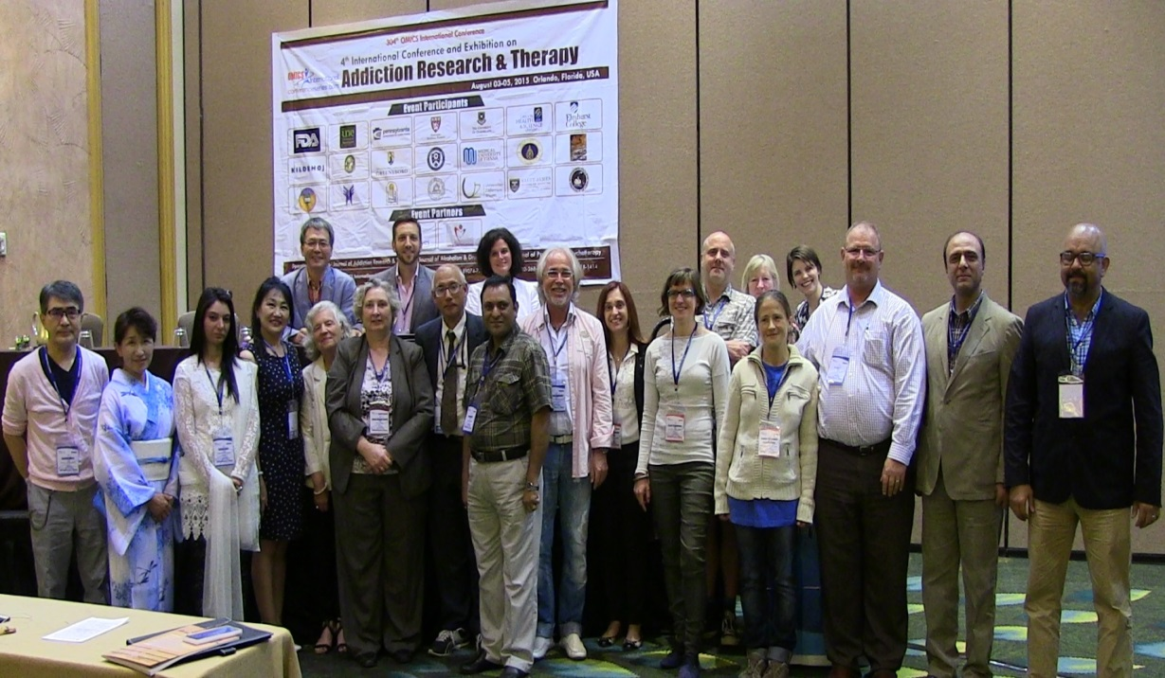

Addiction Therapy 2015
Florida, USA
August 03-08, 2015
Ehab Sayed Ramadan

Slide 2
Detoxification Methods of Benzodiazepines Mono-Dependence: Application and Comparison
Ehab Ramadan
Professor of psychiatry
Neuropsychiatry department
Faculty of Medicine
Tanta University - Egypt

Slide 3
Introduction

Slide 4
Benzodiazepines are psychoactive drugs that increase the effect of the neurotransmitter gama-aminobutyric acid (GABA) at the GABA-A receptors which produces sedative, hypnotic, anxiolytic, anticonvulsant and muscle relaxant effects.
Recent guidelines recommend benzodiazepines to be used for short term periods, when strictly indicated and do not prefer their longer use because of their dangerous side effects (dependency, cognitive impairments, unwanted sedation, reduced coordination, falls, traffic accidents, etc.)

Slide 5
Management of benzodiazepine dependence involves not only short-term interventions such as detoxification but also psychological interventions and rehabilitation programs.

Slide 6
Detoxification aims to get rid of the drug of dependency in a controlled and human fashion and enhancement of treatment retention and detoxiﬁcation success rates while reducing degree of discomfort.
Although detoxiﬁcation is viewed as an ineffective stand-alone treatment for drug dependence, it is a must for starting long-term abstinence-based treatments.

Slide 7
Generally, detoxification can be achieved by one of the two approaches of detoxification:
- abrupt discontinuation of drug use or
- gradual tapering of the drug.

Slide 8
Benzodiazepine dependence is usually treated with tapering of the medication or by substitution by an equivalent dose of a long half-life benzodiazepine drug before tapering, especially when patients are difficult to be treated or have low compliance to treatment. However, there is no obvious evidence suggesting the optimum rate of tapering.

Slide 9
Flumazenil is a medication commonly used in the treatment of acute benzodiazepine toxicity. It is usually known as a benzodiazepine antagonist. Nonetheless, in chronic benzodiazepines’ users, it works as a partial agonist. Flumazenil has been shown to reduce the physical signs of benzodiazepines discontinuation and to reverse anxiety in benzodiazepines’ dependent patients .

Slide 10
Aim of the work

Slide 11
This study aimed to compare three different methods of detoxification of benzodiazepines and to show its differential effect on the control of withdrawal syndrome and relapse rate.

Slide 12
Patients and methods

Slide 13
The study was conducted on 45 Egyptian long-term benzodiazepine dependence male patients coming seeking treatment for benzodiazepine dependence at the “center of Psychiatry, Neurology and Neurosurgery”, Faculty of Medicine, Tanta University.

Slide 14
Medications used in the study
Oxepam® (oxazepam capsules)
Seroquel® (100 mg of quetiapine fumarate tablets)
Anexate® (0.5 mg of flumazenil in 5 ml aqueous solution ampoules)
Tegretol® (200 mg carbamazepine tablets).
Tryptizol (25 mg of amitriptyline hydrochloride tablets)

Slide 15
Study design: Grouping and phasing of the studied benzodiazepines dependent patients (n=45) in 45 days
 | Pretreatment phase (7 days) | Detoxification phase (8 days) | Follow up phase 30 day
Group A | Oxazepam | Flumazenil (8 days) + Oxazepam (3 days) | Benzodiazepine free
Group B | Oxazepam | Oxazepam tapering
Group C | Oxazepam + Quetiapine (100 mg) + Amitriptyline (25 mg) | Quetiapine (100 mg) + Amitriptyline (25 mg) + carbemazepine (600mg) | Benzodiazepine free Carbamazepine 600mg/d for 2 weeks then tapered

Slide 16
Data obtained
- Socio-demographic data
- Pattern of benzodiazepine use
name of the drug(s), route of intake, age of onset of intake, duration of intake, regularity of use, daily dose , motives for intake, drugs currently used and history of previous relapses.
- physical examination

Slide 17
- Psychiatric and psychometric evalution.
Were done at the end of pre-treatment phase (base line) and on daily basis of the detoxification phase

Slide 18
Tyrer Benzodiazepine Withdrawal Symptom Questionnaire (BWSQ).
Visual Analogue Scale (VAS):
Hamilton Anxiety Rating Scale (HAM-A).
Hamilton Depression Rating Scale (HAM-D)

Slide 19
Investigations
Biochemical investigations:
Routin investigation e.g. liver function tests, kidney function tests and Complete blood count. Performed immediately on admission before oxazepam replacement’s doses and after stoppage of treatment.
Toxicological analysis

Slide 20
Toxicological analysis:
(on admission, before starting detoxification phase, at the end of detoxification phase and on day 15 and 30 of the follow up phase)
Rapid screening test: (Quick Profile™ Drugs of Abuse/ Alcohol Test Device). It is a specific immunochemical reaction based one step in vitro test.
Viva-E analyzer : a homogeneous enzyme immunoassay technique used for semi-quantitative analysis of benzodiazepine and benzodiazepine metabolites in human urine.

Slide 21
RESULTS

Slide 22
The ages of the patients ranged from 22 to 60 years with no significant differences between the studied groups(p > 0.05).
All patients were current cigarette smokers whereas the majority of patients were caffeine users (86.67%, 93.33% and 86.67% in group A, B and C respectively).

Slide 23
Clonazepam was used among 53.33%, 60.00% and 46.67% of the studied patients in group A, B and C respectively.
Alprazolam was used among 26.67%, 26.67% and 33.33% of patients in group A, B and C respectively.
Lorazepam was used among 20.00%, 13.33% and 20.00% of the studied patients in the studied groups respectively .

Slide 24
Duration of benzodiazepine intake in the studied patients ranged from 2 to 7 years with mean duration 3.47 ± 1.06, 3.33 ± 1.05 and 3.6 ± 1.45 years in group A, B and C respectively.
The studied patients were switched to equivalent doses of oxazepam. Doses varied from 80 to 480 mg/d.

Slide 25
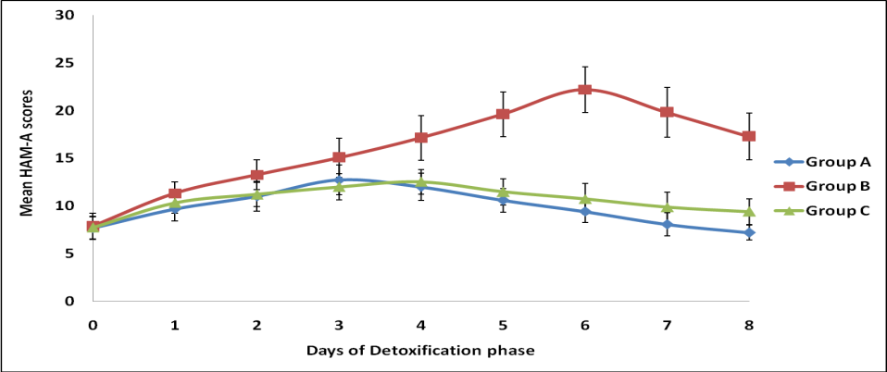
RESULTS
Fig. (1): Mean scores of Tyrer Benzodiazepine Withdrawal Symptom Questionnaire (BWSQ) in the studied groups of benzodiazepine dependent patients (n=45) during the detoxification phase (8 days)
Group A showed significant change from the fourth day to the end of detoxification phase as compared with group C (p < 0.05).

Slide 26
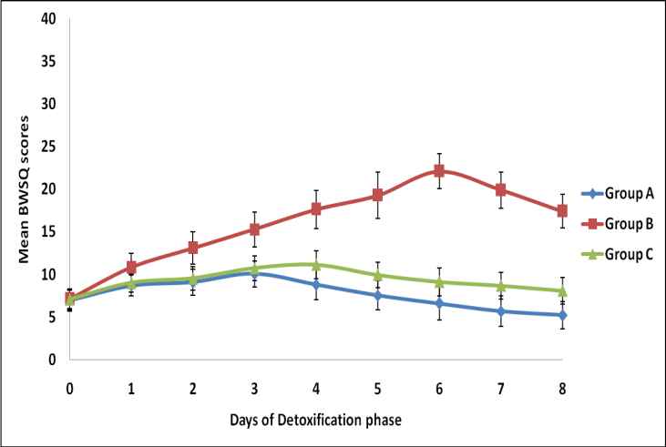
Figure (2): Mean scores of Hamilton Anxiety Rating Scale (HAM-A) in the studied groups of benzodiazepine dependent patients (n=45) during the detoxification phase (8 days).
Group A showed time dependent significant change in their values on the last three days of detoxification phase when compared with group C (p < 0.05).

Slide 27
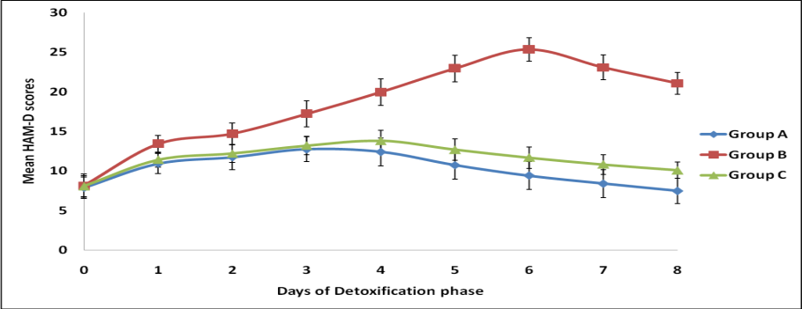
Figure (3): Mean scores of Hamilton Depression Rating Scale (HAM-D) in the studied groups of benzodiazepine dependent patients (n=45) during the detoxification phase (8 days)
There was significant difference between all the studied groups except between group A and B in the 1st three days of detoxifications

Slide 28
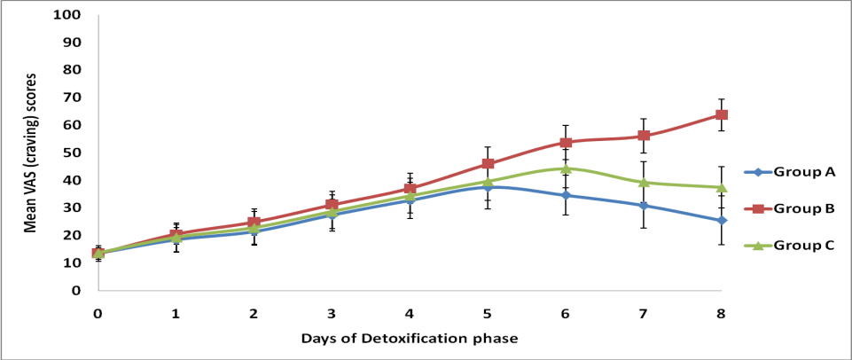
Figure (4): Mean scores of Visual Analogue Scale (VAS) in the studied groups of benzodiazepine dependent patients (n=45) during the detoxification phase (8 days).

Slide 29
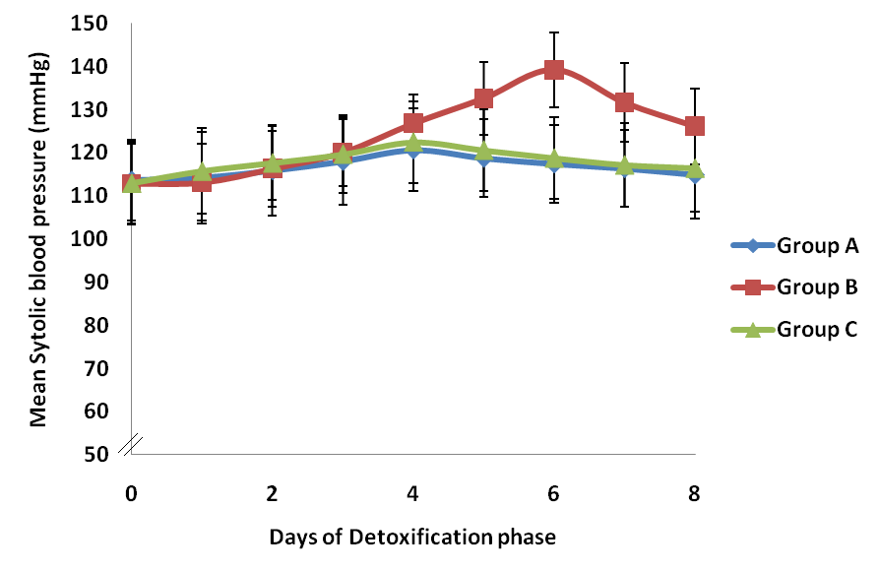
Figure (5): Mean systolic blood pressure (SBP) values in the studied groups of benzodiazepine dependent patients (n=45) during the detoxification phase (8 days). Group A: Flumazenil group; Group B: Oxazepam tapering group; Group C: Abrupt oxazepam discontinuation group.

Slide 30
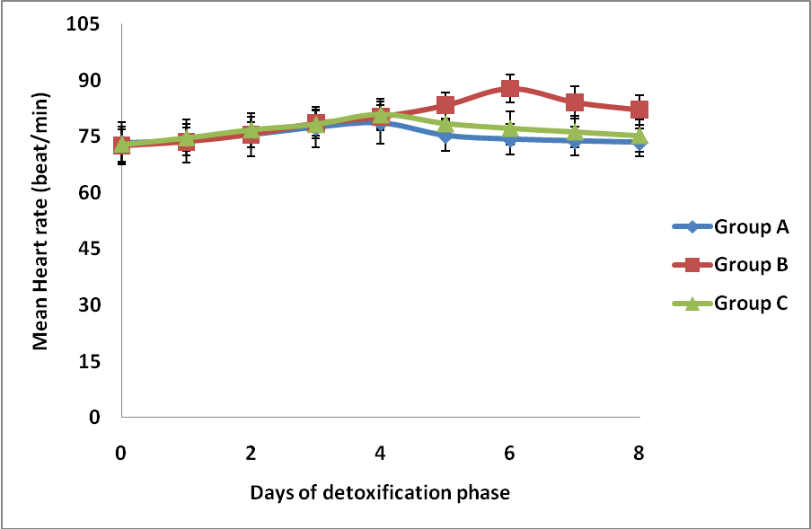
Figure (6): Mean heart rates in the studied groups of benzodiazepine dependent patients (n=45) during the detoxification phase (8 days). Group A: Flumazenil group; Group B: Oxazepam tapering group; Group C: Abrupt oxazepam discontinuation group

Slide 31
Outcomes (relapse rate)
After 15 days from the end of detoxification phase relapse rates were 33.33%, 60% and 40% in group A, B and C respectively;
while, they were 53.33%, 80% and 66.67% respectively after 30 days from the end of detoxification phase.
There were no significant difference between the three studied groups (A, B and C) in the mean ages, age of onset, dose and duration of benzodiazepines intake of the relapsed patients (p > 0.05)

Slide 32
Discussion

Slide 33
The common management of benzodiazepine dependence involves either gradual tapering of the drug or sudden cessation with switching to a longer half-life benzodiazepine or adjunctive medications

Slide 34
Initially, flumazenil was considered as a 'pure' antagonist, later on subsequent work in both animals and humans has shown that flumazenil is a mixed agonist/antagonist, partly dose dependent

Slide 35
This study agrees with the results of other studies which reported that flumazenil infusion was effective in reducing withdrawal syndrome in benzodiazepine dependent patients and was capable to reduce anxiety level and craving during detoxification period as well as inhibited the cardiovascular changes associated with the withdrawal syndrome (Gerra et al., 1993; Saxon et al., 1997; Gerra et al., 2002; Hood et al., 2009 and Lugoboni et al., 2011)

Slide 36
Flumazenil effect may be due to tolerance reversal and attenuation of withdrawal symptoms, anxiety and craving mediated by normalization and up-regulation of benzodiazepine receptors facilitating coupling of the GABA-A receptors and benzodiazepines receptors complexes (Lader & Morton, 1992 and Quaglio et al., 2012

Slide 37
Also flumazenil can reset the benzodiazepine receptor set point that is shifted in the inverse agonist direction by chronic use of benzodiazepines and to increase receptor sensitivity which allows flumazenil to exert its weak partial agonist activity with possible enhanced efficacy. Finally, the capability of flumazenil to attenuate the urge to take benzodiazepines can be explained by its partial agonist activity (Quaglio et al., 2005; Jazvinscak, et al., 2008 and Quaglio et al., 2012).

Slide 38
Similarly, the effectiveness of low-dose oxazepam administered in group A patients together with flumazenil, on the first three nights during the detoxification phase, could have been enhanced by receptor up-regulation (Lader & Morton, 1992 and Gerra, et al., 2002).

Slide 39
The high relapse rates found in benzodiazepines’ dependent patients treated with oxazepam tapering could be attributed to high craving scores especially on the last days of detoxification phase and more consistent withdrawal symptoms (Gerra et al., 2002).
This coincides also with the observation of other studies showed that early stages of withdrawal are more tolerable than the later and final stages (Michelini et al., 1996; Curran et al., 2003 and Lader, 2011)

Slide 40
Conclusion

Slide 41
Flumazenil infusion with low doses of oxazepam appeared to be more effective in controlling withdrawal symptoms after benzodiazepine discontinuation with less incidence of relapse than oxazepam tapering or abrupt oxazepam discontinuation with symptomatic treatment. On the other side, oxazepam tapering over 8 days proved to be the worst of the detoxification methods regarding severity of withdrawal and incidence of relapse.

Slide 42
Statistical methods
Analysis of variance [ANOVA] and student t-tests were used.
Pearson correlations coefficient were done between scores of different psychometric scales and ages, age of onset, dose and duration of benzodiazepine intake of the studied patients.
Tukey's post hoc tests were used to make a quick comparison of several groups that have different numbers.

Slide 43
Thank you

Slide 44

Meet the eminent gathering once again at
Addiction Therapy 2016
Miami, USA
October 06-08, 2016
Addiction Therapy 2016
Website: addictiontherapy.conferenceseries.com

