Slide 1
Treating Cancer in the Era of Omics
Effie Liakopoulou MD, PhD, FRCPath, CMM

Slide 2
Transforming Lives
Stem Cell Transplantation
Aim of treatment for Cancer
To cure the disease
Prolong survival
Improve quality of life

Slide 3


Removal of T cells
Infection
Engraftment
Relapse
GvHD
Early mortality

Slide 4
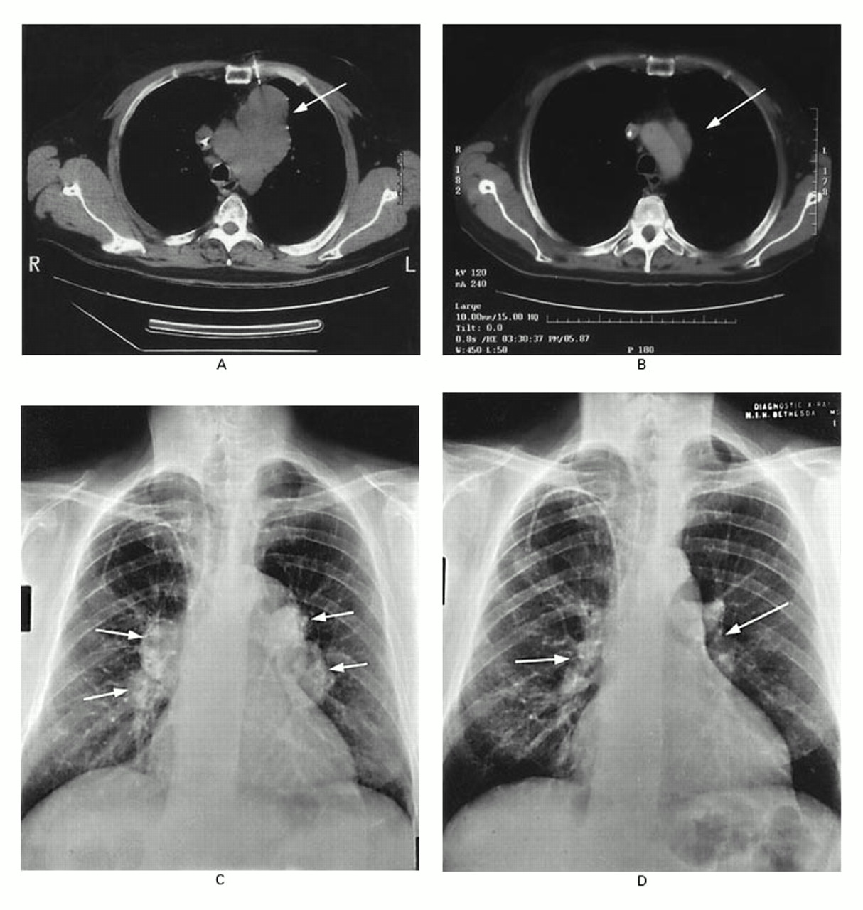
Pre
SCT
Day +276
Post SCT

Slide 5
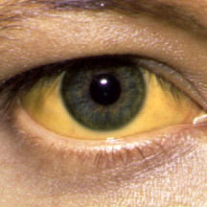
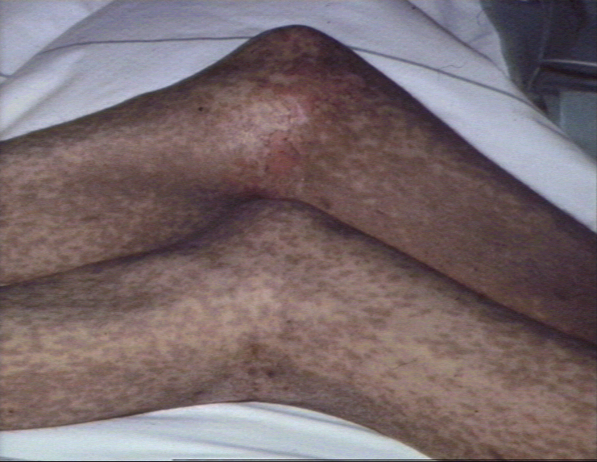
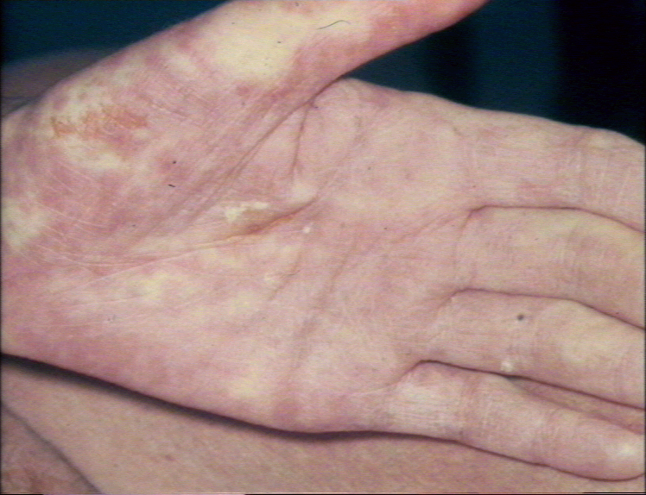
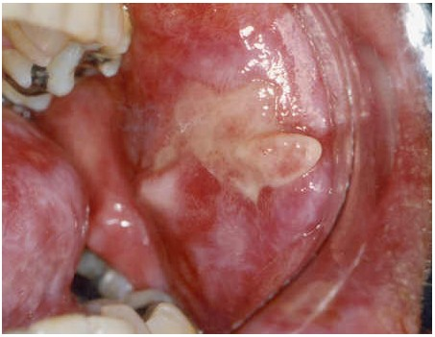

Slide 6
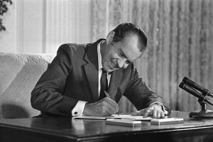
2011: 40 Years War on Cancer

Slide 7
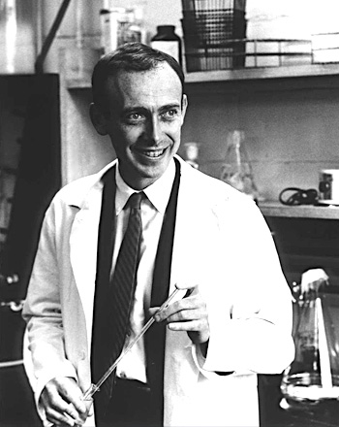
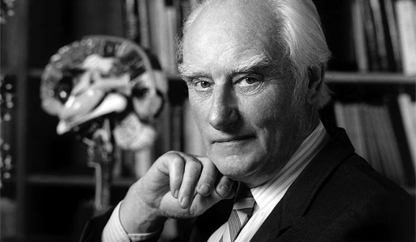
2012: 50 Years Genetic Revolution

Slide 8

2012: National Science Award

Slide 9
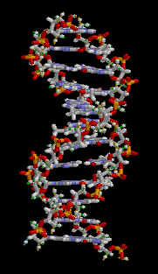
Watson, Crick & Wilkins Achievement
Molecular Structure
of DNA

Slide 10
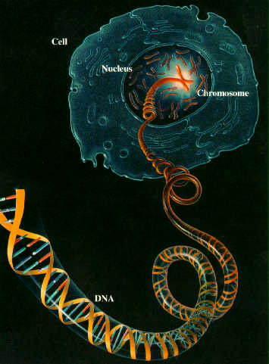
Hood’s Achievement
DNA
Molecular Structure
Structure of
Human Genome

Slide 11
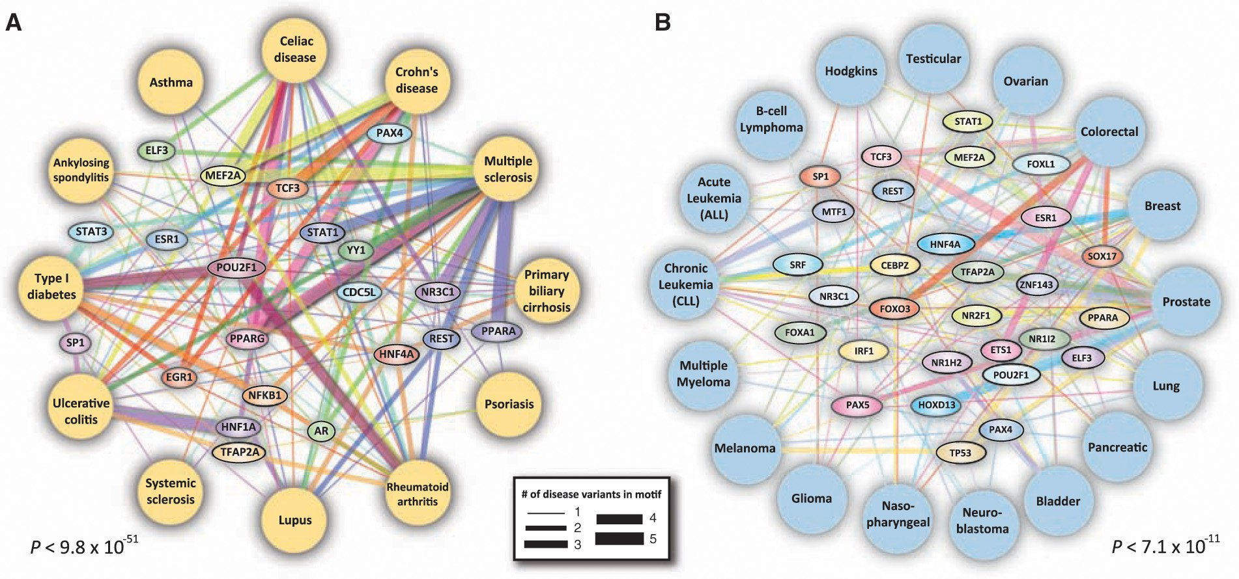
Encyclopedia
of DNA Elements
ENCODE

Slide 12
ENCODE in Numbers
30 Km (22miles) long
16 m (48 ft) wide
paper to print the data generated !!
There is No Junk!

Slide 13
Genetic Revolution
Will we need another 50 Years to make sense of the data?

Slide 14
Genetic Revolution
Will we need another 50 Years to make sense of the data?
From Fragmented data Global information
From Biological Mechanisms Medicines
From Sublime insight Infinite Library of Life
NEED
for technological applications
to facilitate progress

Slide 15
Cancer as a Black Box
Group A
Experimental Treatment
>20K genes
>100K mRNA isoforms,
miRNAs, proteins
and post-translational
modifications.
Pick the Winner
Standard Treatment
Group B

Slide 16
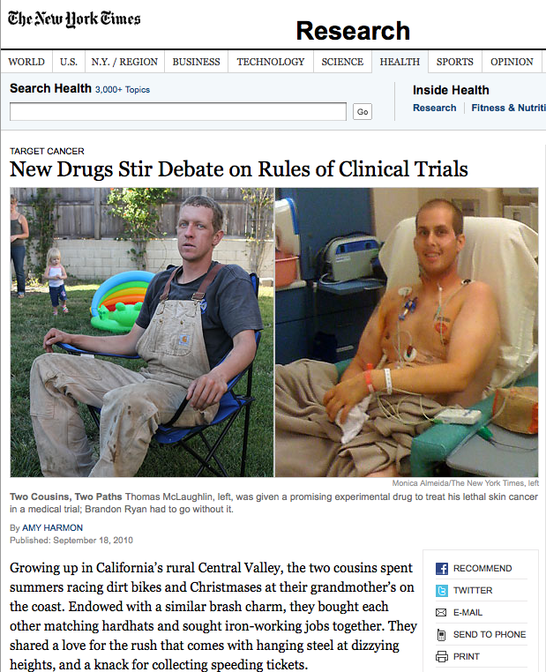

Slide 17
Can we do better?

Slide 18
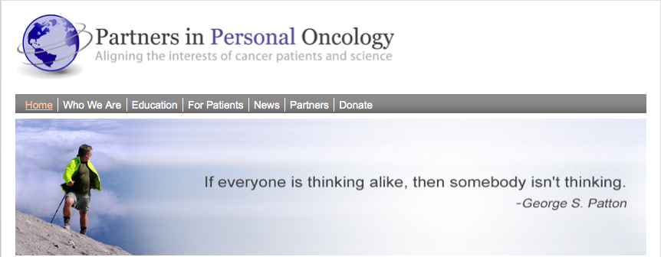
www.personaloncology.org

Slide 19
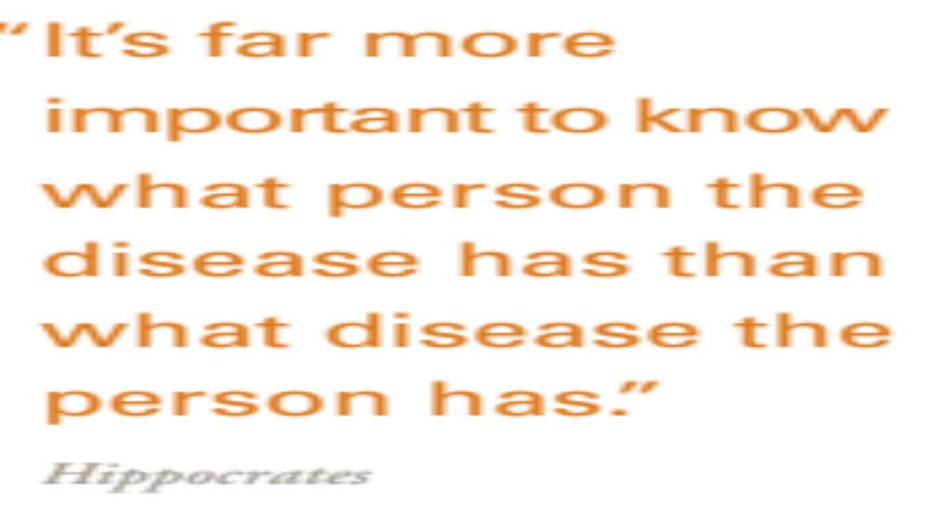

Slide 20
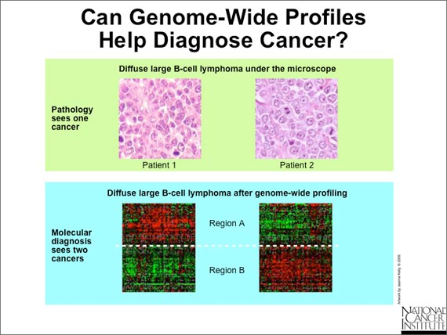

Slide 21

How Many Different Kinds of Lung Cancer ?

Slide 22

How Many Different Kinds of Lung Cancer ?

Slide 23
Transforming Medicine
4 Main Drivers

Slide 24
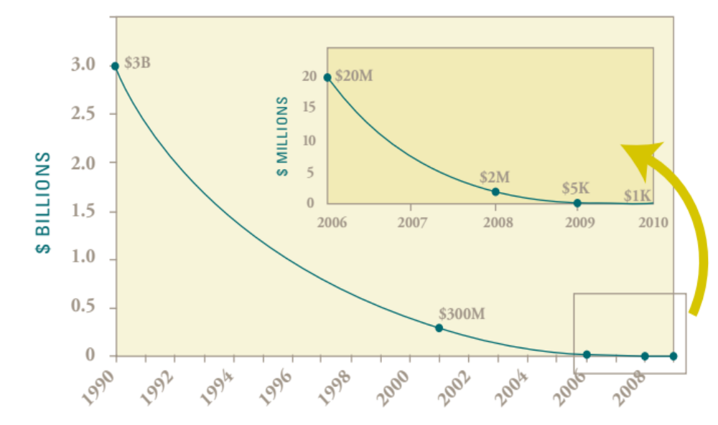
Transforming Medicine #1
The Shrinking Cost of DNA Sequencing
Towards the $1000 Genome

Slide 25
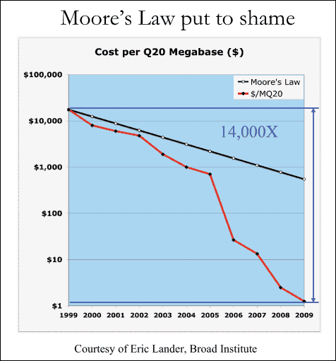
Transforming Medicine #1
Moore’s Law put to shame

Slide 26
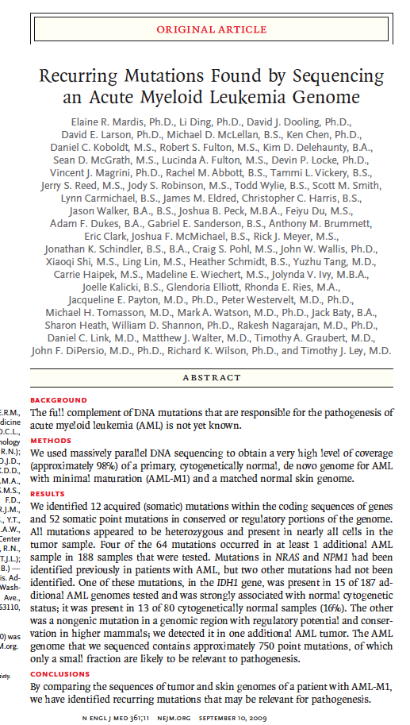
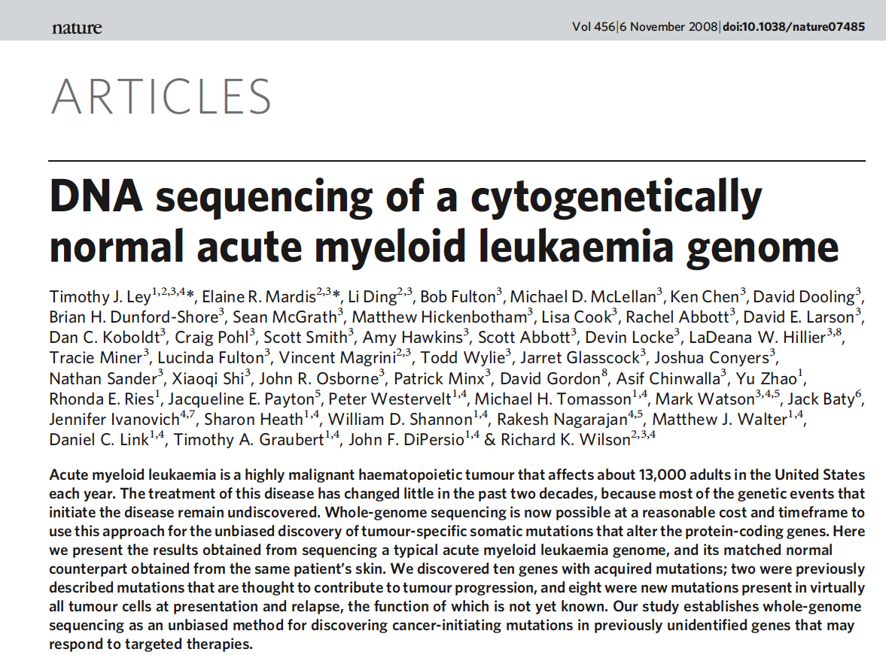
Every Cancer is Different
AML

Slide 27
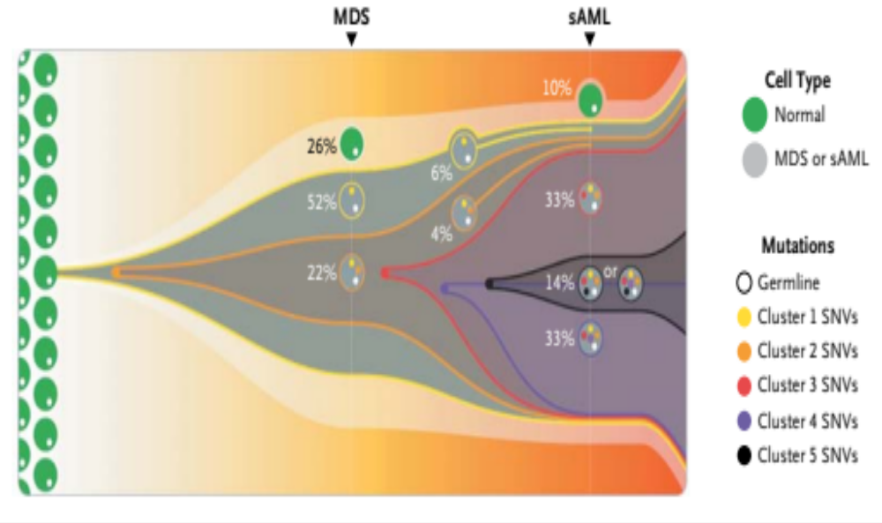
Clonal Evolution from MDS to sAML
M.J Walter et al, NEJM, March 22, 2012

Slide 28
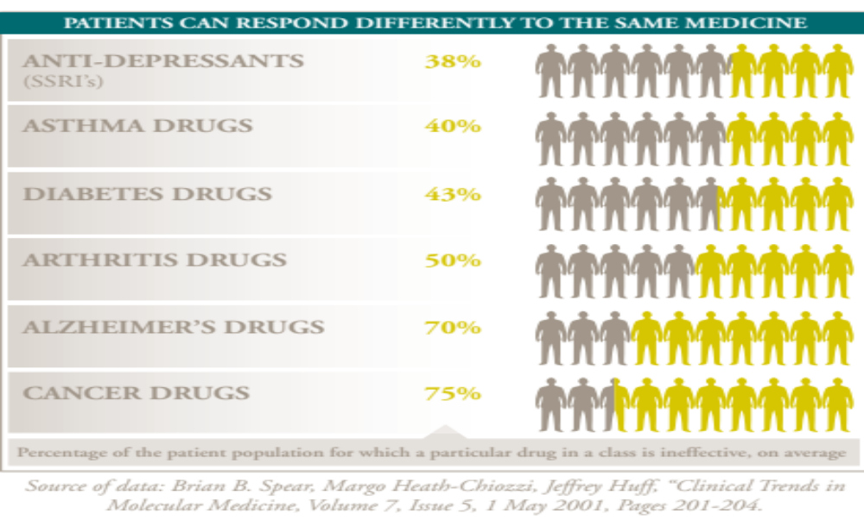
One Size Does Not Fit All

Slide 29
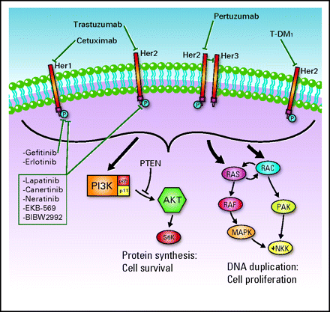
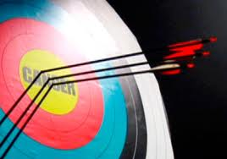
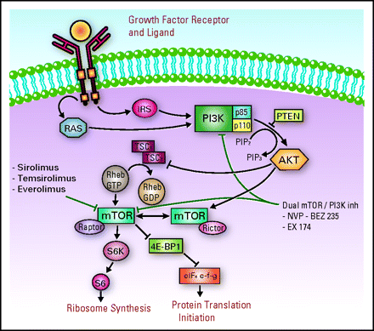
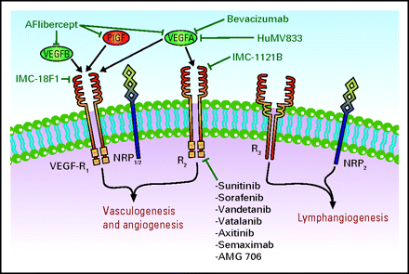
Transforming Medicine #2
Targeted Therapies
EGFR
PI3K/AKT/mTOR
Other RTKs

Slide 30
Some Rationally Designed Cancer Therapies
Chronic myelogenous leukemia (Bcr-Abl)
c-Kit – positive gastrointestinal stromal tumor
Her2 – positive breast cancer
EGFR - mutated lung and colorectal cancer
Alk – mutated lung cancer
BRAF - mutated melanoma

Slide 31
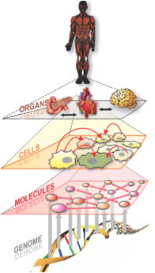
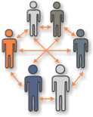
Transforming Medicine #3:
Systems Biology
The Network of Networks
Networks organize,
integrate and model
data to enormously
increase the signal
to noise
Courtesy Dr. Leroy Hood

Slide 32
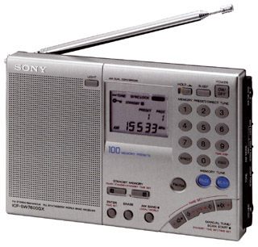
Radio Waves
Sound Waves
Courtesy Dr. Leroy Hood

Slide 33
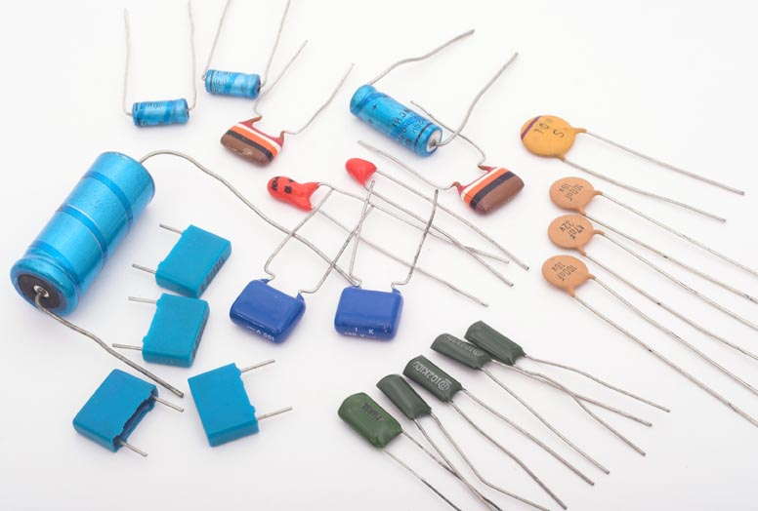
Courtesy Dr. Leroy Hood

Slide 34
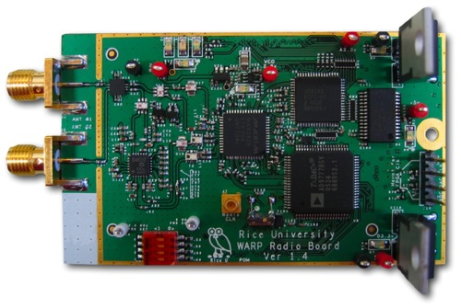
Courtesy Dr. Leroy Hood

Slide 35

Health
Disease
“networks of
networks”
Courtesy Dr. Leroy Hood

Slide 36
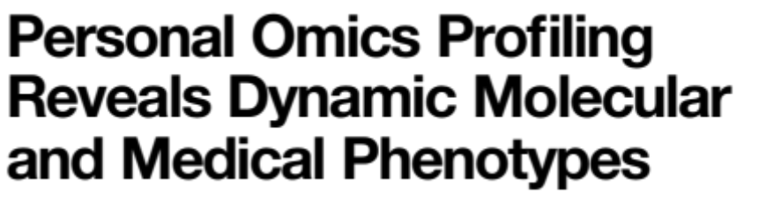
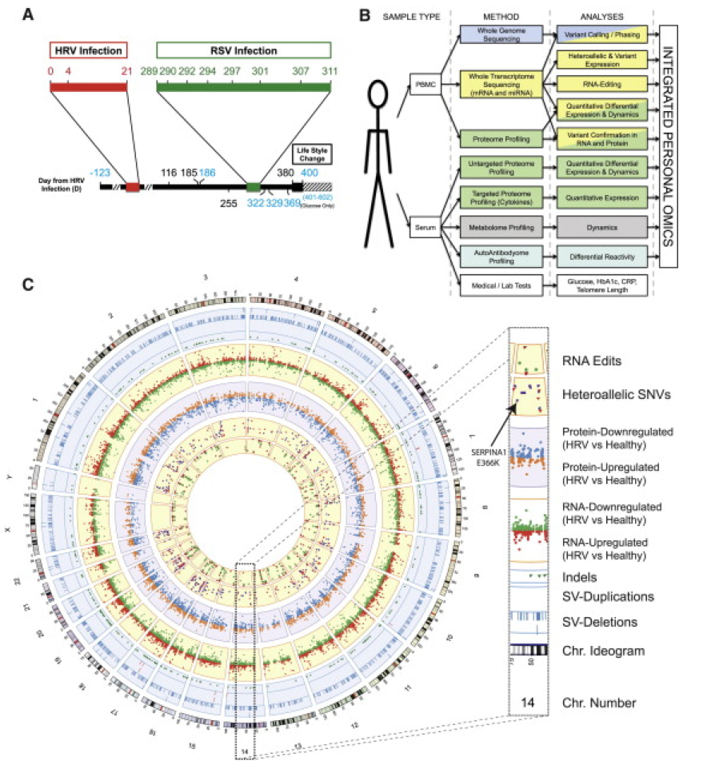
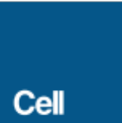
1 Patient, 400 days, 3 billion data points
March 16, 2012

Slide 37

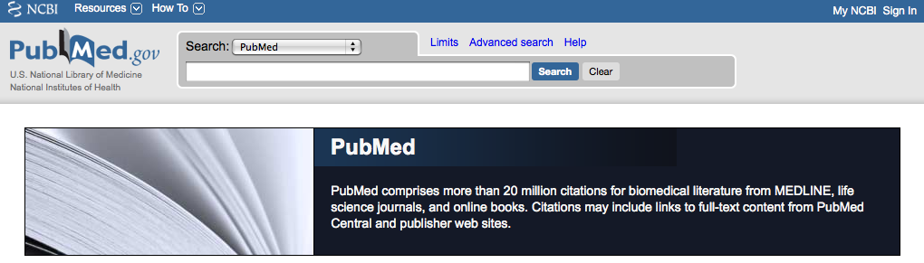
Transforming Medicine #4:
The Internet

Slide 38
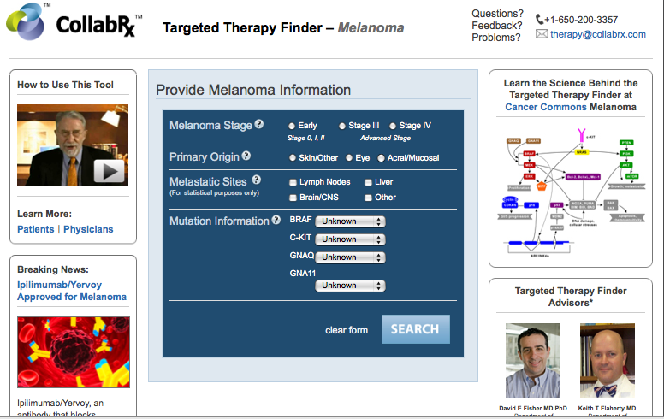

Slide 39
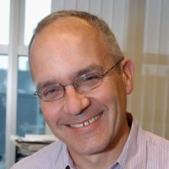
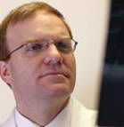
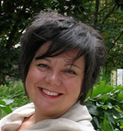
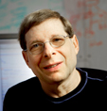
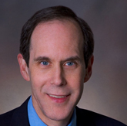

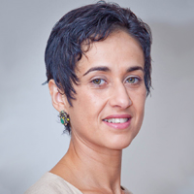
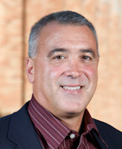
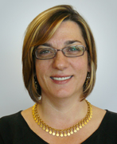
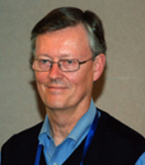
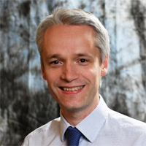
Partners in Personal Oncology
Tony Blau
Greg Foltz
Effie Liakopoulou
Marty Tenenbaum
Lee Hood
Brian Druker
Mike Bisesi
Houda Hachad
Bruce Avolio
Sibel Blau
David Beatty
Robin Jones

Slide 40
Partners in Personal Oncology
Patient
Processing
IT Technology
Disease Pathways
Panel of Top
Medical – Scientific
Expertise
Across Institutions
-
High Quality Tissue
Procurement/storage
Tailor made Treatment
Partners
in
Personal Oncology
Network
How to Deconstruct Cancer One Patient at a time
T. Blau & E. Liakopoulou
Trends in Genetics 2013 &
Cell Press Reviews: Cancer Therapeutics, 2014

Slide 41
Fundamental Idea of Personalized Medicine
Coupling established clinical–pathological indexes
^{with}
State-of-the-art molecular profiling
^{to create}
Diagnostic, prognostic, and therapeutic strategies precisely tailored to patient’s requirements

Slide 42

Two Clinical Trials
Triple Negative Breast Cancer
AML (Pam Becker)
Enroll patients with cancers not generally considered
curable.
Seek to better match patients to drugs.
To do this, both use HTS and Omics.
Both represent grass roots efforts.
Courtesy Dr. Tony Blau

Slide 43
Protocol 8132: ITOMIC-001: Intensive Trial of OMics In Cancer
October 28, 2013: Trial Launch
Highlights:
Multiple samplings from multiple different sites of disease.
Standardized protocols for tissue acquisition, handling, and storage.
3) Coordinate analyses across multiple different labs, platforms & institutions.
Convene ITOMIC tumor board (X4).
Respond rapidly to a change in a patient’s clinical status.
Obtain data from all patients examined thus far.
Prepare reports.
Assist with accessing drugs.
Perform repeated biopsies.
Culture tumor cells, test in drug screen (1 patient).
Serially monitor circulating tumor cells (CTCs) (1 patient).
Patient Surveys
Courtesy Dr. Tony Blau

Slide 44
AML - A Practical Approach
Examining the relationship between gene expression and sensitivity to chemotherapy.
Immediately address drug sensitivity, with treatment based on high throughput drug sensitivity testing.
Courtesy Dr. Tony Blau

Slide 45
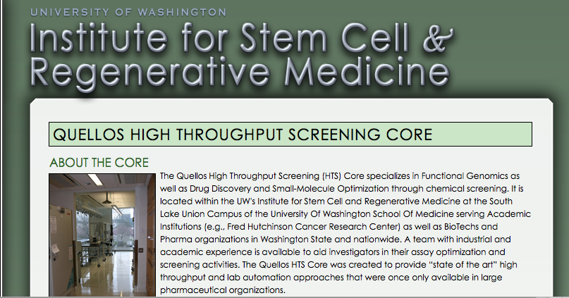

Slide 46
AML Trial
HTS Screen
160 Drugs - 45 FDA Approved, 115 Investigational
Ability to use cryopreserved cells
Use of adherent culture conditions
Courtesy Dr. Tony Blau

Slide 47
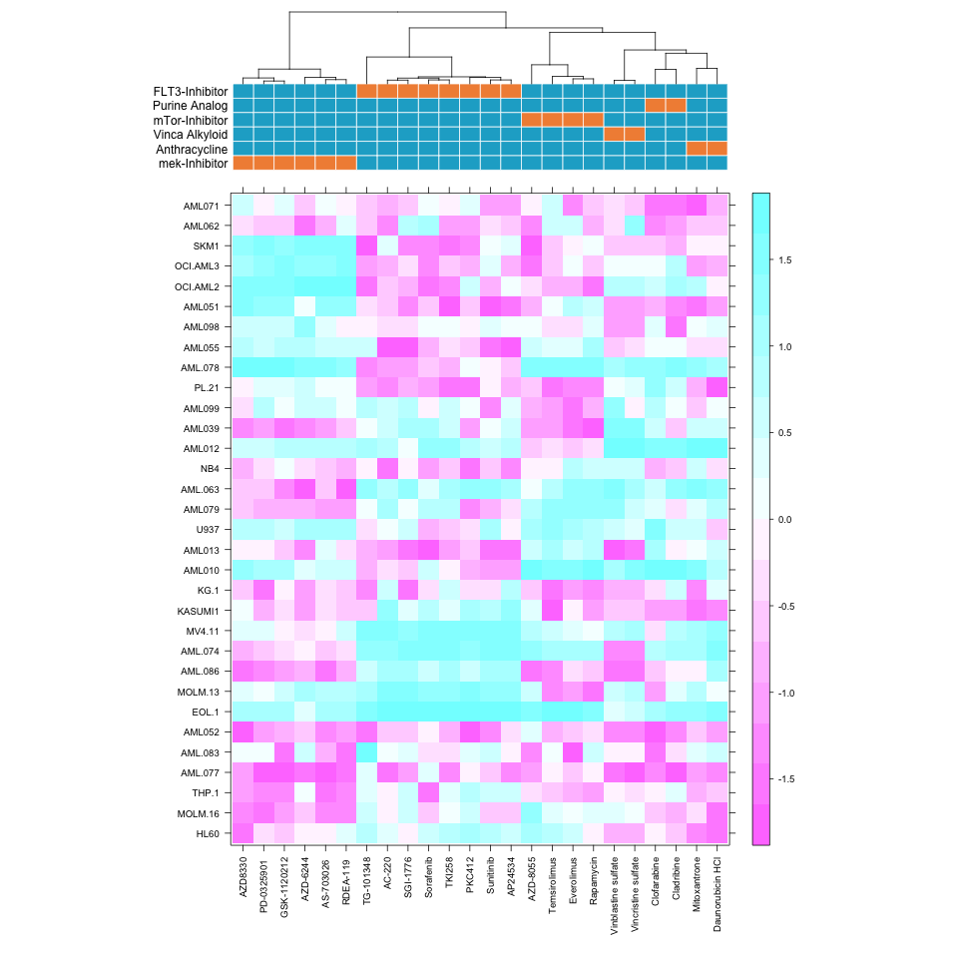
14 AML cell lines, 30 patient samples
Sensitive
Resistant
Each patient exhibits unique result.
Clustering of similar drugs.

Slide 48
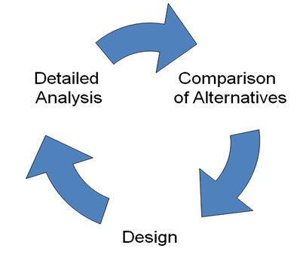
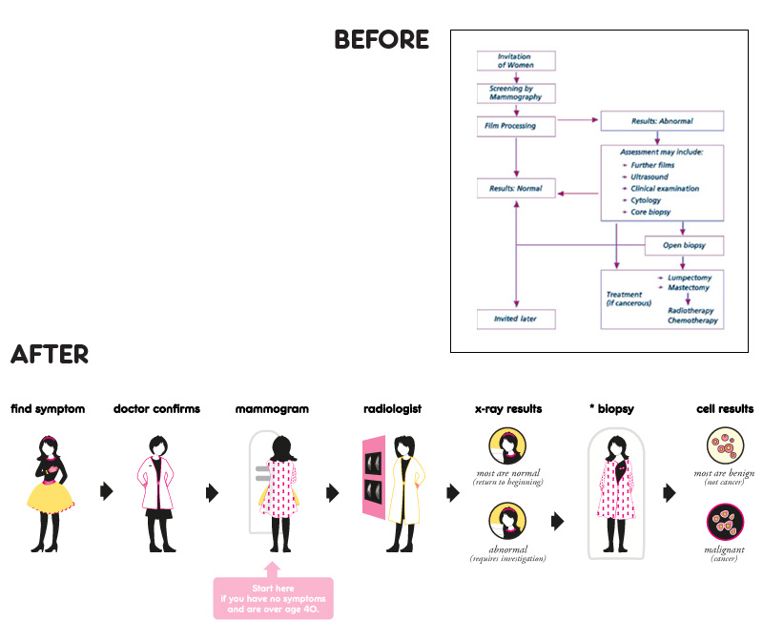
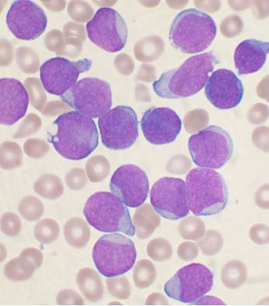

AML Trial
Collect Leukemia Cells
Best Drug
HTS
Courtesy Dr. Tony Blau

Slide 49
AML Trial
Primary Objective: Demonstrate feasibility of the assay as a potential means to predict response
Secondary Objective: Cytoreduction with chosen drugs
Subjects: Multiply relapsed or refractory AML patients
Declines in blast count in all 11 patients treated.
Actual: Drug sensitivity test results 5-7d (mean 5.2d).
All pts treated within 7-21 days.
Courtesy Dr. Tony Blau

Slide 50
Take Home Message
Recent biotechnological advances have led to an explosion of dis- ease-relevant molecular information, with the potential for greatly advancing patient care.
^{Personalized Medicine}
No longer a blip on the horizon
^{Brings new challenges and} ^{success is based:}
⁻ establishing frameworks for regulating,
^{- compiling, and}
- interpreting the in- flux of information that can keep pace with
^{rapid scientific developments}

Slide 51
2nd international Conference on
Hematology and Blood Disorders
Session 4 : 10.20, 1 October 2014
Whole genome methodology for in silico quantification of intra tumor heterogeneity: Model for clinical applications in the treatment of patients with hematological malignancies

Slide 52
Tony Blau
Greg Foltz
Tony Blau

Slide 53
Thank you

