Slide 1
POLYPHENOLIC BOTANICALS – APPLICATIONS FOR PROSTATE HEALTH
Edwin D. Lephart
Department of Physiology and The Neuroscience Center, College of Life Sciences, Brigham Young University, Provo, Utah, USA 84602
7TH World Congress on Healthcare and Technologies
September 26-27, 2016 London, United Kingdom

Slide 2
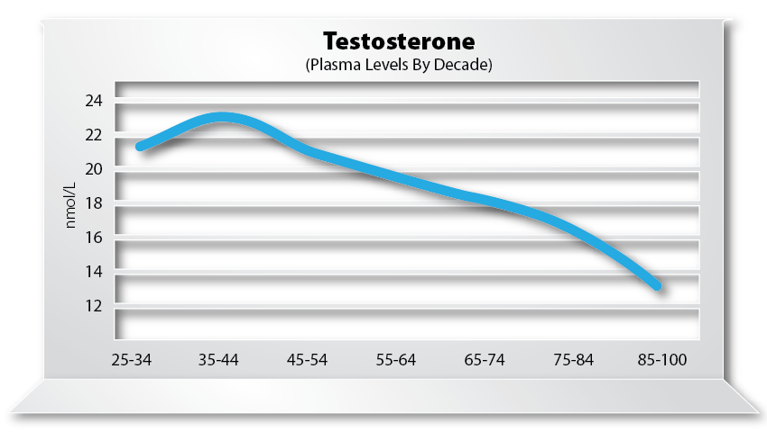
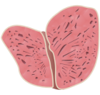
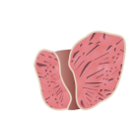
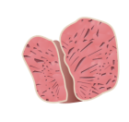





Prostate Growth with Age
As men age, two changes in hormone levels affect prostate health:
  Testosterone declines,
  but 5α-reduction in the
  prostate increases
  Estrogen increases
These two changes
lead to hyperplasia
(an increase in
cell number/size) in the prostate
31g
18g
1.5g
11g
E.D. Lephart,
O J Endo Metab Dis, 2014
birth puberty 20s 50s 70s

Slide 3

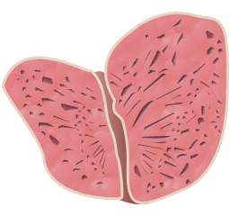

Prostate Growth
This increase in prostate weight with age may result in:
  Prostate Cancer
  Benign Prostatic
  Hyperplasia (BPH)
American Cancer Society:
  Second most common diagnosed cancer in US men (skin cancer is first)
  Second leading cause of cancer death in US men (lung cancer is first)
  1 man in 6 will get prostate cancer in his lifetime
  2010 estimates:
    217,730 new cases
    32,050 deaths
E.D. Lephart,
O J Endo Metab Dis, 2014

Slide 4
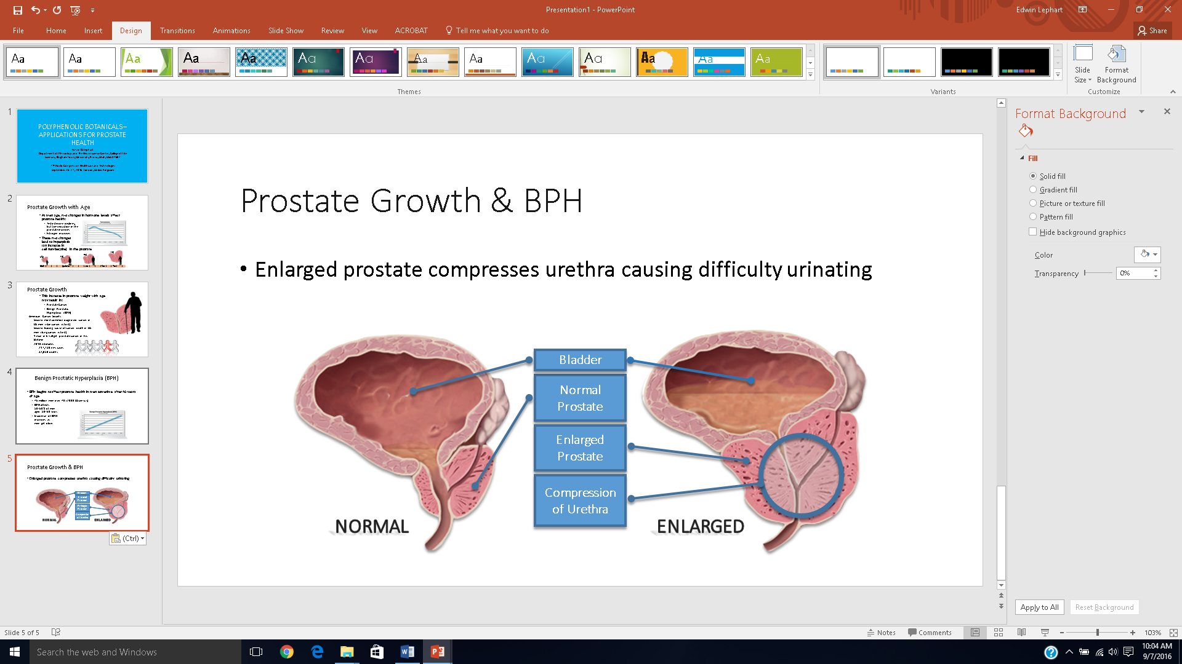
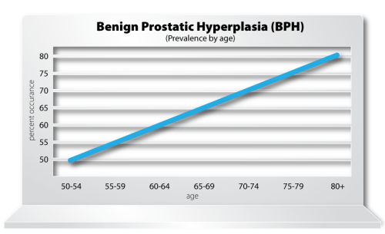
Benign Prostatic Hyperplasia (BPH)
BPH begins to affect prostate health in men sometime after 40 years of age
  46 million men over 40 (2000 US census)
  BPH affects
  50-60% of men
  aged 50-60 years
  Incidence of BPH
  increases as
  men get older
Nocturia, Frequency, Straining, etc.
E.D. Lephart, O J Endo Metab Dis, 2014

Slide 5
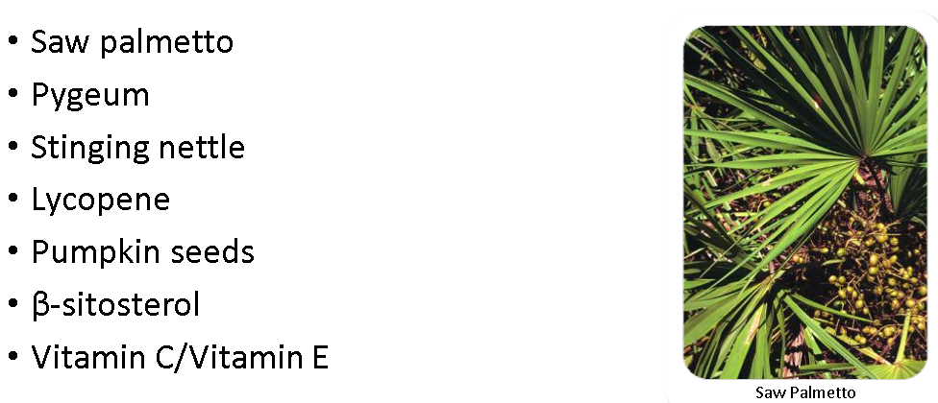
Treatments of BPH:
Prescription Medications—enzyme blockers
  (type 1 5α-reductase enzyme blocker, 1980)
  (type 1 and 2 5α-reductase enzyme blocker, 2001)
  Enzyme blockers block positive and negative effects of those enzymes
  Side effects: decreased libido, erectile dysfunction
  (α 1A adrenoreceptor blocker, 1994), Blocks positive and negative effects of adrenoreceptor. Side effects: abnormal ejaculations, dizziness, rhinitis
♦ Historical – Botanical Prostate Health Treatment Options
E.D. Lephart,
O J Endo Metab Dis, 2014

Slide 6
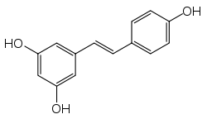
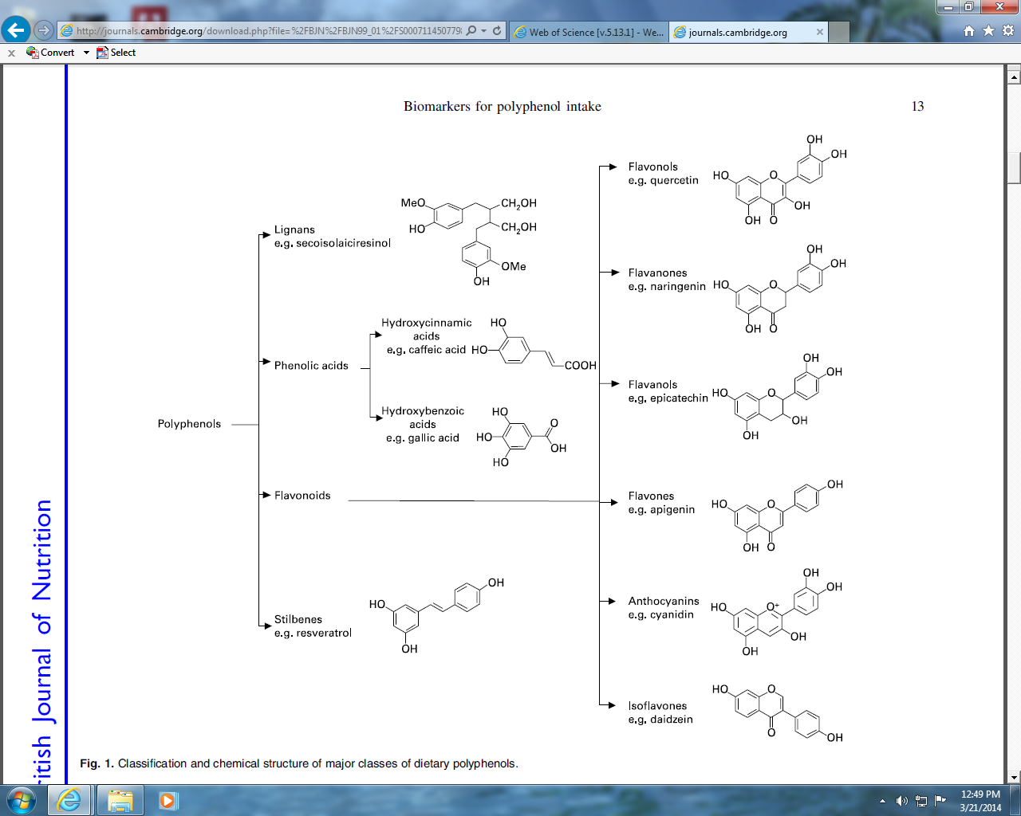
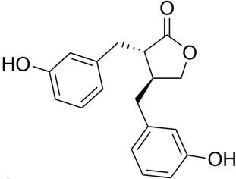
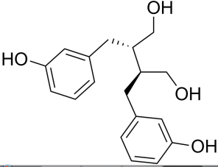
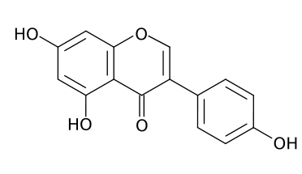
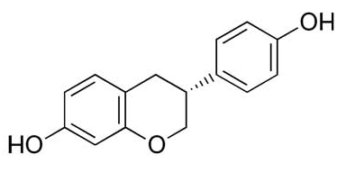
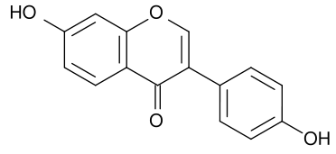
Polyphenols
Phenolics are a group of compounds having at least one hydroxyl group attached to an aromatic ring.
Lignans Phenolic acids Flavonoids Stilbenes
Flavonols
(quercetin)
Flavanones
(naringenin)
Resveratrol
Gallic Acid
or hydroxybenzoic acids
Flavanols
(epicatechin)
Secoisolaiciresinol
Flavones
(apigenin)
Anthocyanins
Caffeic Acid
or hydroxycinnamic acids
(cyanidin)
Enterolactone
Isoflavonoids
Daidzein
Genistein
Equol
Enterodiol
E.D. Lephart, Enzyme Research, 2015
Figure 2. Classification and chemical structure of major classes of polyphenols/phytoestrogens.

Slide 7

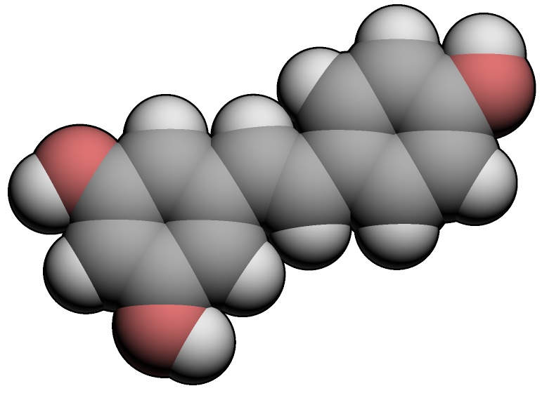
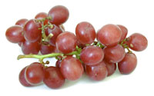
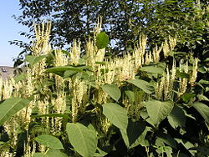
Resveratrol
review
MW 228.25
C₁₄H₁₂O₃
Trans-3,5,4’-Trihydroxystilbene:
Trans-resveratrol
Phytoalexin- “antibiotic” produced by plants under attack by pathogens (found skin red grapes, 2-12 mg/L)
Phytochemical- polyphenolic
Phytoestrogen- mixed agonist ER
Chemical synthesis- primarily derived from Japanese knotweed (up to 187 mg/Kg, extracts up to 50 %)

Slide 8
Properties of Resveratrol
Status- current challenges
Anti-cancer agent- (prostate) (Init; Prom; Progr)
Anti-inflammatory- (iNos,COX-1& 2, NF-kB, AP-1)
Anti-oxidant- (free radicals; LDL oxidation)
⇓ blood sugar (diabetes)- (3-5 gram/day)
Improves Cardiovascular health- “French paradox”
Neuro-protective/prevents neurodegeneration-
Improves Skin Health- (collagen)-cosmetics
Extends Lifespan; anti-aging; Sirtuin I (SIRT 1)
⇑ Athletic performance “endurance” (Cell 2006)
Protects against radiation exposure (Sci 2008)
Improves prostate health (BPH)
1. Resveratrol as a pure compound is unstable- turns yellow at room temperature over short period of time (< 3 months).
2. Oral dosing in humans- resveratrol is required @ high doses (gram amounts in multiple doses) and it is rapidly metabolized/excreted [first-pass glucuronidation and sulfation both (liver and intestinal epithelium) resulting in relatively short half-life (T_{1/2}, 0.13 hours).
In 2015, by Kjaer et al., in the journal –Prostate
Purpose: no human trails have tested resveratrol for BPH/androgen levels
Dose: Resveratrol at 150 mg or 1,000 mg daily for 4 men in middle age men
Outcome: Resveratrol reduces the levels of circulating androgen precursors but had no effect on, testosterone, dihydrotestosterone, PSA levels or prostate volume. A 4-month randomized trial in middle-aged men

Slide 9
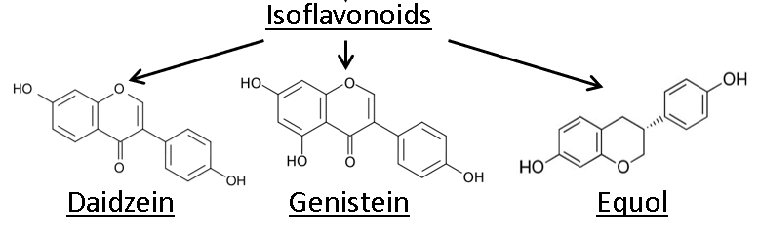
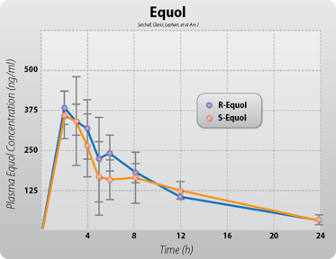
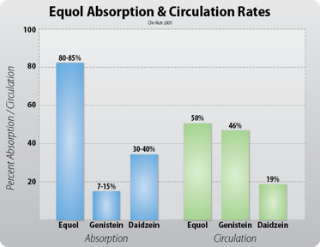
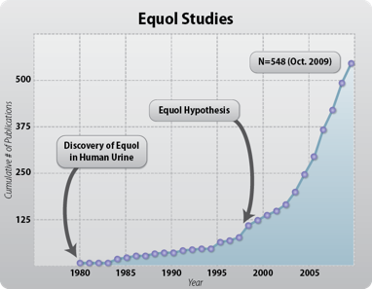
Chiral carbon, isomers of equol (R/S)
Daidzein, Genistein and Equol are found in plants and food products
Equol is over 70% better absorbed than genistein and 50% better absorbed than daidzein
Equol is biologically active in blood due to its increased absorption and not bound to plasma proteins (half-life of 5 to 6 hours), 20 mg bolus administered in human volunteers
E.D. Lephart, O J Endo Metab Dis, 2014

Slide 10
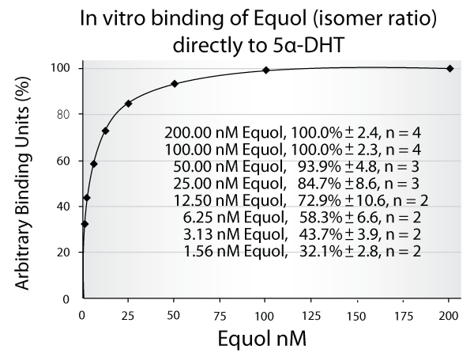
Equol Exclusive Binding Action of Androgen
Binds (& biologically inactivates) specifically to 5α-DHT
Does not bind to other hormones
        Lund TD et al, Reprod Biol Endo 2011
Steroid Compound Equol Binding Assays:
✗ Testosterone | ✗ Epiallotetrahydrocorticosterone
✗ DHEA | ✗ 3β, 5α-Tetrahydrocortisol
✗ 17β-Dihydroandrosterone | ✗ Allodihydropregnanolone
✗ Androstanedione | ✗ Allodihydrocortisone
✓ 5α-DHT | ✗ 5α-Dihydropregnanolone
✗ 5β-DHT | ✗ 5α-Dihydroprogesterone (5α-DHP)
✗ Epiestradiol | ✗ 3α-Hydroxy-5β-tetrahydroprogestone
✗ Estradiol (E2) | ✗ 5β-Dihydrocorticosterone
✗ Estriol (E3) | ✗ Tetrahydrocorticosterone
✗ Estrone (E1) | ✗ Tetrahydrohydrocortisol
✗ 5α-Dihydroandrostenedione | ✗ 5β-Dihydrocortisol
✗ Pregnenolone | ✗ 5β-Dihydrocortisone
✗ Progesterone (P4) | ✗ 5β-Dihydroprogesterone (5β-DHP)
✗ Allopregnanolone | ✗ 5α-Androstan-3β,17α-DIOL
✗ Allodihydrocosterone | ✗ 5α-Androstan-3β,17β-DIOL
✗ Allotetrahydrocorticosterone | ✗ 5α-Androstan-17β-DIOL

Slide 11
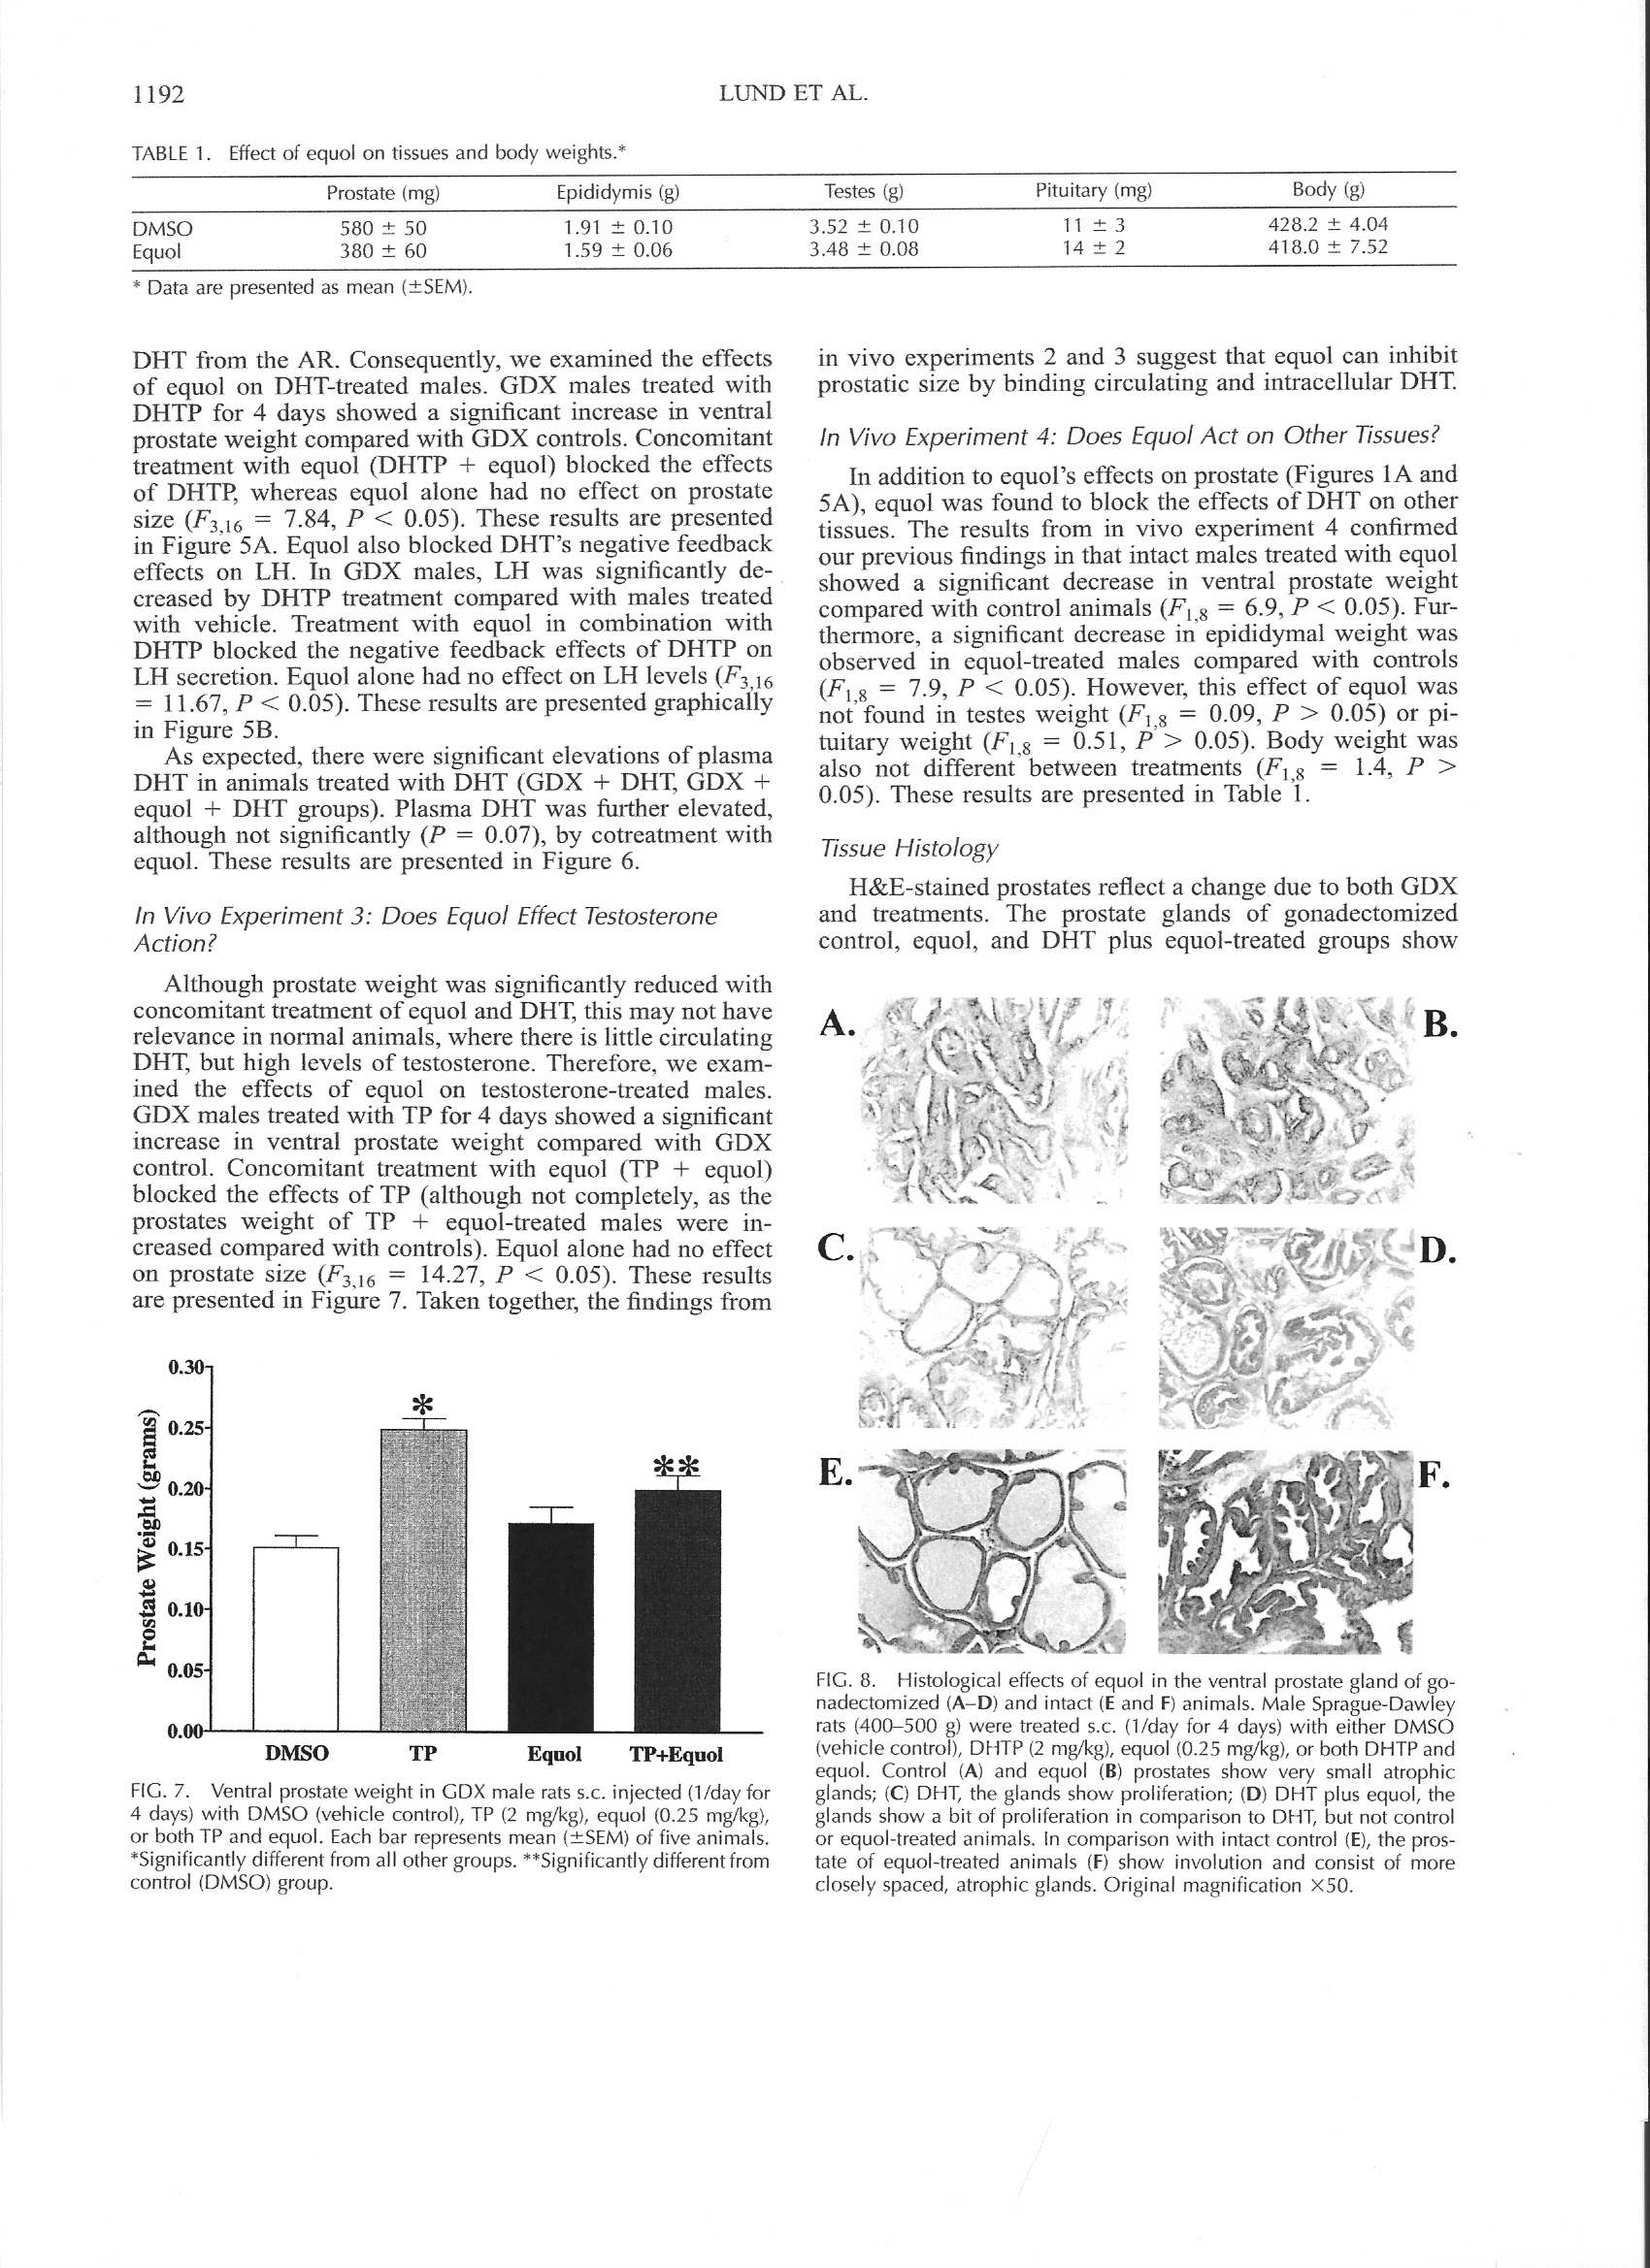
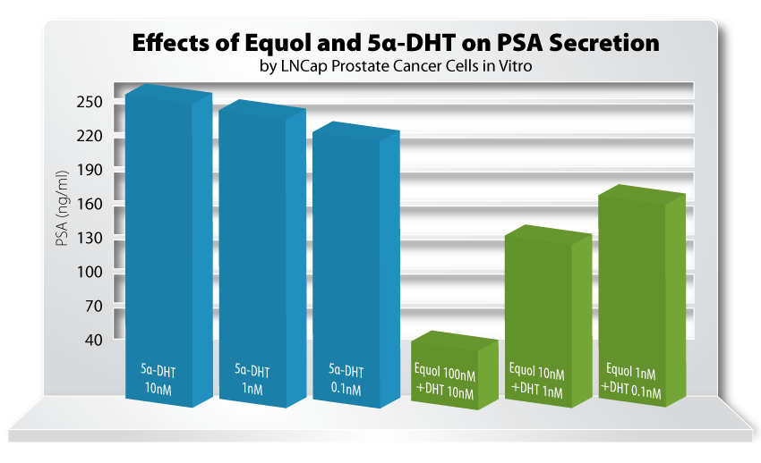
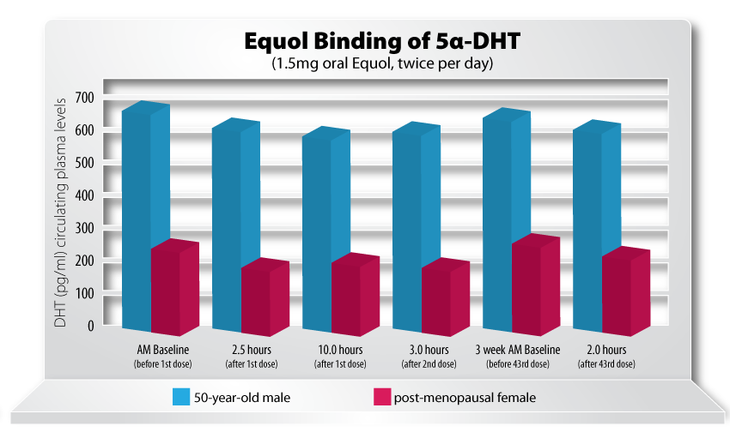
Equol and Prostate Weight
(Animal Study)
Equol: Human in vitro Studies
Rat Ventral Prostate
Decreases PSA levels in LnCAP
prostate cancer cells (in vitro)
Control
Equol
(0.25 mg/Kg for 4 days)
Equol:
decreased DHT
levels in men &
women by 20 %
Lund TD et al, Reproductive Biology and Endocrinology, January 2011, 9; pp 4-
Lund et al., Biol Reprod 2004
o J Urology Lephart 3: 21-26 2013

Slide 12
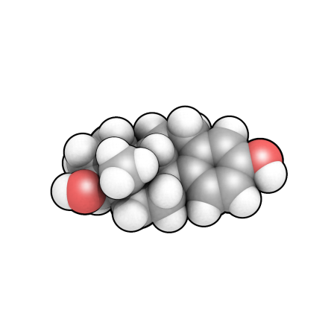
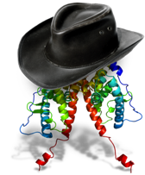
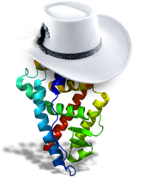
Estrogen Function in the Prostate
Estradiol can bind with and activate either
  Estrogen receptor alpha (ER alpha)
  Estrogen receptor beta (ER beta)
ER-α
ER-β
  Proliferation
  Malignancy
  Inflammation
  Antiproliferative
  Anticarcinogenic
  Anti-inflammatory
E.D. Lephart,
O J Endo Metab Dis, 2014

Slide 13
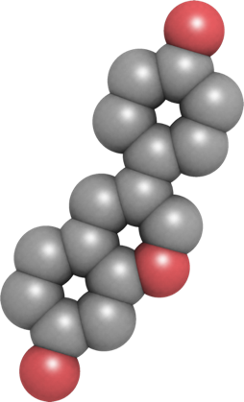
Stimulates Collagen, Elastin & TIMP 1 to Protect against OS
Inhibits AP-1
& Neoplastic Cell Growth via ERRγ to Protect against OS
Inhibits MMPs, Elastase &
5α-Reductase Enzyme to Protect against OS
Protects DNA & Enhances Nerve/Tissue Repair to Guard against OS
Inhibits NFkappB
to ↓ ROS
EQUOL
Inhibits Inflammatory Response to
↓ ROS
Binds 5α-DHT & ERβ
Stimulates Nrf2
to ↑ Antioxidants
that ↓ ROS
E.D. Lephart, Ageing Research Reviews, 2016, in press

Slide 14
Equol Clinical Prostate Study
Protocol: Nutritional supplement study: Equol (6 mg) taken twice per day, once with breakfast and once with dinner
Subjects: 18 healthy males between 49 and 60 years old (BPH) assessed via the International Prostate Symptom Score (IPSS)
  10 subjects - moderately symptomatic (8-19)
  8 subjects - severely symptomatic (20-35)
Duration: 4 weeks
o J Urology Lephart 3: 21-26 2013

Slide 15
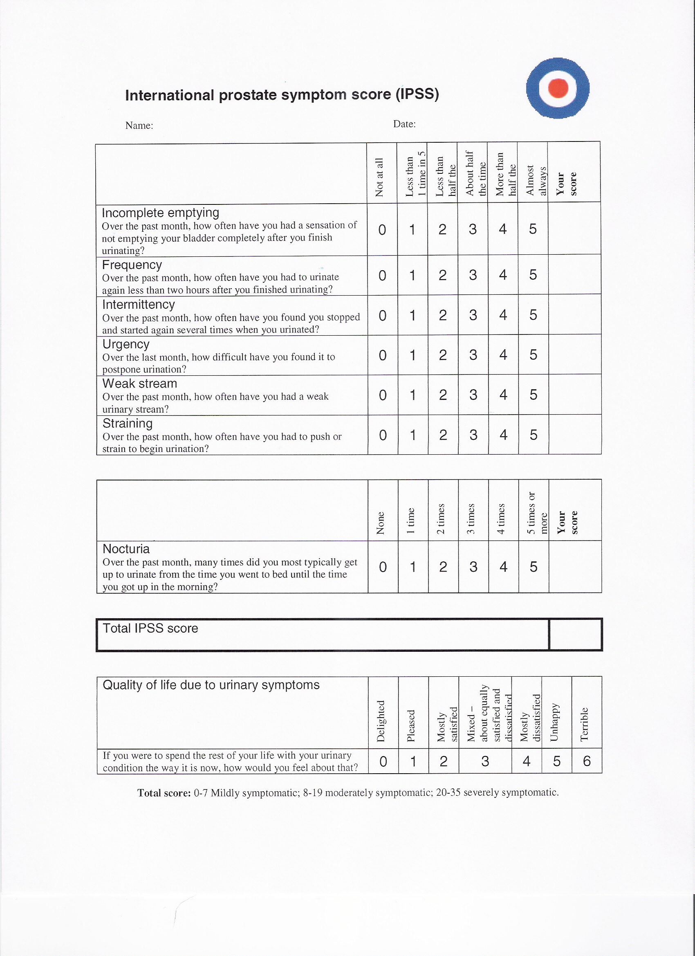
IPSS score
0 = Not at all
5 = almost always
Nocturia
0 = none
5 = 5 times or more
Total score-
0-7 Mildly symptomatic
8-19 Moderately symptomatic
20-35 Severely symptomatic
o J Urology Lephart 3: 21-26 2013

Slide 16
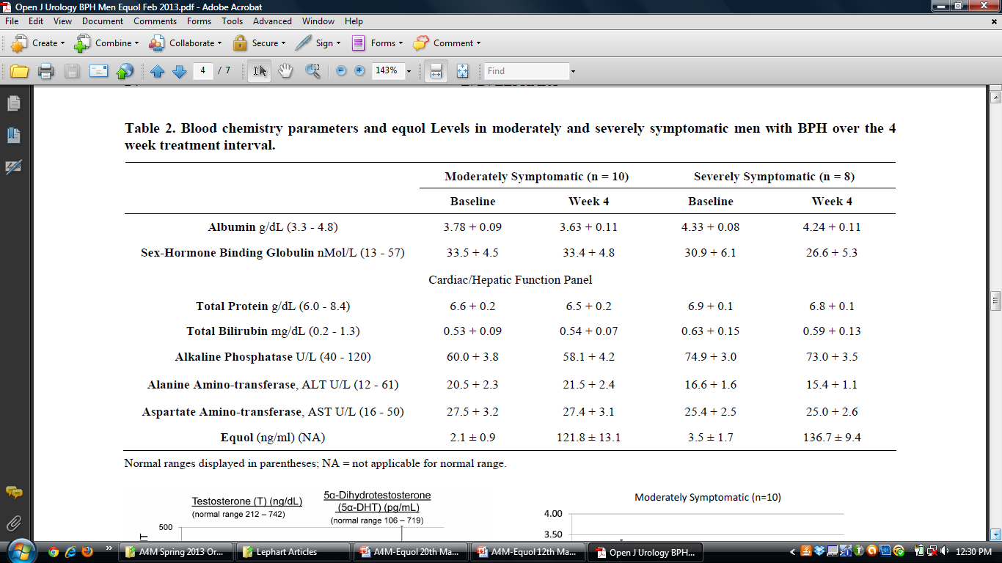
Summary blood chemistries: Albumin, Sex Hormone Binding Globulin, Total Protein/Bilirubin, Alkaline Phosphatase, ALT & AST (no significant changes); Equol levels ↑ with dosing
Blood chemistry parameters & equol levels in moderately & severely symptomatic men with BPH over the 4-week treatment interval
o J Urology Lephart 3: 21-26 2013

Slide 17
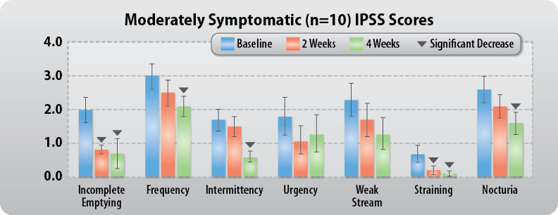
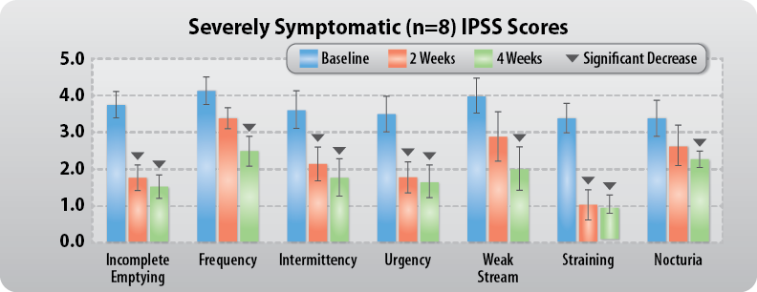
Equol and Prostate
o J Urology Lephart 3: 21-26 2013

Slide 18
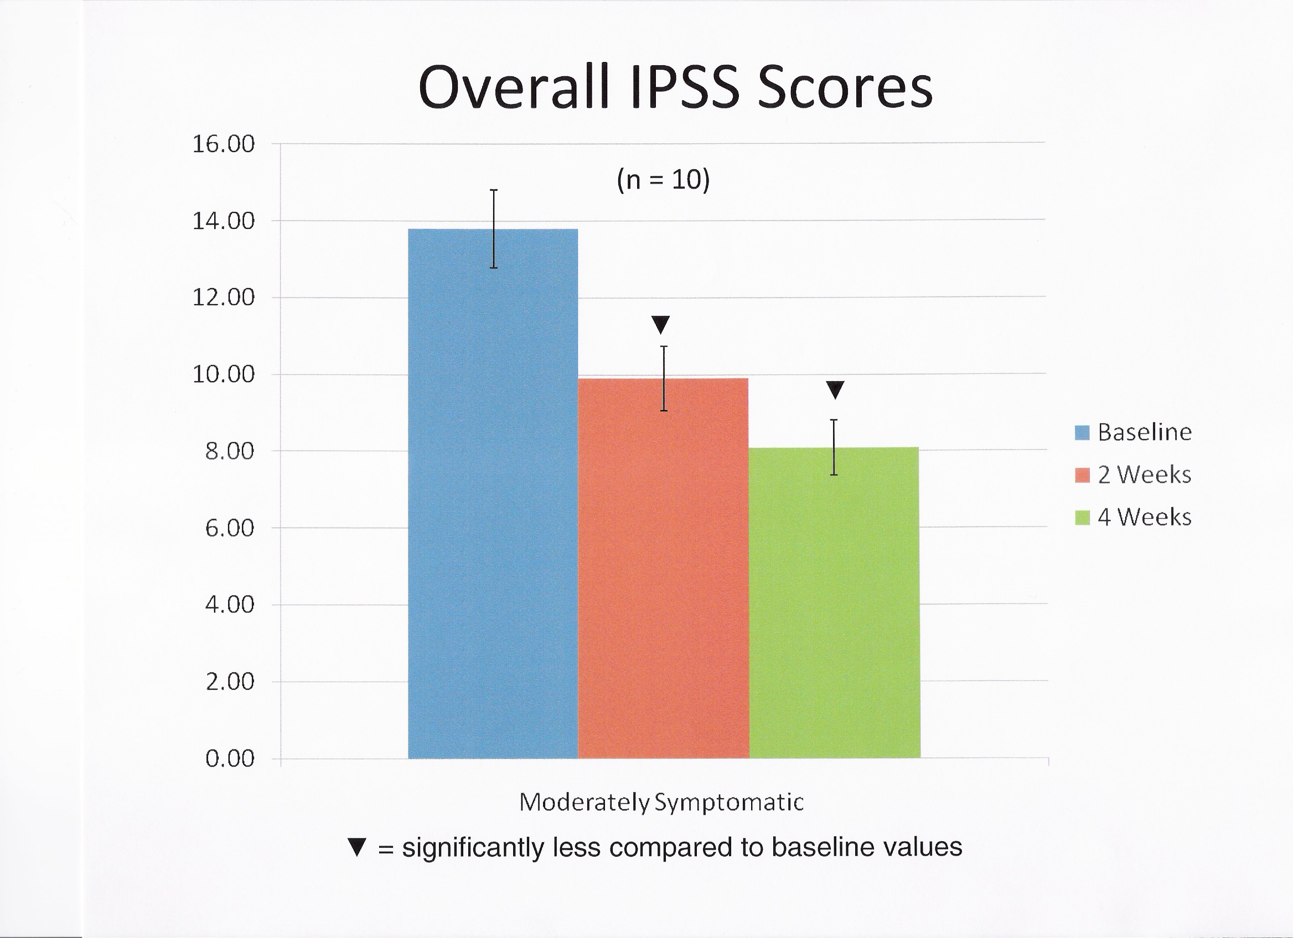
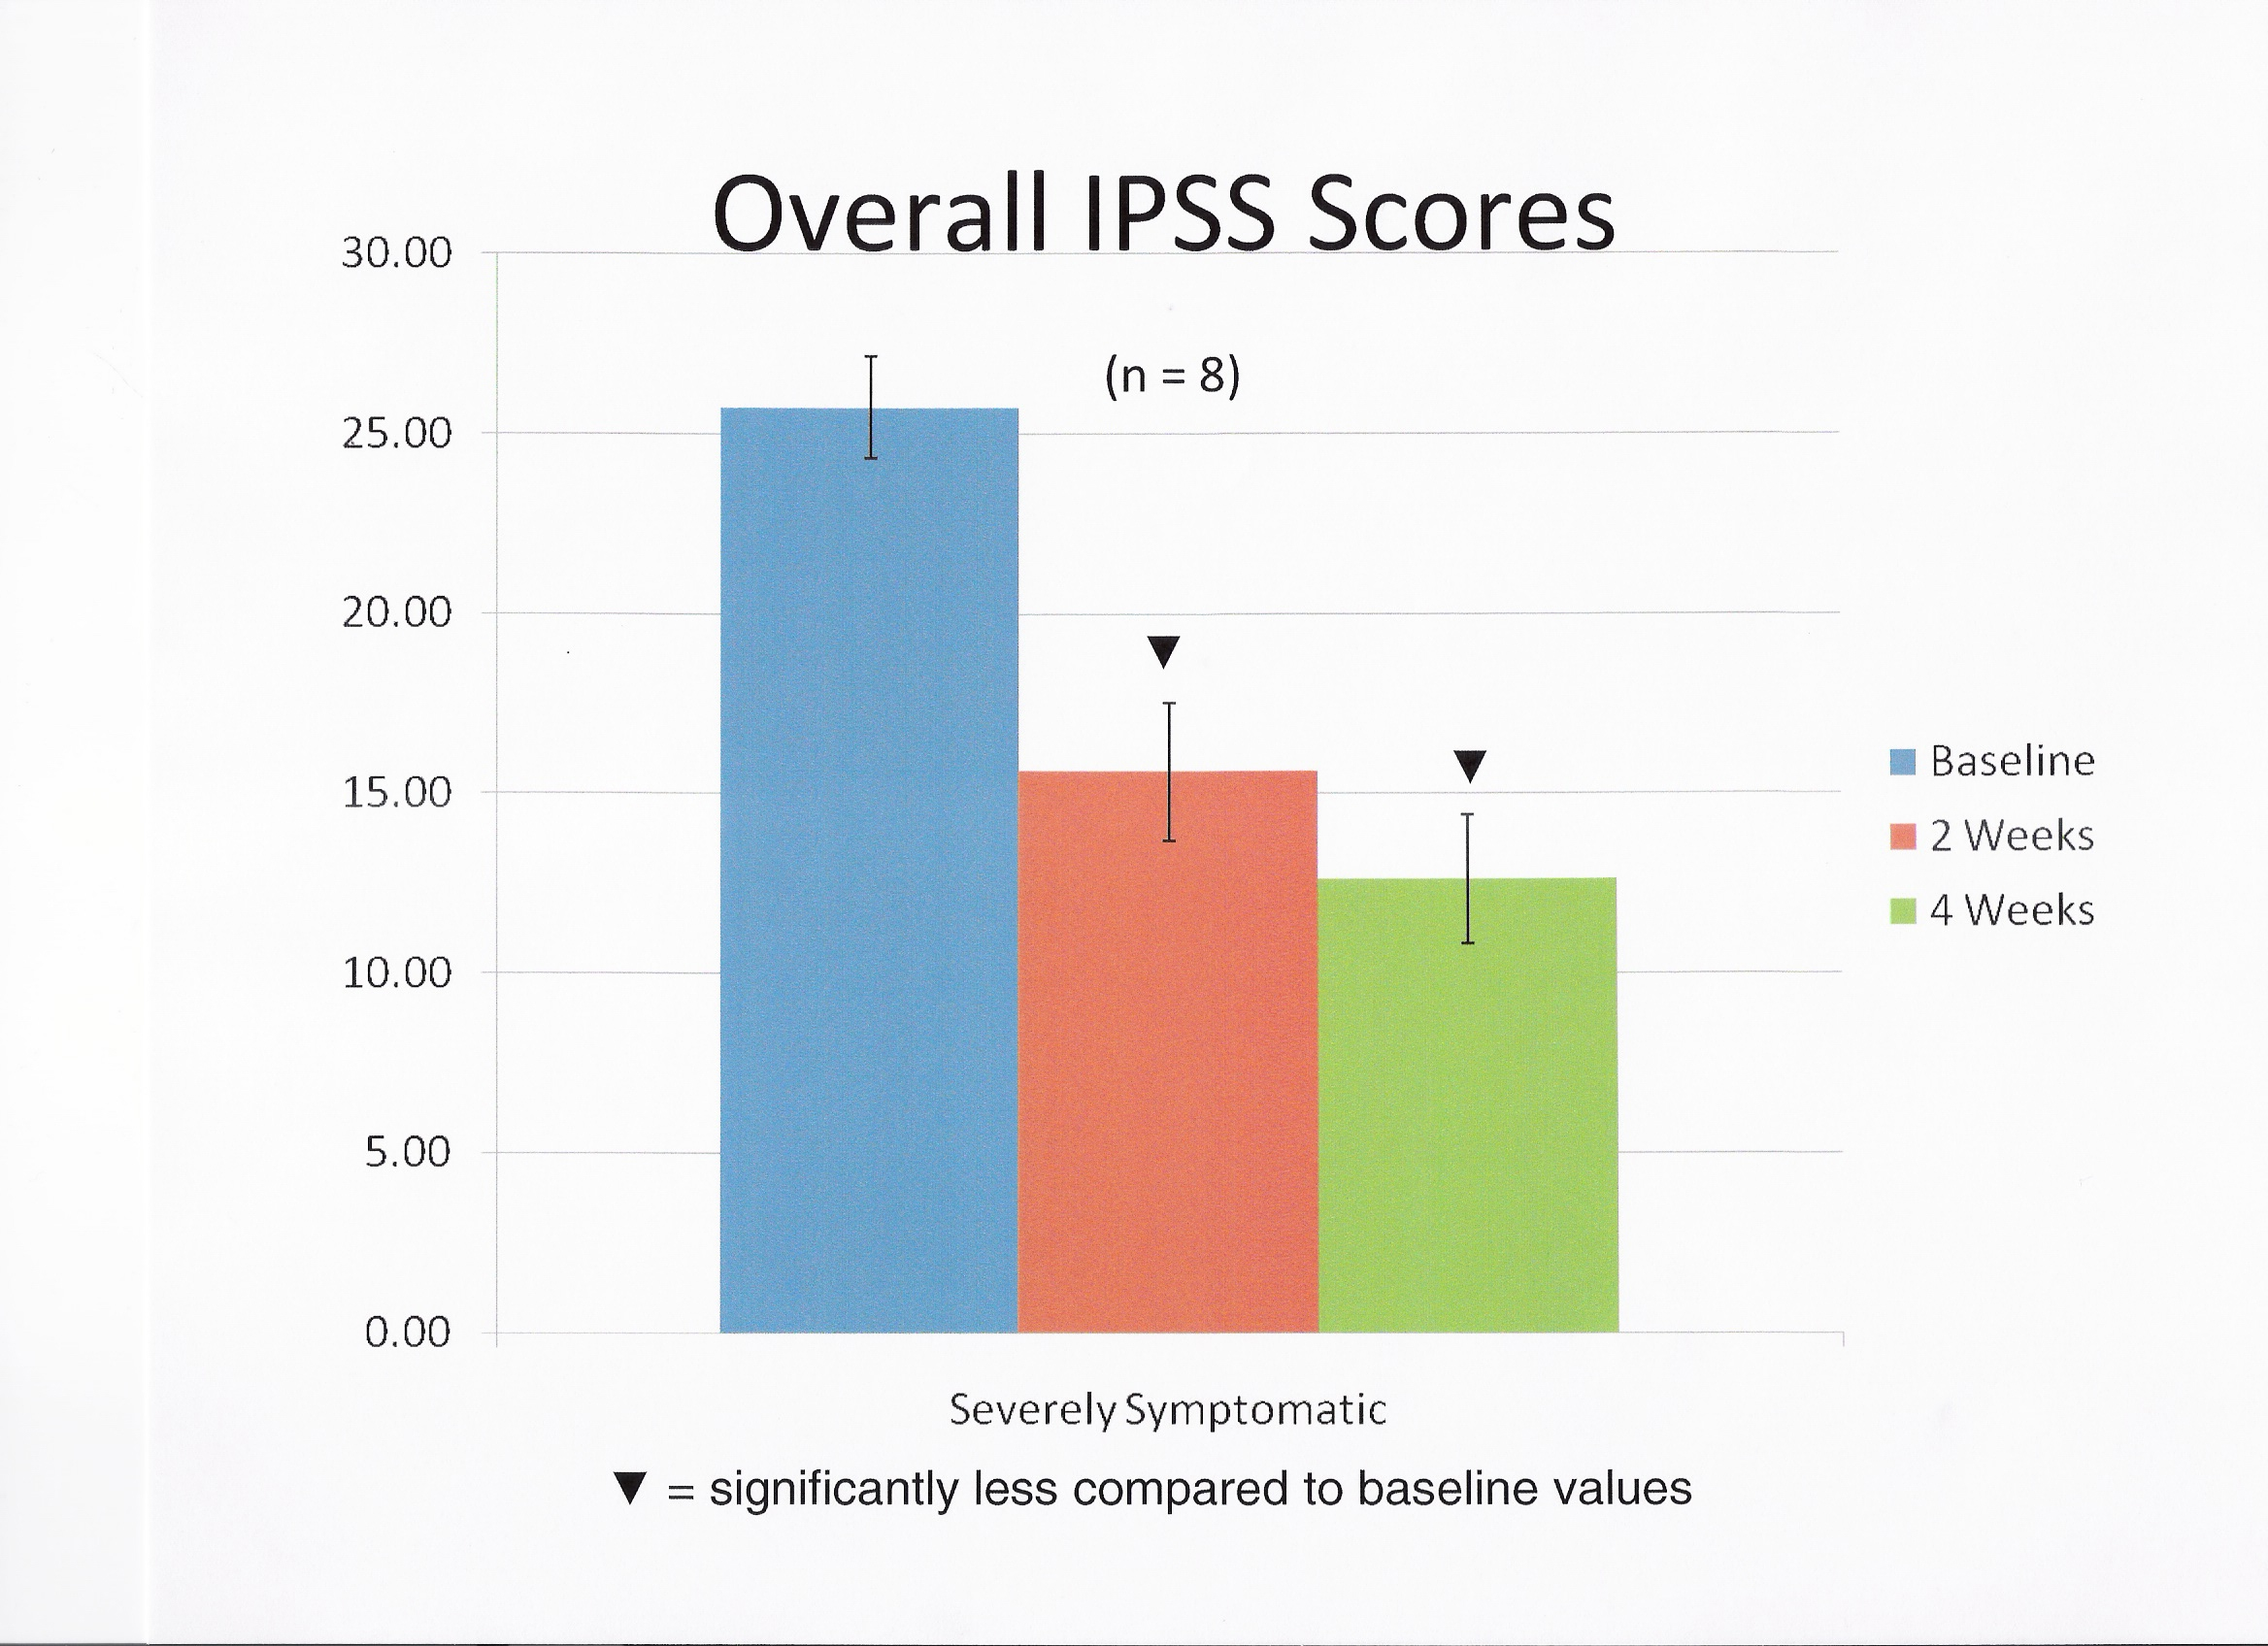
o J Urology Lephart 3: 21-26 2013

Slide 19

How Equol Works:
Binds ERR-γ
Binds ER-β
EQUOL
Binds 5α-DHT
Down-regulates AR
Down-regulates ERα
Moderate EFFECT
MAJOR EFFECT
ERRγ
5α-DHT
ERβ
Negative actions of ERα
Androgen hormone action at androgen receptor (AR)
Proliferation of prostate cells
Inflammation
Carcinogenesis
Prostate Volume
BPH Symptoms
o J Urology Lephart 3: 21-26 2013

Slide 20
Conclusions: Resveratrol & the Prostate (BPH)
Resveratrol is the most high profile polyphenolic compound in the US that
is sold as a treatment for a variety of health conditions in stores
Due to its rapid metabolism by the liver it is estimated that dosing ranging
from 2,000 to 5,000 mg daily may be required for the treatment of BPH
From available studies these high doses appear to be safe but the very
large tablets required for this dosing range reduce ease of administration,
complications in swallowing such large tablets and low compliance
Future humans studies are required to determine the true significance of
Resveratrol as an effective treatment for BPH (@ very high doses)

Slide 21
Conclusions: Equol & the Prostate (BPH)
EQUOL
Moderately symptomatic group (n = 10):
  IPSS parameters, 5 out of 7 indicators significantly improved after 4 weeks of equol treatment
  Overall IPSS scores significantly decreased—baseline level of 13.8 to 8.1 after four weeks of Equol treatment
Severely symptomatic group (n = 8):
  IPSS parameters, all 7 indicators significantly improved after 4 weeks of equol treatment
  Overall IPSS scores significantly decreased - baseline level of 25.75 to 12.50 after four weeks of equol treatment
Quality of life IPSS scores:
  Significant improvement from 4.5 (mostly dissatisfied to unhappy) at baseline to a level of 2.8 toward the mostly satisfied category in the severely symptomatic group
Total number of urinations (average) per day decreased from 12.1 to 9.2 (24 % decrease) [normal = 4 to 7/day]
DHT levels decreased by 21 % in severely symptomatic men versus baseline values
o J Urology Lephart 3: 21-26 2013

Slide 22

Department of Physiology & The Neuroscience Center,
College of Life Sciences,
Brigham Young University
Provo, Utah, USA 84602
Funding provided, in part, by:
United States Department of Agriculture (USDA),The National Institutes of Health (NIH) & TTO/LS College-BYU grants
Collaborators:
Merritt B. Andrus, PhD, Department of Chemistry and Biochemistry, BYU
Trent D. Lund, PhD, Department of Biomedical Science, Colorado State University, Fort Collins, Colorado, USA
Robert J. Handa, PhD, Department of Biomedical Science, Colorado State University, Fort Collins, Colorado, USA
Lihong Bu, MD, PhD, Department of Pathology & Laboratory Sciences, University of Minnesota, Minneapolis, Minnesota, USA
Kenneth Setchell, PhD, Department of Pathology, Cincinnati Children’s Hospital, Cincinnati, Ohio, USA
Publications: Lephart, E.D., 2013. Isoflavones and prenatal exposure to equol. In: Preedy, V.R. (Ed.), Isoflavones: Chemistry, Analysis, Function. The Royal Society of Chemistry, Thomas Graham House, Science Park, Cambridge, England, UK, pp. 480-499.; Lephart, E.D. , 2013. Severe and Moderate BPH Symptoms in Mid-Aged Men Improve with Isoflavonoid-Equol Treatment: Pilot Intervention Study, O J Urology, 3, 21-27; Lephart, E.D., 2014. Review: Antioxidant and anti-aging properties of equol in prostate health (BPH). Open J. Endo. Metab. Disorders. 4. doi: 10.4236/ojemd.2014.41001.
Lephart, E.D., Summerfeldt, J.M., Andrus, M.B., 2014. Resveratrol: Influences on gene expression in human skin. J. Funct. Foods. 10, 377-384; Lephart, E.D., 2015. Modulation of aromatase by phytoestrogens. Enzyme Res. article ID 594656, 2015, doi: 10.1155/2015/594656; Lephart, E.D., 2016. Skin Aging and Oxidative Stress: Equol’s Anti-Aging Effects via Biochemical and Molecular Mechanisms. Ageing Research Reviews, in press, doi:10.1016/j.arr.2016.08.001
Lund et al., 2004. Equol is a novel anti-androgen, Biol Reproduction; Lund, T.D., Blake, C., Bu, L., Hamaker, A.N., Lephart, E.D., 2011. Equol an isoflavonoid: potential for improved prostate health, in vitro and in vivo evidence. Reprod. Biol. Endo. 9,4. doi:10.1186/1477-7827-9-4
Setchell, K.D.R., Clerici, C., Lephart, E.D., Cole, S.J., Heenan, C., Castellani, D., Wolfe, B.E., Nechemias-Zimmer, L., Brown, N.M., Lund, T.D., Handa, R.J., 2005. S-Equol, a potent ligand for estrogen receptor {beta}, is the exclusive enantiomeric form of the soy isoflavone metabolite produced by human intestinal bacterial flora. Am. J. Clin.Nutr. 81, 1072-1079; Setchell, K.D.R., Clerici, C., 2010. Equol: history, chemistry, and formation. J. Nutr.140, pp. 1355S-1362S.

