Slide 1
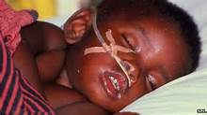
ANEMIA IN A CHILD WITH MALARIA
EDWIN CHANSA
UNIVERSITY OF LUSAKA,
ZAMBIA

Slide 2
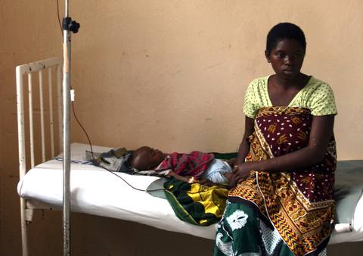
CASE REPORT
Four years old boy presented to Mpongwe Mission Hospital in Zambia in an emergence state
Previously was well
Fever started 5 day ago (intermittent fever)
Did not bother the young mother
Sudden onset of vomiting,
fatigue and sleepy.

Slide 3
….CASE REPORT
Immunization History: Up to date with immunisations
Drug History: Child was not given any medication
Past medical History: Nothing significant, first hospital admission

Slide 4
…..CASE REPORT
At the time of admission child was in coma
Blantyre coma scale of 2/5
In obvious distress
Respiratory rate (RR) 38 breaths/ minute
Pulse rate 125 beats/ minute
Temperature 39°C
Weight 20 kg

Slide 5
…..CASE REPORT
Was very pale
Skin showed no jaundice.
No dehydration
Heart, lungs and abdomen were normal.
Action
Oxygen was quickly administered
Intravenous (IV) access established
Blood for urgent Full Blood Count (FBC)
Nasogastric Tube (NGT) was inserted

Slide 6
…..CASE REPORT
Malaria test using Rapid Diagnostic Test (RDT)
Positive for malaria Plasmodium Falciparum
Diagnosis “severe malaria with anemia”
Antimalarial drugs (Quinine) 400mg in 10% dextrose loading dose
After 45 minutes we received results from the laboratory

Slide 7
…...CASE REPORT
Laboratory results
White Blood Cell (WBC) 17.4 × 10⁹/ L,
Platelets Count 140 × 10⁹ / L ,
Haemogloblin level 4.2g/dl and
Blood group B- rhesus positive.
Unfortunate there was no blood in the Hospital blood bank so we continued with quinine drip.

Slide 8
…..CASE REPORT
Throughout the day and night the child could hardly show some signs of improvement.
The following day we manage to receive blood from a bigger Hospital.
400mls of Blood was transfused in 3 hours
After eight hours the child responded clinically by regaining consciousness.

Slide 9
…..CASE REPORT
In the evening the child was fully conscious and managed to eat three spoons of porridge.
Two days later the child was discharged on:
- Quinine 200mg three times for four days
- Folic Acid 5mg once daily for one month
Return visit three weeks later haemogloblin levels of 8.6g/dl and malaria test was negative.

Slide 10
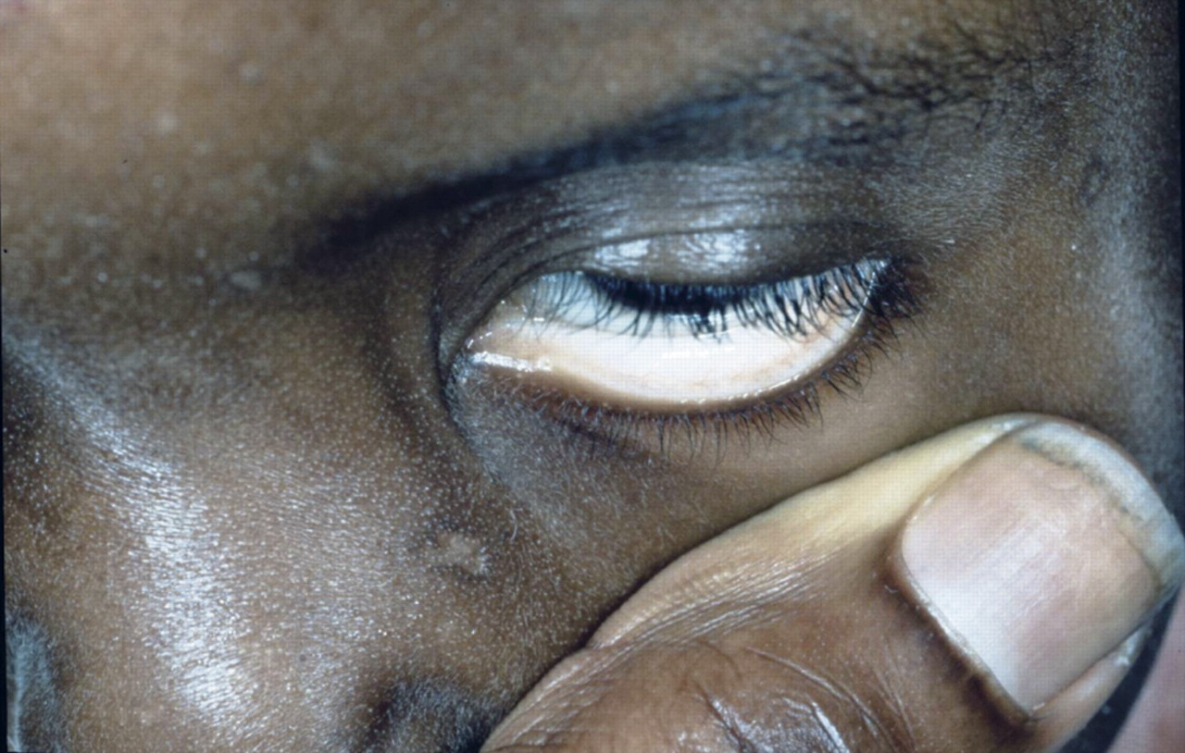
Discussion
Severe anemia is highly prevalent complications of Plasmodium falciparum malaria among children.

Slide 11
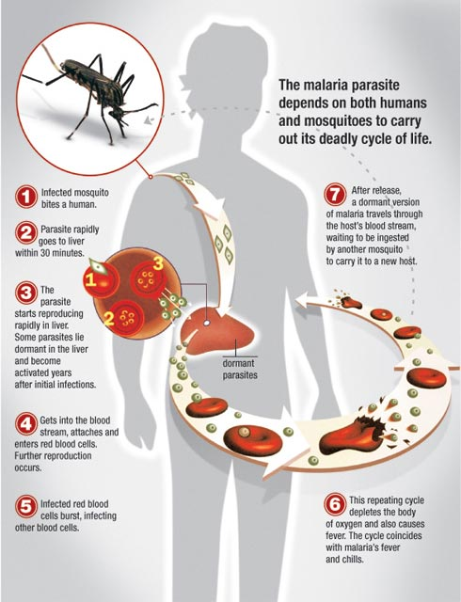
PATHOPHYSIOLOGY

Slide 12
….PATHOPHYSIOLOGY
Malaria parasite undergo two phases:
- Asexual (in human body)
- Sexual (in Mosquito)
Human being is an intermediate host while a mosquito is a definitive host.

Slide 13
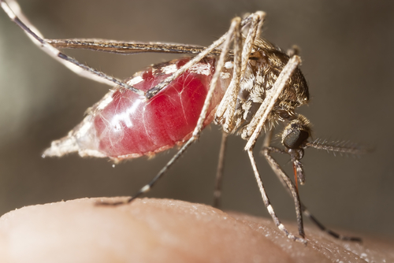
…..PATHOPHYSIOLOGY
Asexual cycle starts: When a Mosquito beats a human being inject sporozoites.

Slide 14
…..PATHOPHYSIOLOGY
Sporozoites disappear within about 60 minutes from peripheral circulation
Many of them are destroyed by phagocytes
But some reach the liver cells,
After 1 – 2 weeks of developing in the liver they become hepatic schizonts which eventually burst releasing merozoites.

Slide 15
PATHOPHYSIOLOGY

Slide 16
…..PATHOPHYSIOLOGY
Number of Merozoites produced from a single sporozoites varies with infecting species.
A single Plasmodium Falciparum sporozoites can form as many as 40 000 merozoites, were as from other species of plasmodia produce only 2000 to 15000 merozoites (hepatic phase)

Slide 17
…..PATHOPHYSIOLOGY
Erythrocytic phase: Many of the merozoites are quickly destroyed
But a significant number attach to specific receptor sites on the Red Blood Cells (RBC)
The merozoites then penetrates the RBC and pass through the stage of trophozoites and schizont.
The erythrocytic phase ends with liberation of merozoites which infect fresh RBCs

Slide 18
PATHOPHYSIOLOGY

Slide 19
…..PATHOPHYSIOLOGY
Severe malarial anemia is usually due to increased removal of circulating erythrocytes as well as decreased production of erythrocytes in the bone marrow.
Severe anemia is known to be associated with a reduction in the oxygen carrying capacity of circulating blood resulting into tissue hypoxia

Slide 20
…..PATHOPHYSIOLOGY
Hypoxia from anemia and the sequestration of red blood cells in the microcirculation results in increased anaerobic respiration leading to the production of large quantities of lactic acid. This manifests as respiratory distress with acidotic breathing.

Slide 21
…..Discussion
These Metabolic derangements further depress the level of consciousness in a child with malaria leading to coma

Slide 22
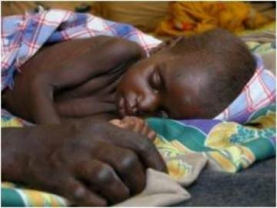
…
Child in coma

Slide 23
Standard treatment
Regime of quinine
Supportive therapy of anti-convulsants
Antipyretic (paracetamol)
Blood transfusion
Fluids should be administered as appropriate
Hypoglycemia corrected with 10% or 25% dextrose (2 ml/kg)
Nasogastric tubes for feeding
Oxygen therapy

Slide 24
Conclusion
In summary our patient was admitted with severe malaria with anemia in a coma state to Mpongwe mission hospital
Estimated haemogloblin of 4.2 g/dl
Rapid Diagnostic Test (RDT) for plasmodium falciparum positive.

Slide 25
…..Conclusion
Intravenous quinine 400 loading dose in dextrose was first given,
Blood transfusion 24 hours later.
The child’s level of consciousness improved significantly shortly after blood transfusion.
We therefore concluded that severe anemia in children with malaria is associated with coma.

Slide 26
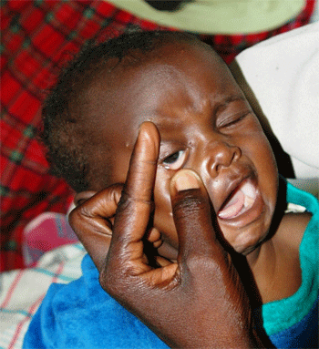
As we walk through the Path of Identifying Novel Therapeutics for Blood Disorders lets not forget that severe malarial anemia is claiming the lives of innocent children in sub-Saharan African.

Slide 27
ACKNOWLEGEMENTS
Britt Gustafsson
Professor in pediatric hematology,
Senior consultant,
Karolinska institutet
Leif Gustafsson (husband)
Ms Nchinga,, senior Head of Public Health Dept,
University of Lusaka.
Professor. Chifwanakeni,
University of Lusaka.
Workmates at Mpongwe Mission Hospital

Slide 28
References
Rowe AK, Rowe SY, Snow RW, et al. The burden of malaria mortality among African children in the year 2000. Int J Epidemiol. 2006;35:691-704.
Marsh K, Forster D, Waruiru C, Mwangi I, et al. Indicators of life threatening malaria in African children. New Eng J Med 1995; 332 (21): 1399 - 404.
Molyneux M E, Taylor T E, Wirima J J, Borgstein A. Clinical features and prognostic indicators in Paediatric cerebral malaria; a study of 131, comatose Malawian children. Quart J Med 1989; 265: 441 - 459.
Warrell D.A. Management of severe malaria. Parasitological 1999; 41: 287–94.
Marsh K, Forster D, Waruiru C, Mwangi I, et al. Indicators of life threatening malaria in African children. New Eng J Med 1995; 332 (21): 1399 - 404.
WHO. Severe falciparum malaria. Trans R Soc Trop Med Hyg.2000 94 (suppl).1:1-45.
Biemba G, Dolmans D, Thuma P.E, Weiss G, Gordeuk R. Severe anemia in Zambian children with Plasmodium Falciparum Malaria. Tropical Medicine 2000; Vol. 5: 9 -16.

Slide 29
…References
Vryonis G. Observations in the parasitizaton of erythrocytes by Plasmodium vivax, with special reference to reticulocytes. Am J Hyg. 1939; 30:41.
Langhorne J, Quin SJ, Sanni LA. Mouse models of blood-stage malaria infections: immune responses and cytokines involved in protection and pathology. Chem Immunol. 2002; 80:204-228.
Looareesuwan S, Ho M, Wattanagoon Y, et al. Dynamic alteration in splenic function during acute falciparum malaria. N Engl J Med. 1987; 317:675-679.
WHO. Severe falciparum malaria. Trans R Soc Trop Med Hyg. 2000 94 (suppl).1:1-45.

Slide 30
THANK YOU !!

