Slide 1


LC/MS method transfer: surprises and troubleshooting.
Eduard Rogatsky
Biomarker Analytical Resource Core
Albert Einstein College of Medicine
Einstein-Montefiore Institute for Clinical & Translational Research. Bronx, NY
Notes:
1

Slide 2
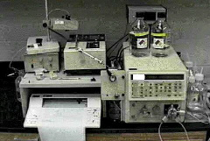
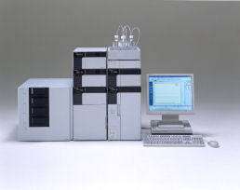

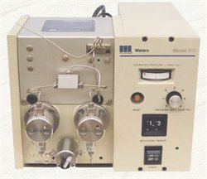
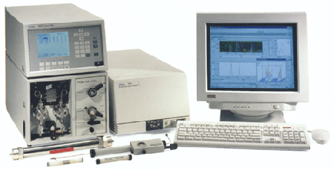
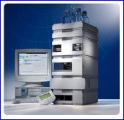
HPLC Instrument Development Milestones
?
1960s-1980s
“old”HPLC
1980s-2000s
“Conventional”
HPLC
2004 - Present
Acquity UPLC (2004)
1992, MS-DOS
1998, Windows 95
2001, Windows XP

Slide 3
HPLC Instrumentation Development
UHPLC was introduced 10 years ago. This new technology, while having great promise for improved efficiency and productivity, has not to date displaced HPLC. This transition will be slow process.
Currently, both HPLC and UHPLC can be working in the same lab.
Efficient method transfer from HPLC to UHPLC
or UHPLC to HPLC is essential.

Slide 4
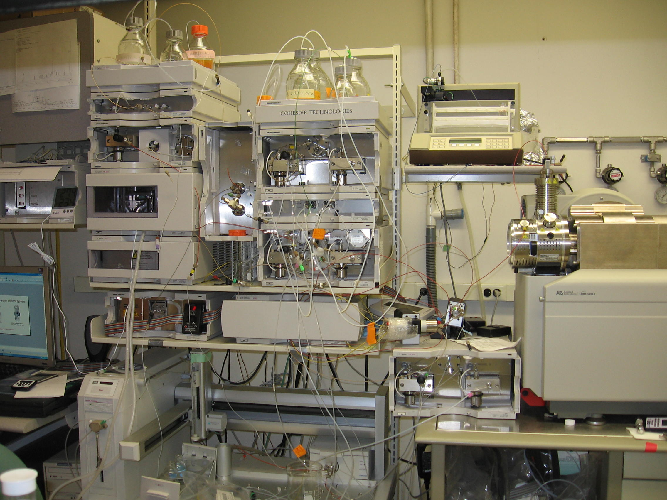
Old LC: Agilent 1100 and 1200 series
Notes:
In our lab we have old and new lc systems

Slide 5
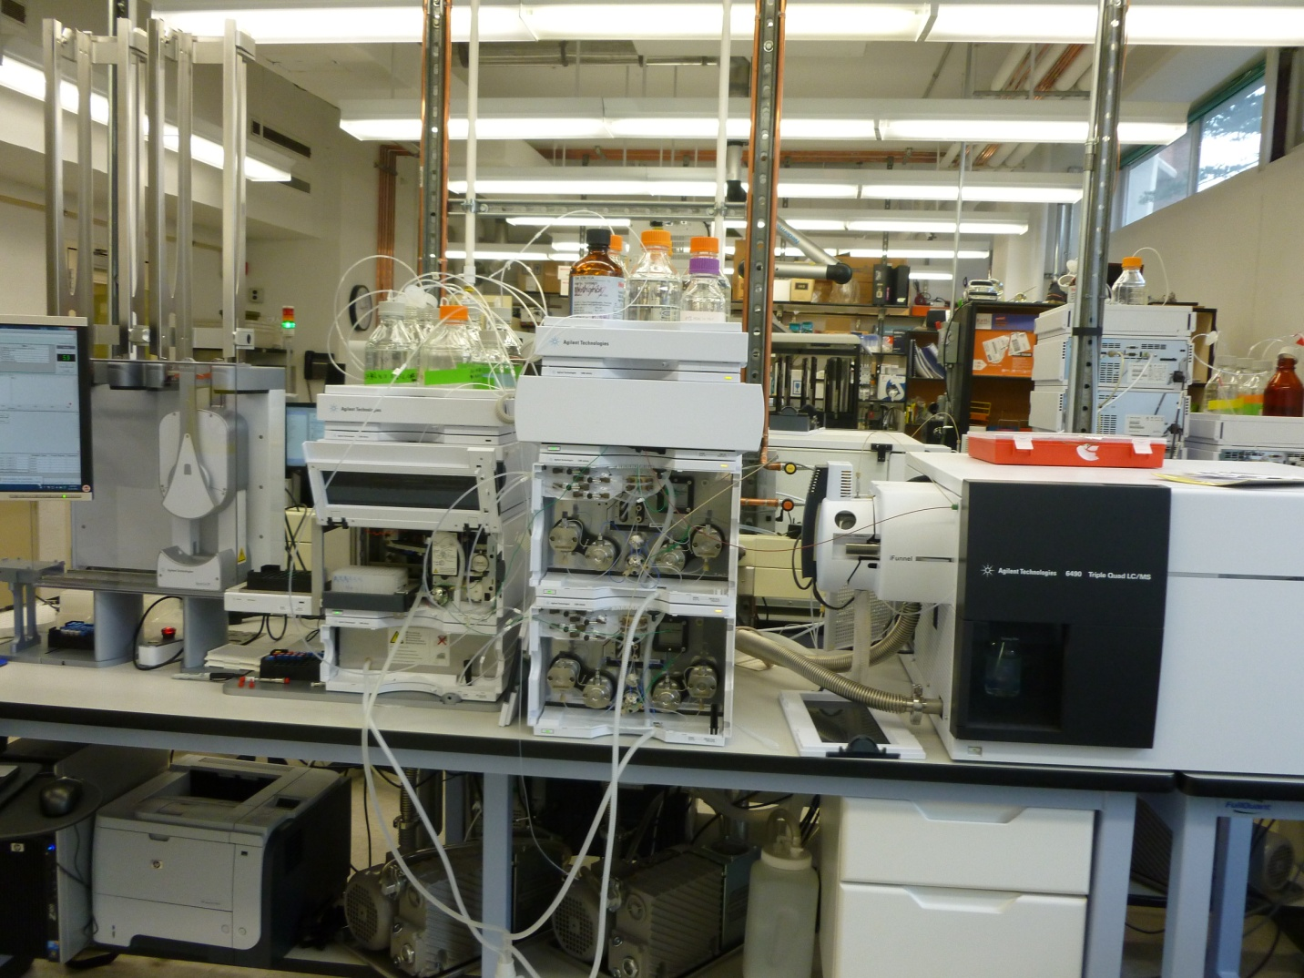
NEW LC: Agilent 1290 series
Notes:
Here is new lc/ms

Slide 6
UHPLC vs HPLC
UHPLC it is not only a system that’s capable of operating at higher pressures. UHPLC is optimized to work with sub 2 micron ultra –high resolution columns to produce very narrow sharp chromatographic peaks.
UHPLC –in contrast to conventional HPLC, is a low dwell volume system designed for fast runs at high pressure.
Notes:
GCRC is intermediate chain between hospital and university. And we are enjoy from both worlds.

Slide 7
Current LC method and pump/system replacement: delay/dwell volume impact
Differences in volume between LC systems can result in different retention times, gradient formation and selectivity. Knowledge of the pump [system] delay volume is essential for successful method transfer from HPLC to UHPLC and visa versa.

Slide 8
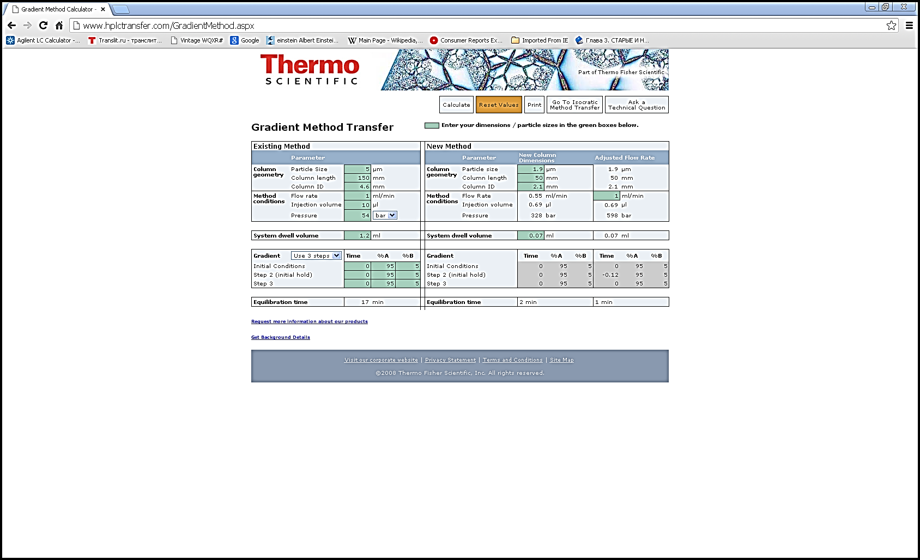
Gradient method transfer
Knowledge of dwell volume is essential for method transfer.

Slide 9
Objective
Dwell (delay) volume is a “system volume from the point at which the mobile phase solvents are mixed until they reach the head of the column”.
Minimization of pump dead volume below 0.1 ml has been essential to recent advances in the field of UHPLC

Slide 10
Dwell volume assessment
The accurate assessment of pump dwell volume is not a simple task. Different manufacturers measure dwell volume using different methodologies (or not at all). As a result, the calculated values may vary, and even be misleading. Currently, there is no consensus on the best methods to use.

Slide 11
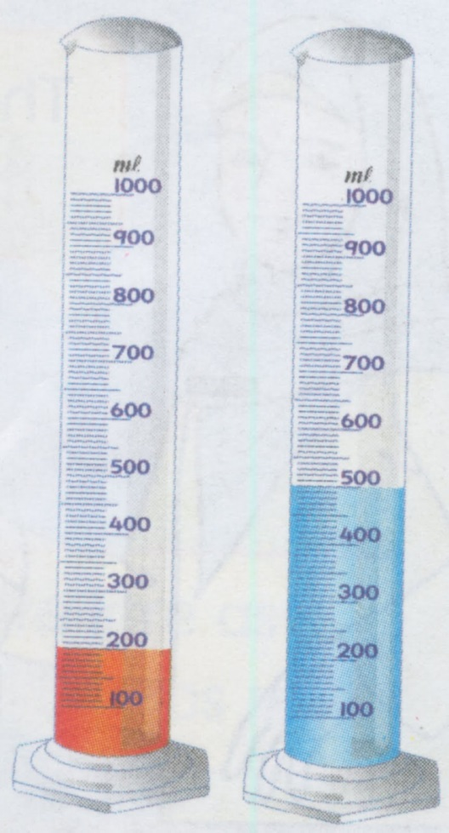
Delay volume: misconception 1
Vol.A+Vol.B =Total volume (for same liquid)
LC delay volume is formed from different components: tubing, filters, mixers, pulse dampers.
Delay volume (total) ≠ sum of physical volumes (swept volumes) of each component contributing delay, even for the same liquid

Slide 12
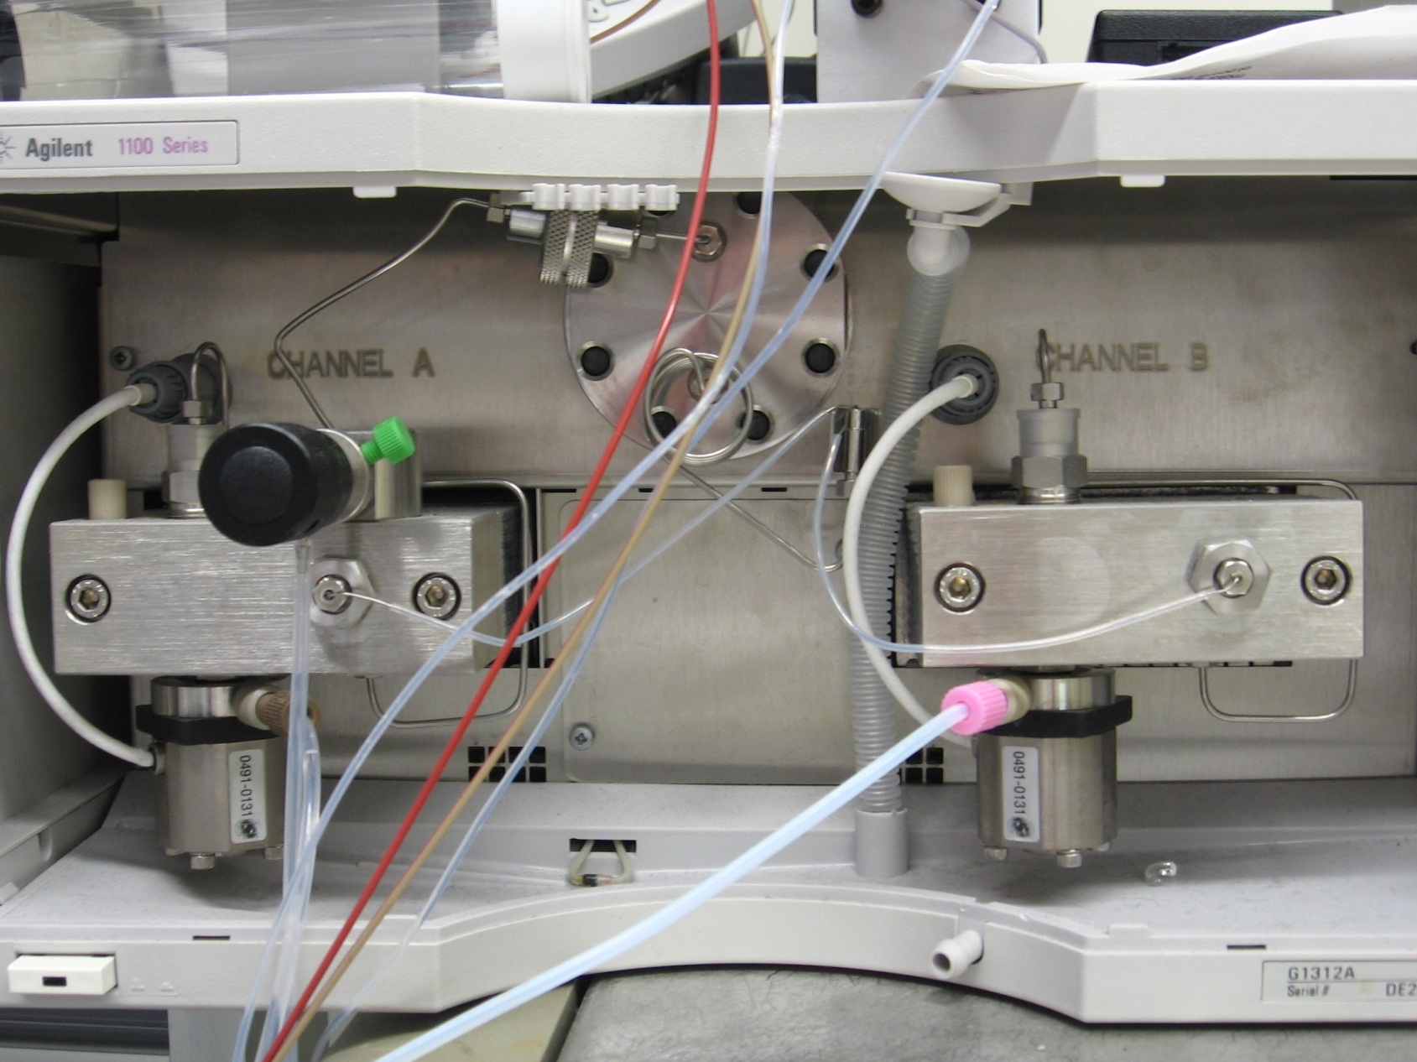
Agilent 1100/1200 series standard binary pump
Mixer
Pulse damper
Mixing
chamber
Filter
Notes:
Compnets specify. Change picture?

Slide 13
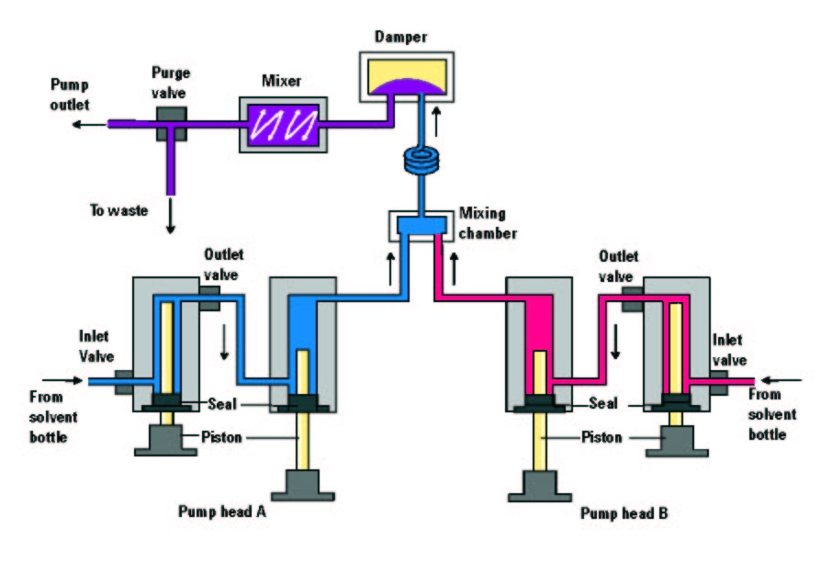
G1312A binary pump flow path diagram
Copyright 2005, Agilent Technologies, Inc. Reproduced with Permission
Agilent Technologies, Inc. makes no warranty as to the accuracy or completeness of the foregoing material and hereby disclaims any responsibility therefore.

Slide 14
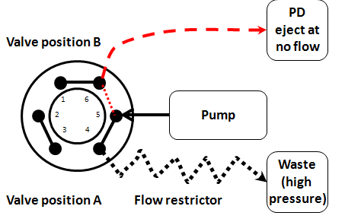
Measurement of dwell volume of 1100 Agilent pump
Pump delivers water at different flow rates (0.1 – 0.885 ml/min) and pressure ranges (49 -390 bar).
65µm ID tubing
Notes:
Remove numbers on other side

Slide 15
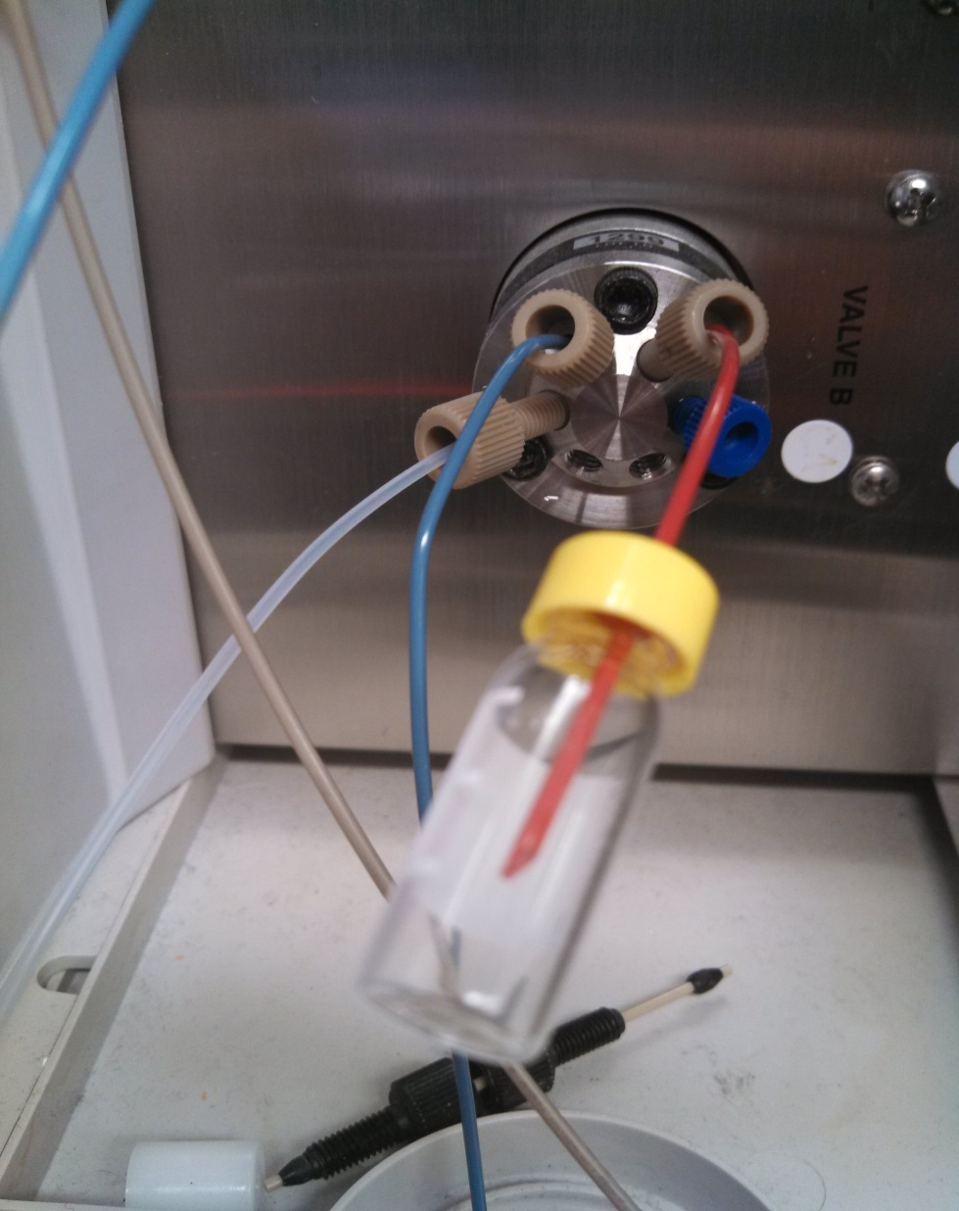
Measurement of dwell volume of 1100 Agilent pump
After 5 min of pressure equilibration at given flow rate, flow is ceased and valve is switched. Pulse damper content ejects into a vial.

Slide 16
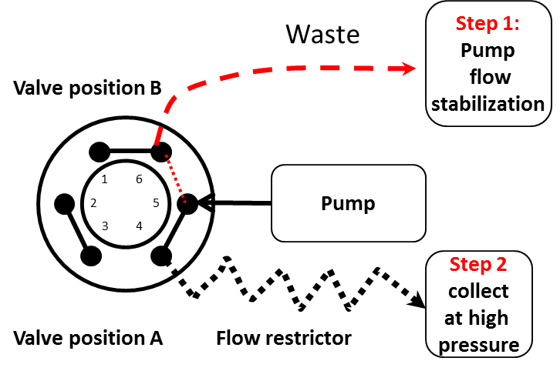
Measurement of dwell volume of 1100 Agilent pump
Dynamic filling experiment
Pump flow stabilizes to waste at the step 1. Valve switched and water collected 5 min at different flow rates.
No pressure
65µm ID tubing
Notes:
Remove numbers on other side

Slide 17
Dynamic filling experiment
Dynamic filling and pulse damper ejection experiments
yield identical results.

Slide 18
Conclusion 1
Reported dwell volume: 180-480 ul (0-400 Bar) =300ul increase at maximum pressure.
Average of collected volume was 361 ul (extrapolated at 400 Bar). It means 20% difference between the experimental data and specifications.
Physical internal volume ≠ delay volume [reported]

Slide 19
Conclusion 1: example
Physical internal volume ≠ delay volume [reported]
Replacement of 600 ul [swept volume] mixer with 300 ul mixer will not improve delay volume by 300 ul.

Slide 20
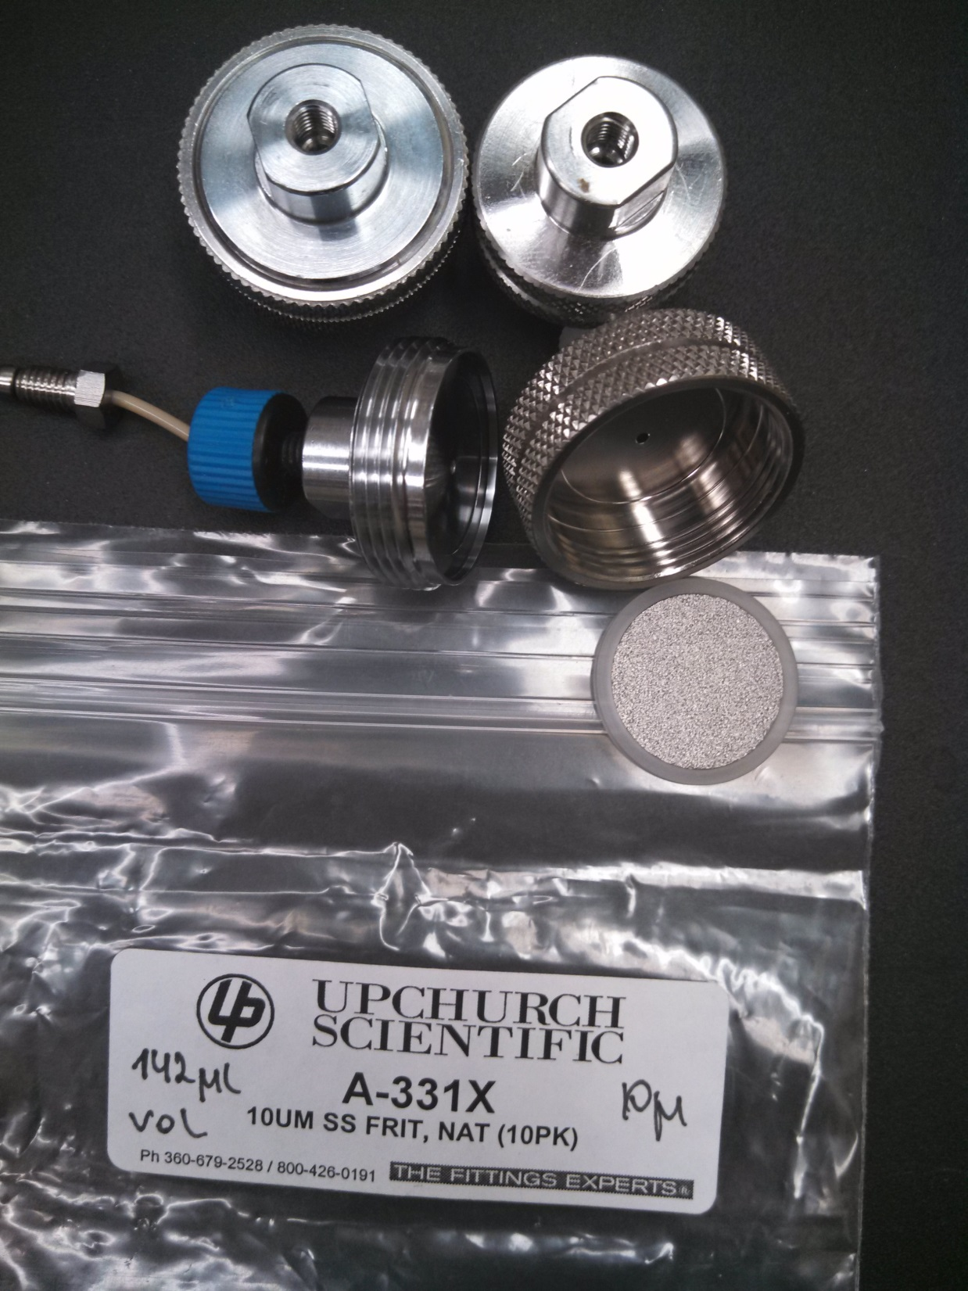
Upchurch filter (total volume ~ 223µl

Slide 21
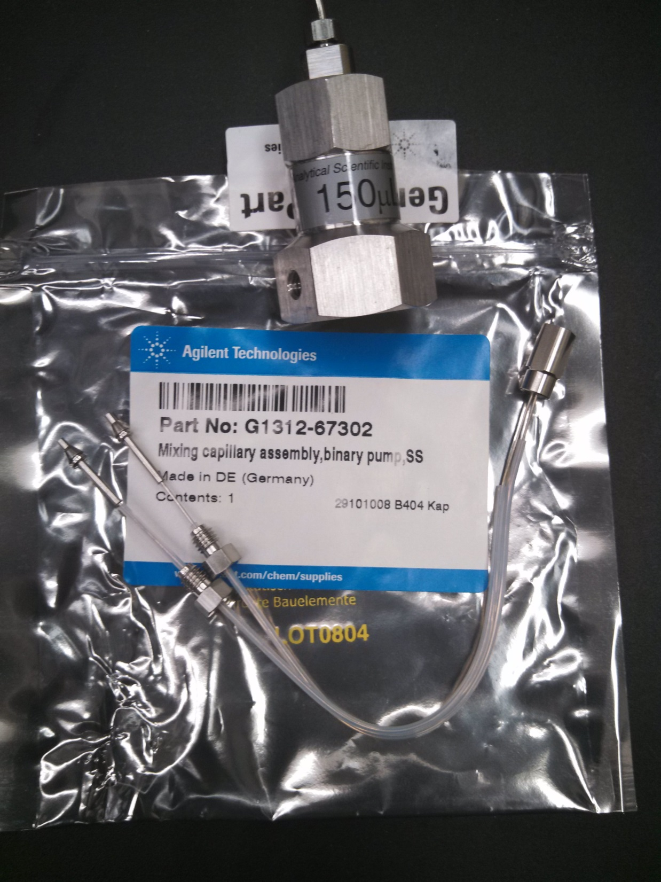
ASI static mixer (total volume ~ 163µl

Slide 22
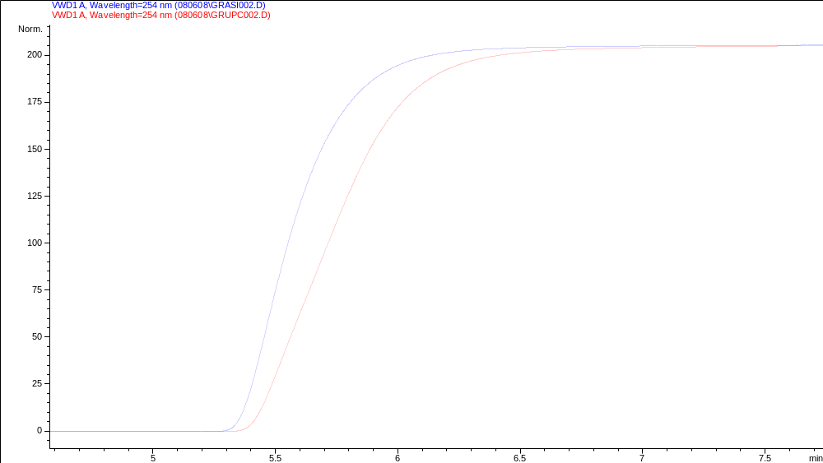
Mixing efficiency – delay volume
60 ul swept vol
difference results
in 120 ul delay
Agilent 1100, no Damper. ~ 350 Bar
Red - Upchurch, Blue - ASI mixer
ASI static mixer (total volume ~ 163µl) and Upchurch filter (223µl). While the expected difference between these devices is ~ 60µl, the delay volume difference becomes - 120µl (n=3). Upchurch filter is inexpensive but poor mixer

Slide 23

Delay volume-pressure impact:
same system has different delay
volume at different pressure
Low Pressure
High Pressure 344Bar
V₅₀ 0.497ml
V₅₀ 0.580 ml
Upchurch filter in the pump, no damper, valve, restrictor, Flow rate 0.7 ml/min

Slide 24
Mixer evaluation
Mixer evaluation should be conducted by the manufacturer at different flow rates in order to better understand the mixer efficiency and specify its optimal applicability.
As we described above, mixer performance can be very different at low or zero pressure, and at high pressure.
Mixer efficiency assessment will facilitate and direct further progress of UHPLC evolution.

Slide 25
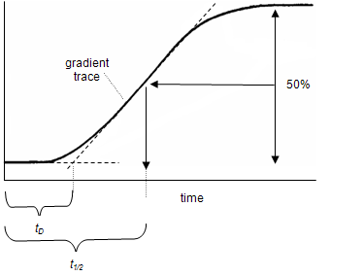
V₀ and V₅₀ approaches to measure delay volume
A – pure
water
B –water
+ 0.1%
acetone
Instead of linear gradient, the step gradient could be used, where 100% A have an abrupt switch to 100% B

Slide 26
Theoretically, delay volume, reported by manufacturer, could be obtained as either the V₀ or V₅₀ value from the step gradient, or from the linear gradient.
Therefore there are 4 potential delay volume values that can be reported by the manufacturer.
However, most likely it is V₀ value from the step gradient or V₅₀ value from the linear gradient.
There is another question: Does flow rate and gradient length/type [also newer specified information] impact the accuracy and precision of the measurement?

Slide 27
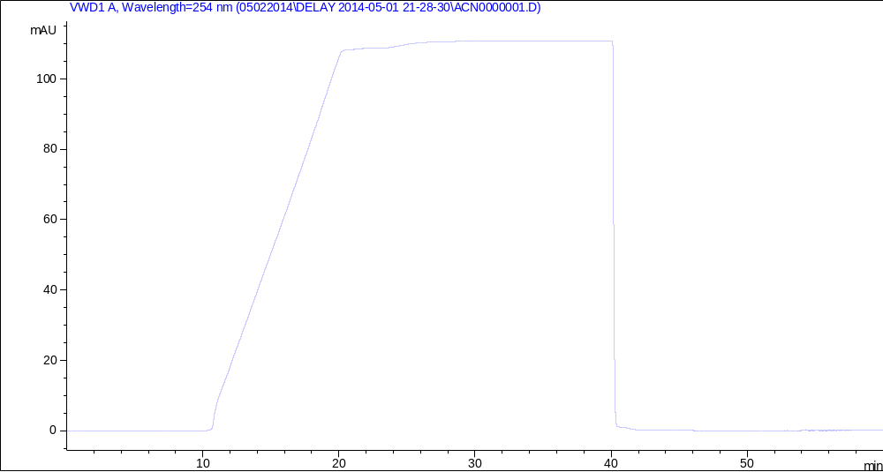
Step gradient intercept drawing 1
100%B- 0%B
Step gradient
10 min linear gradient
Agilent Infinity 1290 pump G4220A

Slide 28

Step gradient intercept drawing 2

Slide 29
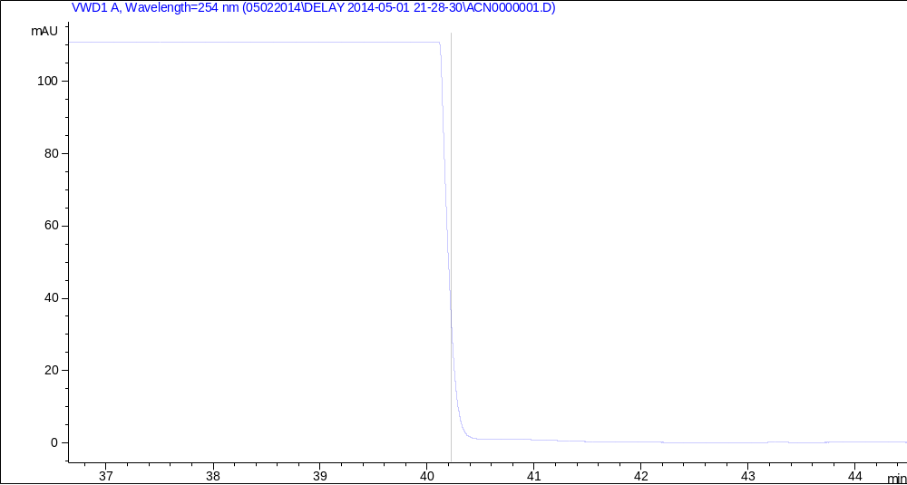
Step gradient intercept drawing 3

Slide 30
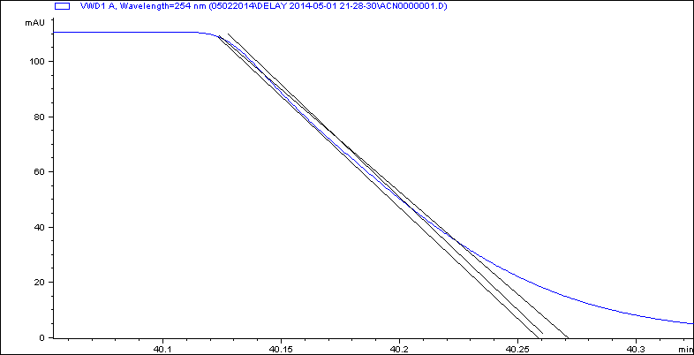
Step gradient intercept drawing 4

Slide 31
Conclusion 2
1) Physical internal volume ≠ delay volume
2) Slope intercept drawing: no high precision and accuracy. Human error.

Slide 32
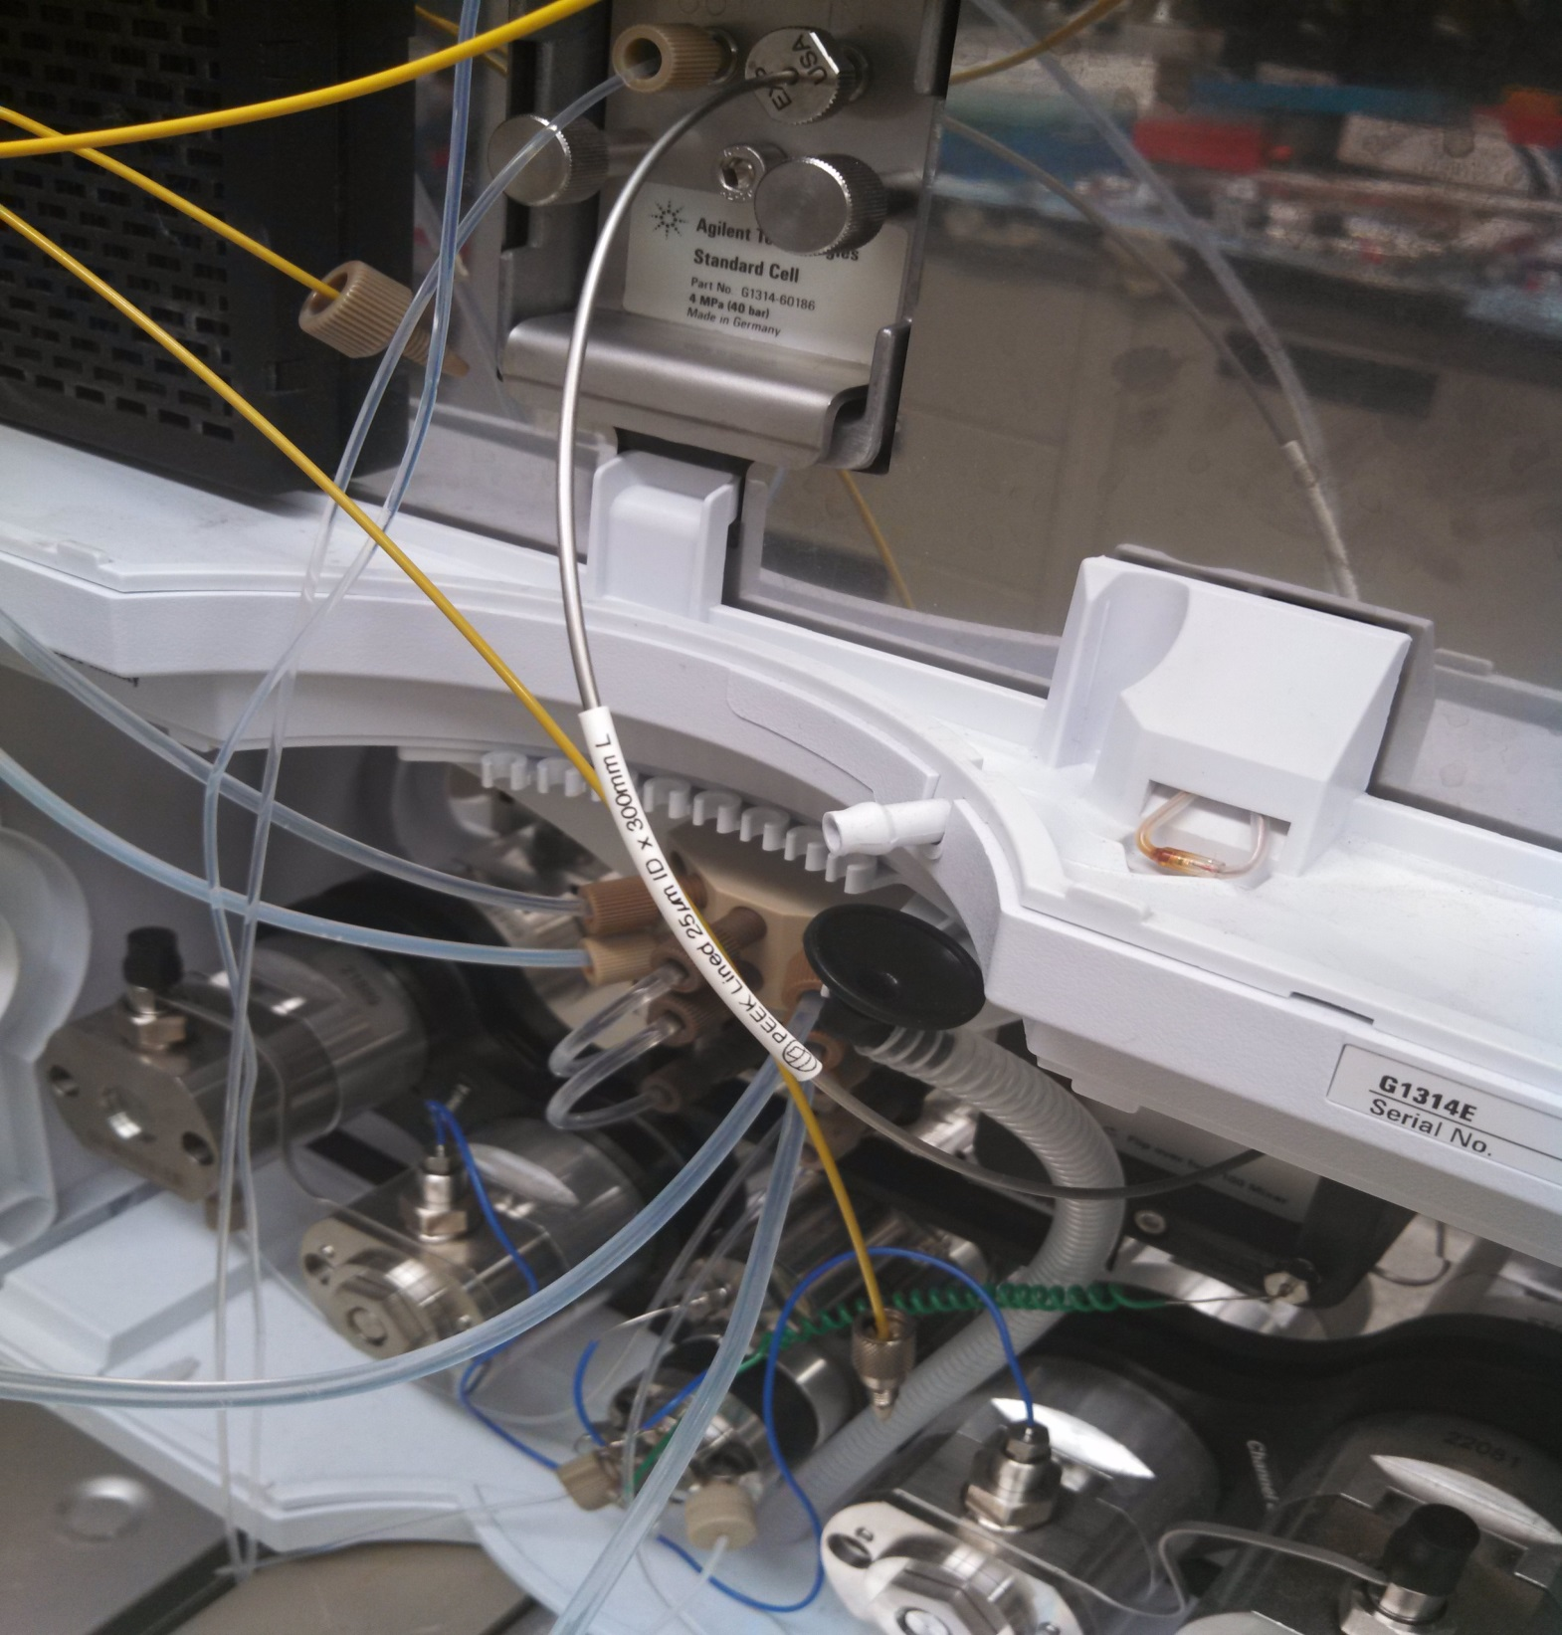
IDEX
PEEK
Lined
SS

Slide 33
V50 volume vs pressure

Slide 34
V50 error vs pressure

Slide 35
Conclusion 3
5) Delay volume should be tested at the method pressure and flow rate.

Slide 36
Summary 1
V_{o} measurement is approximate, imprecise and subjective.
Real meaning of delay – it is delay time.
Delay caused not just by certain internal volume inside of the flow path. Hidden source of delay – it is mixing efficiency

Slide 37
Conclusion 4
V₅₀ measurement from linear gradient can not assess mixing quality and efficiency. Gradient delay volume alone, therefore is an insufficient characteristic.

Slide 38
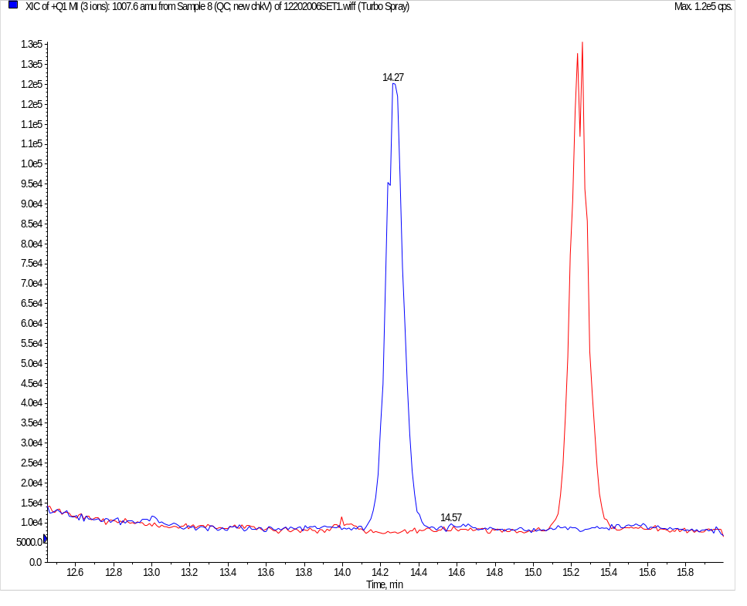
Impact of hardware performance: check valve B underdelivers organic
15.26
min
14.27
min
Analyte retention time is 15.26 min after several hundred injections since maintenance. Analyte retention time become 14.27 min after replacement of the outlet check valve in the channel B . Of note, there is no impact of CkV replacement in the Ch. A

Slide 39
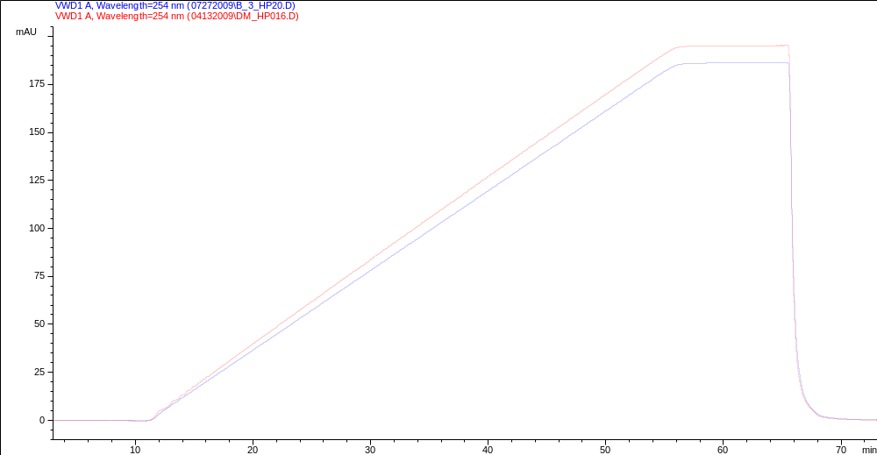
Gradient delay and pump hardware performance

Slide 40
Hardware performance and measured gradient delay
For the ideal binary pump (no dead volume AND both channels A and B work identically) V50 should be identical to half gradient time. In other words, at half gradient time, both channels deliver equal flows and half the maximal signal is expected. Since the pump has a defined dead volume, some time delay to reach the half-max signal obviously occurs. In the case of minor malfunctions, e.g. channel B under delivers (an internal leak) compared to channel A, - as a result, less mobile phase will delivered by B and the half-max (HMX) of the signal will occur earlier and the V50 value with decrease (gradient slope becomes slightly shallow than expected).

Slide 41
V50 values vs gradient length
Different CkV result in different V50 values due to different level of the internal leak.

Slide 42
Conclusion 5
5) Delay volume should be tested at the method pressure and flow rate for both LC systems prior method transfer. Reported by the manufacturer delay volume value could be obtained at different conditions.

Slide 43


Gradient method transfer reality
Please specify System A and System B dwell volume here
System A
System B
Eduard’s remark: Good luck, have an easy method transfer!

Slide 44

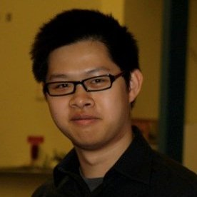
Physical vs delay volume
Zheng Zheng, PhD Candidate
Meyerhoff Research Group
The University of Michigan
Department of Chemistry
Matthew Gallitto
Columbia University Class of 2014
B.A. in Biology

Slide 45
Acknowledgements
Funding:
This research was supported in part by a Clinical and Translational Science Award (CTSA) from the National Institutes of Health (UL11RR025740) awarded to the Albert Einstein College of Medicine of Yeshiva University.
NIH: R01 DK61644-01
Technical Support:
Agilent Technologies
IDEX corporation/Upchurch scientific
Optimize Technologies

