Slide 1

About OMICS Group
OMICS Group International is an amalgamation of Open Access publications and worldwide international science conferences and events. Established in the year 2007 with the sole aim of making the information on Sciences and technology ‘Open Access’, OMICS Group publishes 400 online open access scholarly journals in all aspects of Science, Engineering, Management and Technology journals. OMICS Group has been instrumental in taking the knowledge on Science & technology to the doorsteps of ordinary men and women. Research Scholars, Students, Libraries, Educational Institutions, Research centers and the industry are main stakeholders that benefitted greatly from this knowledge dissemination. OMICS Group also organizes 300 International conferences annually across the globe, where knowledge transfer takes place through debates, round table discussions, poster presentations, workshops, symposia and exhibitions.

Slide 2
About OMICS Group Conferences
OMICS Group International is a pioneer and leading science event organizer, which publishes around 400 open access journals and conducts over 300 Medical, Clinical, Engineering, Life Sciences, Pharma scientific conferences all over the globe annually with the support of more than 1000 scientific associations and 30,000 editorial board members and 3.5 million followers to its credit.
OMICS Group has organized 500 conferences, workshops and national symposiums across the major cities including San Francisco, Las Vegas, San Antonio, Omaha, Orlando, Raleigh, Santa Clara, Chicago, Philadelphia, Baltimore, United Kingdom, Valencia, Dubai, Beijing, Hyderabad, Bengaluru and Mumbai.

Slide 3
Evaluation and Characterisation of Composite mesoporous Membrane for Lactic acid Esterification
BY
OKON, EDIDIONG PRIMUS
Centre for Process Integration & Membrane Technology
(CPIMT),School of Engineering
SUPERVISOR
PROF. EDWARD GOBINA

Slide 4
OUTLINE
2 of 24
Introduction
Ethyl lactate applications
Cation-exchange resin for ethyl lactate
Membrane phenomenon
Innovation
Carrier gas transport
Membrane characterisation
Methodology
Results
Conclusion and future work

Slide 5
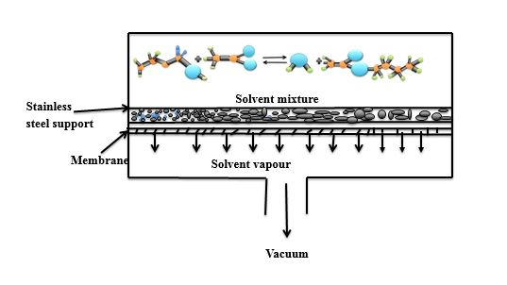
INTRODUCTION
3 of 24
Ethyl lactate (EL) plays a major role as a green solvent and also a replacement for most petrochemical solvents. The production of ethyl lactate suffer a major draw-back such as low conversion and purity, which results in the production to be economically and technically uncompetitive. The use of membranes and heterogeneous catalysts for the selective removal of water from the reaction products to shift the equilibrium towards the higher yield of product have attracted a lot of attention.
Fig. 1: Esterification process on a catalytic membrane

Slide 6
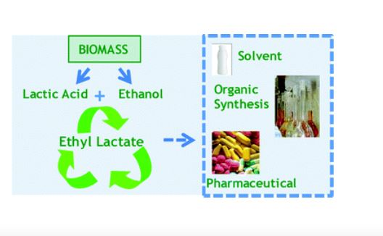
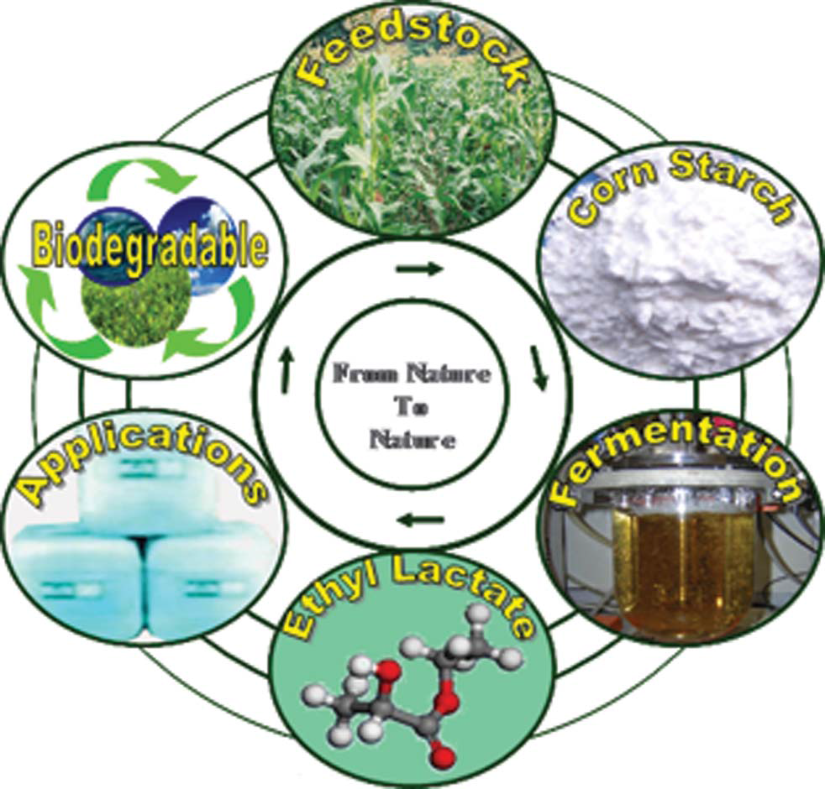
SOURCE OF ETHYL LACTATE
4 of 24
Ethyl lactate from renewable sources such as those from biomass feedstock. It is a biodegradable solvent with an excellent properties to be applied a green solvent in various applications including pharmaceutical, ink and coatings, food additives and organic synthesis.
Fig 2: Ethyl lactate life cycle
Fig. 3: Synthesis of Ethyl lactate

Slide 7
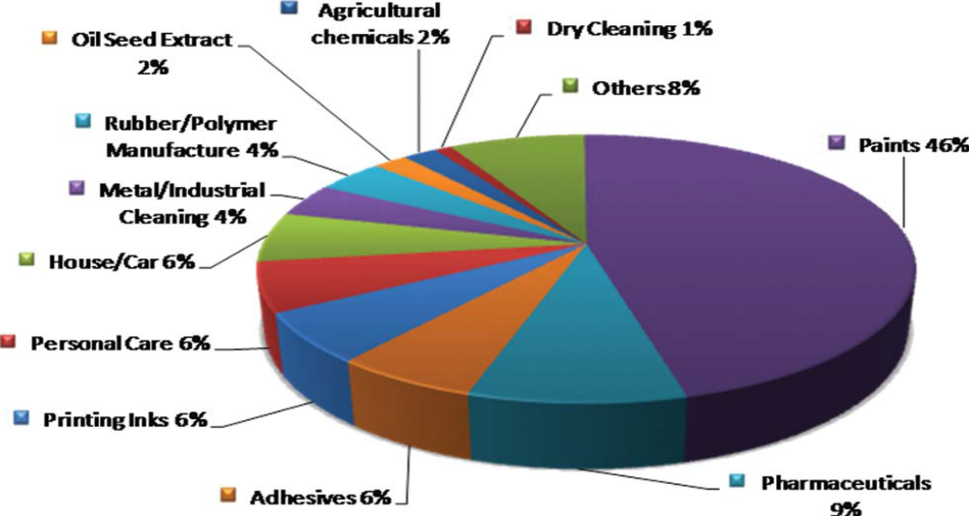
Application of Ethyl lactate by industries
5 of 24
Fig 4: Schematic diagram of Ethyl lactate application by industries

Slide 8
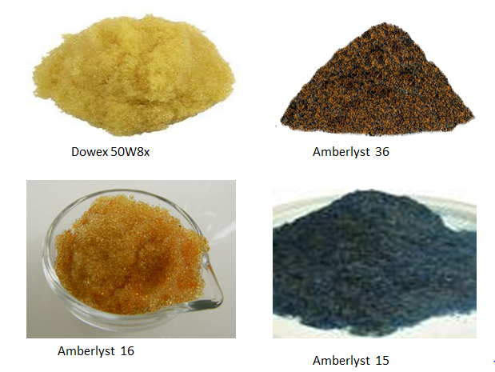
Solid Catalysts for Ethyl lactate Synthesis
6 of 24
Heterogeneous catalysts
Cation-exchange resin
-Amberlyst 36
-Amberlyst 16
-Amberlyst 15
-Dowex 50W8x
Fig. 5: types of heterogeneous catalysts
Fig. 6: Pictorial diagram of the different catalysts

Slide 9
Membrane Phenomenon
7 of 24
Membrane is a selective or physical barrier that reduces or prevent the mass transfer in a certain material. In the past decade membrane have been regarded as a separation agent. Membranes may be classified as organic or inorganic membranes . The different types of inorganic membrane include:
Porous membrane e.g metal, glass
Mesoporous = 2-50nm
Microporous = < 2nm
Macroporous = > 50nm
Inorganic membrane
Composite membrane e.g metal-metal, glass-metal and ceramic metal
Dense membrane e.g metallic, solid-electrode
Fig. 7: Types of inorganic membranes
Notes:
Porous composite and dense membrane

Slide 10
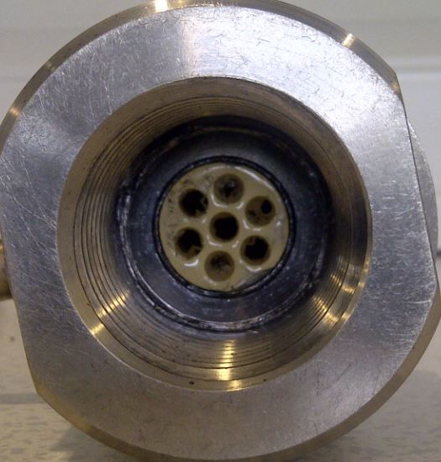
ADVANTAGES OF AN ENHANCED MEMBRANE
8 of 24
Reactor housing
High thermal stability
Mechanical strength
Chemical stability
They allow heterogeneous catalyst
to be deposited easily on the surface.
Increase in yield of product.
Cost effective
Long service life
Seal
Ceramic porous core
Fig. 8: Pictorial diagram of a porous membrane
Notes:
Inorganic membrane possess a lot of advantages

Slide 11
INNOVATION
9 of 24
To characterise resin and ceramic membrane pore size distribution using scanning electron microscopy.
Transport properties of the inorganic composite ceramic membrane with carrier gases use for ethyl lactate separation.
To determine the surface area and pore diameter of a mesoporous membrane using liquid nitrogen adsorption.
To carry out batch process esterification of lactic acid and ethanol and analysed the product using gas chromatograph-mass spectrometer.
Compare the BET surface area and BJH pore diameter results of the 1st and 2nd dip-coated membranes.

Slide 12
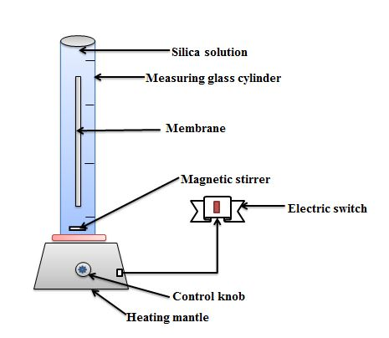
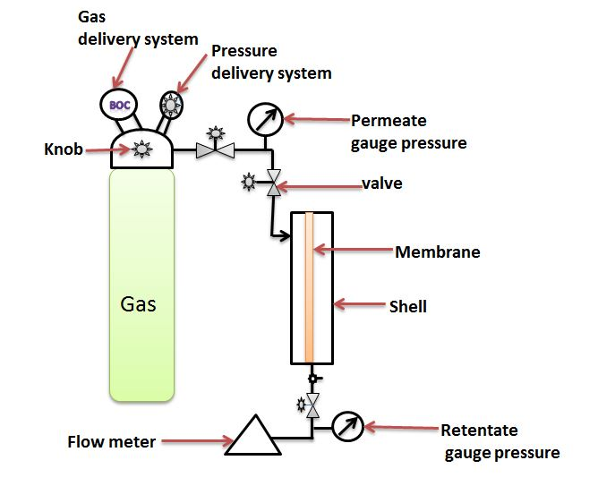
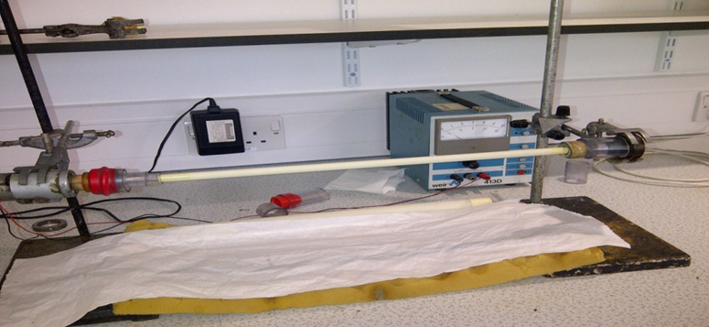
10 of 24
METHODOLOGY
Membrane dip-coating and Carrier Gas Permeation test
Fig. 10: Permeation test set-up
Fig. 9: Membrane dip-coating
The four carrier gases used for the experiment include: Helium (He), Argon (Ar), Carbon dioxide (CO₂) and Nitrogen (N₂).
Fig. 11: Air drying of the membrane
Notes:
The four carrier gas use for the experiment include: Helium, Argon, Carbon dioxide, Nitrogen

Slide 13
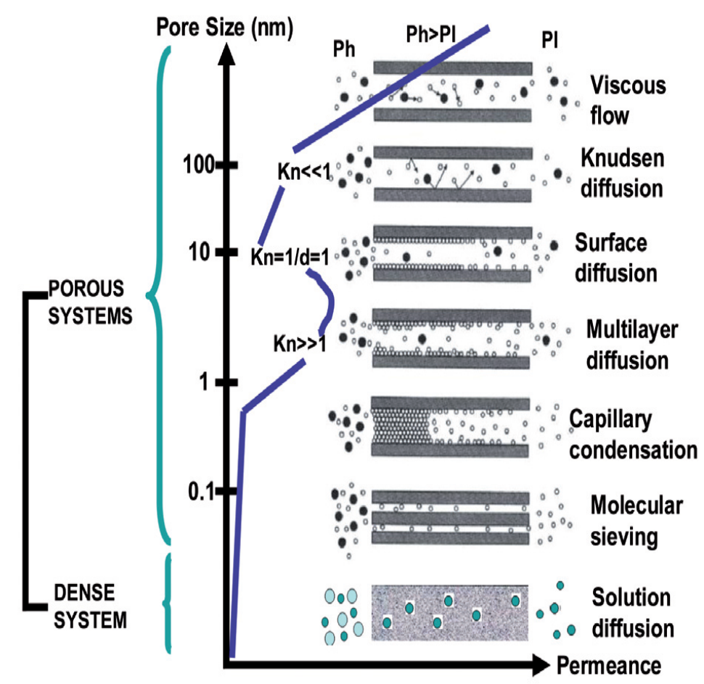
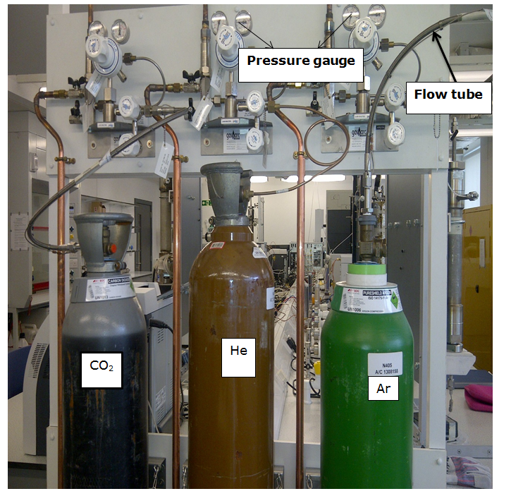
Transport Mechanism in inorganic ceramic membrane
11 of 24
Fig. 12: Transport mechanism in ceramic membrane
Fig. 13: Gas connection system

Slide 14
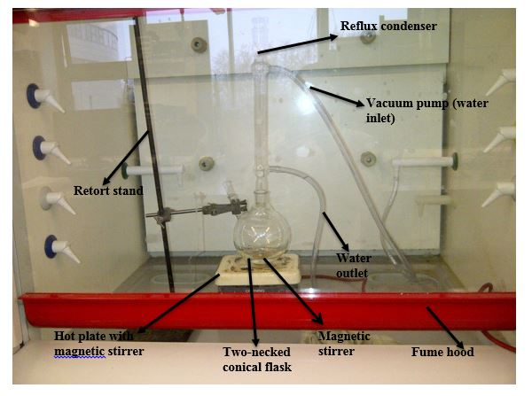
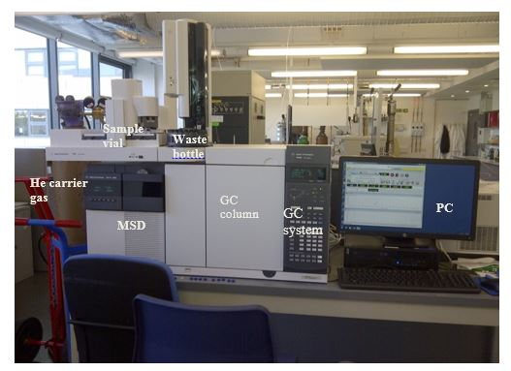
Batch Process Esterification Process
12 of 24
Batch process esterification process and GC-MS instrument for the analysis of esterification product
Fig. 14: Batch process set-up
Fig. 15: Auto sample GC-MS instrument

Slide 15
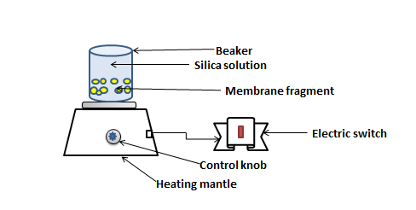
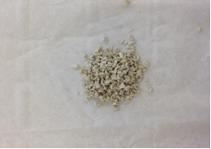
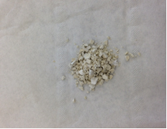
METHODOLOGY
13 of 24
Schematic diagram of ceramic membrane dip-coating technique for liquid nitrogen
Fig. 17: Before modification
Fig. 16: membrane fragment dip-coating
The sample was found to be expand after the modification process
Fig. 18: After modification
Notes:
Schematic diagram of ceramic membrane preparation

Slide 16
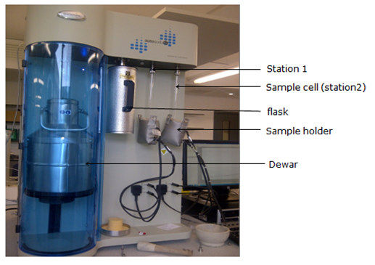
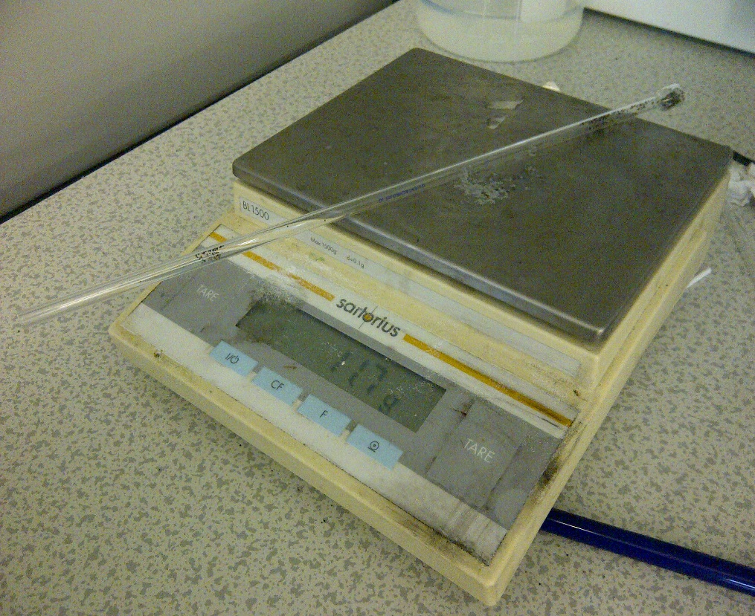
LIQUID NITROGEN ADSORPTION
14 of 24
Sample Preparation before the degassing process
Sample + cell
Weighing balance
Fig. 19: Liquid nitrogen adsorption
Fig. 20: Analytical weighing balance
Notes:
LIQUID NITROGEN ADSORPTION OF MESOPOROUS

Slide 17
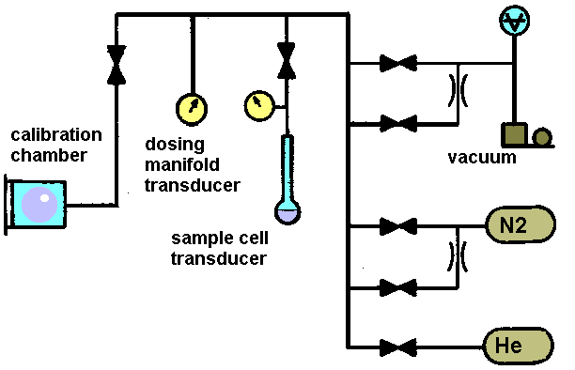
15 of 24
PROPERTIES FOR NITROGEN ADSORPTION MEASEUREMET
Different properties of membrane that could be measured with Gas Adsorption
Size and Shape
Surface area
Pore size
Pore volume
Porosity
Density
The degassing temperature was set at 65 ºC for 2 hrs prior to the sample analysis. The liquid nitrogen temperature was 77 K.
Fig. 21: Typical vacuum apparatus

Slide 18
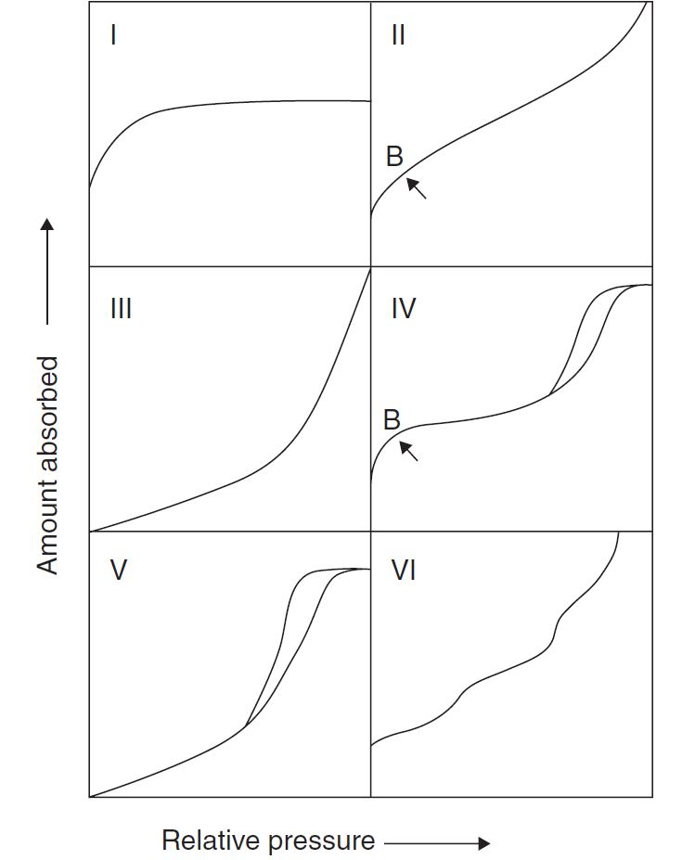
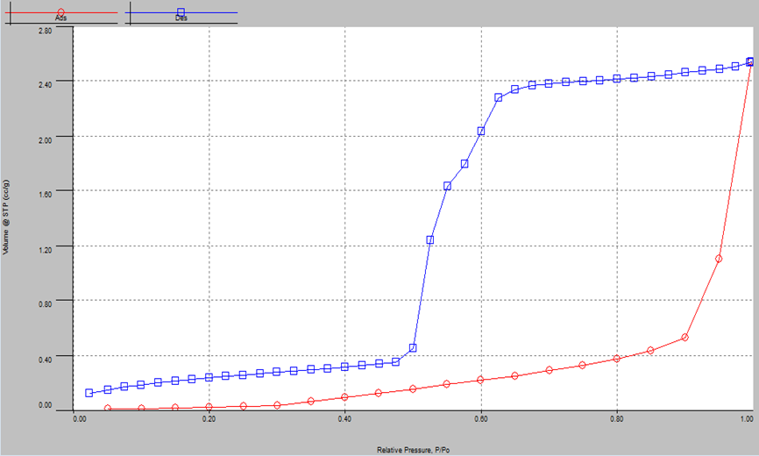
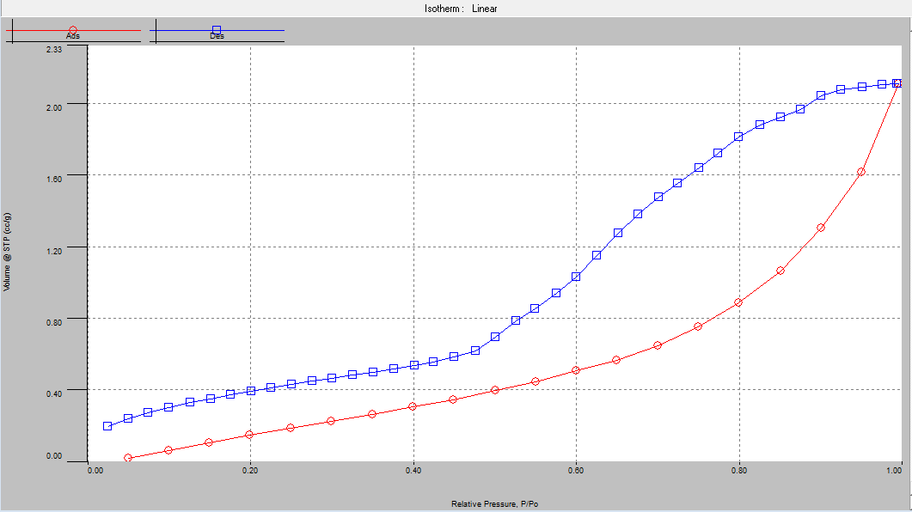
Nitrogen Adsorption Results for the silica membranes at 77 K
16 of 24
BET Curves for 1st and 2nd dip-coated membrane
Fig. 22a: BET curve for 1st dip-coated membrane
Fig.22: Classification of adsorption isotherm
Fig. 23b: BET curve for 2nd dip-coated membrane

Slide 19
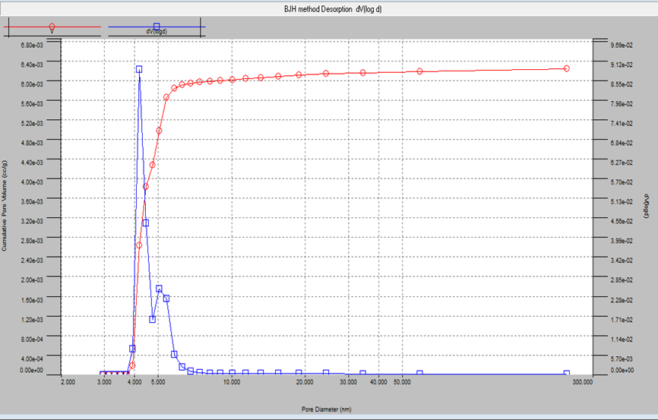
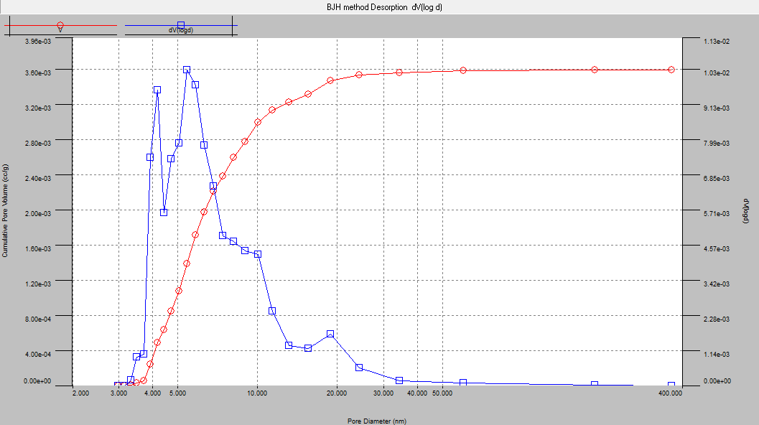
Nitrogen Adsorption Results for the silica membranes at 77 K
17 of 24
BJH Curves for 1st and 2nd dip-coated membrane
Sample | BET Surface area(m²/g) | BJH Pore diameter(nm) | Pore Volume (cc/g)
1st dipping | 0.253 | 4.184 | 0.006
2nd dipping | 1.497 | 4.180 | 0.004
Fig. 24a: BJH curve for 1st dip-coated membrane
Table 1: BET and BJH of the membranes
The BET surface area of the dip-coated silica membrane showed a type IV isotherm characteristic of mesoporous structure with hysteresis. The BJH curves of the silica membrane was in accordance with mesoporous classification
Fig 24b: BJH curve for 2nd dip-coated membrane

Slide 20
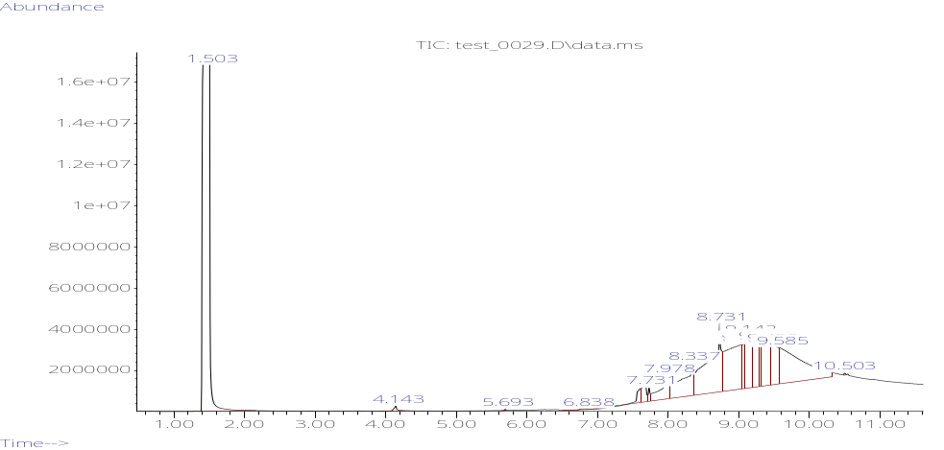
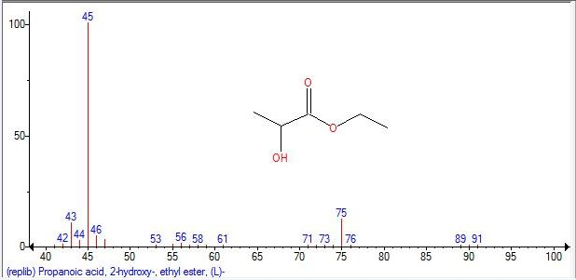
GC-MS Results
18 of 24
Catalysts | Retention time (min) | Peak Area ()
Amberlyst 15 | 1.521 | 149055537.3
 | 4.169 | 1761909.18
 | 7.738 | 4826559.45
 | 9.218 | 113978453.4
Amberlyst 16 | 1.503 | 119782347.8
 | 4.143 | 9286786.17
 | 8.731 | 283366480.1
 | 10.502 | 23075482.13
Amberlyst 36 | 1.527 | 138638054.1
 | 3.628 | 98634990
 | 7.975 | 97944520.42
 | 8.726 | 121332143.6
 | 10.490 | 14091694.59
Dowex 50W8x | 1.523 | 142522149.5
 | 3.627 | 78276693.15
Fig. 25: Ion chromatogram of the esterification product
Table 2: Retention time and peak area of catalysts.
Fig. 26: NIST spectra for ethyl lactate

Slide 21
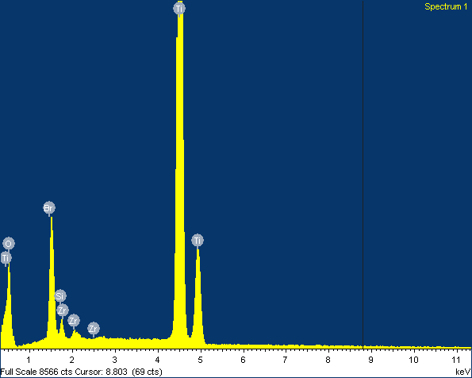
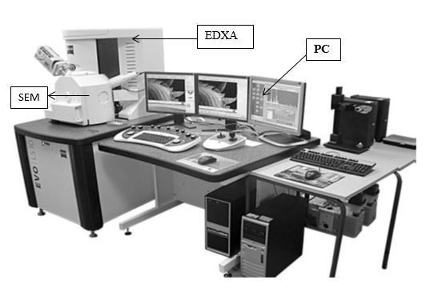
SEM/EDXA Results
19 of 24
SEM/EDXA surface image of the membrane
Ti
Br
O
Ti
Ti
Si
Zr
Zr
Fig. 27: EDXA spectra of the membrane
Fig 28: SEM/EDXA instrument
The membrane showed a defect-free surface with no evidence of crack on the surface of the silica membrane

Slide 22
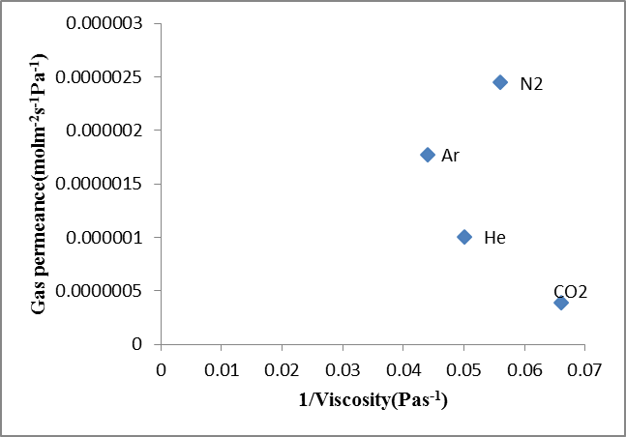
PERMEATION TEST RESULTS
20 of 24
Relationship between gas flow rate and gauge pressure
Fig. 29: Flow rate relation with pressure
Fig. 30: Permeance relation with viscosity
The gas flow rate exhibited an increase with gauge pressure indicating Knudsen flow mechanism. The order of the gas kinetic diameter from the highest is given as: N₂ > Ar > CO₂ > He.
The gas permeance relationship with viscosity was in agreement with the viscous flow mechanism.
Notes:
RESULTS

Slide 23
CONCLUSION
21 of 24
The evaluation and characterization of composite mesoporous membrane for lactic acid Esterification was successfully carried out using different methods including nitrogen adsorption, FTIR, GC-MS and SEM/EDXA.
Helium gas with the higher permeation rate was used as one of the carrier gas for the analysis of esterification product.
The SEM surface image of the membrane showed a defect-free surface.
The NIST mass spectra of the esterification reaction product exhibited the structure of ethyl lactate on the spectra.
The BET surface area of the composite membrane showed a type IV isotherm with hysteresis indicating a mesopourous layer.
The BJH curve for the composite membrane was in accordance with the mesoporous classification
Notes:
CONCLUSION

Slide 24
FURTHER WORK
22 of 24
Further work will be carried out to investigate the following:
To carry out permeation for the 3rd dip-coated membrane at different temperatures in contrast to the 4th dipping for further analysis of carrier gas with membrane.
To compare the specific surface area and pore diameter of the ceramic membrane with subsequence coating using Liquid nitrogen adsorption.
To carry out ethyl lactate production with flat sheet cellulose acetate membrane at different temperatures.
Quantify the esterification reaction product and correlate the experimental data.
Notes:
Further work will be carried out to investigate the effect of the dip-coating on the inorganic ceramic membrane at different temperature in the course of the research.

Slide 25
23 of 24
Thanks for your Attention
Question?

Slide 26
REFERENCES
24 of 24
Mandake MB, Anekar SV, Walke SM. Kinetics study of catalysed and Uncatalyzed Esterification Reaction of acetic acid with methanol. American International Journal of Research in Science, Technology, Engineering & Mathematics. 2013; 3(1):114-121.
Zhang Y, Ma L, Yang J. Kinetics of esterification of lactic acid with ethanol catalyzed by cation-exchange resins. Reactive and Functional Polymers. 2004; 61(1):101-114.
Peters TA, Alzate, JF, Marius AG and Keurentjes TF. Development of a catalytic membrane reactor for integration of reaction and separation in condensation reactions. 2004; 82 (2) 220-228

