Slide 1
New Insights into the management of Acute Compartment Syndrome:
A retrospective case series review
Dr Ehab.F. Girgis
&
Dr Daniel S.Z.M. Boctor

Slide 2
TAKE HOME MESSAGES
1. THINK ABOUT SOFT TISSUE INJURY
2. COMPARTMENT SYNDROME CAN BE
SPONTANEOUS
3. COMPARTMENT SYNDROME CAN BE SPONTANEOUS & UPPER ARM
4. COMPARTMENT SYNDROME AND OPERATIVE POSITIONING!!!
5. ANALGESIA AND COMPARTMENT SYNDROME!!

Slide 3
SO DON’T MISS THE DIAGNOSIS!!

Slide 4
INCLUSION CRITERIA
Retrospective review of clinical and radiological records of 41 patients diagnosed with ACS.
1999 to 2013 done under the care of orthopaedic team
EXCLUSION CRITERIA:
1- Patients diagnosed with chronic compartment syndrome.
2- Patients with post-ischaemic acute compartment syndrome (ACS) done by the vascular surgeons.
3- Patients with ACS who had fasciotomy carried out by the plastics team.

Slide 5
CAUSES OF ACUTE COMPARTMENT SYNDROME:
1- Fractures (25 patients)
2- Soft tissue injury: (14 patients)
A) Crush Injury ( 10 patients).
B) Crush Syndrome (6 limbs in 4 patients)
3- Spontaneous (2 patients)

Slide 6
CRUSH INJURIES
"Acute compartment syndrome in the absence of fracture "
Hope M.J . and M.M.
Journal of Orthopaedic Trauma, 2004.
Patients with ACS in the absence of fracture were:
Older
More co-morbidities
Significantly greater mean delay to fasciotomy of 12.4 hours compared with those with fractures.
At fasciotomy, they had 20% muscle necrosis
compared with 8%.

Slide 7
TAKE HOME MESSAGE 1:
THINK ABOUT SOFT TISSUE INJURY

Slide 8
CASE PRESENTATION NUMBER 1
20 year old female with IDDM
Sudden pain in the calf whilst walking
Attended ED and given analgesia for muscular pain
4 days later: Pain severe, throbbing, intermittent below the knee and became throbbing
Area of redness plus tenderness over the lateral aspect of the lower leg: ?cellulitis or DVT

Slide 9
Next morning numbness in the foot: Fasciotomy
Findings: dead muscle throughout the lateral compartment - Debrided
Loss of eversion (peroneal muscles)

Slide 10
TAKE HOME MESSAGE 2:
COMPARTMENT SYNDROME CAN BE
SPONTANEOUS
Always consider spontaneous ACS in your differential diagnosis of rapid onset of painful swollen limb without history of injury. Doctors usually think about infection or DVT.

Slide 11
CASE PRESENTATION NUMBER 2
70 year old female
In-patient under the medical team for COPD
On Clopidogrel and prophylactic low dose of anti-coagulant
Developed swelling over the antero-medial aspect of
upper arm
Medical doctor on-call at night suspected axillary DVT:
Prescribed therapuetic dose of anti-coagulant

Slide 12
Increased size and pain with numbness in the left hand
O/E:
Tender swollen biceps
Radial pulse is palpable
Median nerve symptoms
CT scan: haematoma left biceps and distal part of deltoid.
Urgent decompression:
On release of biceps muscle sheath 700ml of blood

Slide 13
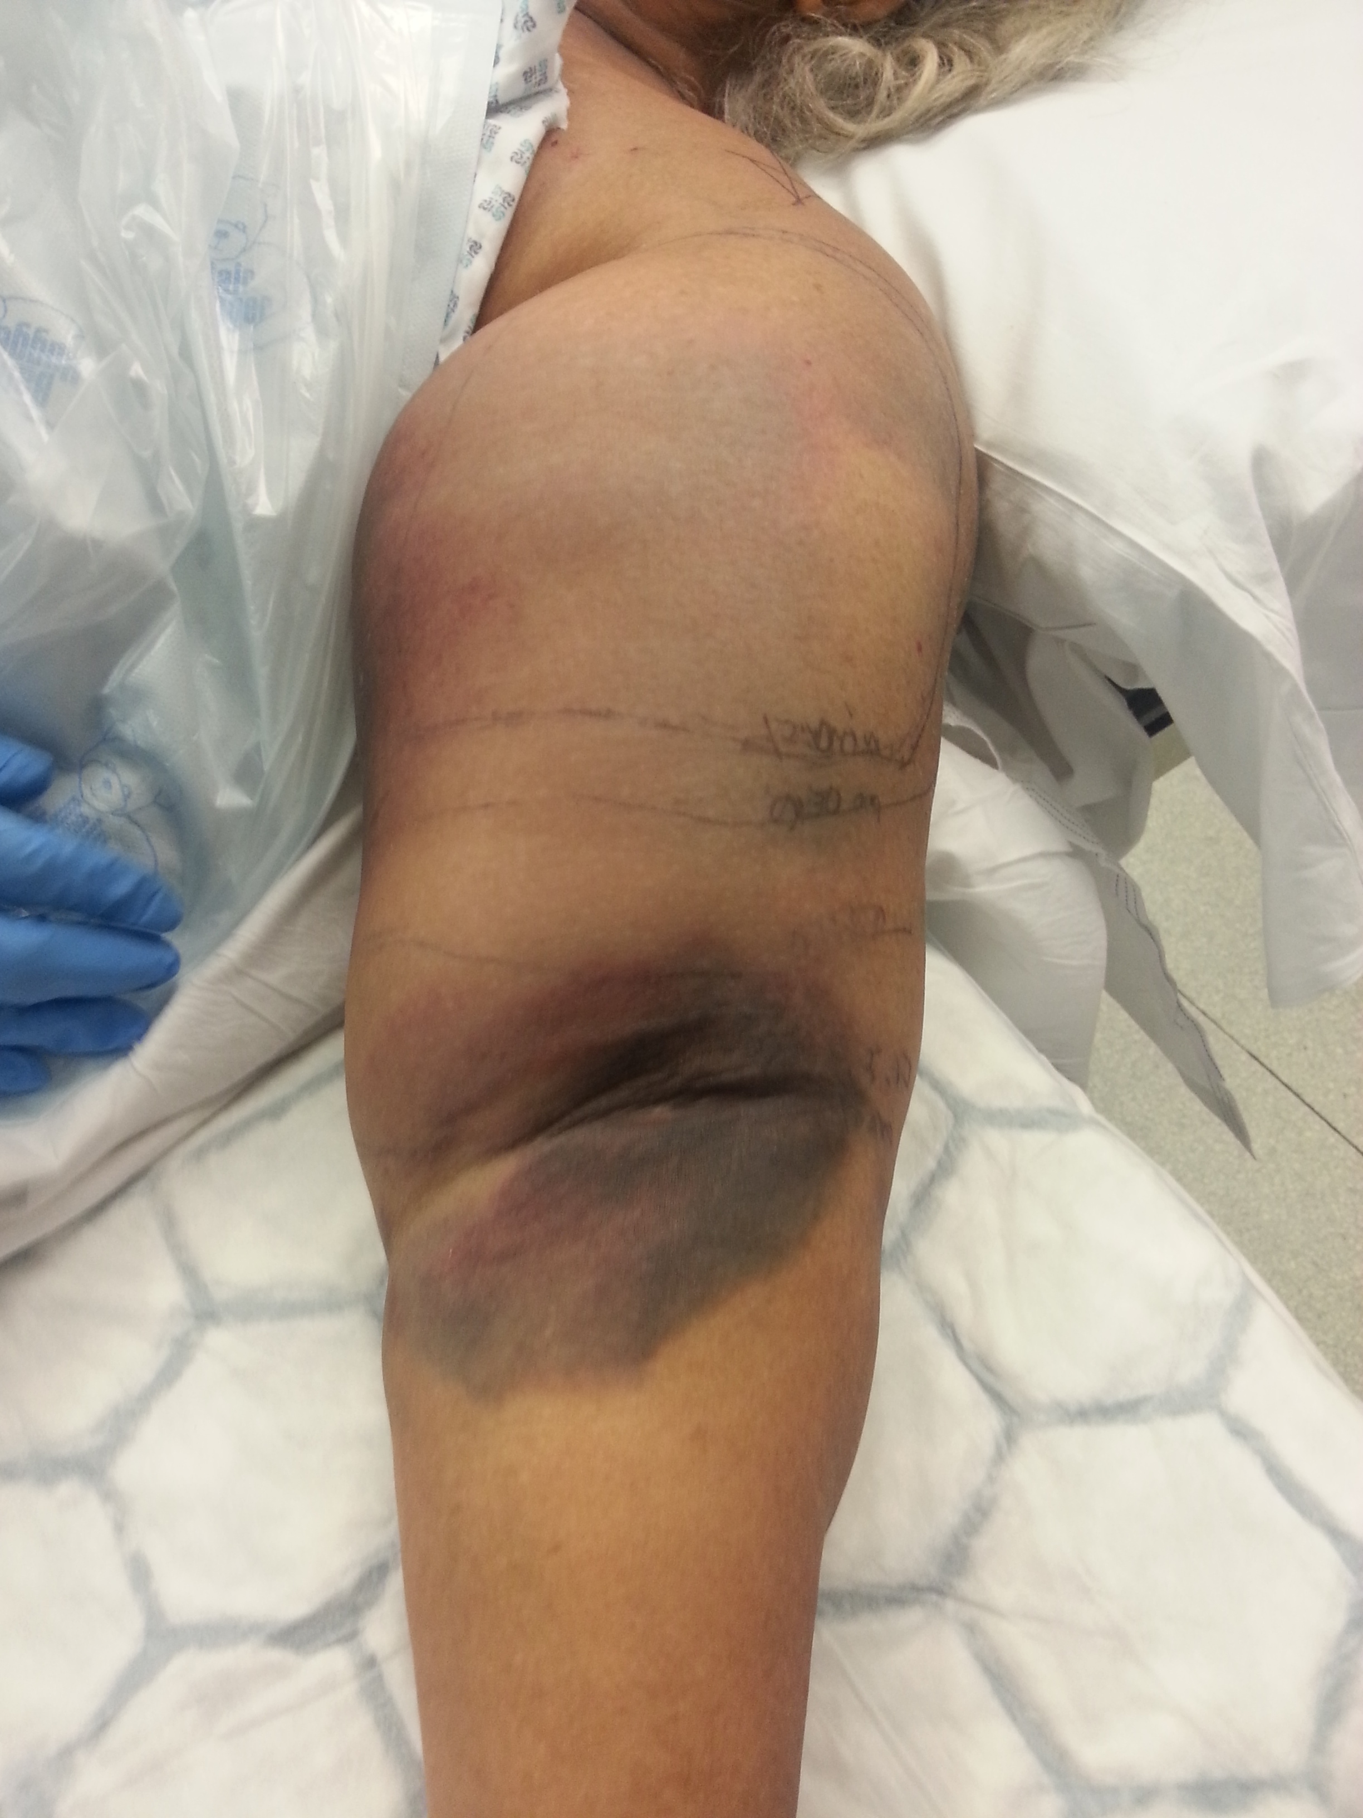
Picture in OR.jp

Slide 14
Body part affected
Lower leg 24
Forearm 13
Thigh 3 (one plus gluteal)
Foot 2
Upper arm 1

Slide 15
TAKE HOME MESSAGE 3:
COMPARTMENT SYNDROME CAN BE SPONTANEOUS &
UPPER ARM

Slide 16
Only the second reported case of spontaneous upper arm compartment syndrome
The first reported case in a patient who was not on warfarin.
Spontaneous Compartment Syndrome of the Upper Arm in a Patient Receiving Anticoagulation Therapy”
David C. Zimmerman, Tushar Kapoor, Mikhail Elfond, Paul Scott
(JOURNAL OF EMERGENCY MEDICINE 2013)

Slide 17
CASE PRESENTATION 3
42 year old male, Overweight 113Kg
Elective operation for anterior resection of Cancer rectum
Legs were elevated in Lloyd-Davis leg holders.
Prolonged operation for 6 hours as tumour was adherent
Post-operative epidural analgesia infusion ( Bupivicaine 0.1% + 2mg/ml Fentanyl)

Slide 18
Thirty six hours later:
- Patient developed severe pain with tense swollen lower legs
- Pain on dorsiflexion of the ankle
- Decreased sensation in all the nerves distribution except the saphenous nerve.
Bilateral fasciotomy 4 hours later
FINDINGS: All 4 compartments bilaterally were tense with muscle escape but healthy muscles.

Slide 19
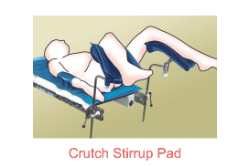
TAKE HOME MESSAGE 4:
COMPARTMENT SYNDROME AND OPERATIVE POSITIONING!!!
Courtesy of normadnd.com

Slide 20
CASE PRESENTATION 4
19yo male motorbike RTA: Femoral fracture
Difficult IM nail – long operation
Patient on traction table
Post-op: Vague and fluctuating Symptoms:
Numbness in leg, lower leg & foot
Increasing pain (no longer controlled by analgesia) (7 doses x 20mg Oramorph)
“All pain killers not working, doctor called”

Slide 21
Later lower leg tense – taken for fasciotomy
Surgery:
1st Look: Some debridement anterior compartment
2nd look: Most of anterior compartment dead
Foot drop
Required tendon transfer
NCS: Peronal nerve – ischaemic axonopathy
Follow up at 1 year: Same numbness present

Slide 22
TAKE HOME MESSAGE 4:
COMPARTMENT SYNDROME AND OPERATIVE POSITIONING!!!
ACS can develop in a compartment distal to the compartments with the fractured bone

Slide 23
TAKE HOME MESSAGE 5:
ANALGESIA AND COMPARTMENT SYNDROME!!

Slide 24
OUR STUDY
1 patient: Diagnosis or masking of the pain
1 patient had post-operative epidural analgesia infusion which did not mask his ACS symptoms.
LITERATURE
Postal survey to anaesthetists: They had seen cases of ACS being masked by regional anaesthesia.
"The use of regional anaesthesia in patients at risk of acute compartment syndrome" Davis et al. Injury. 2006
Vs
Systematic review of 32 patients, symptoms and signs of ACS were present in the presence of epidural analgesia.
Mar G.J. et al. British Journal of Anaesthesia. 2009

Slide 25
TAKE HOME MESSAGES
1. THINK ABOUT SOFT TISSUE INJURY
2. COMPARTMENT SYNDROME CAN BE
SPONTANEOUS
3. COMPARTMENT SYNDROME CAN BE SPONTANEOUS & UPPER ARM
4. COMPARTMENT SYNDROME AND OPERATIVE POSITIONING!!!
5. ANALGESIA AND COMPARTMENT SYNDROME!!

Slide 26
SO DON’T MISS THE DIAGNOSIS!!

