Slide 1


ETIOPATHOGENESIS OF ACUTE KIDNEY INJURY
Dr Dwijen Das, MD, FACP (USA)
Silchar Medical College, Silchar
Assam, India.
Governing body member, ACP India Chapter.
Immediate past Hon Gen Secretary, API
Assam Chapter.
Co-editor Assam Journal of Internal Medicine.
Peer reviewer of 2 nationl journals.

Slide 2
Introduction:
Function of the kidneys—
Excretion of waste materials..ingested or produced
Control volume and composition of body fluids and
Maintenance of electrolytes in the body
Guyton, Arthur C.; Hall, John E. (2006). Textbook of Medical Physiology.

Slide 3
Introduction:
Each human kidney contains 1M nephrons.
It decreases gradually with aging, renal injury and diseases.
After age 40, the number decreases about 10% every 10 years.

Slide 4
Definition:
AKI is defined by an abrupt decrease in kidney function that includes, but is not limited to, ARF.
Broad clinical syndrome…
Specific kidney diseases:
AIN
AGN
VRD
Nonspecific conditions:
Ischaemic
Toxic
Extr-arenal:
-Prerenal
-Post Renal

Slide 5
Definition: (cont..)
Minor acute reduction in KF has an adverse prognosis.
Early detection and treatment of AKI may improve outcomes.
Two similar definitions based on SCr and urine output (RIFLE and AKIN) have been proposed and validated.
There is a need for a single definition for practice, research, and public health.

Slide 6
Definition: (cont…)
AKI is defined as any of the following:
Increase in SCr by ≥0.3 mg/dl (≥26.5 lmol/l) within 48 hours; or
Increase in SCr to ≥1.5 times baseline, which is known or presumed to have occurred within the prior 7 days; or
Urine volume of <0.5 ml/kg/hr for 6 hours.

Slide 7
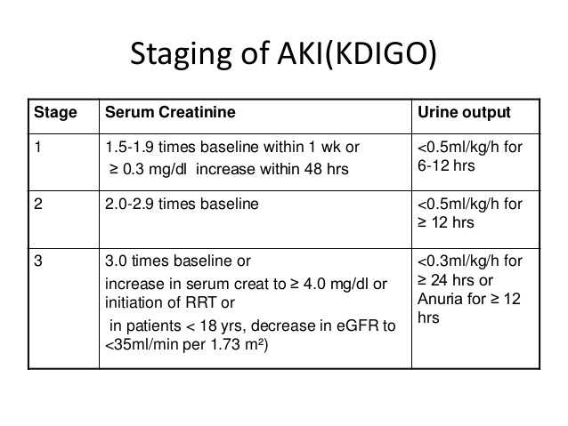
STAGING OF AKI (KDIGO)

Slide 8
Staging: (cont…)
Staging of AKI is appropriate because, with increased stage of AKI, the risk for death and need for RRT increases.
Lancet 2005; 365 (9457): 417–30

Slide 9
Staging: (cont…)
There is long-term risk of subsequent development of CVD or CKD and mortality, even after apparent resolution of AKI.
Lancet 2005; 365 (9457): 417–30

Slide 10
Renal failure:
Kidney failure is defined as a GFR of 15 ml/min per 1.73 m2 BSA, or requirement for RRT.

Slide 11
GFR is the most useful overall index of kidney function in health and disease
Changes in SCr and urine output are surrogates for changes in GFR.
In clinical practice, an abrupt decline in GFR is assessed from an increase in SCr or oliguria.

Slide 12
EPIDEMIOLOGY OF AKI:
AKI complicates 5-7 % of acute care hospital admissions
~ 30 % of admissions to the ICU [AGE, Infection, Disasters],
Mortality due to AKI may exceed 50% in ICU
AKI increases the risk of development or worsening CKD.

Slide 13
AKI
Community acquired:
Volume depletion
Drugs and Toxins
Obstructive uropathy
Hospital acquired:
-sepsis,
-surgical procedures,
-heart and liver failure,
-IV iodinated contrast
-Nephrotoxic medication

Slide 14
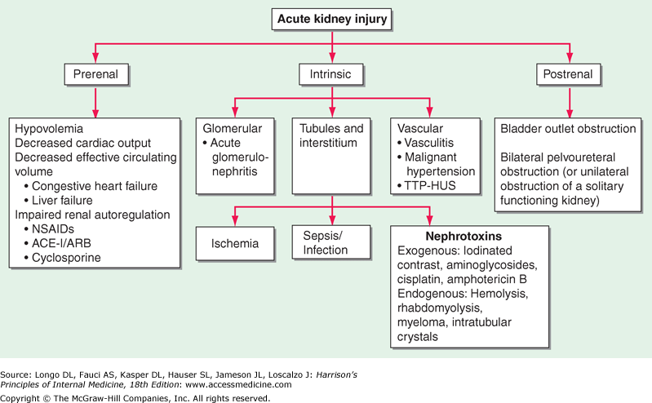
Classification of AKI:

Slide 15
PATHOPHYSIOLOGY OF AKI:
There are three pathophysiologic states in azotemia, as follows:
Prerenal azotemia
Intrarenal azotemia
Postrenal azotemia
Azotemia is defined as a higher blood level of urea or other nitrogen-containing compounds.
Usually caused by inability of the kidneys to excrete these compounds.

Slide 16
PRE-RENAL AZOTEMIA:
Most common cause of AKI Renal hypoperfusion.
- 60-70% are community acquired and 40% hospital acquired.
Hypovolemia,
Decreased CO,
Advanced cirrhosis and
Medications.

Slide 17
Pathogenesis:
Pre-renal AKI
No parenchymal damage
Prolonged pre-renal azotemia may cause ischemia
Intra glomerular hemodynamics are restored
Reversible
ATN
Intensive Care Med. 2010 Mar;36(3):392-411.

Slide 18
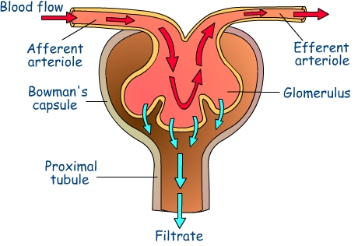
Renal hypoperfusion
AKI…
Very common
IV Volume reduction
Vasodilation
(Splanchic)
Vasodilation
AG II
Vasoconstriction
PG
Cirrhosis of Liver
Triggered by volume depletion & SBP
Renin release
image8-4.jpg
Sympathetic activity
Hepato-renal syndrome
Maintain coronary & cerebral circulation
Increase
Aldosterone
Maintain GFR
Na+ & Water retension
Maintain IV Volume

Slide 19
INTRARENAL AZOTEMIA:
Ischemia associated AKI:
Tubules, interstitium, vasculature and glomerulus.
Causes:
Ischemia
Sepsis
Toxins (Endo/Exo)
Tubular cell injury
ATN
Intensive Care Medicine. 42 (4): 521–530

Slide 20
Ischemic ATN:
Detachment of live & necrotic cells of PCT
Enters into lumen
Cast formation
Lumen blockade
Loss epithelial cell barrier and cell tight junctions
Leakage into interstitium
GFR
afferent arteriolar vasoconstrictionnn
Solute reach fluid to Macula densa
JAMA 2008; 299 (7): 793–805.

Slide 21
Phases of Ischemic ATN:
Four distinct clinical and cellular phases:
-Initiation,
-Extension,
-Maintenance and
-Recovery.

Slide 22
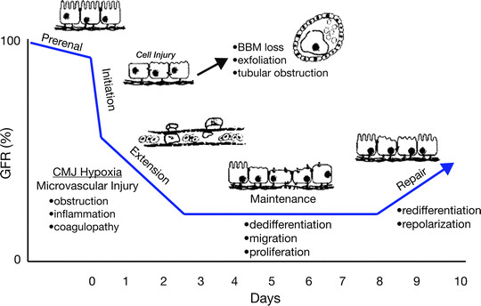
Cellular stages in ischemic ATN:

Slide 23
Post operative ATN:
Cardiac & intraperitoneal surgery
Intra-operative blood loss or hypotension
Decreased renal perfusion
ATN
JAMA 2008;. 299 (7): 793–805.

Slide 24
Burns and pancreatitis:
AKI seen in 25% cases
GFR
Hypovolemia
ATN
Immune dysregulation
Sepsis
ALI
Fluid resuscitation
Abdominal compartmental syndrome

Slide 25
Sepsis associated AKI:
AKI complicates > 50% of the cases of severe sepsis
Increases the risk of death.
GFR in sepsis can occur in absence of hypotension
Tubular injury/ interstitial edema/ mitochondrial damage, must be considered in the pathophysiology of sepsis induced AKI.

Slide 26
Mechanism of AKI in Sepsis:
Sepsis
RAAS activation
Microvascular thrombosis
Oxidative stress
Leukocyte adhesion
Tubular cell damage
NO
Endothelin
Vasopressin
Renal vasoconstriction
Efferent arteriolar dilatation
GFR
JAMA 2008; 299 (7): 793–805.

Slide 27
Nephrotoxin induced AKI:
High susceptibility to nephrotoxicity due to extremely high blood perfusion.
Risk factors include CKD, old age, and DM.

Slide 28
Contrast induced nephrotoxicity:
Iodinated contrast agent used for the cardiovascular and CT imaging are the leading causes of AKI.
It occurs due to the combination of factors including
Hypoxia due to perturbations in microcirculation and occlusion of small vessels.
Cytotoxic injury to tubule and oxidative free radicals
Transient tubule obstruction due to precipitous contrast
Risk is high in diabetics

Slide 29
Antibiotics induced AKI:
Aminoglycosides and Amphotericin B both causes tubular necrosis.
Non-oliguric AKI accompanies 10-30% of courses of aminoglycoside antibiotics.
Aminoglycosides freely filtered across glomerulus and accumulate in renal cortex.
Intensive Care Medicine 2015; 42 (4): 521–530.

Slide 30
Amphotericin B causes renal vasoconstriction as well as direct tubular injury mediated by reactive oxygen species.

Slide 31
Cisplatin and Carboplatin accumulated by the PCT causes necrosis and apoptosis.
Other drugs which are associated with AKI are ifosphomide, mitomycin C, gemcitabine and bevacizumab.

Slide 32
Toxin induced AKI:
Exogenous
Endogenous
Ethylene glycol
Fish Bile
Myoglobin/ hemoglobin
Metabolites
Metabolites
Rhabdomyolysis
Hemolysis
oxalic acid,
glycolaldehyde and
glyoxylate,
5α -Cyprinol sulfate
Crush injury, seizure, myopathy etc.
Direct tubulotoxic
Tubulo Toxic
-Tubulo toxic
-Occlusion
-Vasoconstriction
Br Med J 1941; 1 (4185): 427–32.

Slide 33
AKI in tumor lysis syndrome:
TLS: following cytotoxic therapy for high grade lymphomas and ALL;
Massive release of uric acid (>15 mg/dl) leads to its accumulation in renal tubules and AKI.
Associated with hyperkalemia and hyperphosphatemia
Also seen in solid tumors & MM

Slide 34
POST RENAL AZOTEMIA:
Caused by obstruction to luminal flow of the glomerular filtrate.
Results in transmission of backpressure to Bowman space of the glomerulus.
This backpressure would reduce the GFR.
However, by dilation of afferent arteriole, the GFR is preserved.
Br Med J 1941;1 (4185): 427–32.

Slide 35
CONCLUSION:
AKI is common, harmful and significant contributors of morbidity and mortality.
Pre-renal AKI is the commonest type.
Early diagnosis can improve mortality and morbidity.
Diagnosis is still based on S Creat and UO.
There is a need of early biomarkers to detect AKI early.

Slide 36
THANK YOU

